Slide 1
Visual Analytics:
Visual Exploration, Analysis, and presentation of large complex data
Remco Chang, PhD
(Charlotte Visualization Center) (Tufts University)

Slide 2
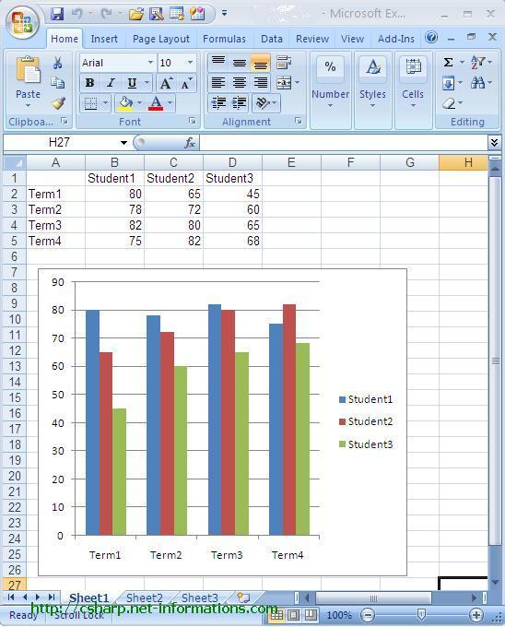
Values of Visualization
Presentation
Analysis
Notes:
2008 – 455 billion
2009 – proposed 533 billion

Slide 3
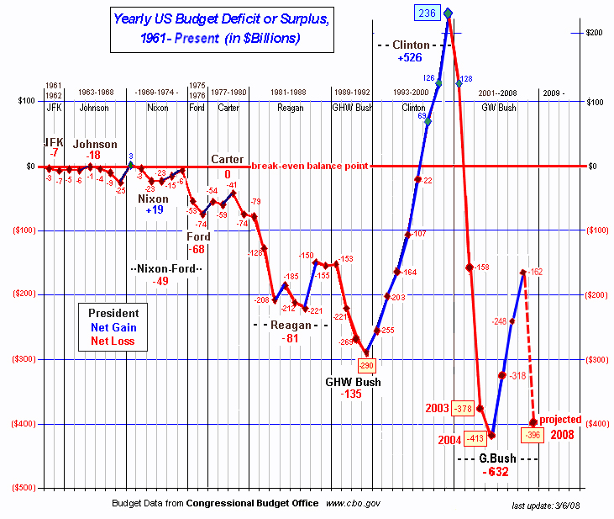
Values of Visualization
Presentation
Analysis
Notes:
2008 – deficit 455 billion
2009 – deficit 407 billion
2010 – estimated deficit 1.171 trillion

Slide 4
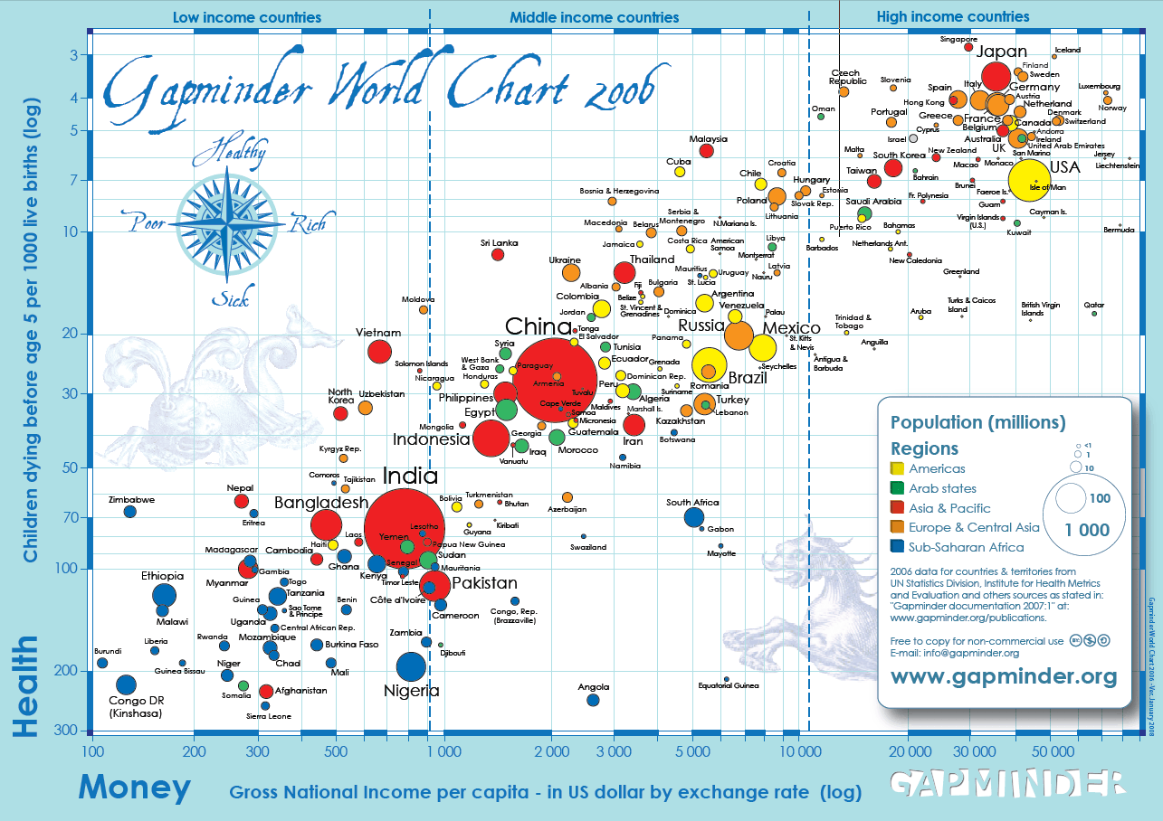
Values of Visualization
Presentation
Analysis
Notes:
2008 – 455
2009 – proposed 533

Slide 5
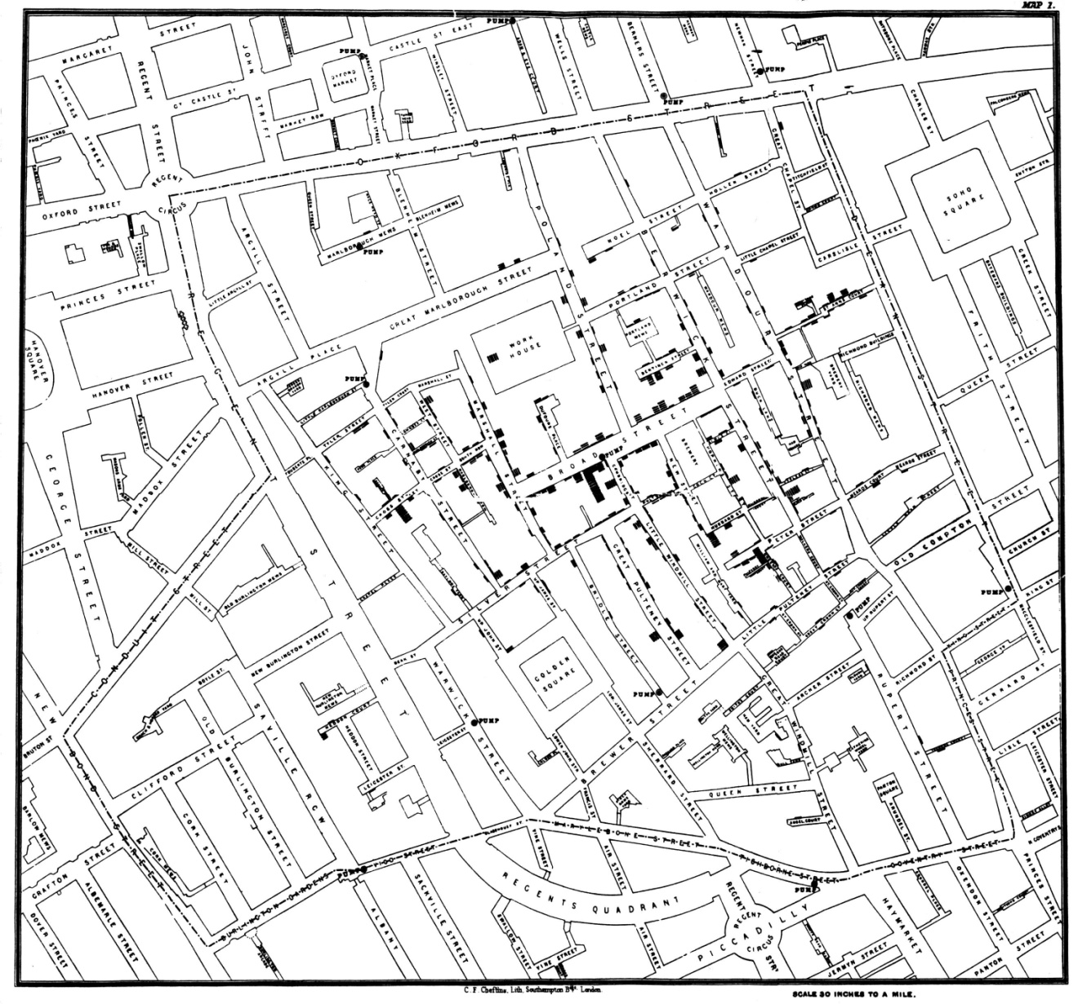
Values of Visualization
Presentation
Analysis
Notes:
I recently finished reading a wonderful book by Steven Johnson entitled The Ghost Map: The Story of London’s Most Terrifying Epidemic – and How It Changed Science, Cities, and the Modern World. In the summer of 1854 cholera swept through a section of London with unprecedented intensity. At the time, the cause of cholera was unknown and rapidly growing modern cities such as London, with dense populations packed into small areas, were rich breeding grounds for this disease. Most of those who concerned themselves with disease and its cure held tightly to the miasma theory that cholera spread through the air and was associated with the bad smells and the unclean urban environments that produced them. In fact, cholera is a bacterium, which was spreading through the water supply. This book tells the story much as a journalist who witnessed it firsthand would do, but a journalist who had the advantage of hindsight informed by knowledge of modern medicine.
Several people of the time play important roles in this story – none more than John Snow, a medical doctor and research scientist. The ghost map refers to a map that he drew by hand during the process of his investigations, which could clearly demonstrate to anyone with open eyes that the source of the outbreak was the Broad Street well. Despite the evidence that this map displayed, however, the miasma theory of cholera transmission prevailed for several years after the epidemic. Eventually, due largely to the tenacious efforts of John Snow and an unlikely supporter, Reverend Henry Whitehead, the evidence won out and steps were taken to eliminate the conditions in which cholera could spread.

Slide 6
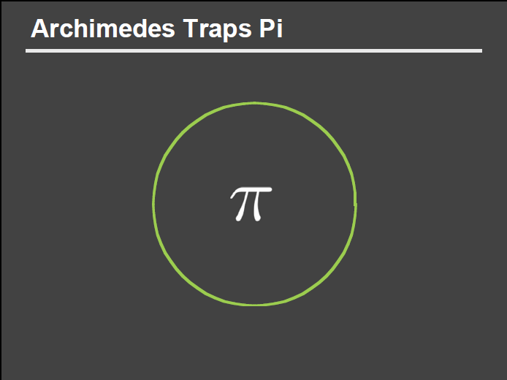
Values of Visualization
Presentation
Analysis
Slide courtesy of Dr. Pat Hanrahan, Stanford

Slide 7
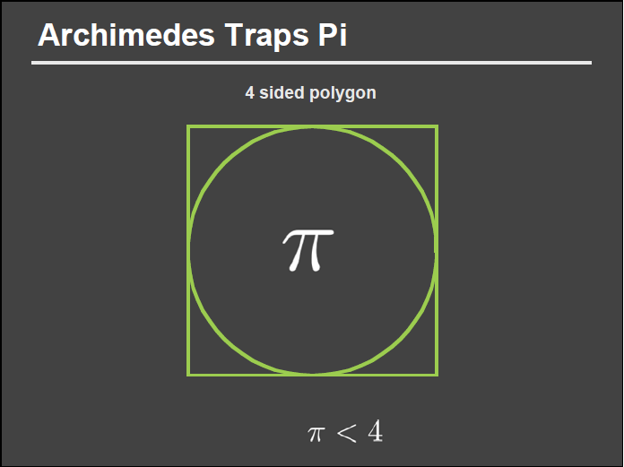
Values of Visualization
Presentation
Analysis
Slide courtesy of Dr. Pat Hanrahan, Stanford

Slide 8
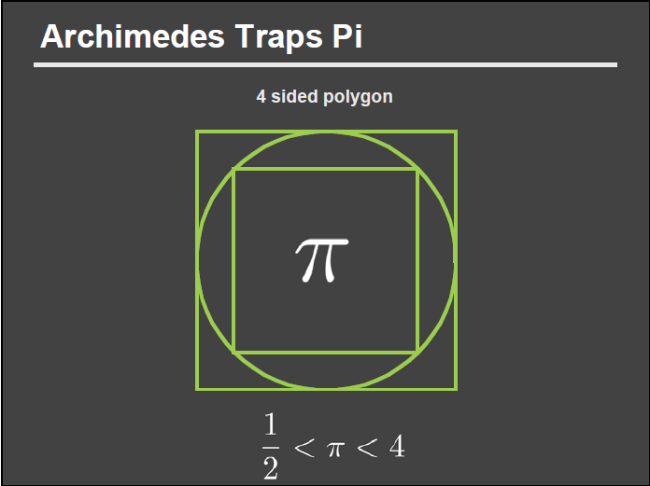
Values of Visualization
Presentation
Analysis
Slide courtesy of Dr. Pat Hanrahan, Stanford

Slide 9
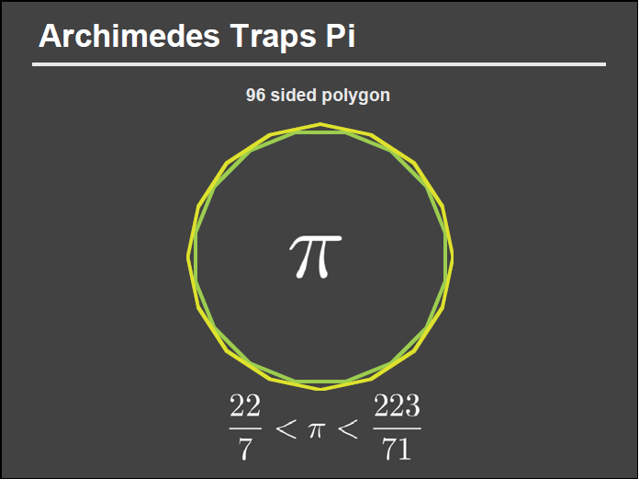
Values of Visualization
Presentation
Analysis
>
>
Slide courtesy of Dr. Pat Hanrahan, Stanford
Notes:
22/7: 3.14286
223/71: 3.140845

Slide 10
Values of Visualization
Presentation
Analysis
3.14286
>
3.140845
>
Slide courtesy of Dr. Pat Hanrahan, Stanford
Notes:
22/7: 3.14286
223/71: 3.140845

Slide 11
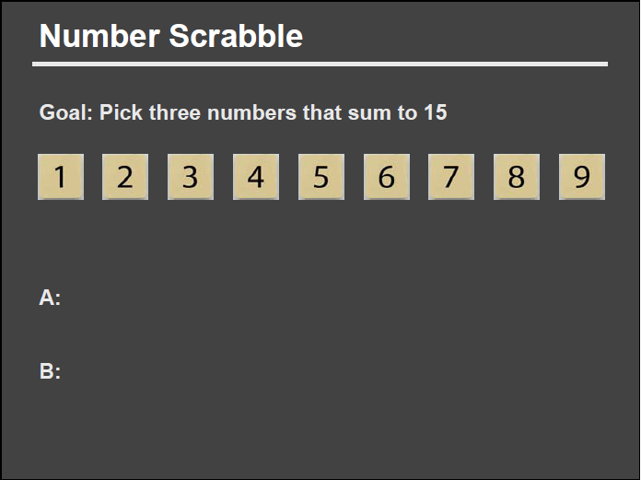
Values of Visualization
Presentation
Analysis
Slide courtesy of Dr. Pat Hanrahan, Stanford

Slide 12
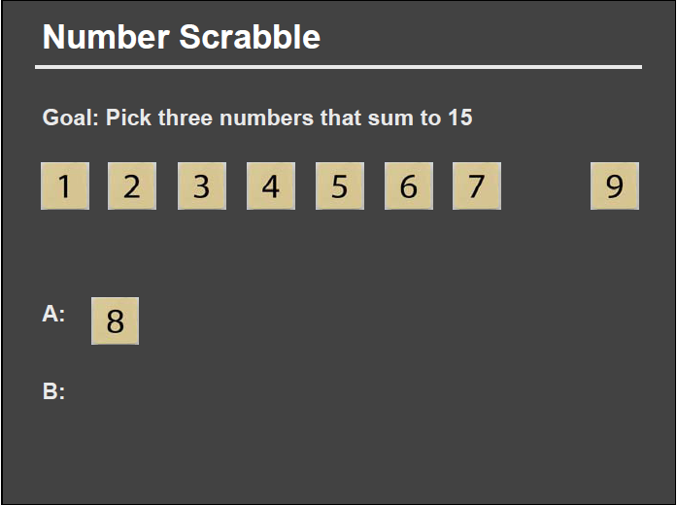
Values of Visualization
Presentation
Analysis
Slide courtesy of Dr. Pat Hanrahan, Stanford

Slide 13
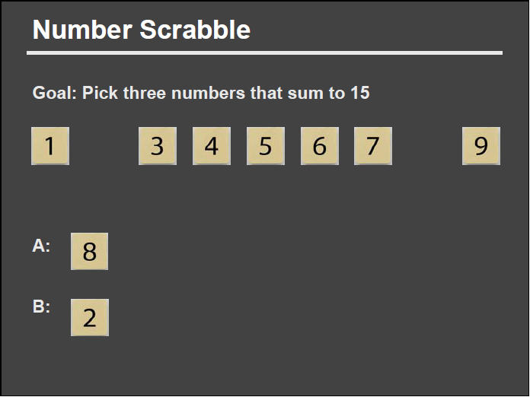
Values of Visualization
Presentation
Analysis
Slide courtesy of Dr. Pat Hanrahan, Stanford

Slide 14
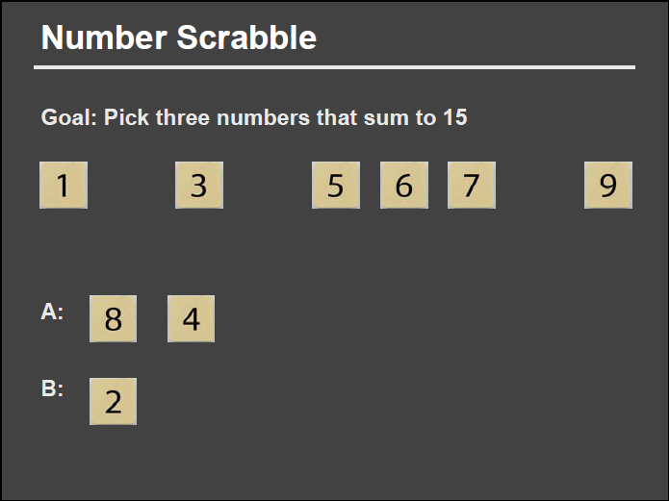
Values of Visualization
Presentation
Analysis
Slide courtesy of Dr. Pat Hanrahan, Stanford

Slide 15
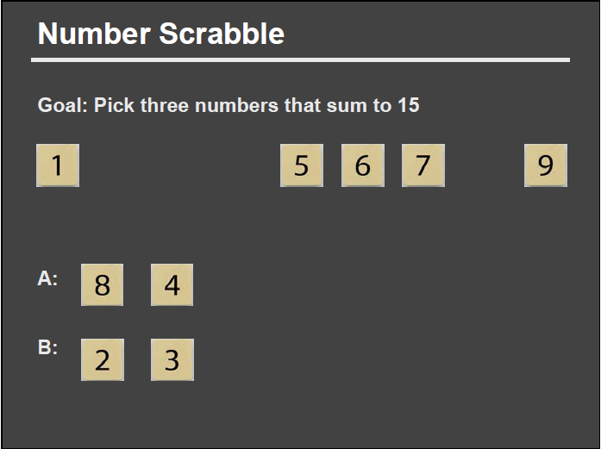
Values of Visualization
Presentation
Analysis
Slide courtesy of Dr. Pat Hanrahan, Stanford

Slide 16
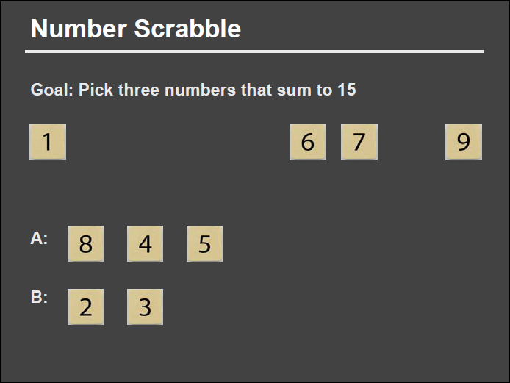
Values of Visualization
Presentation
Analysis
Slide courtesy of Dr. Pat Hanrahan, Stanford

Slide 17

Values of Visualization
Presentation
Analysis
Slide courtesy of Dr. Pat Hanrahan, Stanford

Slide 18
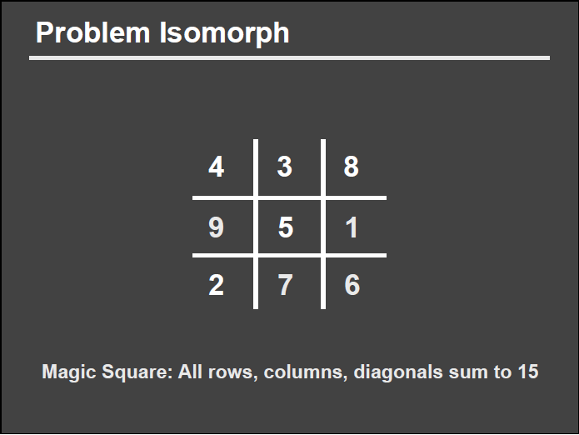
Values of Visualization
Presentation
Analysis
Slide courtesy of Dr. Pat Hanrahan, Stanford

Slide 19
Values of Visualization
Presentation
Analysis
Slide courtesy of Dr. Pat Hanrahan, Stanford

Slide 20
Values of Visualization
Presentation
Analysis
Slide courtesy of Dr. Pat Hanrahan, Stanford

Slide 21
Values of Visualization
Presentation
Analysis
Slide courtesy of Dr. Pat Hanrahan, Stanford

Slide 22
Values of Visualization
Presentation
Analysis
Slide courtesy of Dr. Pat Hanrahan, Stanford

Slide 23
Values of Visualization
Presentation
Analysis
Slide courtesy of Dr. Pat Hanrahan, Stanford

Slide 24
Values of Visualization
Presentation
Analysis
?
Slide courtesy of Dr. Pat Hanrahan, Stanford

Slide 25
Using Visualizations To
Solve Real-World Problems…
Visualizing the Global Terrorism Database
Financial Fraud Analysis
Biomechanical Motion Analysis
Urban Visualization
Social Simulation using Probes

Slide 26
(1) WireVis: Financial Fraud Analysis
In collaboration with Bank of America
  Looks for suspicious wire transactions
  Currently beta-deployed at WireWatch
  Visualizes 15 million transactions over 1 year
Uses interaction to coordinate four perspectives:
  Keywords to Accounts
  Keywords to Keywords
  Keywords/Accounts over Time
  Account similarities (search by example)
R. Chang et al., Scalable and interactive visual analysis of financial wire transactions for fraud detection. Information Visualization,2008.
R. Chang et al., Wirevis: Visualization of categorical, time-varying data from financial transactions. IEEE VAST, 2007.

Slide 27
(1) WireVis: Financial Fraud Analysis
Search by Example (Find Similar Accounts)
Heatmap View
(Accounts to Keywords Relationship)
Keyword Network
(Keyword Relationships)
Strings and Beads
(Relationships over Time)
R. Chang et al., Scalable and interactive visual analysis of financial wire transactions for fraud detection. Information Visualization,2008.
R. Chang et al., Wirevis: Visualization of categorical, time-varying data from financial transactions. IEEE VAST, 2007.

Slide 28
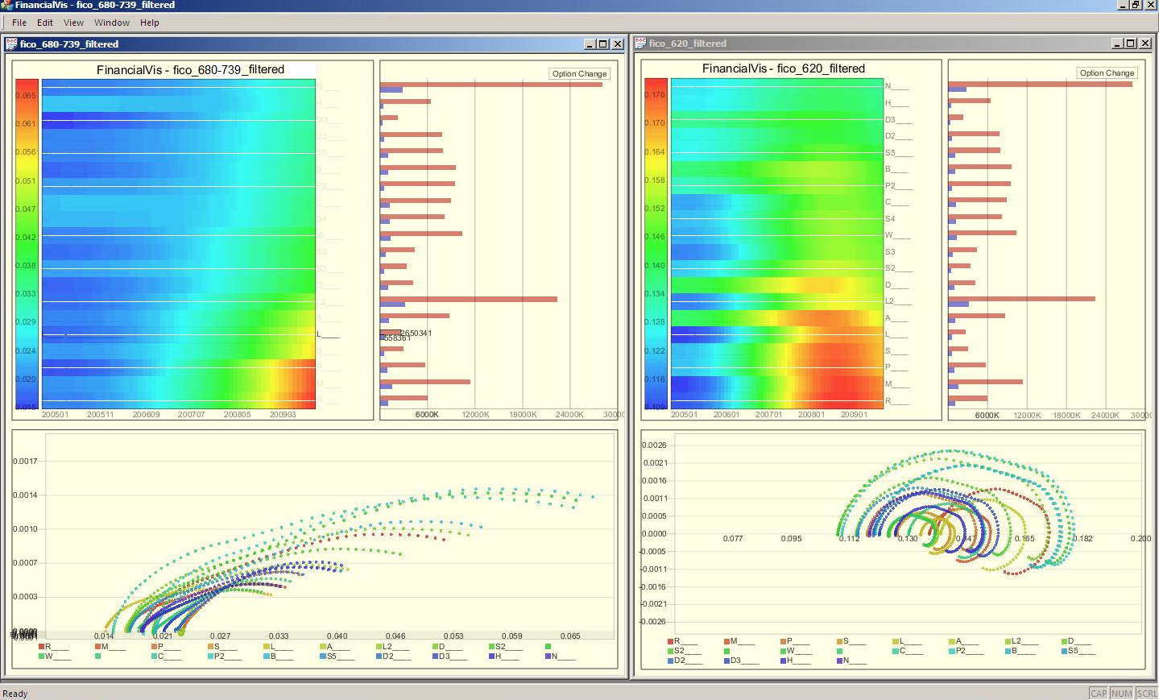
(1) Financial Risk Analysis

Slide 29
(2) Investigative GTD
Collaboration with U. Maryland’s DHS Center of Excellence START (Study of Terrorism And Response to Terrorism)
  Global Terrorism Database (GTD)
  International terrorism activities from 1970-1997
  60,000 incidents recorded over 120 dimensions
  Projected funded by DHS via NVAC and RVAC
Visualization is designed to be “investigative” in that it is modeled after the 5 W’s:
  Who, what, where, when, and [why]
  Interaction allows the user to adjust one or more of the W’s and see how that affects the other W’s

Slide 30
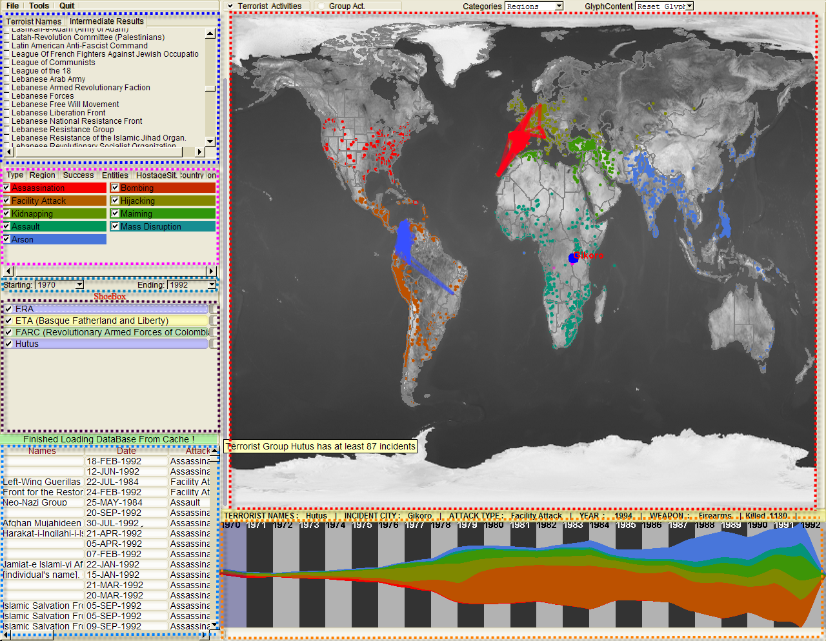
(2) Investigative GTD
Who
Where
What
Evidence
Box
Original
Data
When
R. Chang et al., Investigative Visual Analysis of Global Terrorism, Journal of Computer Graphics Forum (Eurovis), 2008.

Slide 31
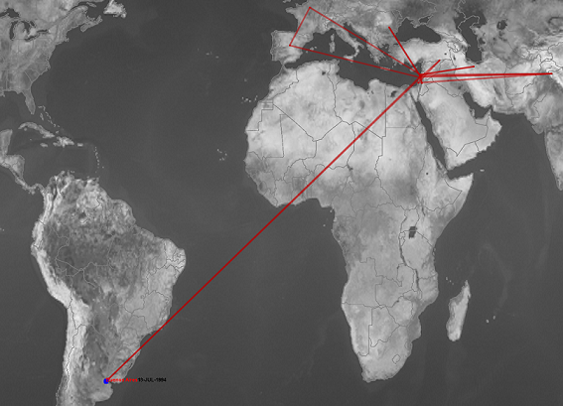
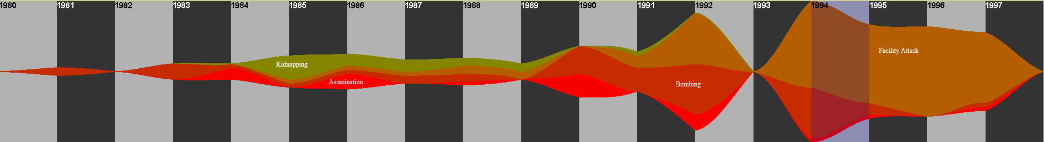
(2) Investigative GTD:
Revealing Global Strategy
This group’s attacks are not bounded by geo-locations but instead, religious beliefs.
Its attack patterns changed with its developments.
WHY
?

Slide 32
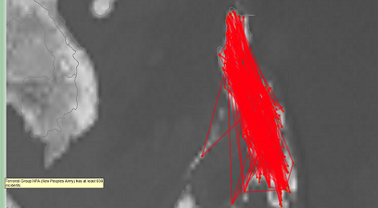
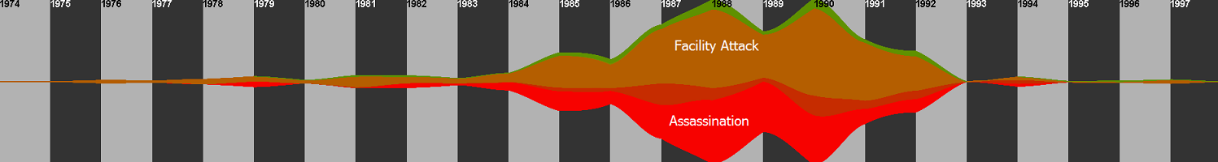
(2) Investigative GTD:
Discovering Unexpected Temporal Pattern
A geographically-bounded entity in the Philippines.
Domestic Group
The ThemeRiver shows its rise and fall as an entity and its modus operandi.
Notes:
An examination of the ThemeRiver
however, shows an interesting temporal pattern in Organization B's
activities. It appears that while Organization B was indeed active
during the '80s, it stopped operating entirely in 1992. This
unexpected temporal behavior, unfortunately, cannot be explained
using only the data within the GTD.
In order to find out what
happened in 1992 in the Philippines. we turn to
newspaper archives and found out that in 1992 Fidel Ramos became the
twelfth president of the Philippines, and immediately offered peace
treaties to various terrorist groups including Organization

Slide 33
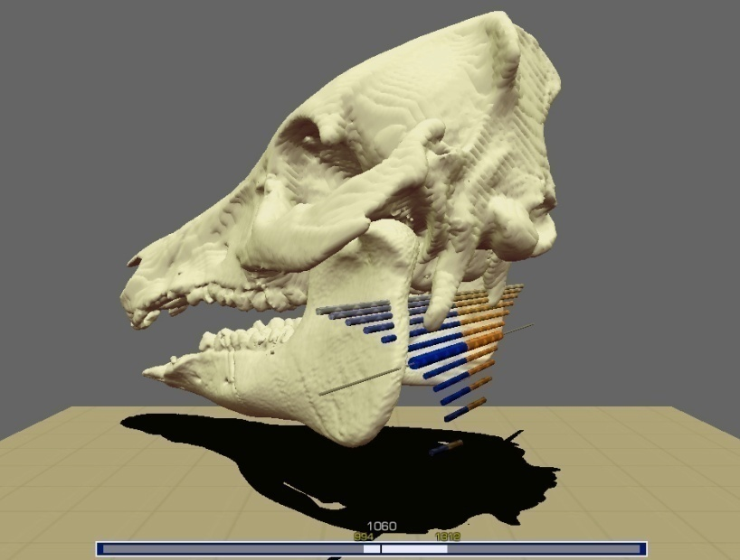
(3) Analysis of Biomechanical Motion
Biomechanical motion sequences (animation) are difficult to analyze.
Watching the movie repeatedly does not easily lead to insight.
Collaboration with Brown University and Univ. of Minnesota to examine the mechanics of a pig chewing different types and amounts of food (nuts, pig chow, etc.)
The data is typically organized by the rigid bodies in the model, where each rigid body contains 6 variables per frame -- 3 for translation, and 3 for rotation.

Slide 34

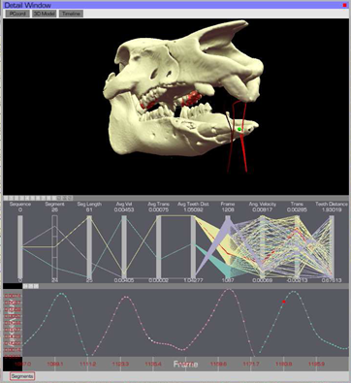
(3) Analysis of Biomechanical Motion
R. Chang et al., Interactive Coordinated Multiple-View Visualization of Biomechanical Motion Data, IEEE Vis (TVCG) 2009. To Appear.

Slide 35
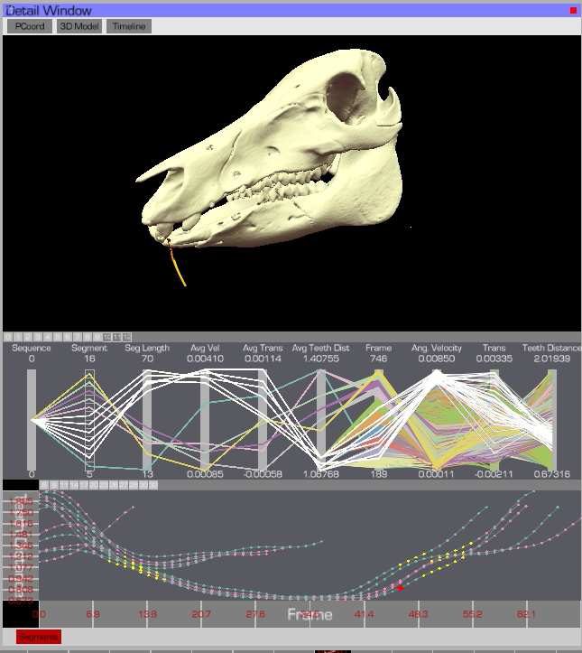
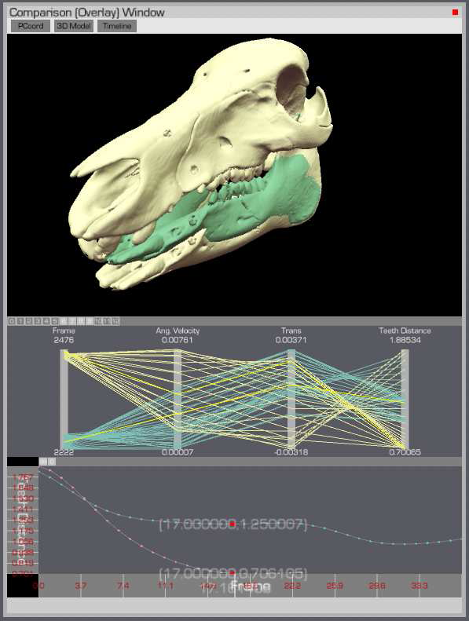

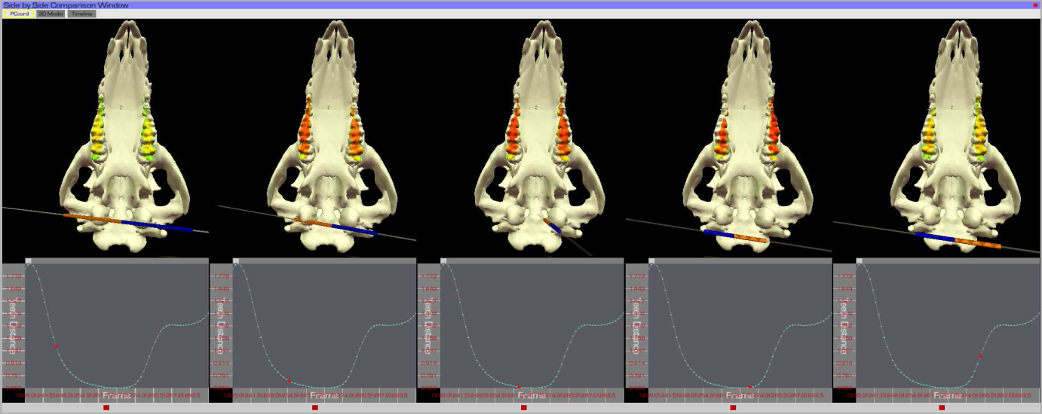
(3) Analysis of Biomechanical Motion
Our emphasis is on “interactive comparison.” Following the work by Robertson [InfoVis 2008], comparisons can be performed using:
  Small Multiples
  Side by side comparison
  Overlap
    Between two datasets
    Different cycles in the same data

Slide 36
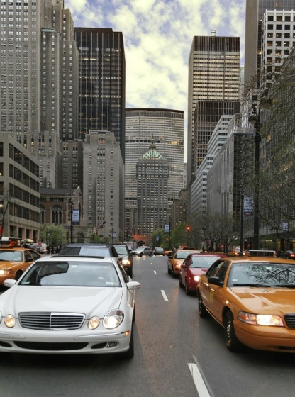
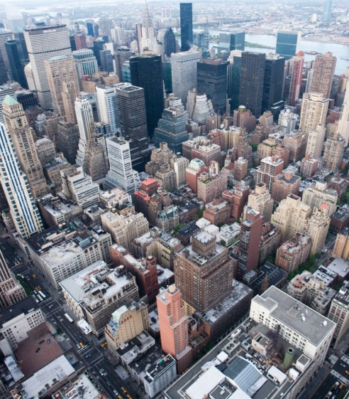
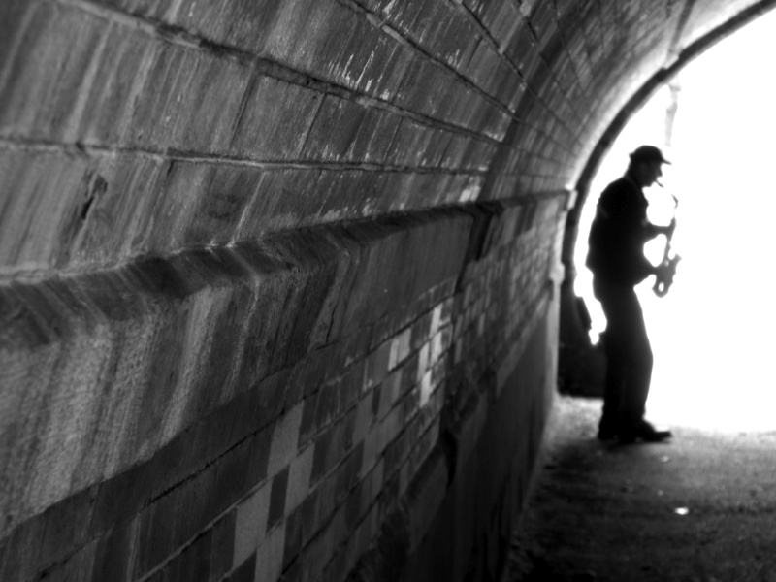
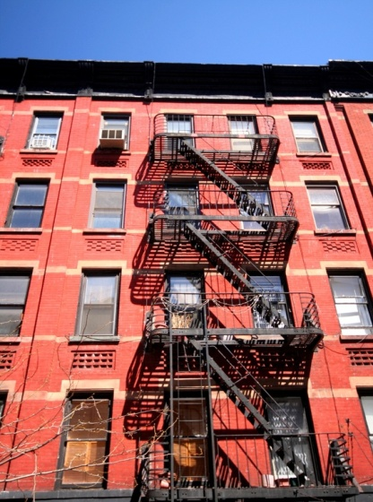
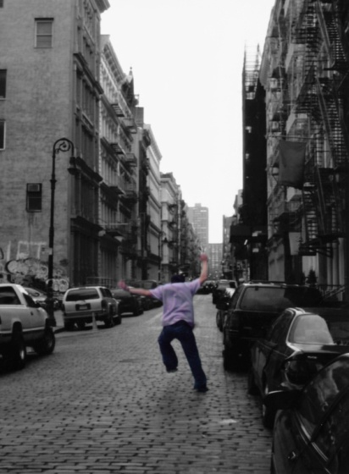
(4) Urban Visualization with Semantics
How do people think about a city?
  Describe New York…
    Response 1: “New York is large, compact, and crowded.”
    Response 2: “The area where I live there has a strong mix of ethnicities.”
Geometric,
Information,
View Dependent (Cognitive)

Slide 37
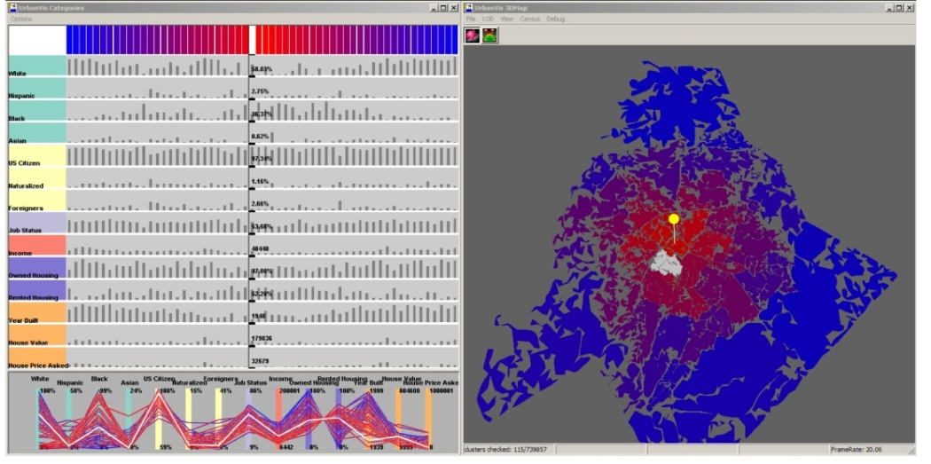
(4) Urban Visualization with Semantics
Geometric
  Create a hierarchy of shapes based on the rules of legibility
Information
  Matrix view and Parallel Coordinates show relationships between clusters and dimensions
View Dependence (Cognitive)
  Uses interaction to alter the position of focus
R. Chang et al., Legible cities: Focus-dependent multi-resolution visualization of urban relationships. IEEE Transactions on Visualization and Graphics , 13(6):1169–1175, 2007

Slide 38
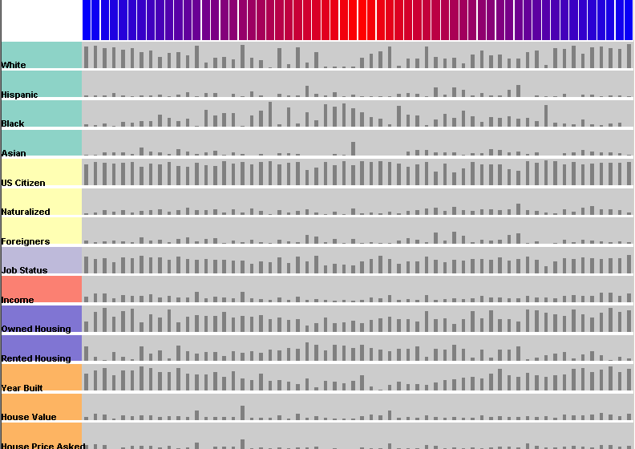
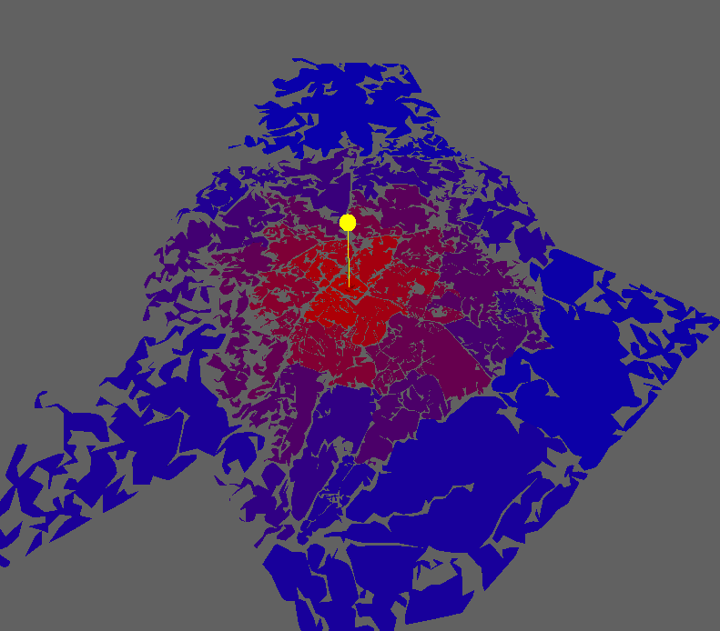
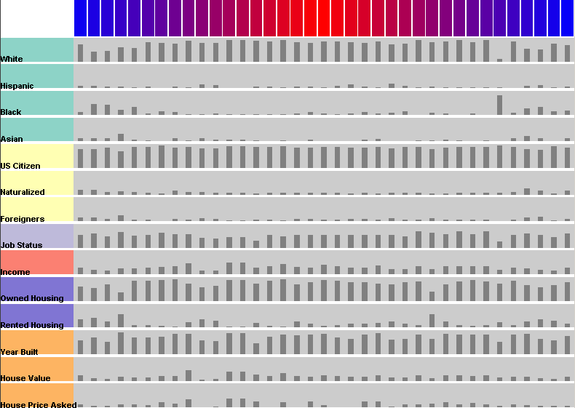
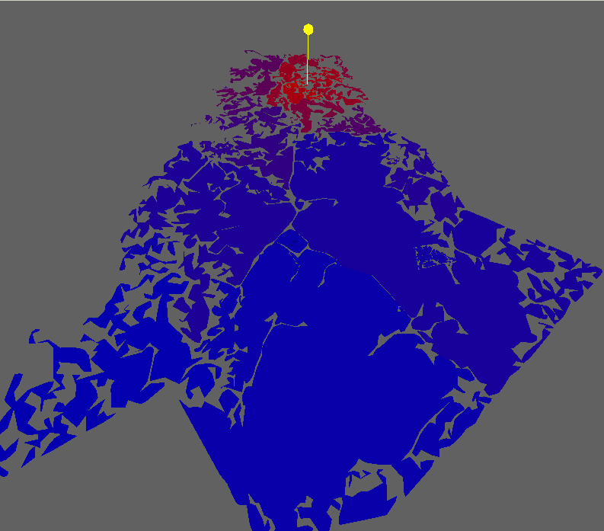
(4) Urban Visualization with Semantics
Scenario 1: Comparing cities…
Charlotte
Davidson

Slide 39
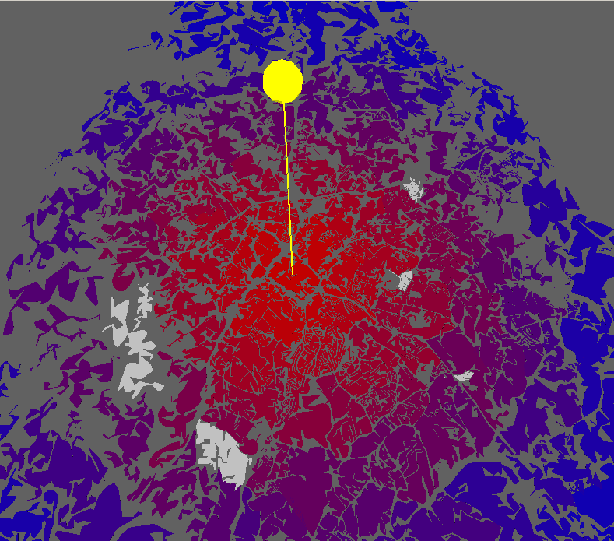
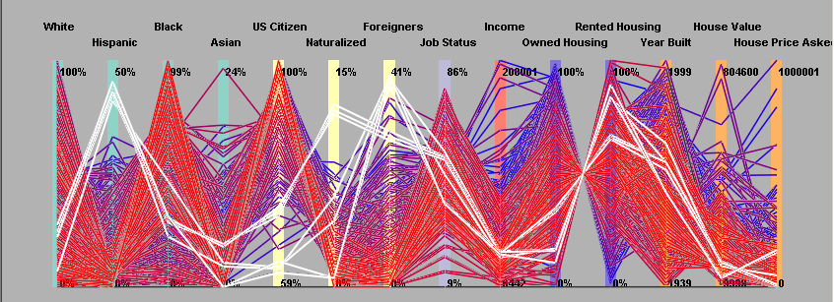
(4) Urban Visualization with Semantics
Scenario 2:
  Looking for high Hispanic populations around downtown Charlotte.

Slide 40
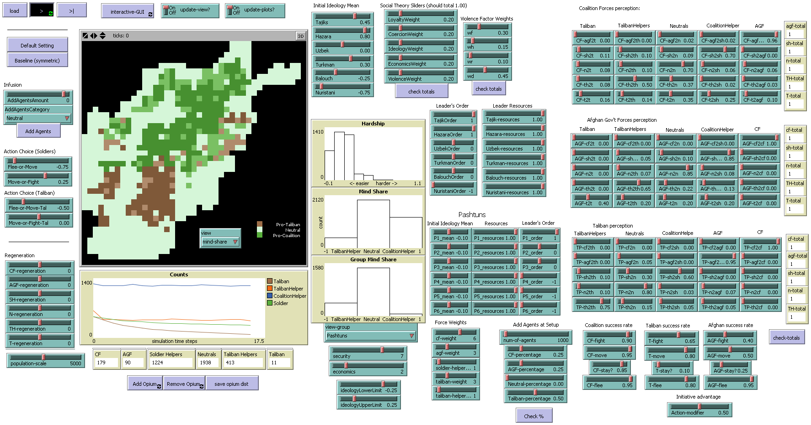
(5) Social Simulation with Probes
“Hearts & Minds” of Afghanistan population
Test Social Theories using agent-based simulations
Single Perspective: Visualization & Controls (using NetLogo)
Projected funded by DARPA (Sean O’Brien) through Mirsad Hadzikadic

Slide 41
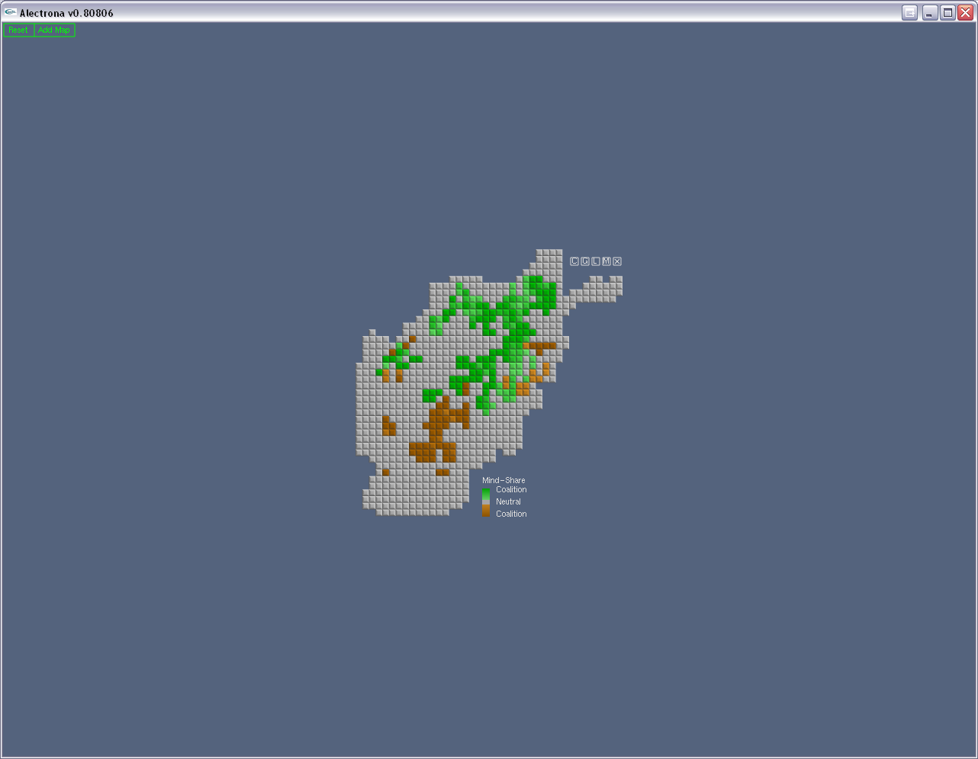
R. Chang et al., Multi-Focused Geospatial Analysis Using Probes, IEEE InfoVis (TVCG) 2008.

Slide 42
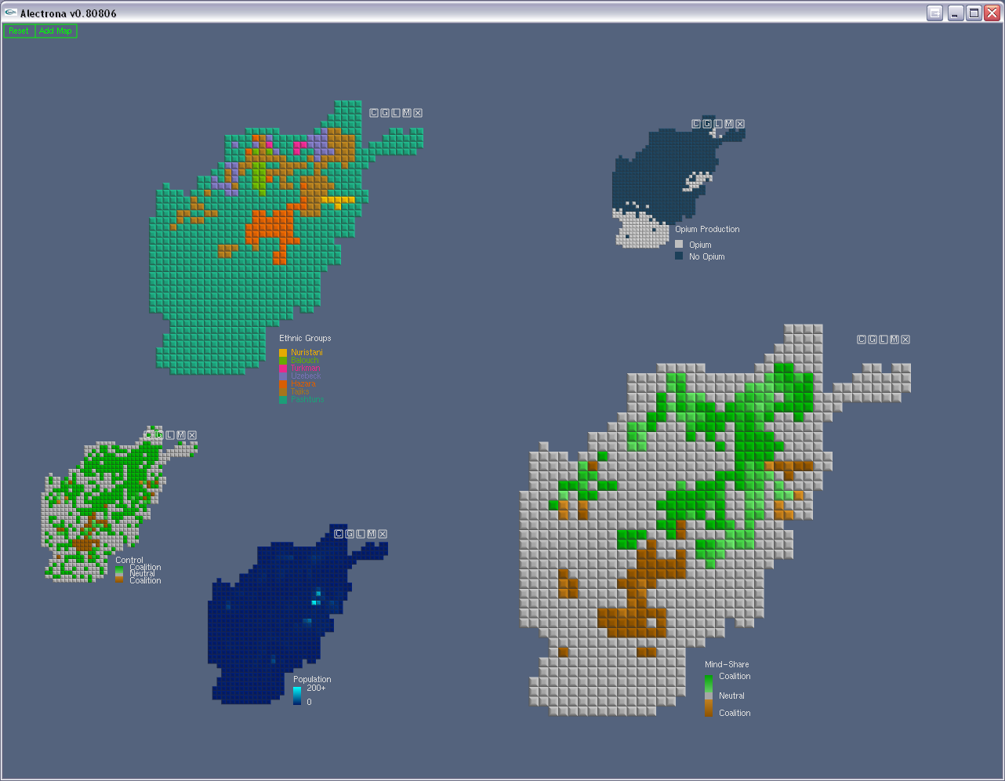

Slide 43
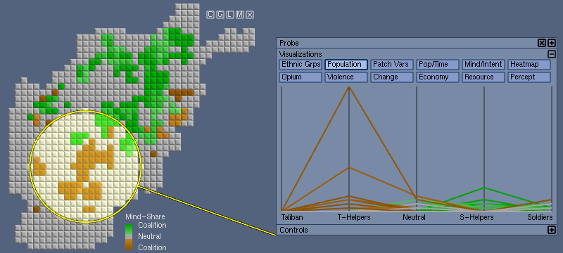
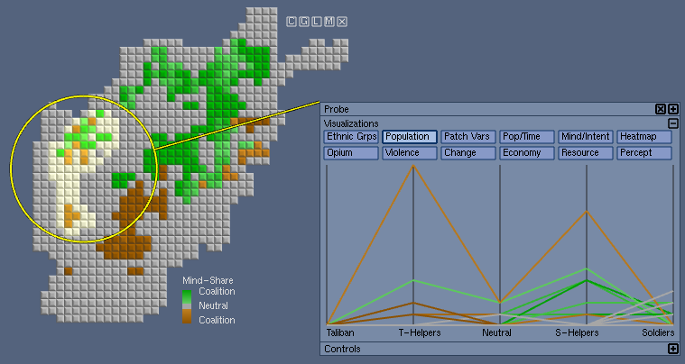
(5) Social Simulation with Probes
Region-of-Interest:
Uniform:
Focal Point +
Extent (Radius)
Non-uniform:
Manual selection
(painting)

Slide 44
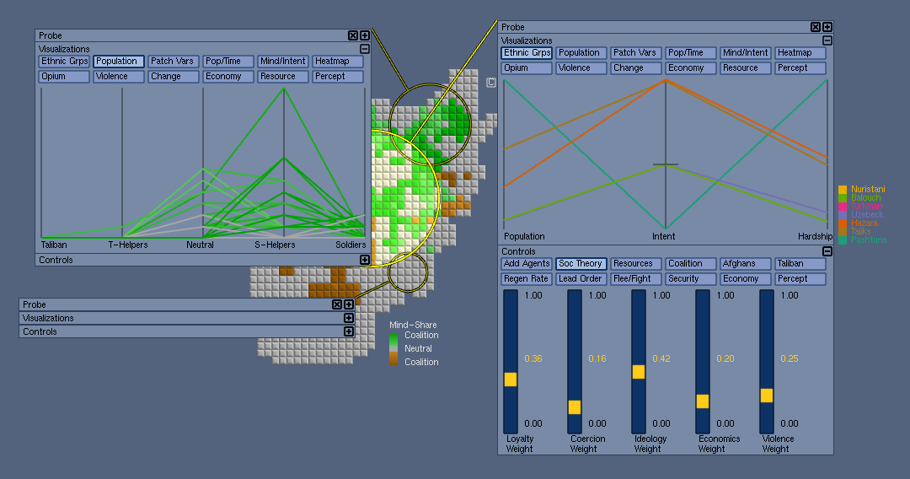
Expandable Probe Interfaces

Slide 45
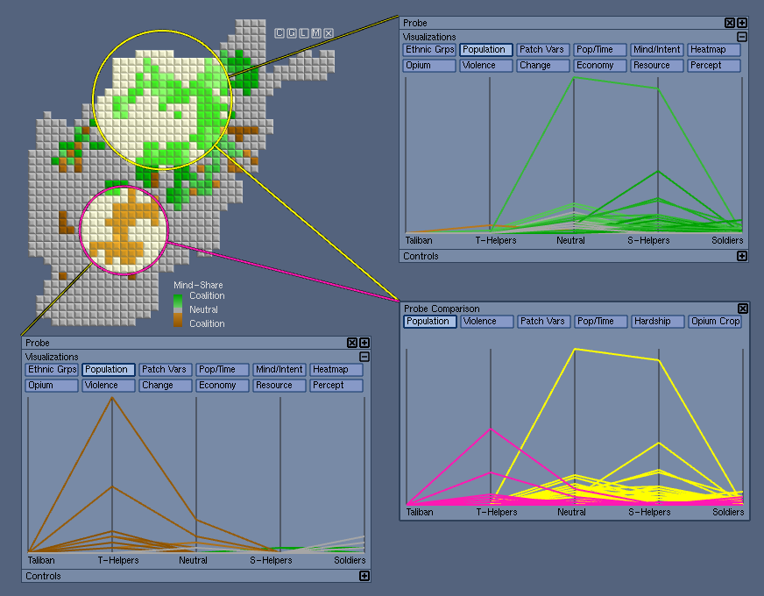
Direct Comparison

Slide 46
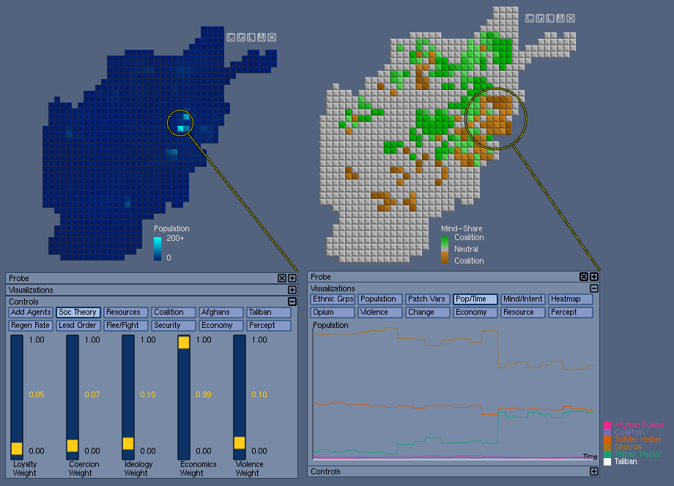
Local Control and Local Inspection on different ROIs

Slide 47
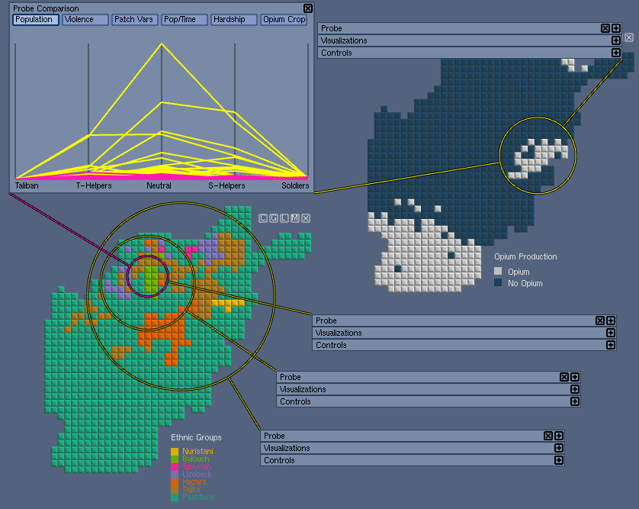
Complex inter-map and inter-region relationships possible

Slide 48
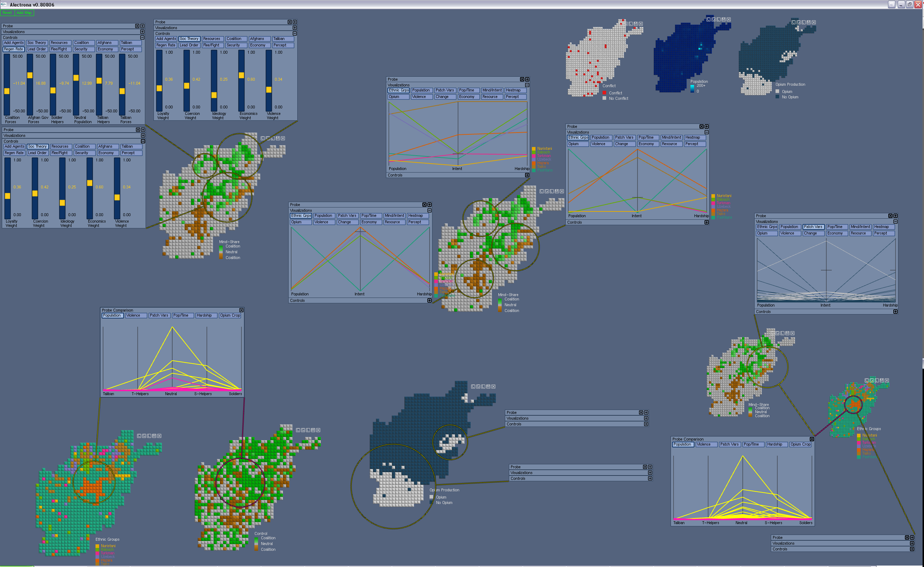

Slide 49
Discussions…
Visualizations do not have to be social networks
Visualizations do not have to be 3D
Visualizations do not have to be shiny
Visualizations should be intuitive
Visualizations should be interactive
Visualizations should be faithful to the data
Visualizations should be insightful

Slide 50
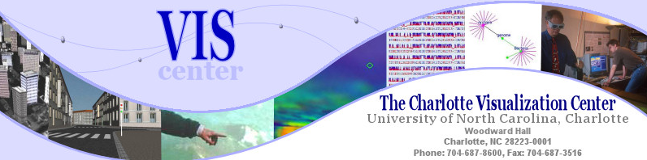
Thank you!
rchang@uncc.edu
http://www.viscenter.uncc.edu/~rchang

Slide 51



Extending Visual Analytics Principles
Global Terrorism Database
  With University of Maryland
  Application of the investigative 5 W’s
Bridge Maintenance
  With US DOT
  Exploring subjective inspection reports
Biomechanical Motion
  With U. Minnesota and Brown
  Interactive motion comparison methods
R. Chang et al., An Interactive Visual Analytics System for Bridge Management, Journal of Computer Graphics Forum, 2010. To Appear.

Slide 52
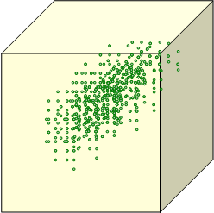


Dimension Reduction using PCA
Dimension reduction using principle component analysis (PCA)
Quick Refresher of PCA
  Find most dominant eigenvectors as principle components
  Data points are re-projected into the new coordinate system
    For reducing dimensionality
    For finding clusters
For many (especially novices), PCA is easy to understand mathematically, but difficult to understand “semantically”.
height
GPA
0.5*GPA + 0.2*age + 0.3*height = ?
age

Slide 53

Exploring Dimension Reduction: iPCA
R. Chang et al., iPCA: An Interactive System for PCA-based Visual Analytics. Computer Graphics Forum (Eurovis), 2009.

Slide 54
What’s Next?
The probe interface is generalizable and immediately applicable to agent-based simulations
Bangladesh Dataset from Steve
  Showing causality
    Using the WireVis framework
  Considering temporal (trend) changes
    Handling dynamic social network

Slide 55
Remco’s Rants:
Visualization != Social Networks
Visualization is not the end step to “pretty-up” your results
Visual analytics is an up-and-coming discipline in the scientific community (DHS, DOD, DOE, NSF, etc.), get it while it’s hot.

