Slide 1
Visualization and Analysis of Text
Remco Chang, PhD
Assistant Professor
Department of Computer Science
Tufts University
December 17, 2010
Cologne, Germany

Slide 2
Introduction
Information Visualization
  Novel visual representations
  Storytelling
  User-Driven
Visual Analysis
  Data exploration
  Hypotheses generation
  Interactive visualization + Computation

Slide 3
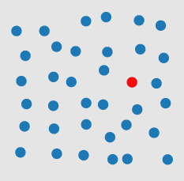

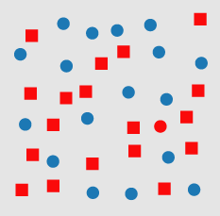
Visualization
Pre-attentive Processing
Examples courtesy of Chris Healey

Slide 4
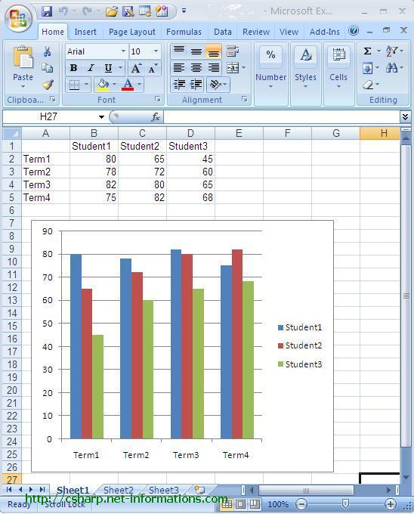
Visualization
This is helpful because:
  It allows us to process more information quickly
  We can see trends and patterns

Slide 5
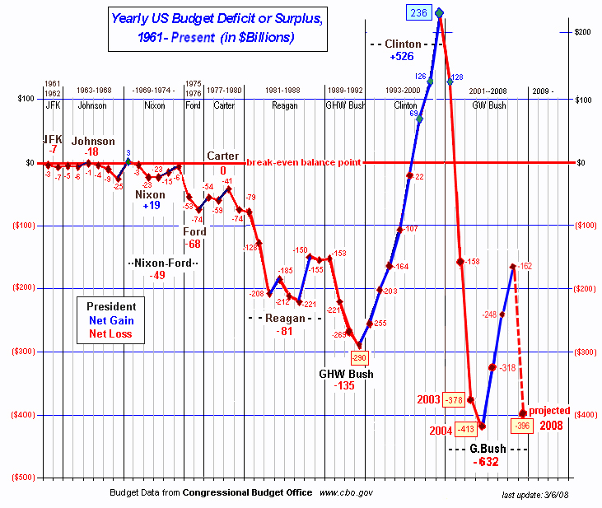
Storytelling
US Budget from 1961 - 2008

Slide 6
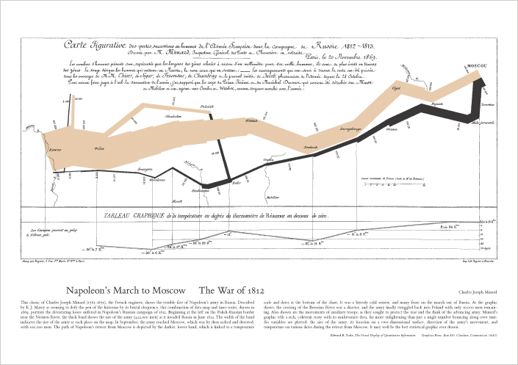
Storytelling
Minard’s Map:
Napolean’s March to Moscow
Notes:
6 variables
Date/time
Troop location
Troop direction
Temperature
Troop size
Type of troop movement (attack/retreat)

Slide 7
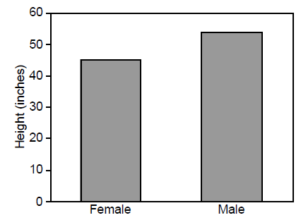
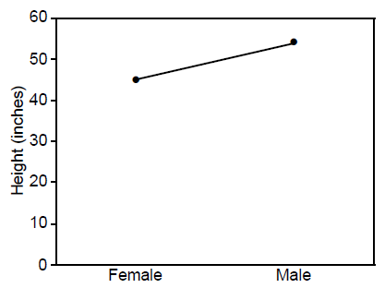
Visualization
Influences the thought…
Images courtesy of Barbara Tversky

Slide 8
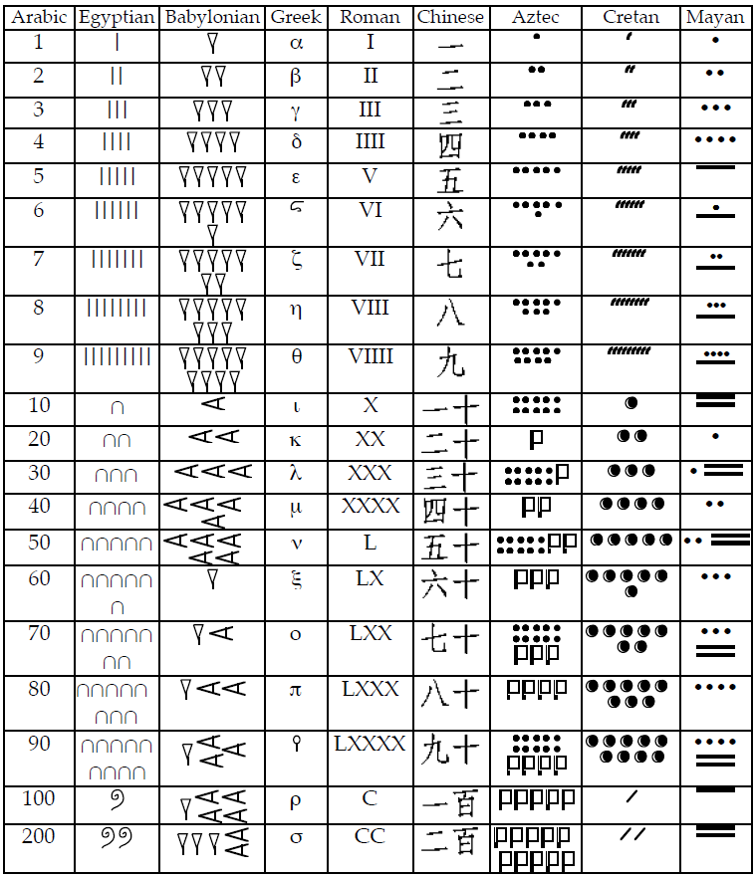
Visual Encoding
Affects the:
  Types of possible operations
  The user’s thinking process
Zhang and Norman. The Representation Of Numbers. Cognition. (1995)

Slide 9
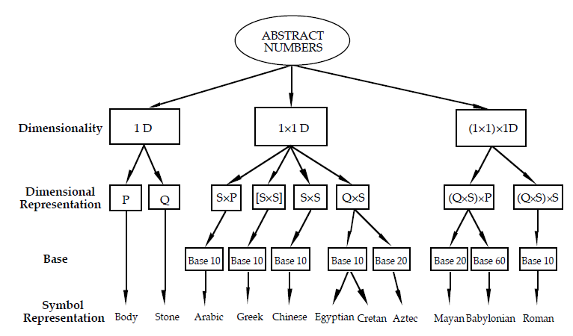
Classifying Numeric Systems

Slide 10
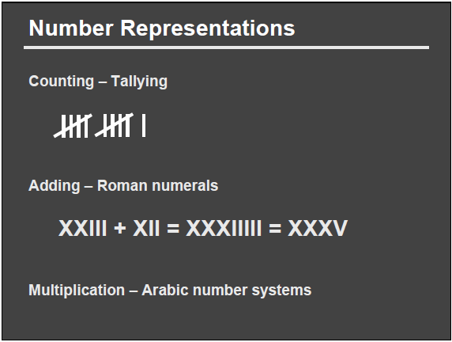
Example: Arithmetic
Slide courtesy of Pat Hanrahan

Slide 11
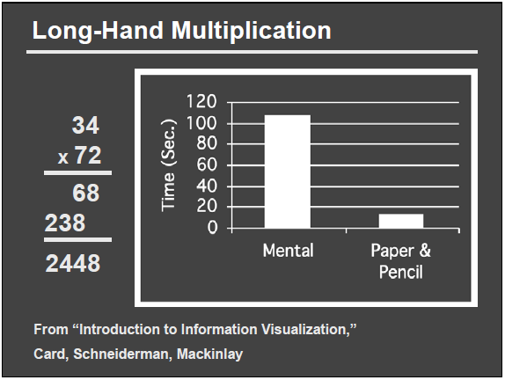
Example: Arithmetic

Slide 12
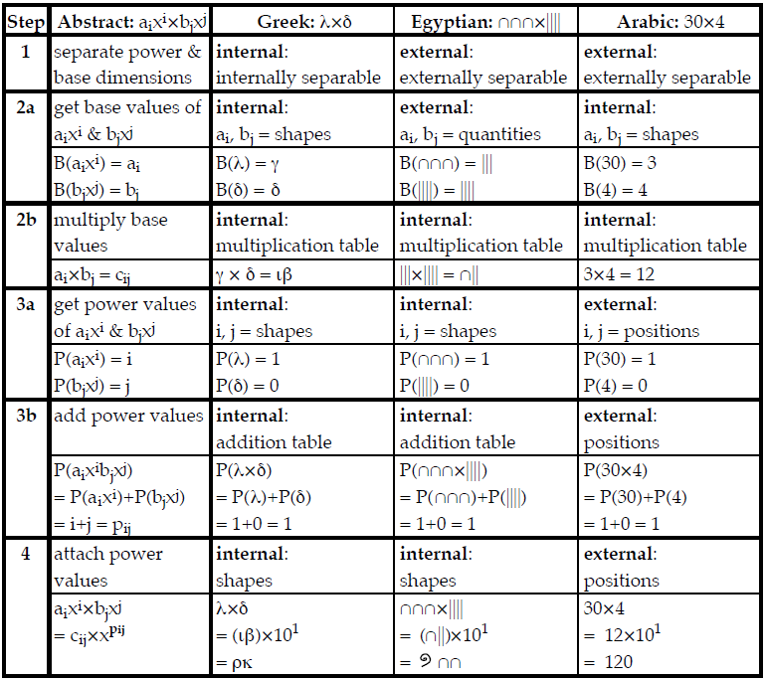
Example: Arithmetic

Slide 13
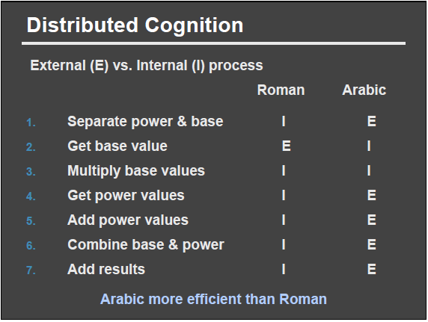
Example: Arithmetic

Slide 14
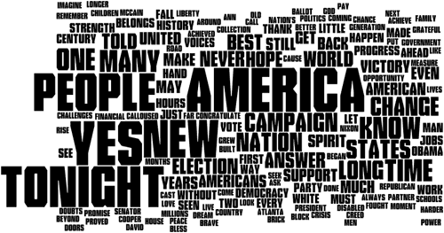
Examples of Text Visualization
Wordle
Images Courtesy of Many Eyes

Slide 15
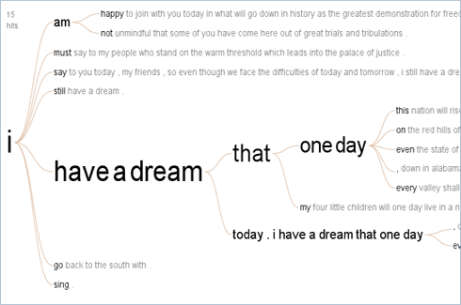
Examples of Text Visualization
WordTree

Slide 16
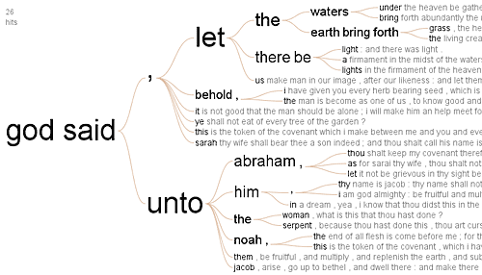
Examples of Text Visualization
WordTree

Slide 17
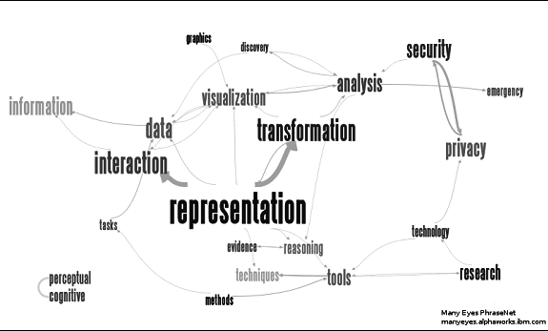
Examples of Text Visualization
Phrase Net

Slide 18
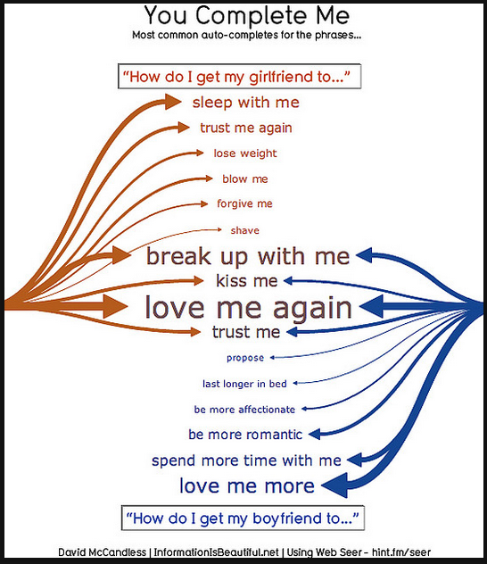
Examples of Text Visualization
Google Auto-Complete

Slide 19
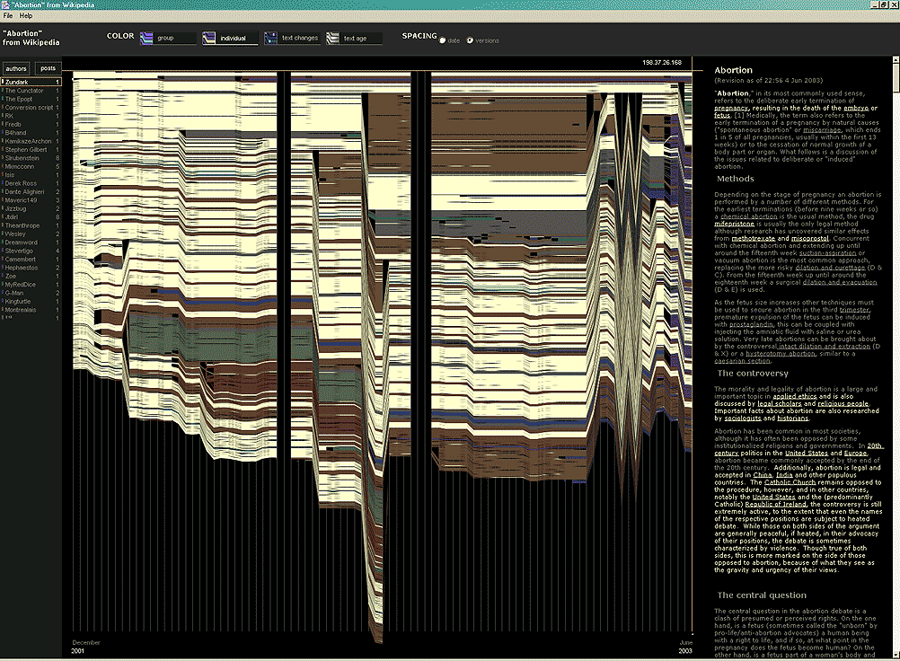
Examples of Text Visualization
Visualizing changes in Wikipedia
Images Courtesy of Info.fm

Slide 20
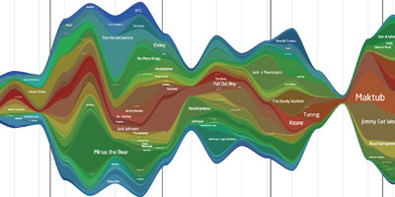
Examples of Text Visualization
ThemeRiver

Slide 21
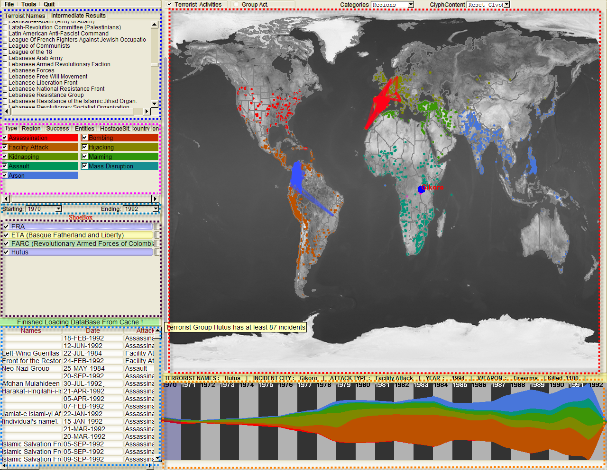
Visual Exploration
Coordinated Multi-Views (CMV)
Who
Where
What
Evidence
Box
Original
Data
When

Slide 22
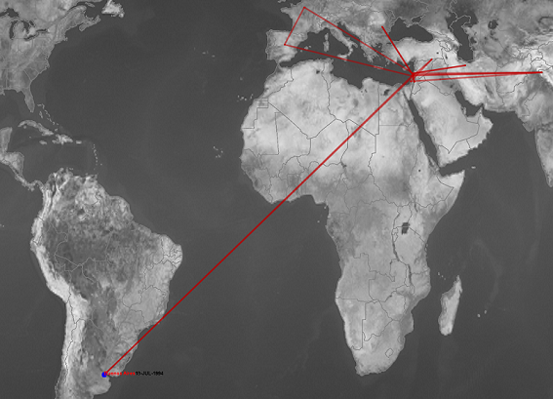
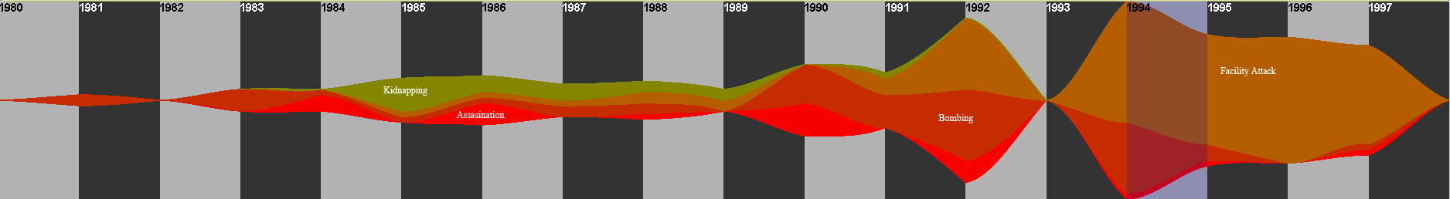
Coordinated Multi-Views
This group’s attacks are not bounded by geo-locations but instead, religious beliefs.
Its attack patterns changed with its developments.
WHY
?

Slide 23
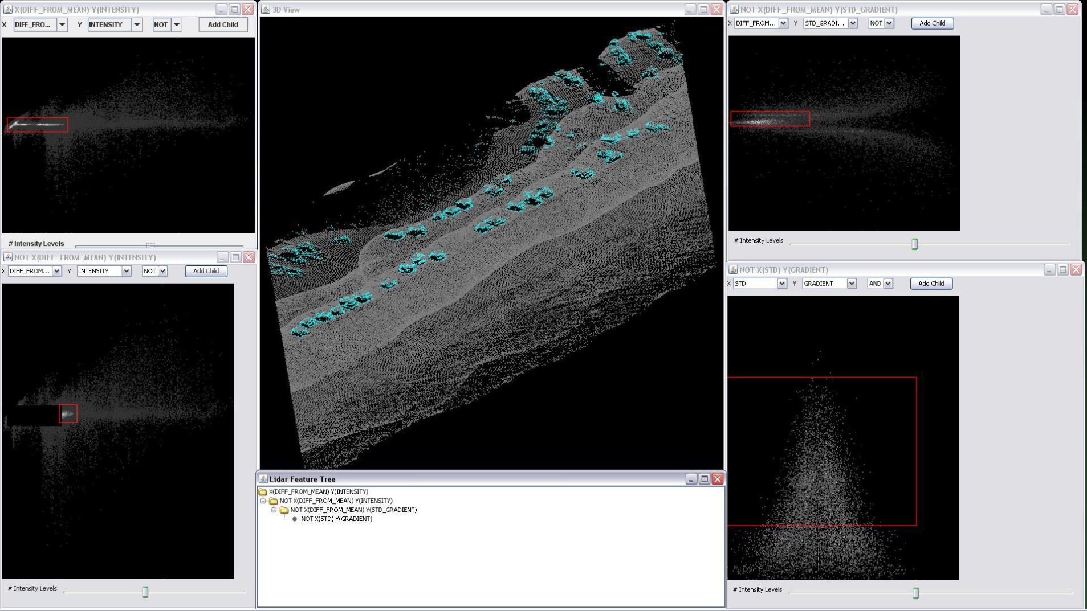
LIDAR Linked Feature Space

Slide 24
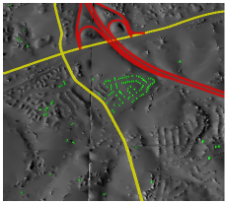
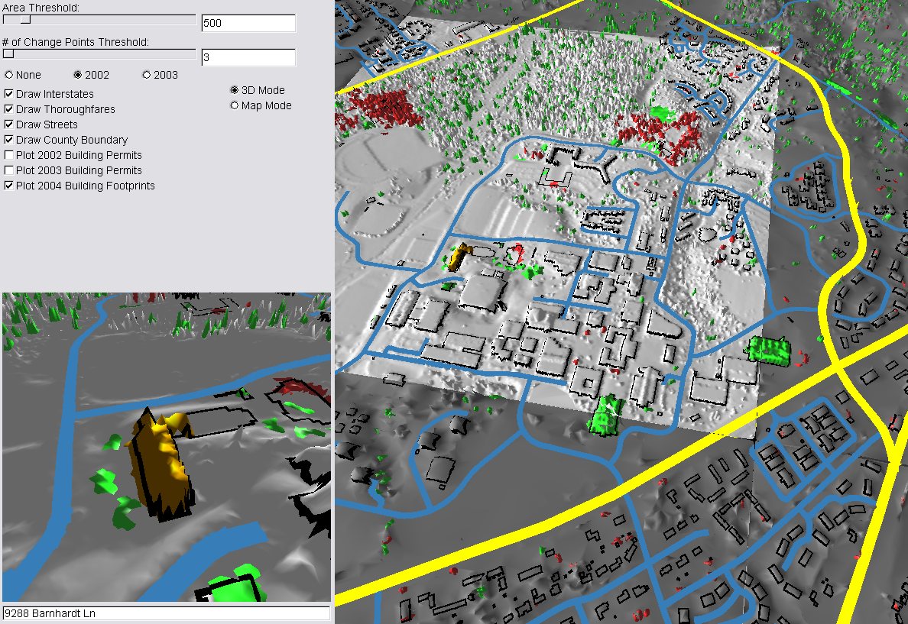
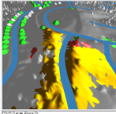
LIDAR Change Detection

Slide 25
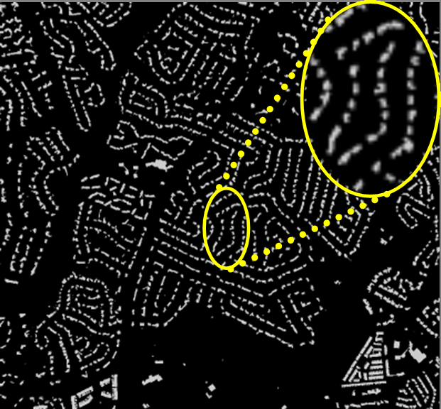
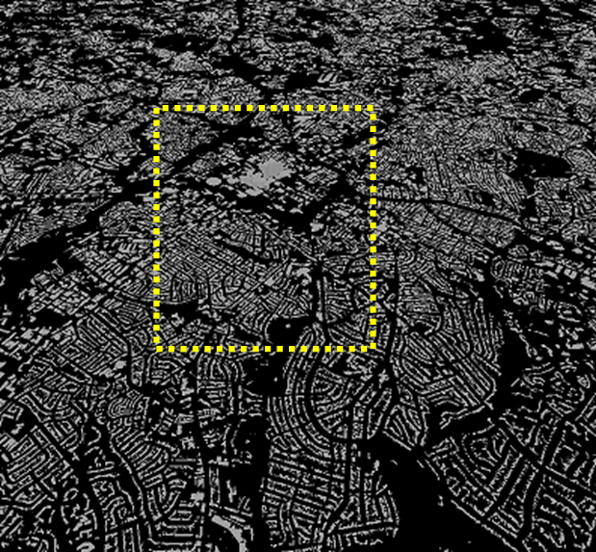
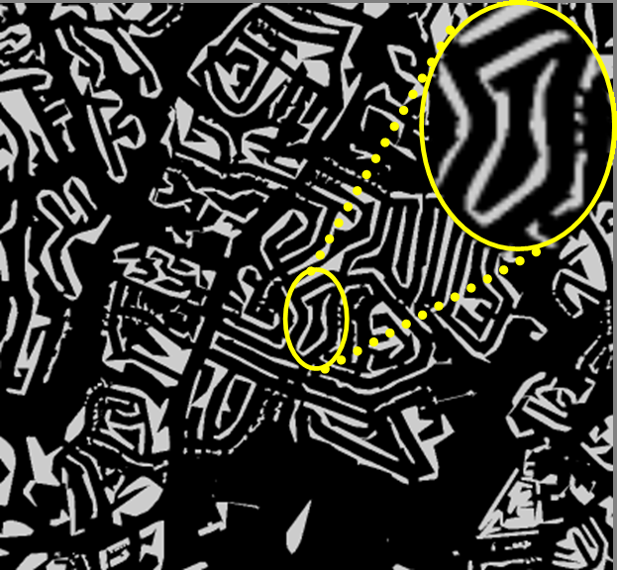
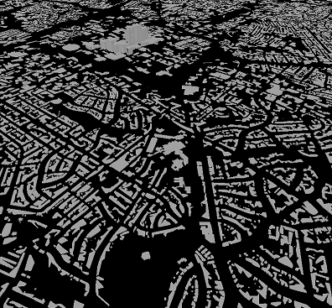
Urban Model

Slide 26
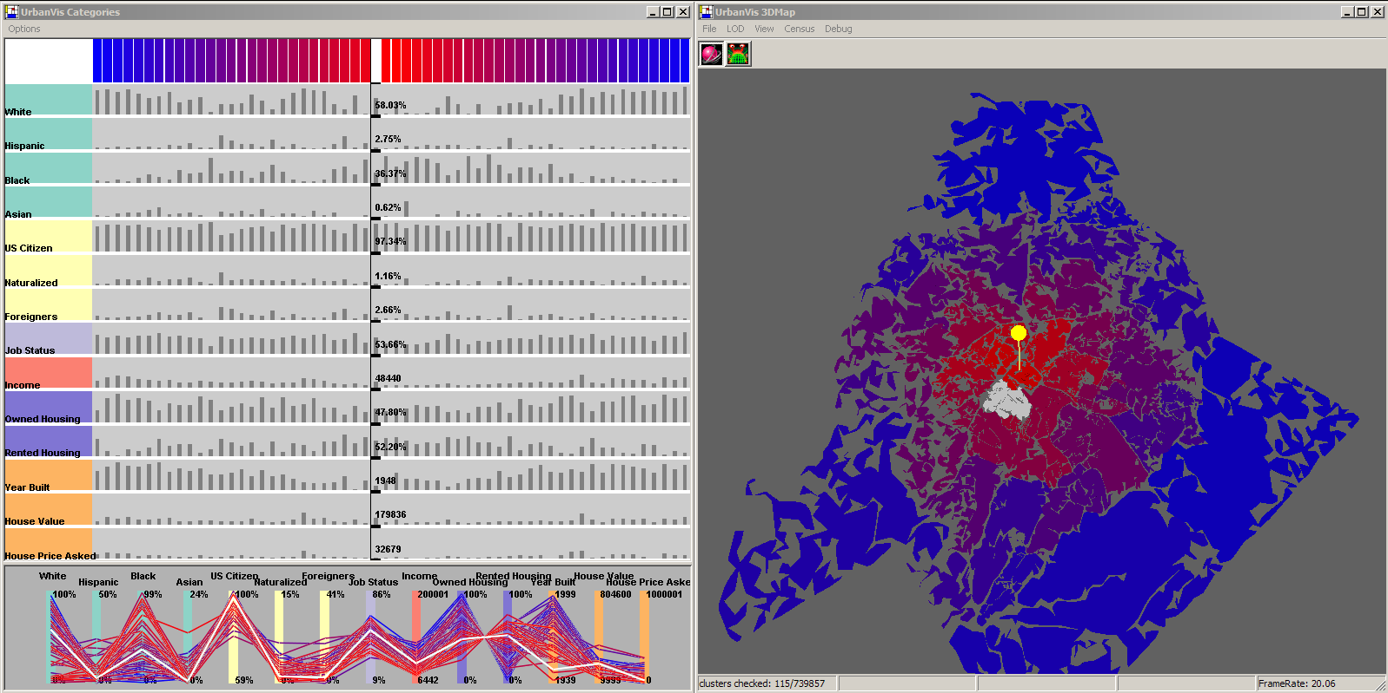
Urban Visualization

Slide 27
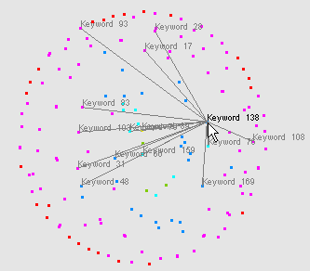
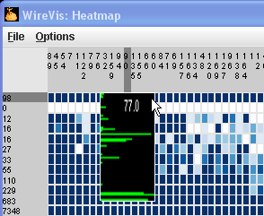
Coordinated Multi-Views
Financial Wire Fraud
  With Bank of America
  Discover suspicious international wire transactions
Bridge Maintenance
  With US DOT
  Exploring subjective inspection reports
Biomechanical Motion
  With U. Minnesota and Brown
  Interactive motion comparison methods

Slide 28



Coordinated Multi-Views
Financial Wire Fraud
  With Bank of America
  Discover suspicious international wire transactions
Bridge Maintenance
  With US DOT
  Exploring subjective inspection reports
Biomechanical Motion
  With U. Minnesota and Brown
  Interactive motion comparison methods

Slide 29



Coordinated Multi-Views
Financial Wire Fraud
  With Bank of America
  Discover suspicious international wire transactions
Bridge Maintenance
  With US DOT
  Exploring subjective inspection reports
Biomechanical Motion
  With U. Minnesota and Brown
  Interactive motion comparison methods

Slide 30
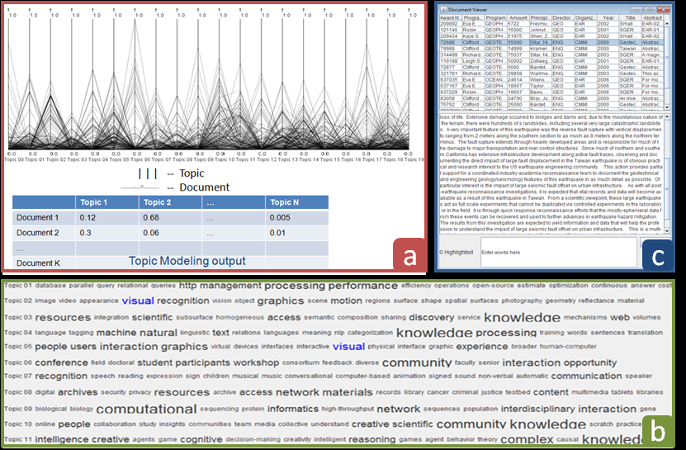
CMV + Text Analysis

Slide 31
Parallel Topics
Task: Given the proposals submitted to the National Science Foundation (NSF), identify:
  Proposals that are interdisciplinary
  Proposals that are potentially transformative
  Proposals that are focused

Slide 32
Parallel Topics
Approach:
  Apply topic modeling algorithms to identify latent topics (David Blei, “Latent dirichlet allocation”, 2003)
  Visualize the distribution of proposals based on the topics

Slide 33
Topic Modeling
Given a set of k documents, find n number of topics
  Each document then is described as:
    (W₁ * Topic₁, W₂ * Topic₂, W₃ * Topic₃, …, W_{n} * Topic_{n})
    W₁ + W₂ + W₃ + … + W_{n} = 1
 | Topic 1 | Topic 2 | … | Topic N
Document 1 | 0.12 | 0.68 | … | 0.005
Document 2 | 0.3 | 0.06 | … | 0.01
…
Document K
∑ = 1
∑ = 1
...

Slide 34
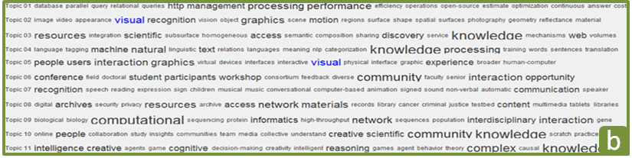
Topic Modeling
A topic is a combination of keywords

Slide 35
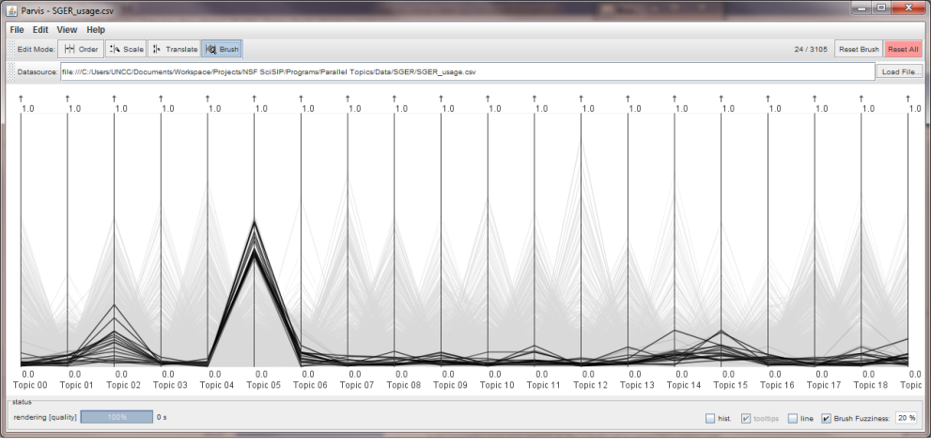
Parallel Topics
Based on “Parallel Coordinates”
  Each vertical axis is a topic
  Each set of horizontal connected lines is a document

Slide 36
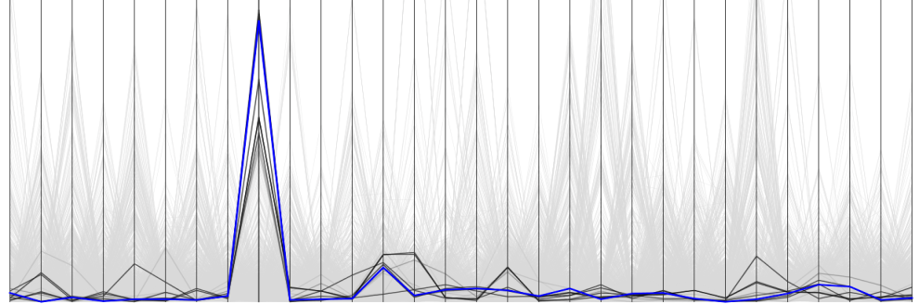
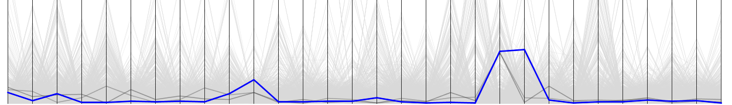
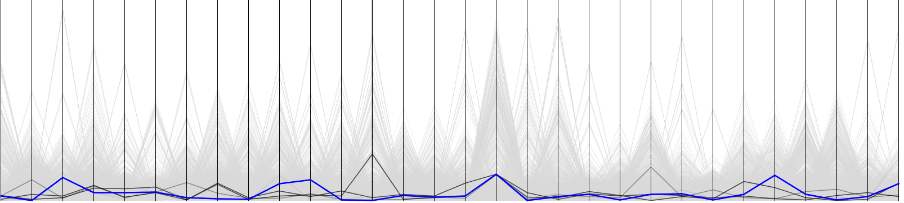
Visual Signatures
We identify different signatures for proposals:
  Single Topic – focused research
  Bi-Topic – Interdisciplinary research
  No-Topic – Potentially transformative research
Single topic
Bi-topic
No salient topic
Notes:
You might wonder what the topics are, let take a quick look at a few examples of the topics.
NLP, Machine translation
Creativity, creative thinking
Bioinformatics
With a better understanding of the topics, we now will be able to make sense of the visual patterns of the documents.

Slide 37
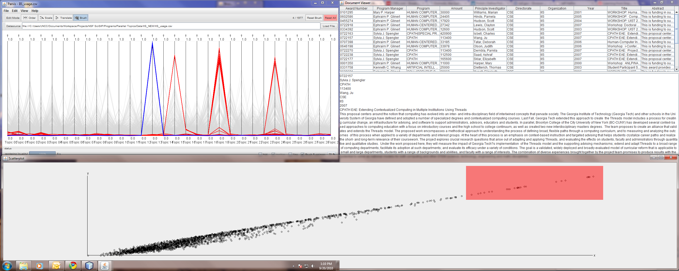
Selecting Single Topic Proposals
Max
SD
 | Topic 1 | Topic 2 | … | Topic N
Document 1 | 0.12 | 0.68 | … | 0.005
Document 2 | 0.3 | 0.06 | … | 0.01
…
Document K
SD = 0.14
SD = 0.06

Slide 38
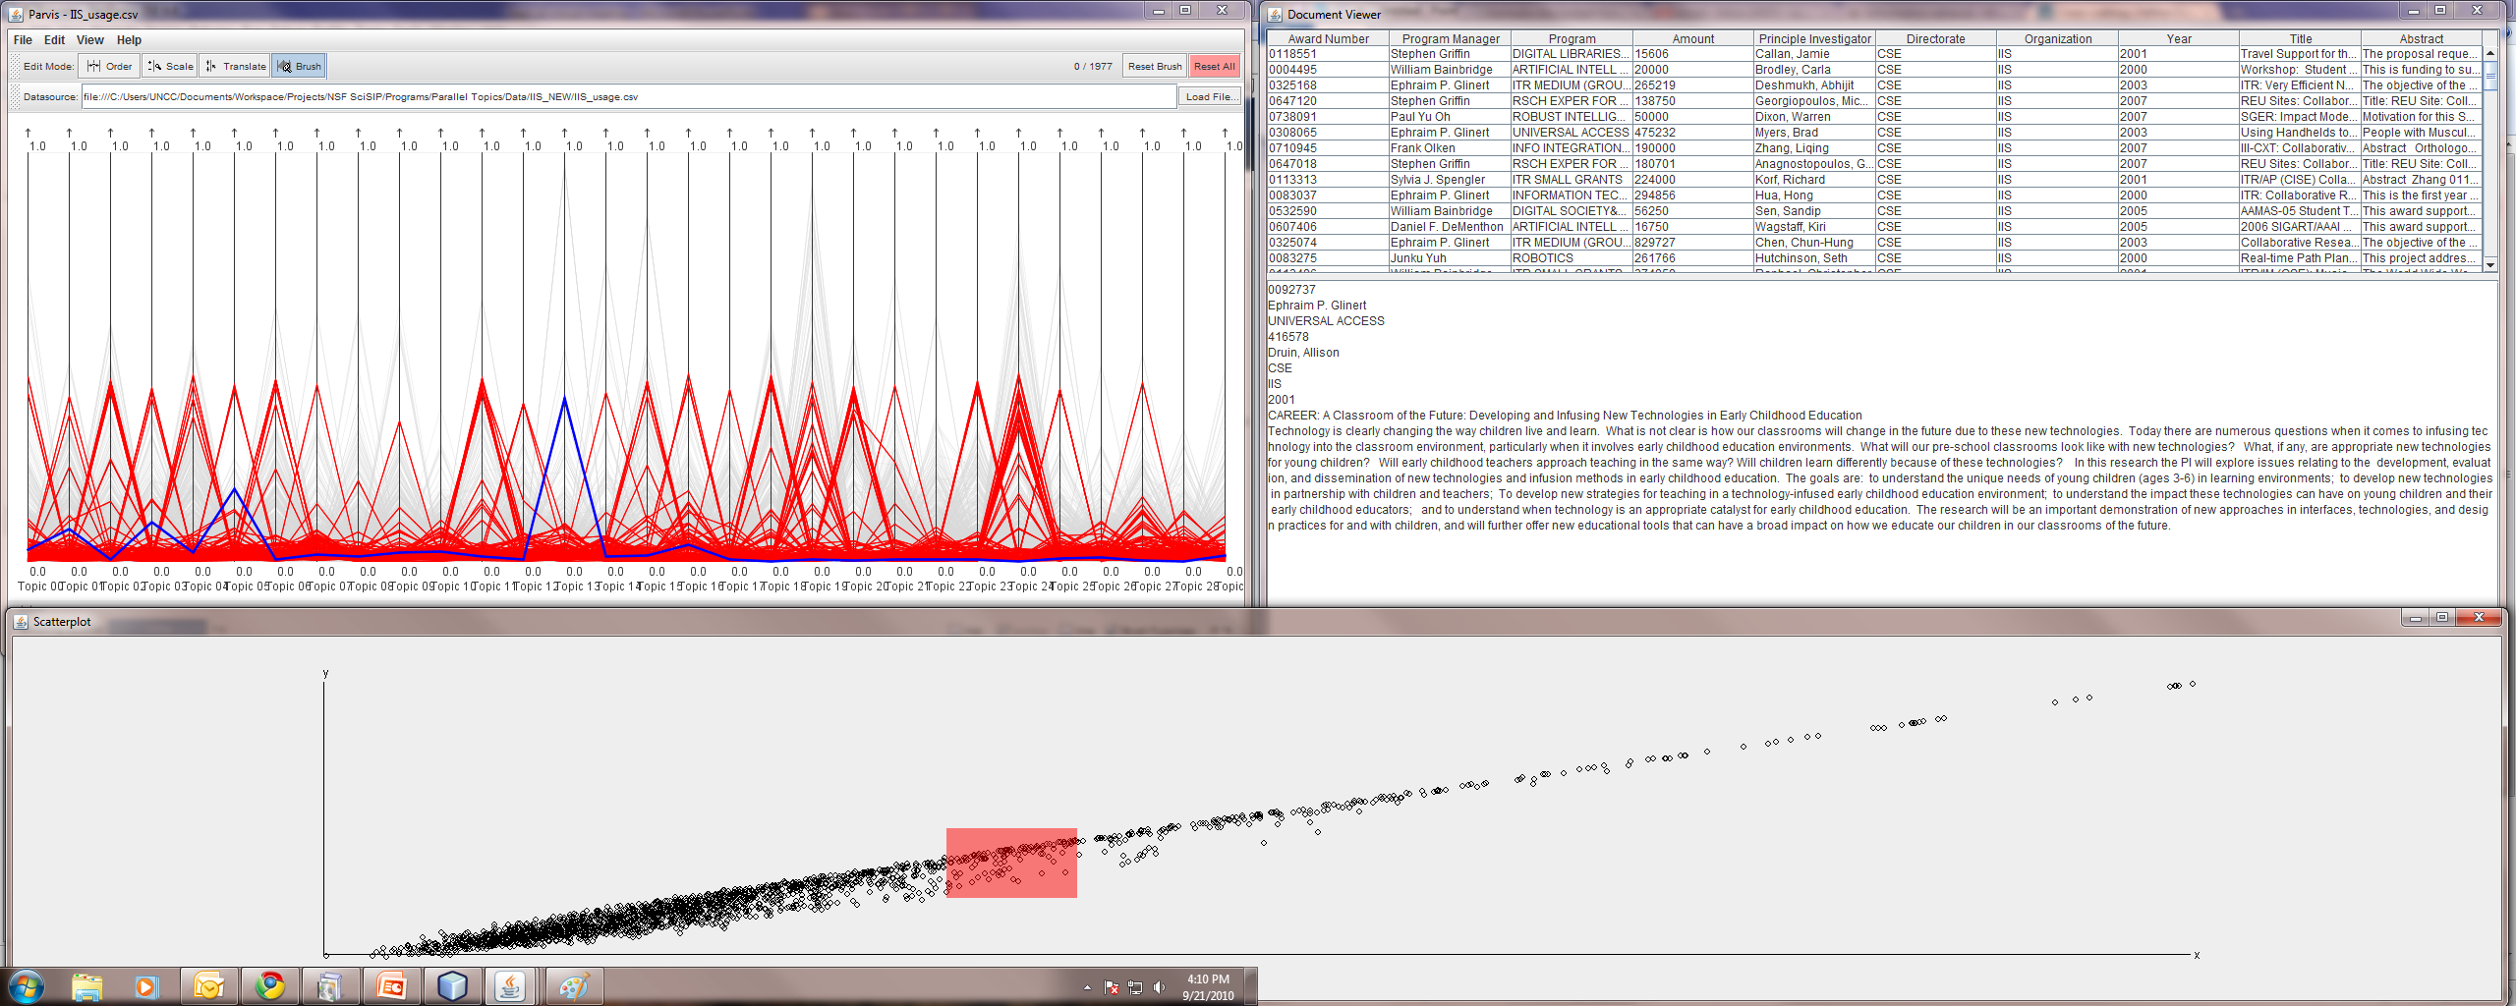

Selecting Multi-Topic Proposals
Interactive environment
technology
education
Notes:
Education, societal impact of technology,

Slide 39
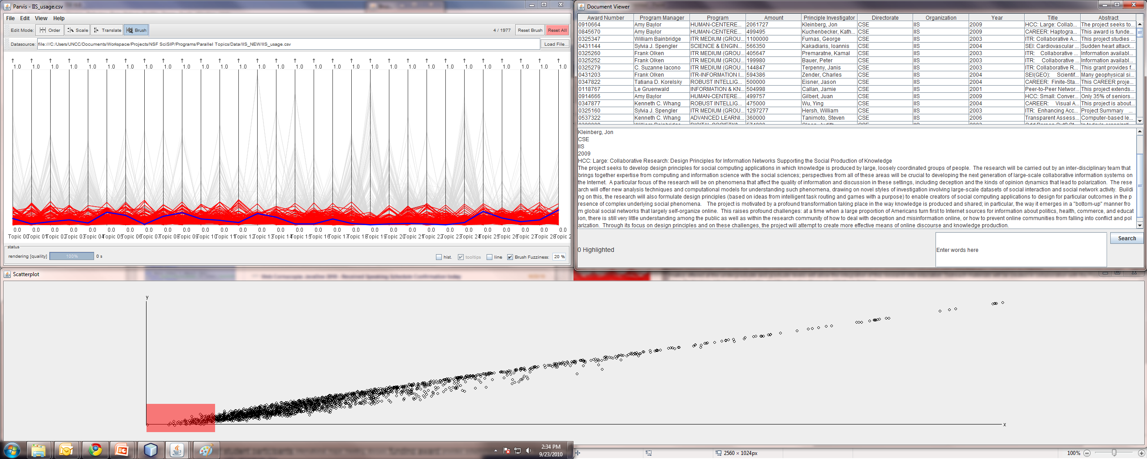
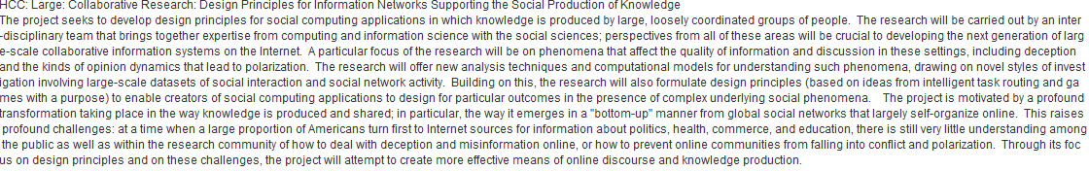
Selecting No-Topic Proposals
Notes:
Design principles for Information Networks Supporting the Social Production of Knowledge
Brings expertise from computing and information science with the social sciences

Slide 40
Recap
Objective: To discover interdisciplinary and potentially innovative research proposals
Parallel Topics – data-centric approach
Approach: To support interactive selection of proposals based on their number of topics

Slide 41
Questions and Comments?
Thank you!!
remco@cs.tufts.edu
http://www.cs.tufts.edu/~remco

