Slide 1
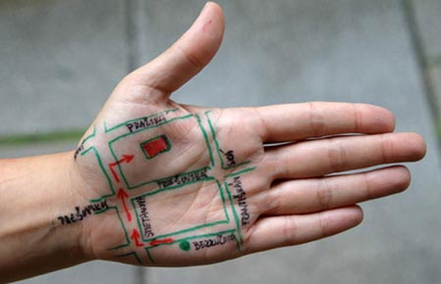
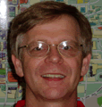




UrbanVis
research group
Dr. Jean-Claude Thill, Knight Distinguished Professor, Geography, UNCC
Dr. Remco Chang, Research Scientist, Vis Center, UNCC
Eric Sauda, Professor, DDC, School of Architecture, UNCC
Ginette Wessel, Doctoral Student, Architecture, Berkeley
Elizabeth Unruh, Research Assistant, DDC, School of Architecture, UNCC

Slide 2
Problem
Problem
Rapid growth of Urbanism
Layers of Information
Spatial and Semantic Information
Ill defined (or even Wicked) Urbanism
complexity and heterogeneity of information
new city forms
gateway visualization through space
UrbanVis
research group

Slide 3
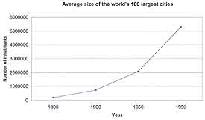
Problem
Problem
Rapid growth of Urbanism
complexity and heterogeneity of information
new city forms
gateway visualization through space
UrbanVis
research group

Slide 4
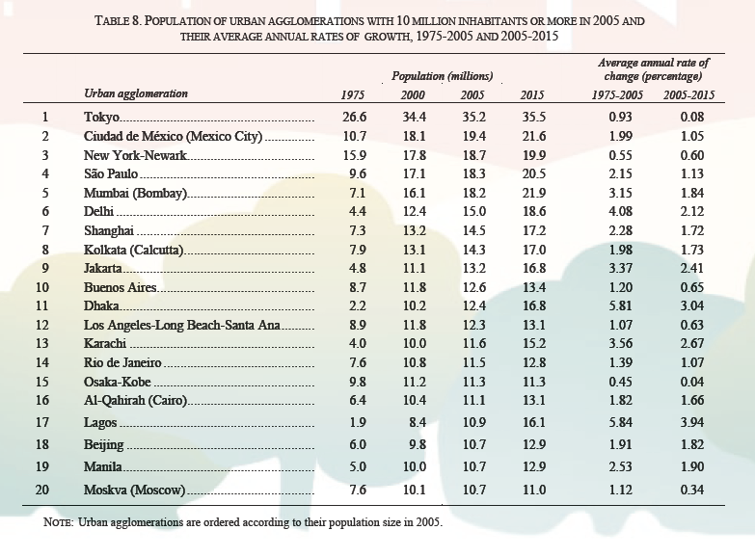
Problem
Problem
Rapid growth of Urbanism
complexity and heterogeneity of information
new city forms
gateway visualization through space
UrbanVis
research group

Slide 5
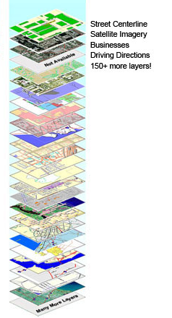
Problem
Problem
Layers of Information
Not just more information
But heterogenous information
complexity and heterogeneity of information
new city forms
gateway visualization through space
UrbanVis
research group

Slide 6
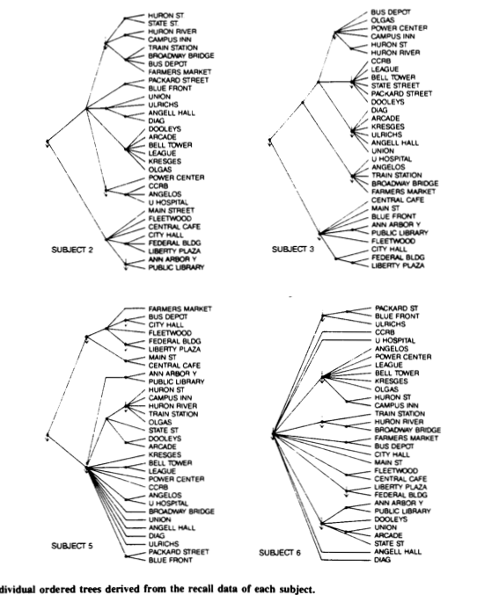
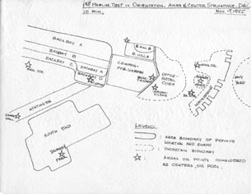
Problem
Problem
Spatial and Semantic Information
Two forms of information
Semantic (what)
Spatial (where)
Neurological basis
complexity and heterogeneity of information
new city forms
gateway visualization through space
UrbanVis
research group

Slide 7
Problem
Problem
Ill defined (or even Wicked) Urbanism
Relationship of form of the city to its content
Evidence from Urban Theory
Well defined
Ill Defined
Wicked
complexity and heterogeneity of information
new city forms
gateway visualization through space
UrbanVis
research group

Slide 8
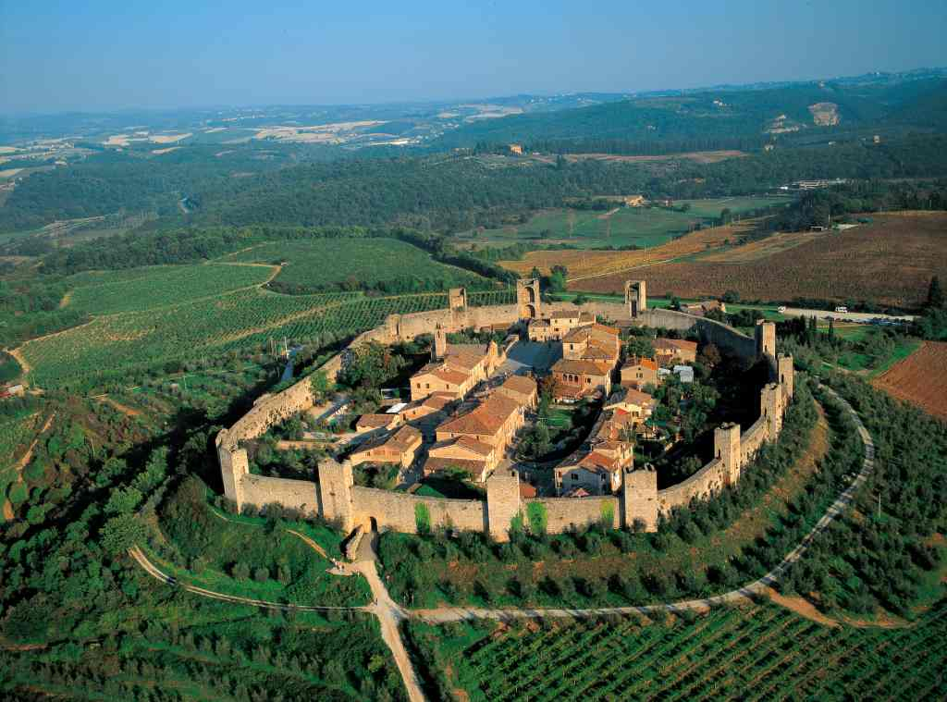
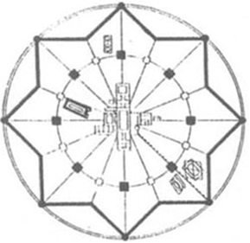
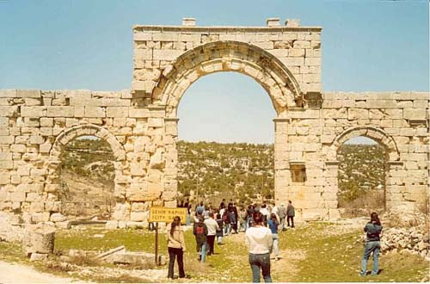
Problem
Urban Theory
Limited Size
Local
Clear Boundaries
Honored positions
Well defined
Monteriggioni
complexity and heterogeneity of information
new city forms
gateway visualization through space
UrbanVis
Ideal plan of Sforzinda, 1464.
Diocaesarea
research group

Slide 9
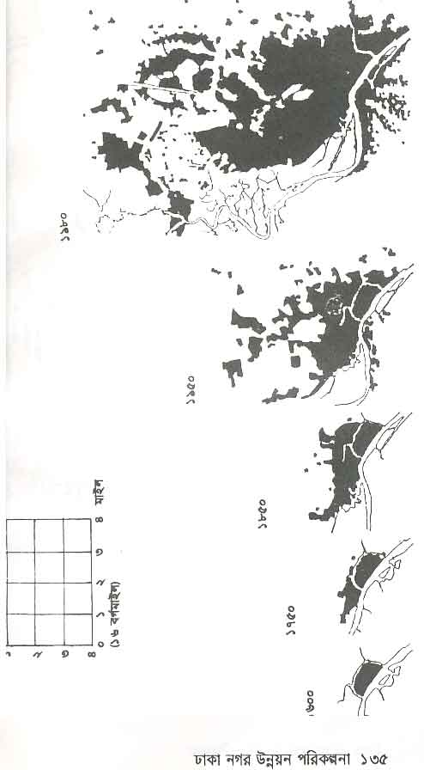
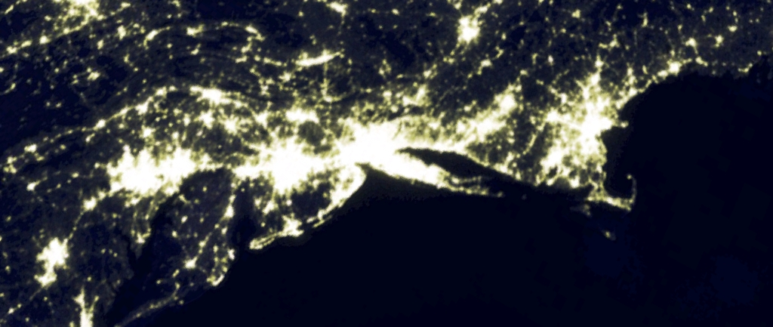
Problem
Urban Theory
Explosive growth
Transportations Technology
Regional
Blurred edges
Honored positions
Ill defined
complexity and heterogeneity of information
new city forms
gateway visualization through space
Satellite view of BosWash
Growth of Dhaka City 1600-1980
UrbanVis
research group

Slide 10
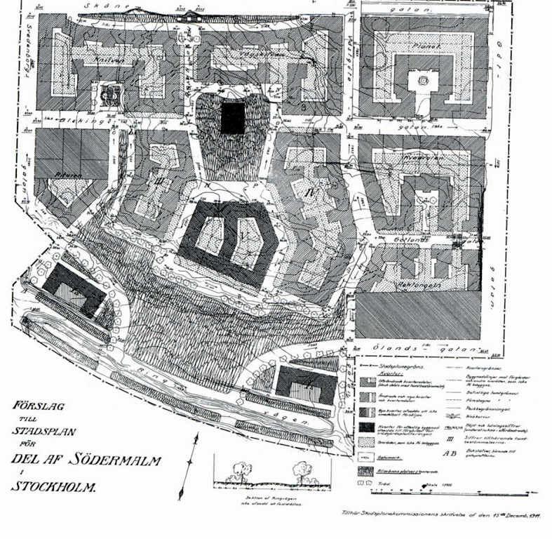
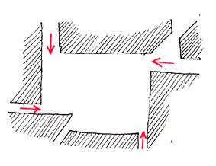
Problem
Urban Theory
Camillo Sitte
(Rob Krier
Aldo Rossi
New Urbanism
……………)
complexity and heterogeneity of information
new city forms
gateway visualization through space
UrbanVis
research group

Slide 11
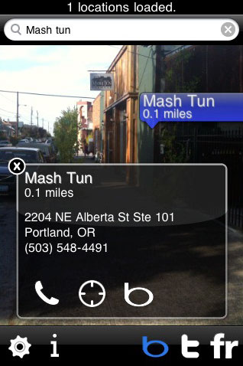
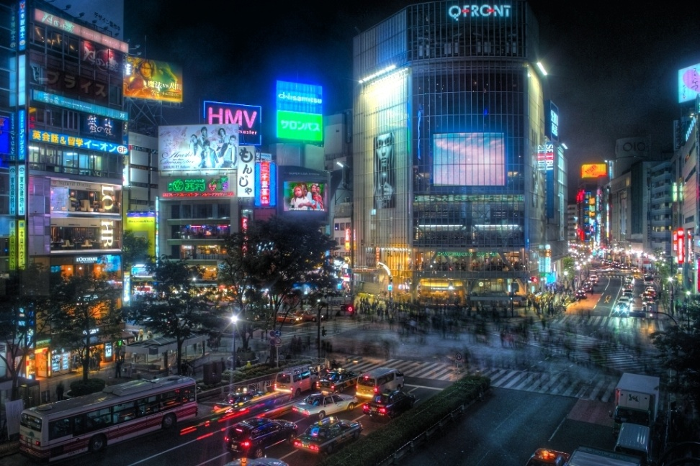
Problem
Urban Theory
Multinodal
Overlay of new media
Information
Urban-Rural gone
View dependent
Wicked City
complexity and heterogeneity of information
new city forms
gateway visualization through space
Robotvision
Shibuya, Tokyo, 2009.
UrbanVis
research group

Slide 12
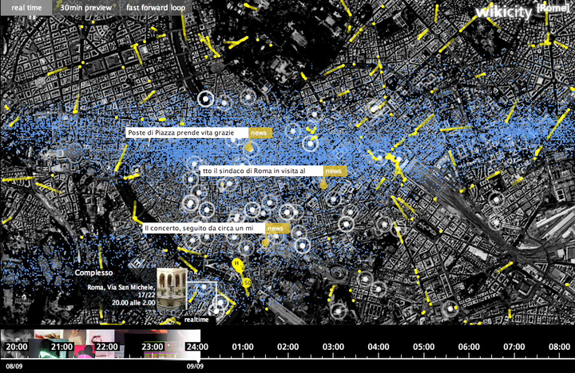
Problem
Urban Theory
Carlo Ratti
(Rem Koolhaas
Bernard Tschumi
Landscape Urbanism
Henri LeLefebvre
……………)
complexity and heterogeneity of information
new city forms
gateway visualization through space
Carlo Ratti, Senseable Cities
UrbanVis
research group

Slide 13

Problem
Geography & Geographic Information Sciences
Study of phenomena from the perspective of their spatial relations:
  Location, scale, place, and space
Semantic generalization of the City
  Defining socially coherent and homogeneous neighborhoods
  Use of factor analysis and cluster analysis to reduce the data matrix to a few latent dimensions and a few regions: Typology
  More recently, use of data mining techniques such as self-organizing maps
  Geodemographics
complexity and heterogeneity of information
new city forms
gateway visualization through space
UrbanVis
research group

Slide 14
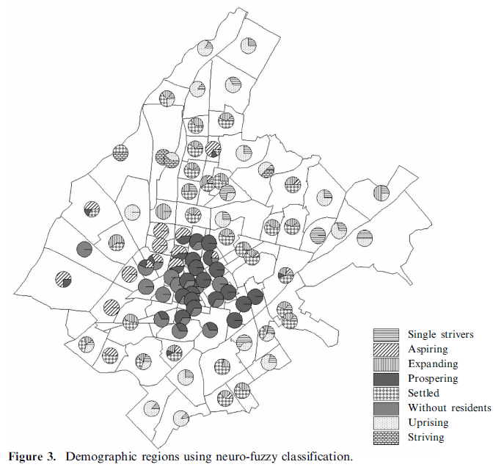
Problem
Fuzzy SOM regional classification of Athens, Greece (Hatzichristos, 2004)
complexity and heterogeneity of information
new city forms
gateway visualization through space
UrbanVis
research group

Slide 15
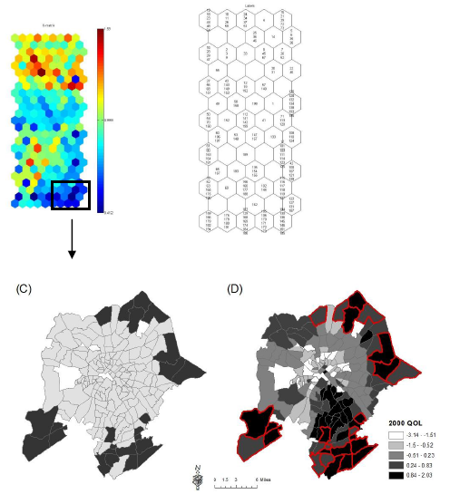
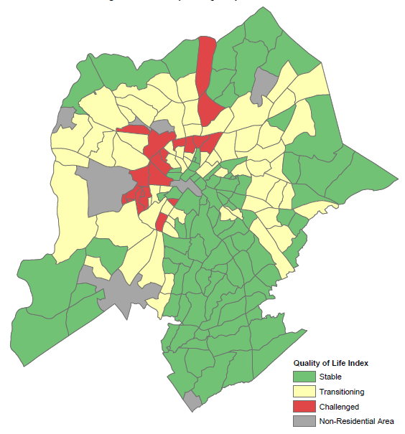
Problem
Quality of life, Charlotte, NC
complexity and heterogeneity of information
new city forms
gateway visualization through space
UrbanVis
research group

Slide 16
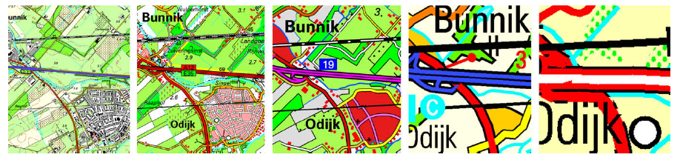
Scale-dependence and generalization
  Cartographic representation
  Algorithms that preserve spatial property of data: topology, density, geometry
  Multiple scale-dependent representations
    Allowing for queries
    Preserving consistency
complexity and heterogeneity of information
new city forms
gateway visualization through space
UrbanVis
research group

Slide 17
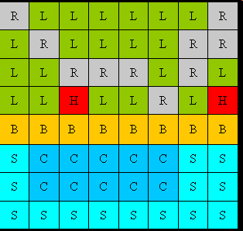
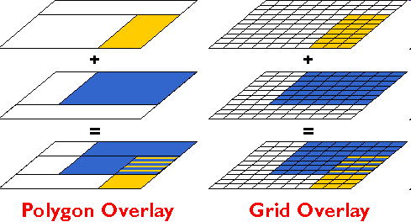
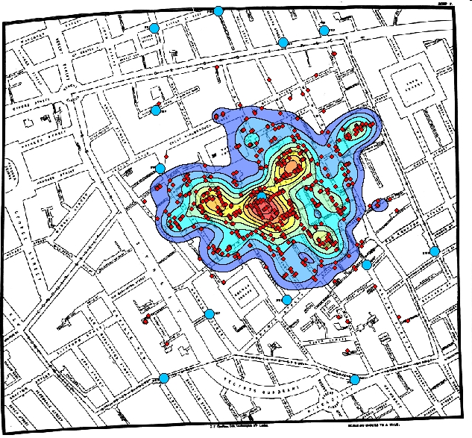
Urban Analytics:
Data Integration
Data integration
  Heterogeneity of semantic data layers
    Points, lines, polygons, volumes
  Common data structure: data raster
  Approaches
    Geospatial overlays
    Kernel density estimation for point and line data
    Dasymetric methods
UrbanVis
research group

Slide 18
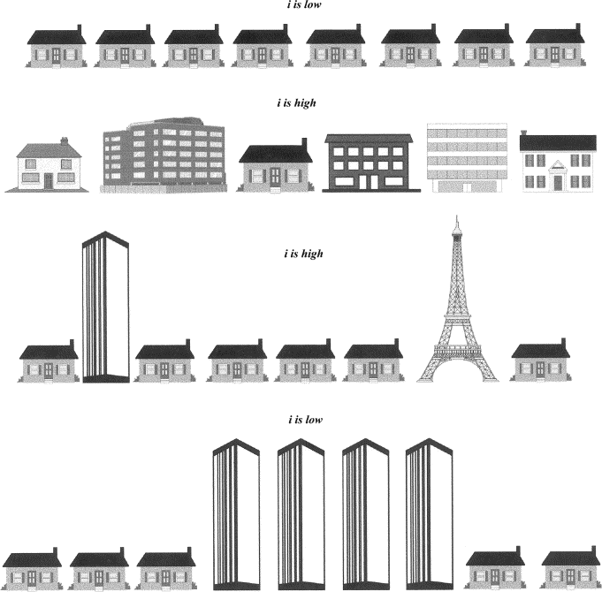


Problem
Urban Analytics:
Information Theory
Shannon’s Information Theory:
Where
N = number of houses in a cluster
N_{j} = number of houses that fit a specific criteria
complexity and heterogeneity of information
new city forms
gateway visualization through space
UrbanVis
research group

Slide 19
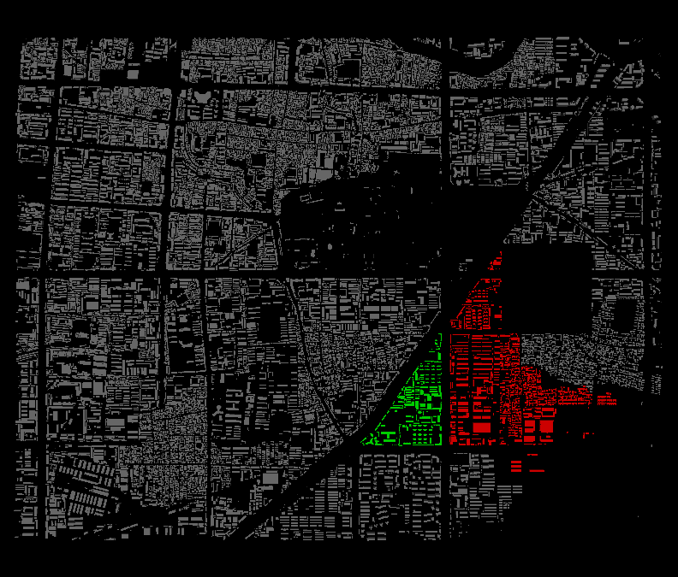
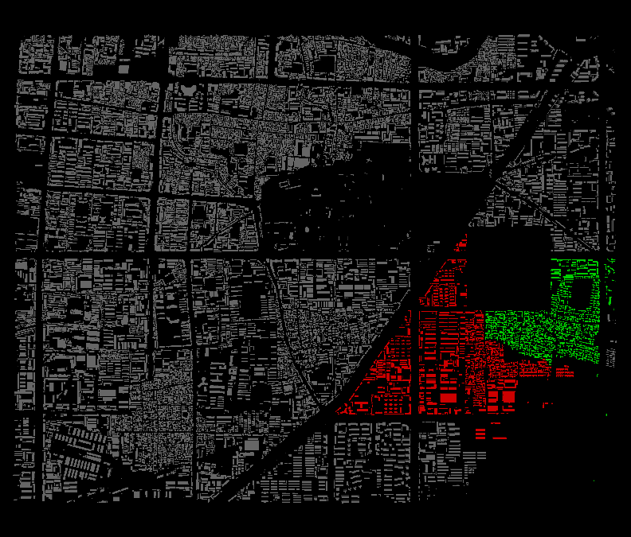
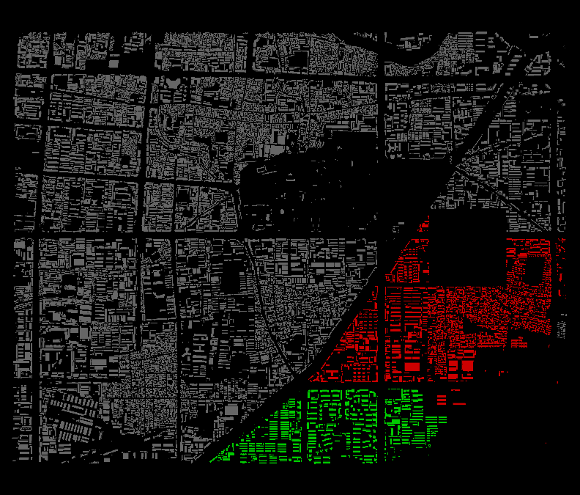
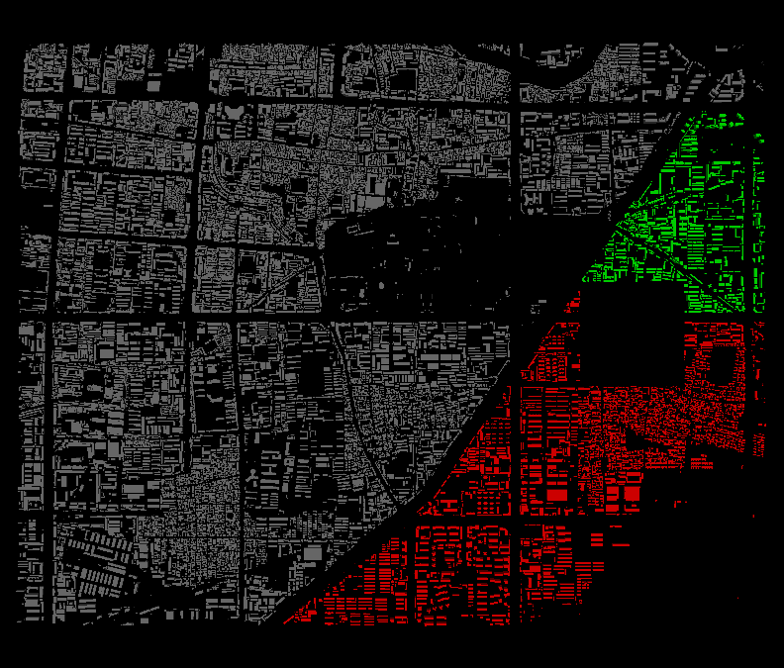
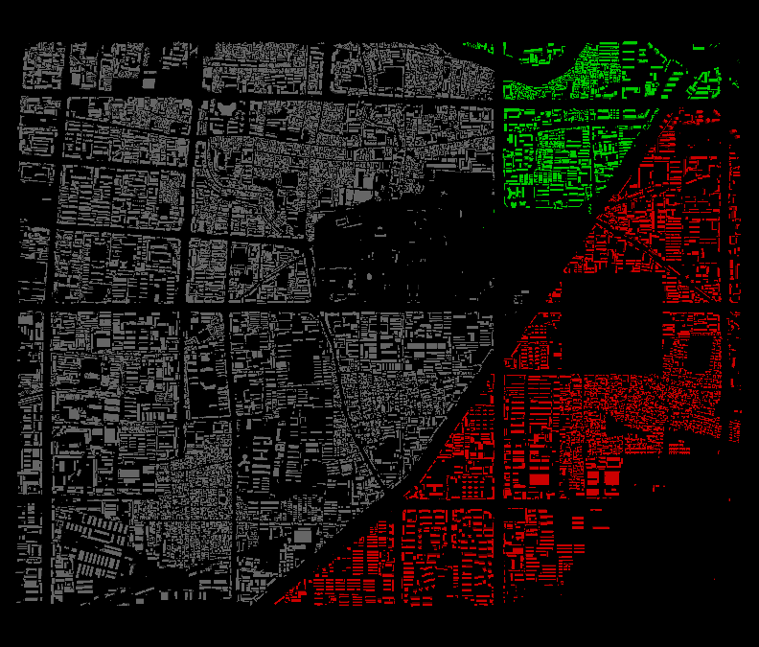
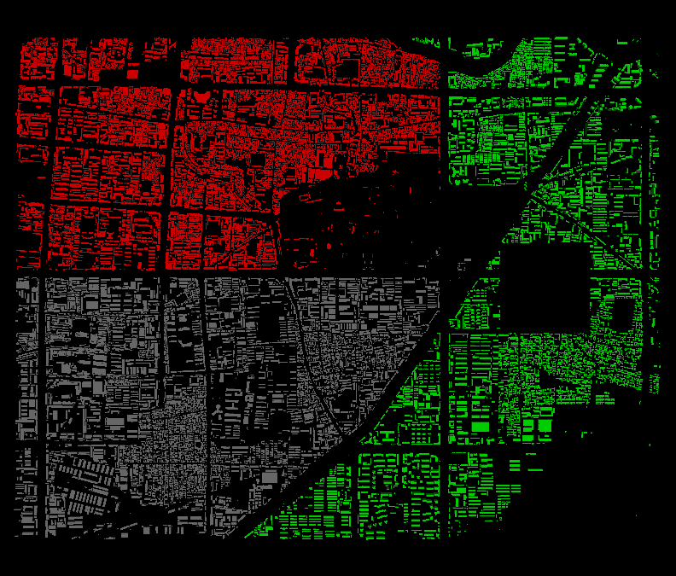
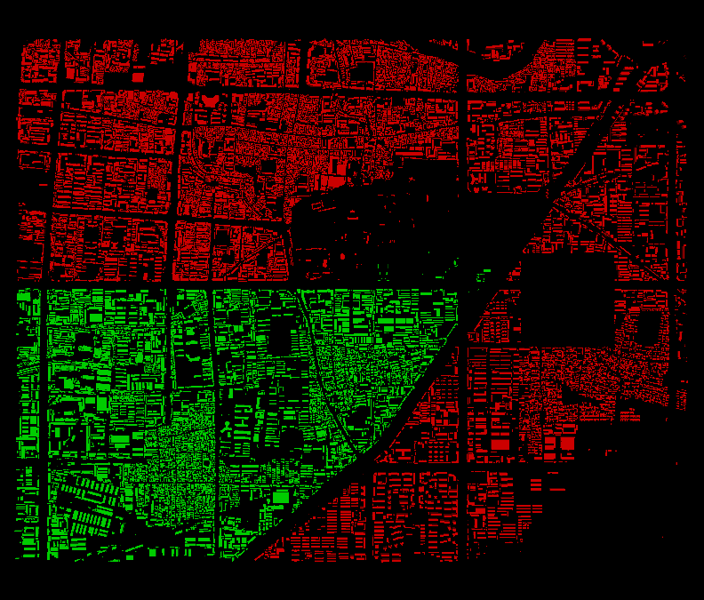
Problem
Urban Analytics:
Applying Information Theory Hierarchically
a
b
c
d
e
f
bc
de
complexity and heterogeneity of information
new city forms
gateway visualization through space
def
abc
bcdef
abcdef
UrbanVis
research group

Slide 20
Problem
Urban Analytics:
Information Theory Applied
Information Theory has been used and applied to clustering
  In particular, it has been applied to categorical data clustering where the distance measurement between clusters is difficult to define.
In visualization, as well as in urban computing, when information theory is applied hierarchically,
  The hierarchy is mostly applied to a grid structure
  While generalizable, it defeats the purpose of creating “legible cities”
We propose to merge the work on urban legibility with information theory to:
  Create hierarchies based on both spatial (geometric) information, as well as semantic information
  Traverse the hierarchy to determine “neighborhoods” in a city based on both geometric and semantic information.
complexity and heterogeneity of information
new city forms
gateway visualization through space
UrbanVis
research group

Slide 21
Problem
Urban Analytics:
Geometric + Semantic
Currently, our algorithm works only on geometric information for creating the clusters.
  Clusters are created based on the geometric distances between buildings
To integrate geometric and semantic information, the naïve method would be to add weights to the two variables, for example:
  Distance between clusters = (α * geometric distance) + (β * semantic similarities)
However, it’s clear that if this equation is applied to clustering buildings in a city, there will be clusters that are not geometrically contiguous (and therefore not legible)
Our proposed approach is a two-staged approach:
  1. find geometric neighbors.
  2. cluster them if their semantic similarities are within an acceptable range.
complexity and heterogeneity of information
new city forms
gateway visualization through space
UrbanVis
research group

Slide 22
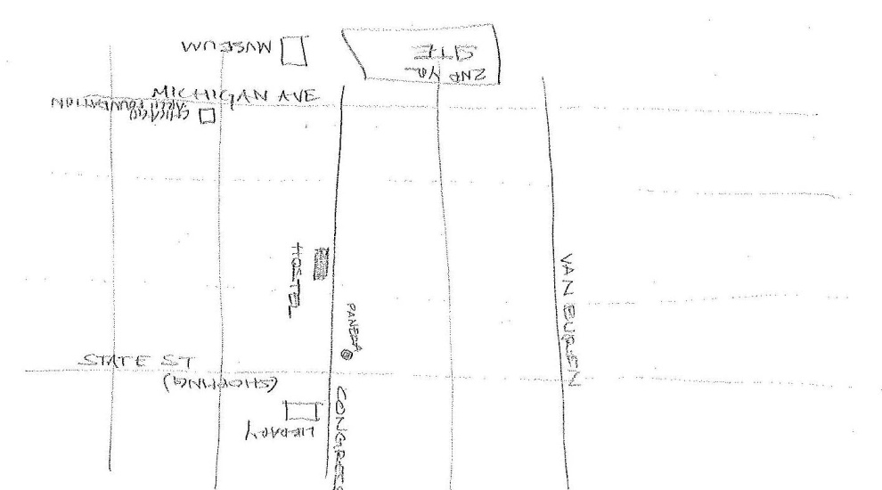
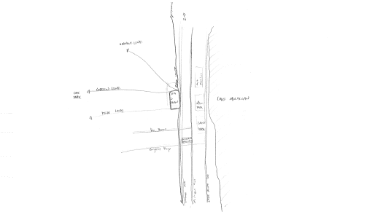
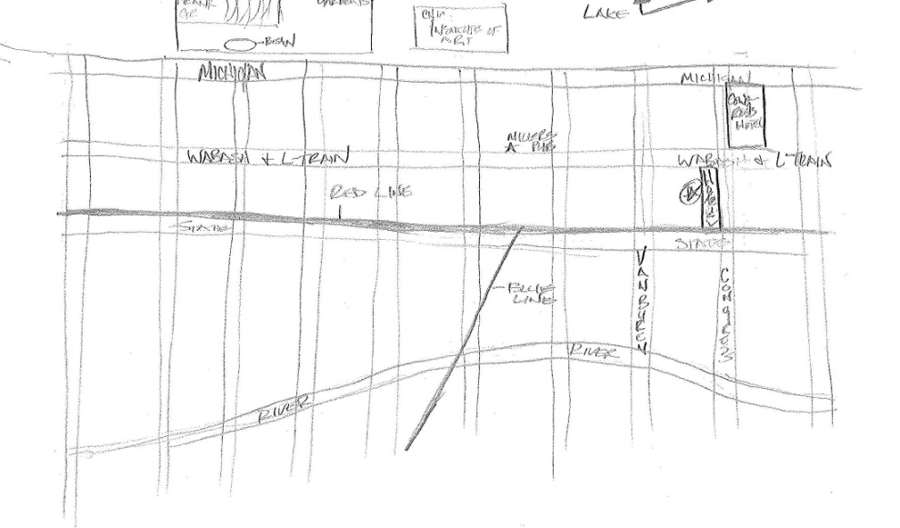
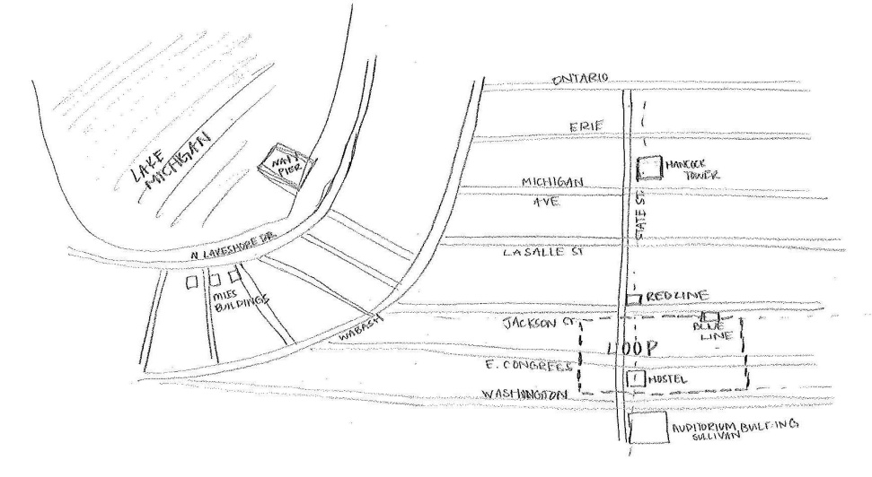
Problem
Urban Analytics:
Sketch Mapping Study
Local Scale
Citywide Scale
new city forms
gateway visualization through space
More segments, less neighborhoods
More segments, less landmarks
UrbanVis
research group

Slide 23
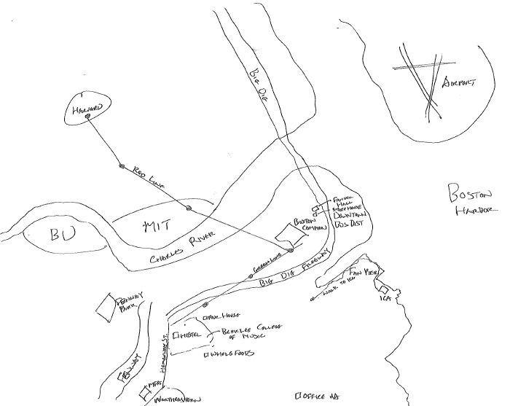
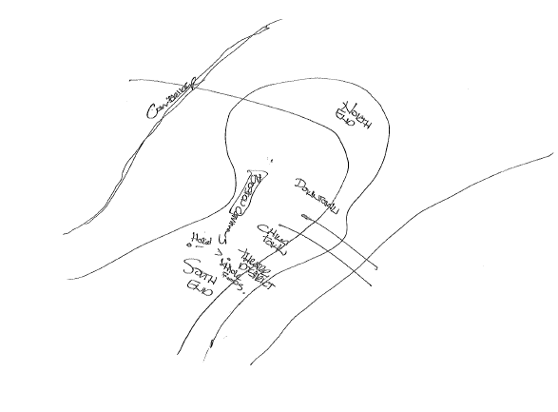
Problem
Urban Analytics:
Sketch Mapping Study
new city forms
gateway visualization through space
Rated Most Effective
Rated Least Effective
UrbanVis
research group

Slide 24
Evaluation of Method through Urban Morphology
We have claimed that our algorithm creates legible clusters.
  Validation through expert-user evaluation.
  However, a computational approach could be helpful and more informative.
How “structured” is a city?
  Plot the distance used in each step of the single-link clustering onto a graph.
  “Grid-like” structures will have slower rises in the graphs
Atlanta, Georgia
Xinxiang, China
UrbanVis
research group

Slide 25
Evaluation of Method through Urban Morphology
Concept similar to that of “Space Syntax”, which is a method to compute the “intelligibility” of a city.
  Converts a city into a graph
  Computes “integration” and “connectivity”
Example: AlphaWorld
  Axial lines depicting roads [7]
  Color indicates “integration”
“An intelligible system is one in which well-connected spaces also tend to be well-integrated spaces. An unintelligible system is one where well-connected spaces are not well integrated” – Hillier 1996
UrbanVis
research group

