Slide 1
User-Centric Visual Analytics
Remco Chang
Tufts University

Slide 2
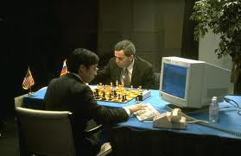
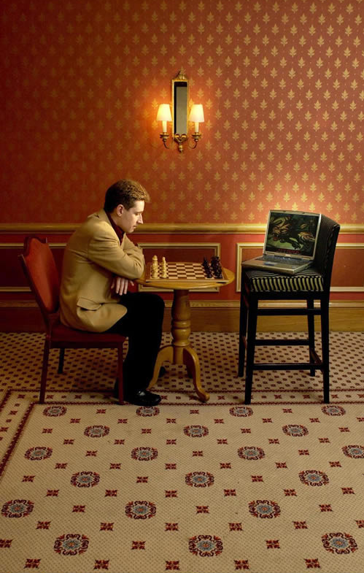
Human + Computer
Human vs. Artificial Intelligence
Garry Kasparov vs. Deep Blue (1997)
  Computer takes a “brute force” approach without analysis
  “As for how many moves ahead a grandmaster sees,” Kasparov concludes: “Just one, the best one”
Artificial vs. Augmented Intelligence
Hydra vs. Cyborgs (2005)
  Grandmaster + 1 chess program > Hydra (equiv. of Deep Blue)
  Amateur + 3 chess programs > Grandmaster + 1 chess program¹
1. http://www.collisiondetection.net/mt/archives/2010/02/why_cyborgs_are.php

Slide 3
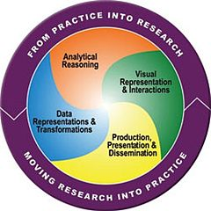
Visual Analytics = Human + Computer
Visual analytics is "the science of analytical reasoning facilitated by visual interactive interfaces.“ ¹
By definition, it is a collaboration between human and computer to solve problems.
1. Thomas and Cook, “Illuminating the Path”, 2005.

Slide 4
Survey of VAST 2010
In VAST 2010, 4 out of 5 paper sessions were devoted to (a) visual analytic systems, (b) visualization techniques.
A few papers on systems that combine human analysis and automated computing (e.g., Machine Learning) through visual interfaces.
Only 3 papers on studying the human user (and I’m on 2 of the papers)
There were no papers on understanding how humans and computers could work together.

Slide 5
Talk Outline
Discuss 4 Visual Analytics problems from a User-Centric perspective:
  One optimal visualization for every user?
  Can a user’s reasoning process be recorded and stored
  Can a user express their domain knowledge quantitatively?
  Can we scale human computation with more analysts?

Slide 6
1. How Personality Influences
Compatibility with Visualization Style

Slide 7
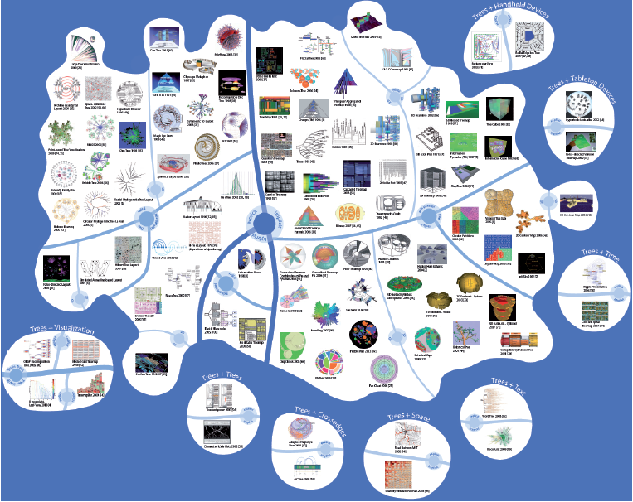
What’s the Best Visualization for You?
Jürgensmann and Schulz, “Poster: A Visual Survey of Tree Visualization”. InfoVis, 2010.

Slide 8
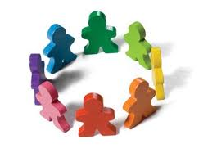
What’s the Best Visualization for You?
Intuitively, not everyone is created equal.
  Our background, experience, and personality should affect how we perceive and understand information.
So why should our visualizations be the same for all users?

Slide 9
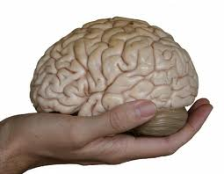
Cognitive Profile
Objective: to create personalized information visualizations based on individual differences
Hypothesis: cognitive factors affect a person’s ability (speed and accuracy) in using different visualizations.

Slide 10
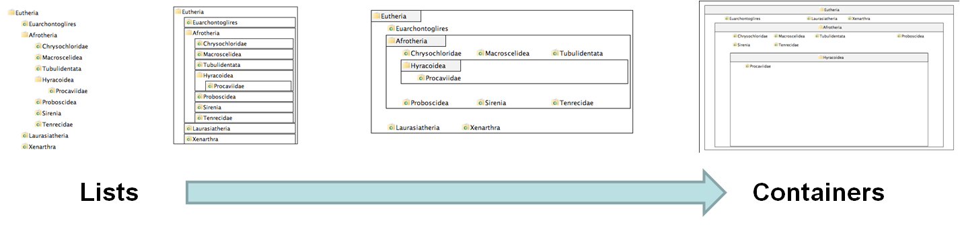
Experiment Procedure
250 participants using Amazon’s Mechanical Turk
Questionnaire on “locus of control” (LOC)
4 visualizations on hierarchical visualization
  From list-like view to containment view
Notes:
locus of control, the degree to which a person attributes outcomes to themselves (internal locus of control) or to outside forces (external locus of control)

Slide 11
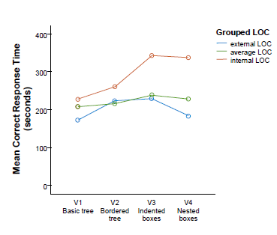
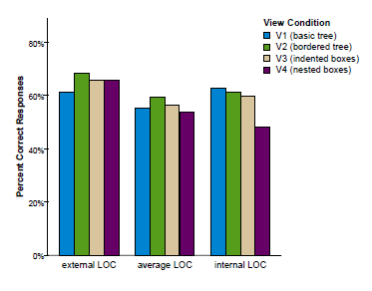
Results
Internal LOC users are significantly faster and more accurate with list view than containment view in complex information retrieval tasks

Slide 12
Conclusion
Cognitive factors can affect how a user perceives and understands information from a visualization
The effect could be significant in terms of both efficiency and accuracy
Personalized displays should take into account a user’s cognitive profile
Full paper to be presented at VAST 2011

Slide 13
2. What’s In a User’s Interactions?

Slide 14
Human + Computer
Visualizing data
Human perceptual system
Capture a user’s interactions in a visual analytics system
Translate the interactions into something that would affect the computation in a meaningful way
Computer
Process
(Translate)
Human
Challenge:
  Can we capture and extract a user’s reasoning and intent through capturing a user’s interactions?

Slide 15
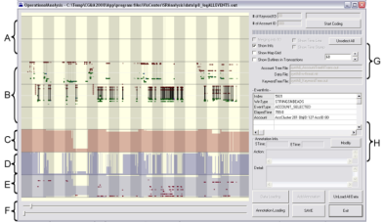
What is in a User’s Interactions?
Goal: determine if a user’s reasoning and intent are reflected in a user’s interactions.
Grad
Students
(Coders)
Analysts
Compare!
(manually)
Strategies
Methods
Findings
Guesses of
Analysts’ thinking
Logged
(semantic)
Interactions
WireVis
Interaction-Log Vis

Slide 16
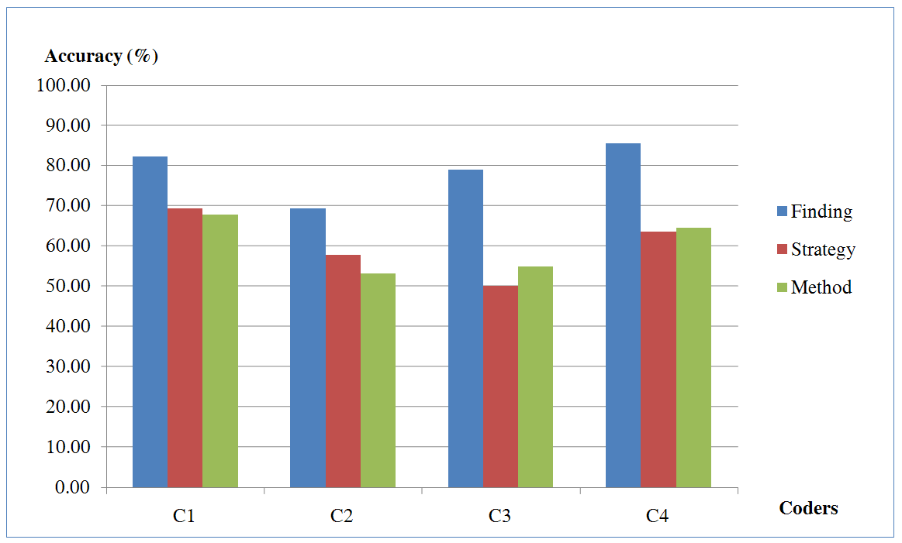
What’s in a User’s Interactions
From this experiment, we find that interactions contains at least:
  60% of the (high level) strategies
  60% of the (mid level) methods
  79% of the (low level) findings
R. Chang et al., Recovering Reasoning Process From User Interactions. CG&A, 2009.
R. Chang et al., Evaluating the Relationship Between User Interaction and Financial Visual Analysis. VAST, 2009.

Slide 17
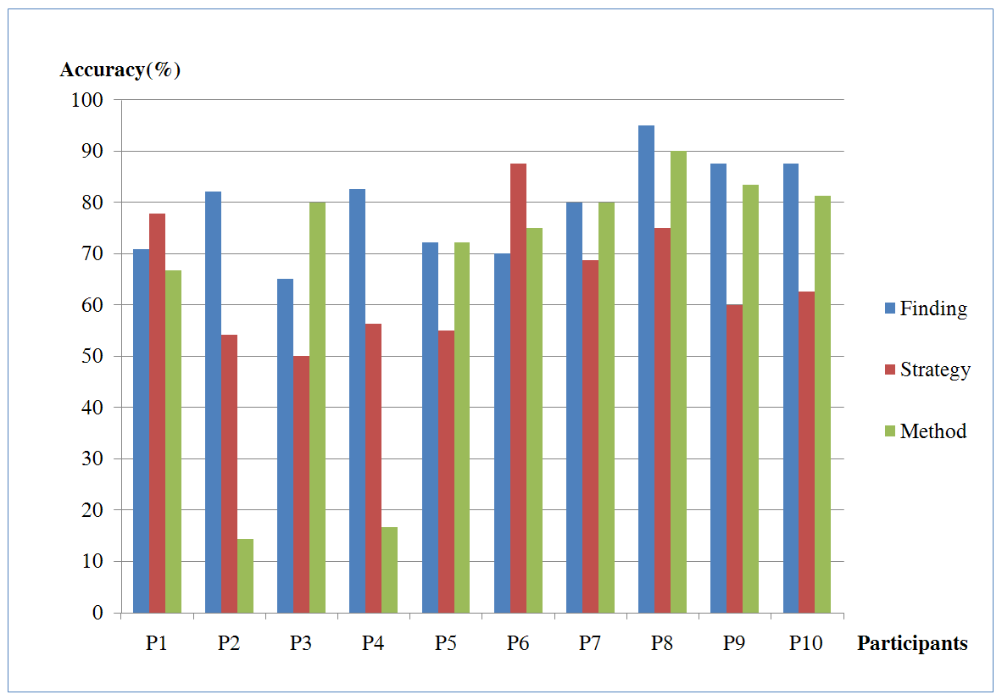
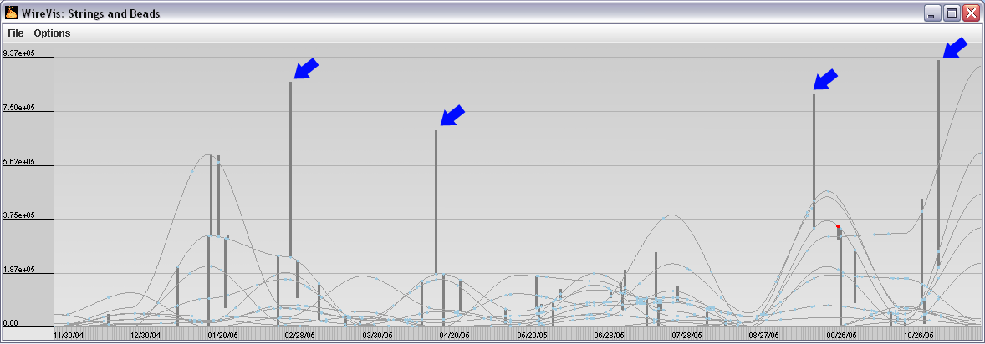
What’s in a User’s Interactions
Why are these so much lower than others?
  (recovering “methods” at about 15%)
Only capturing a user’s interaction in this case is insufficient.

Slide 18
Conclusion
A high percentage of a user’s reasoning and intent are reflected in a user’s interactions.
Raises lots of question: (a) what is the upper-bound, (b) how to automated the process, (c) how to utilize the captured results, etc.
This study is not exhaustive. It merely provides a sample point of what is possible.
VisWeek Panel on Analytic Provenance at VAST 2011

Slide 19
3. Can a User Express Their
Domain Knowledge Through Interaction

Slide 20
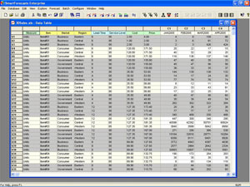
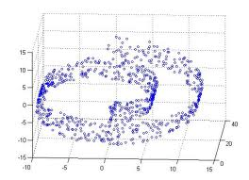
Find Distance Function, Hide Model Inference
Problem Statement: Given a high dimensional dataset from a domain expert, how does the domain expert create a good distance function?
Assumption: The domain expert knows about the data, but cannot express it mathematically

Slide 21
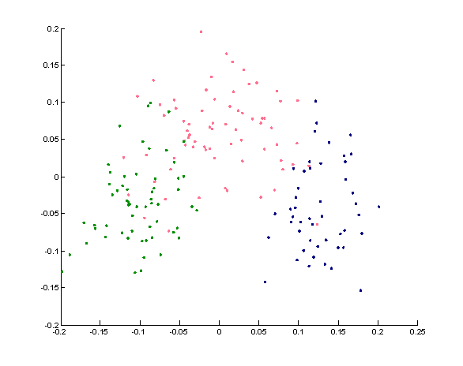
In An Ideal World…
The domain expert “guesses” a distance function, and produces the following scatter plot:

Slide 22
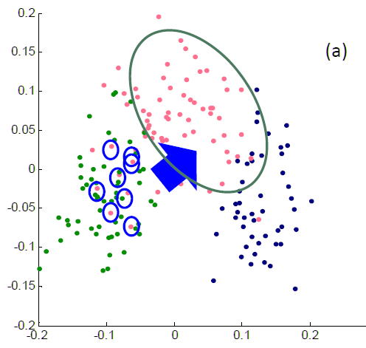
In An Ideal World…
The domain expert than interactively “moves” the “bad” data points towards the right direction:

Slide 23
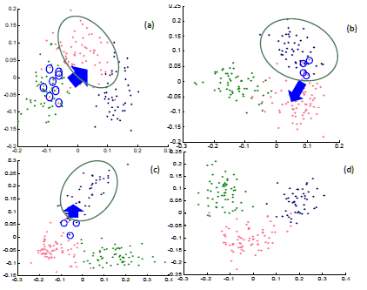
In An Ideal World…
The process is repeated a few times until the layout looks about right.
The system outputs a new distance function!

Slide 24
As It Turns Out…
This can be done.
Need to make a few assumptions:
The type of distance function (linear, quadratic, etc.)
What it means to move a point from one location to another (is it moving closer to a cluster? Or away from some other points?)

Slide 25
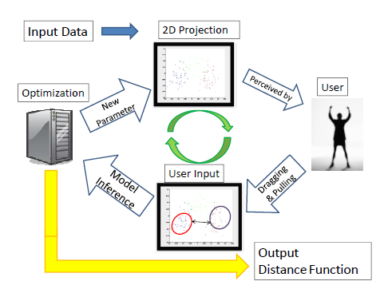
System Overview

Slide 26
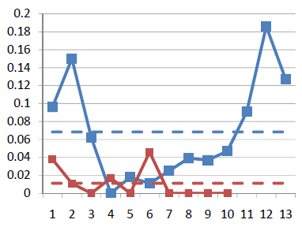
Results
Used the “Wine” dataset (13 dimensions, 3 clusters)
  Assume a linear (sum of squares) distance function
Added 10 extra dimensions, and filled them with random values
Interactively moved the “bad” points
Blue: original data dimension
Red: randomly added dimensions
X-axis: dimension number
Y-axis: final weights of the distance function

Slide 27
Conclusion
With an appropriate projection model, it is possible to quantify a user’s interactions.
In our system, we let the domain expert interact with a familiar representation of the data (scatter plot), and hides the ugly math (distance function)
The system “reveals” the domain knowledge of the user.
Poster to be presented at VAST 2011

Slide 28
4. How to Aggregate Multiple Analysis
To Perform Group Analytics

Slide 29
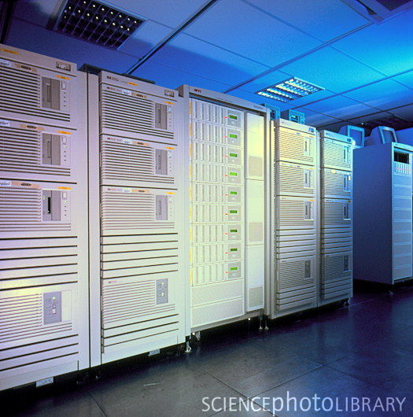
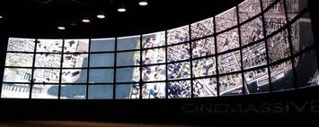
Scaling Human Computation
Problem Statement: Computing can be scaled (by adding more CPUs). Visualizations can be scaled (by adding more monitors). Can analysis be scaled by adding more humans?
Assumption: Conventional wisdom says that humans cannot be scaled because of difficulty in communicating analytical reasoning efficiently.

Slide 30
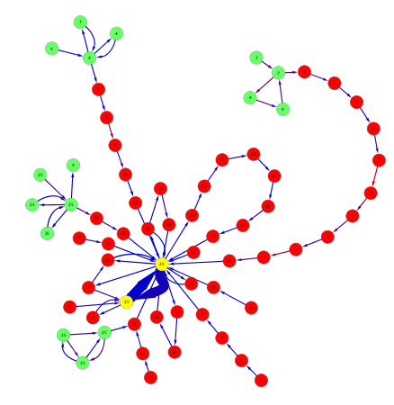
Temporal Graph
Research Proposal: We propose a Temporal Graph approach to model analytical trails. In a temporal graph,
  Node = a unique state in the visual analysis trail.
  Edge = a (temporal) transition from one state to another.

Slide 31


For Example:
2 analysts, A and B, each performed an analysis on the same data
A0
A1
A2
A3
A4
A5
B0
B1
B2
B3
B4

Slide 32
For Example:
If A2 is the same as B1 (in that they represent the same analysis step)…
A0
A1
A3
A4
A5
A2
B1
B0
B2
B3
B4

Slide 33
For Example:
We will merge the two nodes
A0
A1
A3
A4
A5
A2
B1
B0
B2
B3
B4

Slide 34

For Example
This process is repeated for all analysis trails across all analysts, and we could get a temporal graph that look like:

Slide 35
With a Temporal Graph…
We can answer many questions. For example:
  Given a particular outcome (a yellow states), is there a state that is the catalyst in which every subsequent analysis trail start from?
    the answer is yes:
    The red states are “points of no return”
    The green states are the “last decision points”

Slide 36
Conclusion
There are many benefits to posing analysis trails as a temporal graph problem.
Mostly, the benefit comes from our ability to apply known graph algorithms.
Incidentally, this temporal graph formulation can be applied to visualize and analyze other problems involving large state space.
Poster to be presented at VAST 2011

Slide 37
Summary

Slide 38

Summary
While Visual Analytics have grown and is slowly finding its identity,
There is still many open problems that need to be addressed.
I propose that one research area that has largely been unexplored is in the understanding and supporting of the human user.

Slide 39
Summary
The Visual Analytics Lab at Tufts (VALT) have been pursuing problems in this area.
The four projects represent a select subset of the problems that we’ve been working on.
For other projects, please feel free to talk to us, or check out our papers and posters at VisWeek!

Slide 40

Thank you!
Questions?

