Slide 1

Big Data Visual Analytics:
Challenges and Opportunities
Remco Chang
Tufts University

Slide 2
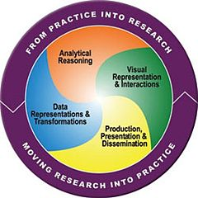
Visual Analytics = Human + Computer
Visual analytics is "the science of analytical reasoning facilitated by visual interactive interfaces.“ ¹
By definition, it is a collaboration between human and computer to solve problems.
1. Thomas and Cook, “Illuminating the Path”, 2005.

Slide 3
Example: What Does (Wire) Fraud Look Like?
Financial Institutions like Bank of America have legal responsibilities to report all suspicious wire transaction activities (money laundering, supporting terrorist activities, etc)
Data size: approximately 200,000 transactions per day (73 million transactions per year)
Problems:
  Automated approach can only detect known patterns
  Bad guys are smart: patterns are constantly changing
  Data is messy: lack of international standards resulting in ambiguous data
Current methods:
  10 analysts monitoring and analyzing all transactions
  Using SQL queries and spreadsheet-like interfaces
  Limited time scale (2 weeks)

Slide 4
WireVis: Financial Fraud Analysis
In collaboration with Bank of America
  Develop a visual analytical tool (WireVis)
  Visualizes 7 million transactions over 1 year
  Beta-deployed at WireWatch
A great problem for visual analytics:
  Ill-defined problem (how does one define fraud?)
  Limited or no training data (patterns keep changing)
  Requires human judgment in the end (involves law enforcement agencies)
Design philosophy: “combating human intelligence requires better (augmented) human intelligence”
R. Chang et al., Scalable and interactive visual analysis of financial wire transactions for fraud detection. Information Visualization,2008.
R. Chang et al., Wirevis: Visualization of categorical, time-varying data from financial transactions. IEEE VAST, 2007.

Slide 5
WireVis: A Visual Analytics Approach
Search by Example (Find Similar Accounts)
Heatmap View
(Accounts to Keywords Relationship)
Keyword Network
(Keyword Relationships)
Strings and Beads
(Relationships over Time)

Slide 6




Applications of Visual Analytics
Political Simulation
  Agent-based analysis
  With DARPA
Global Terrorism Database
  With DHS
Bridge Maintenance
  With US DOT
  Exploring inspection reports
Biomechanical Motion
  Interactive motion comparison
R. Chang et al., Two Visualization Tools for Analysis of Agent-Based Simulations in Political Science. IEEE CG&A, 2012

Slide 7
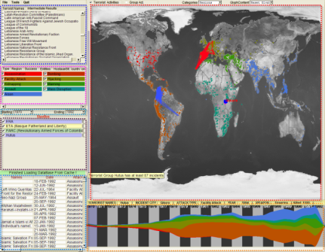
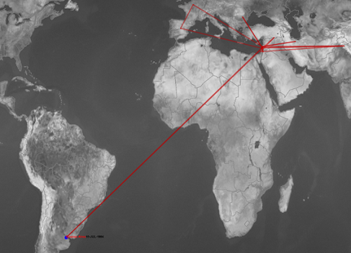
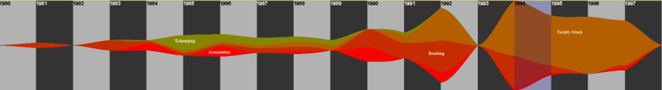
Applications of Visual Analytics
Who
Where
Political Simulation
  Agent-based analysis
  With DARPA
Global Terrorism Database
  With DHS
Bridge Maintenance
  With US DOT
  Exploring inspection reports
Biomechanical Motion
  Interactive motion comparison
What
Evidence
Box
Original
Data
When
R. Chang et al., Investigative Visual Analysis of Global Terrorism, Journal of Computer Graphics Forum, 2008.

Slide 8



Applications of Visual Analytics
Political Simulation
  Agent-based analysis
  With DARPA
Global Terrorism Database
  With DHS
Bridge Maintenance
  With US DOT
  Exploring inspection reports
Biomechanical Motion
  Interactive motion comparison
R. Chang et al., An Interactive Visual Analytics System for Bridge Management, Journal of Computer Graphics Forum, 2010. To Appear.

Slide 9



Applications of Visual Analytics
Political Simulation
  Agent-based analysis
  With DARPA
Global Terrorism Database
  With DHS
Bridge Maintenance
  With US DOT
  Exploring inspection reports
Biomechanical Motion
  Interactive motion comparison
R. Chang et al., Interactive Coordinated Multiple-View Visualization of Biomechanical Motion Data, IEEE Vis (TVCG) 2009.

Slide 10
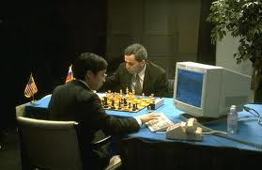
Talk Outline
Visual Analytics + Big Data:
  What is Big Data Visual Analytics? Definition and Problem Statement
  How to Visualize High Dimensional Data?
  How to Visualize Large Amounts of Data?
  Research at Tufts

Slide 11
1. What is Big Data Visual Analytics?
A Definition and Problem Statement

Slide 12
Recall Bank of America Project
Financial Institutions like Bank of America have legal responsibilities to report all suspicious wire transaction activities (money laundering, supporting terrorist activities, etc)
Data size: approximately 200,000 transactions per day (73 million transactions per year)
Question: How many people think this is Big Data?

Slide 13
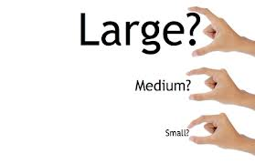
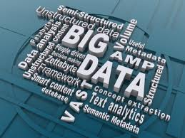
Defining Big Data for Visual Analytics
Let’s say that I have a billion data items, is that Big Data?
What if:
  These data items only have two attributes (e.g., latitude, longitude)?
  If I transpose this dataset such that I have two rows of data, but with a billion attributes?

Slide 14
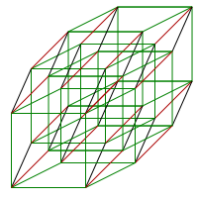
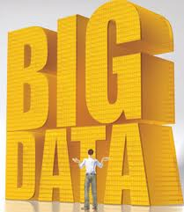
Defining Big Data for Visual Analytics
Big Data is NOT just about the size of your data
For the purpose of this talk, let’s talk about Big Data in the following way:
  Complexity: The number of attributes (k)
    Assume (k > 2)
  Size: The number of rows (n)
    Assume the amount of data cannot fit into a desktop computer’s memory

Slide 15

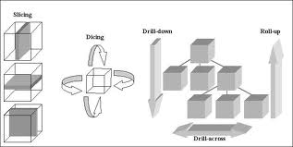
Problem Statements
Considering the two together is too difficult, so we’ll tackle the two issues independently for now
Our goal is to visualize (complex | large) data sets while:
  Maintaining interactivity: rendering at 10 fps
  Allowing for operations on the data (zoom, pivot, etc)

Slide 16
2. How to Visualize Complex
(High-Dimensional) Data?

Slide 17
Why is This Problem Hard?
You can only see 2D because
Your monitor is 2D
In other words:
you can show at most 2 dimensional data.
Everything else is a hack.

Slide 18
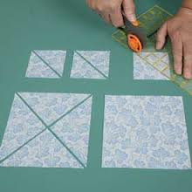
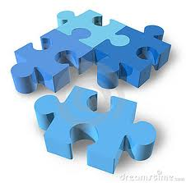
Ways to Visualize k-Dimensional Data
Two primary ways to do this “hack”
  Divide up the 2D screen into multiple 2D regions
    Showing no correlation between dimensions
    Showing k-1 correlations
    Showing all pair-wise correlations
  Project k-Dimensional Data into 2D
    3D to 2D
    k-D projection

Slide 19
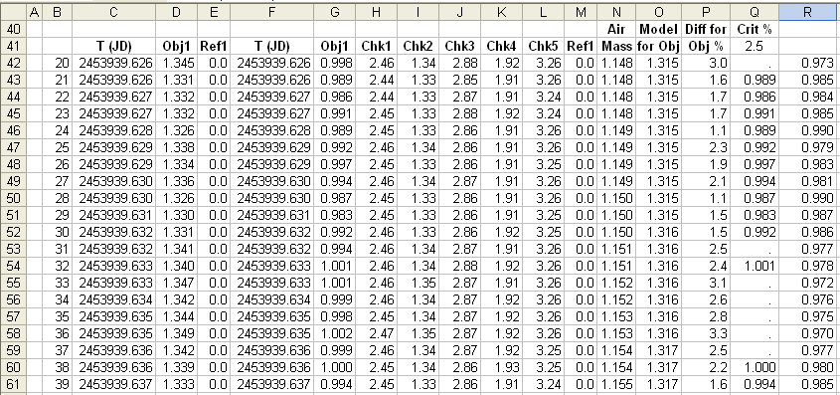
Ways to Visualize k-Dimensional Data
Divide up the 2D screen into multiple 2D regions
  Showing no correlation between dimensions
  Showing k-1 correlations
  Showing all pair-wise correlations
Project k-Dimensional Data into 2D
  3D to 2D
  k-D projection

Slide 20
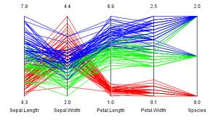
Ways to Visualize k-Dimensional Data
Divide up the 2D screen into multiple 2D regions
  Showing no correlation between dimensions
  Showing k-1 correlations
  Showing all pair-wise correlations
Project k-Dimensional Data into 2D
  3D to 2D
  k-D projection
Parallel Coordinates

Slide 21
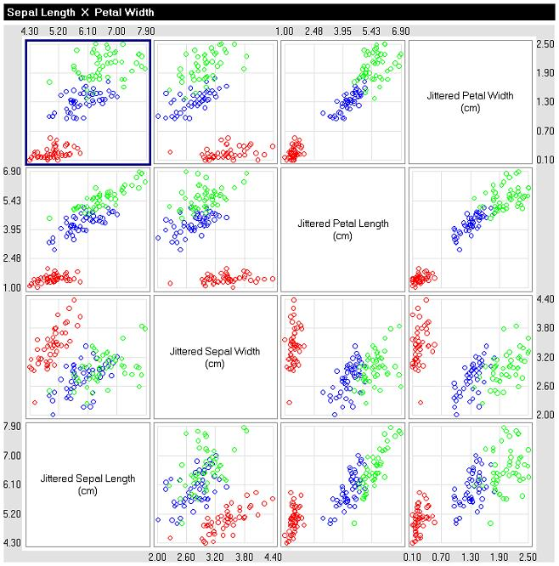
Ways to Visualize k-Dimensional Data
Divide up the 2D screen into multiple 2D regions
  Showing no correlation between dimensions
  Showing k-1 correlations
  Showing all pair-wise correlations
Project k-Dimensional Data into 2D
  3D to 2D
  k-D projection
Scatterplot Matrix

Slide 22
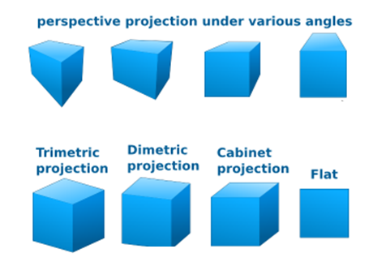
Ways to Visualize k-Dimensional Data
Divide up the 2D screen into multiple 2D regions
  Showing no correlation between dimensions
  Showing k-1 correlations
  Showing all pair-wise correlations
Project k-Dimensional Data into 2D
  3D to 2D
  k-D projection

Slide 23

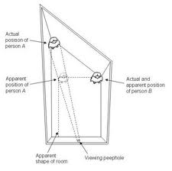
Ways to Visualize k-Dimensional Data
Divide up the 2D screen into multiple 2D regions
  Showing no correlation between dimensions
  Showing k-1 correlations
  Showing all pair-wise correlations
Project k-Dimensional Data into 2D
  3D to 2D
  k-D projection

Slide 24
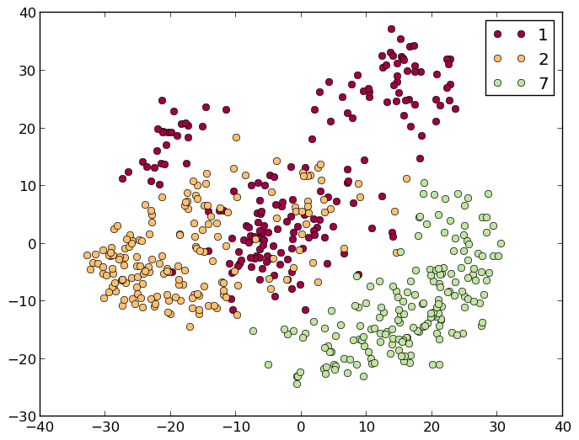
Ways to Visualize k-Dimensional Data
Divide up the 2D screen into multiple 2D regions
  Showing no correlation between dimensions
  Showing k-1 correlations
  Showing all pair-wise correlations
Project k-Dimensional Data into 2D
  3D to 2D
  k-D projection
Example Projection Methods:
(Dimension Reduction)
PCA
MDS
LDA
LLE
Many others! Usually, try to preserve distances in 2D as they exist in k-D

Slide 25
What We Have Done (at Tufts)
We like projection methods because it is more scalable than the “divide the screen” methods
iPCA – does interaction help understanding high dimensional data?
  Demo
Dis-Function – are interactions in 2D meaningful (recoverable) in k-D?

Slide 26
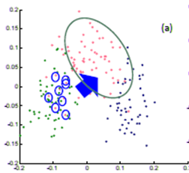
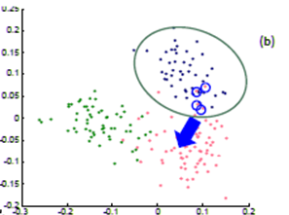
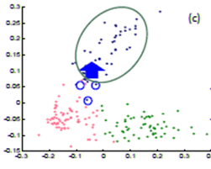
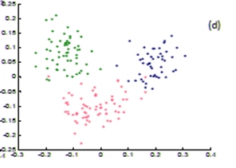
Dis-Function: Direct Manipulation of Visualization
The user directly moves points on the 2D plane that don’t “look right”…
Until the expert is happy (or the visualization can not be improved further)
The system learns the weights (importance) of each of the original k dimensions

Slide 27
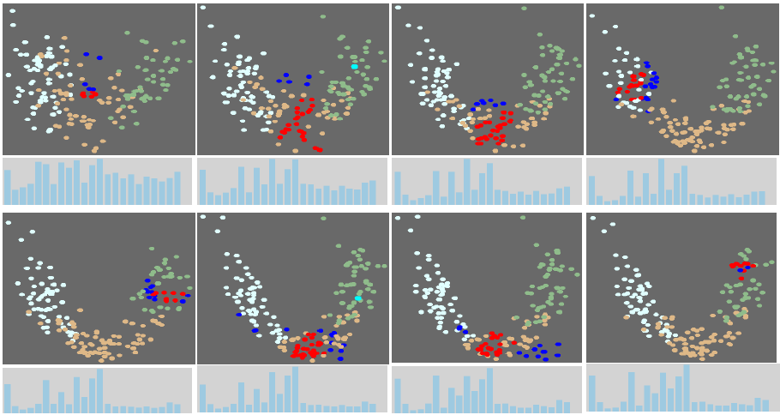
Dis-Function
This iterative metric learning process finds the weights of the k-dimensions over a series of 2D interactions
R. Chang et al., Find Distance Function, Hide Model Inference. IEEE VAST Poster 2011
R. Chang et al., Dis-function: Learning Distance Functions Interactively, IEEE VAST 2012. To Appear

Slide 28
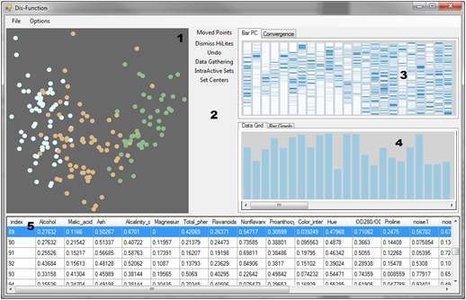


Dis-Function: Implementation
Linear distance
function:
Optimization:

Slide 29
Open Questions in
High-Dimensional Data Visualization
When to use what?
  Projection methods scale better, but are harder to understand
What happens when the data attributes are not all numeric, but contains categorical or text data?
  Use multiple coordinated views
But what if k gets to be really large and the types are mixed?
  Uh…

Slide 30
3. How to Visualize Large Amount of Data?

Slide 31



Problem Statement
Visualization on a
Commodity Hardware
Large Data in a
Data Warehouse

Slide 32
Problem Statement
Constraint: Data is too big to fit into the memory or hard drive of the personal computer
  Note: Ignoring various database technologies (OLAP, Column-Store, No-SQL, Array-Based, etc)
Classic Computer Science Problem…
What are some previous techniques?
  Truncate (sample, filter)
  Resolution reduction (“blurring”, image zooming)
  Stream (think Netflix, Hulu)
  Pre-fetch (think open world 3D video games)

Slide 33
Pros and Cons: Truncate
Truncate (sample, filter)
  Pros: Easy to implement; efficient; scalable
  Cons: Sampling is often data- or task-dependent
Sampling
Algorithm

Slide 34

Pros and Cons: Resolution Reduction
Resolution reduction (“blurring”)
  Pros: Allows hierarchical navigations
  Cons:
    Fine details are often lost,
    not all data types can be easily blurred (order-invariant data)

Slide 35
Pros and Cons: Streaming
Stream [Fisher et al. CHI 2012]
  Pros: Query can be terminated at any time
  Cons: It is inefficient on the database end
t = 1 second
t = 5 minute
Fisher et al. , Trust Me, I'm Partially Right: Incremental Visualization Lets Analysts Explore Large Datasets Faster. CHI 2012

Slide 36

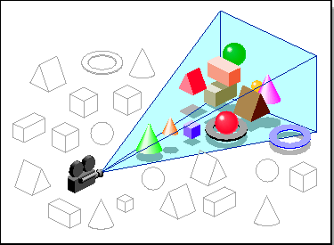
Pros and Cons: Pre-Fetch
Pre-fetch
  Pros: Seamless to the user
  Cons: Predicting the future is kind of hard
    Possible in 3D games because of limited degrees of freedom
    http://www.youtube.com/watch?v=n27NLuc44Lk

Slide 37
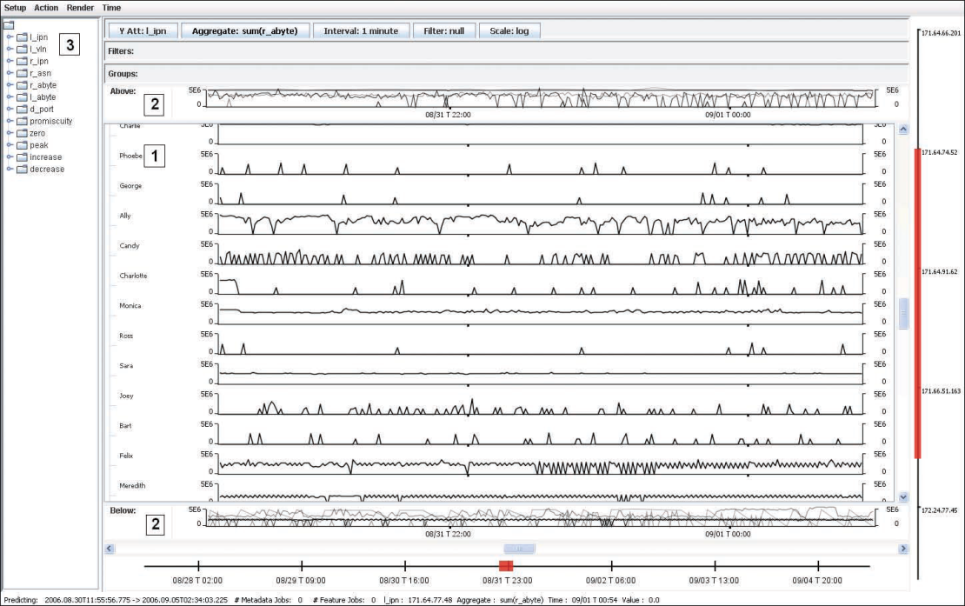
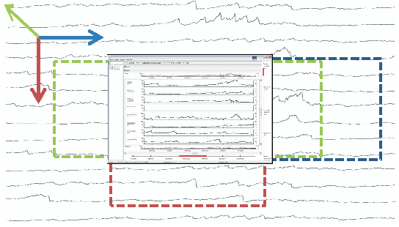
Pros and Cons: Pre-Fetch
Pre-fetch in Visual Analytics [Chan, Hanrahan, 2008 VAST]
  Limit the types of operations a user can do
  Allows interactive analysis of over a billion data points
Chan et al. ,. Maintaining Interactivity While Exploring Massive Time Series. IEEE VAST 2008

Slide 38
Quick Summary
Most of the time, a combination of techniques is used in a given system. For example, streaming and sampling.
Pre-fetching is very interesting because:
  The success metric is quantitative (cache misses)
  Multiple approaches for prediction
    Feature-based (what data features is the user interested in?)
    Momentum-based (has the user been panning to the right?)
    Probabilistic models (what is the user likely going to do?)
    Profile-based (what type of user is it?)
    etc

Slide 39
4. Research at Tufts:
Visual Analytics of Large Amounts of Data
Joint work with Caroline Ziemkiewicz , Alvitta Ottley

Slide 40
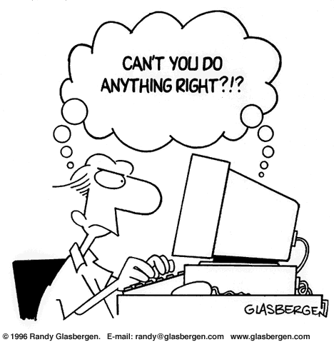
Motivation

Slide 41
Individual Differences and Interaction Pattern
Existing research shows that all the following factors affect how someone uses a visualization:
  Spatial Ability
  Cognitive Workload/Mental Demand
  Personality
  Experience (novice vs. expert)
  Emotional State
  Perceptual Speed
  … and more

Slide 42
Preliminary Study – Novice v. Expert
Novice vs. Expert financial experts use of the WireVis system when searching for fraud
  Novice exhibited “breadth-first-search” behaviors
  Experts exhibited “depth-first-search” behaviors
Our next step is to use Machine Learning methods to distinguish a user by analyzing their interactions in real-time

Slide 43
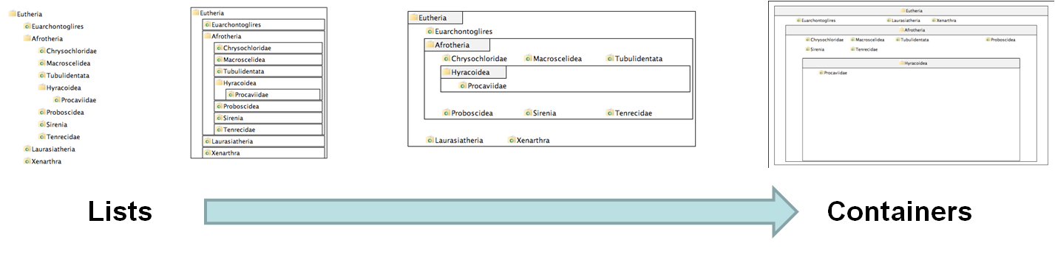
Preliminary Study – Locus of Control
Identified the personality factor, Locus of Control (LOC), as a predictor for how a user interacts with the following visualizations:

Slide 44
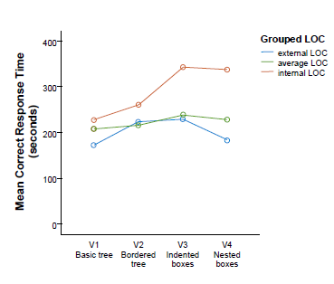
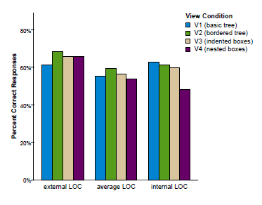
Results
When with list view compared to containment view, internal LOC users are:
  faster (by 70%)
  more accurate (by 34%)
Only for complex (inferential) tasks
The speed improvement is about 2 minutes (116 seconds)
R. Chang et al., How Locus of Control Influences Compatibility with Visualization Style, IEEE VAST 2011.
R. Chang et al., How Visualization Layout Relates to Locus of Control and Other Personality Factors. TVCG 2012. To Appear.

Slide 45

Preliminary Study – Cognitive Priming

Slide 46
Results: Averages Primed More Internal
Performance
Good
External LOC
Average LOC
Average ->Internal
Internal LOC
Poor
Visual Form
List-View
Containment
R. Chang et al., LOC it Down: Manipulating and Controlling for Personality Effects on Visualization Tasks. (In Submission to CHI)

Slide 47
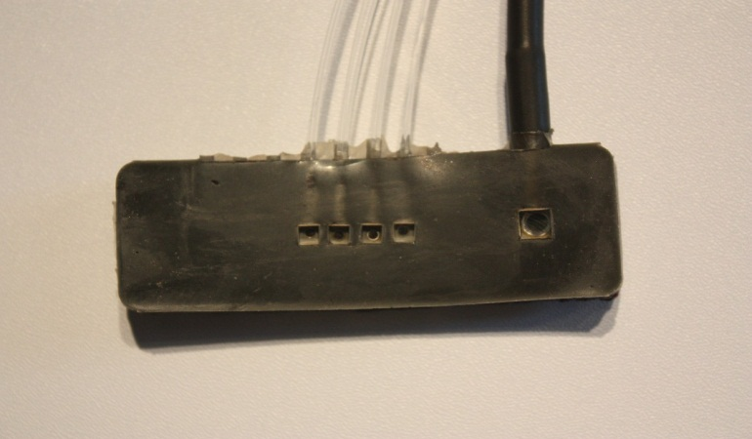

Preliminary Study – Using Brain Sensing (fNIRS)
Functional Near-Infrared Spectroscopy
a lightweight brain sensing technique
measures mental demand (working memory)
R. Chang et al., Using fNIRS Brain Sensing to Evaluate Information Visualization Interfaces (In submission at CHI)

Slide 48
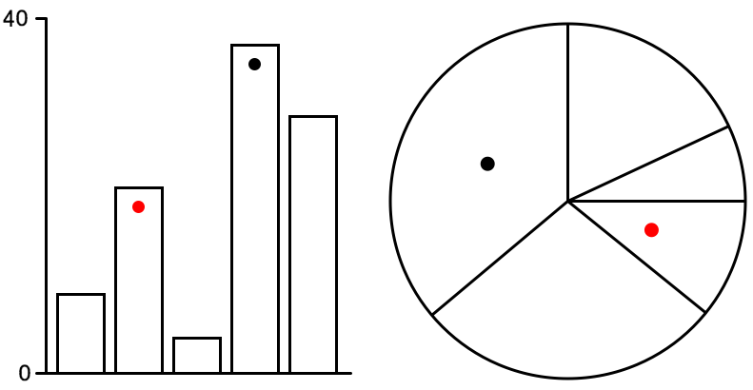
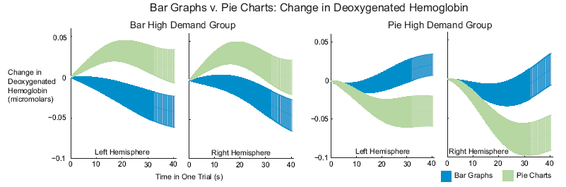
This is Your Brain on Bar graphs and Pie Charts

Slide 49
Make the Computer Aware of the User!

Slide 50
Summary

Slide 51

Summary
Visual Analytics + Big Data is a critically important problem that isn’t going to go away
Thinking of Big Data as problems of data complexity and size can lead to clearer research paths
I propose that one research area that has largely been unexplored is in the understanding of the human user.

Slide 52
Summary
Visual Analytics + Big Data:
  What is Big Data Visual Analytics? Definition and Problem Statement
  How to Visualize High Dimensional Data?
  How to Visualize Large Amounts of Data?
  Research at Tufts

Slide 53


