Slide 1
User-Centric Visual Analytics
Remco Chang
Tufts University

Slide 2
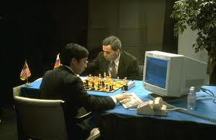
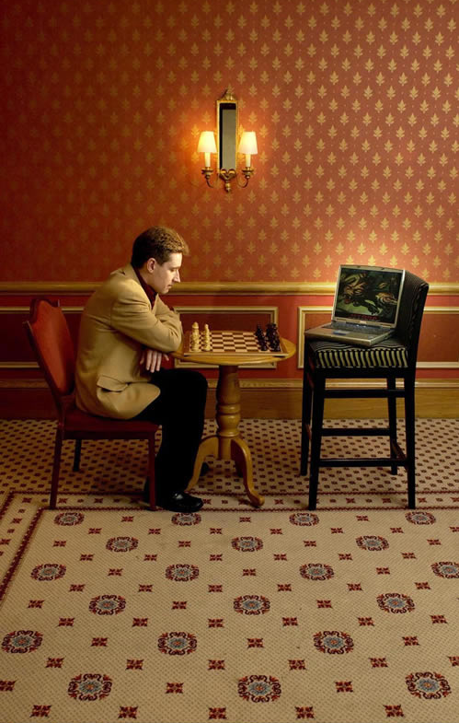
Human + Computer
Human vs. Artificial Intelligence
Garry Kasparov vs. Deep Blue (1997)
  Computer takes a “brute force” approach without analysis
  “As for how many moves ahead a grandmaster sees,” Kasparov concludes: “Just one, the best one”
Artificial vs. Augmented Intelligence
Hydra vs. Cyborgs (2005)
  Grandmaster + 1 chess program > Hydra (equiv. of Deep Blue)
  Amateur + 3 chess programs > Grandmaster + 1 chess program¹
1. http://www.collisiondetection.net/mt/archives/2010/02/why_cyborgs_are.php

Slide 3
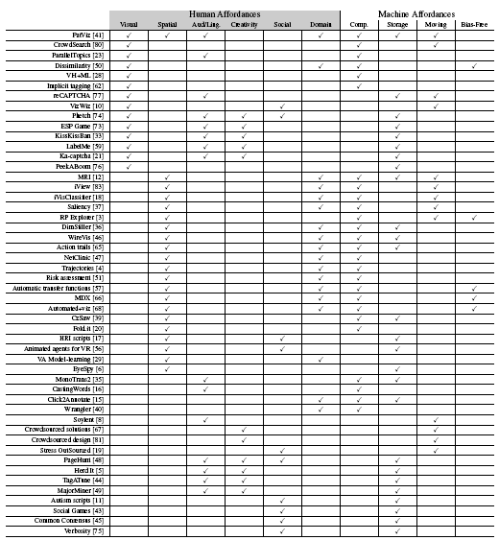
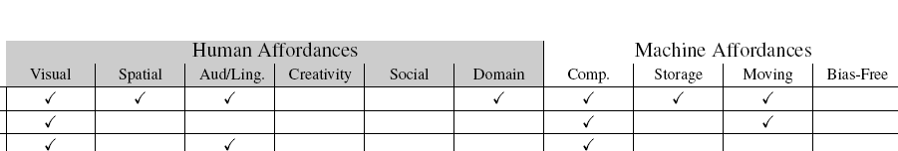
Understanding Human Complexity
Surveyed 1,200+ papers from CHI, IUI, KDD, Vis, InfoVis, VAST
Found 49 relating to human + computer collaboration
Using a model of human and computer affordances, examined each of the projects to identify what “works” and what could be missing
Joint work with Jordan Couser. An affordance-based framework for human computation and human-computer collaboration.
IEEE VAST 2012. To Appear

Slide 4
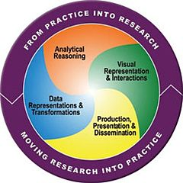
Visual Analytics = Human + Computer
Visual analytics is "the science of analytical reasoning facilitated by visual interactive interfaces.“ ¹
By definition, it is a collaboration between human and computer to solve problems.
1. Thomas and Cook, “Illuminating the Path”, 2005.

Slide 5
Example: What Does (Wire) Fraud Look Like?
Financial Institutions like Bank of America have legal responsibilities to report all suspicious wire transaction activities (money laundering, supporting terrorist activities, etc)
Data size: approximately 200,000 transactions per day (73 million transactions per year)
Problems:
  Automated approach can only detect known patterns
  Bad guys are smart: patterns are constantly changing
  Data is messy: lack of international standards resulting in ambiguous data
Current methods:
  10 analysts monitoring and analyzing all transactions
  Using SQL queries and spreadsheet-like interfaces
  Limited time scale (2 weeks)

Slide 6
WireVis: Financial Fraud Analysis
In collaboration with Bank of America
  Develop a visual analytical tool (WireVis)
  Visualizes 7 million transactions over 1 year
  Beta-deployed at WireWatch
A great problem for visual analytics:
  Ill-defined problem (how does one define fraud?)
  Limited or no training data (patterns keep changing)
  Requires human judgment in the end (involves law enforcement agencies)
Design philosophy: “combating human intelligence requires better (augmented) human intelligence”
R. Chang et al., Scalable and interactive visual analysis of financial wire transactions for fraud detection. Information Visualization,2008.
R. Chang et al., Wirevis: Visualization of categorical, time-varying data from financial transactions. IEEE VAST, 2007.

Slide 7
WireVis: A Visual Analytics Approach
Search by Example (Find Similar Accounts)
Heatmap View
(Accounts to Keywords Relationship)
Keyword Network
(Keyword Relationships)
Strings and Beads
(Relationships over Time)

Slide 8




Applications of Visual Analytics
Political Simulation
  Agent-based analysis
  With DARPA
Global Terrorism Database
  With DHS
Bridge Maintenance
  With US DOT
  Exploring inspection reports
Biomechanical Motion
  Interactive motion comparison
R. Chang et al., Two Visualization Tools for Analysis of Agent-Based Simulations in Political Science. IEEE CG&A, 2012

Slide 9
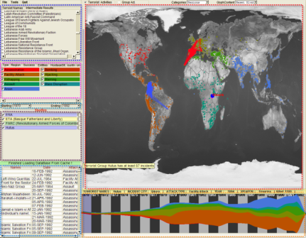
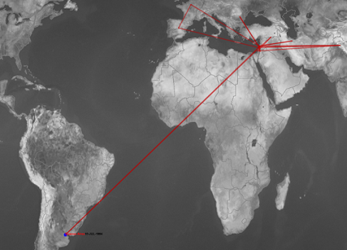
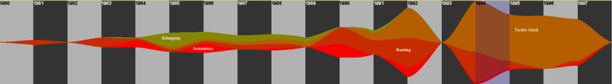
Applications of Visual Analytics
Who
Where
Political Simulation
  Agent-based analysis
  With DARPA
Global Terrorism Database
  With DHS
Bridge Maintenance
  With US DOT
  Exploring inspection reports
Biomechanical Motion
  Interactive motion comparison
What
Evidence
Box
Original
Data
When
R. Chang et al., Investigative Visual Analysis of Global Terrorism, Journal of Computer Graphics Forum, 2008.

Slide 10



Applications of Visual Analytics
Political Simulation
  Agent-based analysis
  With DARPA
Global Terrorism Database
  With DHS
Bridge Maintenance
  With US DOT
  Exploring inspection reports
Biomechanical Motion
  Interactive motion comparison
R. Chang et al., An Interactive Visual Analytics System for Bridge Management, Journal of Computer Graphics Forum, 2010. To Appear.

Slide 11



Applications of Visual Analytics
Political Simulation
  Agent-based analysis
  With DARPA
Global Terrorism Database
  With DHS
Bridge Maintenance
  With US DOT
  Exploring inspection reports
Biomechanical Motion
  Interactive motion comparison
R. Chang et al., Interactive Coordinated Multiple-View Visualization of Biomechanical Motion Data, IEEE Vis (TVCG) 2009.

Slide 12
Talk Outline
Discuss Visual Analytics problems from a User-Centric perspective:
  One optimal visualization for every user?
  Does the user always behave the same with a visualization?
  Can a user’s reasoning process be recorded and stored?
  Can such reasoning processes and knowledge be expressed quantitatively?

Slide 13
1. Is there an optimal visualization?
How personality influences
compatibility with visualization style
Joint work with Caroline Ziemkiewicz , Alvitta Ottley

Slide 14
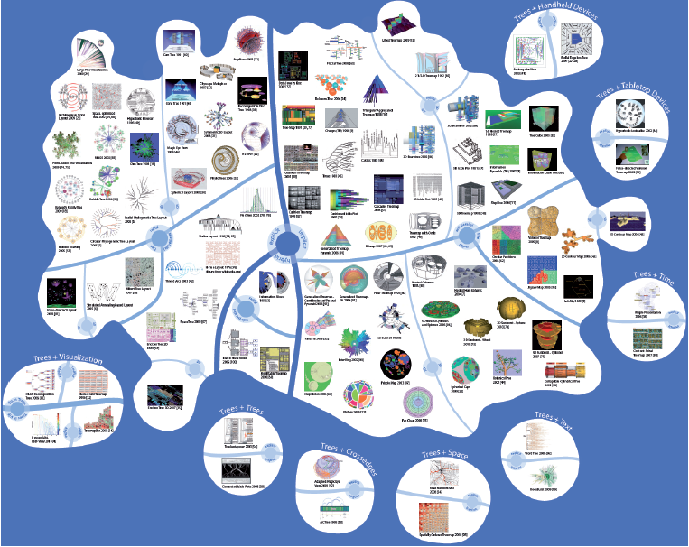
What’s the Best Visualization for You?
Jürgensmann and Schulz, “Poster: A Visual Survey of Tree Visualization”. InfoVis, 2010.

Slide 15
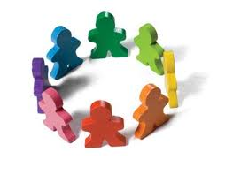
What’s the Best Visualization for You?
Intuitively, not everyone is created equal.
  Our background, experience, and personality should affect how we perceive and understand information.
So why should our visualizations be the same for all users?

Slide 16
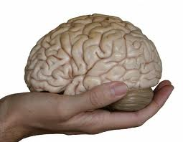
Cognitive Profile
Objective: to create personalized information visualizations based on individual differences
Hypothesis: cognitive factors affect a person’s ability (speed and accuracy) in using different visualizations.

Slide 17
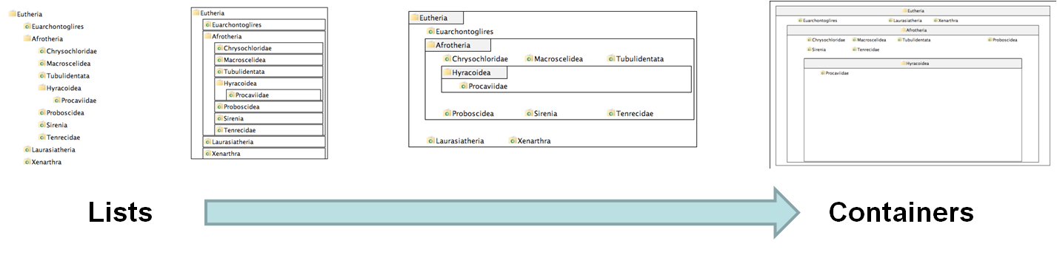
Experiment Procedure
4 visualizations on hierarchical visualization
  From list-like view to containment view
250 participants using Amazon’s Mechanical Turk
Questionnaire on “locus of control” (LOC)
  Definition of LOC: the degree to which a person attributes outcomes to themselves (internal LOC) or to outside forces (external LOC)
V1
V2
V3
V4

Slide 18
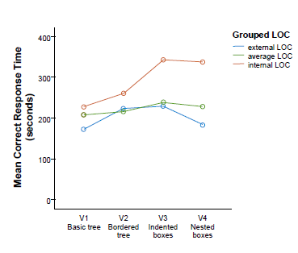
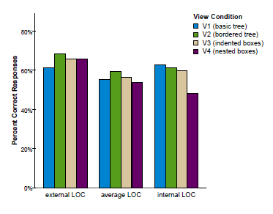
Results
When with list view compared to containment view, internal LOC users are:
  faster (by 70%)
  more accurate (by 34%)
Only for complex (inferential) tasks
The speed improvement is about 2 minutes (116 seconds)
R. Chang et al., How Locus of Control Influences Compatibility with Visualization Style, IEEE VAST 2011.
R. Chang et al., How Visualization Layout Relates to Locus of Control and Other Personality Factors. TVCG 2012. To Appear.

Slide 19
Conclusion
Cognitive factors can affect how a user perceives and understands information from using a visualization
The effect could be significant in terms of both efficiency and accuracy
Design Implications: Personalized displays should take into account a user’s cognitive profile (cognitive traits)

Slide 20
2. WHAT??
Is the relationship between LOC
and visual style coincidental or dependent?
Joint work with Alvitta Ottley, Caroline Ziemkiewicz

Slide 21
What We Know About LOC and Visualization:
Performance
Good
External LOC
Average LOC
Internal LOC
Poor
Visual Form
List-View (V1)
Containment (V4)

Slide 22
We Also Know:
Based on Psychology research, we know that locus of control can be temporarily affected through priming
For example, to reduce locus of control (to make someone have a more external LOC)
  “We know that one of the things that influence how well you can do everyday tasks is the number of obstacles you face on a daily basis. If you are having a particularly bad day today, you may not do as well as you might on a day when everything goes as planned. Variability is a normal part of life and you might think you can’t do much about that aspect. In the space provided below, give 3 examples of times when you have felt out of control and unable to achieve something you set out to do. Each example must be at least 100 words long.”

Slide 23
Research Question
Known Facts:
  There is a relationship between LOC and use of visualization
  LOC can be primed
Research Question:
  If we can affect the user’s LOC, will that affect their use of visualization?
Hypothesis:
  If yes, then the relationship between LOC and visualization style is dependent
  If no, then we claim that LOC is a stable indicator of a user’s visualization style
=>Publication!
=>Publication!

Slide 24
LOC and Visualization
Performance
Good
External LOC
Condition 1:
Make Internal LOC more like External LOC
Average LOC
Internal LOC
Poor
Visual Form
List-View (V1)
Containment (V4)

Slide 25
LOC and Visualization
Performance
Good
External LOC
Condition 2:
Make External LOC more like Internal LOC
Average LOC
Internal LOC
Poor
Visual Form
List-View (V1)
Containment (V4)

Slide 26
LOC and Visualization
Performance
Good
Condition 3:
Make 50% of the Average LOC more like Internal LOC
Condition 4:
Make 50% of the Average LOC more like External LOC
External LOC
Average LOC
Internal LOC
Poor
Visual Form
List-View (V1)
Containment (V4)

Slide 27
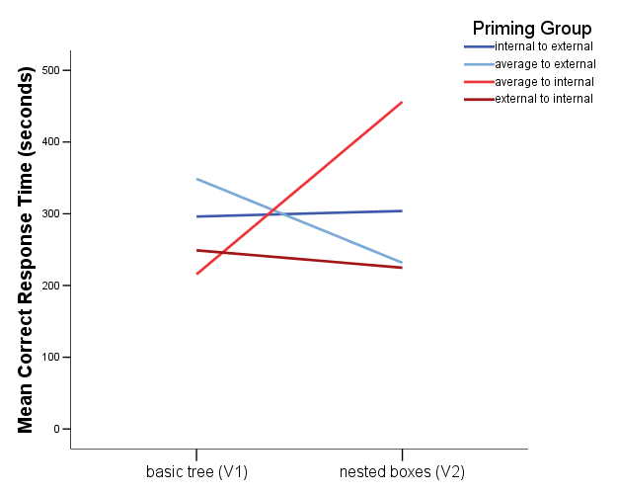
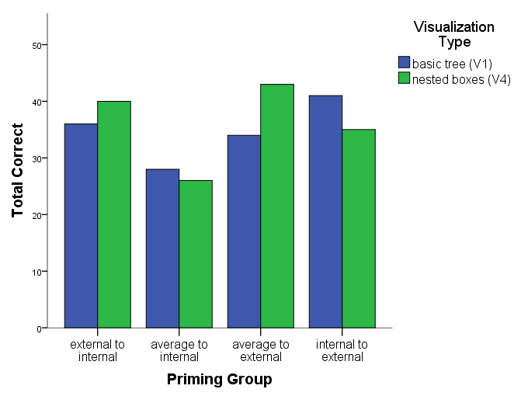
Result
Yes, users behaviors can be altered by priming their LOC! However, this is only true for:
  Speed (less so for accuracy)
  Only for complex tasks (inferential tasks)

Slide 28
Effects of Priming (Condition 3)
Performance
Good
External LOC
Average -> External
Average LOC
Internal LOC
Poor
Visual Form
List-View (V1)
Containment (V4)

Slide 29
Effects of Priming (Condition 4)
Performance
Good
External LOC
Average LOC
Average ->Internal
Internal LOC
Poor
Visual Form
List-View (V1)
Containment (V4)

Slide 30
Effects of Priming (Condition 1)
Performance
Good
External LOC
Average LOC
Internal->External
Internal LOC
Poor
Visual Form
List-View (V1)
Containment (V4)

Slide 31
Effects of Priming (Condition 2)
Performance
Good
External LOC
Average LOC
External -> Internal
Internal LOC
Poor
Visual Form
List-View (V1)
Containment (V4)

Slide 32


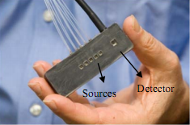
Cognitive States and Traits
How does cognitive states and traits affect a user’s ability with a visualization?
  Cognitive Priming with LOC
  Affective State and Visual Judgment
  Brain Sensing (fNIRS) with Visualizations

Slide 33
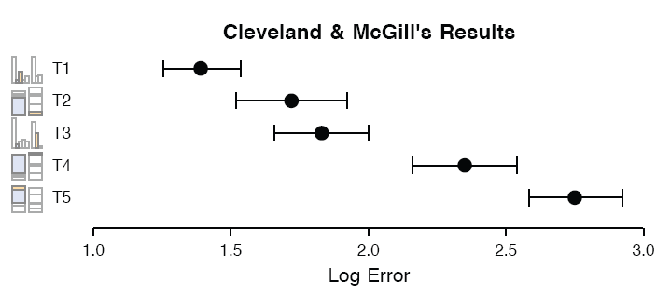
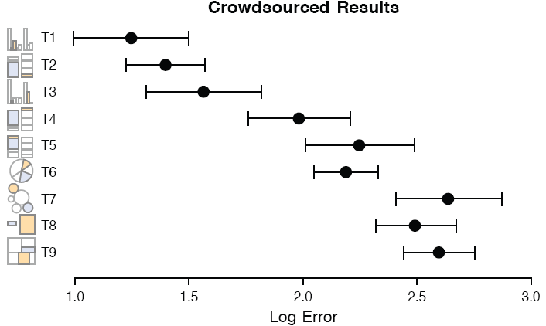
Visual Judgment
Cleveland and McGill study on perception of angle vs. position in statistical charts. (1984)
  Indicates that humans are better at judging length (in bar graph) than angles (in pie chart)
Heer and Bostock extension to using Amazon’s Mechanical Turk (2010)
  Replicated Cleveland-McGill and show that Turk is feasible for perceptual experiments
Joint work with Lane Harrison

Slide 34
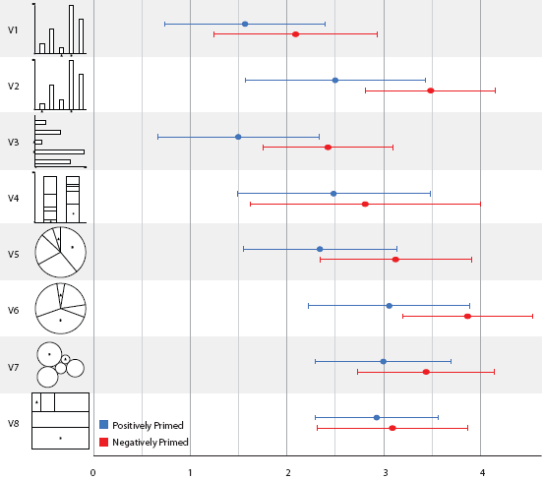
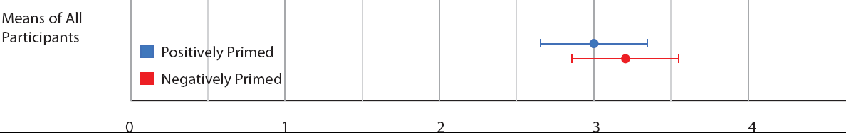
Visual Judgment
We introduced affective-priming to Heer-Bostock and found significance in how positively-primed subjects perform better in visual judgment.
  Priming was introduced through text (verbal priming).
  Uplifting and discouraging stories found on NY Times

Slide 35
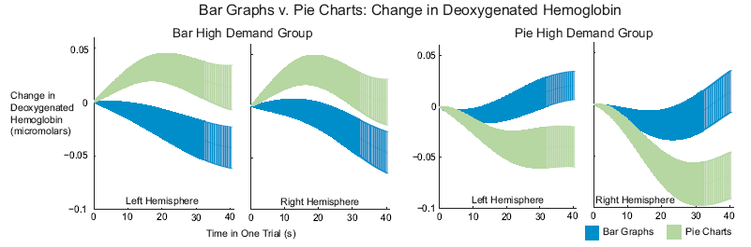
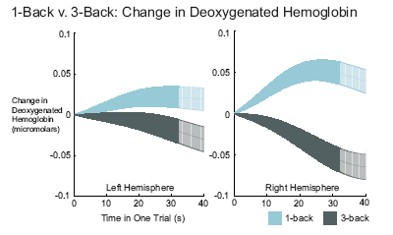
fNIRS with Visualizations
Bar graphs have been shown to be better than pie charts for visual judgment. Why are pie charts everywhere?
  Increasing workload in n-back tests
  Mental workload difference
Joint work with Evan Peck, Rob Jacob

Slide 36
Conclusion
The relationship between Locus of Control and visualization style appears to be dependent: by priming a user’s LOC, we an alter their behavior with a visualization in a deterministic manner.
Future work: examine if the interaction patterns are different between the LOC groups.
  Can train machine learning models to learn a personality profile based on interaction pattern.
  Sell the software to Google!
LOC is not the end. As we are discovering, affective state is also a factor. While some of these cognitive factors can be measured using questionnaires, some simply cannot. The use of brain sensing technology can be a game-changer in visualization research.
Funding from NSF HCC: “Toward Objective, In-Situ, and Generalizable Evaluation of Visual Analytics by Integrating Brain Imaging with Cognitive Factors Analysis”

Slide 37
3. What’s In a User’s Interactions?
How much of a user’s reasoning can be recovered from the interaction log?
Joint work with Wenwen Dou

Slide 38

What is in a User’s Interactions?
Keyboard, Mouse, etc
Visualization
Input
Human
Output
Images (monitor)
Types of Human-Visualization Interactions
  Word editing (input heavy, little output)
  Browsing, watching a movie (output heavy, little input)
  Visual Analysis (closer to 50-50)
Challenge:
  Can we capture and extract a user’s reasoning and intent through capturing a user’s interactions?

Slide 39
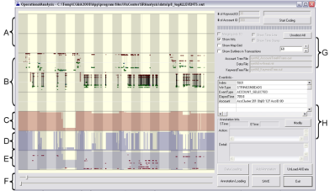
What is in a User’s Interactions?
Goal: determine if a user’s reasoning and intent are reflected in a user’s interactions.
Grad
Students
(Coders)
Analysts
Compare!
(manually)
Strategies
Methods
Findings
Guesses of
Analysts’ thinking
Logged
(semantic)
Interactions
WireVis
Interaction-Log Vis

Slide 40
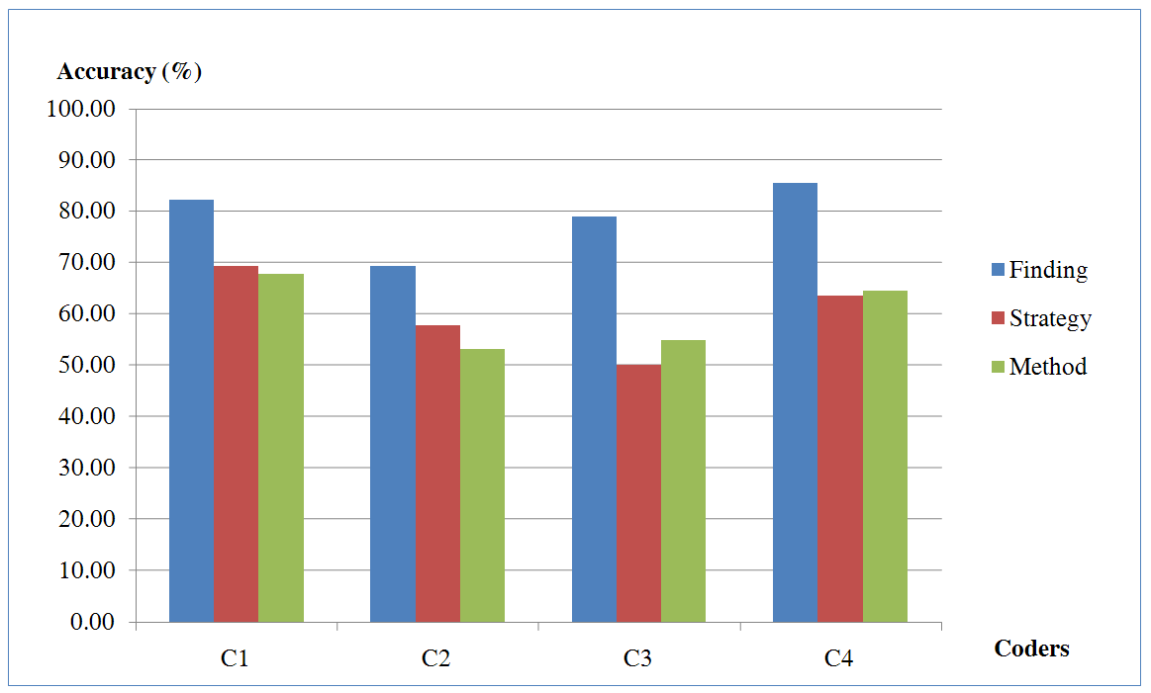
What’s in a User’s Interactions
From this experiment, we find that interactions contains at least:
  60% of the (high level) strategies
  60% of the (mid level) methods
  79% of the (low level) findings
R. Chang et al., Recovering Reasoning Process From User Interactions. CG&A, 2009.
R. Chang et al., Evaluating the Relationship Between User Interaction and Financial Visual Analysis. VAST, 2009.

Slide 41
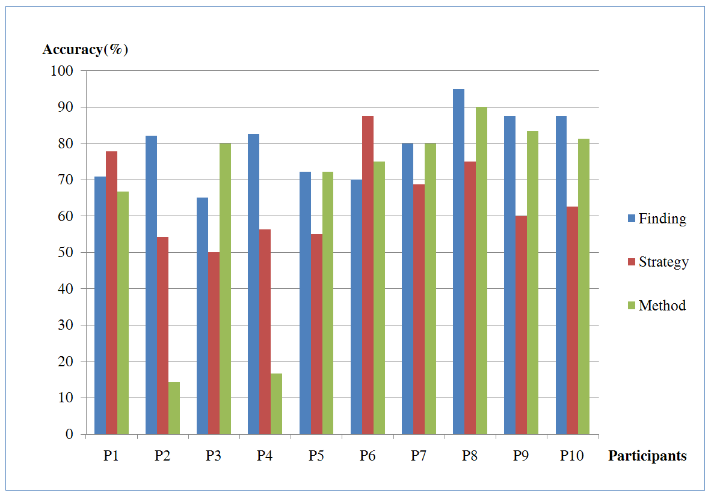
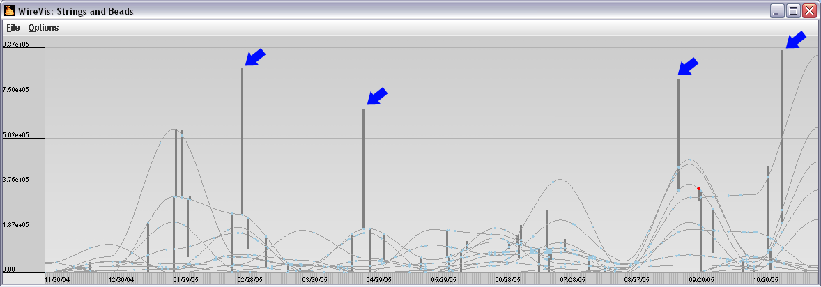
What’s in a User’s Interactions
Why are these so much lower than others?
  (recovering “methods” at about 15%)
Only capturing a user’s interaction in this case is insufficient.

Slide 42
Conclusion
A high percentage of a user’s reasoning and intent are reflected in a user’s interactions.
Raises lots of question: (a) what is the upper-bound, (b) how to automate the process, (c) how to utilize the captured results
This study is not exhaustive. It merely provides a sample point of what is possible.
R. Chang et al., Analytic Provenance Panel at IEEE VisWeek. 2011
R. Chang et al., Analytic Provenance Workshop at CHI. 2011

Slide 43
4. If Interaction Logs Contain Knowledge…
Can domain knowledge be captured and represented quantitatively?
Joint work with Eli Brown, Jingjing Liu, Carla Brodley

Slide 44
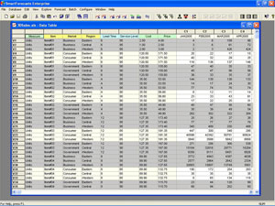
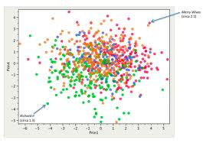
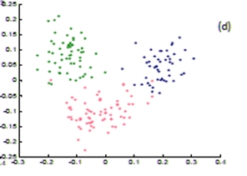
Find Distance Function, Hide Model Inference
Observation: Domain experts do not know how to visualize their own data, but knows it when a visualization looks “wrong”.
More importantly, they often know why it looks wrong

Slide 45
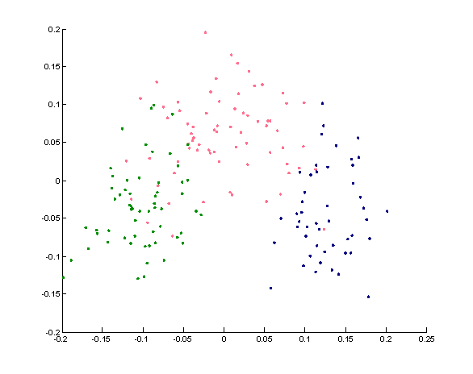
Working with Domain Experts
Common practice: the visualization expert modifies the visualization and asks for the domain expert’s opinion.
  Repeat cycle
  …Find result
Question: why can’t the domain expert “fix” the visualization themselves by interacting with the visualization directly?

Slide 46
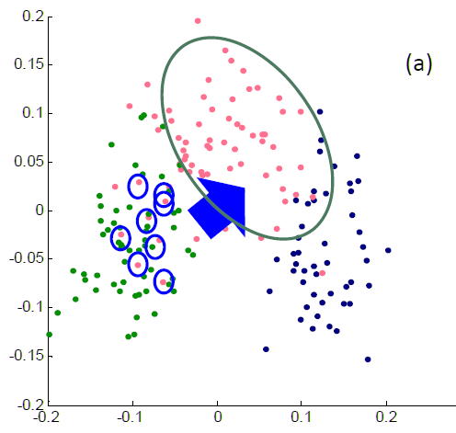
Direct Manipulation of Visualization
We have developed a system that allows the expert to directly move the elements of the visualization to what they think is “right”.
These interactions by the domain user is rich in semantic meaning. If the user drags two groups of points together, the user is indicating that these points are similar.
The goal of this project is to extract these interactions into a quantifiable form – as the weights of a distance function.

Slide 47
Distance Function
 | D1 | D2
P1 | 5 | 1000
P2 | 5 | 1
Distance function: d(x, y) >= 0
  Given two data points, x, y, return a non negative value describing how similar the two points are.
  What is the distance between the two points P1 and P2?
    The answer is ambiguous because it depends on how important the dimensions (D1, D2) are.
    If the user drags P1 and P2 close to each other, the weight (importance) of D1 would be higher than D2.
    Whereas if the user drags P1 and P2 further apart from each other, D2 would be very important, and D1 would not.
    Extend the problem to higher dimensions. The problem gets much more complicated. The goal of this project is to “learn” the relative importance of these data dimensions.

Slide 48
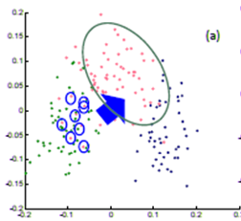
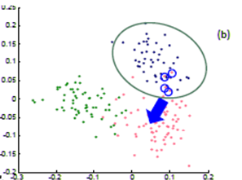
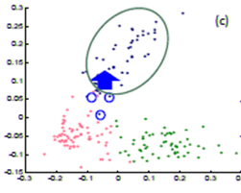
Direct Manipulation of Visualization
The process is repeated a few times…
Until the expert is happy (or the visualization can not be improved further)
The system learns the weights (importance) of each of the dimensions

Slide 49
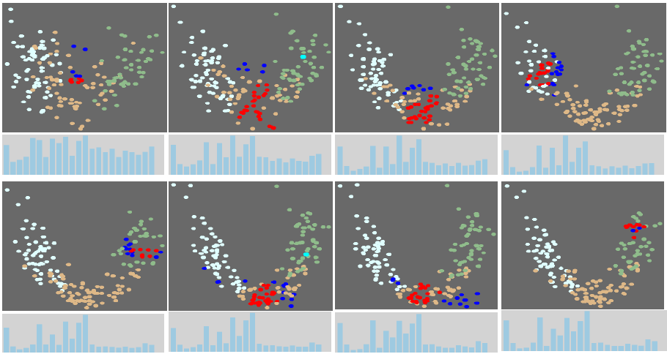
Results
Tells the domain expert what dimension of data they care about, and what dimensions are not useful!
R. Chang et al., Find Distance Function, Hide Model Inference. IEEE VAST Poster 2011
R. Chang et al., Dis-function: Learning Distance Functions Interactively, IEEE VAST 2012. To Appear

Slide 50
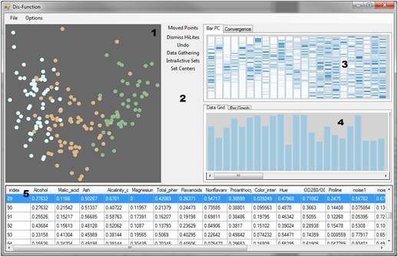


Our Current Implementation
Linear distance
function:
Optimization:

Slide 51
Conclusion
With an appropriate projection model, it is possible to quantify a user’s interactions.
In our system, we let the domain expert interact with a familiar representation of the data (scatter plot), and hides the ugly math (distance function)
The system learns the weights of the distance function. The resulting function reflects the expert’s mental model of the dataset.
Future Work: (a) investigating the use of Mahalanobis distance function, (b) integrate the system into a complete system, (c) evaluate with domain experts

Slide 52
Summary

Slide 53

Summary
While Visual Analytics have grown and is slowly finding its identity,
There is still many open problems that need to be addressed.
I propose that one research area that has largely been unexplored is in the understanding and supporting of the human user.

Slide 54
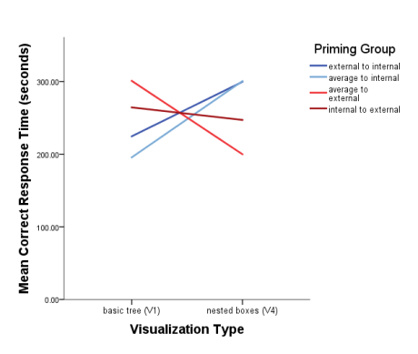
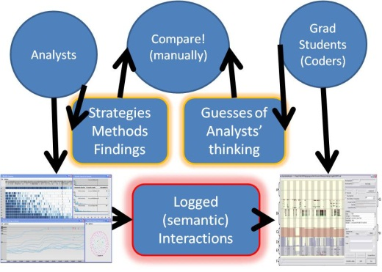
Summary
Is there a best visualization for each user?
  Possibly, through understanding individual differences
Can the user’s behavior with a visualization be altered?
  Yes, priming LOC affects a user’s behavior with a visualization
What is in a user’s interactions?
  A great deal of a user’s reasoning process can be recovered through analyzing a user’s interactions
Can domain knowledge be externalized quantitatively?
  Yes, given some assumptions about the visualization, a user can interactively externalize their knowledge quantitatively.

Slide 55

