Slide 1
User-Centric Visual Analytics
Remco Chang
Tufts University

Slide 2
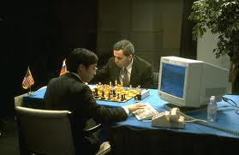
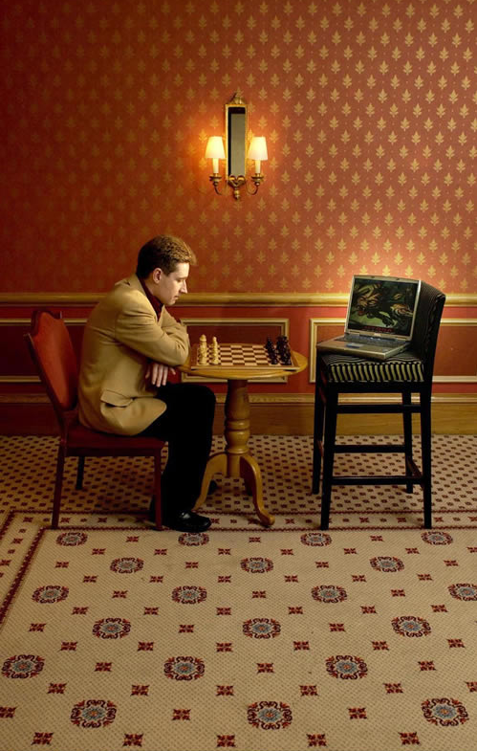
Human + Computer
Human vs. Artificial Intelligence
Garry Kasparov vs. Deep Blue (1997)
  Computer takes a “brute force” approach without analysis
  “As for how many moves ahead a grandmaster sees,” Kasparov concludes: “Just one, the best one”
Artificial vs. Augmented Intelligence
Hydra vs. Cyborgs (2005)
  Grandmaster + 1 chess program > Hydra (equiv. of Deep Blue)
  Amateur + 3 chess programs > Grandmaster + 1 chess program¹
1. http://www.collisiondetection.net/mt/archives/2010/02/why_cyborgs_are.php

Slide 3
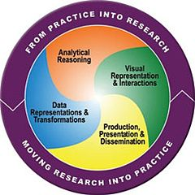
Visual Analytics = Human + Computer
Visual analytics is "the science of analytical reasoning facilitated by visual interactive interfaces.“ ¹
By definition, it is a collaboration between human and computer to solve problems.
1. Thomas and Cook, “Illuminating the Path”, 2005.

Slide 4
Example: What Does (Wire) Fraud Look Like?
Financial Institutions like Bank of America have legal responsibilities to report all suspicious wire transaction activities (money laundering, supporting terrorist activities, etc)
Data size: approximately 200,000 transactions per day (73 million transactions per year)
Problems:
  Automated approach can only detect known patterns
  Bad guys are smart: patterns are constantly changing
  Data is messy: lack of international standards resulting in ambiguous data
Current methods:
  10 analysts monitoring and analyzing all transactions
  Using SQL queries and spreadsheet-like interfaces
  Limited time scale (2 weeks)

Slide 5
WireVis: Financial Fraud Analysis
In collaboration with Bank of America
  Develop a visual analytical tool (WireVis)
  Visualizes 7 million transactions over 1 year
  Beta-deployed at WireWatch
A great problem for visual analytics:
  Ill-defined problem (how does one define fraud?)
  Limited or no training data (patterns keep changing)
  Requires human judgment in the end (involves law enforcement agencies)
Design philosophy: “combating human intelligence requires better (augmented) human intelligence”
R. Chang et al., Scalable and interactive visual analysis of financial wire transactions for fraud detection. Information Visualization,2008.
R. Chang et al., Wirevis: Visualization of categorical, time-varying data from financial transactions. IEEE VAST, 2007.

Slide 6
WireVis: A Visual Analytics Approach
Search by Example (Find Similar Accounts)
Heatmap View
(Accounts to Keywords Relationship)
Keyword Network
(Keyword Relationships)
Strings and Beads
(Relationships over Time)

Slide 7




Applications of Visual Analytics
Political Simulation
  Agent-based analysis
  With DARPA
Global Terrorism Database
  With DHS
Bridge Maintenance
  With US DOT
  Exploring inspection reports
Biomechanical Motion
  Interactive motion comparison
R. Chang et al., Two Visualization Tools for Analysis of Agent-Based Simulations in Political Science. IEEE CG&A, 2012

Slide 8
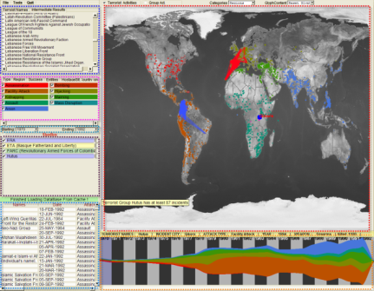
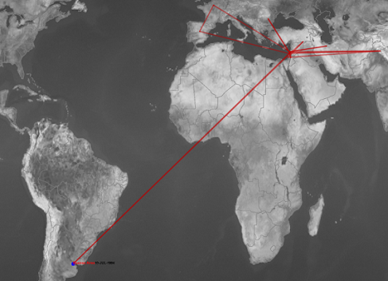
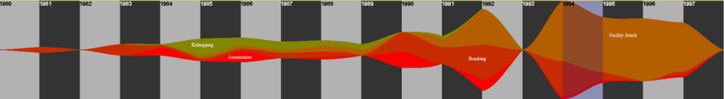
Applications of Visual Analytics
Who
Where
Political Simulation
  Agent-based analysis
  With DARPA
Global Terrorism Database
  With DHS
Bridge Maintenance
  With US DOT
  Exploring inspection reports
Biomechanical Motion
  Interactive motion comparison
What
Evidence
Box
Original
Data
When
R. Chang et al., Investigative Visual Analysis of Global Terrorism, Journal of Computer Graphics Forum, 2008.

Slide 9



Applications of Visual Analytics
Political Simulation
  Agent-based analysis
  With DARPA
Global Terrorism Database
  With DHS
Bridge Maintenance
  With US DOT
  Exploring inspection reports
Biomechanical Motion
  Interactive motion comparison
R. Chang et al., An Interactive Visual Analytics System for Bridge Management, Journal of Computer Graphics Forum, 2010. To Appear.

Slide 10



Applications of Visual Analytics
Political Simulation
  Agent-based analysis
  With DARPA
Global Terrorism Database
  With DHS
Bridge Maintenance
  With US DOT
  Exploring inspection reports
Biomechanical Motion
  Interactive motion comparison
R. Chang et al., Interactive Coordinated Multiple-View Visualization of Biomechanical Motion Data, IEEE Vis (TVCG) 2009.

Slide 11
Talk Outline
Discuss 4 Visual Analytics problems from a User-Centric perspective:
  One optimal visualization for every user?
  Does the user always behave the same with a visualization?
  Can a user’s reasoning process be recorded and stored?
  Can such reasoning processes and knowledge be expressed quantitatively?

Slide 12
1. Is there an optimal visualization?
How personality influences
compatibility with visualization style

Slide 13
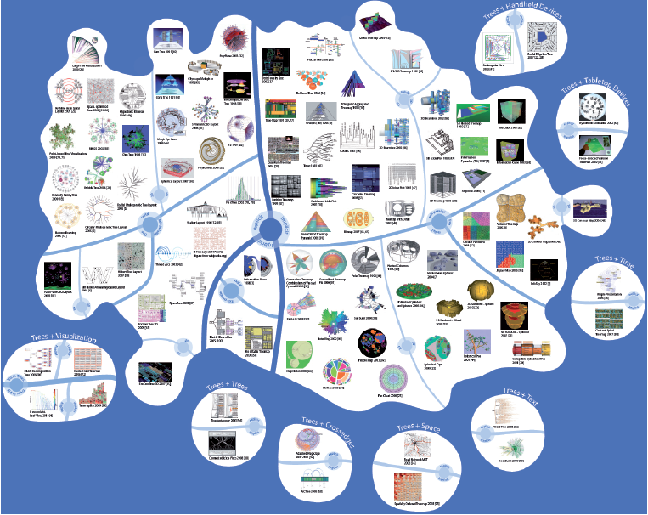
What’s the Best Visualization for You?
Jürgensmann and Schulz, “Poster: A Visual Survey of Tree Visualization”. InfoVis, 2010.

Slide 14
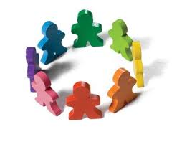
What’s the Best Visualization for You?
Intuitively, not everyone is created equal.
  Our background, experience, and personality should affect how we perceive and understand information.
So why should our visualizations be the same for all users?

Slide 15
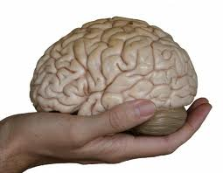
Cognitive Profile
Objective: to create personalized information visualizations based on individual differences
Hypothesis: cognitive factors affect a person’s ability (speed and accuracy) in using different visualizations.

Slide 16
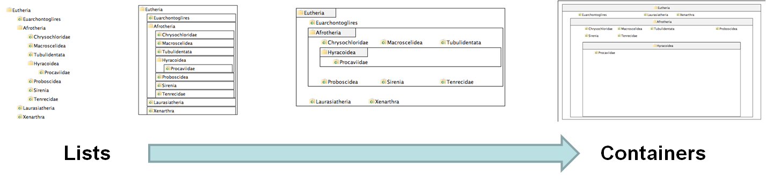
Experiment Procedure
4 visualizations on hierarchical visualization
  From list-like view to containment view
250 participants using Amazon’s Mechanical Turk
Questionnaire on “locus of control” (LOC)
  Definition of LOC: the degree to which a person attributes outcomes to themselves (internal LOC) or to outside forces (external LOC)
V1
V2
V3
V4
R. Chang et al., How Locus of Control Influences Compatibility with Visualization Style, IEEE VAST 2011.

Slide 17
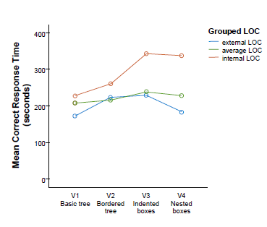
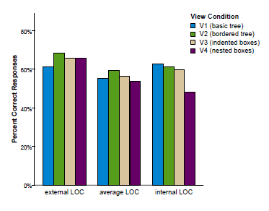
Results
When with list view compared to containment view, internal LOC users are:
  faster (by 70%)
  more accurate (by 34%)
Only for complex (inferential) tasks
The speed improvement is about 2 minutes (116 seconds)

Slide 18
Conclusion
Cognitive factors can affect how a user perceives and understands information from using a visualization
The effect could be significant in terms of both efficiency and accuracy
Design Implications: Personalized displays should take into account a user’s cognitive profile

Slide 19
2. WHAT??
Is the relationship between LOC
and visual style coincidental or dependent?

Slide 20
What We Know About LOC and Visualization:
Performance
Good
External LOC
Average LOC
Internal LOC
Poor
Visual Form
List-View (V1)
Containment (V4)

Slide 21
We Also Know:
Based on Psychology research, we know that locus of control can be temporarily affected through priming
For example, to reduce locus of control (to make someone have a more external LOC)
  “We know that one of the things that influence how well you can do everyday tasks is the number of obstacles you face on a daily basis. If you are having a particularly bad day today, you may not do as well as you might on a day when everything goes as planned. Variability is a normal part of life and you might think you can’t do much about that aspect. In the space provided below, give 3 examples of times when you have felt out of control and unable to achieve something you set out to do. Each example must be at least 100 words long.”

Slide 22
Research Question
Known Facts:
  There is a relationship between LOC and use of visualization
  LOC can be primed
Research Question:
  If we can affect the user’s LOC, will that affect their use of visualization?
Hypothesis:
  If yes, then the relationship between LOC and visualization style is dependent
  If no, then we claim that LOC is a stable indicator of a user’s visualization style
=>Publication!
=>Publication!

Slide 23
LOC and Visualization
Performance
Good
External LOC
Condition 1:
Make Internal LOC more like External LOC
Average LOC
Internal LOC
Poor
Visual Form
List-View (V1)
Containment (V4)

Slide 24
LOC and Visualization
Performance
Good
External LOC
Condition 2:
Make External LOC more like Internal LOC
Average LOC
Internal LOC
Poor
Visual Form
List-View (V1)
Containment (V4)

Slide 25
LOC and Visualization
Performance
Good
Condition 3:
Make 50% of the Average LOC more like Internal LOC
Condition 4:
Make 50% of the Average LOC more like External LOC
External LOC
Average LOC
Internal LOC
Poor
Visual Form
List-View (V1)
Containment (V4)

Slide 26
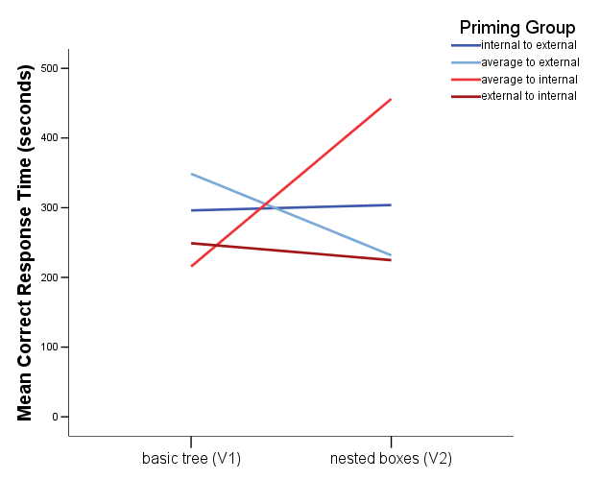
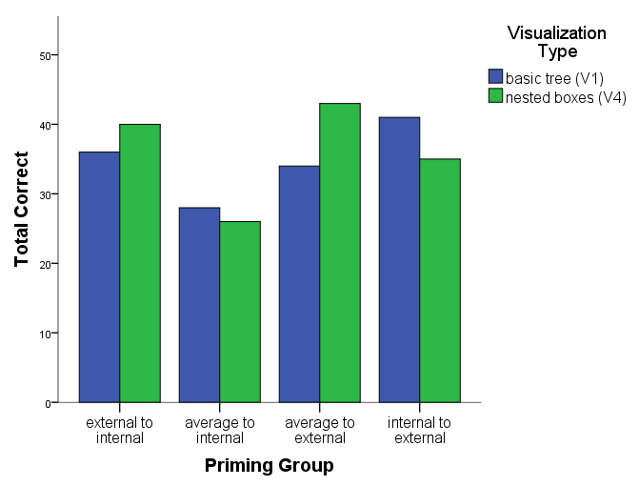
Result
Yes, users behaviors can be altered by priming their LOC! However, this is only true for:
  Speed (less so for accuracy)
  Only for complex tasks (inferential tasks)

Slide 27
Effects of Priming (Condition 3)
Performance
Good
External LOC
Average -> External
Average LOC
Internal LOC
Poor
Visual Form
List-View (V1)
Containment (V4)

Slide 28
Effects of Priming (Condition 4)
Performance
Good
External LOC
Average LOC
Average ->Internal
Internal LOC
Poor
Visual Form
List-View (V1)
Containment (V4)

Slide 29
Effects of Priming (Condition 1)
Performance
Good
External LOC
Average LOC
Internal->External
Internal LOC
Poor
Visual Form
List-View (V1)
Containment (V4)

Slide 30
Effects of Priming (Condition 2)
Performance
Good
External LOC
Average LOC
External -> Internal
Internal LOC
Poor
Visual Form
List-View (V1)
Containment (V4)

Slide 31
Conclusion
The relationship between Locus of Control and visualization style appears to be causal: by priming a user’s LOC, we an alter their behavior with a visualization in a deterministic manner.
Future work: examine if the interaction patterns are different between the LOC groups.
  Can train machine learning models to learn a personality profile based on interaction pattern.
  Sell the software to Google!
Implications to (a) evaluations of visualizations, and (b) designing visual interfaces.

Slide 32
3. What’s In a User’s Interactions?
How much of a user’s reasoning can be recovered from the interaction log?

Slide 33

What is in a User’s Interactions?
Keyboard, Mouse, etc
Visualization
Input
Human
Output
Images (monitor)
Types of Human-Visualization Interactions
  Word editing (input heavy, little output)
  Browsing, watching a movie (output heavy, little input)
  Visual Analysis (closer to 50-50)
Challenge:
  Can we capture and extract a user’s reasoning and intent through capturing a user’s interactions?

Slide 34
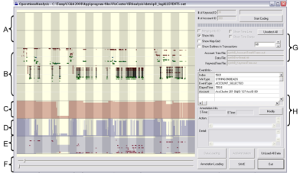
What is in a User’s Interactions?
Goal: determine if a user’s reasoning and intent are reflected in a user’s interactions.
Grad
Students
(Coders)
Analysts
Compare!
(manually)
Strategies
Methods
Findings
Guesses of
Analysts’ thinking
Logged
(semantic)
Interactions
WireVis
Interaction-Log Vis

Slide 35
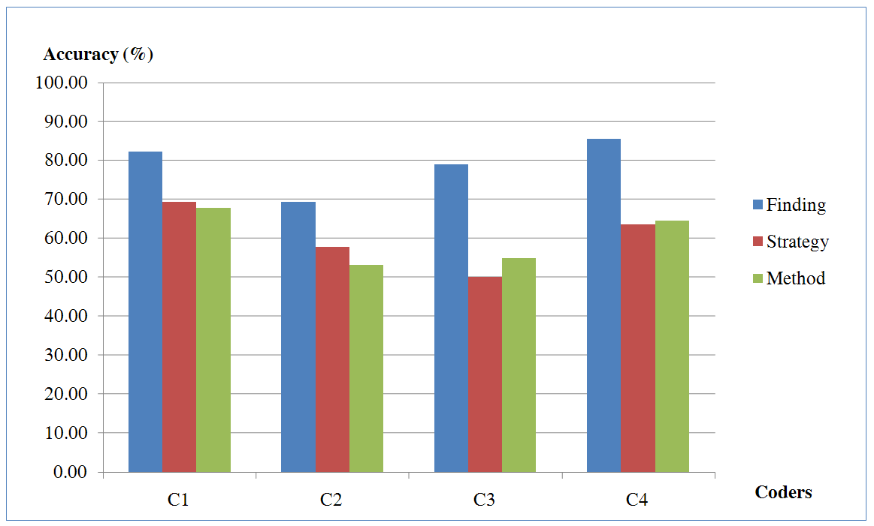
What’s in a User’s Interactions
From this experiment, we find that interactions contains at least:
  60% of the (high level) strategies
  60% of the (mid level) methods
  79% of the (low level) findings
R. Chang et al., Recovering Reasoning Process From User Interactions. CG&A, 2009.
R. Chang et al., Evaluating the Relationship Between User Interaction and Financial Visual Analysis. VAST, 2009.

Slide 36
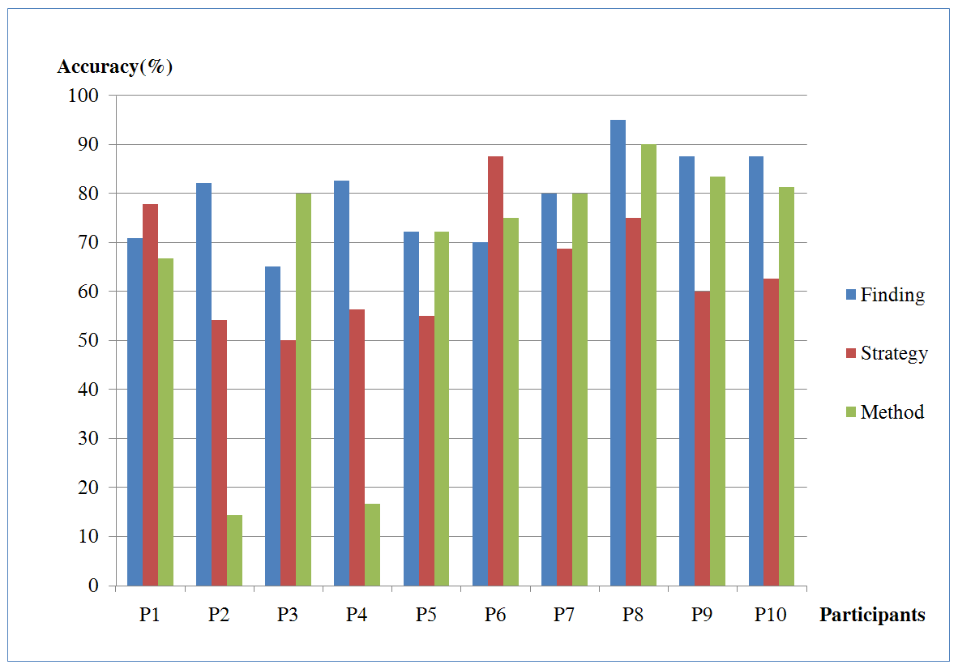
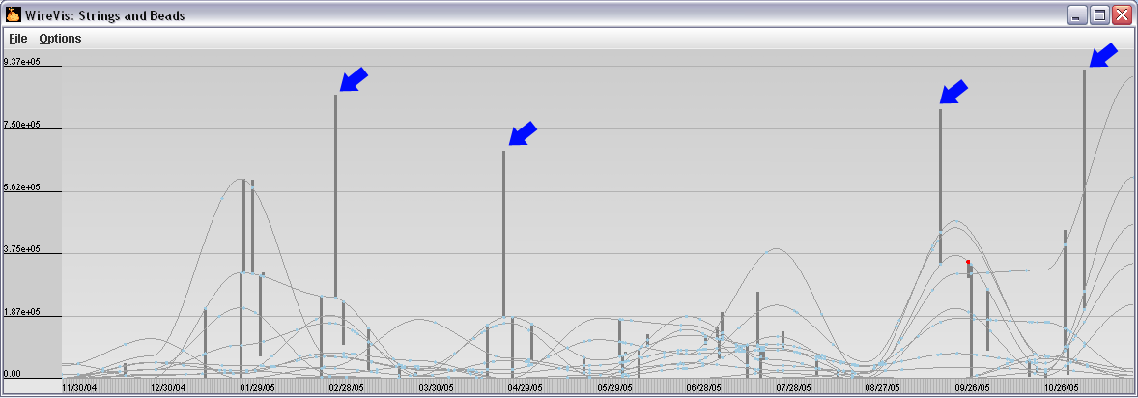
What’s in a User’s Interactions
Why are these so much lower than others?
  (recovering “methods” at about 15%)
Only capturing a user’s interaction in this case is insufficient.

Slide 37
Conclusion
A high percentage of a user’s reasoning and intent are reflected in a user’s interactions.
Raises lots of question: (a) what is the upper-bound, (b) how to automate the process, (c) how to utilize the captured results
This study is not exhaustive. It merely provides a sample point of what is possible.
R. Chang et al., Analytic Provenance Panel at IEEE VisWeek. 2011
R. Chang et al., Analytic Provenance Workshop at CHI. 2011

Slide 38
4. If Interaction Logs Contain Knowledge…
Can domain knowledge be captured and represented quantitatively?

Slide 39
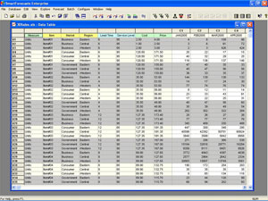
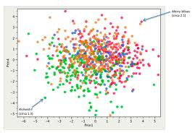
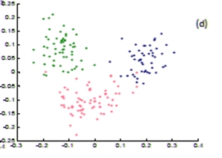
Find Distance Function, Hide Model Inference
Observation: Domain experts do not know how to visualize their own data, but knows it when a visualization looks “wrong”.
More importantly, they often know why it looks wrong

Slide 40
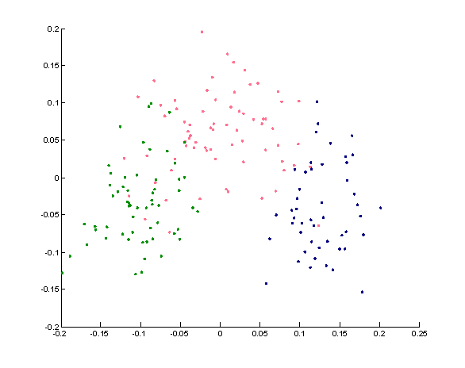
Working with Domain Experts
Common practice: the visualization expert modifies the visualization and asks for the domain expert’s opinion.
  Repeat cycle
  …Publish results
Question: why can’t the domain expert “fix” the visualization themselves by interacting with the visualization directly?

Slide 41
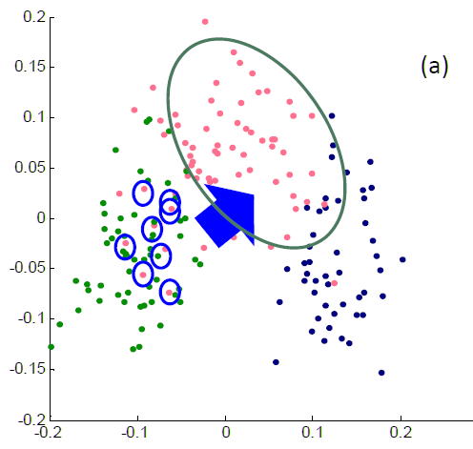
Direct Manipulation of Visualization
We have developed a system that allows the expert to directly move the elements of the visualization to what they think is “right”.
We start by “guessing” a distance function, and ask the user to move the points to the “right” place

Slide 42
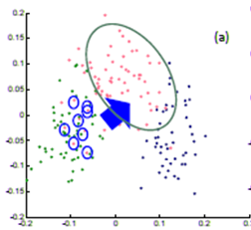
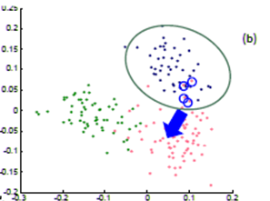
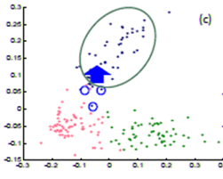
Direct Manipulation of Visualization
The process is repeated a few times…
Until the expert is happy (or the visualization can not be improved further)
The system outputs a new distance function!

Slide 43

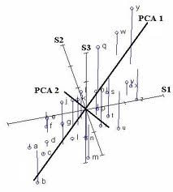
Our Approach
We start with a standard high-D to 2D visualization method using Principal Component Analysis (PCA).
  Input to PCA is a distance matrix
  Meaning that we need to assume a distance function
At t=0, the system assumes the weights to the distance function. We call these weights (Θ⁰). The system creates a visualization
Then the user updates the visualization…
Data
Distance Function (Θ ⁰)
2D Visualization
(t=0)
Principal Component Analysis

Slide 44
Our Approach
At t=1, we look to update our model to (Θ¹) based on the layout that the user created.
We notice that the data is immutable, the PCA cannot be inverted. But we could update the weights to the distance function.
We use a standard gradient descent method to find a set of weights (Θ¹) that best satisfies the layout
Then we repeat the process
Data
Distance Function (Θ ¹)
2D Visualization
(t=1)
Principal Component Analysis

Slide 45
Our Approach
At t=2, we want to use the newly-found set of weights (Θ¹) to create a new visualization.
We do that by using (Θ¹) to compute the distance matrix, which feeds into PCA, and results in a new visualization layout.
This process is iterated until the user finds a satisfactory layout, or the system cannot improve its answer any further.
Data
Distance Function (Θ ¹)
2D Visualization
(t=2)
Principal Component Analysis

Slide 46
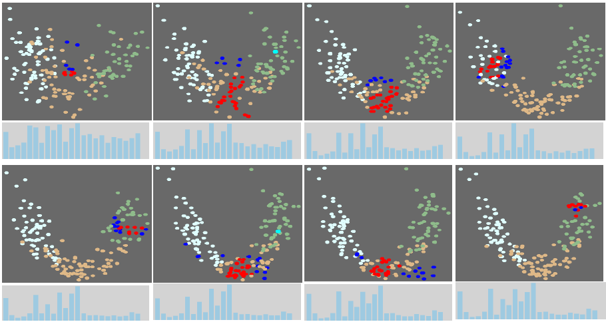
Results
Tells the domain expert what dimension of data they care about, and what dimensions are not useful!

Slide 47
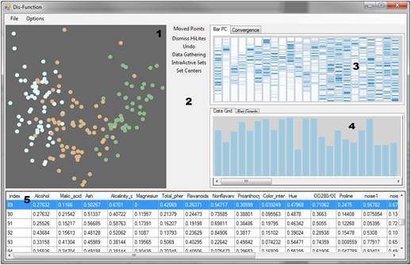

Our Current Implementation
Linear distance
function:
Optimization:

Slide 48
Conclusion
With an appropriate projection model, it is possible to quantify a user’s interactions.
In our system, we let the domain expert interact with a familiar representation of the data (scatter plot), and hides the ugly math (distance function)
The system learns the weights of the distance function. The resulting function reflects the expert’s mental model of the dataset.
Many machine learning algorithms require a valid distance function. We see our system being the “first step” to many visual analytics systems.
R. Chang et al., Find Distance Function, Hide Model Inference. IEEE VAST Poster 2011

Slide 49
Summary

Slide 50

Summary
While Visual Analytics have grown and is slowly finding its identity,
There is still many open problems that need to be addressed.
I propose that one research area that has largely been unexplored is in the understanding and supporting of the human user.

Slide 51
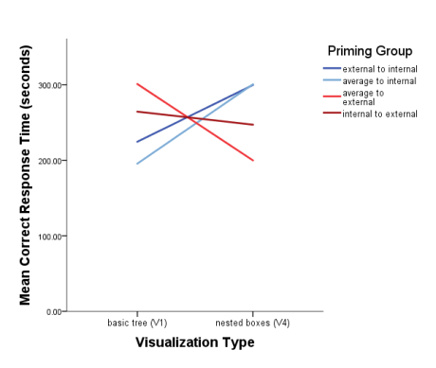
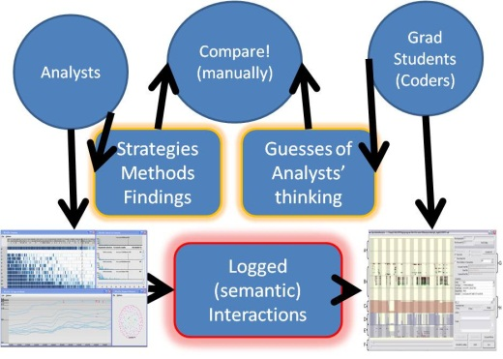
Summary
Is there a best visualization for each user?
  Possibly, through understanding individual differences
Can the user’s behavior with a visualization be altered?
  Yes, priming LOC affects a user’s behavior with a visualization
What is in a user’s interactions?
  A great deal of a user’s reasoning process can be recovered through analyzing a user’s interactions
Can domain knowledge be externalized quantitatively?
  Yes, given some assumptions about the visualization, a user can interactively externalize their knowledge quantitatively.

Slide 52

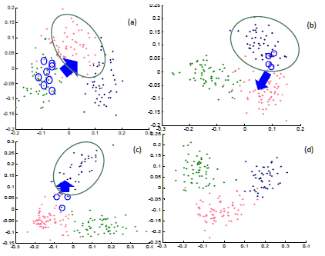

Slide 53
Backup Slides…

Slide 54
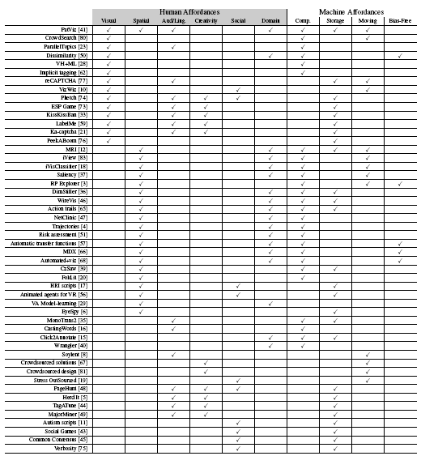
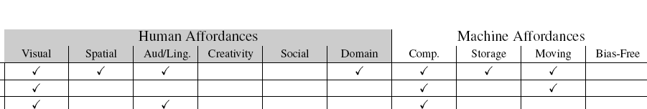
Human Complexity
Surveyed 1,200+ papers from CHI, IUI, KDD, Vis, InfoVis, VAST
Found 49 relating to human + computer collaboration
Using a model of human and computer affordances, examined each of the projects to identify what “works” and what could be missing

Slide 55
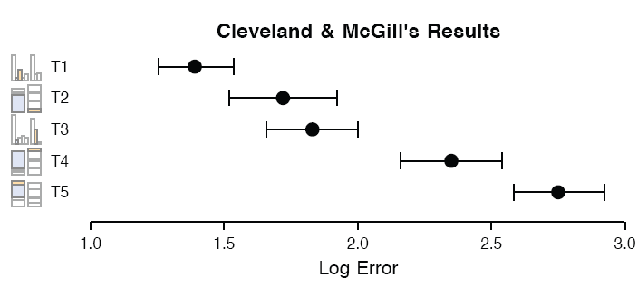
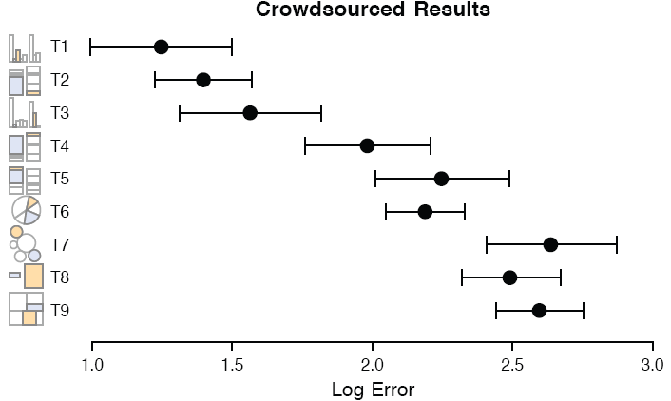
Visual Judgment
Cleveland and McGill study on perception of angle vs. position in statistical charts. (1984)
  Indicates that humans are better at judging length (in bar graph) than angles (in pie chart)
Heer and Bostock extension to using Amazon’s Mechanical Turk (2010)
  Replicated Cleveland-McGill and show that Turk is feasible for perceptual experiments

Slide 56
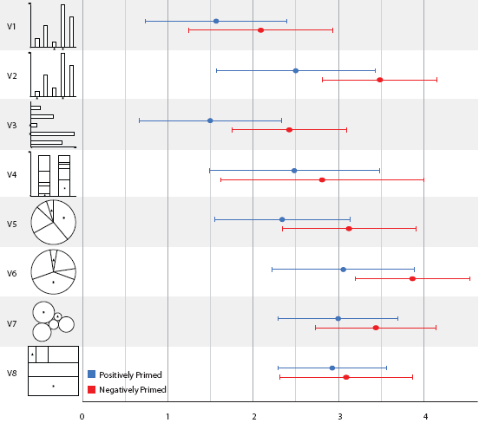
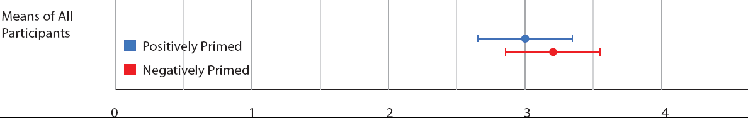
Visual Judgment
We introduced affective-priming to Heer-Bostock and found significance in how positively-primed subjects perform better in visual judgment.
  Priming was introduced through text (verbal priming).
  Uplifting and discouraging stories found on NY Times

Slide 57
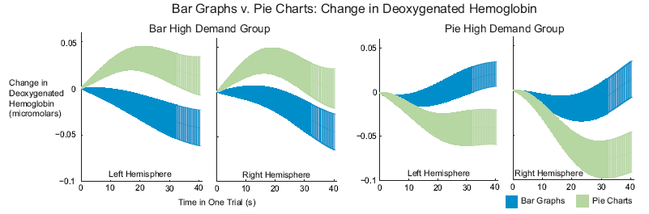
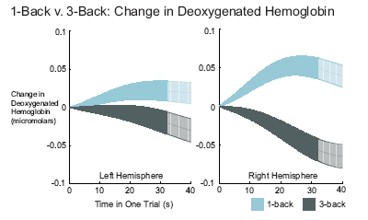
fNIRS with Visualizations
Bar graphs have been shown to be better than pie charts for visual judgment. Why are pie charts everywhere?
  Increasing workload in n-back tests
  Mental workload difference

Slide 58
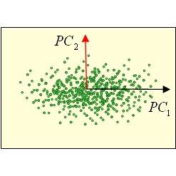
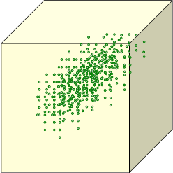
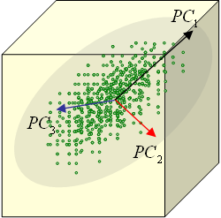
Human + Computer:
Dimension Reduction – Lost in Translation
Dimension reduction using principle component analysis (PCA)
Quick Refresher of PCA
  Find most dominant eigenvectors as principle components
  Data points are re-projected into the new coordinate system
    For reducing dimensionality
    For finding clusters
For many (especially novices), PCA is easy to understand mathematically, but difficult to understand “semantically”.
height
0.5*GPA + 0.2*age + 0.3*height = ?
GPA
age

Slide 59
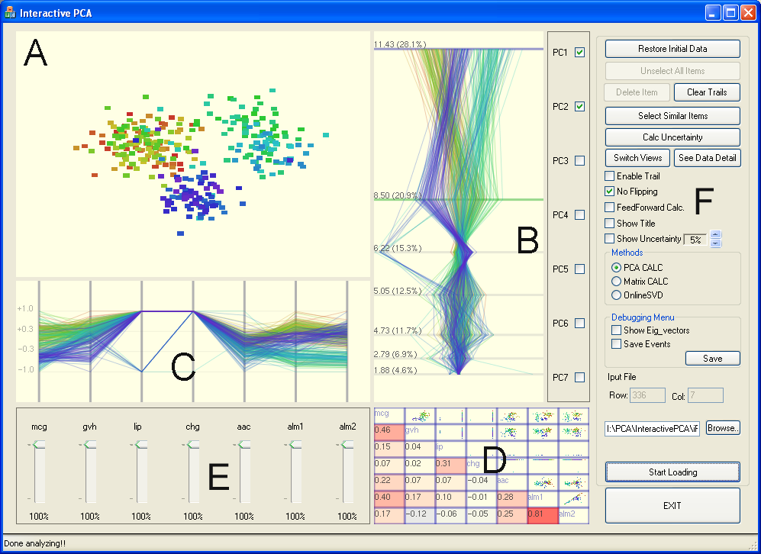
Human + Computer:
Exploring Dimension Reduction: iPCA
R. Chang et al., iPCA: An Interactive System for PCA-based Visual Analytics. Computer Graphics Forum (Eurovis), 2009.

Slide 60
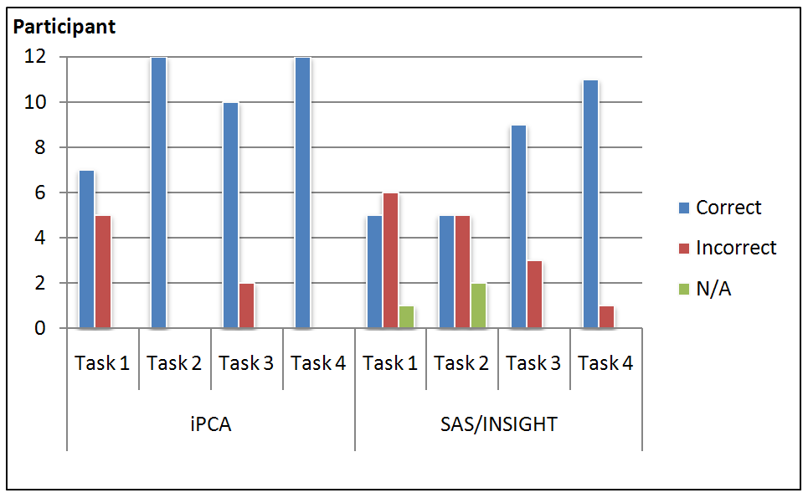
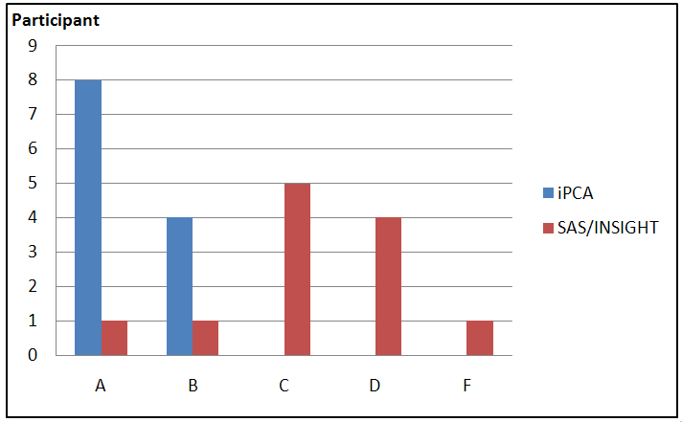
Human + Computer:
Comparing iPCA to SAS/INSIGHT
Results
  Users seem to understand the intuition behind PCA better
  A bit more accurate
  Not faster
  People don’t “give up”
Overall preference
  Using letter grades (A through F) with “A” representing excellent and F a failing grade.
Problem is worse with non-linear dimension reduction
  A lot more work needs to be done…

Slide 61
4. How to Aggregate Multiple Analysis
To Perform Group Analytics

Slide 62
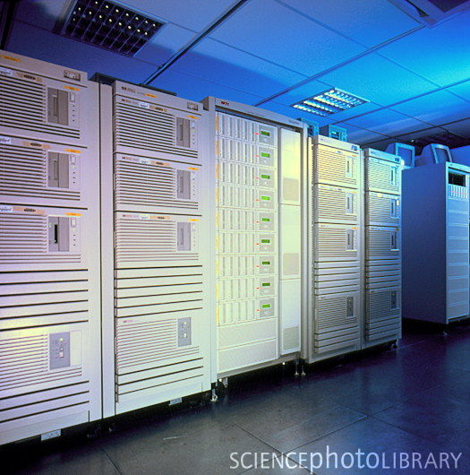
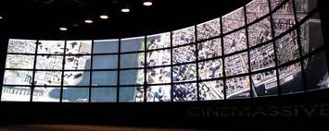
Scaling Human Computation
Problem Statement: Computing can be scaled (by adding more CPUs). Visualizations can be scaled (by adding more monitors). Can analysis be scaled by adding more humans?
Assumption: Conventional wisdom says that humans cannot be scaled because of difficulty in communicating analytical reasoning efficiently.

Slide 63
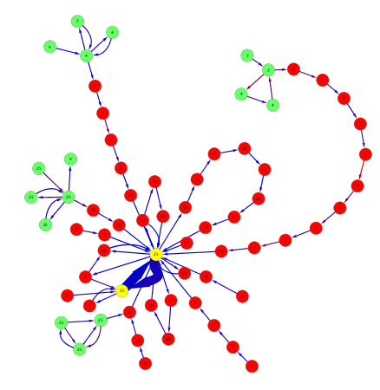
Temporal Graph
Research Proposal: We propose a Temporal Graph approach to model analytical trails. In a temporal graph,
  Node = a unique state in the visual analysis trail.
  Edge = a (temporal) transition from one state to another.

Slide 64


For Example:
2 analysts, A and B, each performed an analysis on the same data
A0
A1
A2
A3
A4
A5
B0
B1
B2
B3
B4

Slide 65
For Example:
If A2 is the same as B1 (in that they represent the same analysis step)…
A0
A1
A3
A4
A5
A2
B1
B0
B2
B3
B4

Slide 66
For Example:
We will merge the two nodes
A0
A1
A3
A4
A5
A2
B1
B0
B2
B3
B4

Slide 67
For Example
This process is repeated for all analysis trails across all analysts, and we could get a temporal graph that look like:

Slide 68
With a Temporal Graph…
We can answer many questions. For example:
  Given a particular outcome (a yellow states), is there a state that is the catalyst in which every subsequent analysis trail start from?
    the answer is yes:
    The red states are “points of no return”
    The green states are the “last decision points”

Slide 69
Conclusion
There are many benefits to posing analysis trails as a temporal graph problem.
Mostly, the benefit comes from our ability to apply known graph algorithms.
Incidentally, this temporal graph formulation can be applied to visualize and analyze other problems involving large state space.
Poster to be presented at VAST 2011

