Slide 1
User-Centric Visual Analytics
Remco Chang
Tufts University
Department of Computer Science

Slide 2
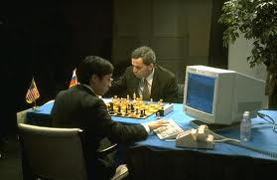
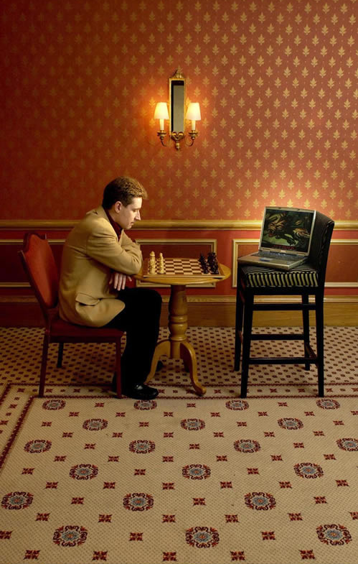
Human + Computer
Human vs. Artificial Intelligence
Garry Kasparov vs. Deep Blue (1997)
  Computer takes a “brute force” approach without analysis
  “As for how many moves ahead a grandmaster sees,” Kasparov concludes: “Just one, the best one”
Artificial vs. Augmented Intelligence
Hydra vs. Cyborgs (2005)
  Grandmaster + 1 chess program > Hydra (equiv. of Deep Blue)
  Amateur + 3 chess programs > Grandmaster + 1 chess program¹
1. http://www.collisiondetection.net/mt/archives/2010/02/why_cyborgs_are.php

Slide 3
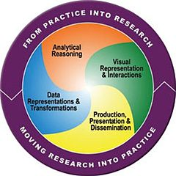
Visual Analytics = Human + Computer
Visual analytics is "the science of analytical reasoning facilitated by visual interactive interfaces.“ ¹
By definition, it is a collaboration between human and computer to solve problems.
1. Thomas and Cook, “Illuminating the Path”, 2005.

Slide 4
Example: What Does (Wire) Fraud Look Like?
Financial Institutions like Bank of America have legal responsibilities to report all suspicious wire transaction activities (money laundering, supporting terrorist activities, etc)
Data size: approximately 200,000 transactions per day (73 million transactions per year)
Problems:
  Automated approach can only detect known patterns
  Bad guys are smart: patterns are constantly changing
  Data is messy: lack of international standards resulting in ambiguous data
Current methods:
  10 analysts monitoring and analyzing all transactions
  Using SQL queries and spreadsheet-like interfaces
  Limited time scale (2 weeks)

Slide 5
WireVis: Financial Fraud Analysis
In collaboration with Bank of America
  Develop a visual analytical tool (WireVis)
  Visualizes 7 million transactions over 1 year
  Beta-deployed at WireWatch
A new class of computer science problem:
  Little or no data to train on
  The data is messy and requires human intelligence
Design philosophy: “combating human intelligence requires better (augmented) human intelligence”
R. Chang et al., Scalable and interactive visual analysis of financial wire transactions for fraud detection. Information Visualization,2008.
R. Chang et al., Wirevis: Visualization of categorical, time-varying data from financial transactions. IEEE VAST, 2007.

Slide 6
WireVis: A Visual Analytics Approach
Search by Example (Find Similar Accounts)
Heatmap View
(Accounts to Keywords Relationship)
Keyword Network
(Keyword Relationships)
Strings and Beads
(Relationships over Time)

Slide 7




Applications of Visual Analytics
Political Simulation
  Agent-based analysis
  With DARPA
Global Terrorism Database
  With DHS
Bridge Maintenance
  With US DOT
  Exploring inspection reports
Biomechanical Motion
  Interactive motion comparison
R. Chang et al., Two Visualization Tools for Analysis of Agent-Based Simulations in Political Science. IEEE CG&A, 2012

Slide 8
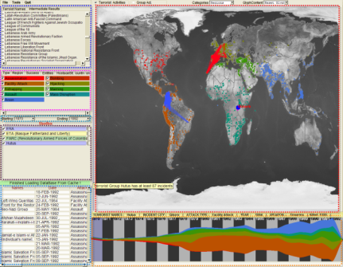
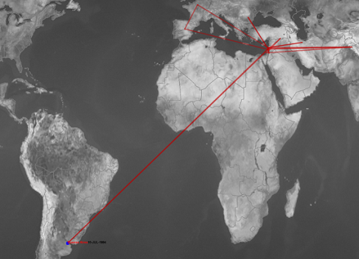
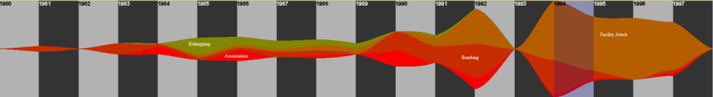
Applications of Visual Analytics
Who
Where
Political Simulation
  Agent-based analysis
  With DARPA
Global Terrorism Database
  With DHS
Bridge Maintenance
  With US DOT
  Exploring inspection reports
Biomechanical Motion
  Interactive motion comparison
What
Evidence
Box
Original
Data
When
R. Chang et al., Investigative Visual Analysis of Global Terrorism, Journal of Computer Graphics Forum, 2008.

Slide 9



Applications of Visual Analytics
Political Simulation
  Agent-based analysis
  With DARPA
Global Terrorism Database
  With DHS
Bridge Maintenance
  With US DOT
  Exploring inspection reports
Biomechanical Motion
  Interactive motion comparison
R. Chang et al., An Interactive Visual Analytics System for Bridge Management, Journal of Computer Graphics Forum, 2010. To Appear.

Slide 10



Applications of Visual Analytics
Political Simulation
  Agent-based analysis
  With DARPA
Global Terrorism Database
  With DHS
Bridge Maintenance
  With US DOT
  Exploring inspection reports
Biomechanical Motion
  Interactive motion comparison
R. Chang et al., Interactive Coordinated Multiple-View Visualization of Biomechanical Motion Data, IEEE Vis (TVCG) 2009.

Slide 11

VALT Research Projects
Analysis -- Jordan Crouser:
  Human + Computer computation
  Network (political science) analysis
Visualization Design -- Samuel Li & Orkun Ozbek:
  Generative visual designs
  Phylogenetic analysis of visualizations
Interactive Machine Learning -- Eli Brown & Helen Zhao:
  Model learning from user interactions
  Analytic provenance
Individual Differences -- Alvitta Ottley:
  Personality factors and Brain Sensing with fNIRS
  Uncertainty visualization (medical)
Big Data -- Leilani Battle (MIT) & Liz Salowitz:
  Interactive DB Visualization & Exploration (collaboration with MIT)

Slide 12
Analysis (Jordan Crouser)
1. Human + Computer Computation:
Can The Two Complement Each Other?

Slide 13
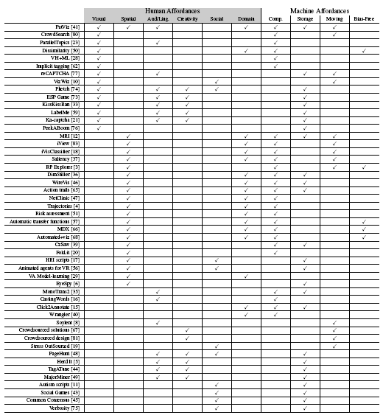
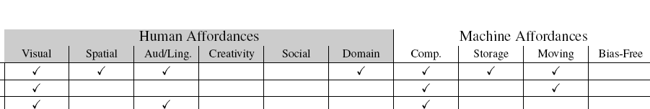
Understanding Human Complexity
Surveyed 1,200+ papers from CHI, IUI, KDD, Vis, InfoVis, VAST
Found 49 relating to human + computer collaboration
Using a model of human and computer affordances, examined each of the projects to identify what “works” and what could be missing
Joint work with Jordan Couser. An affordance-based framework for human computation and human-computer collaboration.
IEEE VAST 2012. To Appear

Slide 14
Visualization Design (Samuel Li / Orkun Ozbek)
2. Space of Visualization Designs:
How Novel Is Your Visualization?

Slide 15
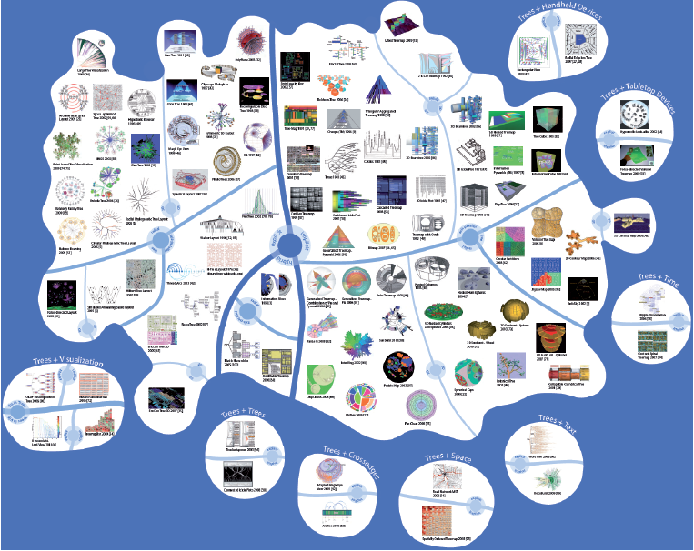
How Similar Are These Visualizations?
Jürgensmann and Schulz, “Poster: A Visual Survey of Tree Visualization”. InfoVis, 2010.

Slide 16
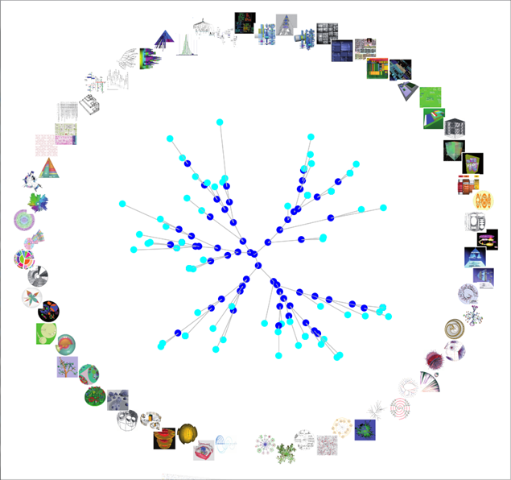

Slide 17
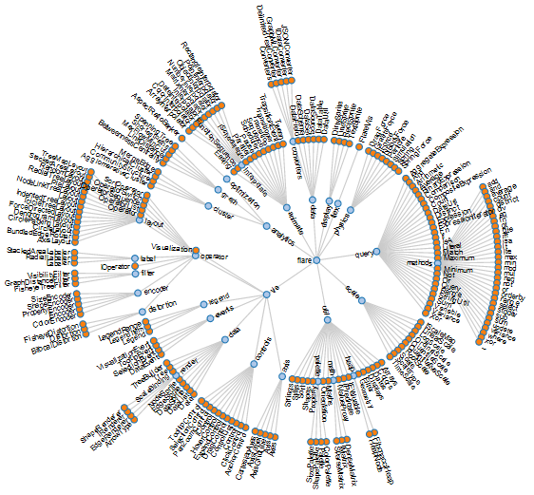
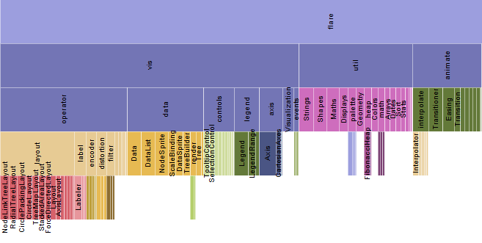
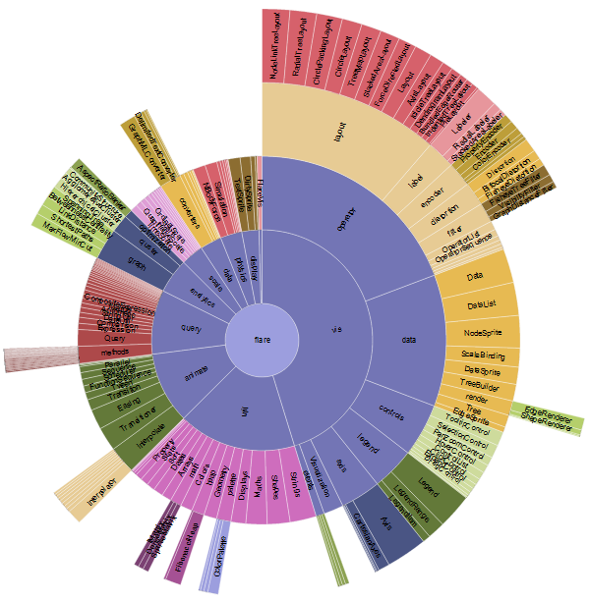
Visualization Transforms?

Slide 18
Interactive Machine Learning (Eli Brown)
3. Interactive Model Learning:
Can Knowledge be Represented Quantitatively?

Slide 19

Iterative Interactive Analysis

Slide 20
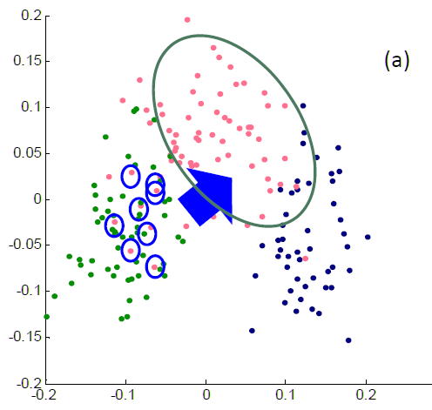


Direct Manipulation of Visualization
Linear distance function:
Optimization:

Slide 21
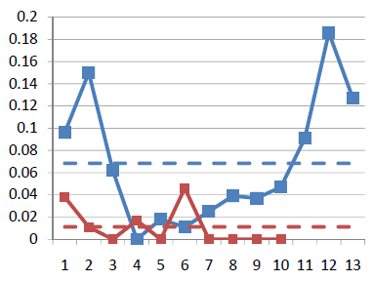
Results
Blue: original data dimension
Red: randomly added dimensions
X-axis: dimension number
Y-axis: final weights of the distance function
Using the “Wine” dataset (13 dimensions, 3 clusters)
  Assume a linear (sum of squares) distance function
Added 10 extra dimensions, and filled them with random values
Tells the users what dimension of data they care about, and what dimensions are not useful!

Slide 22
Individual Differences (Alvitta Ottley)
4. A User’s Cognitive Traits & States,
Experiences & Biases:
How To Identify The End User’s Needs?

Slide 23
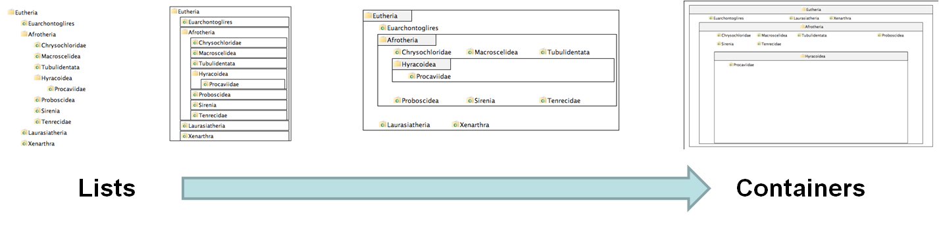
Experiment Procedure
4 visualizations on hierarchical visualization
  From list-like view to containment view
250 participants using Amazon’s Mechanical Turk
Questionnaire on “locus of control” (LOC)
  Definition of LOC: the degree to which a person attributes outcomes to themselves (internal LOC) or to outside forces (external LOC)
V1
V2
V3
V4
R. Chang et al., How Locus of Control Influences Compatibility with Visualization Style, IEEE VAST 2011.

Slide 24
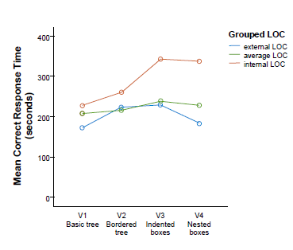
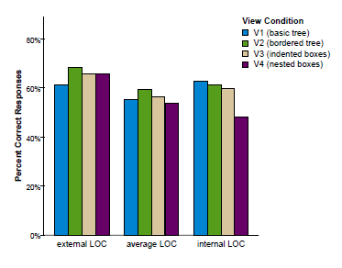
Results
Personality Factor: Locus of Control
  (internal => faster/better with containment)
  (external => faster/better with list)

Slide 25
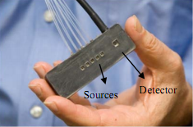
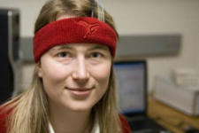
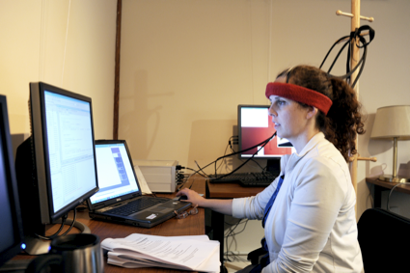
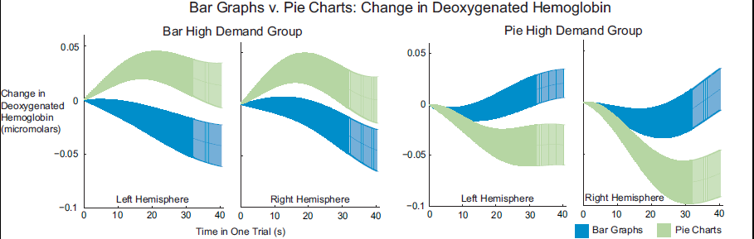
Using Brain Sensing

Slide 26
Big Data (Leilani Battle (MIT) & Liz Salowitz)
5. Interactive Exploration of Large Databases:
Big Database, Small Laptop,
Can a User Interact with Big Data in Real Time?

Slide 27
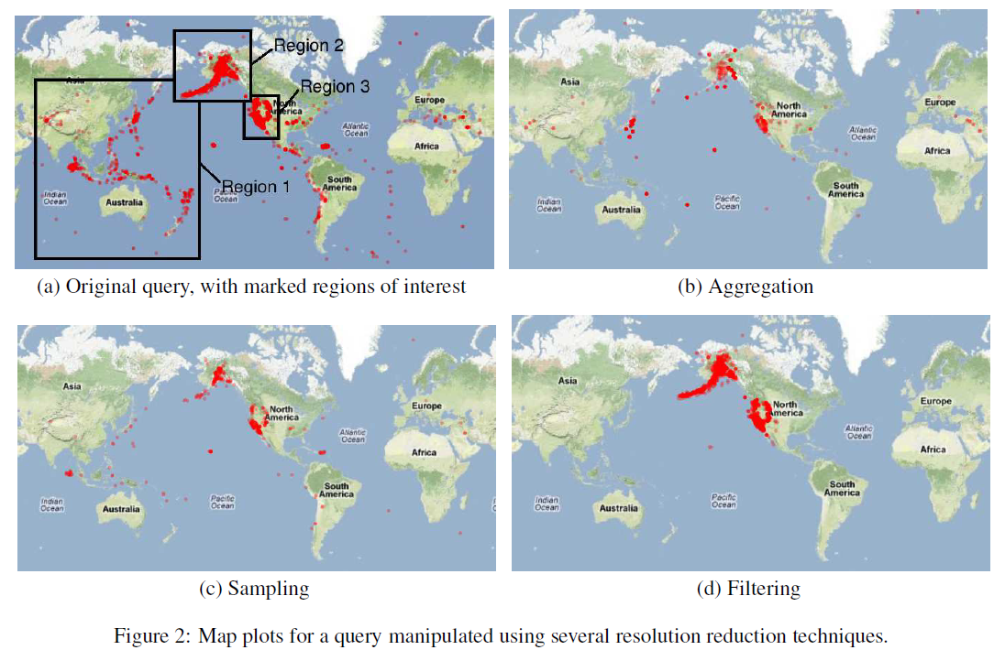
Strategies for Real Time DB Visualization

Slide 28
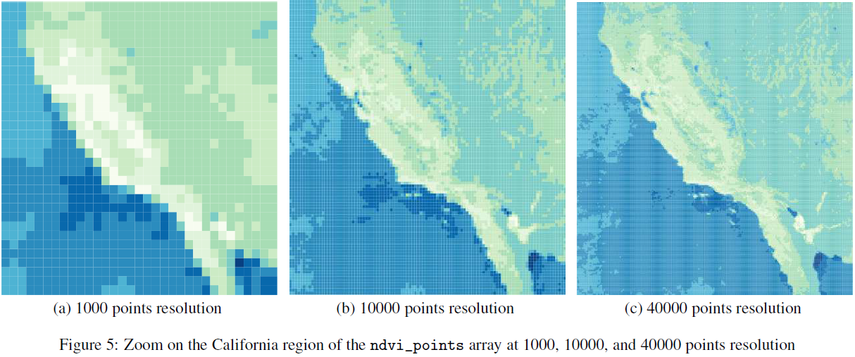
Using SciDB

Slide 29
Analytic Provenance (??)
6. Analyzing User’s Interactions:
Do Interaction Logs Contain Knowledge?

Slide 30
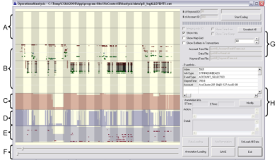
What is in a User’s Interactions?
Goal: determine if a user’s reasoning and intent are reflected in a user’s interactions.
Grad
Students
(Coders)
Analysts
Compare!
(manually)
Strategies
Methods
Findings
Guesses of
Analysts’ thinking
Logged
(semantic)
Interactions
WireVis
Interaction-Log Vis

Slide 31
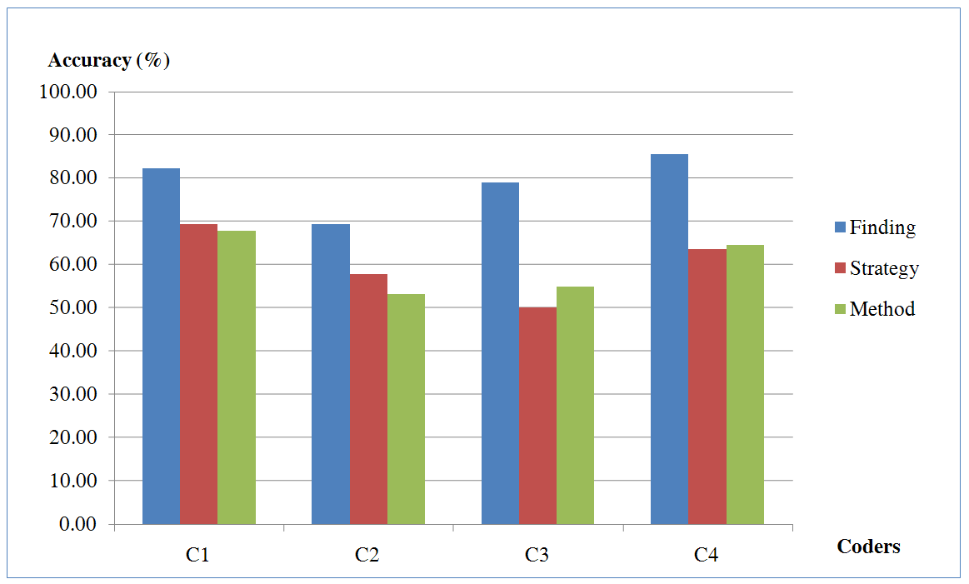
What’s in a User’s Interactions
From this experiment, we find that interactions contains at least:
  60% of the (high level) strategies
  60% of the (mid level) methods
  79% of the (low level) findings
R. Chang et al., Recovering Reasoning Process From User Interactions. CG&A, 2009.
R. Chang et al., Evaluating the Relationship Between User Interaction and Financial Visual Analysis. VAST, 2009.

Slide 32
Summary

Slide 33

Summary
While Visual Analytics have grown and is slowly finding its identity,
There is still many open problems that need to be addressed.
I propose that one research area that has largely been unexplored is in the understanding and supporting of the human user.

Slide 34
