Slide 1
User-Centric Visual Analytics
Remco Chang
Tufts University
Department of Computer Science

Slide 2
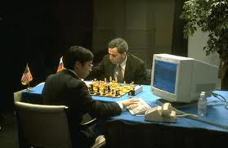
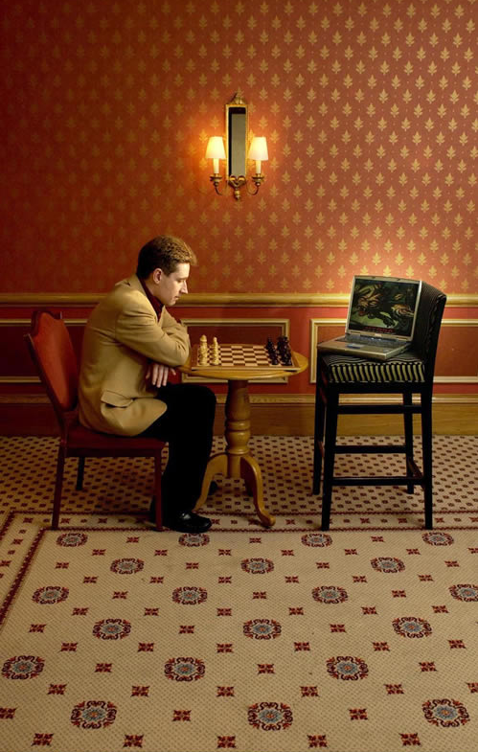
Human + Computer
Human vs. Artificial Intelligence
Garry Kasparov vs. Deep Blue (1997)
  Computer takes a “brute force” approach without analysis
  “As for how many moves ahead a grandmaster sees,” Kasparov concludes: “Just one, the best one”
Artificial vs. Augmented Intelligence
Hydra vs. Cyborgs (2005)
  Grandmaster + 1 chess program > Hydra (equiv. of Deep Blue)
  Amateur + 3 chess programs > Grandmaster + 1 chess program¹
1. http://www.collisiondetection.net/mt/archives/2010/02/why_cyborgs_are.php

Slide 3
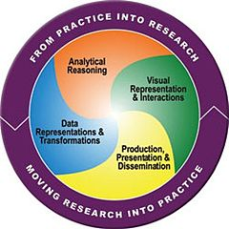
Visual Analytics = Human + Computer
Visual analytics is "the science of analytical reasoning facilitated by visual interactive interfaces.“ ¹
By definition, it is a collaboration between human and computer to solve problems.
1. Thomas and Cook, “Illuminating the Path”, 2005.

Slide 4
Example: What Does (Wire) Fraud Look Like?
Financial Institutions like Bank of America have legal responsibilities to report all suspicious wire transaction activities (money laundering, supporting terrorist activities, etc)
Data size: approximately 200,000 transactions per day (73 million transactions per year)
Problems:
  Automated approach can only detect known patterns
  Bad guys are smart: patterns are constantly changing
  Data is messy: lack of international standards resulting in ambiguous data
Current methods:
  10 analysts monitoring and analyzing all transactions
  Using SQL queries and spreadsheet-like interfaces
  Limited time scale (2 weeks)

Slide 5
WireVis: Financial Fraud Analysis
In collaboration with Bank of America
  Develop a visual analytical tool (WireVis)
  Visualizes 7 million transactions over 1 year
  Beta-deployed at WireWatch
A new class of computer science problem:
  Little or no data to train on
  The data is messy and requires human intelligence
Design philosophy: “combating human intelligence requires better (augmented) human intelligence”
R. Chang et al., Scalable and interactive visual analysis of financial wire transactions for fraud detection. Information Visualization,2008.
R. Chang et al., Wirevis: Visualization of categorical, time-varying data from financial transactions. IEEE VAST, 2007.

Slide 6
WireVis: A Visual Analytics Approach
Search by Example (Find Similar Accounts)
Heatmap View
(Accounts to Keywords Relationship)
Keyword Network
(Keyword Relationships)
Strings and Beads
(Relationships over Time)

Slide 7




Applications of Visual Analytics
Political Simulation
  Agent-based analysis
  With DARPA
Global Terrorism Database
  With DHS
Bridge Maintenance
  With US DOT
  Exploring inspection reports
Biomechanical Motion
  Interactive motion comparison
R. Chang et al., Two Visualization Tools for Analysis of Agent-Based Simulations in Political Science. IEEE CG&A, 2012

Slide 8
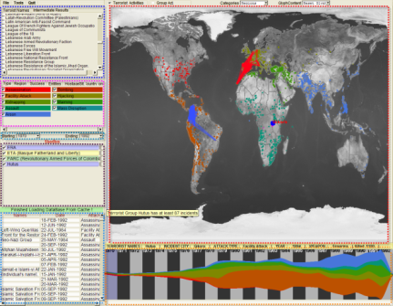
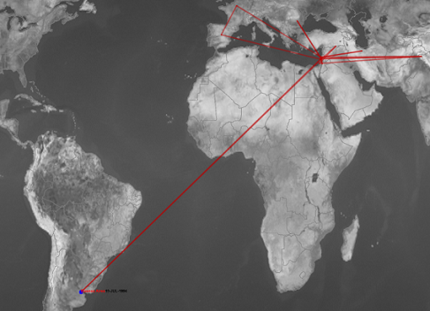
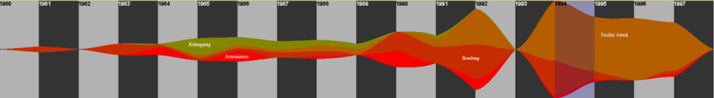
Applications of Visual Analytics
Who
Where
Political Simulation
  Agent-based analysis
  With DARPA
Global Terrorism Database
  With DHS
Bridge Maintenance
  With US DOT
  Exploring inspection reports
Biomechanical Motion
  Interactive motion comparison
What
Evidence
Box
Original
Data
When
R. Chang et al., Investigative Visual Analysis of Global Terrorism, Journal of Computer Graphics Forum, 2008.

Slide 9



Applications of Visual Analytics
Political Simulation
  Agent-based analysis
  With DARPA
Global Terrorism Database
  With DHS
Bridge Maintenance
  With US DOT
  Exploring inspection reports
Biomechanical Motion
  Interactive motion comparison
R. Chang et al., An Interactive Visual Analytics System for Bridge Management, Journal of Computer Graphics Forum, 2010. To Appear.

Slide 10



Applications of Visual Analytics
Political Simulation
  Agent-based analysis
  With DARPA
Global Terrorism Database
  With DHS
Bridge Maintenance
  With US DOT
  Exploring inspection reports
Biomechanical Motion
  Interactive motion comparison
R. Chang et al., Interactive Coordinated Multiple-View Visualization of Biomechanical Motion Data, IEEE Vis (TVCG) 2009.

Slide 11
Talk Outline
Discuss 3 Visual Analytics problems from a User-Centric perspective:
  One optimal visualization for every user?
  Can a user’s reasoning process be recorded and stored?
  Can such reasoning processes and knowledge be expressed quantitatively?

Slide 12
1. Analysis of Visualization Designs:
Is there an optimal visualization?

Slide 13
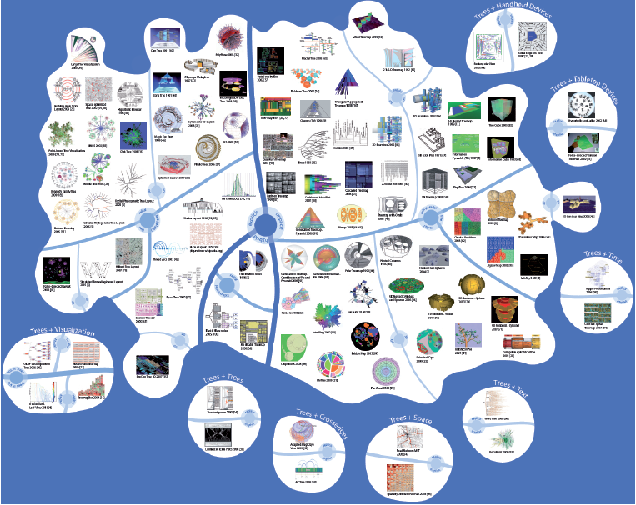
What’s the Best Visualization for You?
Jürgensmann and Schulz, “Poster: A Visual Survey of Tree Visualization”. InfoVis, 2010.

Slide 14
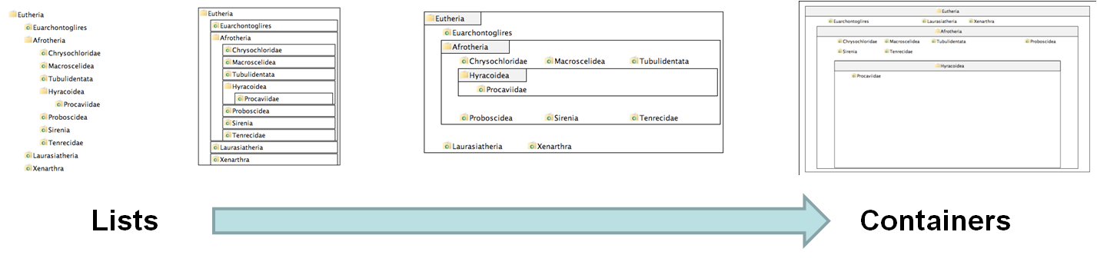
Experiment Procedure
4 visualizations on hierarchical visualization
  From list-like view to containment view
250 participants using Amazon’s Mechanical Turk
Questionnaire on “locus of control” (LOC)
  Definition of LOC: the degree to which a person attributes outcomes to themselves (internal LOC) or to outside forces (external LOC)
V1
V2
V3
V4
R. Chang et al., How Locus of Control Influences Compatibility with Visualization Style, IEEE VAST 2011.

Slide 15
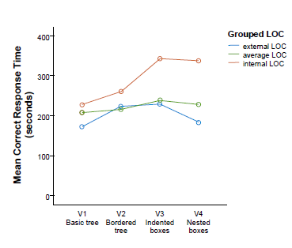
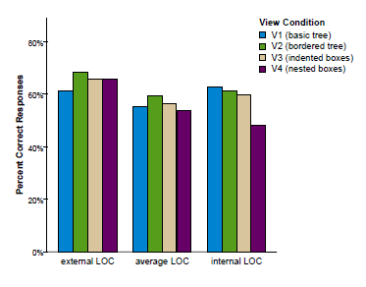
Results
Personality Factor: Locus of Control
  (internal => faster/better with containment)
  (external => faster/better with list)

Slide 16
2. Study of Expert Users’ Interactions:
Does Interaction Logs Contain Knowledge?

Slide 17
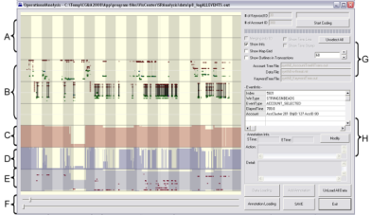
What is in a User’s Interactions?
Goal: determine if a user’s reasoning and intent are reflected in a user’s interactions.
Grad
Students
(Coders)
Analysts
Compare!
(manually)
Strategies
Methods
Findings
Guesses of
Analysts’ thinking
Logged
(semantic)
Interactions
WireVis
Interaction-Log Vis

Slide 18
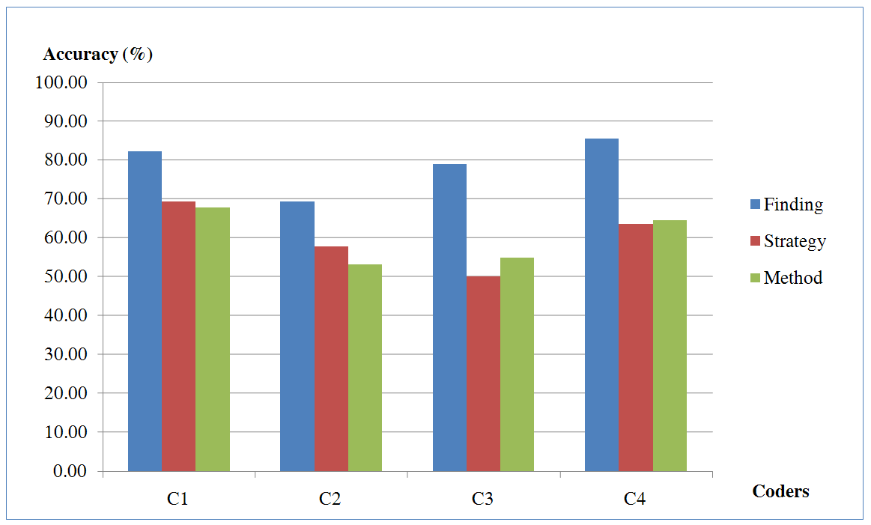
What’s in a User’s Interactions
From this experiment, we find that interactions contains at least:
  60% of the (high level) strategies
  60% of the (mid level) methods
  79% of the (low level) findings
R. Chang et al., Recovering Reasoning Process From User Interactions. CG&A, 2009.
R. Chang et al., Evaluating the Relationship Between User Interaction and Financial Visual Analysis. VAST, 2009.

Slide 19
3. Quantifying Domain Knowledge:
Can Knowledge be Represented Quantitatively?

Slide 20

Iterative Interactive Analysis

Slide 21
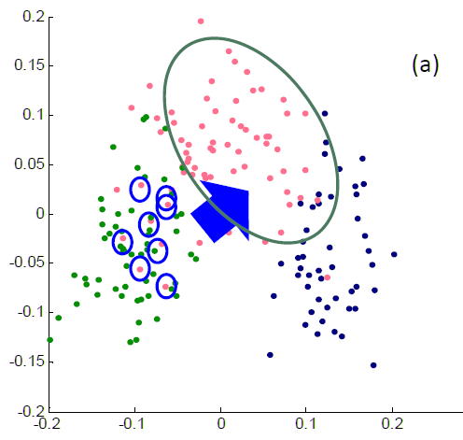


Direct Manipulation of Visualization
Linear distance function:
Optimization:

Slide 22
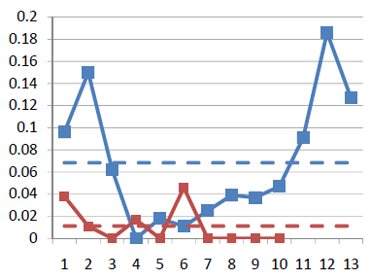
Results
Blue: original data dimension
Red: randomly added dimensions
X-axis: dimension number
Y-axis: final weights of the distance function
Using the “Wine” dataset (13 dimensions, 3 clusters)
  Assume a linear (sum of squares) distance function
Added 10 extra dimensions, and filled them with random values
Tells the users what dimension of data they care about, and what dimensions are not useful!

Slide 23
Summary

Slide 24

Summary
While Visual Analytics have grown and is slowly finding its identity,
There is still many open problems that need to be addressed.
I propose that one research area that has largely been unexplored is in the understanding and supporting of the human user.

Slide 25

