Slide 1
Interactive Data Analysis and Model Exploration:
A Visual Analytics Approach
Remco Chang
Tufts University
Department of Computer Science

Slide 2
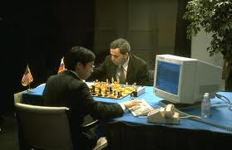
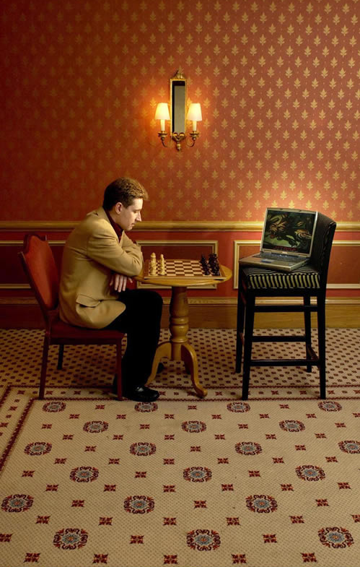
Human + Computer
Human vs. Artificial Intelligence
Garry Kasparov vs. Deep Blue (1997)
  Computer takes a “brute force” approach without analysis
  “As for how many moves ahead a grandmaster sees,” Kasparov concludes: “Just one, the best one”
Artificial vs. Augmented Intelligence
Hydra vs. Cyborgs (2005)
  Grandmaster + 1 chess program > Hydra (equiv. of Deep Blue)
  Amateur + 3 chess programs > Grandmaster + 1 chess program¹
1. http://www.collisiondetection.net/mt/archives/2010/02/why_cyborgs_are.php

Slide 3
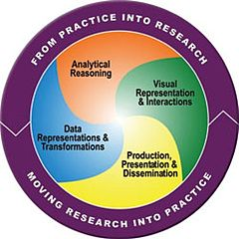
Visual Analytics = Human + Computer
Visual analytics is “the science of analytical reasoning facilitated by visual interactive interfaces.” ¹
By definition, it is a collaboration between human and computer to solve problems.
1. Thomas and Cook, “Illuminating the Path”, 2005.

Slide 4
Example: What Does (Wire) Fraud Look Like?
Financial Institutions like Bank of America have legal responsibilities to report all suspicious wire transaction activities (money laundering, supporting terrorist activities, etc)
Data size: approximately 200,000 transactions per day (73 million transactions per year)
Problems:
  Automated approach can only detect known patterns
  Bad guys are smart: patterns are constantly changing
  Data is messy: lack of international standards resulting in ambiguous data
Current methods:
  10 analysts monitoring and analyzing all transactions
  Using SQL queries and spreadsheet-like interfaces
  Limited time scale (2 weeks)

Slide 5
WireVis: Financial Fraud Analysis
In collaboration with Bank of America
  Develop a visual analytical tool (WireVis)
  Visualizes 7 million transactions over 1 year
  Beta-deployed at WireWatch
Integrates an interactive visual interface with computation:
  User-defined hierarchical clustering
  “Search by example”
  Etc
Design philosophy: “combating human intelligence requires better (augmented) human intelligence”
R. Chang et al., Scalable and interactive visual analysis of financial wire transactions for fraud detection. Information Visualization,2008.
R. Chang et al., Wirevis: Visualization of categorical, time-varying data from financial transactions. IEEE VAST, 2007.

Slide 6
WireVis: A Visual Analytics Approach
Search by Example (Find Similar Accounts)
Heatmap View
(Accounts to Keywords Relationship)
Keyword Network
(Keyword Relationships)
Strings and Beads
(Relationships over Time)

Slide 7




Applications of Visual Analytics
Political Simulation
  Agent-based analysis
  With DARPA
Global Terrorism Database
  With DHS
Bridge Maintenance
  With US DOT
  Exploring inspection reports
Biomechanical Motion
  Interactive motion comparison
R. Chang et al., Two Visualization Tools for Analysis of Agent-Based Simulations in Political Science. IEEE CG&A, 2012

Slide 8
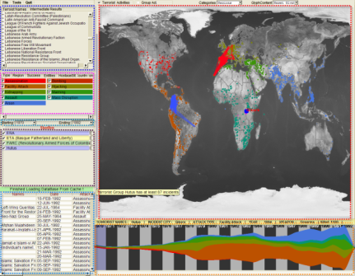
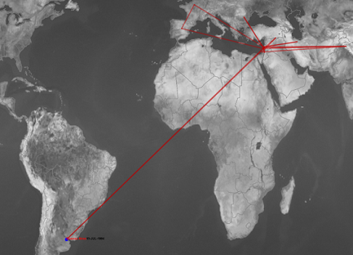
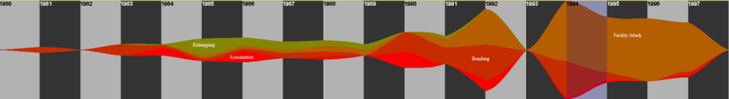
Applications of Visual Analytics
Who
Where
Political Simulation
  Agent-based analysis
  With DARPA
Global Terrorism Database
  With DHS
Bridge Maintenance
  With US DOT
  Exploring inspection reports
Biomechanical Motion
  Interactive motion comparison
What
Evidence
Box
Original
Data
When
R. Chang et al., Investigative Visual Analysis of Global Terrorism, Journal of Computer Graphics Forum, 2008.

Slide 9



Applications of Visual Analytics
Political Simulation
  Agent-based analysis
  With DARPA
Global Terrorism Database
  With DHS
Bridge Maintenance
  With US DOT
  Exploring inspection reports
Biomechanical Motion
  Interactive motion comparison
R. Chang et al., An Interactive Visual Analytics System for Bridge Management, Journal of Computer Graphics Forum, 2010. To Appear.

Slide 10



Applications of Visual Analytics
Political Simulation
  Agent-based analysis
  With DARPA
Global Terrorism Database
  With DHS
Bridge Maintenance
  With US DOT
  Exploring inspection reports
Biomechanical Motion
  Interactive motion comparison
R. Chang et al., Interactive Coordinated Multiple-View Visualization of Biomechanical Motion Data, IEEE Vis (TVCG) 2009.

Slide 11
Interaction
In these examples, one of the keys to making these systems effective is the use of high interactivity
  Technically, this means about 12 frames per second (fps)
  Perceptually, our eyes perceive 12+ fps as “responsive” and “smoothly animated”
  Cognitively, 0.2 seconds is the amount of time our brain can hold sensory memory (the “after image effect”)
In building VA systems, interactivity allows a user to:
  “Externalize” memory
  Perform analysis in an uninterrupted manner
  Express domain knowledge

Slide 12
Analyzing User’s Interactions:
Do Interactions Contain Knowledge?

Slide 13
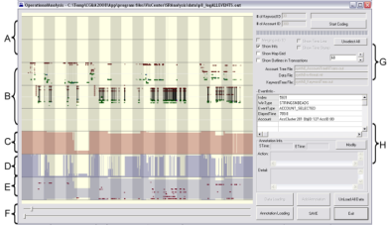
What is in a User’s Interactions?
Goal: determine if a user’s reasoning and intent are reflected in a user’s interactions.
Grad
Students
(Coders)
Analysts
Compare!
(manually)
Strategies
Methods
Findings
Guesses of
Analysts’ thinking
Logged
(semantic)
Interactions
WireVis
Interaction-Log Vis

Slide 14
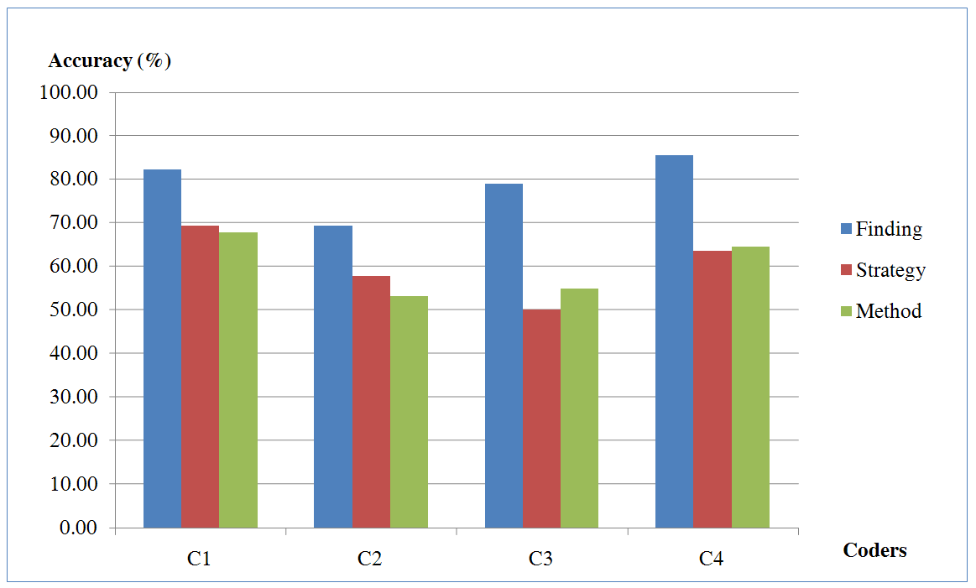
What’s in a User’s Interactions
From this experiment, we find that interactions contains at least:
  60% of the (high level) strategies
  60% of the (mid level) methods
  79% of the (low level) findings
R. Chang et al., Recovering Reasoning Process From User Interactions. CG&A, 2009.
R. Chang et al., Evaluating the Relationship Between User Interaction and Financial Visual Analysis. VAST, 2009.

Slide 15
Human + Computer
Interaction allows the human to express domain knowledge
Part of the purpose of this panel is to demonstrate to you that statistics (computing) + humans is much more powerful than statistics alone or human alone
This can be achieved through well-designed Visual Analytics systems

Slide 16
Final Thought…
“The sexy job in the next 10 years will be statisticians,” said Hal Varian, chief economist at Google. “And I’m not kidding.”
Yet data is merely the raw material of knowledge. “We’re rapidly entering a world where everything can be monitored and measured,” said Erik Brynjolfsson, an economist and director of the Massachusetts Institute of Technology’s Center for Digital Business. “But the big problem is going to be the ability of humans to use, analyze and make sense of the data.”
“The key is to let computers do what they are good at, which is trawling these massive data sets for something that is mathematically odd,” said Daniel Gruhl, an I.B.M. researcher whose recent work includes mining medical data to improve treatment. “And that makes it easier for humans to do what they are good at — explain those anomalies.”¹
Graphics &
Visualization
Interaction &
Reasoning
Computing
1. New York Times. “For Today’s Graduate, Just One Word: Statistics “, August 5, 2009.

Slide 17
Thank you!
Questions?

Slide 18


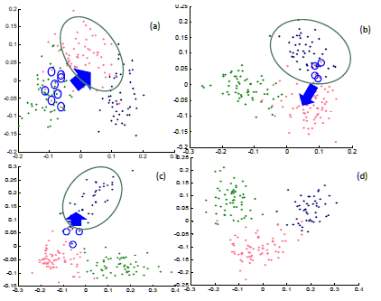

Slide 19
Backup Slides

Slide 20
VALT Research Projects
Theory -- Jordan Crouser:
  Complexity classes of Human+Computer
Interactive Machine Learning -- Eli Brown:
  Model learning from user interactions
  Analytic provenance
Psych / Cog Sci -- Alvitta Ottley:
  Personality factors and Brain Sensing with fNIRS
  Uncertainty visualization (medical)
Big Data -- Leilani Battle (MIT):
  Interactive DB Visualization & Exploration (collaboration with MIT)

Slide 21
Analysis (Jordan Crouser)
1. Human + Computer Computation:
Can The Two Complement Each Other?

Slide 22
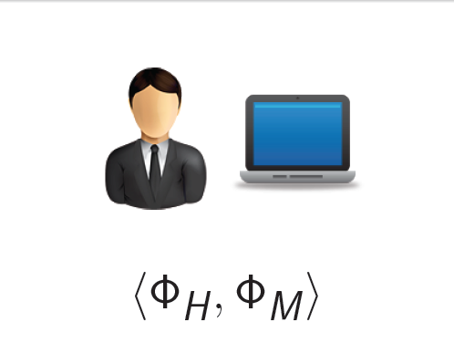
Quantifying Human+Computer Collaboration

Slide 23
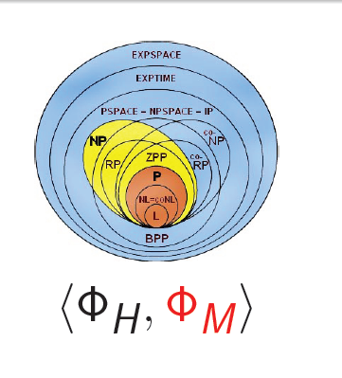
Quantifying Human+Computer Collaboration

Slide 24
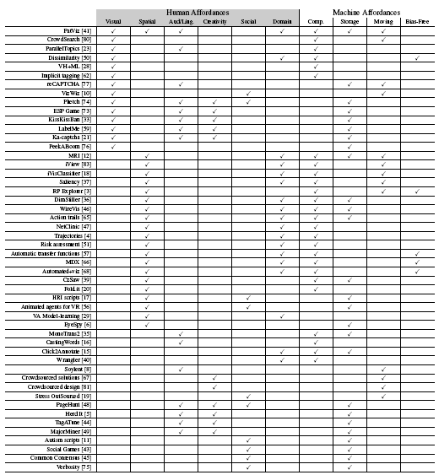
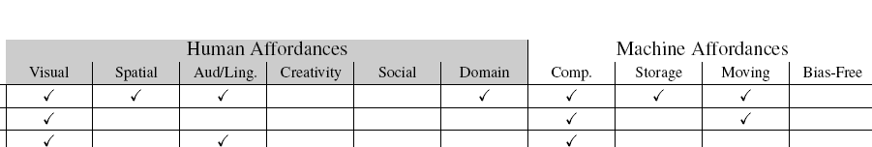
Understanding Human Complexity
Surveyed 1,200+ papers from CHI, IUI, KDD, Vis, InfoVis, VAST
Found 49 relating to human + computer collaboration
Using a model of human and computer affordances, examined each of the projects to identify what “works” and what could be missing
Joint work with Jordan Couser. An affordance-based framework for human computation and human-computer collaboration.
IEEE VAST 2012.

Slide 25
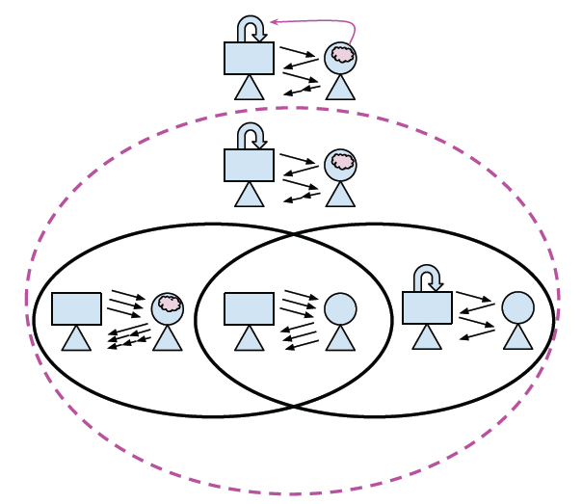
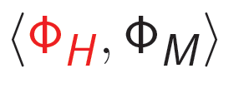
Quantifying Human+Computer Collaboration

Slide 26
Interactive Machine Learning (Eli Brown)
2. Interactive Model Learning:
Can Knowledge be Represented Quantitatively?

Slide 27

Iterative Interactive Analysis

Slide 28
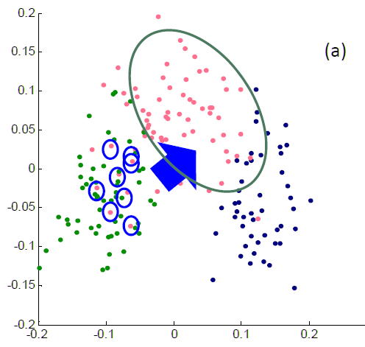


Direct Manipulation of Visualization
Linear distance function:
Optimization:

Slide 29
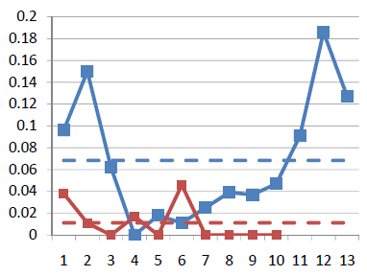
Results
Blue: original data dimension
Red: randomly added dimensions
X-axis: dimension number
Y-axis: final weights of the distance function
Using the “Wine” dataset (13 dimensions, 3 clusters)
  Assume a linear (sum of squares) distance function
Added 10 extra dimensions, and filled them with random values
Tells the users what dimension of data they care about, and what dimensions are not useful!

Slide 30
Individual Differences (Alvitta Ottley)
3. A User’s Cognitive Traits & States,
Experiences & Biases:
How To Identify The End User’s Needs?

Slide 31
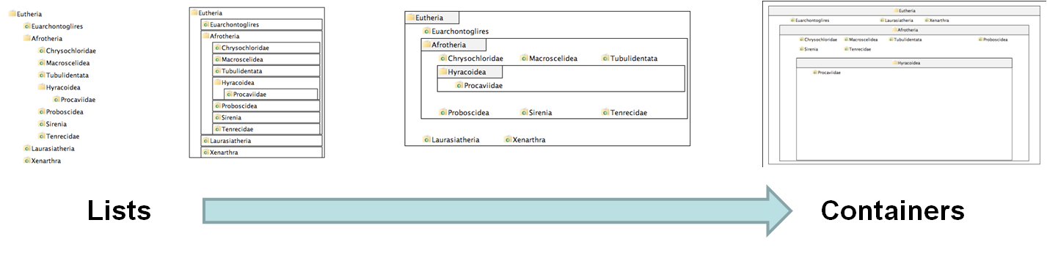
Experiment Procedure
4 visualizations on hierarchical visualization
  From list-like view to containment view
250 participants using Amazon’s Mechanical Turk
Questionnaire on “locus of control” (LOC)
  Definition of LOC: the degree to which a person attributes outcomes to themselves (internal LOC) or to outside forces (external LOC)
V1
V2
V3
V4
R. Chang et al., How Locus of Control Influences Compatibility with Visualization Style, IEEE VAST 2011.

Slide 32
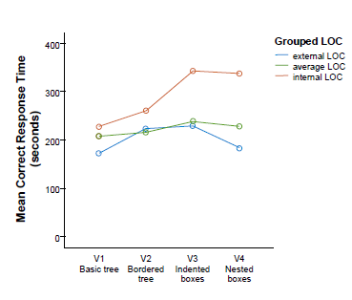
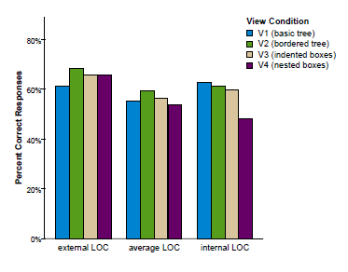
Results
Personality Factor: Locus of Control
  (internal => faster/better with containment)
  (external => faster/better with list)

Slide 33
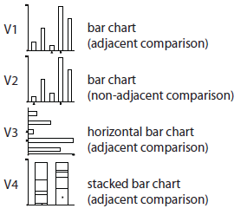
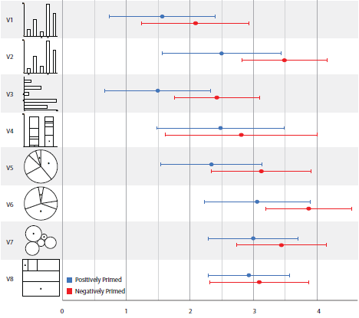
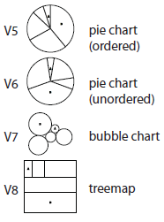
Affective Priming on Visual Judgment
R. Chang et al., Influencing Visual Judgment Through Affective Priming, CHI 2013.

Slide 34
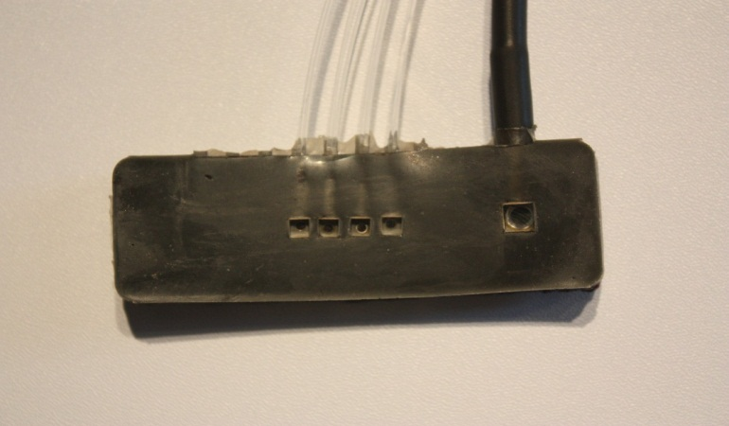
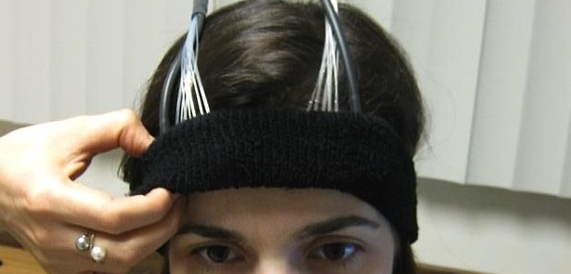
Preliminary Study – Using Brain Sensing (fNIRS)
Functional Near-Infrared Spectroscopy
a lightweight brain sensing technique
measures mental demand (working memory)
R. Chang et al., Using fNIRS Brain Sensing to Evaluate Information Visualization Interfaces. CHI 2013.

Slide 35
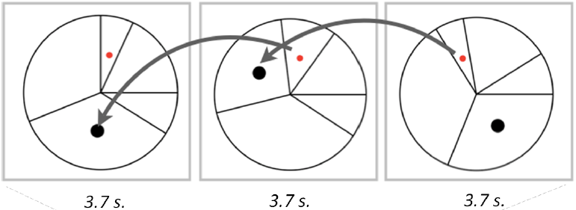
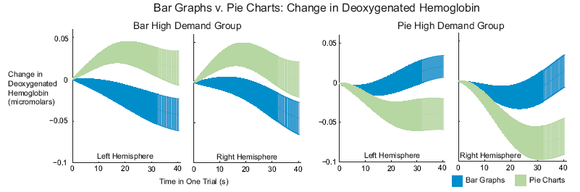
This is Your Brain on Bar graphs and Pie Charts
3-back test

Slide 36
Big Data (Leilani Battle (MIT) & Liz Salowitz)
4. Interactive Exploration of Large Databases:
Big Database, Small Laptop,
Can a User Interact with Big Data in Real Time?

Slide 37



Problem Statement
Visualization on a
Commodity Hardware
Large Data in a
Data Warehouse

Slide 38
Problem Statement
Constraint: Data is too big to fit into the memory or hard drive of the personal computer
  Note: Ignoring various database technologies (OLAP, Column-Store, No-SQL, Array-Based, etc)
Classic Computer Science Problem…
What are some previous techniques?
  Truncate (sample, filter)
  Resolution reduction (“blurring”, image zooming)
  Stream (think Netflix, Hulu)
  Pre-fetch (think open world 3D video games)

Slide 39
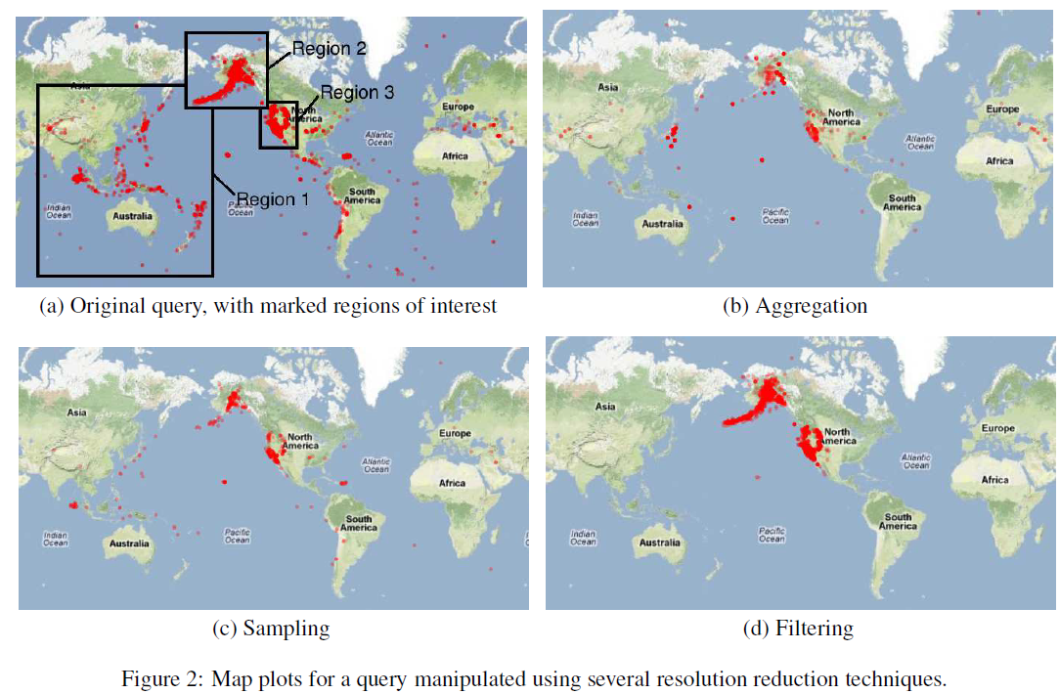
Strategies for Real Time DB Visualization

Slide 40
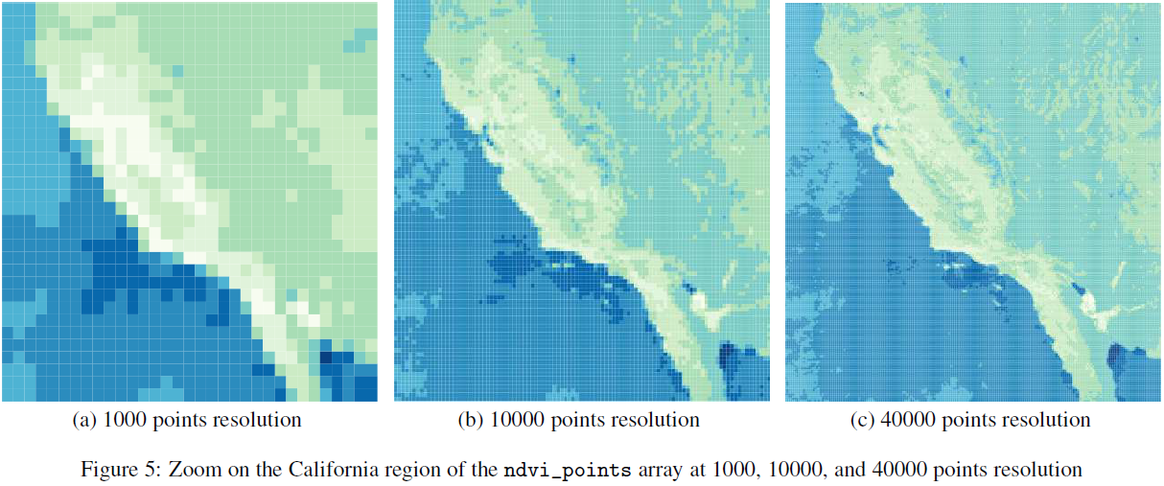
Using SciDB

