Slide 1
Debugging and Hacking the User in Visual Analytics
Remco Chang
Assistant Professor
Tufts University
Lane Harrison
PostDoc
Tufts University

Slide 2
“The computer is incredibly fast, accurate, and stupid. Man is unbelievably slow, inaccurate, and brilliant. The marriage of the two is a force beyond calculation.”
-Leo Cherne, 1977
(often attributed to Albert Einstein)

Slide 3
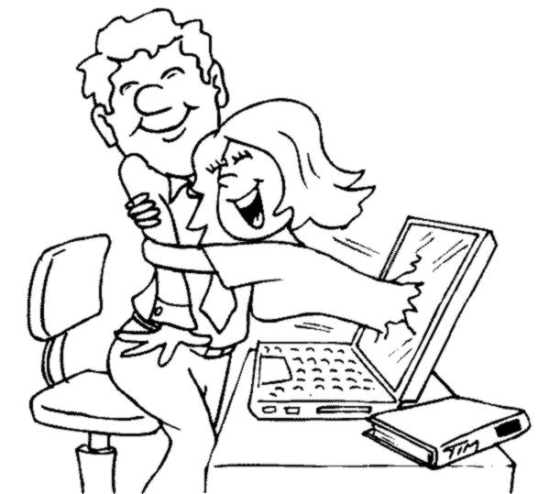
Which Marriage?

Slide 4
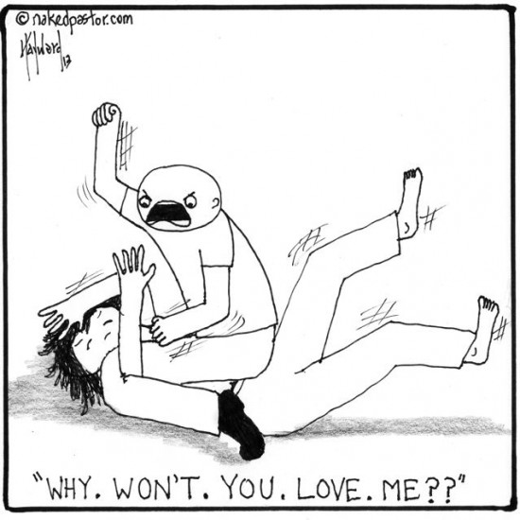
Which Marriage?

Slide 5
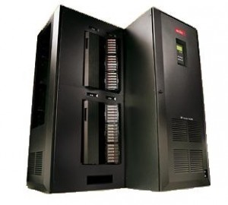

Work Distribution
Data Manipulation
Storage and Retrieval
Bias-Free Analysis
Prediction
Logic
Perception
Creativity
Domain Knowledge
Crouser et al., Balancing Human and Machine Contributions in Human Computation Systems. Human Computation Handbook, 2013
Crouser et al., An affordance-based framework for human computation and human-computer collaboration. IEEE VAST, 2012

Slide 6
Visual Analytics = Human + Computer
Visual analytics is “the science of analytical reasoning facilitated by visual interactive interfaces.”¹
Interactive Data Exploration
Automated Data Analysis
Feedback Loop
Thomas and Cook, “Illuminating the Path”, 2005.
Keim et al. Visual Analytics: Definition, Process, and Challenges. Information Visualization, 2008

Slide 7




Example Visual Analytics Systems
Political Simulation
  Agent-based analysis
  With DARPA
Wire Fraud Detection
  With Bank of America
Bridge Maintenance
  With US DOT
  Exploring inspection reports
Biomechanical Motion
  Interactive motion comparison
Crouser et al., Two Visualization Tools for Analysis of Agent-Based Simulations in Political Science. IEEE CG&A, 2012

Slide 8
Example Visual Analytics Systems
Political Simulation
  Agent-based analysis
  With DARPA
Wire Fraud Detection
  With Bank of America
Bridge Maintenance
  With US DOT
  Exploring inspection reports
Biomechanical Motion
  Interactive motion comparison
R. Chang et al., WireVis: Visualization of Categorical, Time-Varying Data From Financial Transactions, VAST 2008.

Slide 9



Example Visual Analytics Systems
Political Simulation
  Agent-based analysis
  With DARPA
Wire Fraud Detection
  With Bank of America
Bridge Maintenance
  With US DOT
  Exploring inspection reports
Biomechanical Motion
  Interactive motion comparison
R. Chang et al., An Interactive Visual Analytics System for Bridge Management, Journal of Computer Graphics Forum, 2010.

Slide 10


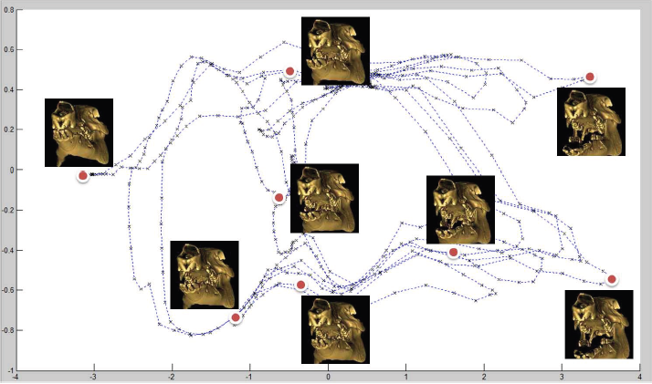
Example Visual Analytics Systems
Political Simulation
  Agent-based analysis
  With DARPA
Wire Fraud Detection
  With Bank of America
Bridge Maintenance
  With US DOT
  Exploring inspection reports
Biomechanical Motion
  Interactive motion comparison
R. Chang et al., Interactive Coordinated Multiple-View Visualization of Biomechanical Motion Data, IEEE Vis (TVCG) 2009.

Slide 11

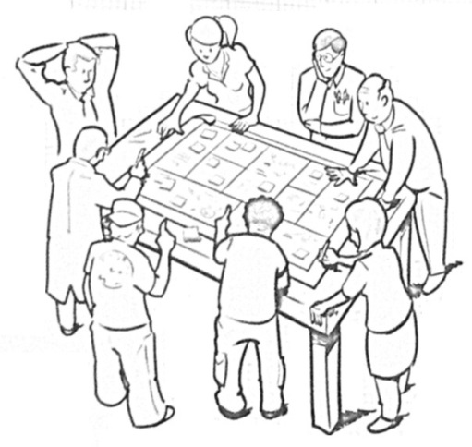
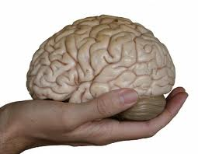
Research Statement
“Reverse engineer” the human black box
Computational Methods:
  Debugging User’s Reasoning and intent
  Extract user’s knowledge
Cognitive and Perceptual:
  Debugging/Hacking: Understanding and Influencing a user’s behavior
Use these techniques for “good”
  4. Adaptive visualizations
R. Chang et al., Science of Interaction, Information Visualization, 2009.

Slide 12
1. Debugging the User
What is in a User’s Interactions?

Slide 13
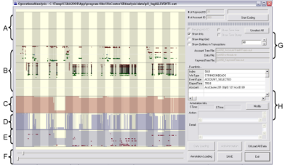
What is in a User’s Interactions?
Goal: determine if a user’s reasoning and intent are reflected in a user’s interactions.
Grad
Students
(Coders)
Analysts
Compare!
(manually)
Strategies
Methods
Findings
Guesses of
Analysts’ thinking
Logged
(semantic)
Interactions
WireVis
Interaction-Log Vis

Slide 14
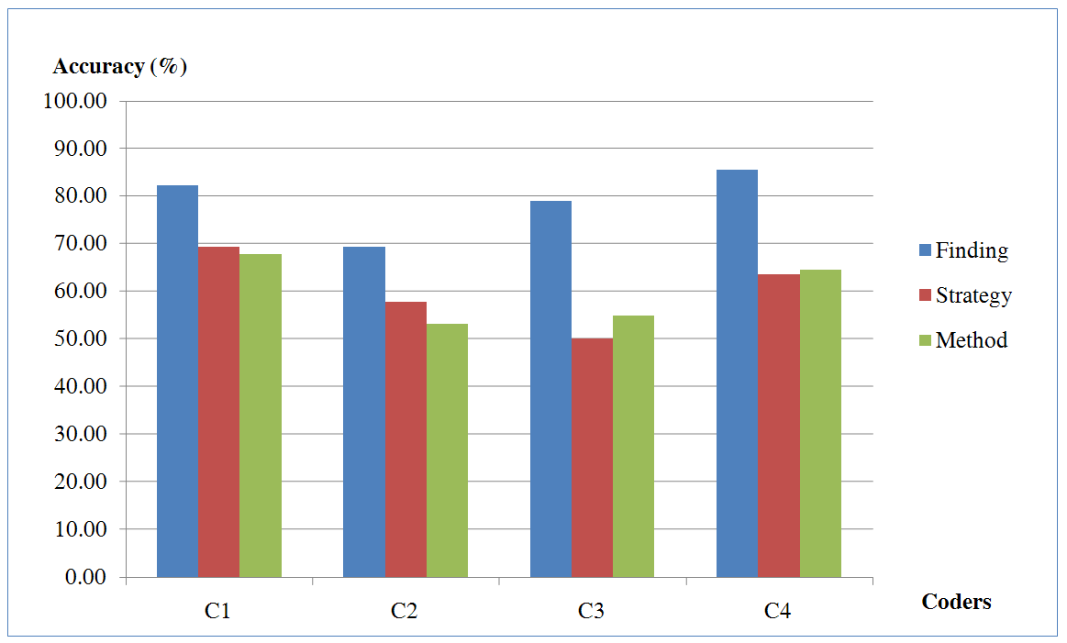
What’s in a User’s Interactions
From this experiment, we find that interactions contains at least:
  60% of the (high level) strategies
  60% of the (mid level) methods
  79% of the (low level) findings
R. Chang et al., Recovering Reasoning Process From User Interactions. CG&A, 2009.
R. Chang et al., Evaluating the Relationship Between User Interaction and Financial Visual Analysis. VAST, 2009.

Slide 15
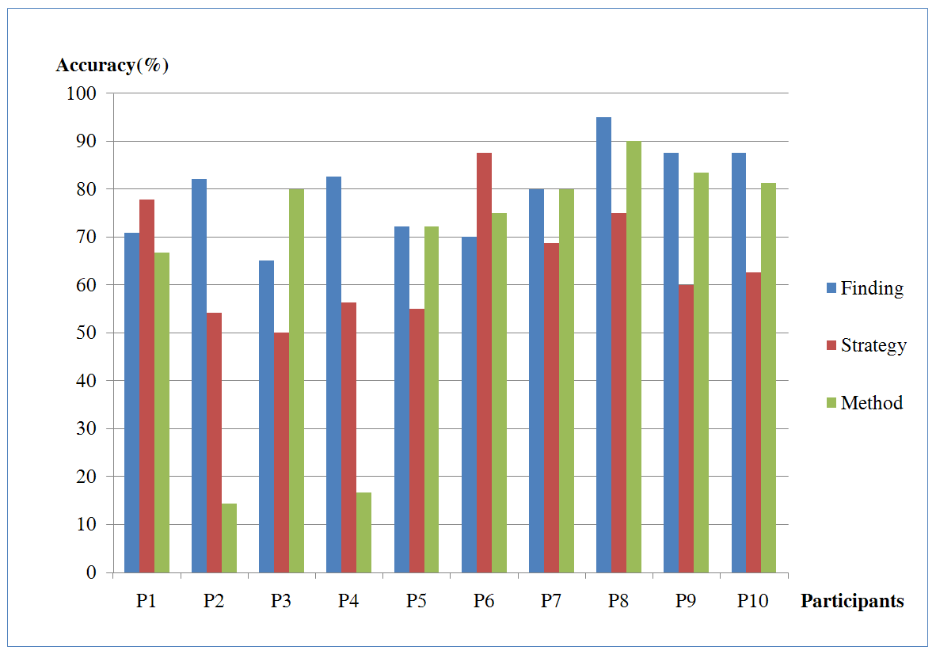
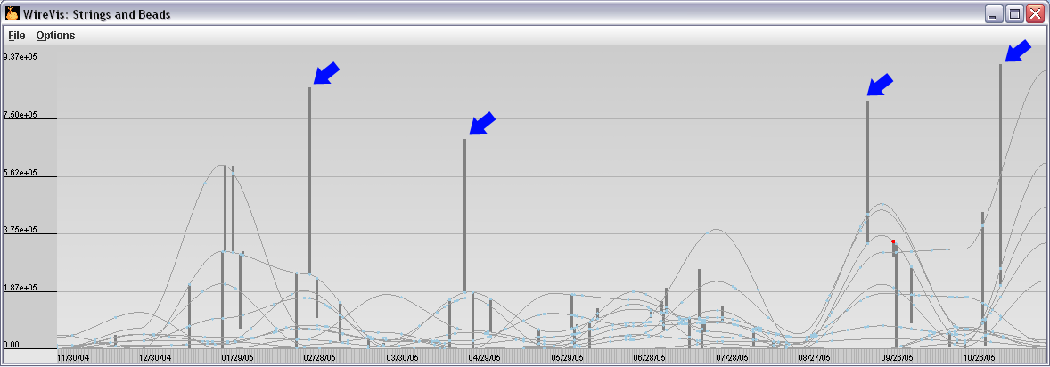
What’s in a User’s Interactions
Why are these so much lower than others?
(recovering “methods” at about 15%)
Only capturing a user’s interaction in this case is insufficient.

Slide 16
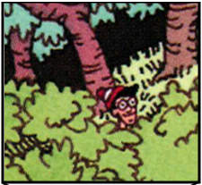
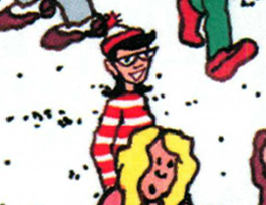
Experiment: Finding Waldo
Google-Maps style interface
  Left, Right, Up, Down, Zoom In, Zoom Out, Found

Slide 17
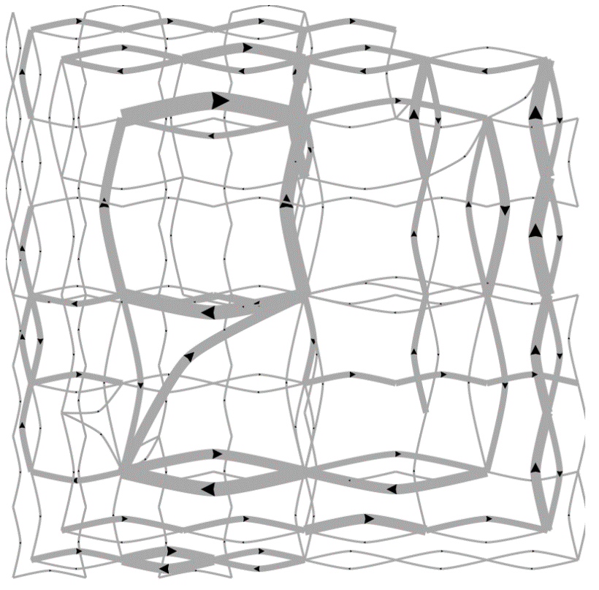
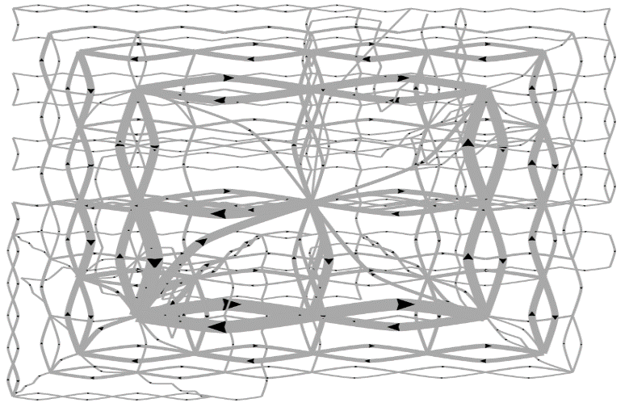
Pilot Visualization – Completion Time
Fast completion time
Slow completion time
Eli Brown et al., Where’s Waldo. IEEE VAST 2014, Conditionally Accepted.

Slide 18
Post-hoc Analysis Results
Mean Split (50% Fast, 50% Slow)
Data Representation | Classification Accuracy | Method
State Space | 72% | SVM
Edge Space | 63% | SVM
Action Sequence | 77% | Decision Tree
Mouse Event | 62% | SVM
Fast vs. Slow Split (Mean+0.5σ=Fast, Mean-0.5σ=Slow)
Data Representation | Classification Accuracy | Method
State Space | 96% | SVM
Edge Space | 83% | SVM
Action Sequence | 79% | Decision Tree
Mouse Event | 79% | SVM

Slide 19
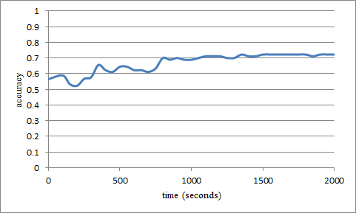
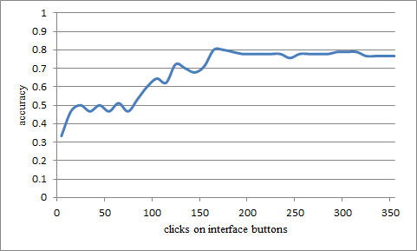
“Real-Time” Prediction
(Limited Time Observation)
State-Based
Linear SVM
Accuracy: ~70%
Interaction Sequences
N-Gram + Decision Tree
Accuracy: ~80%

Slide 20
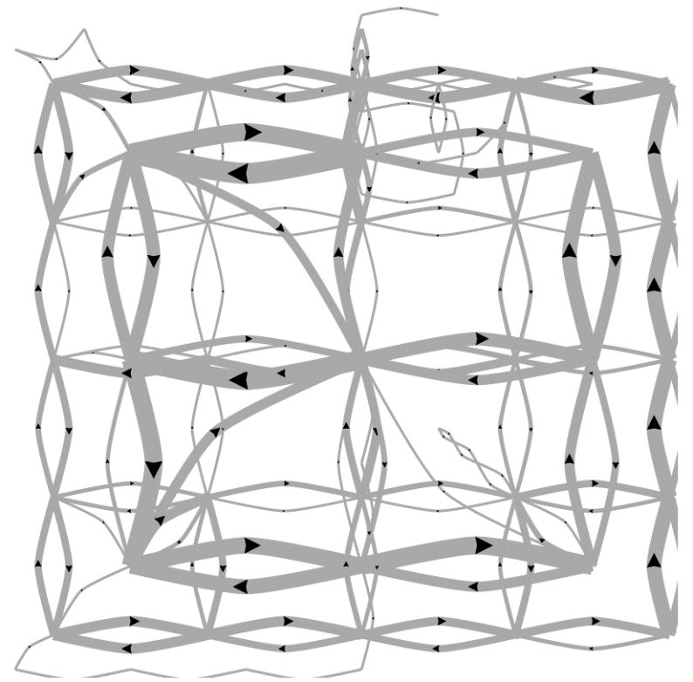
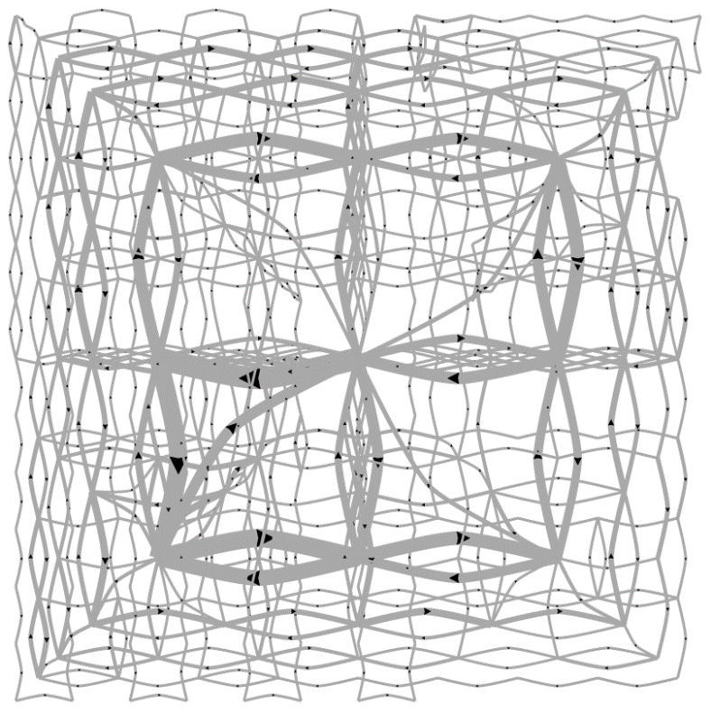
Predicting a User’s Personality
External Locus of Control
Internal Locus of Control
Ottley et al., How locus of control inﬂuences compatibility with visualization style. IEEE VAST , 2011.
Ottley et al., Understanding visualization by understanding individual users. IEEE CG&A, 2012.

Slide 21
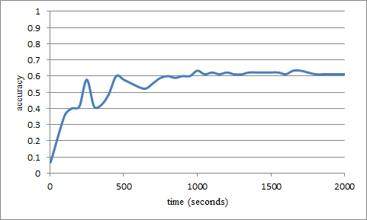
Predicting Users’ Personality Traits
Predicting user’s “Extraversion”
Linear SVM
Accuracy: ~60%
Noisy data, but can detect the users’ individual traits “Extraversion”, “Neuroticism”, and “Locus of Control” at ~60% accuracy by analyzing the user’s interactions alone.

Slide 22
2. Hacking the User
What information can I
extract out of the user’s brain?

Slide 23
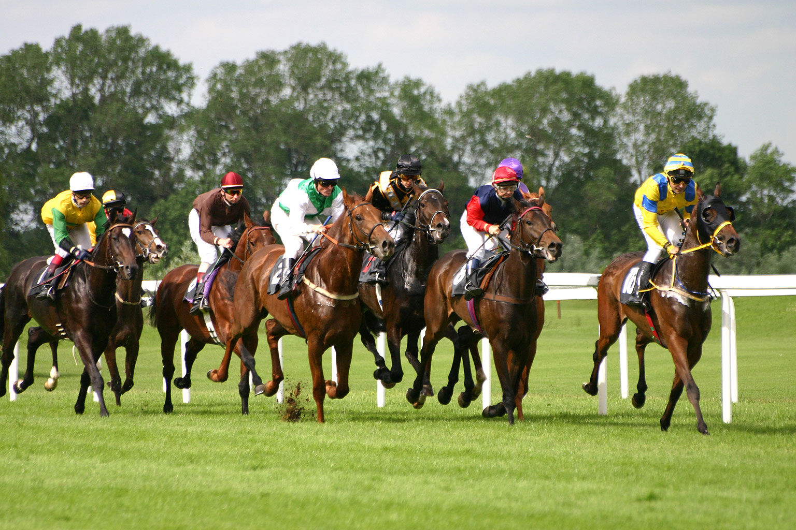
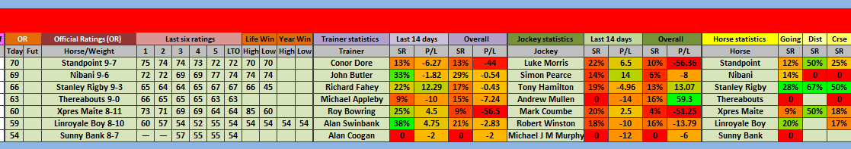
1. Richard Heuer. Psychology of Intelligence Analysis, 1999. (pp 53-57)

Slide 24

Metric Learning
Finding the weights to a linear distance function
Instead of a user manually give the weights, can we learn them implicitly through their interactions?

Slide 25
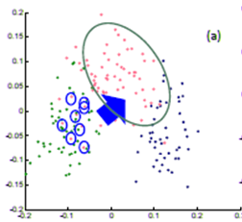
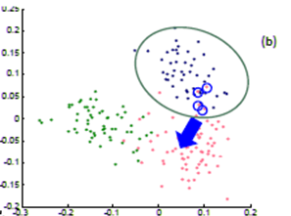
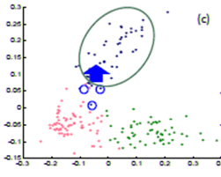
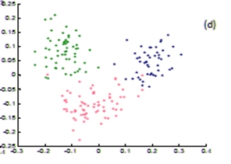
Metric Learning
In a projection space (e.g., MDS), the user directly moves points on the 2D plane that don’t “look right”…
Until the expert is happy (or the visualization can not be improved further)
The system learns the weights (importance) of each of the original k dimensions
Short Video (play)

Slide 26


Dis-Function
Optimization:
Brown et al., Find Distance Function, Hide Model Inference. IEEE VAST Poster 2011
Brown et al., Dis-function: Learning Distance Functions Interactively. IEEE VAST 2012.

Slide 27
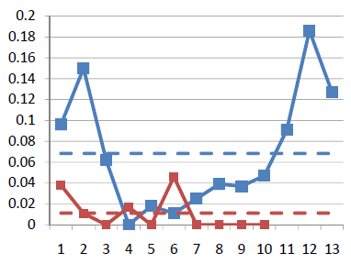
Results
Used the “Wine” dataset (13 dimensions, 3 clusters)
  Assume a linear (sum of squares) distance function
Added 10 extra dimensions, and filled them with random values
Blue: original data dimension
Red: randomly added dimensions
X-axis: dimension number
Y-axis: final weights of the distance function
Shows that the user doesn’t care about many of the features (in this case, only 5 dimensions matter)
Reveals the user’s knowledge about the data (often in a way that the user isn’t even aware)

Slide 28
Perception and Cognition
3. How does user variability impact performance?
Can we debug the user?
Can we hack the user?

Slide 29
Debugging the User: Bayes Reasoning
The probability that a woman over age 40 has breast cancer is 1%. However, the probability that mammography accurately detects the disease is 80% with a false positive rate of 9.6%.
If a 40-year old woman tests positive in a mammography exam, what is the probability that she indeed has breast cancer?
Answer: Bayes’ theorem states that P(A|B) = P(B|A) * P(A) / P(B). In this case, A is having breast cancer, B is testing positive with mammography. P(A|B) is the probability of a person having breast cancer given that the person is tested positive with mammography. P(B|A) is given as 80%, or 0.8, P(A) is given as 1%, or 0.01. P(B) is not explicitly stated, but can be computed as P(B,A)+P(B,˜A), or the probability of testing positive and the patient having cancer plus the probability of testing positive and the patient not having cancer. Since P(B,A) is equal 0.8*0.01 = 0.008, and P(B,˜A) is 0.093 * (1-0.01) = 0.09207, P(B) can be computed as 0.008+0.09207 = 0.1007. Finally, P(A|B) is therefore 0.8 * 0.01 / 0.1007, which is equal to 0.07944.

Slide 30
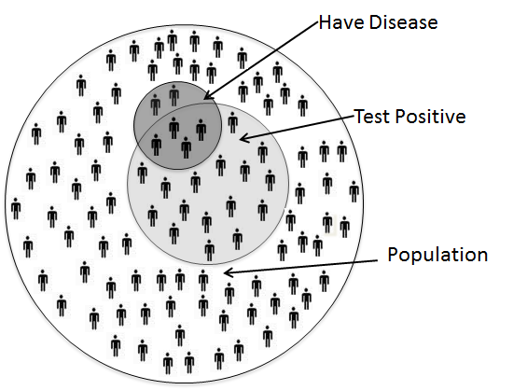
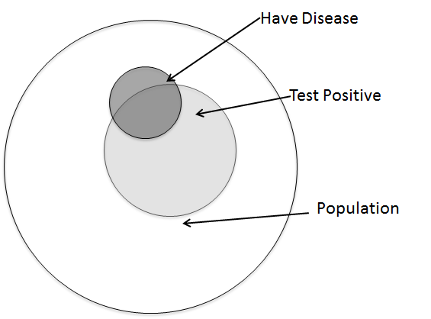
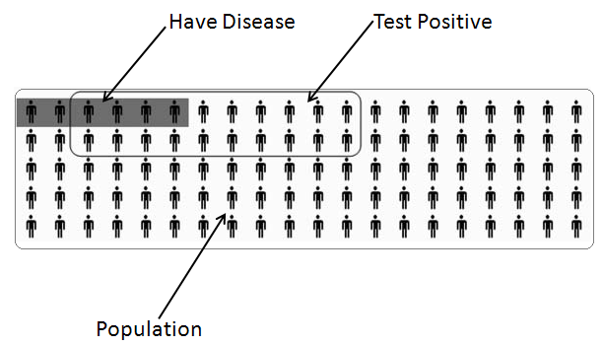
Visualization Aids
Ottley et al., Visually Communicating Bayesian Statistics to Laypersons. Tufts CS Tech Report, 2012.

Slide 31
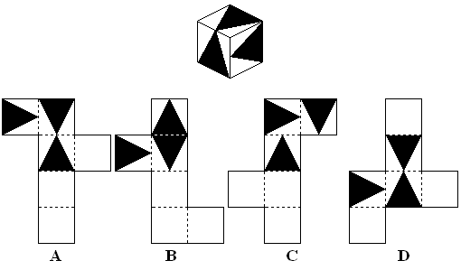
Spatial Ability
High spatial aptitude -> higher accuracy in solving Bayes problems (with visualization)
What individual differences impact performance?
Ottley et al., Improving Bayesian Reasoning: Designing Visualizations for Spatial Ability., IEEE TVCG, In Preparation

Slide 32
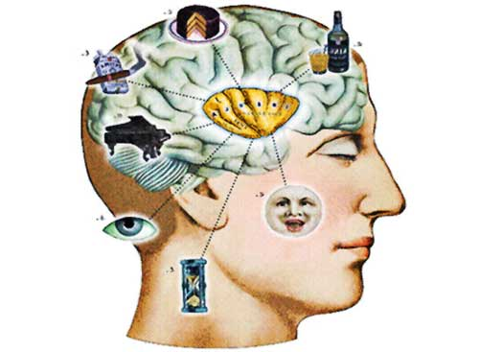
Individual Differences and Vis Performance
Existing research shows that all the following factors affect how someone uses a visualization:
  Spatial Ability
  Experience (novice vs. expert)
  Cognitive Workload/Mental Demand
  Emotional State
  Perception
  Personality
  … and more
Peck et al., ICD³: Towards a 3-Dimensional Model of Individual Cognitive Differences. BELIV 2012
Peck et al., Using fNIRS Brain Sensing To Evaluate Information Visualization Interfaces. CHI 2013

Slide 33
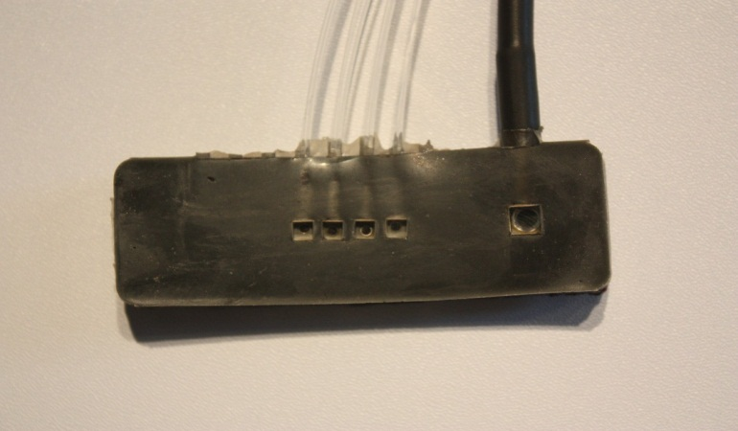
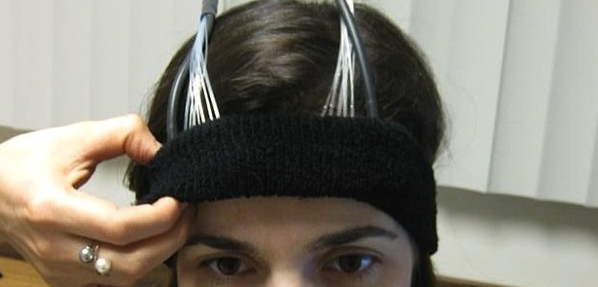
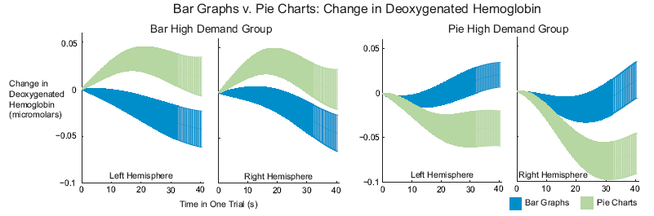
Cognitive Load
Functional Near-Infrared Spectroscopy
fNIRS
a lightweight brain sensing technique
measures mental demand (working memory)
Evan Peck et al., Using fNIRS Brain Sensing to Evaluate Information Visualization Interfaces. CHI 2013.

Slide 34

Emotion (Affective Priming)

Slide 35
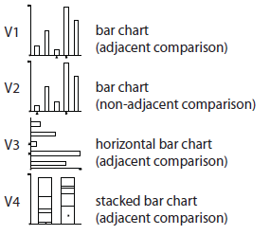
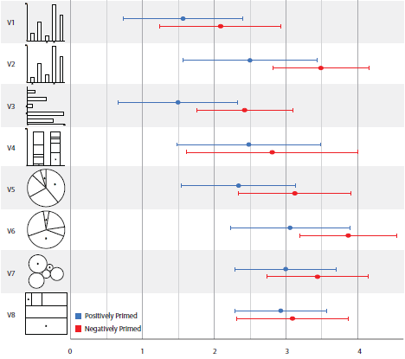
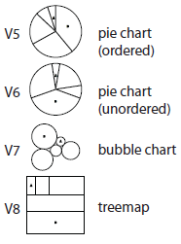
Emotion and Visual Judgment
Harrison et al., Influencing Visual Judgment Through Affective Priming, CHI 2013

Slide 36


Modeling User Perception with Weber’s Law

Slide 37
Weber’s Law & Just Noticeable Difference (JND)
Perception
Perception
Perceived Stimulus
Ideal
Just Noticeable Difference
Ideal
Objective Stimulus
Objective Stimulus

Slide 38
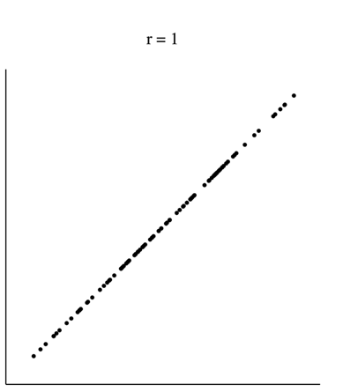
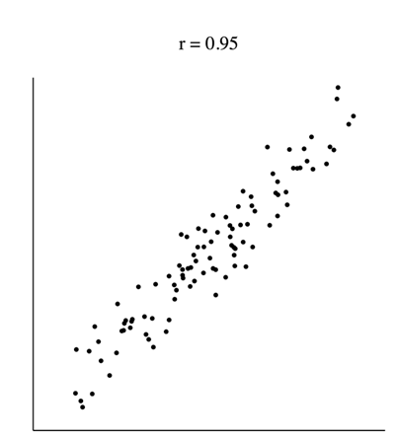
Perception of Correlation and Weber’s
Rensink and Baldridge, The Perception of Correlation in Scatterplots. EuroVis 2010.

Slide 39
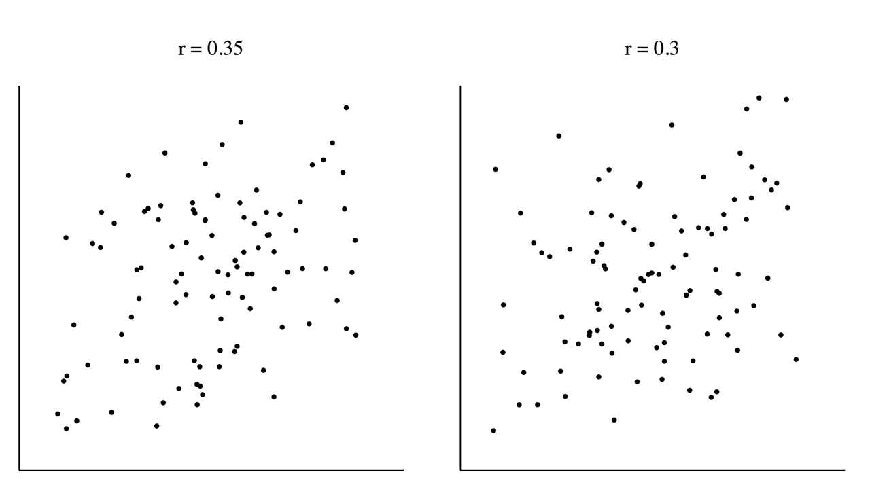
Perception of Correlation and Weber’s

Slide 40
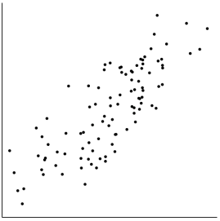
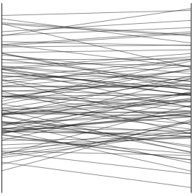
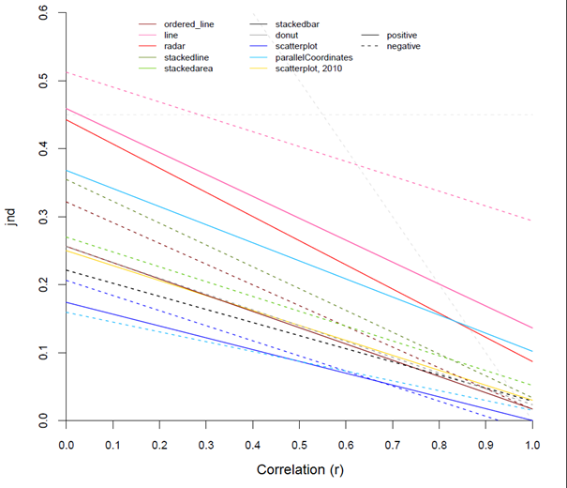
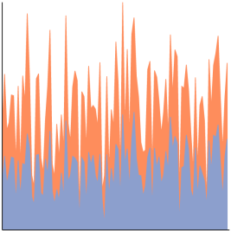
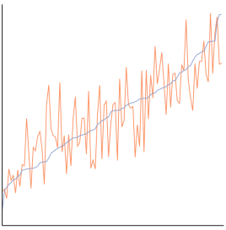
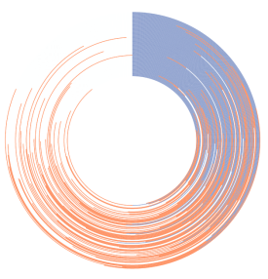
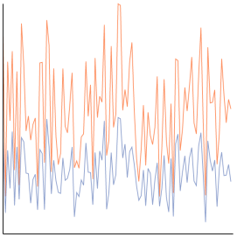
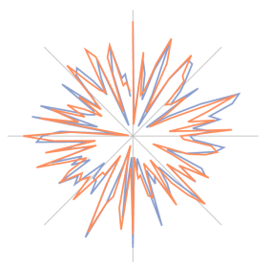
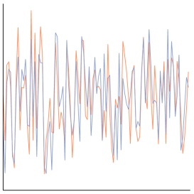
Ranking Visualizations
Harrison et al., Ranking Visualization of Correlation with Weber’s Law. InfoVis 2014 (Conditional)

Slide 41
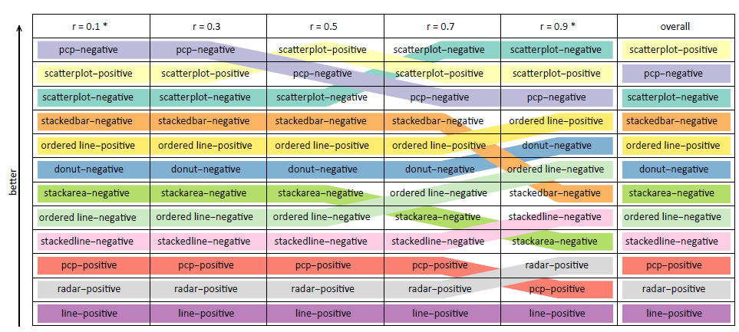
Ranking Visualizations of Correlation

Slide 42
Mixed Initiative (Adaptive) Systems
4. What Can a System Do
If It Knows Everything About Its User?

Slide 43



Adaptive Visualization
Color-Blindness, Cultural Differences, Personality, etc.
Cognitive Workload
Afergan et al., Dynamic Difficulty Using Brain Metrics of Workload. CHI 2014

Slide 44
Adaptive Computation
A new approach for Big Data visualization
Observation: Data is so large that…
  There are more data items than there are pixels
  Each computation (across all data items) takes tremendous amount of time, space, and energy
Solution: User-Driven Computation
  Conserve these precious resources by computing “partial” information based on User and Data Models

Slide 45



Example Problem: Big Data Exploration
Visualization on a
Commodity Hardware
Large Data in a
Data Warehouse

Slide 46

Example 1:
JND + Streaming Data
Streaming visualization (Fisher et al., CHI 2012)
JND-based streaming data and visualization
  Stop the computation and streaming at JND
  Similar to audio (mp3), image (jpg2000), graphics (progressive meshing)
  Differ in that the JND will be based on semantic information (e.g. correlation)
t = 1 second
t = 5 minute

Slide 47



Example 2: Predictive
Pre-Computation and Pre-Fetching
In collaboration with MIT and Brown
Using an “ensemble” approach for prediction
  Large number of prediction algorithms
  Each prediction algorithm is given more computational resources based on past performance
Evaluated system with domain scientists using the NASA MODIS dataset (multi-sensory satellite imagery)
Remote analysis on commodity hardware shows (near) real-time interactive analysis

Slide 48
Summary

Slide 49



Summary
“Interaction is the analysis”¹
A user’s interactions in a visual analytics system encodes a large amount of data
Successful analysis can lead to a better understanding of the user
The future of visual analytics lies in better human-computer collaboration
That future starts by enabling the computer to better understand the user
1. R. Chang et al., Science of Interaction, Information Visualization, 2009.

Slide 50


Questions?
[remco,lane]@cs.tufts.edu

Slide 51
Backup

Slide 52

Priming Inferential Judgment
The personality factor, Locus of Control* (LOC), is a predictor for how a user interacts with the following visualizations:
Ottley et al., How locus of control inﬂuences compatibility with visualization style. IEEE VAST , 2011.

Slide 53


Locus of Control vs. Visualization Type
When with list view compared to containment view, internal LOC users are:
  faster (by 70%)
  more accurate (by 34%)
Only for complex (inferential) tasks
The speed improvement is about 2 minutes (116 seconds)

Slide 54
Priming LOC - Stimulus
Borrowed from Psychology research: reduce locus of control (to make someone have a more external LOC)
  “We know that one of the things that influence how well you can do everyday tasks is the number of obstacles you face on a daily basis. If you are having a particularly bad day today, you may not do as well as you might on a day when everything goes as planned. Variability is a normal part of life and you might think you can’t do much about that aspect. In the space provided below, give 3 examples of times when you have felt out of control and unable to achieve something you set out to do. Each example must be at least 100 words long.”

Slide 55
Results: Averages Primed More Internal*
Performance
Good
External LOC
Average LOC
Average ->Internal
Internal LOC
Poor
Visual Form
List-View
Containment
Ottley et al., Manipulating and Controlling for Personality Effects on Visualization Tasks, Information Visualization, 2013

Slide 56
Results

