Slide 1
(Big Data Analytics for Everyone)
Big Data Visual Analytics:
A User-Centric Approach
Remco Chang
Assistant Professor
Department of Computer Science
Tufts University

Slide 2
“The computer is incredibly fast, accurate, and stupid. Man is unbelievably slow, inaccurate, and brilliant. The marriage of the two is a force beyond calculation.”
-Leo Cherne, 1977
(often attributed to Albert Einstein)

Slide 3
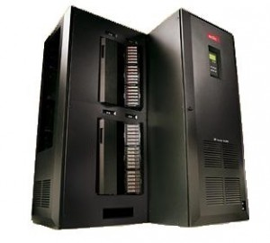

Work Distribution
Data Manipulation
Storage and Retrieval
Bias-Free Analysis
Prediction
Logic
Perception
Creativity
Domain Knowledge
Crouser et al., Balancing Human and Machine Contributions in Human Computation Systems. Human Computation Handbook, 2013
Crouser et al., An affordance-based framework for human computation and human-computer collaboration. IEEE VAST, 2012

Slide 4
Visual Analytics = Human + Computer
Visual analytics is “the science of analytical reasoning facilitated by visual interactive interfaces.”
Interactive Data Exploration
Automated Data Analysis
Feedback Loop
Thomas and Cook, “Illuminating the Path”, 2005.
Keim et al. Visual Analytics: Definition, Process, and Challenges. Information Visualization, 2008

Slide 5




Visual Analytics Systems
Political Simulation
  Agent-based analysis
  With DARPA
Wire Fraud Detection
  With Bank of America
Bridge Maintenance
  With US DOT
  Exploring inspection reports
Biomechanical Motion
  Interactive motion comparison
Crouser et al., Two Visualization Tools for Analysis of Agent-Based Simulations in Political Science. IEEE CG&A, 2012

Slide 6
Visual Analytics Systems
Political Simulation
  Agent-based analysis
  With DARPA
Wire Fraud Detection
  With Bank of America
Bridge Maintenance
  With US DOT
  Exploring inspection reports
Biomechanical Motion
  Interactive motion comparison
R. Chang et al., WireVis: Visualization of Categorical, Time-Varying Data From Financial Transactions, VAST 2008.

Slide 7



Visual Analytics Systems
Political Simulation
  Agent-based analysis
  With DARPA
Wire Fraud Detection
  With Bank of America
Bridge Maintenance
  With US DOT
  Exploring inspection reports
Biomechanical Motion
  Interactive motion comparison
R. Chang et al., An Interactive Visual Analytics System for Bridge Management, Journal of Computer Graphics Forum, 2010.

Slide 8


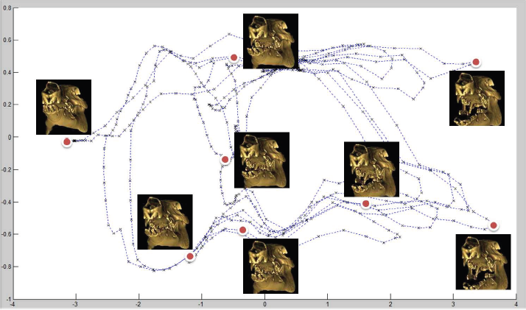
Visual Analytics Systems
Political Simulation
  Agent-based analysis
  With DARPA
Wire Fraud Detection
  With Bank of America
Bridge Maintenance
  With US DOT
  Exploring inspection reports
Biomechanical Motion
  Interactive motion comparison
R. Chang et al., Interactive Coordinated Multiple-View Visualization of Biomechanical Motion Data, IEEE Vis (TVCG) 2009.

Slide 9



Current Big Data Practice

Slide 10

Human+Computer in Big Data Analytics
Goal: Allow an analyst (user) to fluidly explore and analyze a large remote data warehouse from commodity hardware

Slide 11



Problem: Big Data is BIG and Far Away
Visualization on a
Commodity Hardware
Large Data in a
Data Warehouse

Slide 12
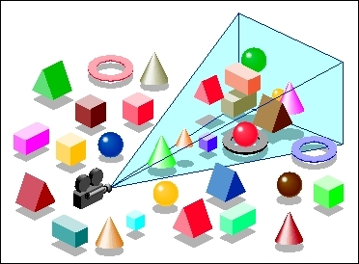
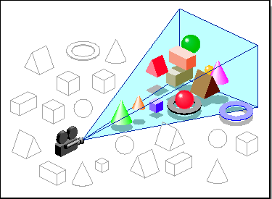
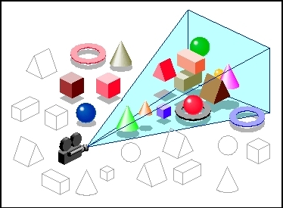
Approach: Predictive Prefetching

Slide 13

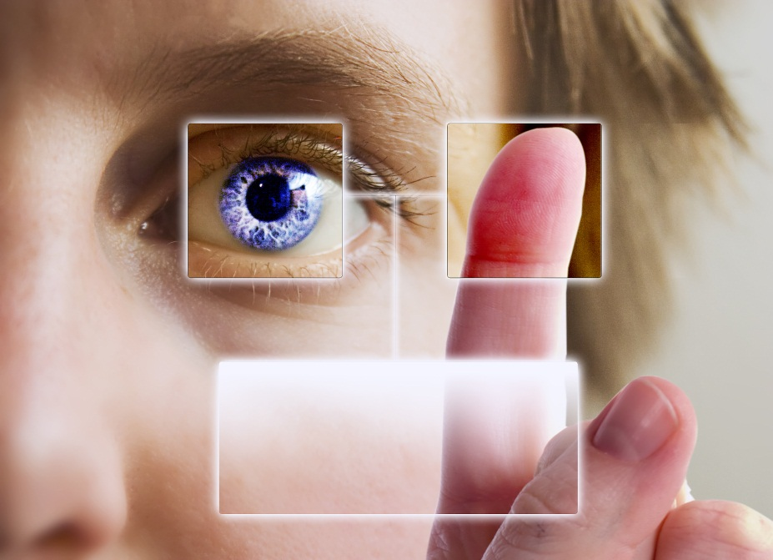
Predict User Behavior from User Interactions?

Slide 14
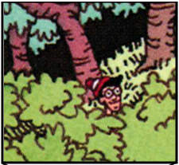
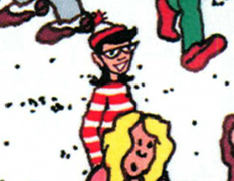
Experiment: Finding Waldo

Slide 15
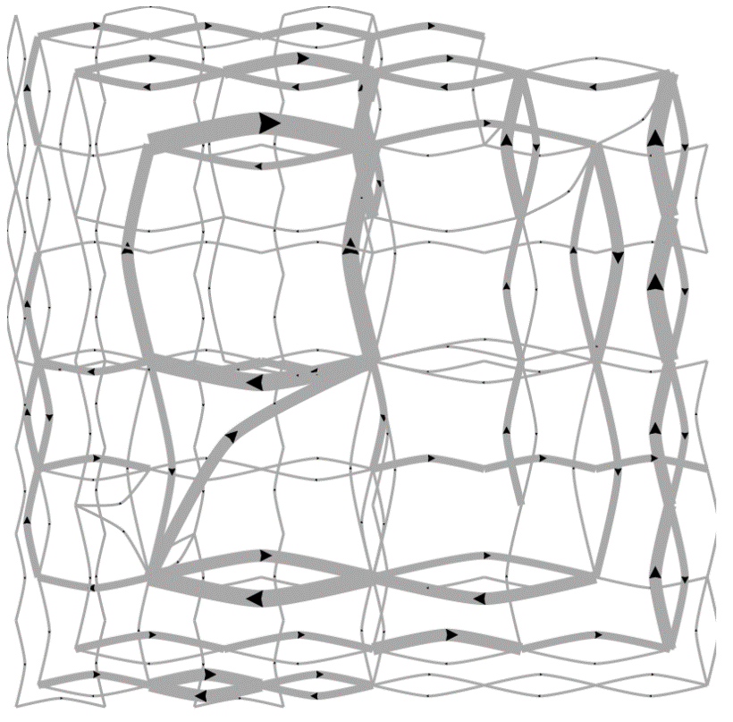
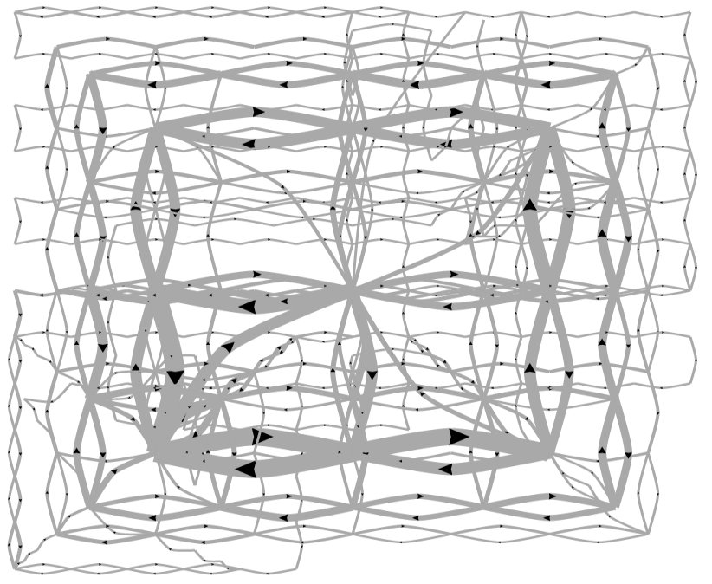
Predicting a User’s Completion Time
Fast completion time
Slow completion time

Slide 16
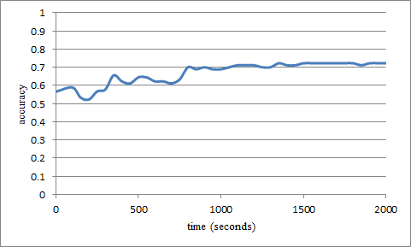
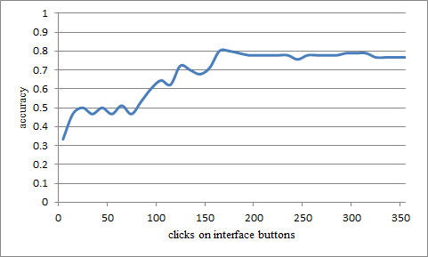
Analyses Results: Performance
Biometric (low-level mouse data)
Accuracy: ~70%
Interaction pattern (high-level button clicks)
Accuracy: ~80%

Slide 17
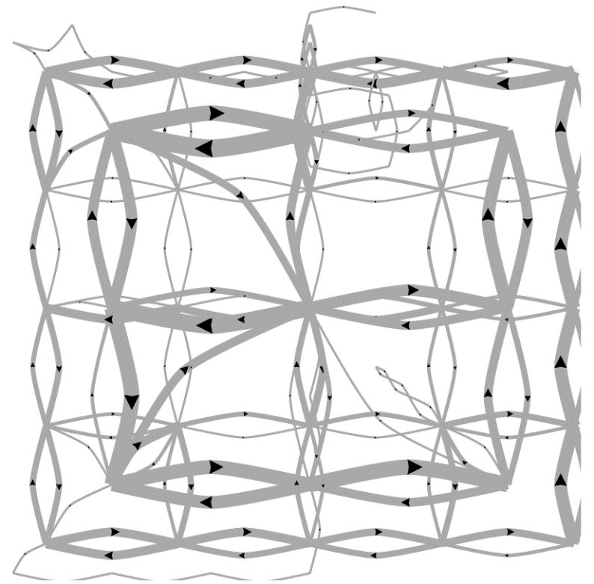
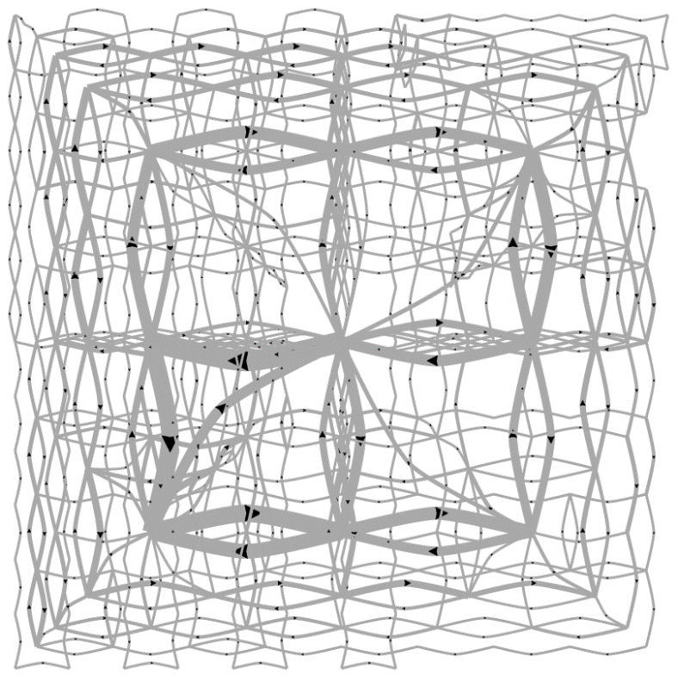
Predicting a User’s Personality
External Locus of Control
Internal Locus of Control
Ottley et al., How locus of control inﬂuences compatibility with visualization style. IEEE VAST , 2011.
Ottley et al., Understanding visualization by understanding individual users. IEEE CG&A, 2012.

Slide 18
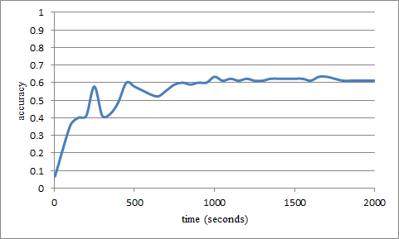
Analysis Results: Personality Traits
Predicting user’s “Extraversion”
Accuracy: ~60%
Noisy data, but can detect the users’ individual traits “Extraversion”, “Neuroticism”, and “Locus of Control” at ~60% accuracy by analyzing the user’s interactions alone.

Slide 19
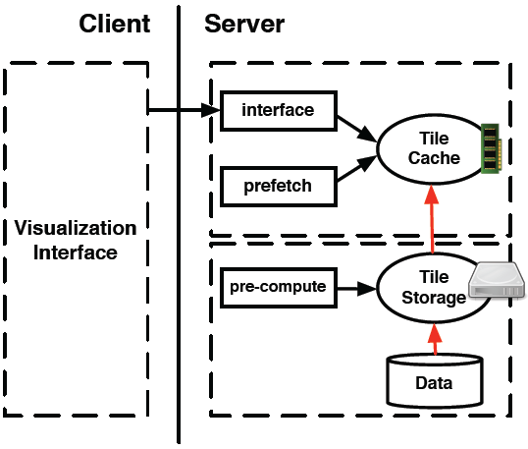
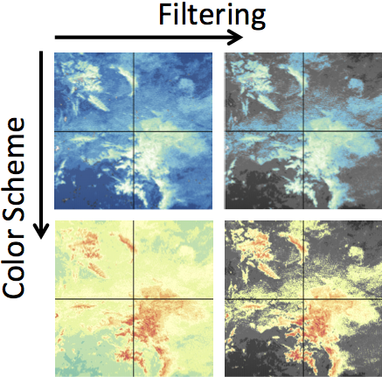
Wrap Up: Theory Into Practice
Developed a prototype system (ForeCache) in collaboration with the Big Data Center at MIT and researchers at Brown
Evaluated system with domain scientists using the NASA MODIS dataset (multi-sensory satellite imagery)
Remote analysis on commodity hardware shows (near) real-time interactive analysis

Slide 20


Questions?
Remco Chang
(remco@cs.tufts.edu)

