Slide 1

Knowledge Representation using Information Visualization
Remco Chang
Computer Science

Slide 2
Outline
Role of Information Visualization
  For storytelling
  For data analysis
  As knowledge externalization
Information Visualization at a Glance
  Data to visual element mapping
  Colors, perception, and cognitive biases
Projects at Tufts
  Just Noticeable Differences (JND)
  Bayesian Reasoning

Slide 3
Role of Information Visualization

Slide 4
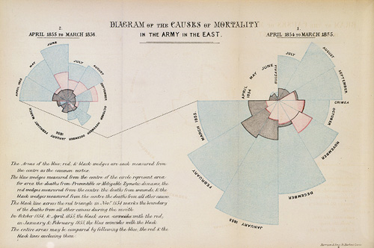
Storytelling: Nightingale’s Rose
Notes:
Florence Nightingale’s Coxcomb Plots
Blue wedge: deaths from preventable diseases
Red wedge: deaths from wounds
Black wedge: deaths other causes
April 1855 – March 1856
April 1854 – March 1855
Nightingale’s caring of wounded soldiers during the Crimean War
Her extensive reports and presentations convinced Queen Victoria to appoint a commission to change procedures in the military for better hygiene in the hospital, which kept many thousands of her soldiers alive.

Slide 5
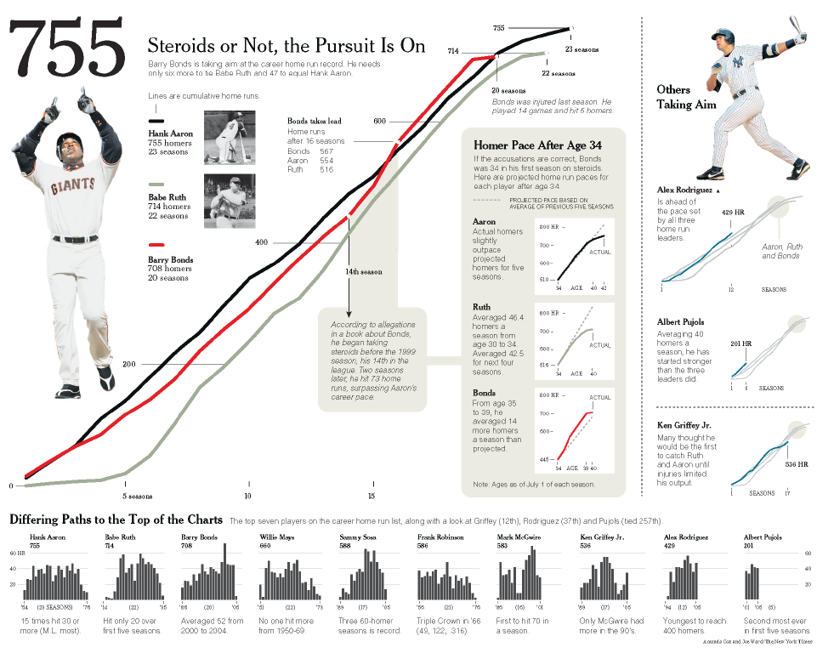
Storytelling: In Popular Media

Slide 6
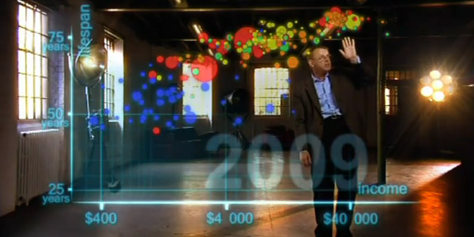
Storytelling: Hans Rosling’s Gapminder
http://www.youtube.com/watch?v=jbkSRLYSojo

Slide 7
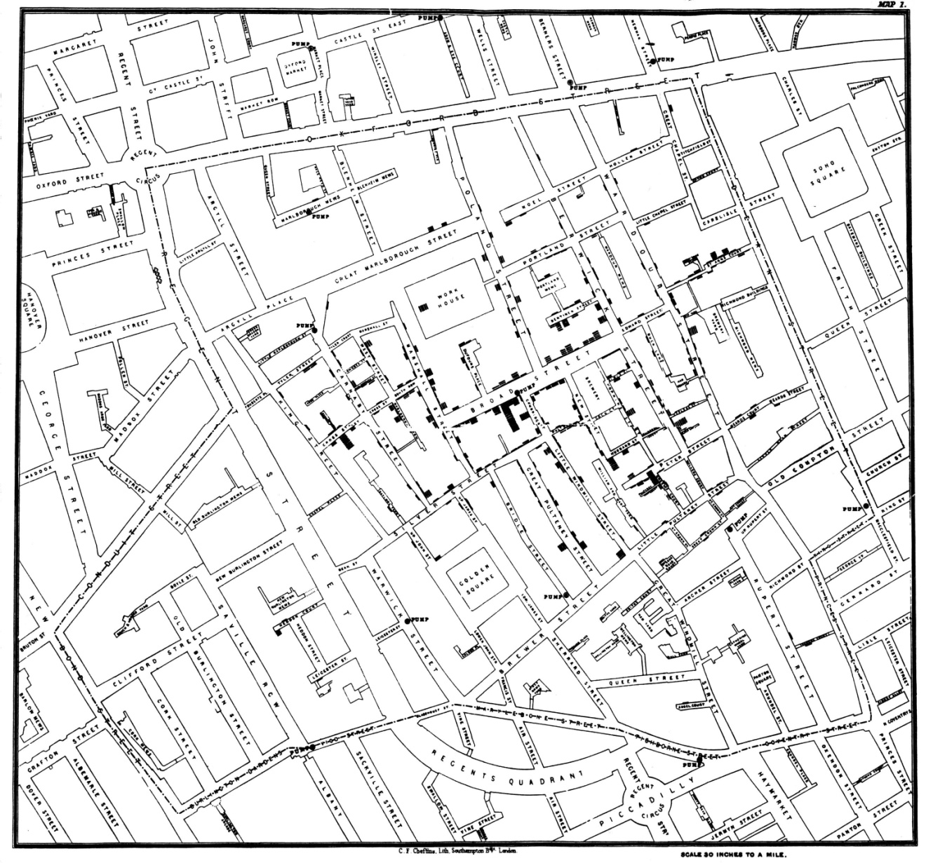
Data Analysis: Snow’s Map of Cholera
Notes:
I recently finished reading a wonderful book by Steven Johnson entitled The Ghost Map: The Story of London’s Most Terrifying Epidemic – and How It Changed Science, Cities, and the Modern World. In the summer of 1854 cholera swept through a section of London with unprecedented intensity. At the time, the cause of cholera was unknown and rapidly growing modern cities such as London, with dense populations packed into small areas, were rich breeding grounds for this disease. Most of those who concerned themselves with disease and its cure held tightly to the miasma theory that cholera spread through the air and was associated with the bad smells and the unclean urban environments that produced them. In fact, cholera is a bacterium, which was spreading through the water supply. This book tells the story much as a journalist who witnessed it firsthand would do, but a journalist who had the advantage of hindsight informed by knowledge of modern medicine.
Several people of the time play important roles in this story – none more than John Snow, a medical doctor and research scientist. The ghost map refers to a map that he drew by hand during the process of his investigations, which could clearly demonstrate to anyone with open eyes that the source of the outbreak was the Broad Street well. Despite the evidence that this map displayed, however, the miasma theory of cholera transmission prevailed for several years after the epidemic. Eventually, due largely to the tenacious efforts of John Snow and an unlikely supporter, Reverend Henry Whitehead, the evidence won out and steps were taken to eliminate the conditions in which cholera could spread.

Slide 8
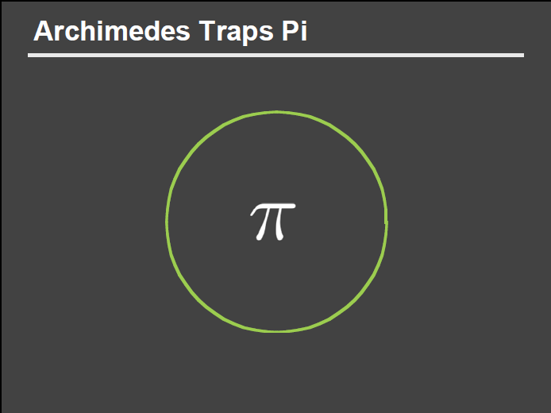
Data Analysis: Trapping Pi
Analysis
Slide courtesy of Dr. Pat Hanrahan, Stanford

Slide 9
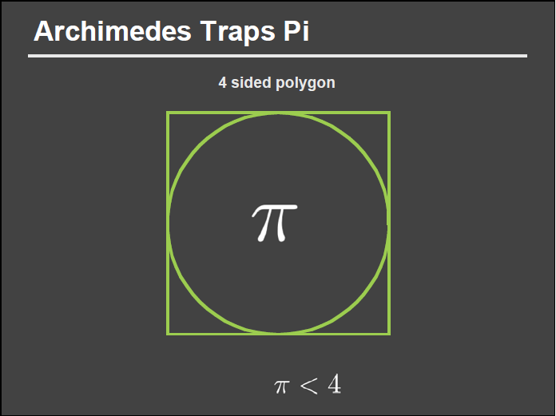
Data Analysis: Trapping Pi
Analysis
Slide courtesy of Dr. Pat Hanrahan, Stanford

Slide 10
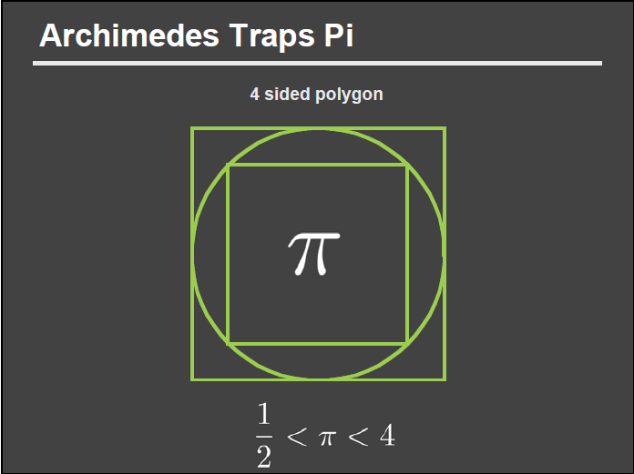
Data Analysis: Trapping Pi
Analysis
Slide courtesy of Dr. Pat Hanrahan, Stanford

Slide 11
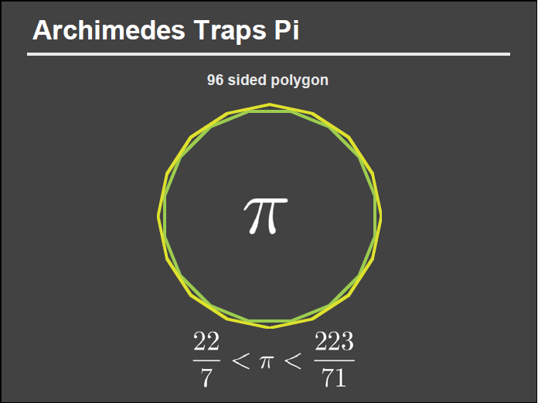
Data Analysis: Trapping Pi
Analysis
>
>
Slide courtesy of Dr. Pat Hanrahan, Stanford
Notes:
22/7: 3.14286
223/71: 3.140845

Slide 12
Data Analysis: Trapping Pi
Analysis
3.14286
>
3.140845
>
Slide courtesy of Dr. Pat Hanrahan, Stanford
Notes:
22/7: 3.14286
223/71: 3.140845

Slide 13
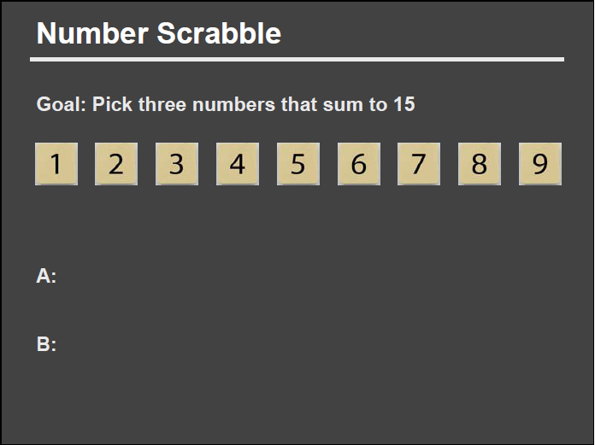
Knowledge Externalization: Number Scrabble
Slide courtesy of Dr. Pat Hanrahan, Stanford

Slide 14
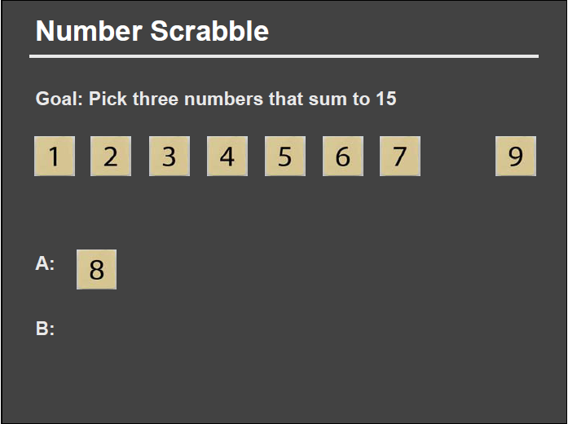
Knowledge Externalization: Number Scrabble
Slide courtesy of Dr. Pat Hanrahan, Stanford

Slide 15
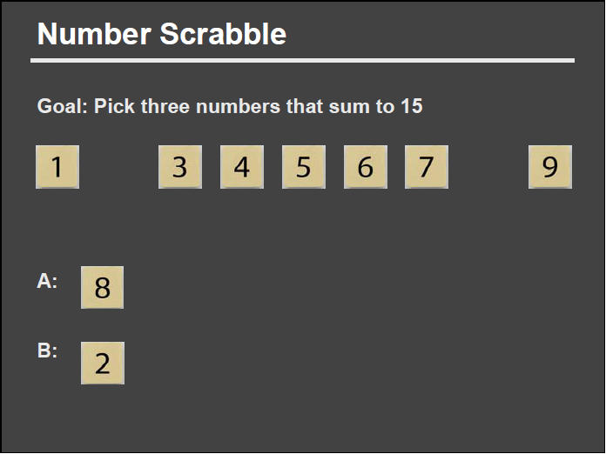
Knowledge Externalization: Number Scrabble
Slide courtesy of Dr. Pat Hanrahan, Stanford

Slide 16
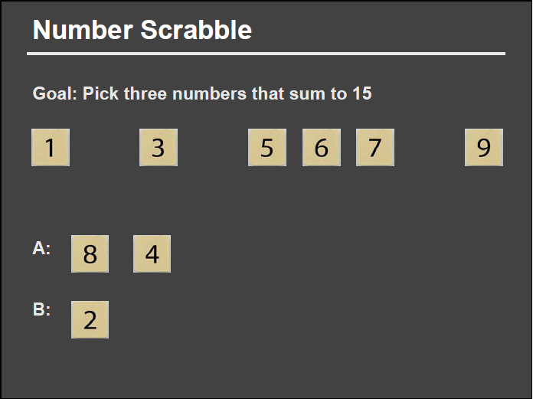
Knowledge Externalization: Number Scrabble
Slide courtesy of Dr. Pat Hanrahan, Stanford

Slide 17
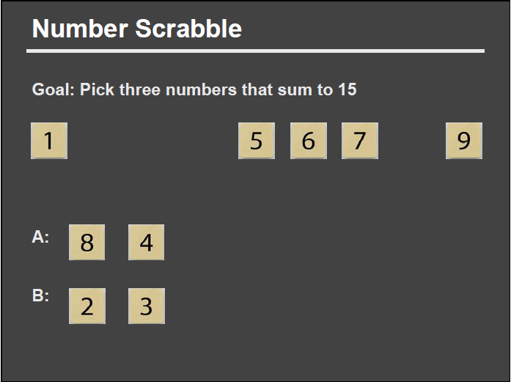
Knowledge Externalization: Number Scrabble
Slide courtesy of Dr. Pat Hanrahan, Stanford

Slide 18
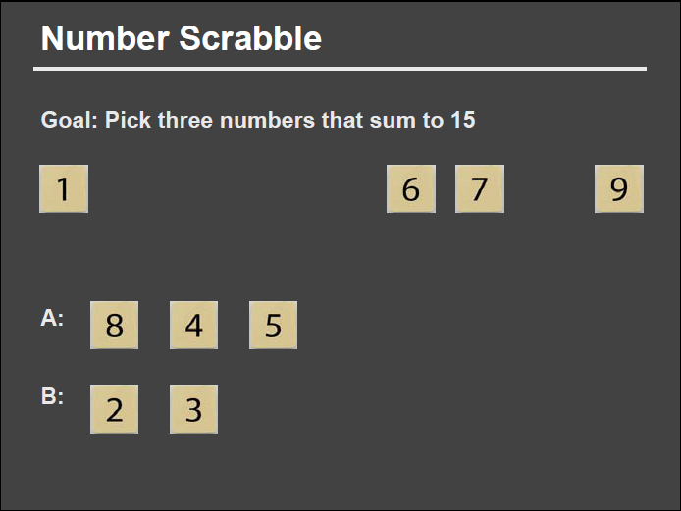
Knowledge Externalization: Number Scrabble
Slide courtesy of Dr. Pat Hanrahan, Stanford

Slide 19

Knowledge Externalization: Number Scrabble
Slide courtesy of Dr. Pat Hanrahan, Stanford

Slide 20
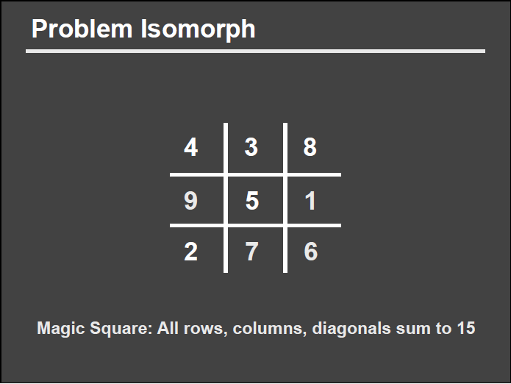
Knowledge Externalization: Number Scrabble
Slide courtesy of Dr. Pat Hanrahan, Stanford

Slide 21
Knowledge Externalization: Number Scrabble
Slide courtesy of Dr. Pat Hanrahan, Stanford

Slide 22
Knowledge Externalization: Number Scrabble
Slide courtesy of Dr. Pat Hanrahan, Stanford

Slide 23
Knowledge Externalization: Number Scrabble
Slide courtesy of Dr. Pat Hanrahan, Stanford

Slide 24
Knowledge Externalization: Number Scrabble
Slide courtesy of Dr. Pat Hanrahan, Stanford

Slide 25
Knowledge Externalization: Number Scrabble
Slide courtesy of Dr. Pat Hanrahan, Stanford

Slide 26
Knowledge Externalization: Number Scrabble
?
Slide courtesy of Dr. Pat Hanrahan, Stanford

Slide 27
Knowledge Externalization: Number Representations
Zhang and Norman (1995). The Representation Of Numbers. Cognition.

Slide 28
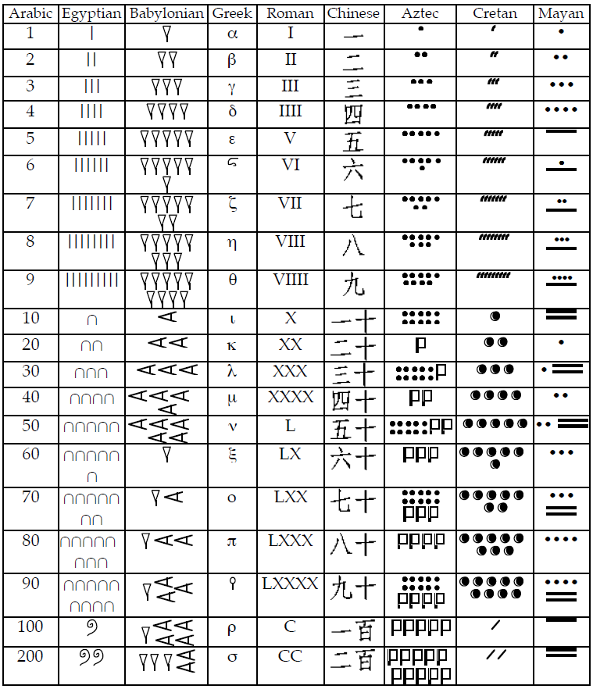
Knowledge Externalization: Number Representations

Slide 29
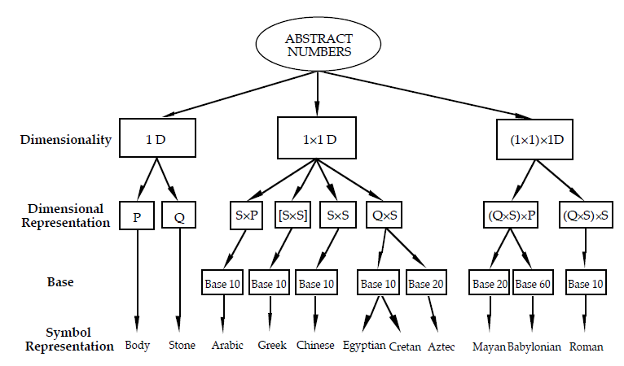
Knowledge Externalization: Number Representations

Slide 30
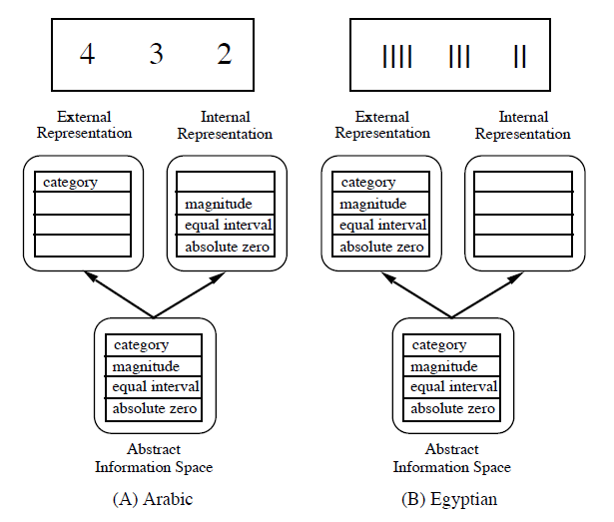
Knowledge Externalization: Number Representations

Slide 31
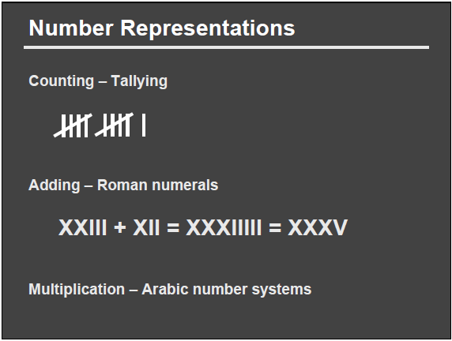
Knowledge Externalization: Number Representations
Slide courtesy of Pat Hanrahan

Slide 32
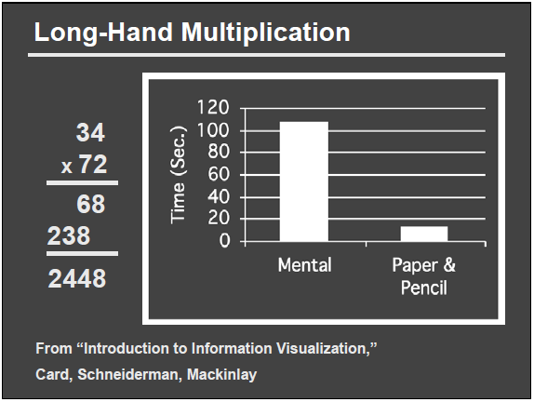
Knowledge Externalization: Number Representations
Slide courtesy of Pat Hanrahan

Slide 33
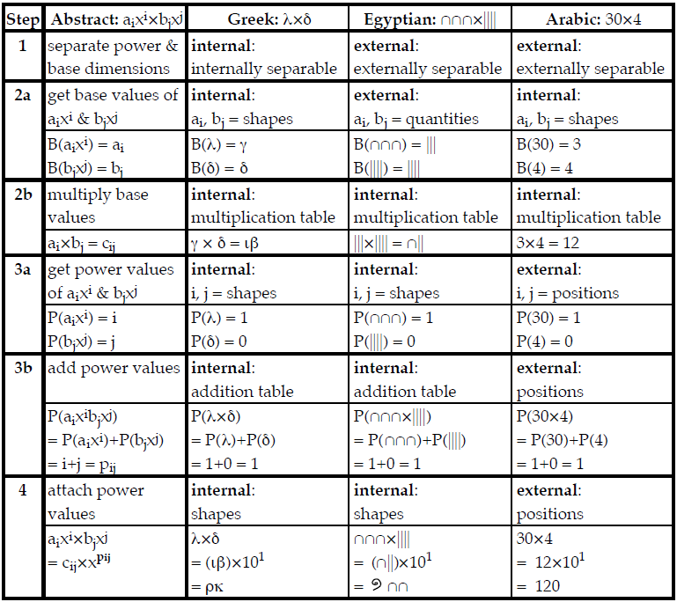
Knowledge Externalization: Number Representations

Slide 34
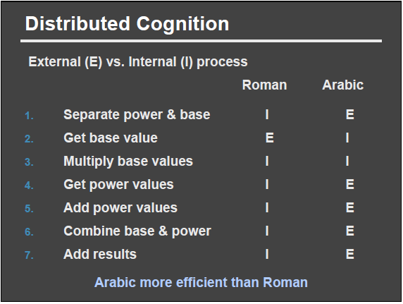
Knowledge Externalization: Number Representations
Slide courtesy of Pat Hanrahan

Slide 35
Information Visualization at a Glance

Slide 36
Information Visualization, a Summary
Unfortunately, while the visualization of information holds a great deal of promise for storytelling, data analysis, and knowledge externalization, there is still no principled way of creating effective visualizations.
The three major theoretical underpinnings for information visualization remain very “low level”:
  Color theory
  Perceptual theory
  Data-visual mapping

Slide 37
Information Visualization, a Summary (2)
As such, the field remains in an “exploratory” phase where:
  We design new visualizations based on intuition and creativity
  And we test their effectiveness against the current state of the art
  And we hope that through these evaluations, we being to understand “why” some visual designs are more effective than others
This is why collaboration with Psych and Cog Sci is so important!
  It affords a “model-driven” approach to understanding visualization
  We can borrow known models or theories (such as distributed cognition) to better understand visualization practice

Slide 38
Basic Data Types
Nominal
Ordinal
Scale / Quantitative
  Interval
  ratio
Def: A set of not-ordered and non-numeric values
For example:
Categorical (finite) data
  {apple, orange, pear}
  {red, green, blue}
Arbitrary (infinite) data
  {“12 Main St. Boston MA”, “45 Wall St. New York NY”, …}
  {“John Smith”, “Jane Doe”, …}

Slide 39
Basic Data Types
Nominal
Ordinal
Scale / Quantitative
  Interval
  ratio
Def: A tuple (an ordered set)
For example:
Numeric
  <2, 4, 6, 8>
Binary
  <0, 1>
Non-numeric
  <G, PG, PG-13, R>

Slide 40
Basic Data Types
Nominal
Ordinal
Scale / Quantitative
  Interval
  ratio
Def: A numeric range
Interval
  Ordered numeric elements on a scale that can be mathematically manipulated, but cannot be compared as ratios
  For example: date, current time
    (Sept 14, 2010 cannot be described as a ratio of Jan 1, 2011)
Ratio
  where there exists an “absolute zero”
  For example: height, weight

Slide 41
Basic Data Types (Formal)
Nominal (N) {…}
Ordinal (O) <…>
Scale / Quantitative (Q) […]
Q → O
  [0, 100] → <F, D, C, B, A>
O → N
  <F, D, C, B, A> → {C, B, F, D, A}
N → O (??)
  {John, Mike, Bob} → <Bob, John, Mike>
  {red, green, blue} → <blue, green, red>??
O → Q (??)
  Hashing?
  Bob + John = ??
Readings in Information Visualization: Using Vision To Think. Card, Mackinglay, Schneiderman, 1999

Slide 42
Operations on Basic Data Types
What are the operations that we can perform on these data types?
  Nominal (N)
    = and ≠
  Ordinal (O)
    >, <, ≥, ≤
  Scale / Quantitative (Q)
    everything else (+, -, *, /, etc.)
Consider a distance function

Slide 43
Connecting Data To Visualization
Data have attributes (dimensions)
Visualizations have attributes (dimensions)
Can the two map to each other?
Jacques Bertin, Semiologie Graphique (Semiology of Graphcis), 1967.

Slide 44

Elements of Visualization
Images are composed of marks: “ink”, graphical primitives
Slide courtesy of Sara Su

Slide 45
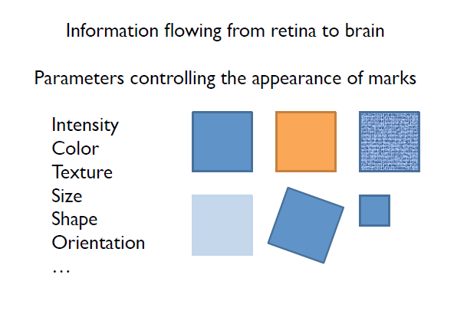
Visual Channels

Slide 46
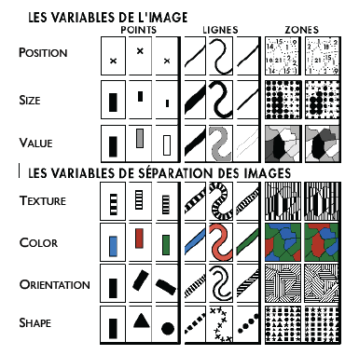
Elements of Visualization
Slide courtesy of Sara Su

Slide 47
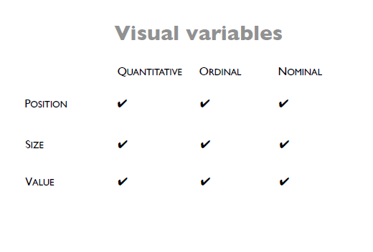

Slide 48
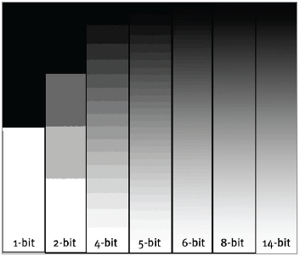
Value (Intensity)
Discrete or Continuous?
Slide courtesy of Sara Su

Slide 49
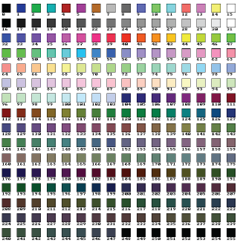
Color (Hue)
Discrete or Continuous?
Slide courtesy of Sara Su

Slide 50
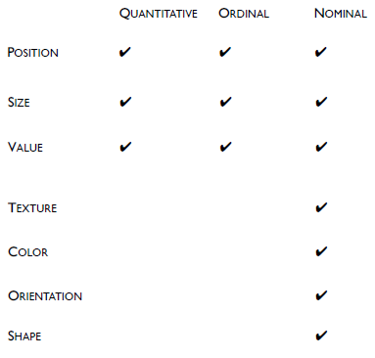
Visual Variables
Slide courtesy of Sara Su

Slide 51
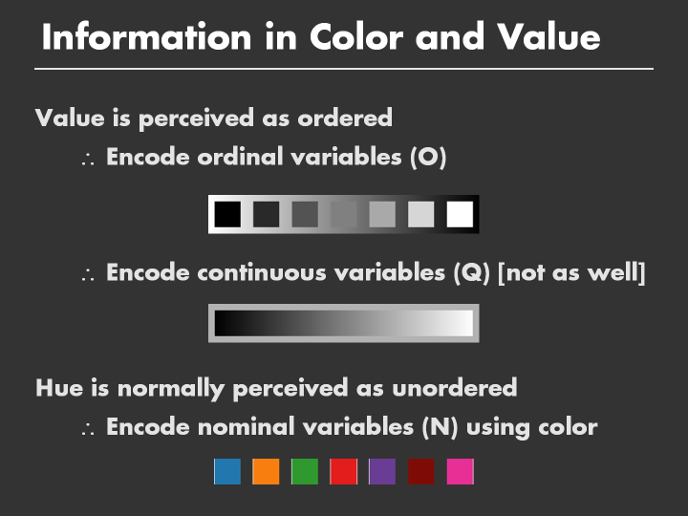

Slide 52
Vibrant Industry
These (very basic) principles have led to a multi-billion dollar industry in data visualization, in particular in business intelligence and national defense.
  Tableau, Spotfire, SAS, etc.
When combined with some interactive interfaces, we can build very sophisticated tools and software.

Slide 53




Example Visual Analytics Systems
Political Simulation
  Agent-based analysis
  With DARPA
Wire Fraud Detection
  With Bank of America
Bridge Maintenance
  With US DOT
  Exploring inspection reports
Biomechanical Motion
  Interactive motion comparison
Crouser et al., Two Visualization Tools for Analysis of Agent-Based Simulations in Political Science. IEEE CG&A, 2012

Slide 54
Example Visual Analytics Systems
Political Simulation
  Agent-based analysis
  With DARPA
Wire Fraud Detection
  With Bank of America
Bridge Maintenance
  With US DOT
  Exploring inspection reports
Biomechanical Motion
  Interactive motion comparison
R. Chang et al., WireVis: Visualization of Categorical, Time-Varying Data From Financial Transactions, VAST 2008.

Slide 55



Example Visual Analytics Systems
Political Simulation
  Agent-based analysis
  With DARPA
Wire Fraud Detection
  With Bank of America
Bridge Maintenance
  With US DOT
  Exploring inspection reports
Biomechanical Motion
  Interactive motion comparison
R. Chang et al., An Interactive Visual Analytics System for Bridge Management, Journal of Computer Graphics Forum, 2010.

Slide 56


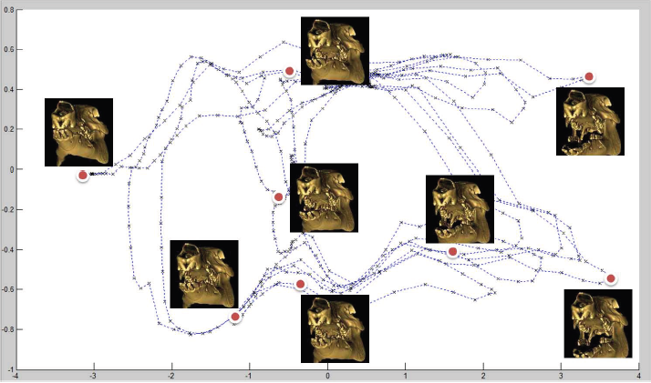
Example Visual Analytics Systems
Political Simulation
  Agent-based analysis
  With DARPA
Wire Fraud Detection
  With Bank of America
Bridge Maintenance
  With US DOT
  Exploring inspection reports
Biomechanical Motion
  Interactive motion comparison
R. Chang et al., Interactive Coordinated Multiple-View Visualization of Biomechanical Motion Data, IEEE Vis (TVCG) 2009.

Slide 57
Great Start, but…
The data-visual mapping principles are very much limited because it does not include the notion of “task” or “intent”
Consider the following and determine which of them is more appropriate

Slide 58
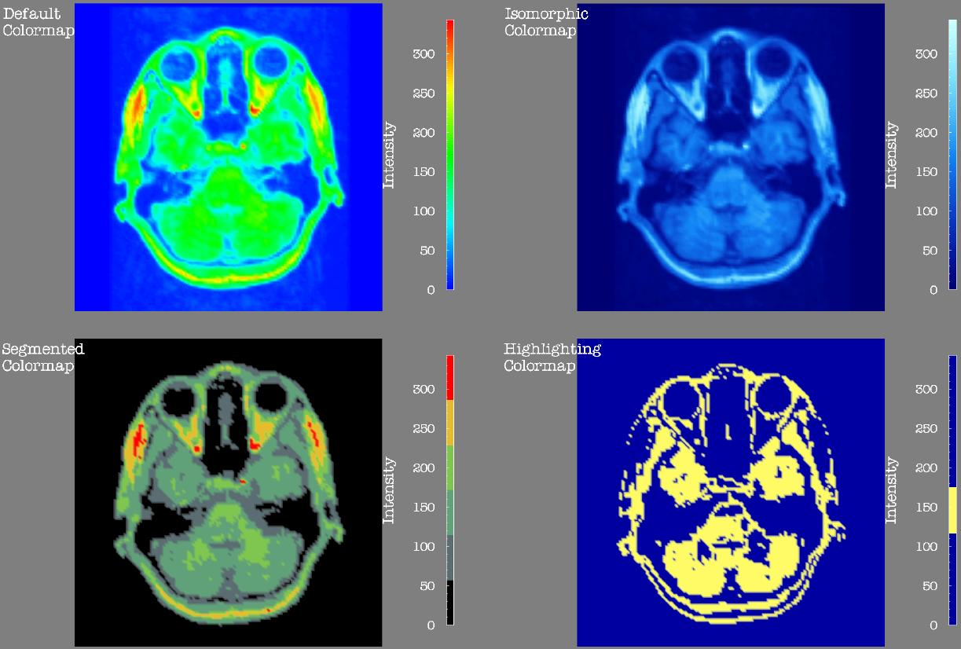
Using Visualization to Influence?

Slide 59
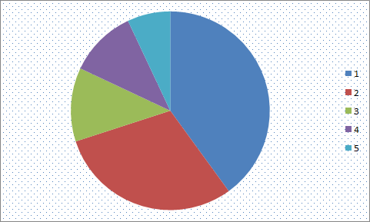
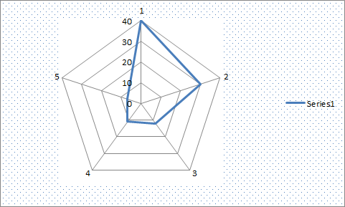
Appropriateness?
Which data dimension should be mapped to what visual variable?

Slide 60
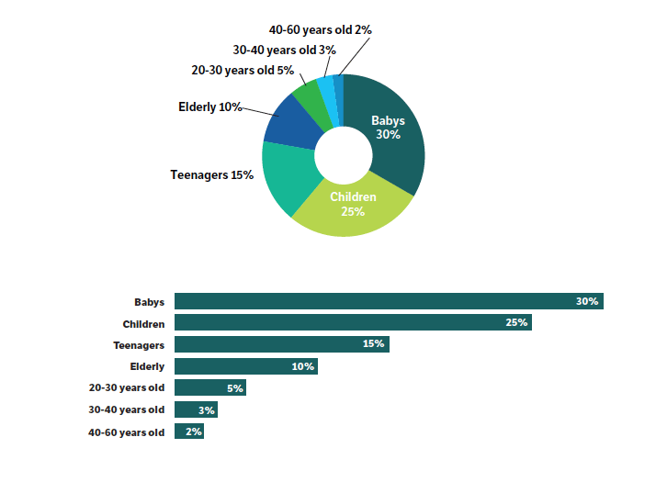
Appropriateness?

Slide 61
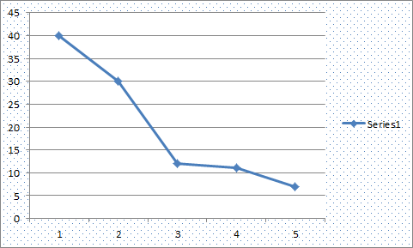
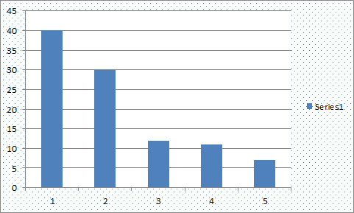
Appropriateness?

Slide 62
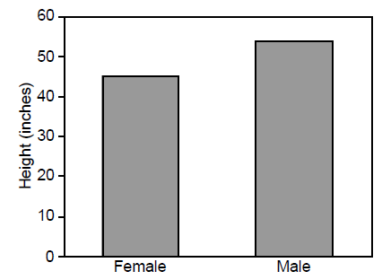
Structure and Form
Image courtesy of Barbara Tversky

Slide 63
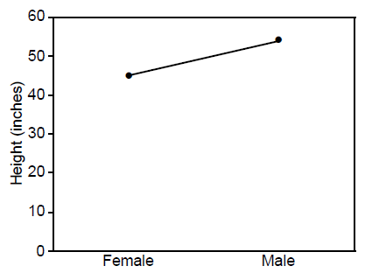
Structure and Form
Image courtesy of Barbara Tversky

Slide 64
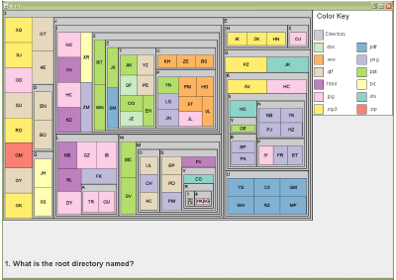
Visual Metaphors
Image courtesy Caroline Ziemkiewicz

Slide 65
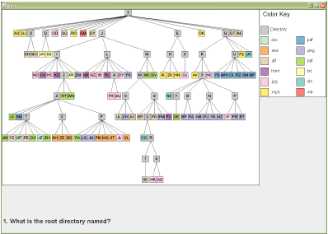
Visual Metaphors

Slide 66
Projects at Tufts
1) Just Noticeable Differences

Slide 67
Visual Embedding
To this end, Demiralp et al. have proposed that we consider visual encoding in the context of data encoding

Slide 68
A Concrete Example
Let’s say that I want to visualize (real) numbers from 0 to 1.
One way we can visualize it is by using color
  Since the data is continuous, we choose to use a continuous color scale from Red to Blue
This is problematic because the two spaces are not a match!
  Red -> Blue will go through White, which is visually salient, and usually perceived as “neutral”
  Given the data, White will be mapped to an unremarkable 0.5.

Slide 69
Implication…
This implies that we need to understand what the “model space” for visual primitives are…
While I agree with the left figure, I am less optimistic about the right figure…

Slide 70
Visual Markings
There have been ample evidence to show that there are “interference” effects between different visual markings
An example of interference between icon spacing (representing a linear variable) and icon brightness (representing a more general scalar ﬁeld). Areas of high brightness create false lower-spacing regions.

Slide 71
Models, Models, Models
Given the exponential growth of possible pairings of visual markings (and their interactions), testing all permutations is infeasible…
What we need then, are generalizable perceptual models!

Slide 72
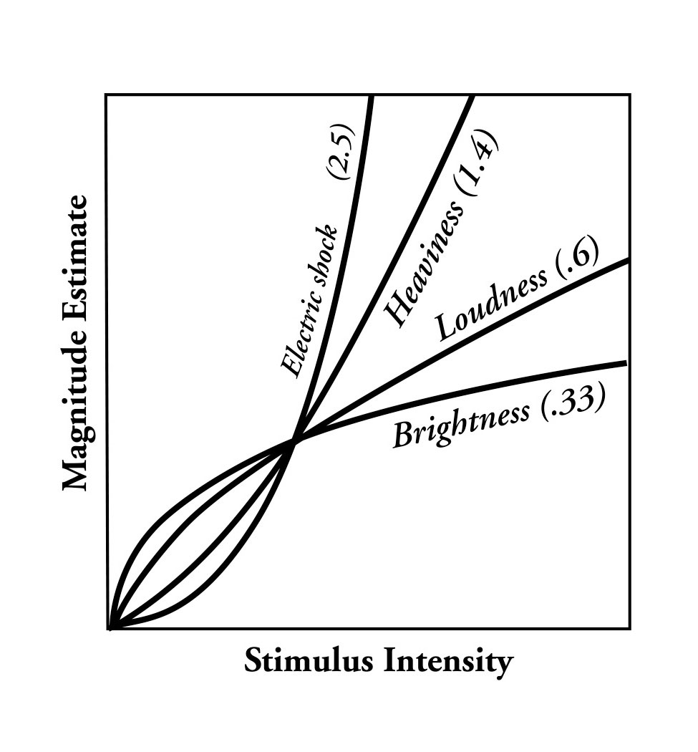
Weber’s Law
The general notion of Weber’s Law (or Steven’s Power Law) is relatively well understood.
The finding is intuitive, that there’s an inverse logarithmic relationship between stimulus intensity and perceived intensity

Slide 73
Perception of Correlation as Weber’s Law
Rensink (2010) showed that our perception of correlation using scatterplot follows the Weber’s Law…

Slide 74
Perception of Correlation as Weber’s Law

Slide 75
A “Perceptually Optimal” Model?
This is remarkable! A model means no more painstaking testing of every parameter!
Given this model, some obvious questions:
  Do all bivariate visualizations of correlations follow Weber’s Law?
  Assume that the “curves” are different, can we use this to determine if one visualization is categorically better than another???

Slide 76
Our Project…
Goals:
Replicate Rensink’s results using Mechanical Turk
Test out a slew of (common) bivariate visualizations
Compare the results

Slide 77
1. Replication on MTurk
(Left) Rensink’s lab result; (Right) Our MTurk result

Slide 78
2. Other Visualizations
Scatter plot
Two lines
Parallel coordinates
Stacked bar
Donut
Radar

Slide 80
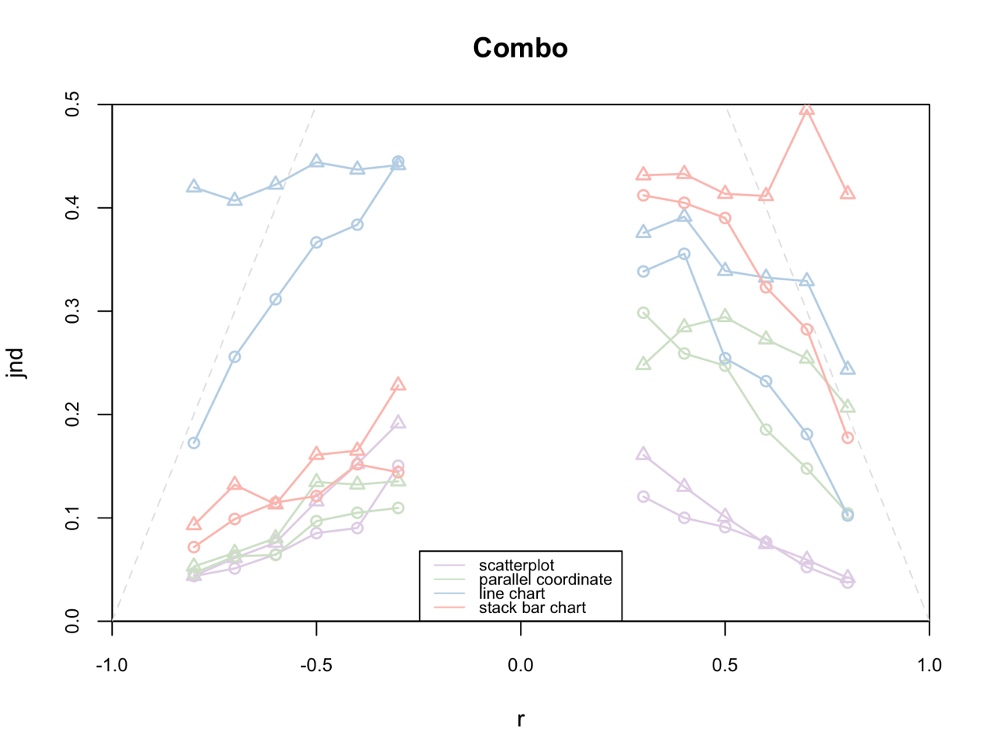
3. Compare Them!

Slide 81
Open Questions
Why do some visualizations obey Weber’s Law and some don’t?
  We might have some idea on this one…
Can this approach be used for evaluating data properties?
Have we really escaped the “interactions” problem between visual variables?
  The “constants” in this experiment are pretty strict… Screen width/height, number of data points, the type of correlation, etc.
How much should companies pay us for such amazing results??
  If they don’t, are we missing a next step? (e.g. automated adaptive visualizations?)

Slide 82
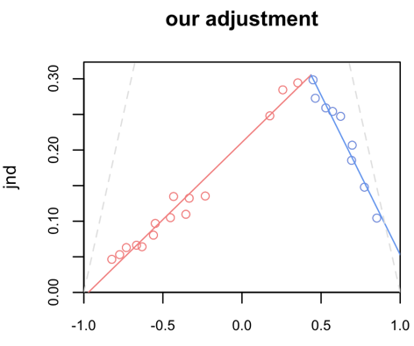
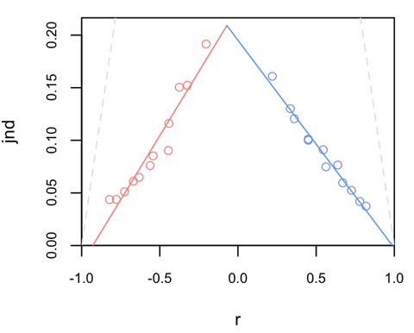
Visual Features…
What visual patterns do you look for?
Why?
What happens when it’s ambiguous?
Scatter Plot
Parallel Coordinates

Slide 83
Projects at Tufts
2) Bayesian Reasoning

Slide 84
Information Presentation vs. Analysis Aide
For the purpose of information presentation, the previous “perceptually driven” approach works great
For data analysis, do visualizations help?
  Presumably, yes (or at least so we want to believe)
  But there are **SO MANY** more variables to consider!!

Slide 85
Problem: Bayes Reasoning
The probability that a woman over age 40 has breast cancer is 1%. However, the probability that mammography accurately detects the disease is 80% with a false positive rate of 9.6%.
If a 40-year old woman tests positive in a mammography exam, what is the probability that she indeed has breast cancer?
Answer: Bayes’ theorem states that P(A|B) = P(B|A) * P(A) / P(B). In this case, A is having breast cancer, B is testing positive with mammography. P(A|B) is the probability of a person having breast cancer given that the person is tested positive with mammography. P(B|A) is given as 80%, or 0.8, P(A) is given as 1%, or 0.01. P(B) is not explicitly stated, but can be computed as P(B,A)+P(B,˜A), or the probability of testing positive and the patient having cancer plus the probability of testing positive and the patient not having cancer. Since P(B,A) is equal 0.8*0.01 = 0.008, and P(B,˜A) is 0.093 * (1-0.01) = 0.09207, P(B) can be computed as 0.008+0.09207 = 0.1007. Finally, P(A|B) is therefore 0.8 * 0.01 / 0.1007, which is equal to 0.07944.

Slide 86
Bayes Problem
This problem has baffled doctors, patients, decision makers…
  In a previous study, it’s been shown that doctors get this right about 30% of the time…
  Has great societal impact!
This problem seems perfect for visualizations!
  It has data
  It requires some logic and mental manipulation
Question:
  Which visualization?

Slide 87
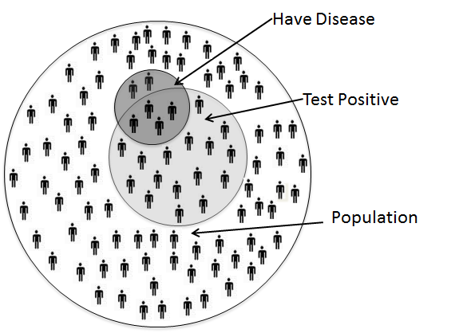
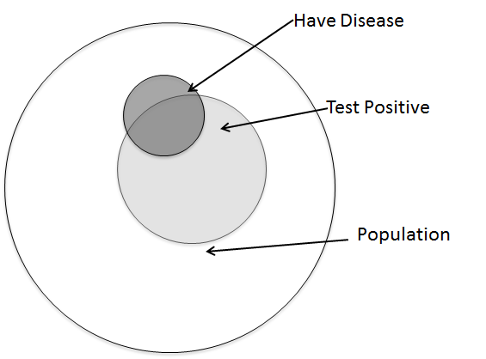
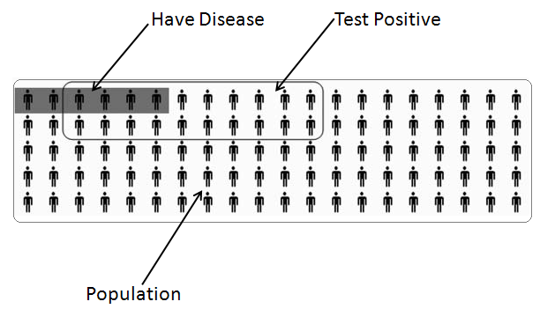
As It Turns Out…

Slide 88
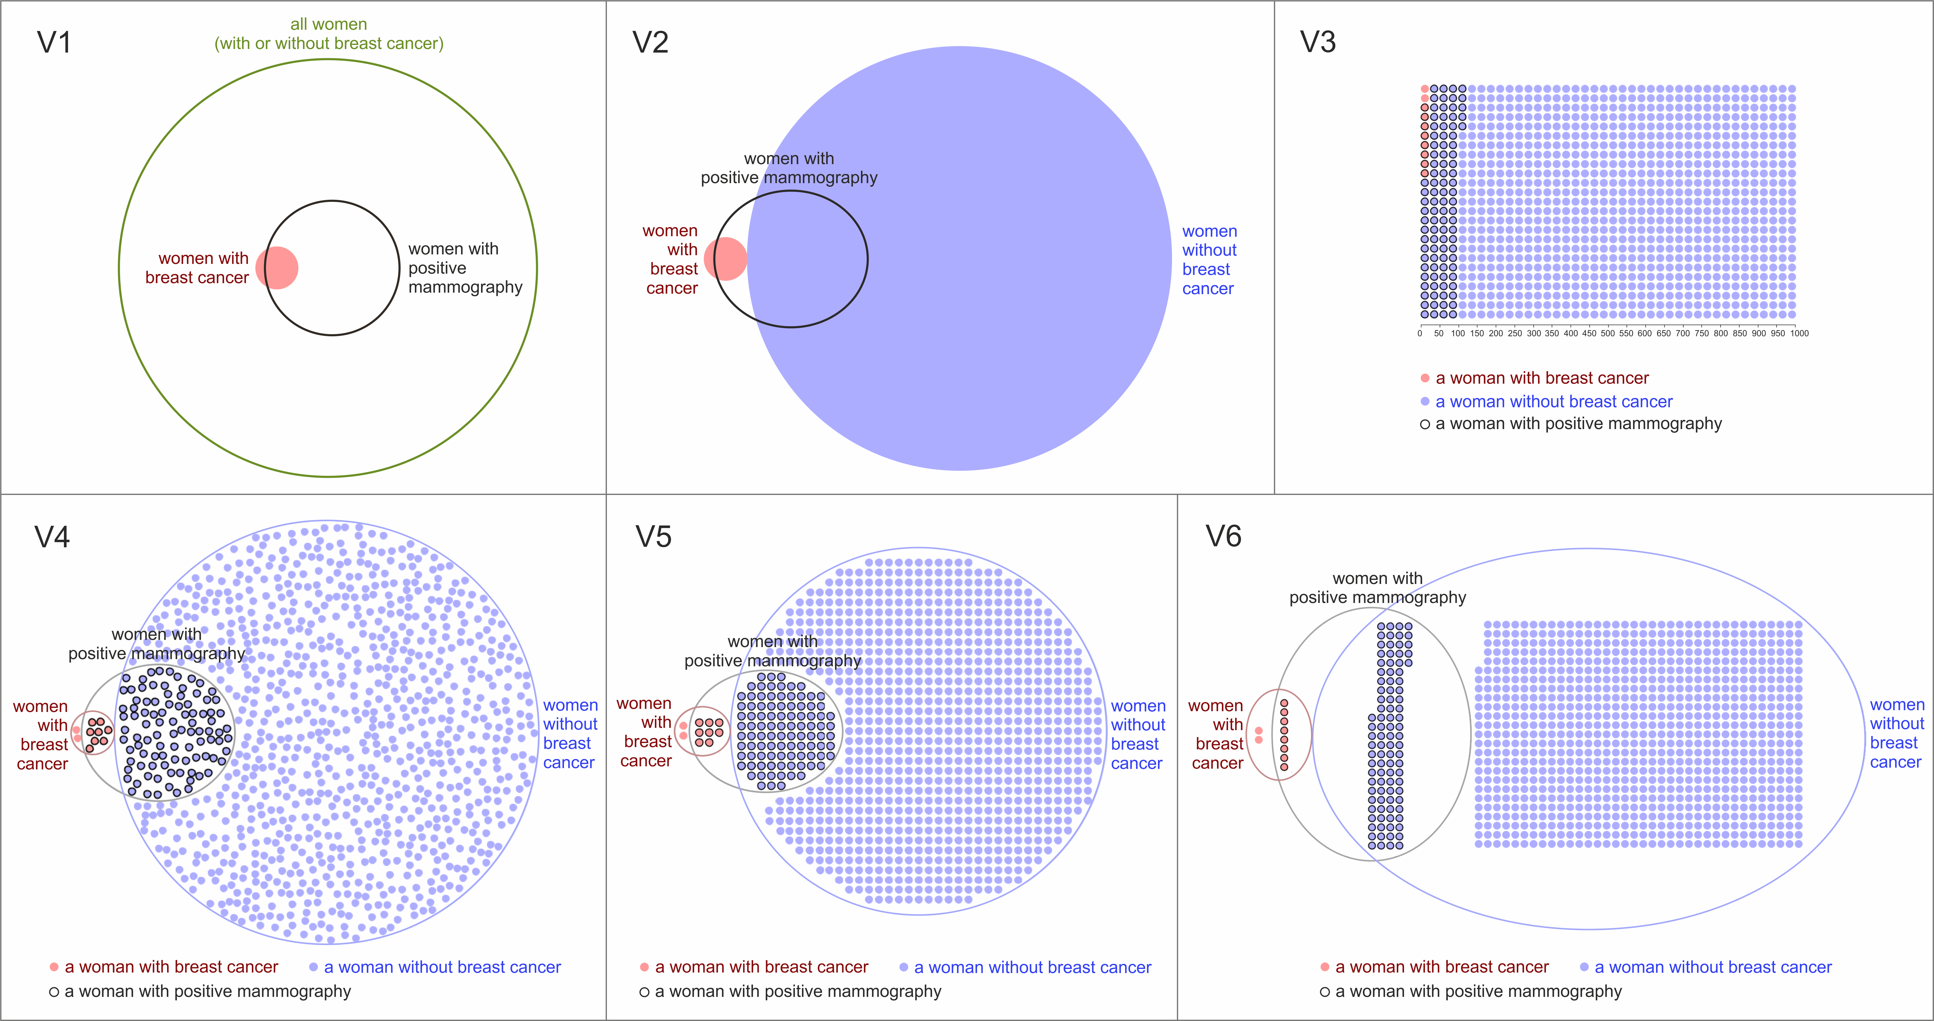
As It Turns Out…

Slide 89
WHAT?
Really? That’s so depressing!!
Did we do something wrong?
  Wrong visual encoding?
  Wrong visualization metaphor?
Or is it that visualizations are truly useless?

Slide 90
Hypothesis
Based on Kellen (2012), here’s a hypothesis of what’s going on:
  When the task is difficult, the participant perceived the text and the visualization separately as two disconnected problems
  So effectively, the participant is solving the same problem twice, each time using a different strategy (text vs. visual)

Slide 91
In Other Words…
Given this hypothesis, it seems that it should be theoretically possible for a visualization to be “harmful”
  For example, if the participant solves the problem twice and got two very different answers
Question then is, when is a visualization harmful, and how to make it do more good than bad?

Slide 92
Multi-Pronged Problem
There are numerous issues happening simultaneously.
  Text: the structure and method of the problem narrative has been examined extensively. Gigerenzer (1995) has noted that natural frequency is better than percentage (i.e., instead of 1%, say 1 out of 100)
  Training: for practical reasons, many people have looked at effective methods for training doctors (domain experts). With training, people can solve this problem effectively
  Visualization design: many people have investigated effective ways for communicating uncertainty, but the result is a bit of a mixed-bag.
  Individual differences: perhaps the problem is not with the presentation itself, but how different people perceive the same information differently…

Slide 93
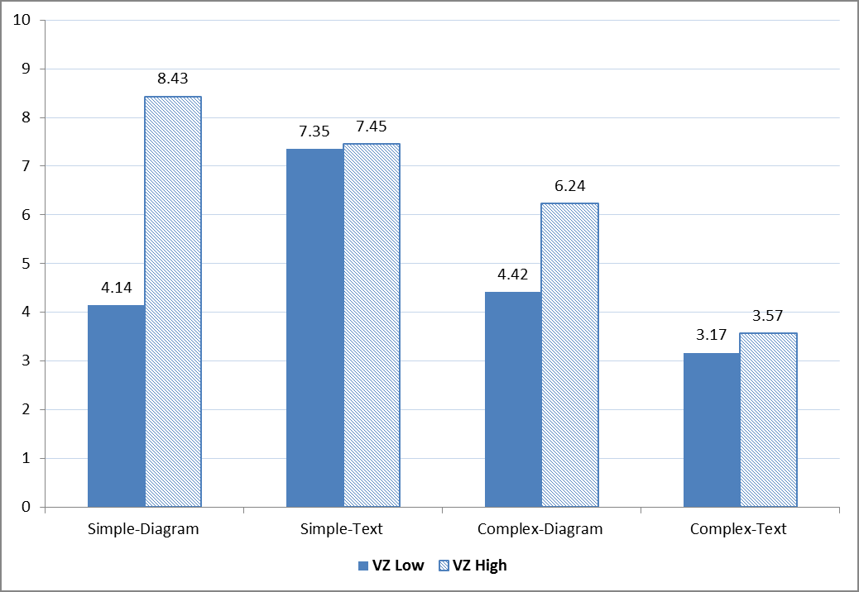
Individual Differences
Kellen suspected that the difference does not lie (entirely) in the visualization design, but in the users of the visualization…
In particular, Kellen suggested that spatial ability is the key factor.

Slide 94
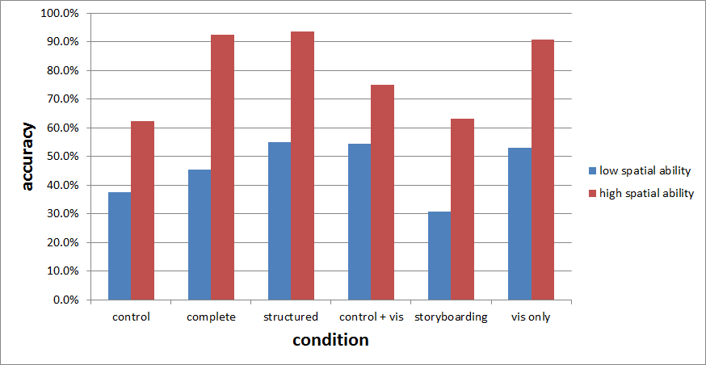
Different Representation Styles

Slide 95

Different Representation Styles

Slide 96
Conditions:
Control
Structured Text
Complete (Unstructured Text)
Control + Vis
Storyboarding
Vis Only

Slide 97

Conditions: Structured Text

Slide 98

Complete (Unstructured Text)

Slide 99


Condition: Storyboarding

Slide 100

Differences in Spatial Abilities
For those who got the correct answers, here are the average spatial ability scores

Slide 101
Modifying the Text
One important thing to note is that we have modified the Text question from its original format
There is a total of 1000 people in the population. Out of the 1000 people in the population, 10 people actually have the disease X. Out of these 10 people, 8 will receive a positive test result and 2 will receive a negative test result. On the other hand, 990 people do not have the disease (that is, they are perfectly healthy). Out of these 990 people, 95 will receive a positive test result and 895 will receive a negative test result.
The probability that a person has the disease X is 1%. However, the probability that a screening test accurately detects the disease is 80% with a false positive rate of 9.6%.

Slide 102
Modifying the Question
In addition, we have preliminary evidence that asking one question instead of two increases people’s accuracy:
Out of a new representative sample of people, how many of them will receive a positive screening test result?
Of those people, how many will actually have the disease?
what is the probability that a person indeed has disease X?

Slide 103
Lots of Open Questions!
Recall Kellen’s original hypothesis that when the text problem is hard, the addition of a visualization can be harmful
We did not see this problem because we have tuned our text problem to be significantly easier (except for the Storyboarding condition)

Slide 104
Discussion and Questions
Our goal is to transform the way that patients are told their screening test results
Not only do we want to increase accuracy, but we also want to use this opportunity to understand how knowledge should be best represented visually (and textually).
What should we look at next??

Slide 105


Questions? remco@cs.tufts.edu

