Slide 1
Big Data Visual Analytics:
A User-Centric Approach
Remco Chang
Assistant Professor
Computer Science
Tufts University

Slide 2

Financial Fraud – A Case Study for Visual Analytics

Slide 3
Example: What Does (Wire) Fraud Look Like?
Financial Institutions like Bank of America have legal responsibilities to report all suspicious wire transaction activities (money laundering, supporting terrorist activities, etc)
Data size: approximately 200,000 transactions per day (73 million transactions per year)
Problems:
  Automated approach can only detect known patterns
  Bad guys are smart: patterns are constantly changing
  Data is messy: lack of international standards resulting in ambiguous data
Previous methods:
  10 analysts monitoring and analyzing all transactions
  Using SQL queries and spreadsheet-like interfaces
  Limited time scale (2 weeks)

Slide 4
WireVis: Financial Fraud Analysis
In collaboration with Bank of America
  Develop a visual analytical tool (WireVis)
  Visualizes 7 million transactions over 1 year
A great problem for visual analytics:
  Ill-defined problem (how does one define fraud?)
  Limited or no training data (patterns keep changing)
  Requires human judgment in the end (involves law enforcement agencies)
R. Chang et al., Scalable and interactive visual analysis of financial wire transactions for fraud detection. Information Visualization,2008.
R. Chang et al., Wirevis: Visualization of categorical, time-varying data from financial transactions. IEEE VAST, 2007.

Slide 5
WireVis: A Visual Analytics Approach
Search by Example (Find Similar Accounts)
Heatmap View
(Accounts to Keywords Relationship)
Keyword Network
(Keyword Relationships)
Multiple Temporal View
(Relationships over Time)

Slide 6
Evaluation
Challenging – lack of ground truth
Two types of evaluations:
  Grounded Evaluation: real fraud analysts, real data
    Find transactions that existing techniques can find
    Find new transactions that appear suspicious
  Controlled Evaluation: real financial analysts, synthetic data
    Find all injected threat scenarios
Adoption and Deployment

Slide 7

Good Lessons Learned
No “one view to rule them all”
Multiple Coordinated Views
High Interactivity

Slide 8





Interactive Visualization Systems
Jordan Crouser
Political Simulation
  Agent-based analysis
Bridge Maintenance
  Exploring inspection reports
Biomechanical Motion
  Interactive motion comparison
Interactive Metric Learning
  DisFunction: learn a model from projection
High-D Data Exploration
  iPCA: Interactive PCA
R. Chang et al., Two Visualization Tools for Analysis of Agent-Based Simulations in Political Science. IEEE CG&A, 2012

Slide 9



Interactive Visualization Systems
Political Simulation
  Agent-based analysis
Bridge Maintenance
  Exploring inspection reports
Biomechanical Motion
  Interactive motion comparison
Interactive Metric Learning
  DisFunction: learn a model from projection
High-D Data Exploration
  iPCA: Interactive PCA
R. Chang et al., An Interactive Visual Analytics System for Bridge Management, Journal of Computer Graphics Forum, 2010.

Slide 10



Interactive Visualization Systems
Political Simulation
  Agent-based analysis
Bridge Maintenance
  Exploring inspection reports
Biomechanical Motion
  Interactive motion comparison
Interactive Metric Learning
  DisFunction: learn a model from projection
High-D Data Exploration
  iPCA: Interactive PCA
R. Chang et al., Interactive Coordinated Multiple-View Visualization of Biomechanical Motion Data, IEEE Vis (TVCG) 2009.

Slide 11

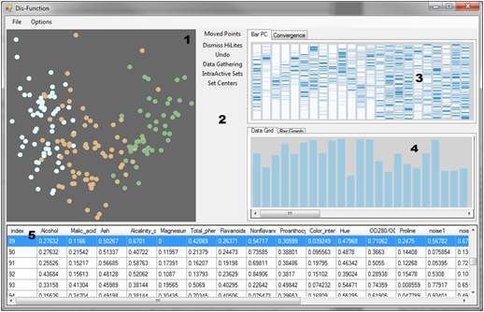
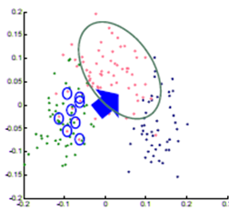

Interactive Visualization Systems
Eli Brown
Political Simulation
  Agent-based analysis
Bridge Maintenance
  Exploring inspection reports
Biomechanical Motion
  Interactive motion comparison
Interactive Metric Learning
  DisFunction: learn a model from projection
High-D Data Exploration
  iPCA: Interactive PCA
R. Chang et al., Dis-function: Learning Distance Functions Interactively, IEEE VAST 2011.

Slide 12
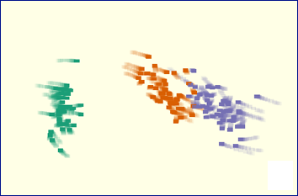
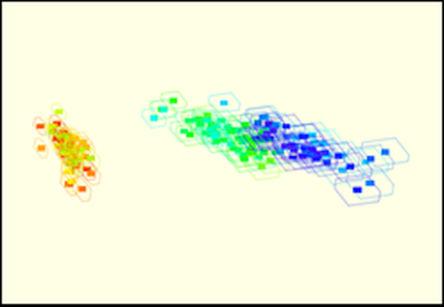
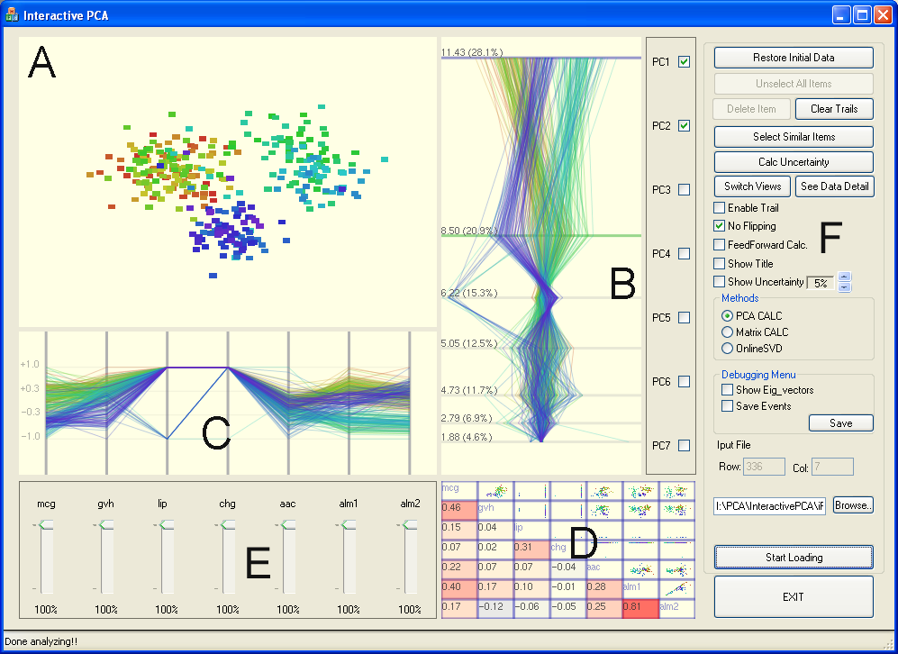
Interactive Visualization Systems
Political Simulation
  Agent-based analysis
Bridge Maintenance
  Exploring inspection reports
Biomechanical Motion
  Interactive motion comparison
Interactive Metric Learning
  DisFunction: learn a model from projection
High-D Data Exploration
  iPCA: Interactive PCA
R. Chang et al., iPCA: An Interactive System for PCA-based Visual Analytics, EuroVis 2009.

Slide 13
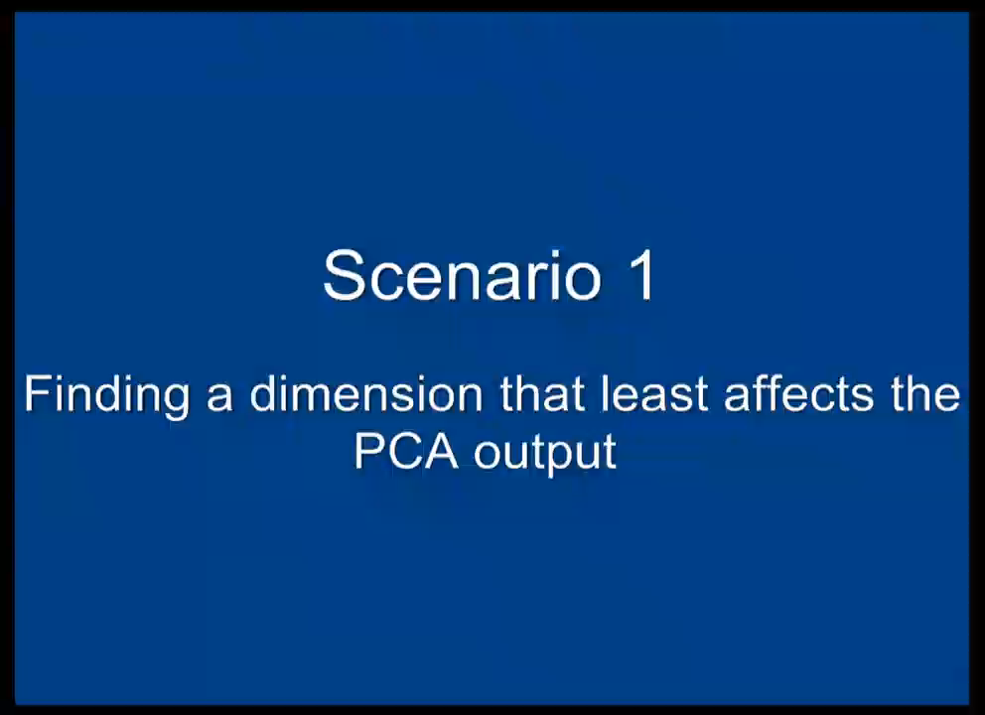

Slide 14
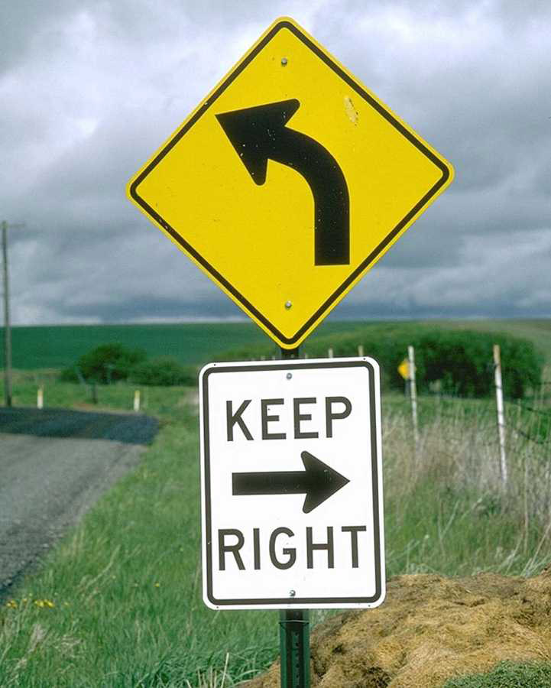
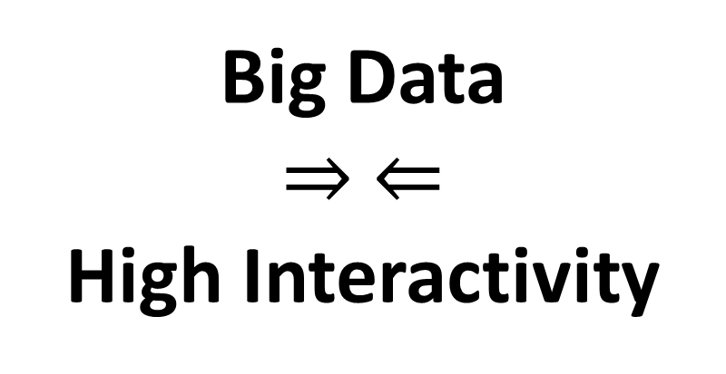
“Tough” Lessons Learned
Big Data
$⇒ ⇐$
High Interactivity

Slide 15


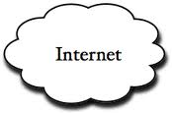
Problem Statement
Visualization on a
Commodity Hardware
Large Data in a
Data Warehouse

Slide 16
Related Work
Pull-based Databases
  Tableau, Spotfire
Pre-compiled Data Cubes
  Nanocube (Scheidegger), imMens* (Liu, Heer), Map-D* (Mostak)
Sampling
  BlinkDB (Agrawal, Berkeley), DICE (Kamat, Nandi)
Pre-Fetching
  Xmdv (Doshi, Ward), Time-series (Chan, Hanrahan)
* GPU-accelerated

Slide 17
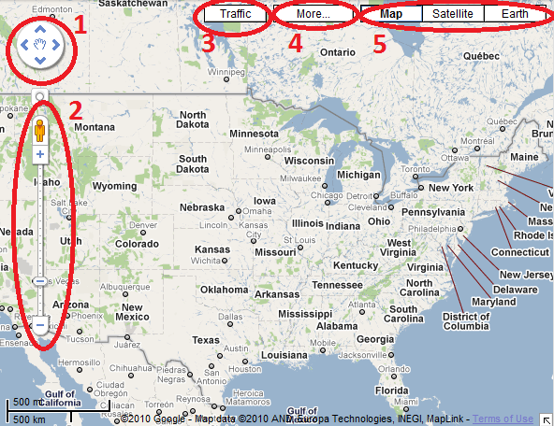
Two Observations:
User’s actions are consistent and number of possible actions are finite.
Visualization itself is a bottleneck

Slide 18
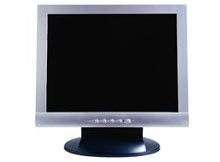

Two Observations:
User’s actions are consistent and number of possible actions are finite.
Visualization itself is a bottleneck
  User’s perception and cognition are added constraints
1000 pixels
1000 pixels
1000x1000x3 = 3 million

Slide 19
Problem Statement
Problem: Data is too big to fit into the memory of the personal computer
  Note: Ignoring various database technologies (OLAP, Column-Store, No-SQL, Array-Based, etc)
Goal: Guarantee a result set to a user’s query within X number of seconds.
  Based on HCI research, the upperbound for X is 10 seconds
  Ideally, we would like to get it down to 1 second or less
Method: trading accuracy and storage (caching), optimize on minimizing latency (user wait time).

Slide 20


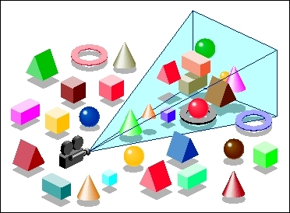
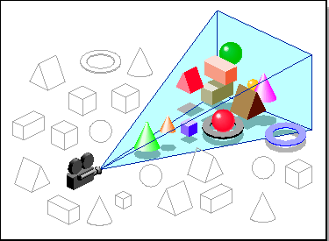
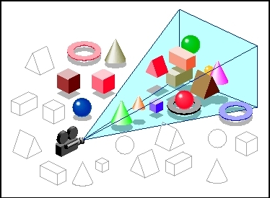

Our Approach: Predictive
Pre-Computation and Pre-Fetching
Stonebraker
Leilani Battle
In collaboration with MIT (Leilani Battle, Mike Stonebraker)
ForeCache: Three-tiered architecture
  Thin client (visualization)
  Backend (array-based database, e.g. data cubes / OLAP)
  Fat middleware
    Prediction Algorithms
    Storage Architecture
    Cache Management (Eviction Strategies)
R. Chang et al., Dynamic Prefetching of Data Tiles for Interactive Visualization. In Submission to SIGMOD

Slide 22



Prediction Algorithms
General Idea:
  Lots of “experts” who recommend chunks of data to pre-fetch / pre-compute
  One “manager” who listens to the experts and chooses which experts’ advice to follow
  Each “expert” gets more of their recommendations accepted if they keep guessing correctly

Slide 23
Iteration: 0
13
48
11
3
99
2
13
99
67
45
82
7
22
42
31

Slide 24
Iteration: 0
13
48
11
3
99
2
13
99
67
45
82
7
22
42
31

Slide 25
Iteration: 0
13
48
11
3
99
2
13
99
67
45
82
7
22
42
31
User Requests Data Block 13

Slide 26


Iteration: 0
13
48
11
3
99
2
13
99
67
45
82
7
22
42
31
User Requests Data Block 13

Slide 27
Iteration: 0
13
48
11
3
99
2
13
99
67
45
82
7
22
42
31
User Requests Data Block 13

Slide 28
Iteration: 1
4
12
34
88
27
5
23
1
92
34
42
12
31
32
13

Slide 29
Training
Instead of training the manager in real-time, this process can be done offline
  Using past user interaction logs
This approach is similar to how Database are currently tuned
  Instead of a DBA manually tune the performance of a database
  Past SQL logs are used to automatically tune the database for an organization’s specific needs (e.g. read-mostly, write-often, etc.)

Slide 30
How to Determine the “Experts”?
More detail on this later
Some obvious ones include:
  Momentum-based
  Data similarity-based
  Frequency (hot-spot)-based
  Past action sequence-based
Generally speaking, given the “manager” approach, we want as many different types of “experts” as possible

Slide 31
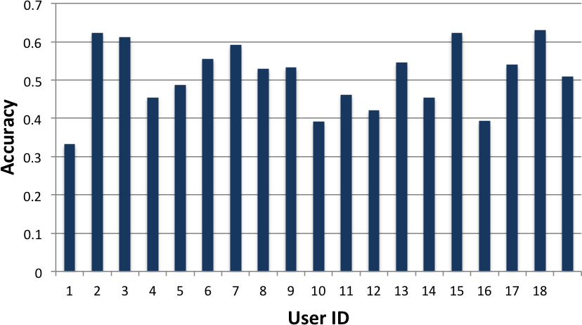
Preliminary Results
Using a simple Google-maps like interface
18 users explored the NASA MODIS dataset
Tasks include “find 4 areas in Europe that have a snow coverage index above 0.5”

Slide 32
Worst Case Scenario: Cache Miss
13
48
11
3
99
2
13
99
67
45
82
7
22
42
31
User’s Requests Data Block 52

Slide 33
Cache Miss
Stonebraker
Leilani Battle
How to guarantee response time when there’s a cache miss?
Trick: the ‘EXPLAIN’ command
Usage:
  explain select * from myTable;
Middleware “intercepts” a query from the client, and first asks for an “explain”
  If “ok” with explain result, execute the original query
  If “not ok”, modify the query dynamically
R. Chang et al., Dynamic Reduction of Result Sets for Interactive Visualization, IEEE Big Data Workshop on Visualization, 2013.

Slide 34
Example EXPLAIN Output from SciDB
Example SciDB the output of (a query similar to)
Explain SELECT * FROM earthquake
[("[pPlan]:
schema earthquake
<datetime:datetime NULL DEFAULT null,
magnitude:double NULL DEFAULT null,
latitude:double NULL DEFAULT null,
longitude:double NULL DEFAULT null>
[x=1:6381,6381,0,y=1:6543,6543,0]
bound start {1, 1} end {6381, 6543}
density 1 cells 41750883 chunks 1
est_bytes 7.97442e+09
")]
The four attributes in the table ‘earthquake’
Notes that the dimensions of this array (table) is 6381x6543
This query will touch data elements from (1, 1) to (6381, 6543), totaling 41,750,833 cells
Estimated size of the returned data is 7.97442e+09 bytes (~8GB)

Slide 35
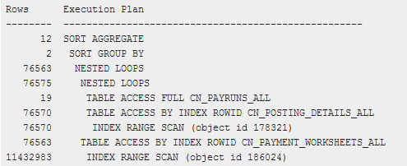
Other Examples
Oracle 11g Release 1 (11.1)

Slide 36
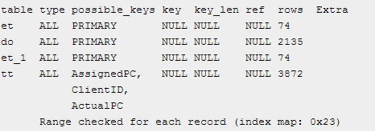
Other Examples
MySQL 5.0

Slide 37
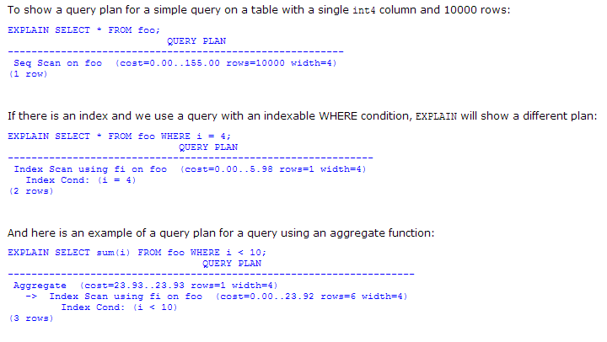
Other Examples
PostgreSQL 7.3.4

Slide 38
Reduction Strategies
If the query result is estimated to be too large, we can dynamically “modify” the query:
  Aggregation:
    In SciDB, this operation is carried out as
    regrid (scale_factorX, scale_factorY)
  Sampling
    In SciDB, uniform sampling is carried out as
    bernoulli (query, percentage, randseed)
  Filtering
    Currently, the filtering criteria is user specified
    where (clause)

Slide 39
Quick Summary
Key Components:
Pre-computation and pre-fetching
Three-tiered system
Pre-fetching based on “expert-manager” approach
Use the “explain” trick to handle cache-miss
Guarantees response time, but not data quality
Backbone (invisible) to data analysts

Slide 40
Two Observations (Ongoing & Future Work)
User’s actions are consistent and number of possible actions are finite.
  Need more “recommenders” – techniques for learning about a user from their interaction
Visualization and User Perception are bottlenecks
  Need quantitative methods for understanding the users’ perceptual and cognitive limitations

Slide 41

Analyzing a User’s Interactions
Alvitta Ottley
Eli Brown
How are the user’s interactions predictable?

Slide 42
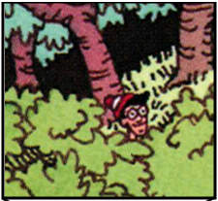
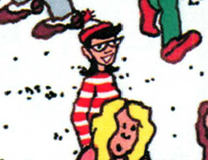
Experiment: Finding Waldo
Google-Maps style interface
  Left, Right, Up, Down, Zoom In, Zoom Out, Found
R. Chang et al., Finding Waldo: Learning about Users from their Interactions. IEEE VAST 2014

Slide 43
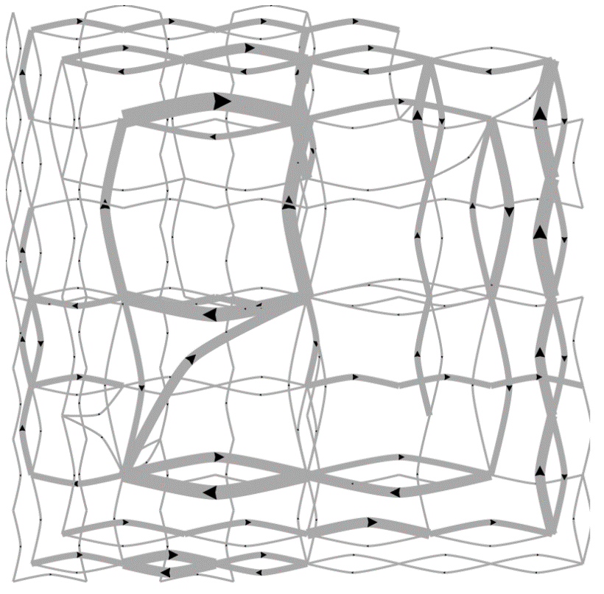
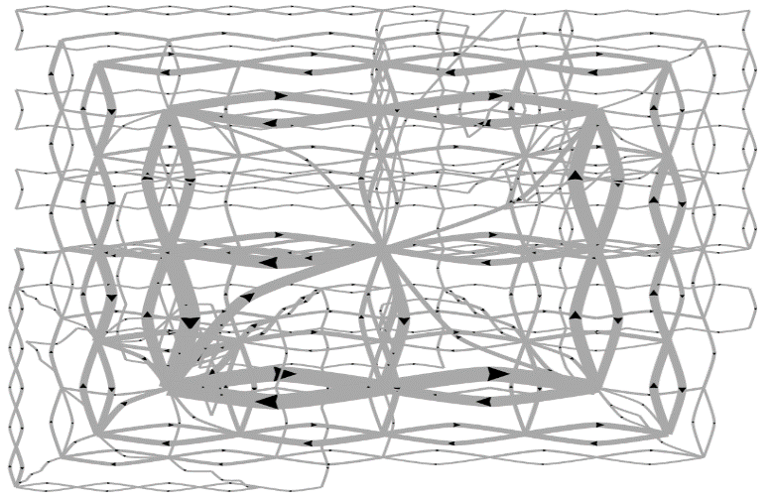
Pilot Visualization – Completion Time
Fast completion time
Slow completion time

Slide 44
Post-hoc Analysis Results
Mean Split (50% Fast, 50% Slow)
Data Representation | Classification Accuracy | Method
State Space | 72% | SVM
Edge Space | 63% | SVM
Sequence (n-gram) | 77% | Decision Tree
Mouse Event | 62% | SVM
Fast vs. Slow Split (Mean+0.5σ=Fast, Mean-0.5σ=Slow)
Data Representation | Classification Accuracy | Method
State Space | 96% | SVM
Edge Space | 83% | SVM
Sequence (n-gram) | 79% | Decision Tree
Mouse Event | 79% | SVM

Slide 45
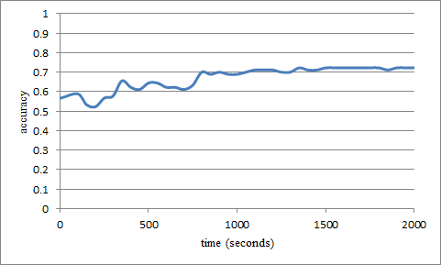
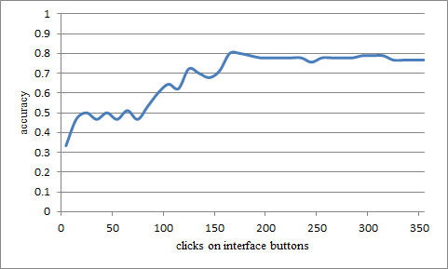
“Real-Time” Prediction
(Limited Time Observation)
State-Based
Linear SVM
Accuracy: ~70%
Interaction Sequences
N-Gram + Decision Tree
Accuracy: ~80%

Slide 46
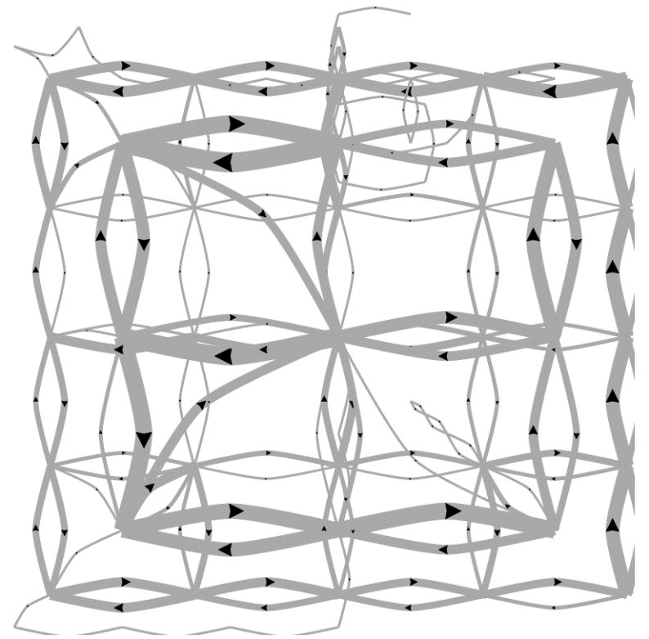
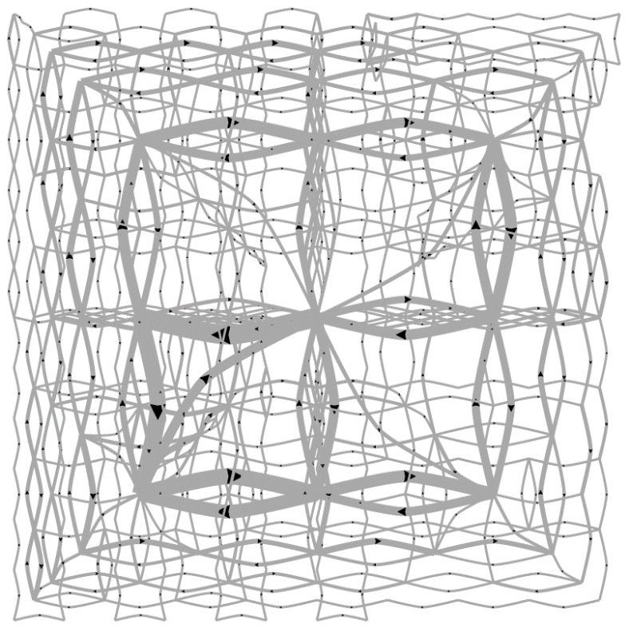
Predicting a User’s Personality
External Locus of Control
Internal Locus of Control
Ottley et al., How locus of control inﬂuences compatibility with visualization style. IEEE VAST , 2011.
Ottley et al., Understanding visualization by understanding individual users. IEEE CG&A, 2012.

Slide 47
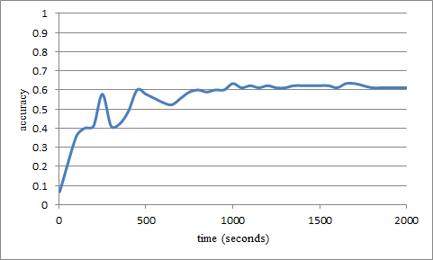
Predicting Users’ Personality Traits
Predicting user’s “Extraversion”
Linear SVM
Accuracy: ~60%
Noisy data, but can (almost) detect the users’ individual traits “Extraversion”, “Neuroticism”, and “Locus of Control” at ~60% accuracy.

Slide 48
Quick Summary
User’s interaction log encode a great deal of a user’s analysis behavior
Representation remains the biggest issue
Need more techniques for extracting this type of data
External Locus of Control
Internal Locus of Control

Slide 49


Modeling Perception of Data
Lane Harrison
Fumeng Yang
Can a user’s ability to perceive Information
from visualization be modeled quantitatively?
R. Chang et al., Ranking Visualization Effectiveness Using Weber's Law. IEEE InfoVis 2014

Slide 50
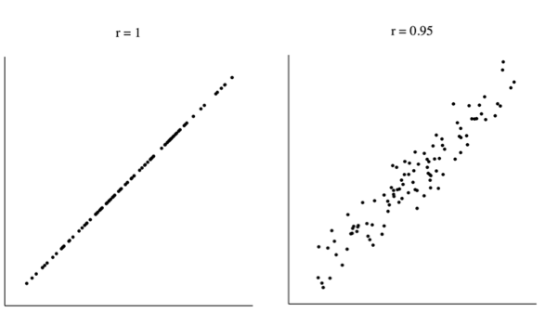

Slide 52
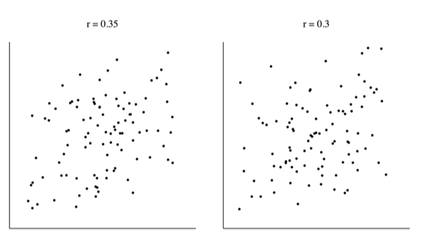

Slide 54
Another Experiment
Imagine yourself in a dark room….

Slide 59
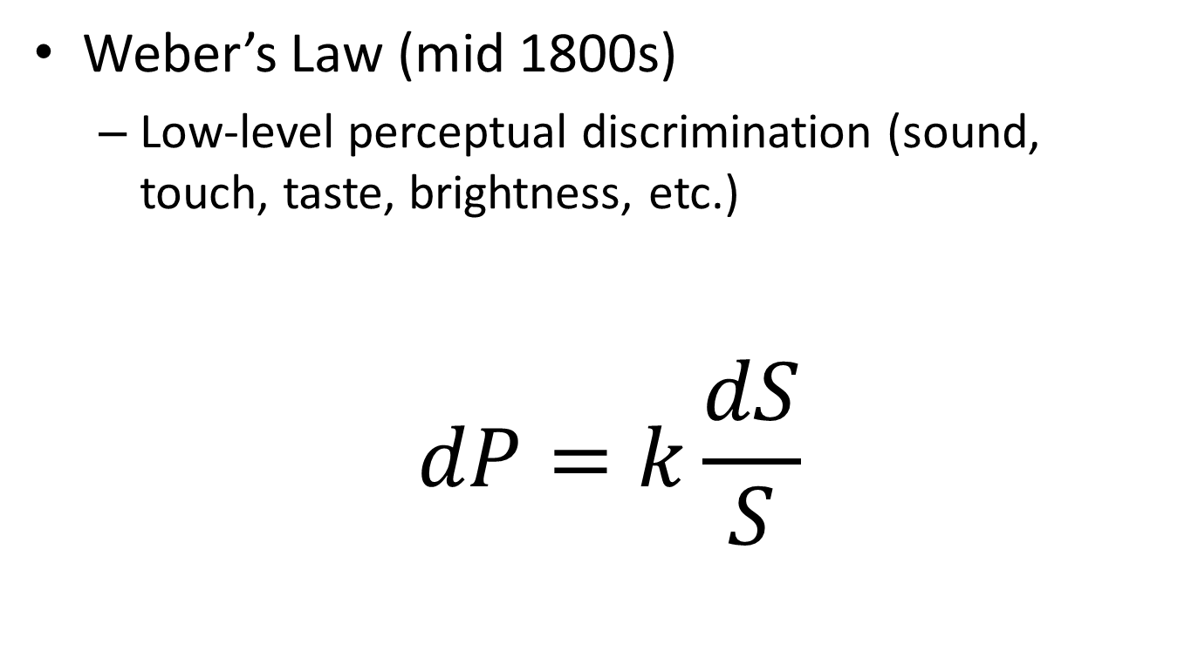
Perceptual Modeling
Weber’s Law (mid 1800s)
  Low-level perceptual discrimination (sound, touch, taste, brightness, etc.)
$$dP=k\frac{dS}{S}$$
Change in Intensity
Perceived Difference
Weber’s Constant
(via experiments)
Intensity of the Stimulus

Slide 60
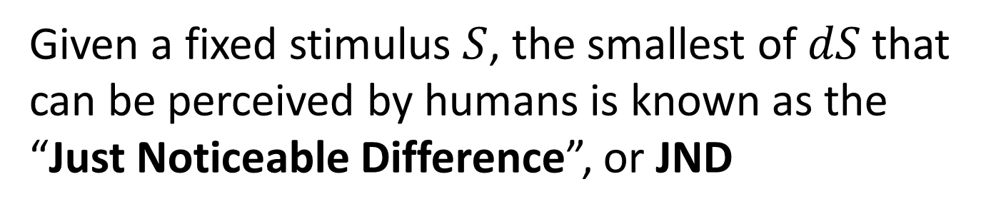
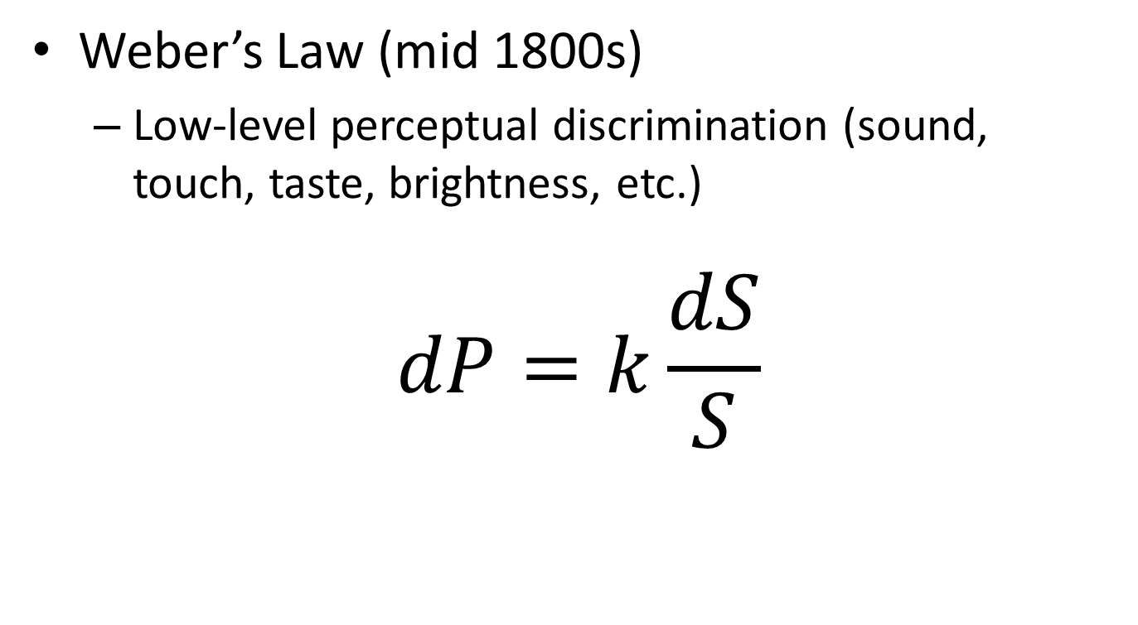
Perceptual Modeling
Weber’s Law (mid 1800s)
  Low-level perceptual discrimination (sound, touch, taste, brightness, etc.)
$$dP=k\frac{dS}{S}$$
Given a fixed stimulus $S$, the smallest of $dS$that
can be perceived by humans is known as the
“Just Noticeable Difference”, or JND

Slide 61
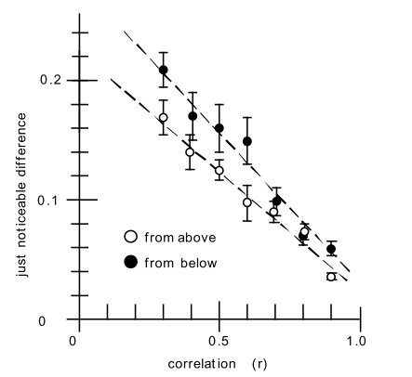
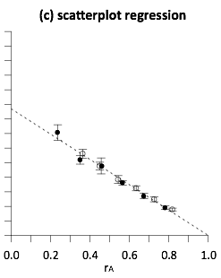
Perceptual Modeling
In 2010, Ron Rensink (UBC) found that the relationship between JND and correlation (r) is linear and follows the Weber’s Law

Slide 62
Our Question…
worse
If the perception of correlation in scatterplots follows Weber’s law…
better

Slide 63
worse
What does the perception of correlation in other charts look like?
better
Notes:
are some linear like scatterplots, or logarithmic, or exponential?

Slide 64
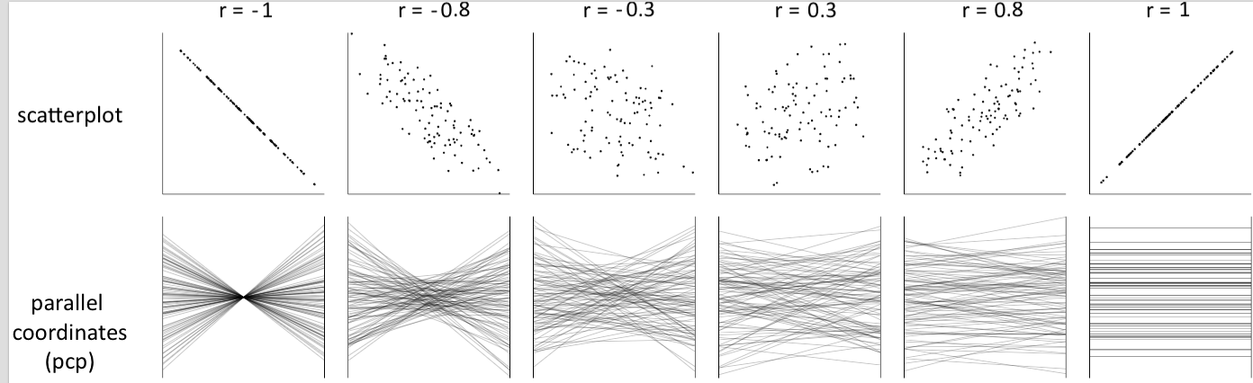
Notes:
both positively and negatively correlated data

Slide 65
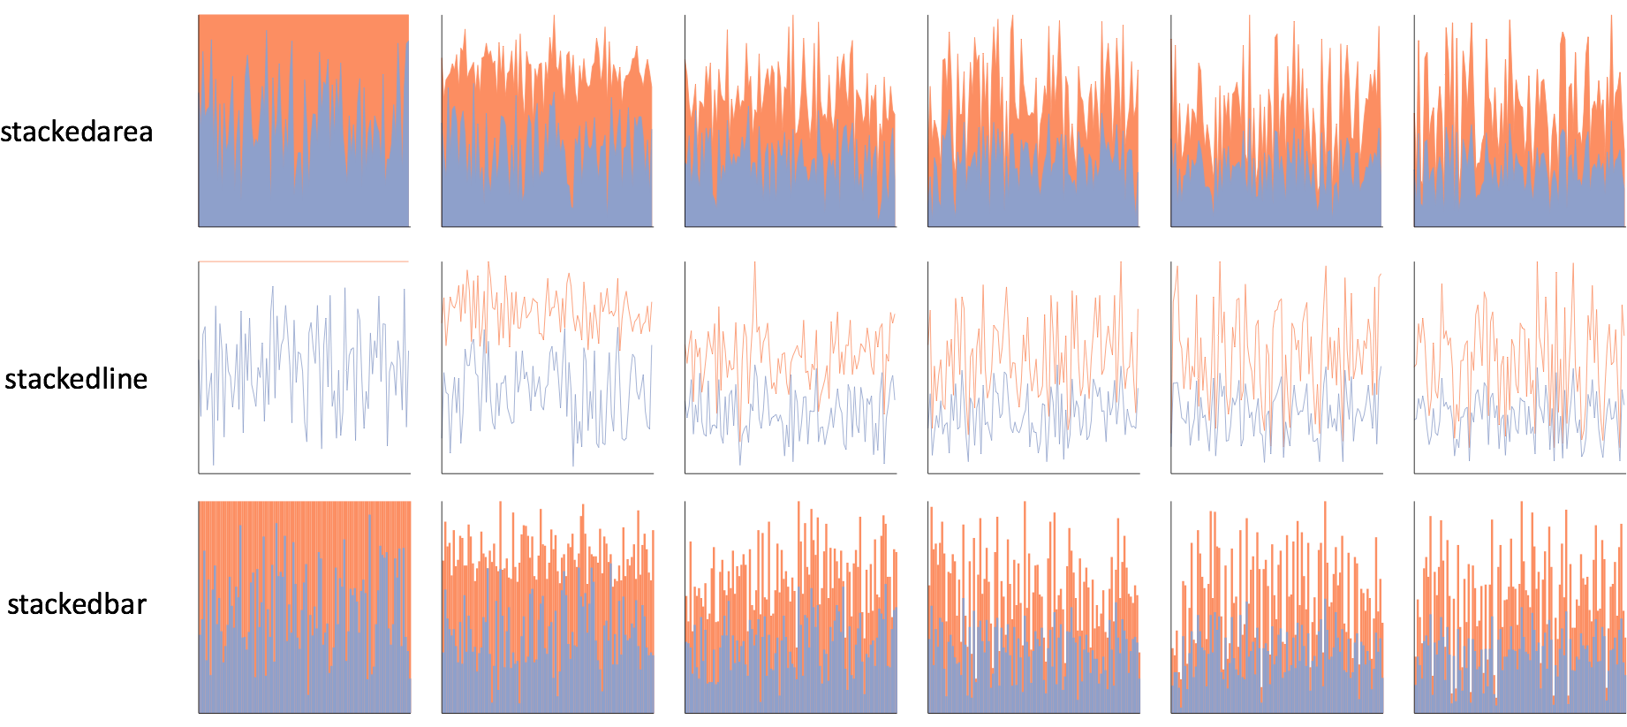
Notes:
one click away in excel

Slide 66
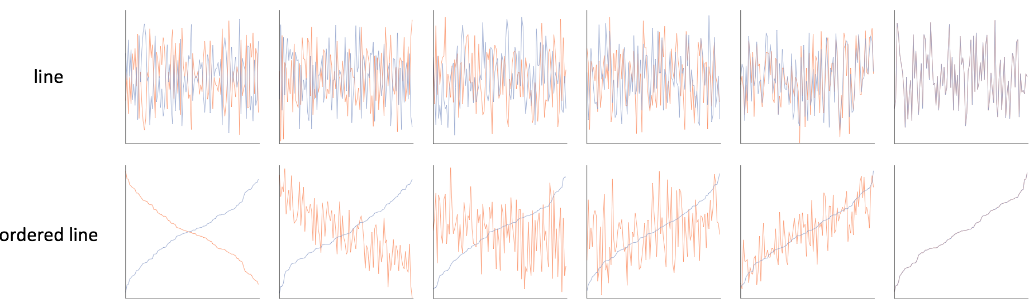

Slide 67
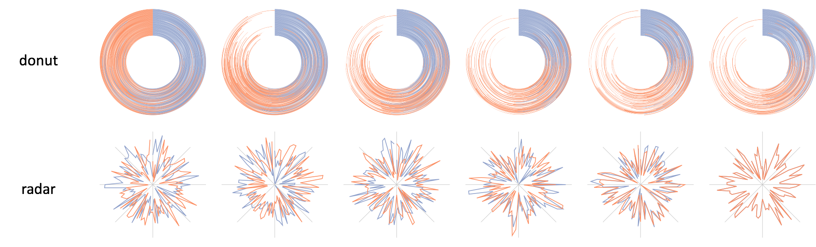

Slide 68
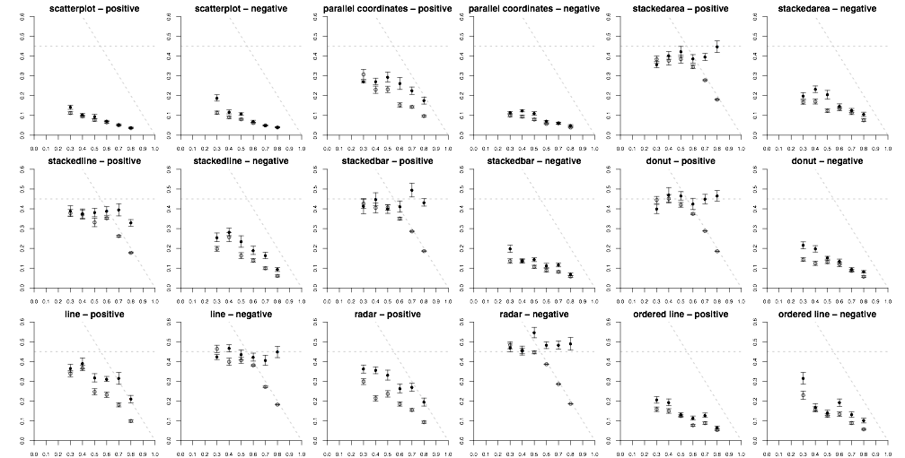
Notes:
whereas Rensink had one…
roughly 200,000 individual perceptual judgements

Slide 69
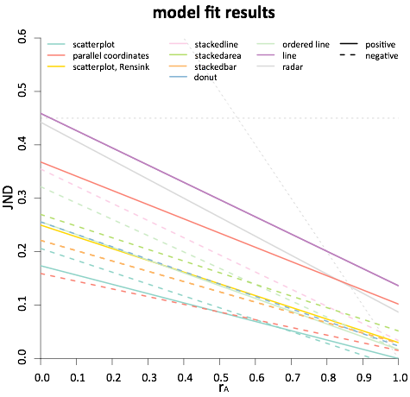
less precise
more precise
Notes:
this is essentially seeing if the trend of JNDs is linear
the moment of truth came when we checked the statistics

Slide 70
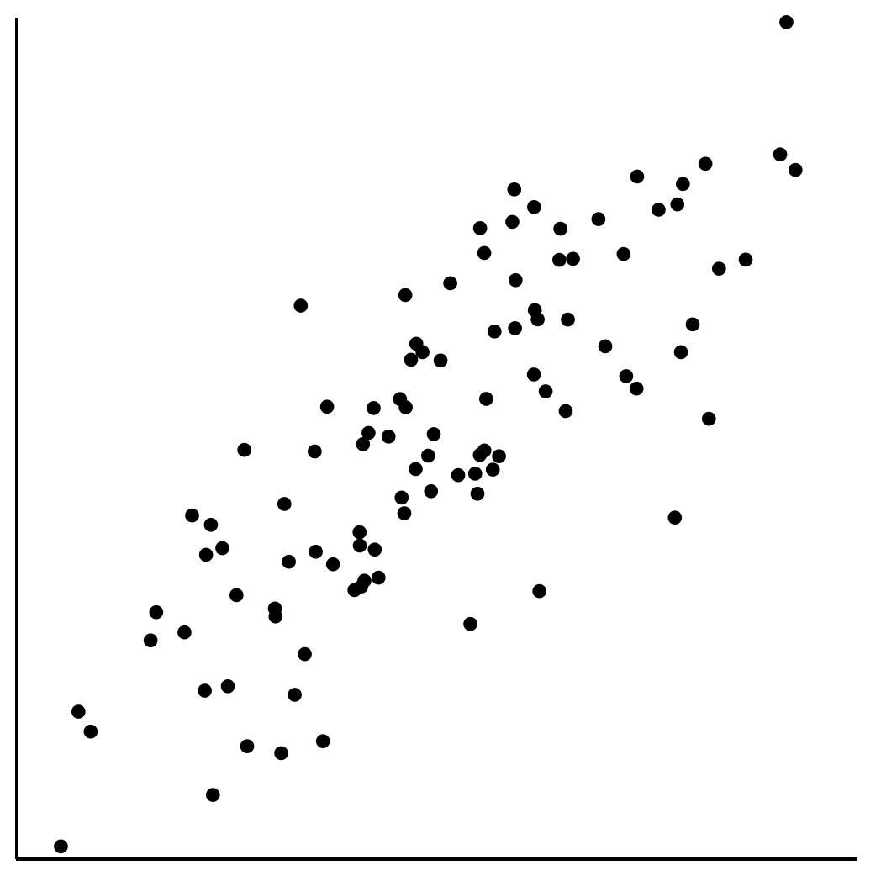
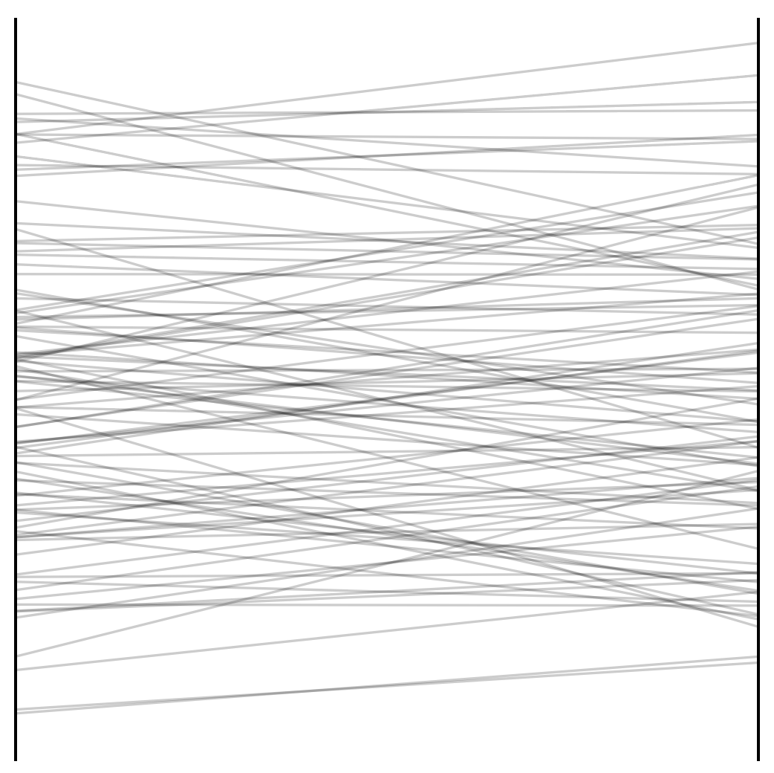
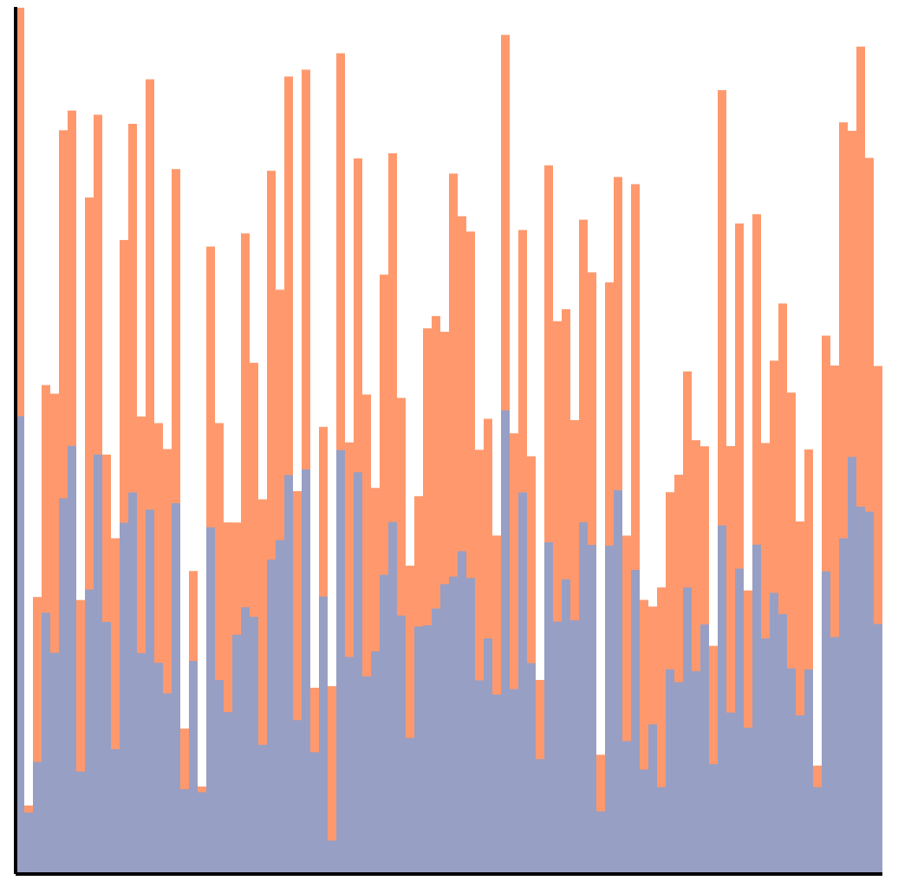
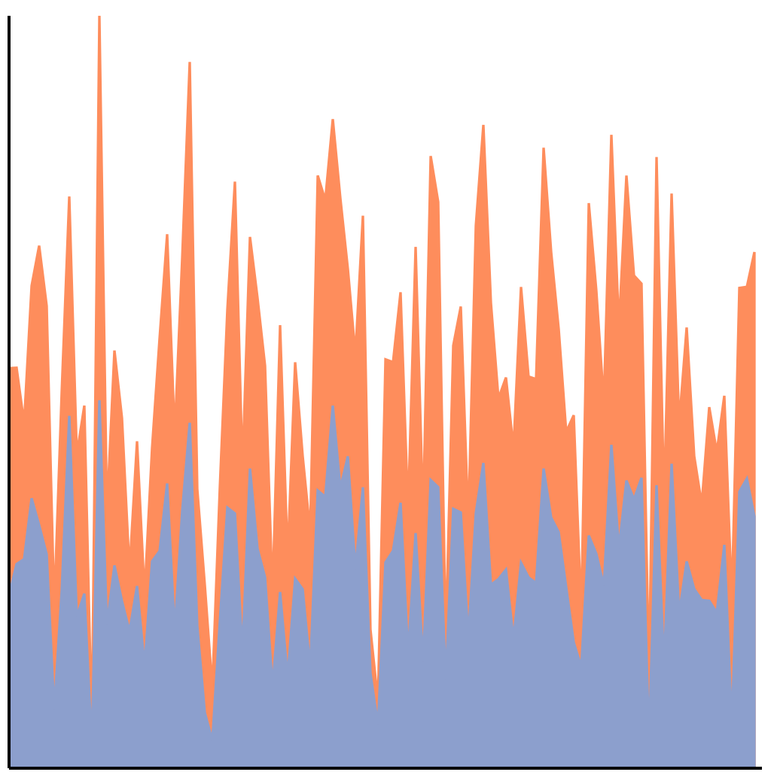
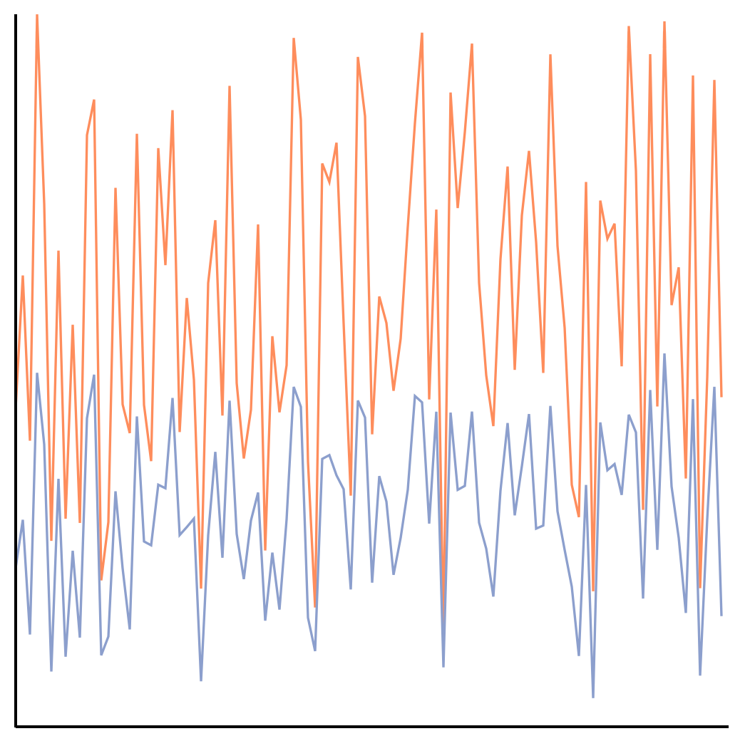
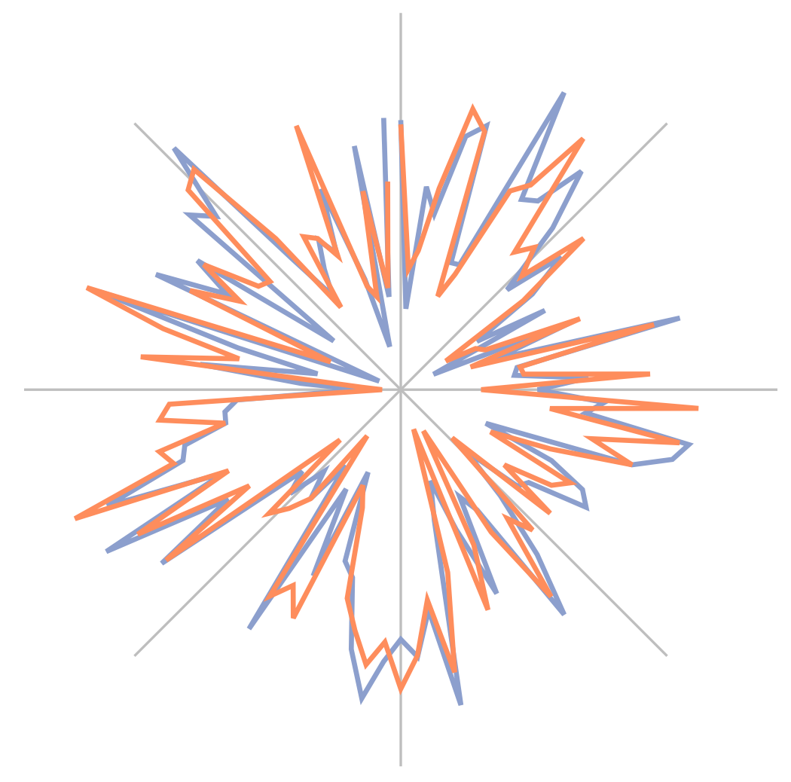
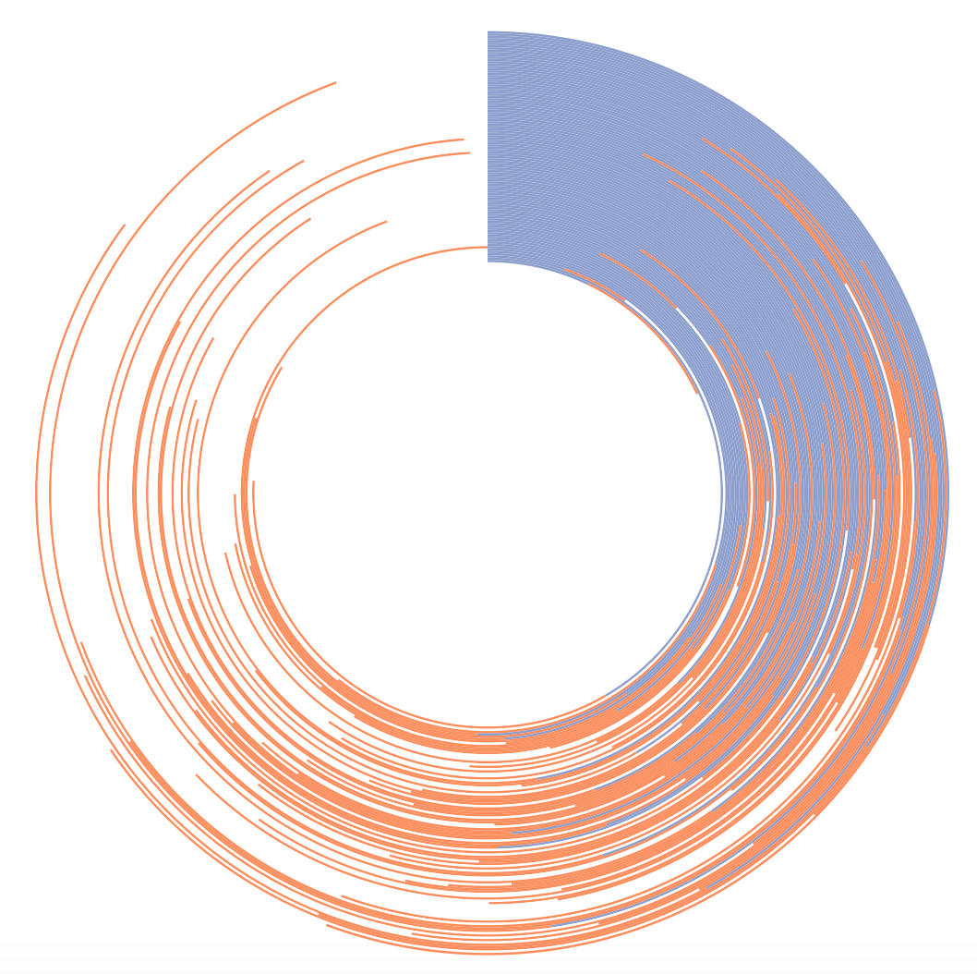
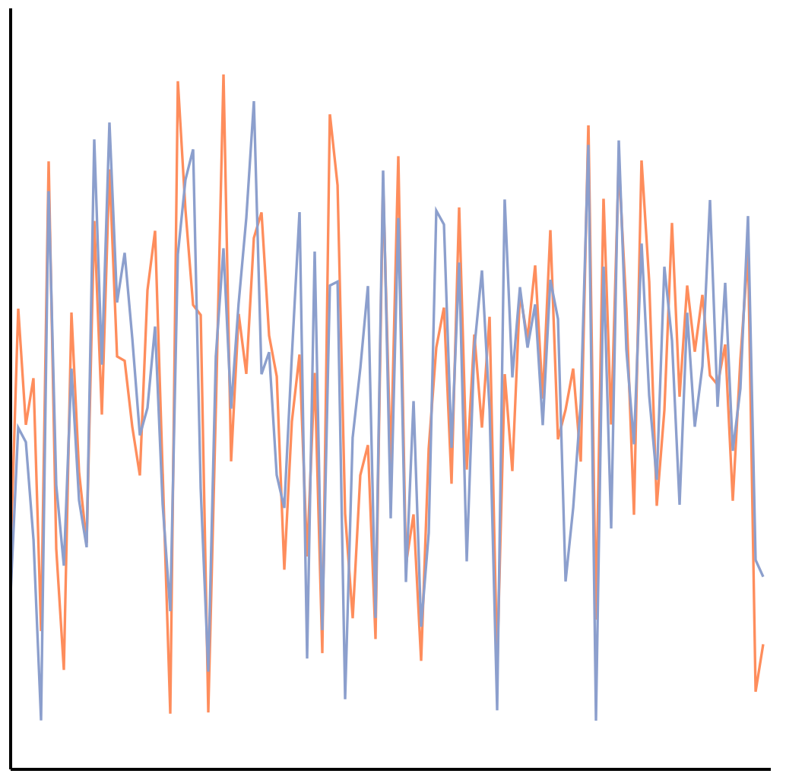
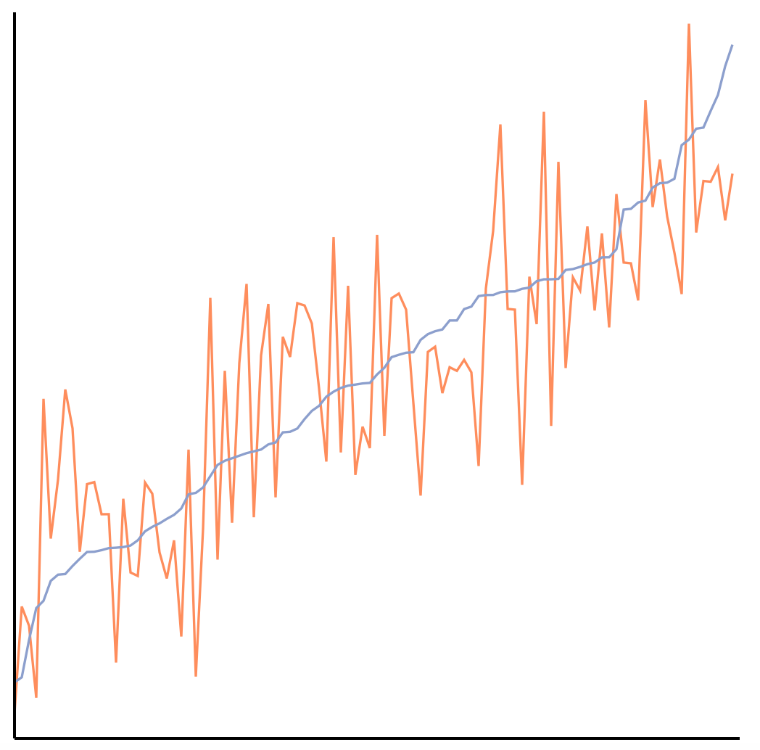
The perception of correlation
in every tested chart can be modeled using Weber’s law.
Notes:
Here we have a perceptual law that is used to study things like taste, line-length, brightness. Not only are we using it to model correlation, which is a higher-level concept, but it also applies across every chart tested!

Slide 71
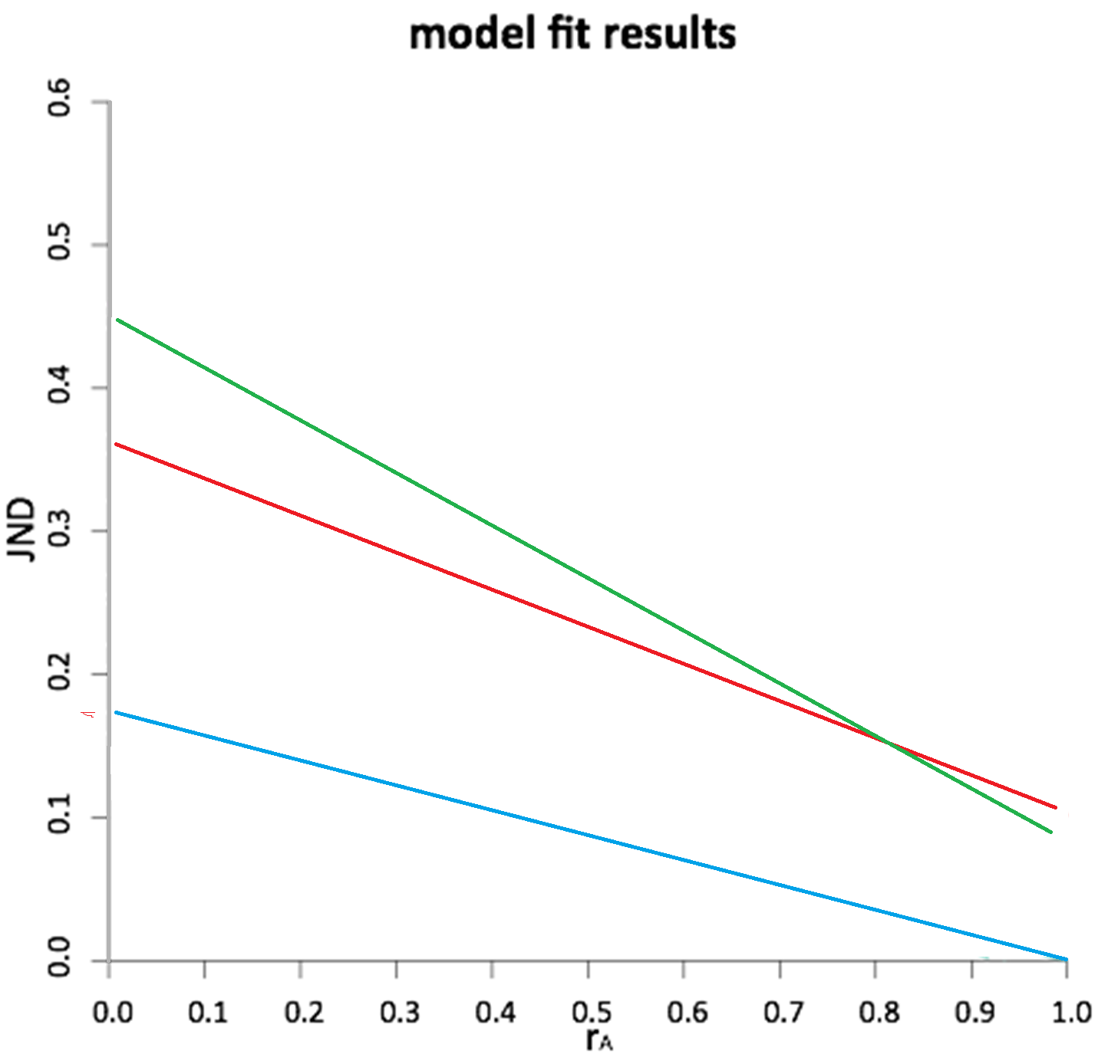




Slide 72

Application: Ranking Visualizations of Correlation

Slide 73

Potential Application: JND-based Sampling
Limits of Big Data visualization
  Screen resolution
JND-based sampling and visualization
  Similar to image compression (jpg2000)
  Differ in that the JND will be based on higher-level information (e.g. correlation)

Slide 74









Summary: Theory Into Practice
Interaction is key to exploratory visualizations
Big data -><- high interactivity
ForeCache seeks to address this
  Predictive prefetching based on past user actions (Waldo Experiment)
  Cache miss using EXPLAIN
Future Work: Build perceptual models to design sampling strategies

Slide 75


Questions? remco@cs.tufts.edu

Slide 76
Backup

Slide 77

!
!
!!!

Slide 78

Rensink and Baldridge (2010)
In 2010, Ron Rensink (UBC) ran a series of experiments testing the perception of correlation in scatterplots
Worse
To see a difference when r = 0.3, the comparison plot needs to be +/- 0.2
Better

Slide 79


1. Richard Heuer. Psychology of Intelligence Analysis, 1999. (pp 53-57)

Slide 80
Exploring High-Dimensional Space: iPCA
Jeong et al., iPCA: An Interactive System for PCA-based Visual Analytics. Eurovis 2009.

Slide 81

Metric Learning
Finding the weights to a linear distance function
Instead of a user manually give the weights, can we learn them implicitly through their interactions?

Slide 82




Metric Learning
In a projection space (e.g., MDS), the user directly moves points on the 2D plane that don’t “look right”…
Until the expert is happy (or the visualization can not be improved further)
The system learns the weights (importance) of each of the original k dimensions
Short Video (play)

Slide 83

Dis-Function
Optimization:
Brown et al., Find Distance Function, Hide Model Inference. IEEE VAST Poster 2011
Brown et al., Dis-function: Learning Distance Functions Interactively. IEEE VAST 2012.

Slide 84

Results
Used the “Wine” dataset (13 dimensions, 3 clusters)
Added 10 extra dimensions, and filled them with random values
Blue: original data dimension
Red: randomly added dimensions
X-axis: dimension number
Y-axis: final weights of the distance function

Slide 85
Backup

Slide 86

Individual Differences and Interaction Pattern
Existing research shows that all the following factors affect how someone uses a visualization:
  Spatial Ability
  Experience (novice vs. expert)
  Emotional State
  Personality
  Cognitive Workload/Mental Demand
  Perception
  … and more
Peck et al., ICD³: Towards a 3-Dimensional Model of Individual Cognitive Differences. BELIV 2012
Peck et al., Using fNIRS Brain Sensing To Evaluate Information Visualization Interfaces. CHI 2013

Slide 87

Cognitive Priming

Slide 88



Emotion and Visual Judgment
Harrison et al., Influencing Visual Judgment Through Affective Priming, CHI 2013

Slide 89



Cognitive Load
Functional Near-Infrared Spectroscopy
a lightweight brain sensing technique
measures mental demand (working memory)
Evan Peck et al., Using fNIRS Brain Sensing to Evaluate Information Visualization Interfaces. CHI 2013.

Slide 90
Spatial Ability: Bayes Reasoning
The probability that a woman over age 40 has breast cancer is 1%. However, the probability that mammography accurately detects the disease is 80% with a false positive rate of 9.6%.
If a 40-year old woman tests positive in a mammography exam, what is the probability that she indeed has breast cancer?
Answer: Bayes’ theorem states that P(A|B) = P(B|A) * P(A) / P(B). In this case, A is having breast cancer, B is testing positive with mammography. P(A|B) is the probability of a person having breast cancer given that the person is tested positive with mammography. P(B|A) is given as 80%, or 0.8, P(A) is given as 1%, or 0.01. P(B) is not explicitly stated, but can be computed as P(B,A)+P(B,˜A), or the probability of testing positive and the patient having cancer plus the probability of testing positive and the patient not having cancer. Since P(B,A) is equal 0.8*0.01 = 0.008, and P(B,˜A) is 0.093 * (1-0.01) = 0.09207, P(B) can be computed as 0.008+0.09207 = 0.1007. Finally, P(A|B) is therefore 0.8 * 0.01 / 0.1007, which is equal to 0.07944.

Slide 91



Visualization Aids
Ottley et al., Visually Communicating Bayesian Statistics to Laypersons. Tufts CS Tech Report, 2012.

Slide 92
Spatial Ability

Slide 93

Priming Inferential Judgment
The personality factor, Locus of Control* (LOC), is a predictor for how a user interacts with the following visualizations:
Ottley et al., How locus of control inﬂuences compatibility with visualization style. IEEE VAST , 2011.

Slide 94


Locus of Control vs. Visualization Type
When with list view compared to containment view, internal LOC users are:
  faster (by 70%)
  more accurate (by 34%)
Only for complex (inferential) tasks
The speed improvement is about 2 minutes (116 seconds)

Slide 95
Priming LOC - Stimulus
Borrowed from Psychology research: reduce locus of control (to make someone have a more external LOC)
  “We know that one of the things that influence how well you can do everyday tasks is the number of obstacles you face on a daily basis. If you are having a particularly bad day today, you may not do as well as you might on a day when everything goes as planned. Variability is a normal part of life and you might think you can’t do much about that aspect. In the space provided below, give 3 examples of times when you have felt out of control and unable to achieve something you set out to do. Each example must be at least 100 words long.”

Slide 96
Results: Averages Primed More Internal
Performance
Good
External LOC
Average LOC
Average ->Internal
Internal LOC
Poor
Visual Form
List-View
Containment
Ottley et al., Manipulating and Controlling for Personality Effects on Visualization Tasks, Information Visualization, 2013

Slide 97
Results

Slide 98
Modeling Perception and Cognition
Building cognitive models (even the simple ones) is still a work in progress
Low hanging fruits!
  Direct brain imaging / measurement
  Modeling perception

Slide 99
Cognitive Load
Functional Near-Infrared Spectroscopy
fNIRS
a lightweight brain sensing technique
measures mental demand (working memory)
Evan Peck et al., Using fNIRS Brain Sensing to Evaluate Information Visualization Interfaces. CHI 2013.

Slide 100


Modeling User Perception with Weber’s Law

Slide 101
Weber’s Law & Just Noticeable Difference (JND)
Perception
Perception
Perceived Stimulus
Ideal
Just Noticeable Difference
Ideal
Objective Stimulus
Objective Stimulus

Slide 102


Perception of Correlation and Weber’s
Rensink and Baldridge, The Perception of Correlation in Scatterplots. EuroVis 2010.

Slide 103

Perception of Correlation and Weber’s

Slide 104

Ranking Visualizations
Harrison et al., Ranking Visualization of Correlation with Weber’s Law. InfoVis 2014 (Conditional)

Slide 105
Ranking Visualizations of Correlation

Slide 106
Streaming DB
Integrate Streaming [Fisher et al. CHI 2012]
t = 1 second
t = 5 minute
Fisher et al. , Trust Me, I'm Partially Right: Incremental Visualization Lets Analysts Explore Large Datasets Faster. CHI 2012

Slide 107
Designing “Experts”
How much can a user’s past interactions tell us about:
  The user’s future analysis behaviors?
  The user’s analysis style?
  The user’s analysis intent?
  The user’s mental model of the data and problem?
Fundamental question in Visualization and HCI…

Slide 108

What is in a User’s Interactions?
Keyboard, Mouse, etc
Visualization
Input
Human
Output
Images (monitor)
Types of Human-Visualization Interactions
  Word editing (input heavy, little output)
  Browsing, watching a movie (output heavy, little input)
  Visual Analysis (closer to 50-50)
Challenge:
  Can we capture and extract a user’s reasoning and intent through capturing a user’s interactions?

Slide 109

What is in a User’s Interactions?
Goal: determine if a user’s reasoning and intent are reflected in a user’s interactions.
Grad
Students
(Coders)
Analysts
Compare!
(manually)
Strategies
Methods
Findings
Guesses of
Analysts’ thinking
Logged
(semantic)
Interactions
WireVis
Interaction-Log Vis

Slide 110

What’s in a User’s Interactions
From this experiment, we find that interactions contains at least:
  60% of the (high level) strategies
  60% of the (mid level) methods
  79% of the (low level) findings
R. Chang et al., Recovering Reasoning Process From User Interactions. CG&A, 2009.
R. Chang et al., Evaluating the Relationship Between User Interaction and Financial Visual Analysis. VAST, 2009.

Slide 111


What’s in a User’s Interactions
Why are these so much lower than others?
  (recovering “methods” at about 15%)
Only capturing a user’s interaction in this case is insufficient.

