Slide 1
From vision science to data science: applying perception to problems in big data
Remco Chang
Assistant Professor
Computer Science
Tufts University

Slide 2

Crowdsourcing Experiments in Visualization Research:
Data, Perception, and Cognition
Remco Chang
Assistant Professor
Computer Science
Tufts University

Slide 3

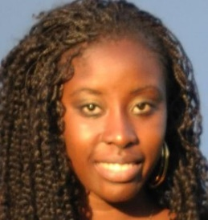





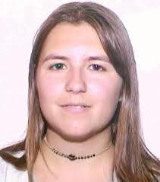



Visual Analytics Lab at Tufts
VIS+Database
  (MIT)
  Big data systems
Machine Learning
  (MIT Lincoln Lab)
  User-in-the-loop visual analytics systems
Modeling
  (Wisconsin)
  Comprehensible modeling
Perception
  (Northwestern)
  (U British Columbia)
  Perceptual modeling
Psychology
  (Tufts Psych Dept)
  Individual difference
“Storytelling”
  (Maine Medical Center)
  Medical risk communication

Slide 4

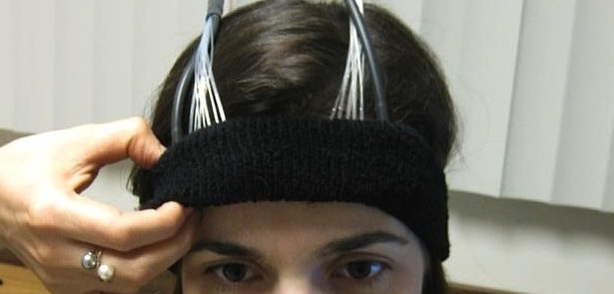
What VIS research can be “Turked”?
Following Bongshin’s talk from Monday
Three types of experiments:
  Collect User Generated Data
  Conduct Perceptual Experiments
  Run Cognitive Studies**
How to design a Mechanical Turk study platform for visualization research
  Lessons learned from experience
** Definition of cognitive studies differs from Bongshin’s example

Slide 5
1: Collect User Generated Data
Research Question: Can users’ interactions predict:
  User’s performance in a task
  User’s individual differences
Need: large number of participants (>100)
Eli Brown
Alvitta Ottley

Slide 6
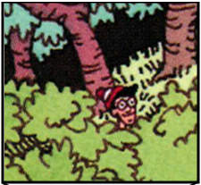
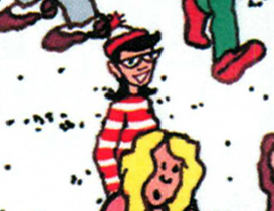
Experiment: Finding Waldo
Google-Maps style interface
  Left, Right, Up, Down, Zoom In, Zoom Out, Found
Brown et al., Finding Waldo: Learning about Users from their Interactions. IEEE VAST 2014

Slide 7
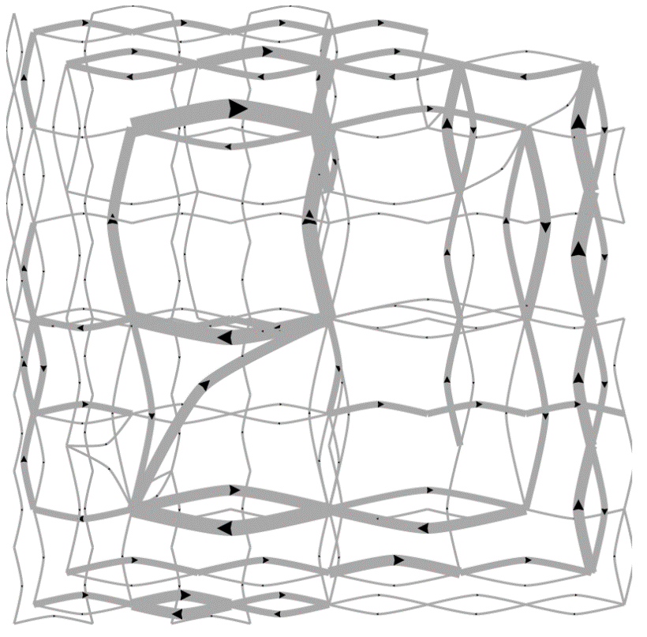
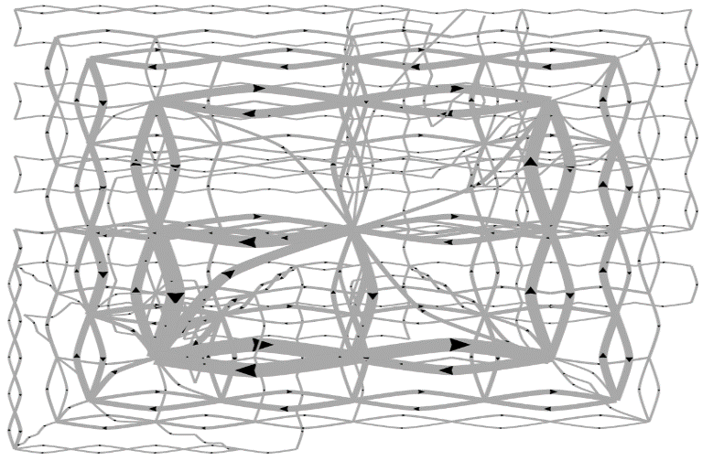
Pilot Visualization – Completion Time
Fast completion time
Slow completion time

Slide 8
Post-hoc Analysis Results
Mean Split (50% Fast, 50% Slow)
Data Representation | Classification Accuracy | Method
State Space | 72% | SVM
Edge Space | 63% | SVM
Sequence (n-gram) | 77% | Decision Tree
Mouse Event | 62% | SVM
Fast vs. Slow Split (Mean+0.5σ=Fast, Mean-0.5σ=Slow)
Data Representation | Classification Accuracy | Method
State Space | 96% | SVM
Edge Space | 83% | SVM
Sequence (n-gram) | 79% | Decision Tree
Mouse Event | 79% | SVM

Slide 9
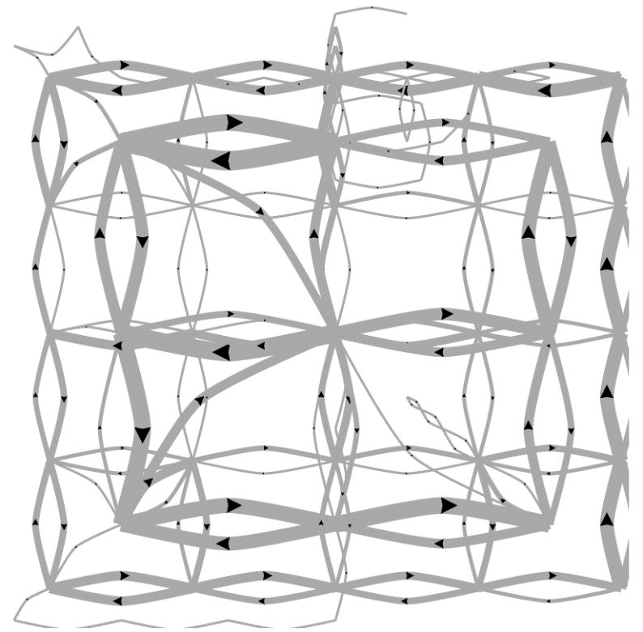
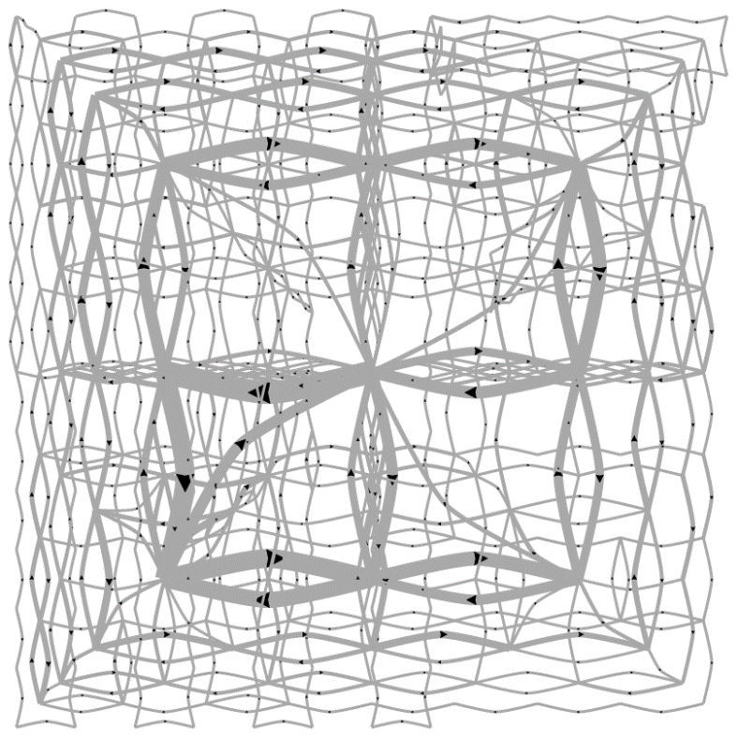
Predicting a User’s Personality
External Locus of Control
Internal Locus of Control
Ottley et al., How locus of control inﬂuences compatibility with visualization style. IEEE VAST , 2011.
Ottley et al., Understanding visualization by understanding individual users. IEEE CG&A, 2012.

Slide 10
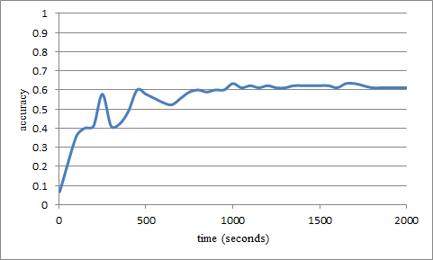
Predicting Users’ Personality Traits
Predicting user’s “Extraversion”
Linear SVM
Accuracy: ~60%
Noisy results:
  “Extraversion”, “Neuroticism”, and “Locus of Control” at ~60% accuracy.

Slide 11
Lessons Learned
Log everything!
  Mouse movement, click, time stamp, etc.
  Useful for manual removal of “bad” data
  E.g. subject leaves for 5 minutes
Mechanism:
  Store in Javascript
  Send in batch via PHP on “next page”
    User doesn’t mind waiting
  PHP writes to server in plain text
    CSV or JSON
External Locus of Control
Internal Locus of Control

Slide 12


2: Perceptual Studies
Research Question: Can we model perception using MTurk?
  Replicate laboratory study
    Re: Darren’s talk on Tuesday
  Extend to other conditions
Need:
  Large number of judgments (200,000)
  Large number of Turkers (> 1,500)
Lane Harrison
Fumeng Yang
Harrison et al., Ranking Visualization Effectiveness Using Weber's Law. IEEE InfoVis 2014

Slide 13
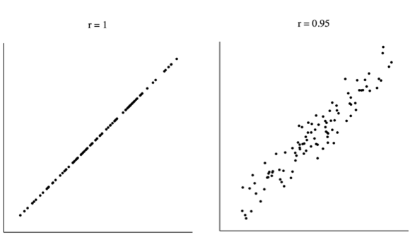

Slide 15
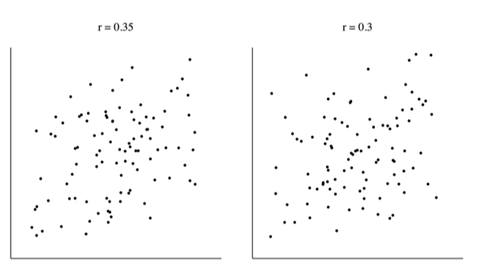

Slide 17
Another Experiment
Imagine yourself in a dark room….

Slide 22
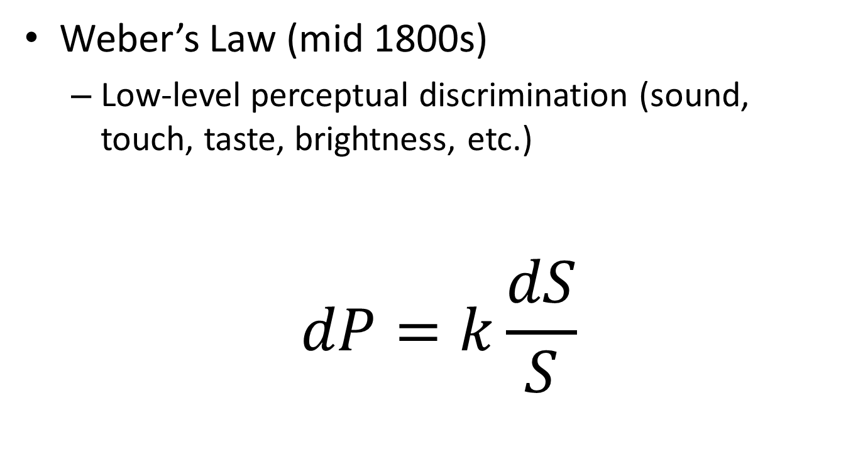
Perceptual Modeling
Weber’s Law (mid 1800s)
  Low-level perceptual discrimination (sound, touch, taste, brightness, etc.)
$$dP=k\frac{dS}{S}$$
Change in Intensity
Perceived Difference
Weber’s Fraction
(via experiments)
Intensity of the Stimulus

Slide 23
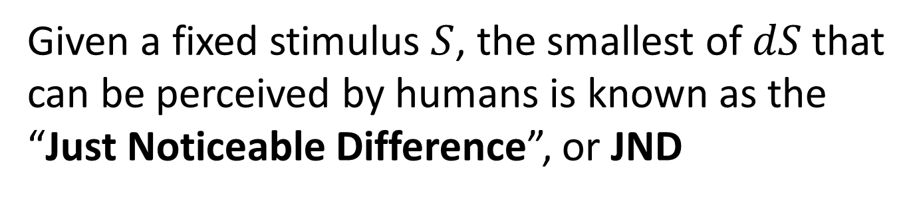
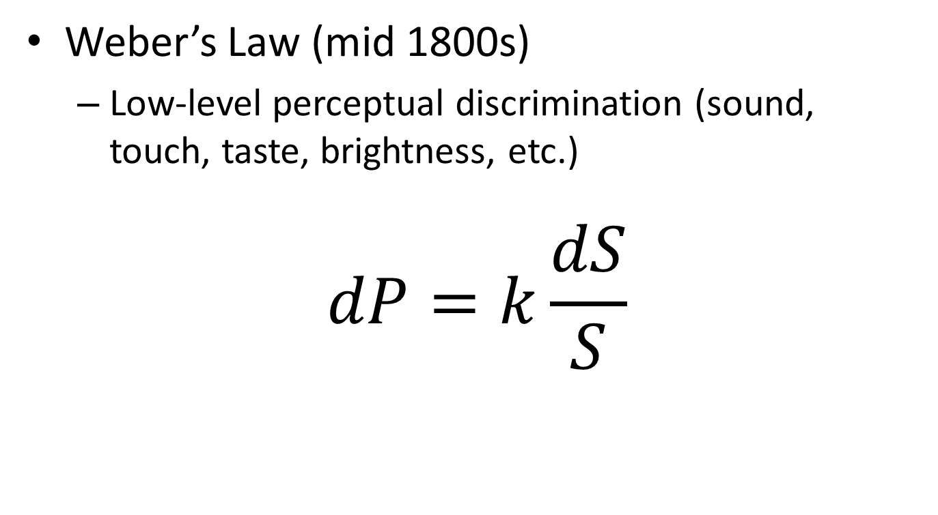
Perceptual Modeling
Weber’s Law (mid 1800s)
  Low-level perceptual discrimination (sound, touch, taste, brightness, etc.)
$$dP=k\frac{dS}{S}$$
Given a fixed stimulus $S$, the smallest of $dS$that
can be perceived by humans is known as the
“Just Noticeable Difference”, or JND

Slide 24
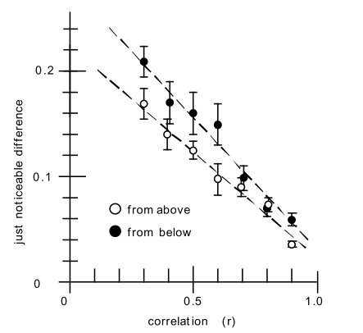
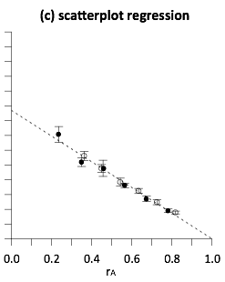
Replication Study
Replicated using MTurk Ron Rensink’s experiment in 2010 which shows the relationship between JND and correlation (r) is linear and follows the Weber’s Law

Slide 25
Our Question...
worse
If the perception of correlation in scatterplots follows Weber’s law...
better

Slide 26
worse
What does the perception of correlation in other charts look like?
better
Notes:
are some linear like scatterplots, or logarithmic, or exponential?

Slide 27
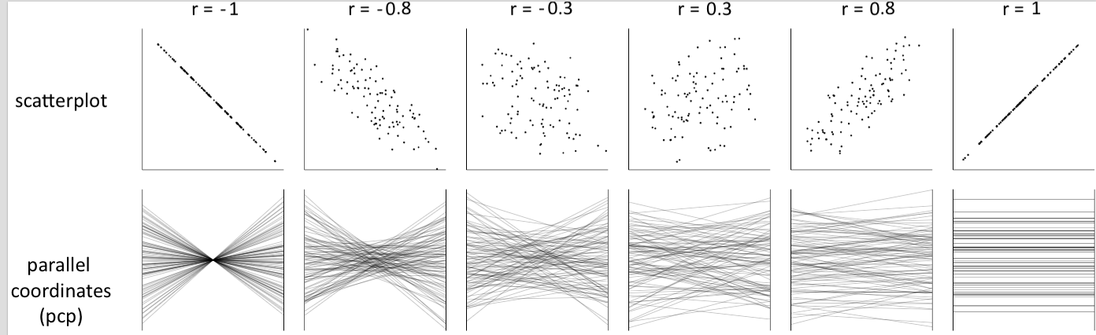
Notes:
both positively and negatively correlated data

Slide 28
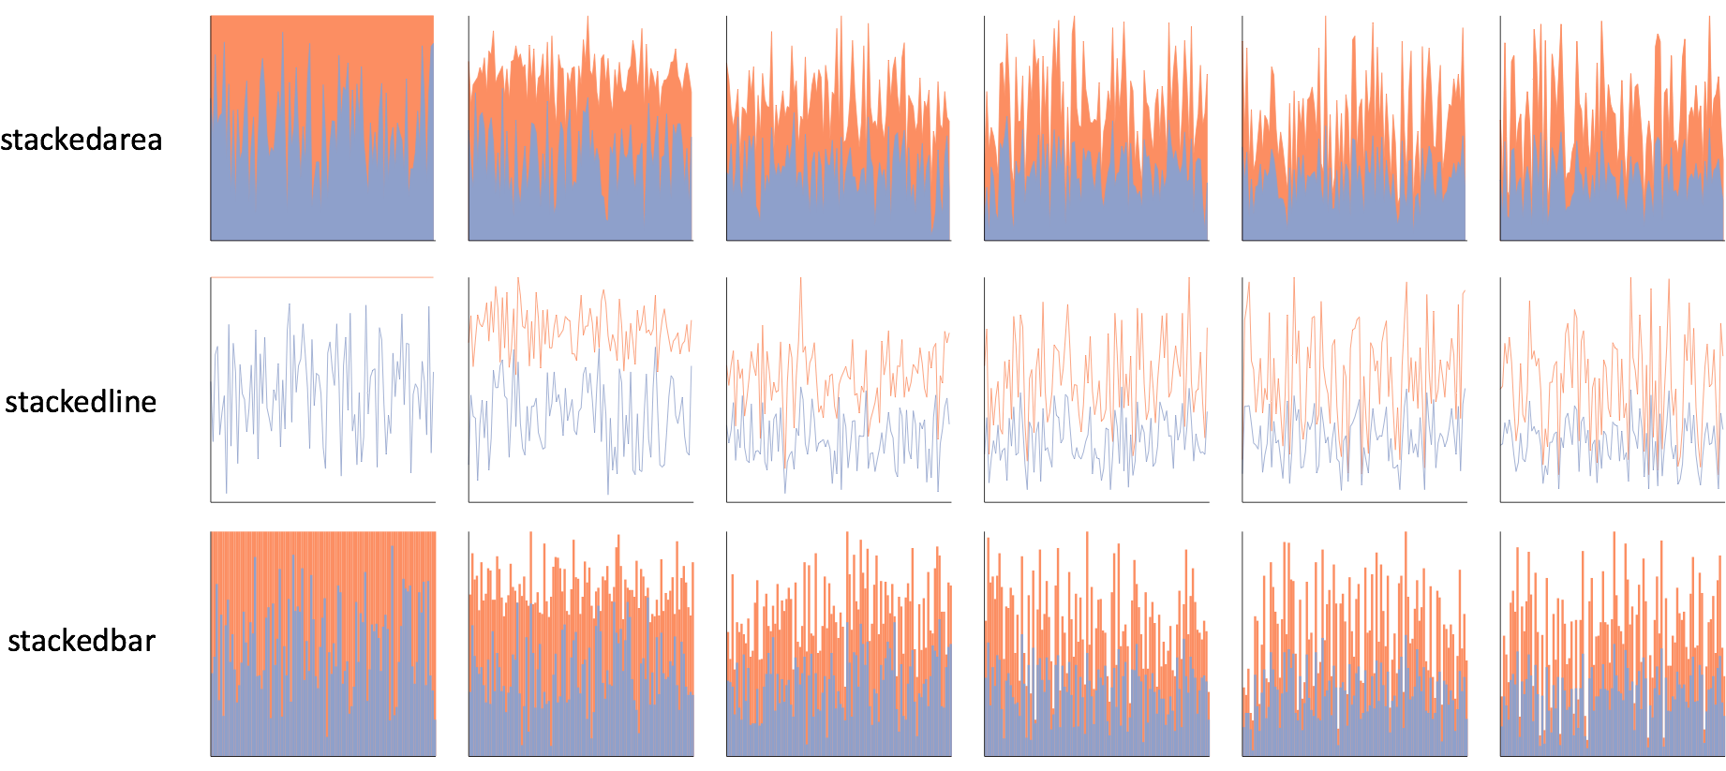
Notes:
one click away in excel

Slide 29
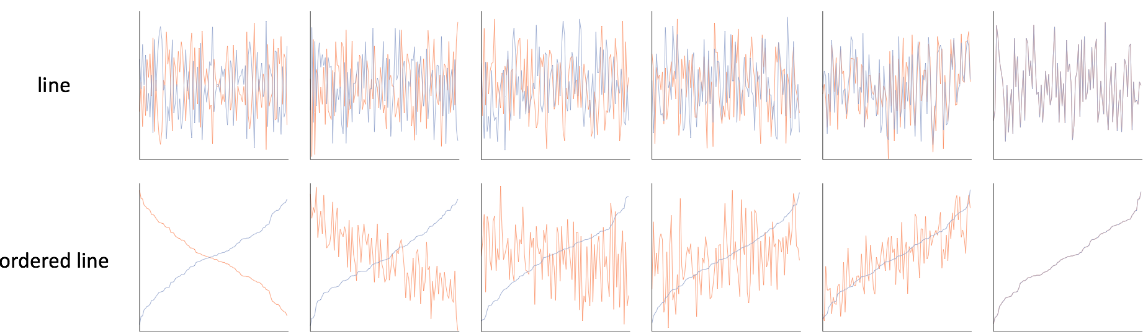

Slide 30
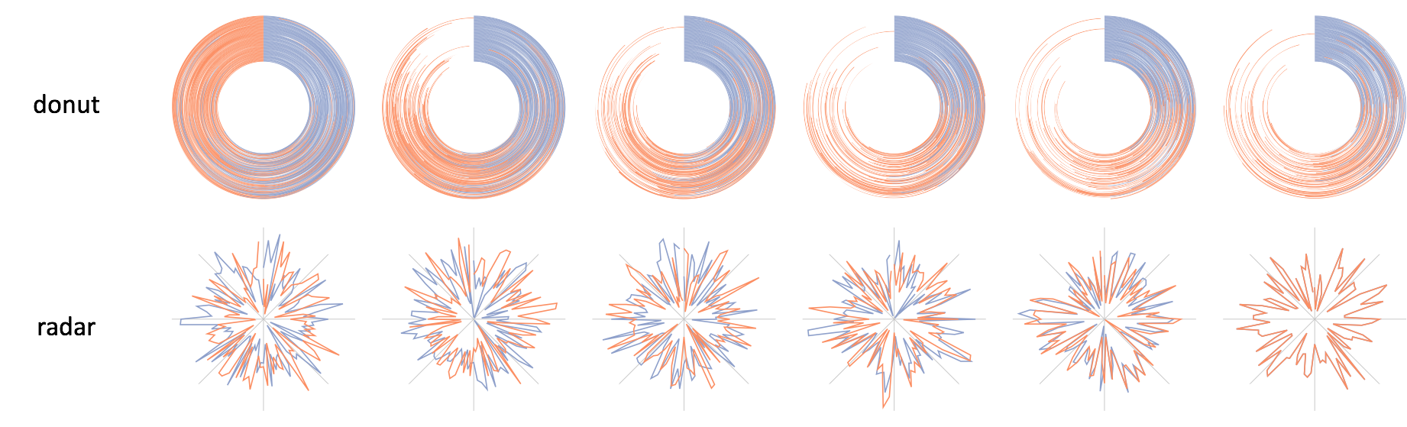

Slide 31
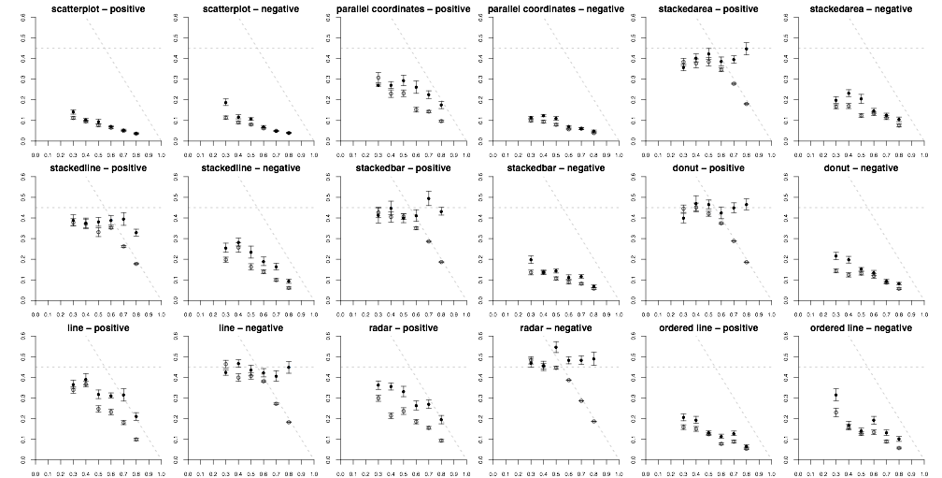
Notes:
whereas Rensink had one…
roughly 200,000 individual perceptual judgements

Slide 32
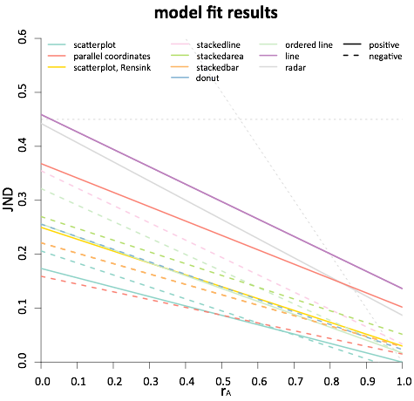
less precise
more precise
Notes:
this is essentially seeing if the trend of JNDs is linear
the moment of truth came when we checked the statistics

Slide 33
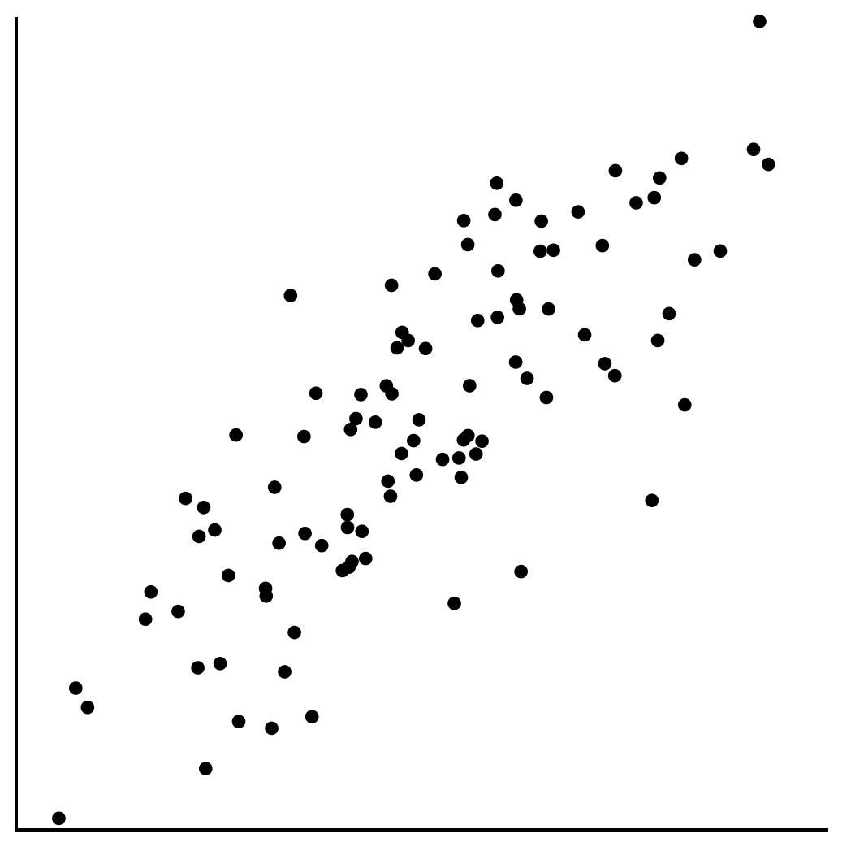
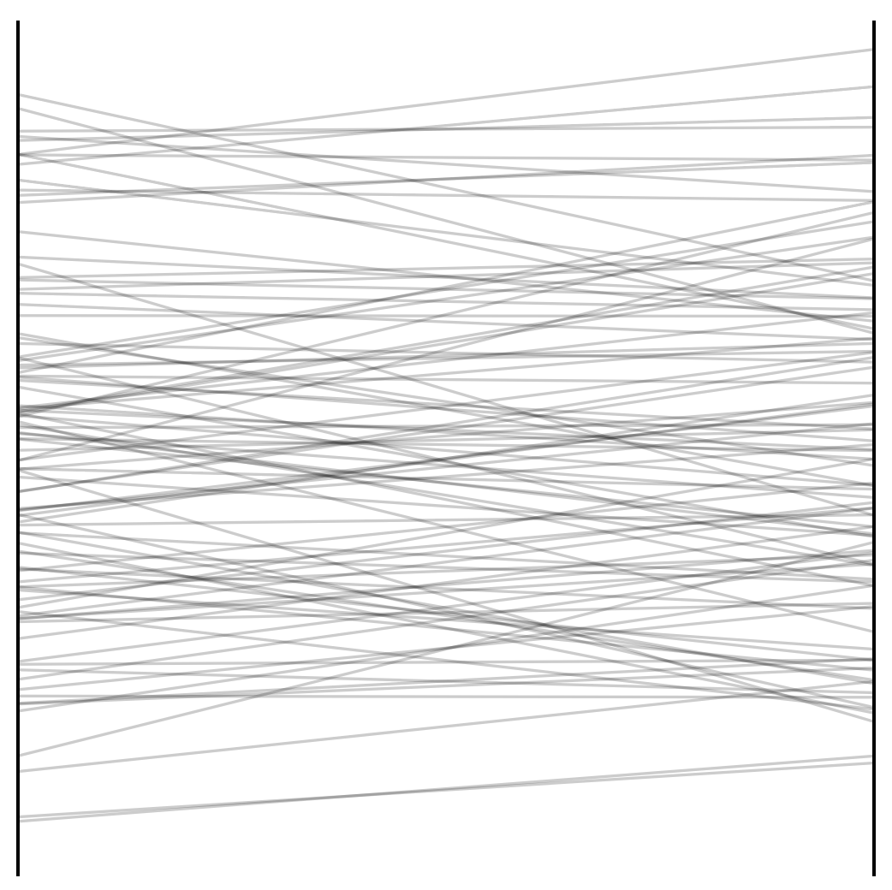
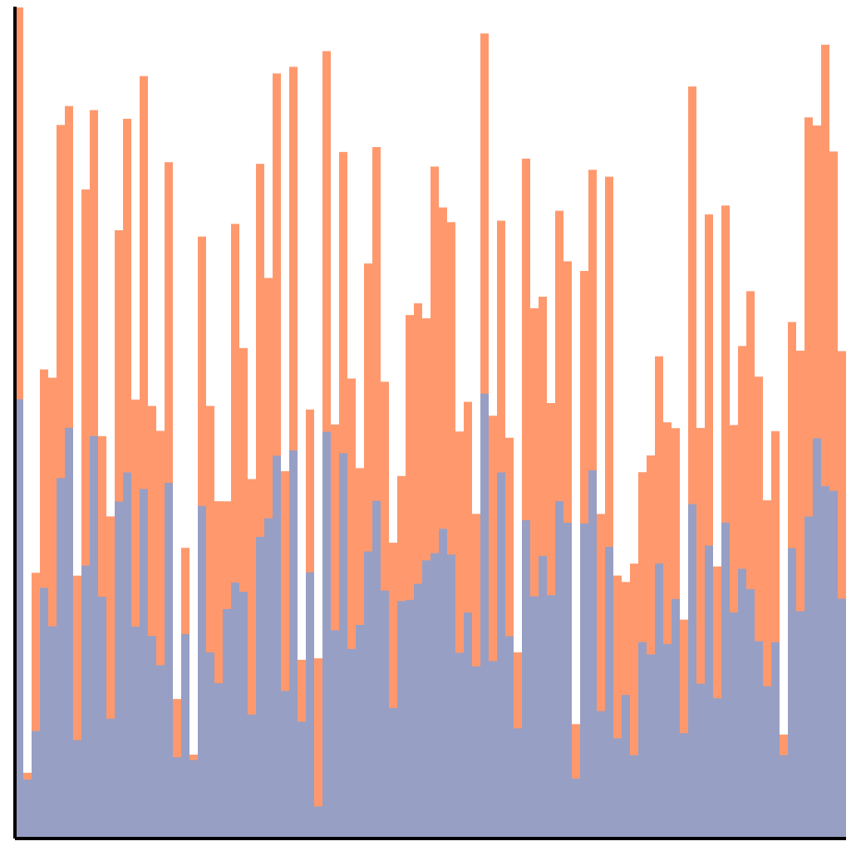
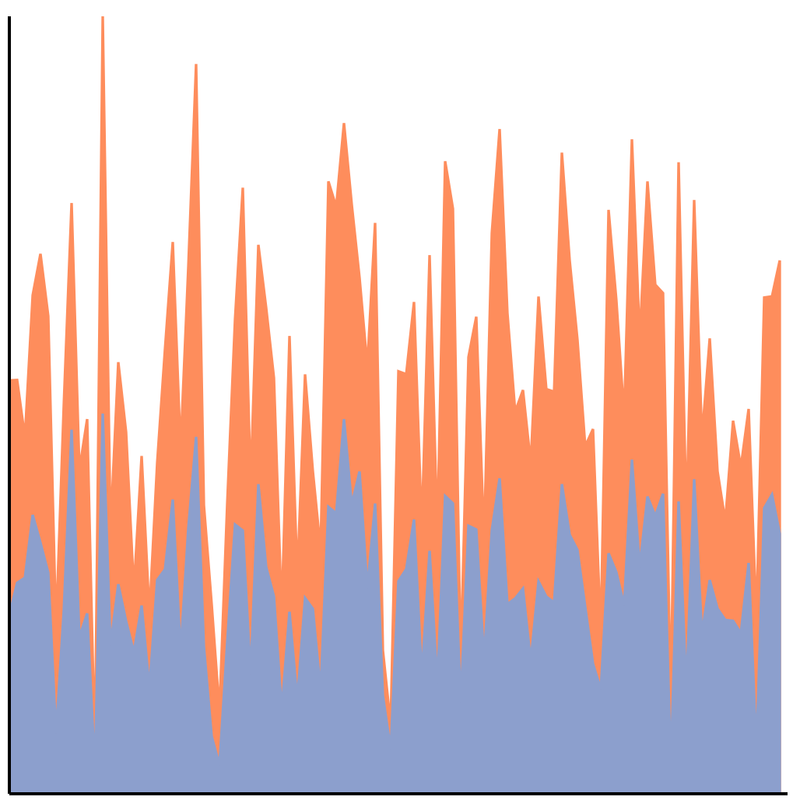
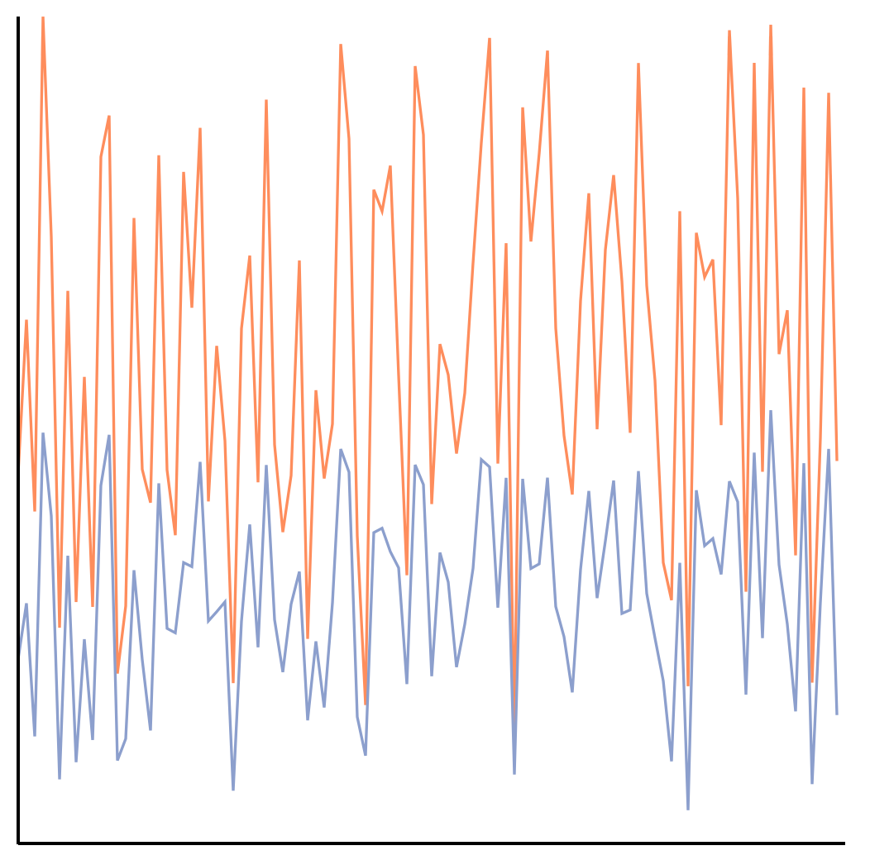
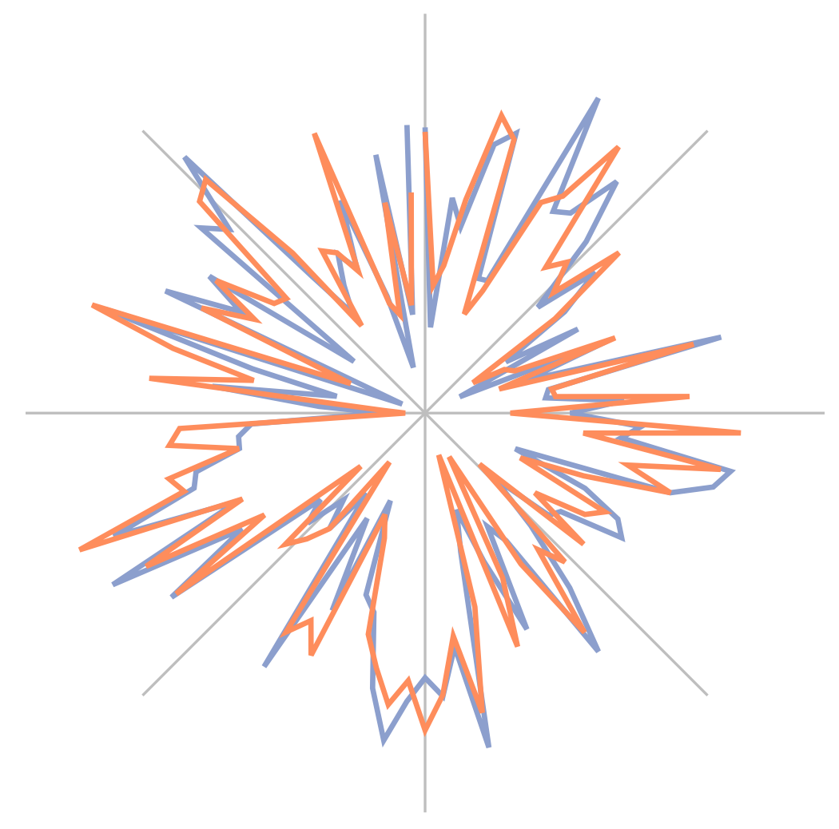
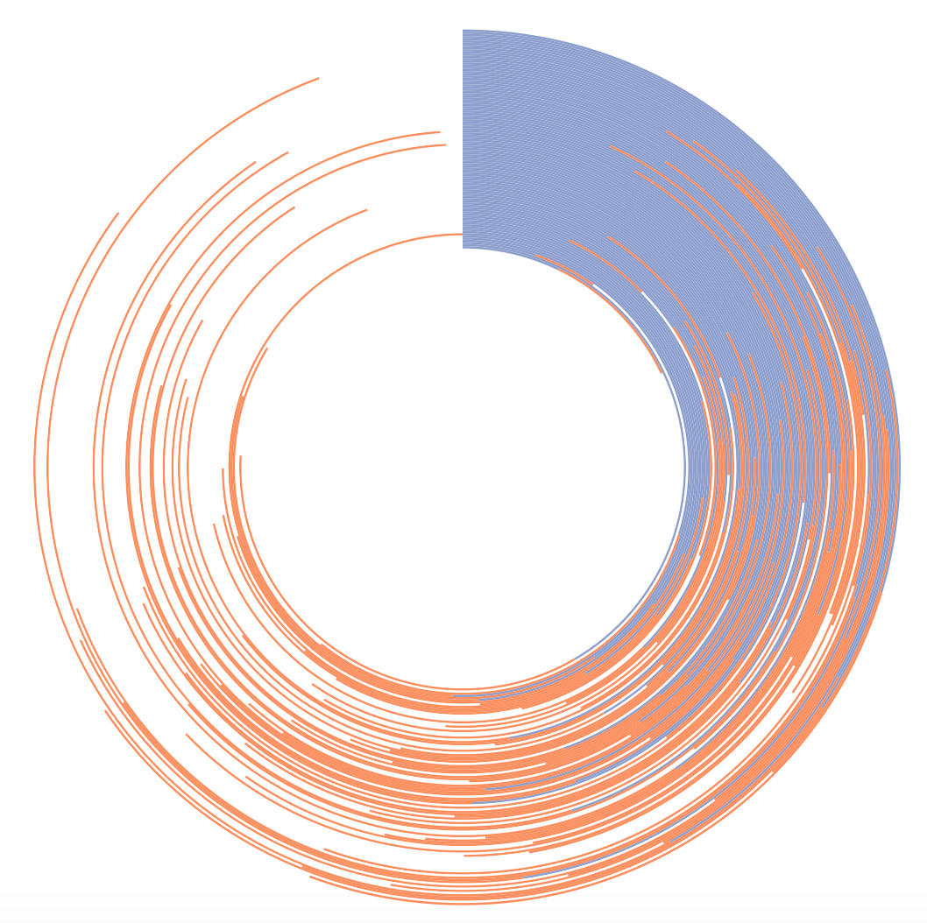
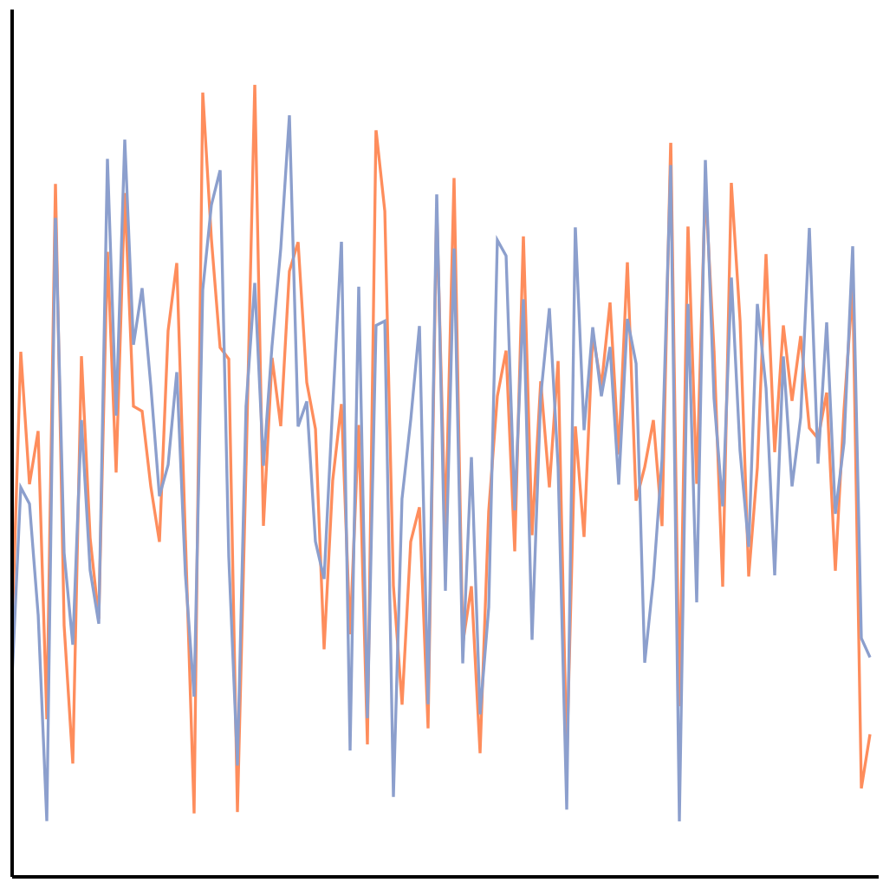
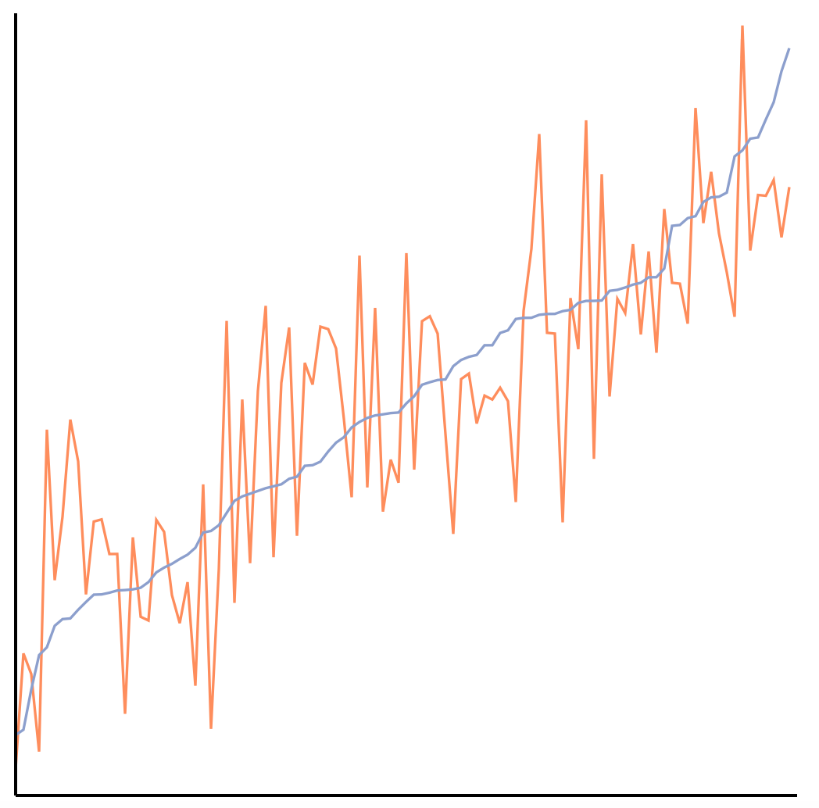
The perception of correlation
in every tested chart can be modeled using Weber’s law.
Notes:
Here we have a perceptual law that is used to study things like taste, line-length, brightness. Not only are we using it to model correlation, which is a higher-level concept, but it also applies across every chart tested!

Slide 34
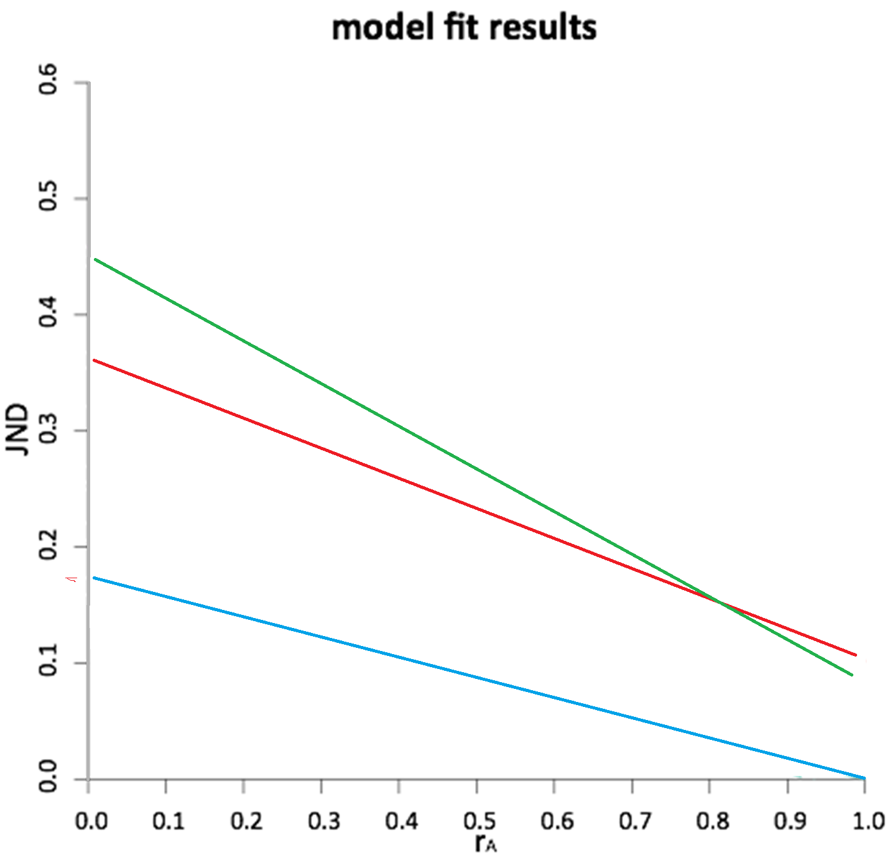
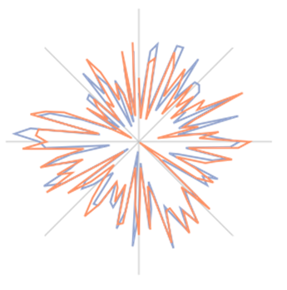
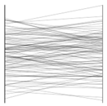
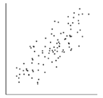

Slide 35
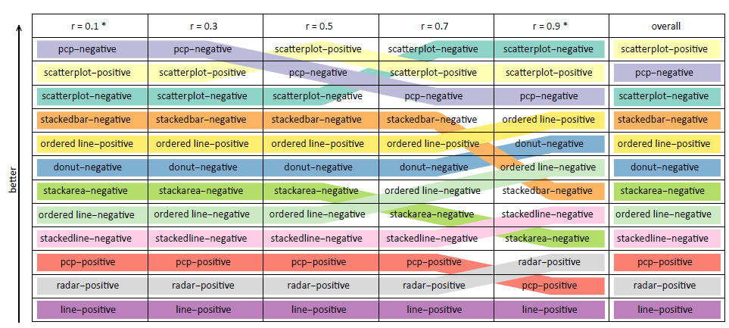
Ranking Visualizations of Correlation

Slide 36
Lessons Learned
MTurk is good for perceptual studies
  Slightly higher variance
  Overall trend and values hold
  Useful for Between-Subject study
Check device/browser type (disallow handheld devices)
Check screen resolution
  window.screen.width
  window.screen.availWidth

Slide 37
3: Cognitive Studies
Research Question: Do individual differences affect people’s ability to use visualizations?
  Priming emotion
  Priming locus of control
Need:
  Large number of participants (~1,000)
  Long complicated study design (~30 minutes)
  Speed (and accuracy) matter
Alvitta Ottley
Lane Harrison

Slide 38
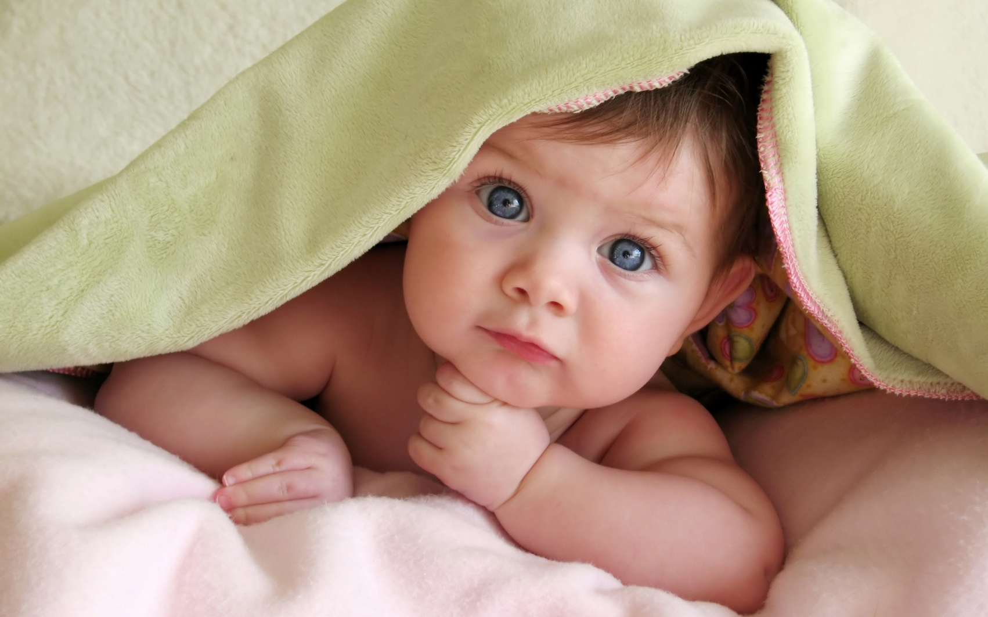
What is Priming?

Slide 39
Verbal Priming
For example, to make someone have a more external LOC
  “We know that one of the things that influence how well you can do everyday tasks is the number of obstacles you face on a daily basis. If you are having a particularly bad day today, you may not do as well as you might on a day when everything goes as planned. Variability is a normal part of life and you might think you can’t do much about that aspect. In the space provided below, give 3 examples of times when you have felt out of control and unable to achieve something you set out to do. Each example must be at least 100 words long.”

Slide 40
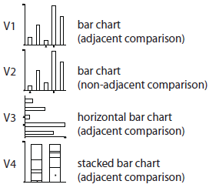
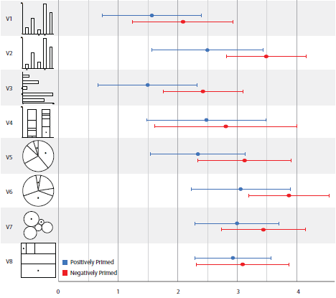
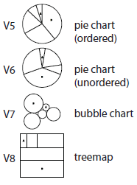
Priming Emotion on Visual Judgment
Harrison et al., Influencing Visual Judgment Through Affective Priming, CHI 2013

Slide 41
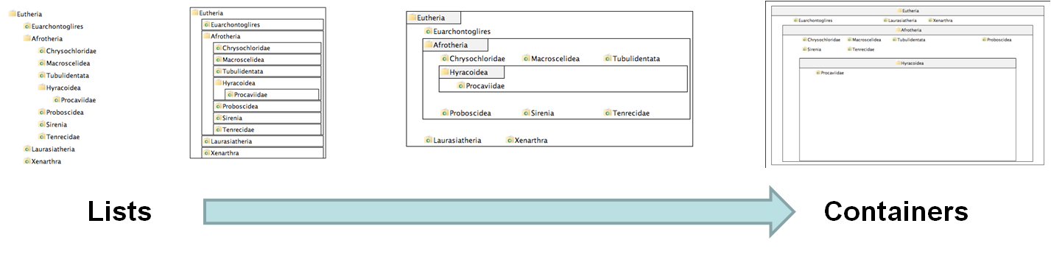
Background: Locus of Control and VIS
Task (Inferential): “There’s something interesting about folder XXX. Find another folder that shares a similar pattern”
V1
V2
V3
V4
Ziemkiewicz et al., How Locus of Control Influences Compatibility with Visualization Style, IEEE VAST 2011.

Slide 42
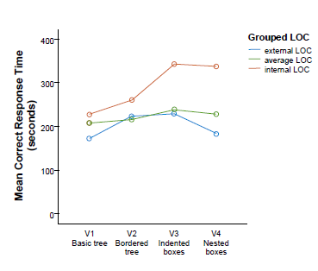
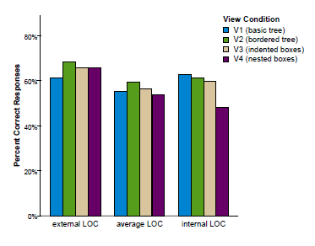
Locus of Control and VIS
When with list view compared to containment view, internal LOC users are:
  Faster (by 70%)
  More Accurate (by 34%)
The speed improvement is about 2 minutes (116 seconds)

Slide 43
Results: Average Primed to be Internal
Performance
Good
External LOC
Average LOC
Internal LOC
Poor
Visual Form
List-View
Containment
Ottley et al., Manipulating and Controlling for Personality Effects on Visualization Tasks, Information Visualization, 2013

Slide 44
Results: Internal Primed to be External
Performance
Good
External LOC
Average LOC
Internal LOC
Poor
Visual Form
List-View
Containment
Ottley et al., Manipulating and Controlling for Personality Effects on Visualization Tasks, Information Visualization, 2013

Slide 45
Results: External Primed to be Internal
Performance
Good
External LOC
Average LOC
Internal LOC
Poor
Visual Form
List-View
Containment
Ottley et al., Manipulating and Controlling for Personality Effects on Visualization Tasks, Information Visualization, 2013

Slide 46
Results

Slide 47

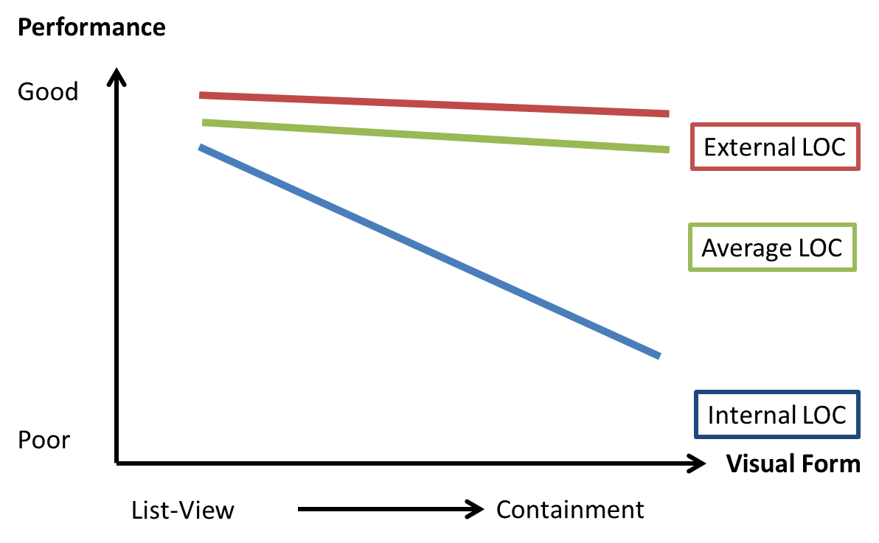
Lessons Learned
Pay minimum wage
  30 minutes ~= $3
  IRB requires that we pay everyone
Bonus on time and accuracy
  Disable the “Back” button
Estimate about 20%** of all resulting data will be “bad” in some way, e.g.
  Failing pre-task or consistency check
  Completed way too fast
Recruit from North America only
** The percentage has decreased in the past few years. Used to be around 40%

Slide 48
Conclusion
Crowdsourcing works for VIS experiments
  Collect User Generated Data
  Conduct Perceptual Experiments
  Run Cognitive Studies
Many “gotchas” but most of them are avoidable

Slide 49

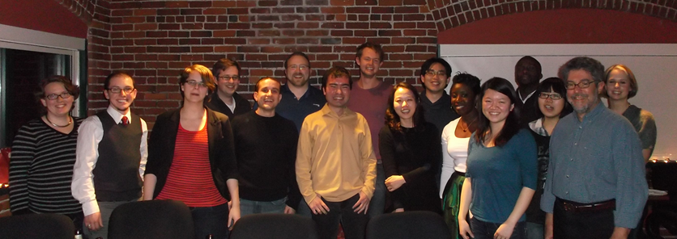
Questions? remco@cs.tufts.edu

