Slide 1
Big Data Visual Analytics:
A User-Centric Approach
Remco Chang
Assistant Professor
Computer Science
Tufts University

Slide 2
Three Styles of Big Data Visualization
Hadley
Big Data ->
Medium Data ->
Small Data + R
Sheelagh
Novel visual representation + User Interactions
Bowei
Divide and conquer + Parallel Computation

Slide 3

Financial Fraud – A Case Study for Visual Analytics

Slide 4
Example: What Does (Wire) Fraud Look Like?
Financial Institutions like Bank of America have legal responsibilities to report all suspicious wire transaction activities (money laundering, supporting terrorist activities, etc)
Data size: approximately 200,000 transactions per day (73 million transactions per year)
Problems:
  Automated approach can only detect known patterns
  Bad guys are smart: patterns are constantly changing
  Data is messy: lack of international standards resulting in ambiguous data
Previous methods:
  10 analysts monitoring and analyzing all transactions
  Using SQL queries and spreadsheet-like interfaces
  Limited time scale (2 weeks)

Slide 5
WireVis: Financial Fraud Analysis
In collaboration with Bank of America
  Develop a visual analytical tool (WireVis)
  Visualizes 7 million transactions over 1 year
A great problem for visual analytics:
  Ill-defined problem (how does one define fraud?)
  Limited or no training data (patterns keep changing)
  Requires human judgment in the end (involves law enforcement agencies)
R. Chang et al., Scalable and interactive visual analysis of financial wire transactions for fraud detection. Information Visualization,2008.
R. Chang et al., Wirevis: Visualization of categorical, time-varying data from financial transactions. IEEE VAST, 2007.

Slide 6
WireVis: A Visual Analytics Approach
Search by Example (Find Similar Accounts)
Heatmap View
(Accounts to Keywords Relationship)
Keyword Network
(Keyword Relationships)
Multiple Temporal View
(Relationships over Time)

Slide 7
Evaluation
Challenging – lack of ground truth
Two types of evaluations:
  Grounded Evaluation: real fraud analysts, real data
    Find transactions that existing techniques can find
    Find new transactions that appear suspicious
  Controlled Evaluation: real financial analysts, synthetic data
    Find all injected threat scenarios
Adoption and Deployment

Slide 8

Good Lessons Learned
No “one view to rule them all”
Multiple Coordinated Views
High Interactivity

Slide 9





Interactive Visualization Systems
Jordan Crouser
Political Simulation
  Agent-based analysis
Bridge Maintenance
  Exploring inspection reports
Biomechanical Motion
  Interactive motion comparison
Interactive Metric Learning
  DisFunction: learn a model from projection
High-D Data Exploration
  iPCA: Interactive PCA
R. Chang et al., Two Visualization Tools for Analysis of Agent-Based Simulations in Political Science. IEEE CG&A, 2012

Slide 10



Interactive Visualization Systems
Political Simulation
  Agent-based analysis
Bridge Maintenance
  Exploring inspection reports
Biomechanical Motion
  Interactive motion comparison
Interactive Metric Learning
  DisFunction: learn a model from projection
High-D Data Exploration
  iPCA: Interactive PCA
R. Chang et al., An Interactive Visual Analytics System for Bridge Management, Journal of Computer Graphics Forum, 2010.

Slide 11



Interactive Visualization Systems
Political Simulation
  Agent-based analysis
Bridge Maintenance
  Exploring inspection reports
Biomechanical Motion
  Interactive motion comparison
Interactive Metric Learning
  DisFunction: learn a model from projection
High-D Data Exploration
  iPCA: Interactive PCA
R. Chang et al., Interactive Coordinated Multiple-View Visualization of Biomechanical Motion Data, IEEE Vis (TVCG) 2009.

Slide 12

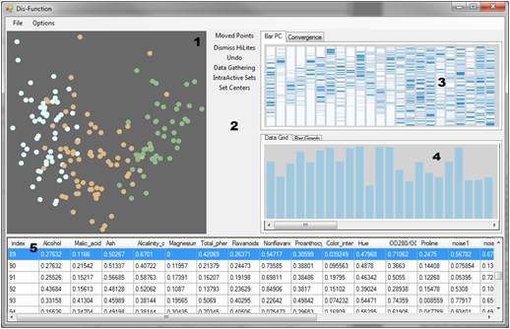
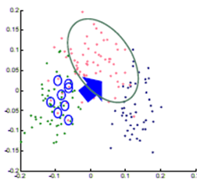

Interactive Visualization Systems
Eli Brown
Political Simulation
  Agent-based analysis
Bridge Maintenance
  Exploring inspection reports
Biomechanical Motion
  Interactive motion comparison
Interactive Metric Learning
  DisFunction: learn a model from projection
High-D Data Exploration
  iPCA: Interactive PCA
R. Chang et al., Dis-function: Learning Distance Functions Interactively, IEEE VAST 2011.

Slide 13
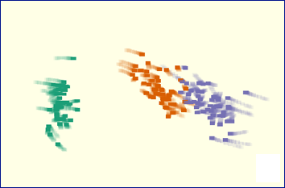
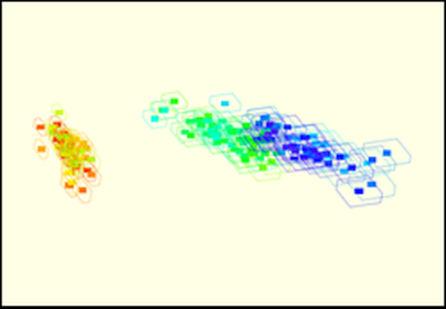
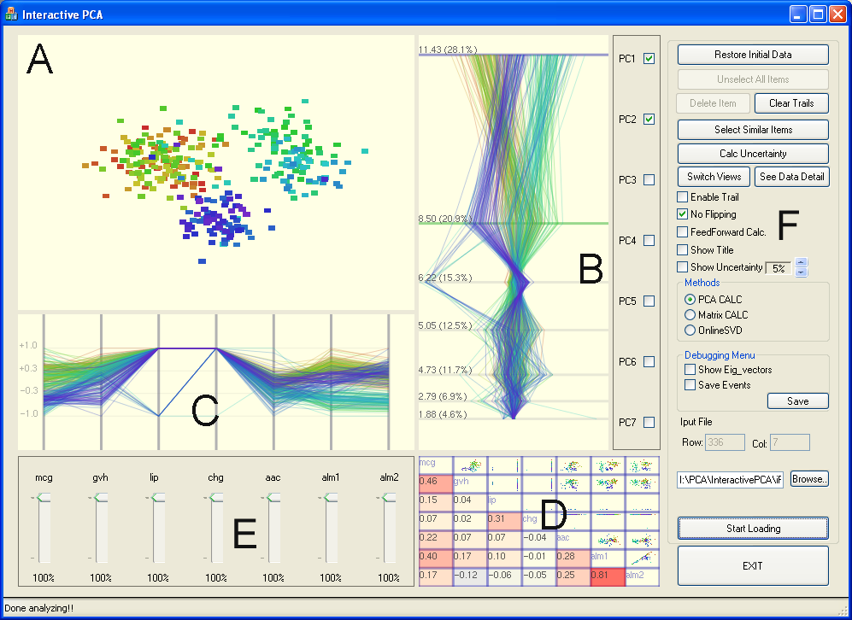
Interactive Visualization Systems
Political Simulation
  Agent-based analysis
Bridge Maintenance
  Exploring inspection reports
Biomechanical Motion
  Interactive motion comparison
Interactive Metric Learning
  DisFunction: learn a model from projection
High-D Data Exploration
  iPCA: Interactive PCA
R. Chang et al., iPCA: An Interactive System for PCA-based Visual Analytics, EuroVis 2009.

Slide 14
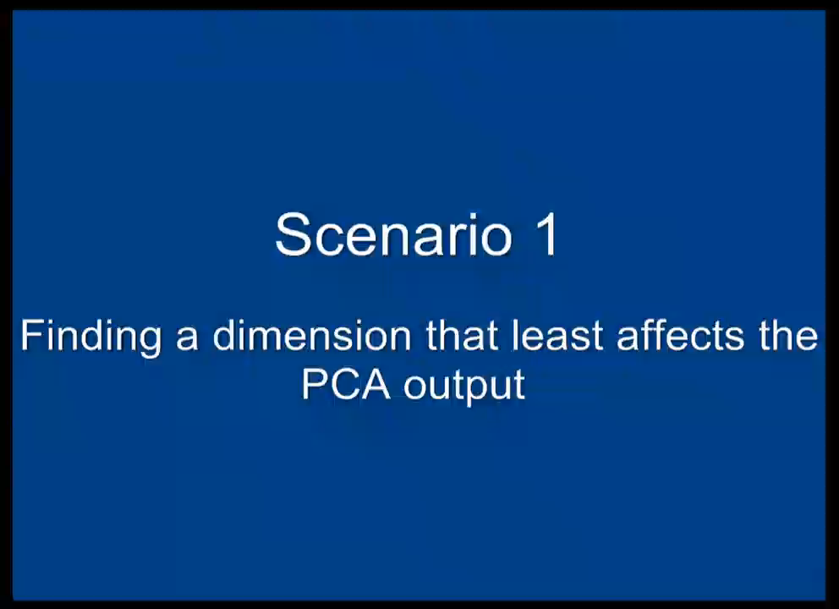

Slide 15
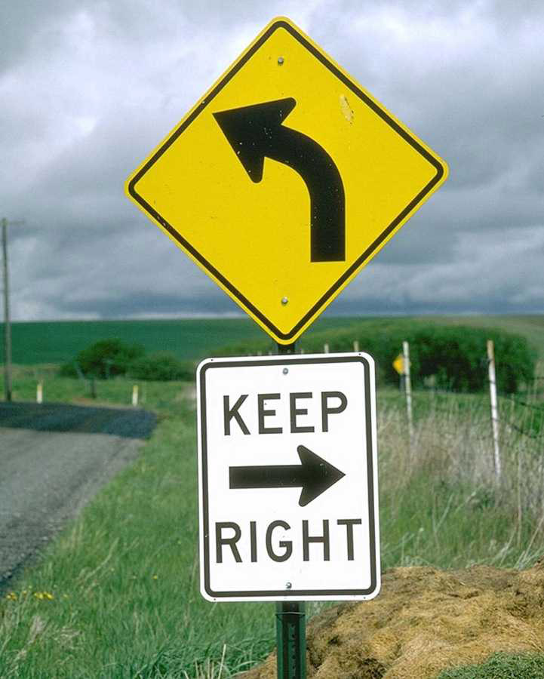
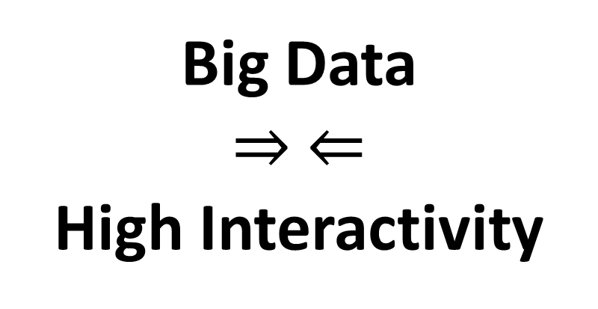
“Tough” Lessons Learned
Big Data
$⇒ ⇐$
High Interactivity

Slide 16


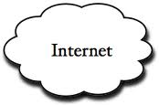
Problem Statement
Visualization on a
Commodity Hardware
Large Data in a
Data Warehouse

Slide 17
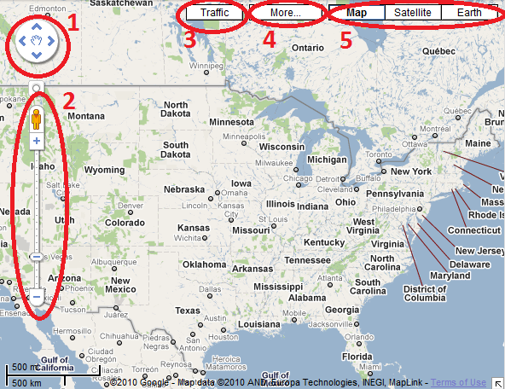
Two Observations:
User’s actions are consistent and number of possible actions are finite.
Visualization itself is a bottleneck

Slide 18
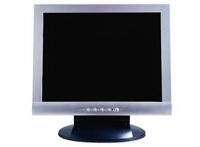

Two Observations:
User’s actions are consistent and number of possible actions are finite.
Visualization itself is a bottleneck
  User’s perception and cognition are added constraints
1000 pixels
1000 pixels
1000x1000x3 = 3 million

Slide 19
Problem Statement
Problem: Data is too big to fit into the memory of the personal computer
  Note: Ignoring various database technologies (OLAP, Column-Store, No-SQL, Array-Based, etc)
Goal: Guarantee a result set to a user’s query within X number of seconds.
  Based on HCI research, the upperbound for X is 10 seconds
  Ideally, we would like to get it down to 1 second or less
Method: trading accuracy and storage (caching), optimize on minimizing latency (user wait time).

Slide 20

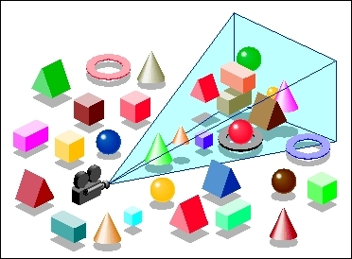
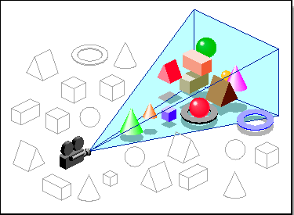
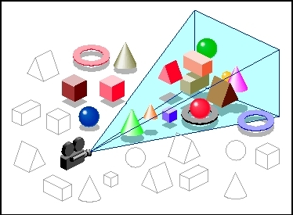

Our Approach: Predictive
Pre-Computation and Pre-Fetching
Leilani Battle
In collaboration with MIT (Leilani Battle, Mike Stonebraker)
ForeCache: Three-tiered architecture
  Thin client (visualization)
  Backend (array-based database, e.g. data cubes / OLAP)
  Fat middleware
    Prediction Algorithms
    Precomputation Techniques
    Caching Management (Eviction Strategies)
R. Chang et al., Dynamic Prefetching of Data Tiles for Interactive Visualization. In Submission to VLDB 2015

Slide 22



Prediction Algorithms
General Idea:
  Lots of “experts” who recommend chunks of data to pre-fetch / pre-compute
  One “manager” who listens to the experts and chooses which experts’ advice to follow
  Each “expert” gets more of their recommendations accepted if they keep guessing correctly

Slide 23
Iteration: 0
13
48
11
3
99
2
13
99
67
45
82
7
22
42
31

Slide 24
Iteration: 0
13
48
11
3
99
2
13
99
67
45
82
7
22
42
31

Slide 25
Iteration: 0
13
48
11
3
99
2
13
99
67
45
82
7
22
42
31
User Requests Data Block 13

Slide 26


Iteration: 0
13
48
11
3
99
2
13
99
67
45
82
7
22
42
31
User Requests Data Block 13

Slide 27
Iteration: 0
13
48
11
3
99
2
13
99
67
45
82
7
22
42
31
User Requests Data Block 13

Slide 28
Iteration: 1
4
12
34
88
27
5
23
1
92
34
42
12
31
32
13

Slide 29
Training
Instead of training the manager in real-time, this process can be done offline
  Using past user interaction logs
This approach is similar to how Database are currently tuned
  Instead of a DBA manually tune the performance of a database
  Past SQL logs are used to automatically tune the database for an organization’s specific needs (e.g. read-mostly, write-often, etc.)

Slide 30
How to Determine the “Experts”?
More detail on this later
Some obvious ones include:
  Momentum-based
  Data similarity-based
  Frequency (hot-spot)-based
  Past action sequence-based
Generally speaking, given the “manager” approach, we want as many different types of “experts” as possible

Slide 31
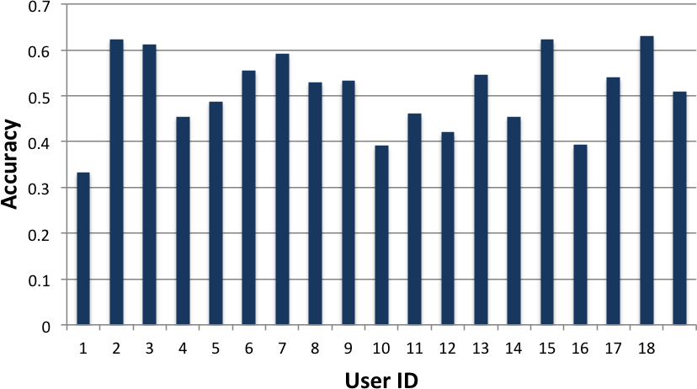
Preliminary Results
Using a simple Google-maps like interface
18 users explored the NASA MODIS dataset
Tasks include “find 4 areas in Europe that have a snow coverage index above 0.5”

Slide 32
Worst Case Scenario: Cache Miss
13
48
11
3
99
2
13
99
67
45
82
7
22
42
31
User’s Requests Data Block 52

Slide 33
Cache Miss
Leilani Battle
How to guarantee response time when there’s a cache miss?
Trick: the ‘EXPLAIN’ command
Usage:
  explain select * from myTable;
Middleware “intercepts” a query from the client, and first asks for an “explain”
  If “ok” with explain result, execute the original query
  If “not ok”, modify the query dynamically
R. Chang et al., Dynamic Reduction of Result Sets for Interactive Visualization, IEEE Big Data Workshop on Visualization, 2013.

Slide 34
Example EXPLAIN Output from SciDB
Example SciDB the output of (a query similar to)
Explain SELECT * FROM earthquake
[("[pPlan]:
schema earthquake
<datetime:datetime NULL DEFAULT null,
magnitude:double NULL DEFAULT null,
latitude:double NULL DEFAULT null,
longitude:double NULL DEFAULT null>
[x=1:6381,6381,0,y=1:6543,6543,0]
bound start {1, 1} end {6381, 6543}
density 1 cells 41750883 chunks 1
est_bytes 7.97442e+09
")]
The four attributes in the table ‘earthquake’
Notes that the dimensions of this array (table) is 6381x6543
This query will touch data elements from (1, 1) to (6381, 6543), totaling 41,750,833 cells
Estimated size of the returned data is 7.97442e+09 bytes (~8GB)

Slide 35
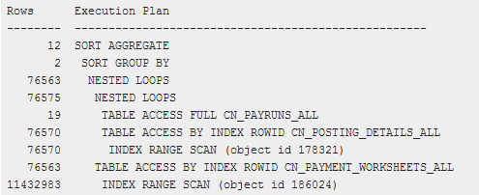
Other Examples
Oracle 11g Release 1 (11.1)

Slide 36
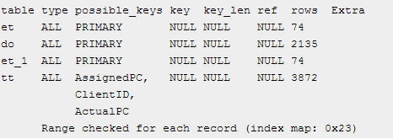
Other Examples
MySQL 5.0

Slide 37
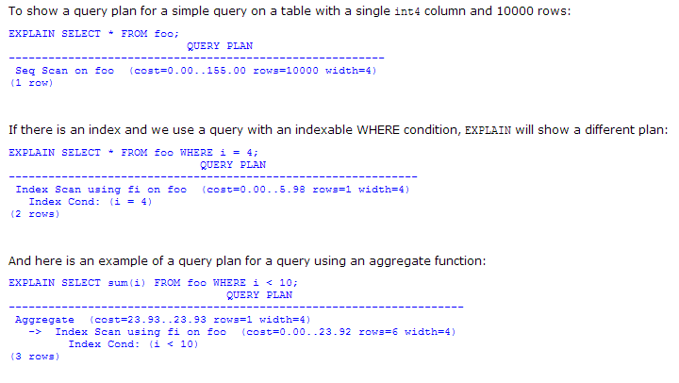
Other Examples
PostgreSQL 7.3.4

Slide 38
Reduction Strategies
If the query result is estimated to be too large, we can dynamically “modify” the query:
  Aggregation:
    In SciDB, this operation is carried out as
    regrid (scale_factorX, scale_factorY)
  Sampling
    In SciDB, uniform sampling is carried out as
    bernoulli (query, percentage, randseed)
  Filtering
    Currently, the filtering criteria is user specified
    where (clause)

Slide 39
Quick Summary
Key Components:
Pre-computation and pre-fetching
Three-tiered system
Pre-fetching based on “expert-manager” approach
Use the “explain” trick to handle cache-miss
Guarantees response time, but not data quality
Backbone (invisible) to data analysts

Slide 40
Two Observations (Ongoing & Future Work)
User’s actions are consistent and number of possible actions are finite.
  Need more “recommenders” – techniques for learning about a user from their interaction
Visualization and User Perception are bottlenecks
  Need quantitative methods for understanding the users’ perceptual and cognitive limitations

Slide 41

Analyzing a User’s Interactions
Alvitta Ottley
Eli Brown
Do a User’s Interactions encode
their analysis behaviors and strategies?

Slide 42
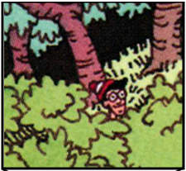
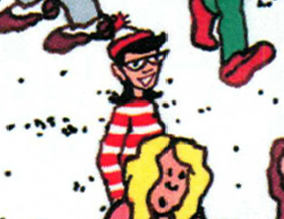
Experiment: Finding Waldo
Google-Maps style interface
  Left, Right, Up, Down, Zoom In, Zoom Out, Found
R. Chang et al., Finding Waldo: Learning about Users from their Interactions. IEEE VAST 2014

Slide 43
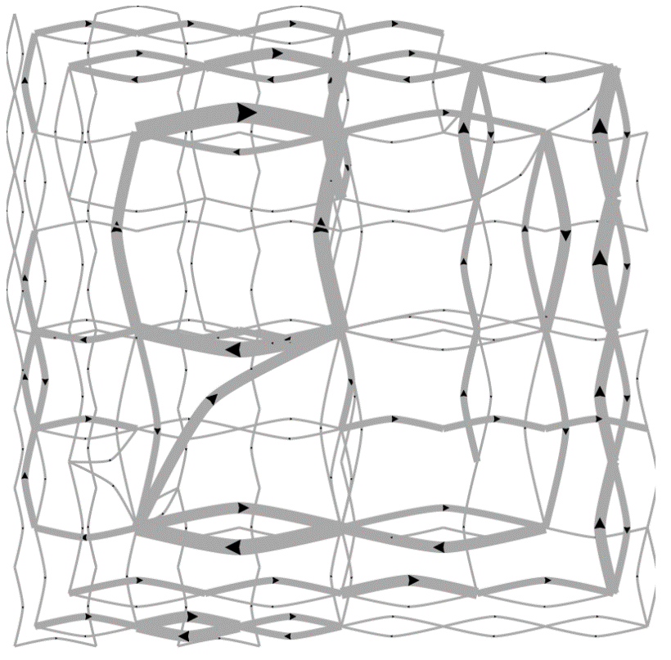
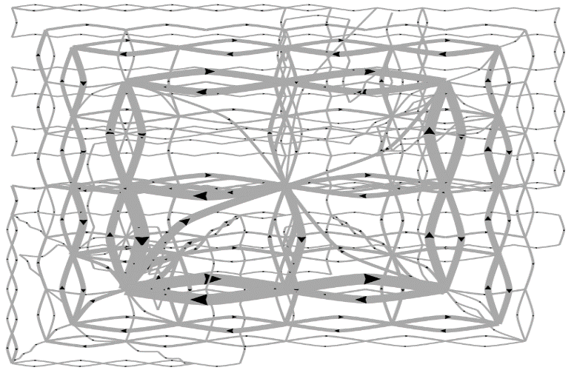
Pilot Visualization – Completion Time
Fast completion time
Slow completion time

Slide 44
Post-hoc Analysis Results
Mean Split (50% Fast, 50% Slow)
Data Representation | Classification Accuracy | Method
State Space | 72% | SVM
Edge Space | 63% | SVM
Sequence (n-gram) | 77% | Decision Tree
Mouse Event | 62% | SVM
Fast vs. Slow Split (Mean+0.5σ=Fast, Mean-0.5σ=Slow)
Data Representation | Classification Accuracy | Method
State Space | 96% | SVM
Edge Space | 83% | SVM
Sequence (n-gram) | 79% | Decision Tree
Mouse Event | 79% | SVM

Slide 45
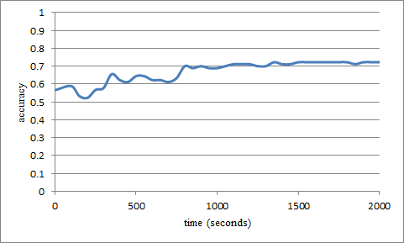
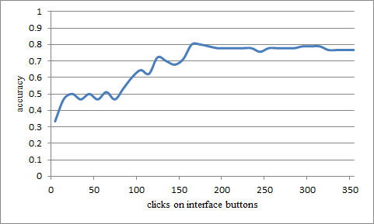
“Real-Time” Prediction
(Limited Time Observation)
State-Based
Linear SVM
Accuracy: ~70%
Interaction Sequences
N-Gram + Decision Tree
Accuracy: ~80%

Slide 46
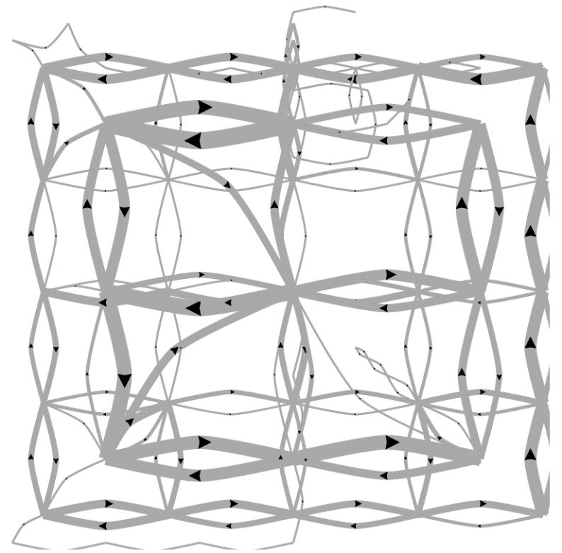
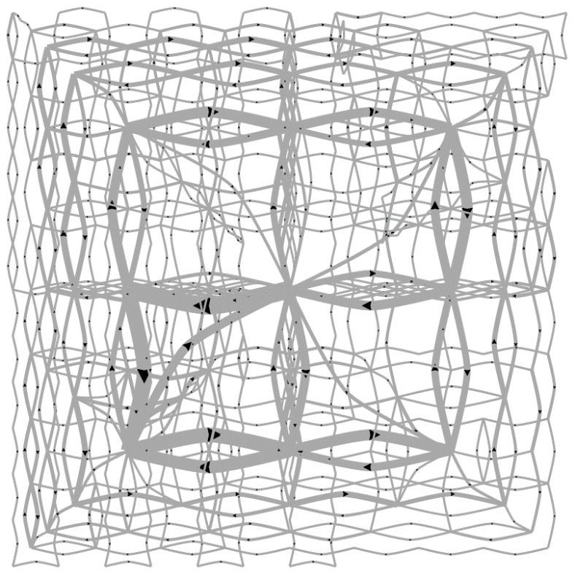
Predicting a User’s Personality
External Locus of Control
Internal Locus of Control
Ottley et al., How locus of control inﬂuences compatibility with visualization style. IEEE VAST , 2011.
Ottley et al., Understanding visualization by understanding individual users. IEEE CG&A, 2012.

Slide 47
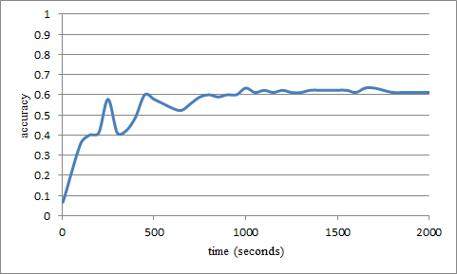
Predicting Users’ Personality Traits
Predicting user’s “Extraversion”
Linear SVM
Accuracy: ~60%
Noisy data, but can (almost) detect the users’ individual traits “Extraversion”, “Neuroticism”, and “Locus of Control” at ~60% accuracy.

Slide 48
Quick Summary
User’s interaction log encode a great deal of a user’s analysis behavior
Representation remains the biggest issue
Need more techniques for extracting this type of data
External Locus of Control
Internal Locus of Control

Slide 49


Modeling Perception of Data
Lane Harrison
Fumeng Yang
Can a user’s ability to perceive Information
from visualization be modelled quantitatively?
R. Chang et al., Ranking Visualization Effectiveness Using Weber's Law. IEEE InfoVis 2014

Slide 50
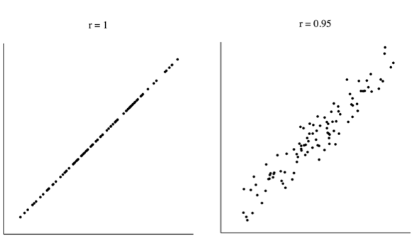

Slide 52
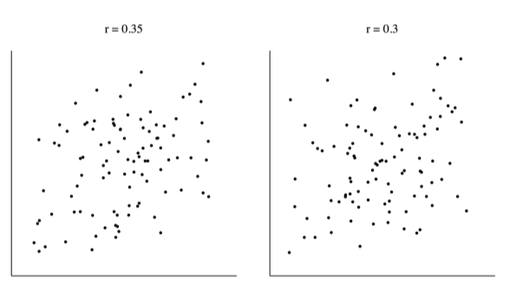

Slide 54
Another Experiment
Imagine yourself in a dark room….

Slide 59
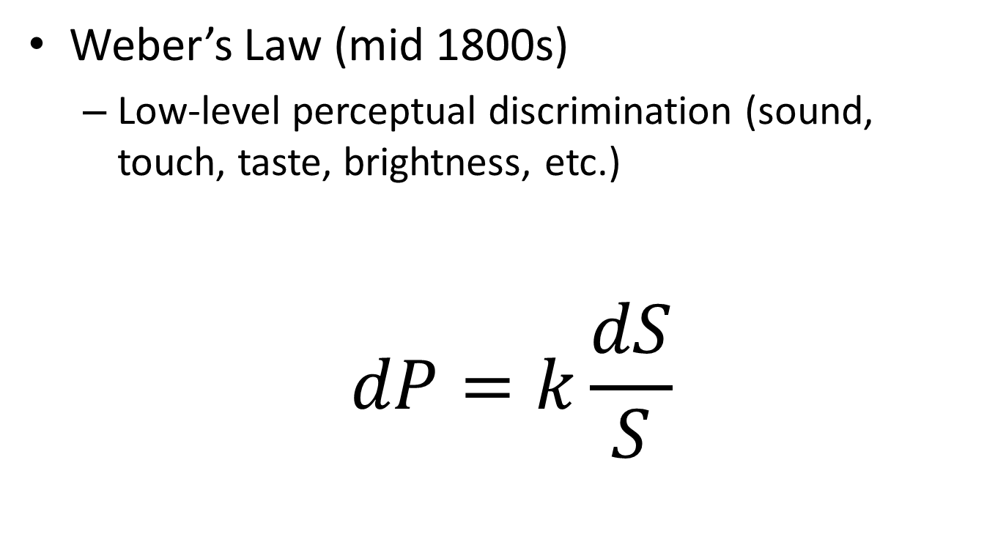
Perceptual Modeling
Weber’s Law (mid 1800s)
  Low-level perceptual discrimination (sound, touch, taste, brightness, etc.)
$$dP=k\frac{dS}{S}$$
Change in Intensity
Perceived Difference
Weber’s Constant
(via experiments)
Intensity of the Stimulus

Slide 60
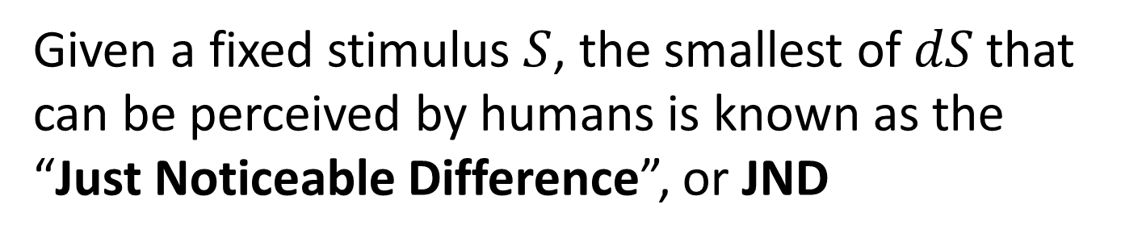
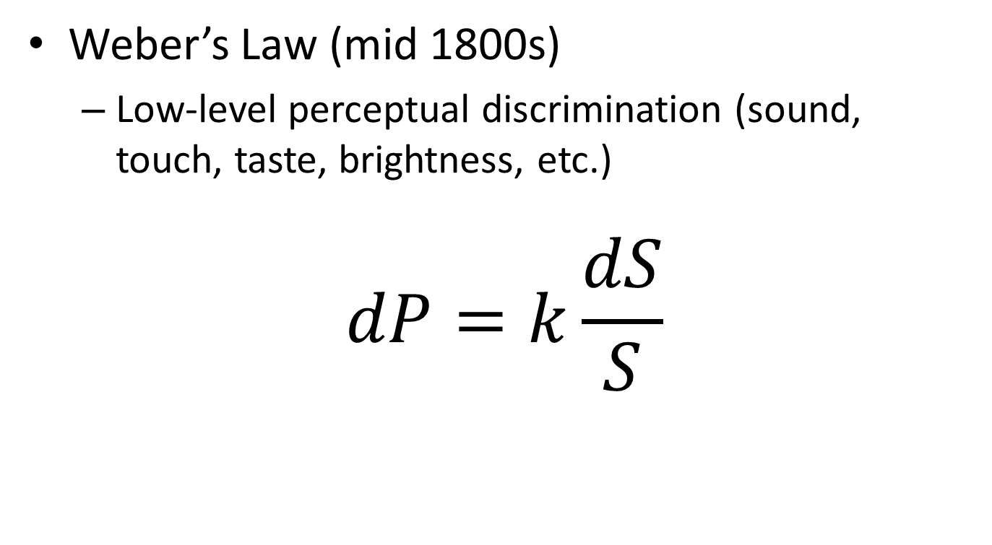
Perceptual Modeling
Weber’s Law (mid 1800s)
  Low-level perceptual discrimination (sound, touch, taste, brightness, etc.)
$$dP=k\frac{dS}{S}$$
Given a fixed stimulus $S$, the smallest of $dS$that
can be perceived by humans is known as the
“Just Noticeable Difference”, or JND

Slide 61
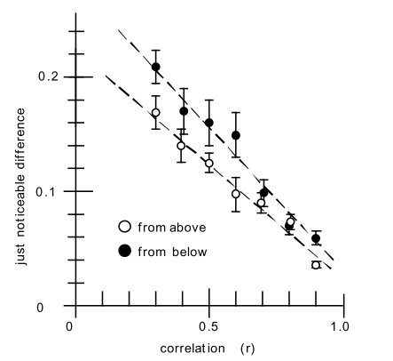
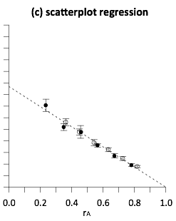
Perceptual Modeling
In 2010, Ron Rensink (UBC) found that the relationship between JND and correlation (r) is linear and follows the Weber’s Law

Slide 62
Our Question…
worse
If the perception of correlation in scatterplots follows Weber’s law…
better

Slide 63
worse
What does the perception of correlation in other charts look like?
better
Notes:
are some linear like scatterplots, or logarithmic, or exponential?

Slide 64
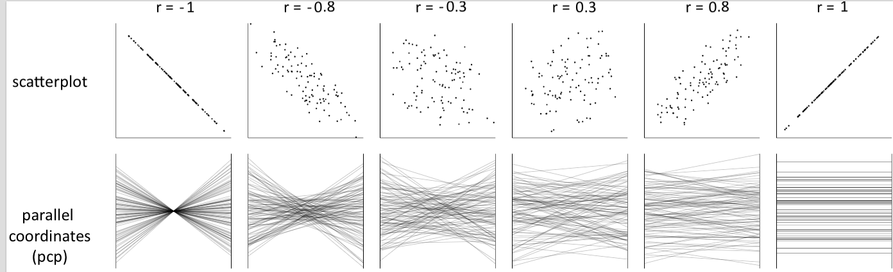
Notes:
both positively and negatively correlated data

Slide 65
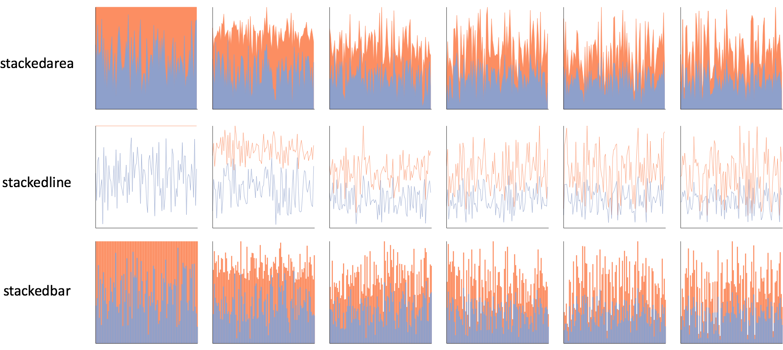
Notes:
one click away in excel

Slide 66
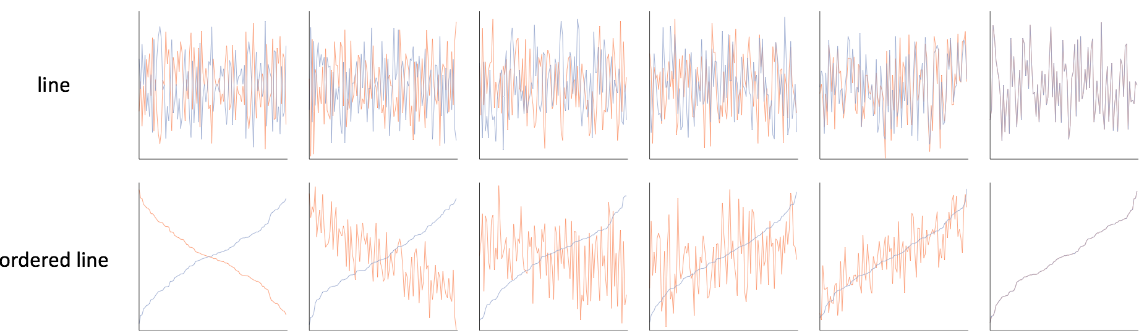

Slide 67
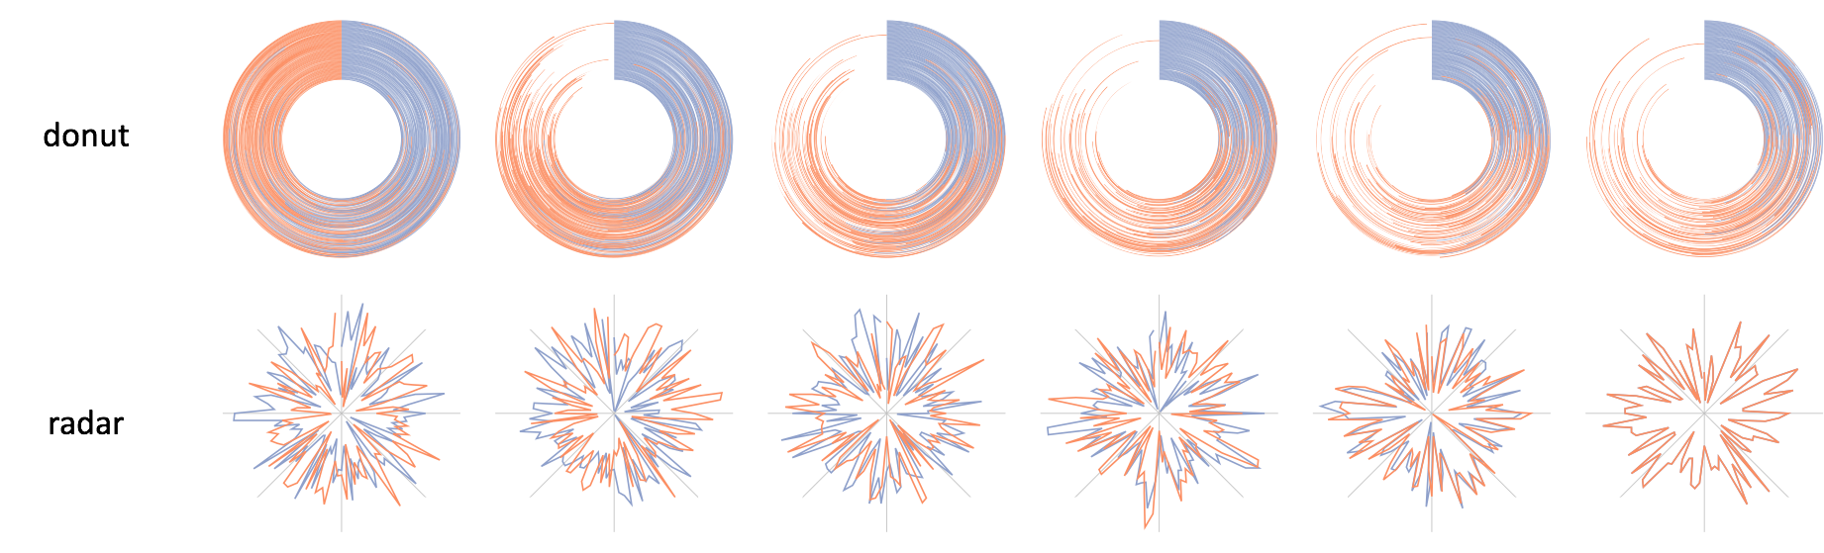

Slide 68
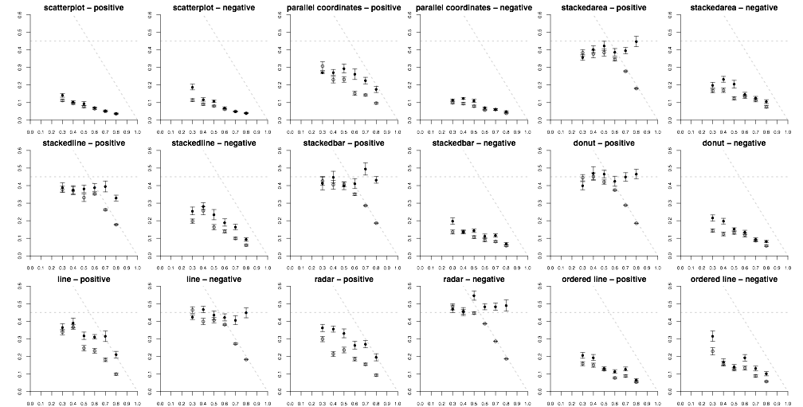
Notes:
whereas Rensink had one…
roughly 200,000 individual perceptual judgements

Slide 69
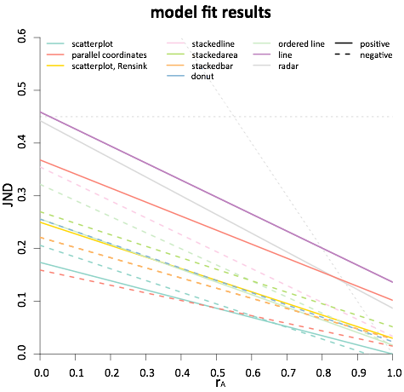
less precise
more precise
Notes:
this is essentially seeing if the trend of JNDs is linear
the moment of truth came when we checked the statistics

Slide 70
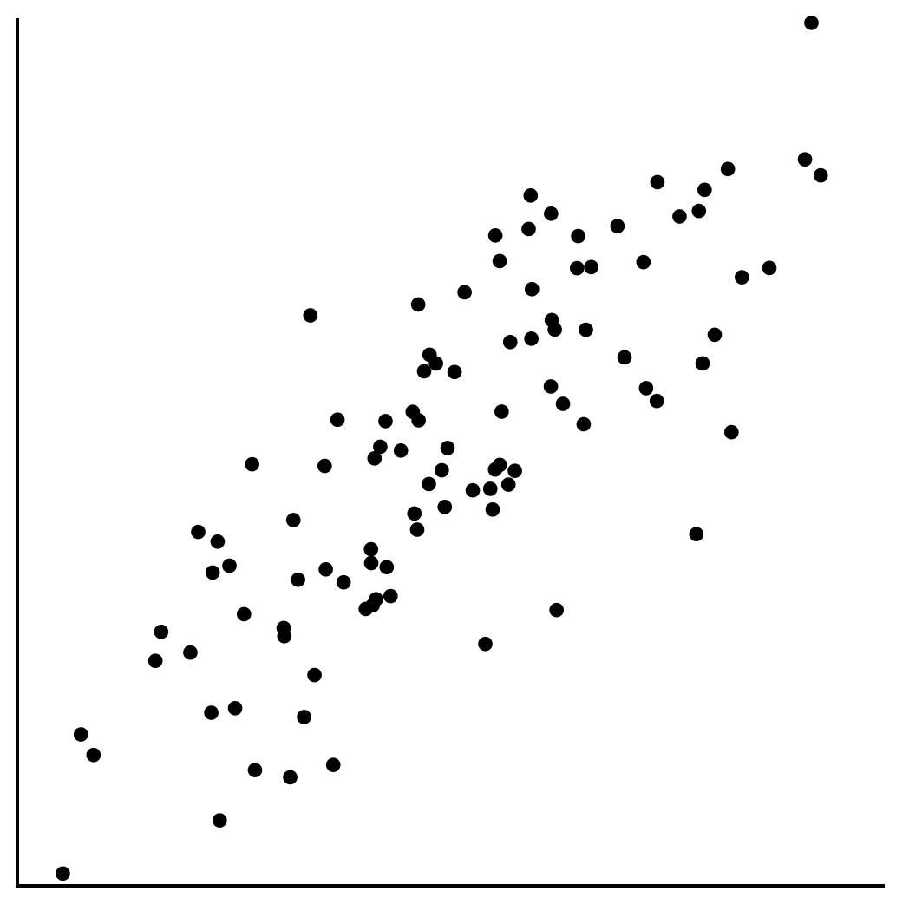
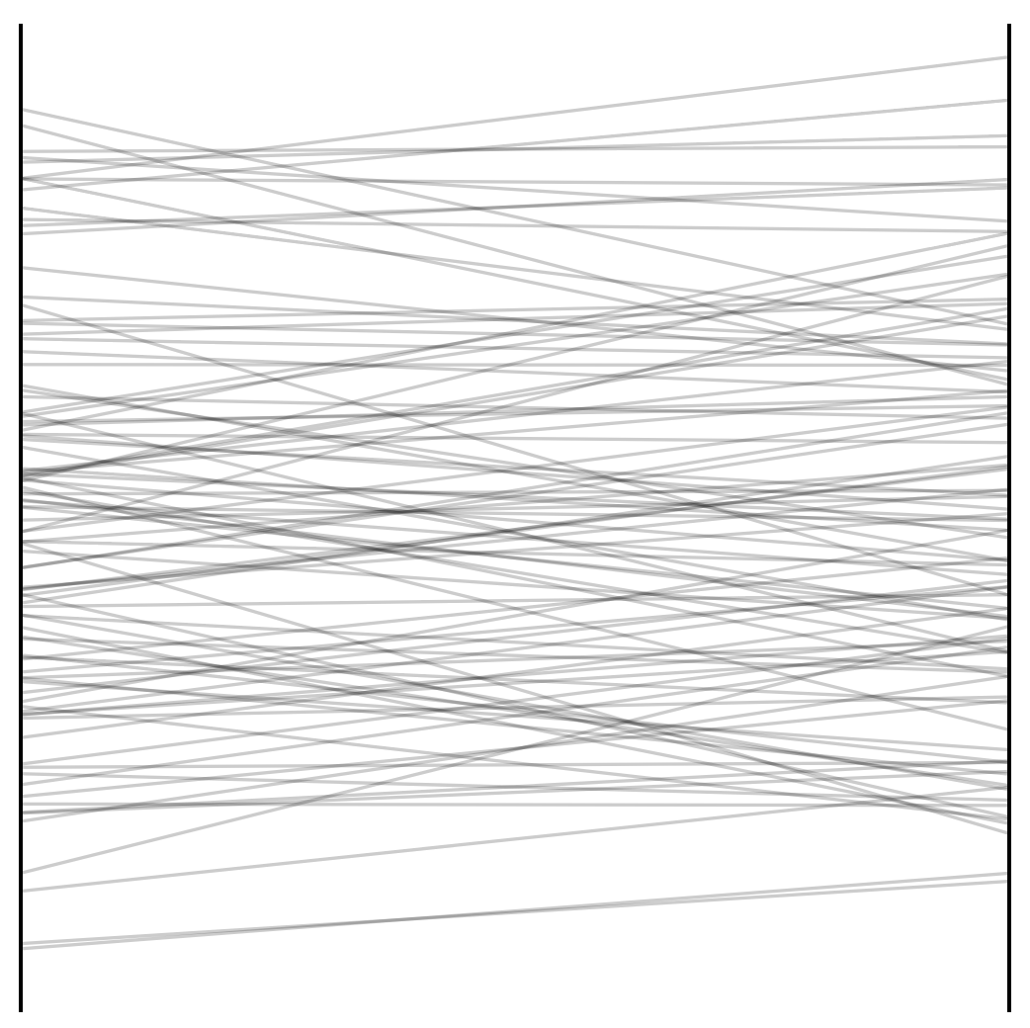
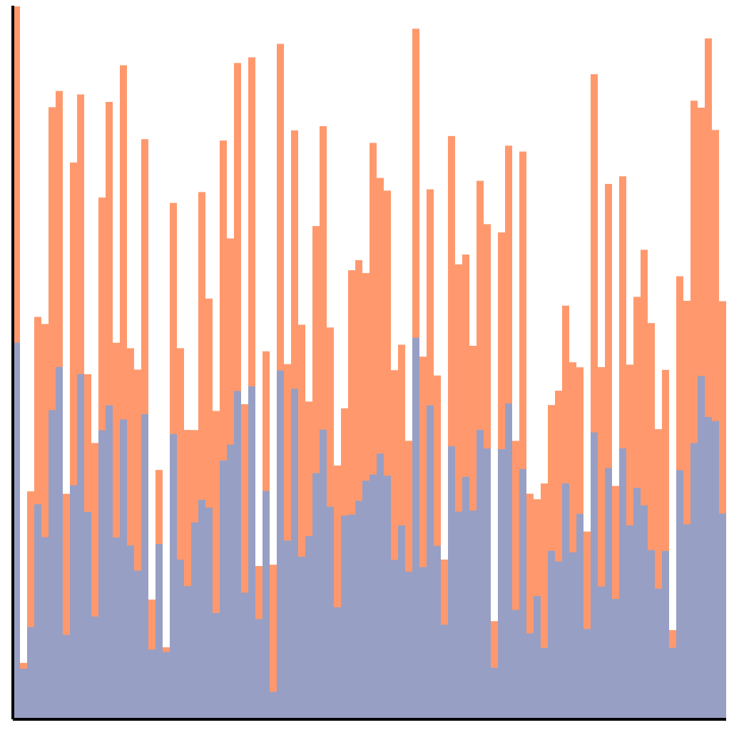
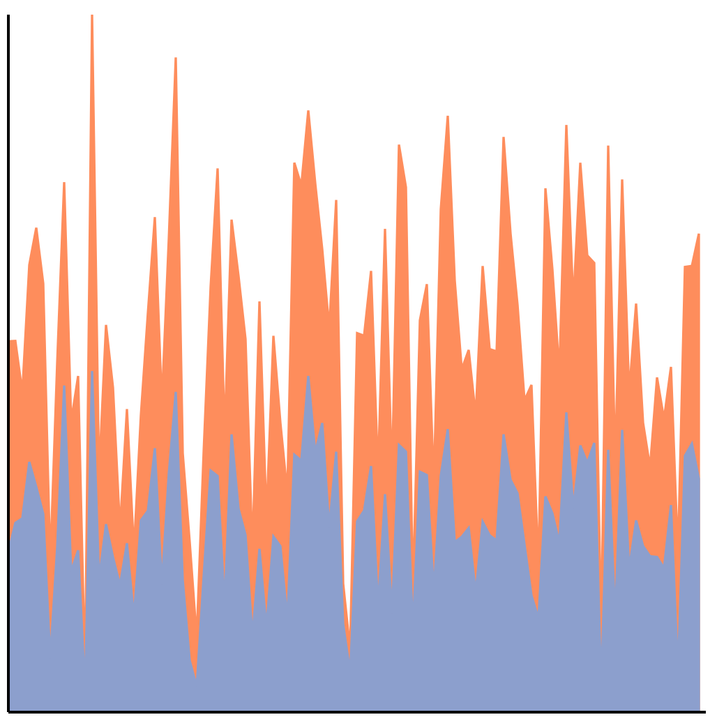
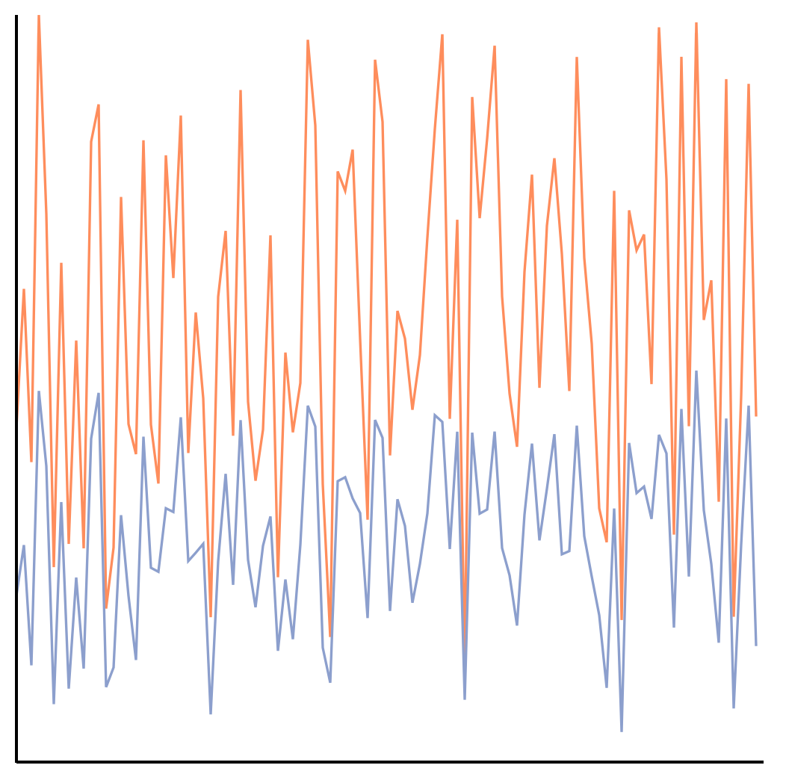
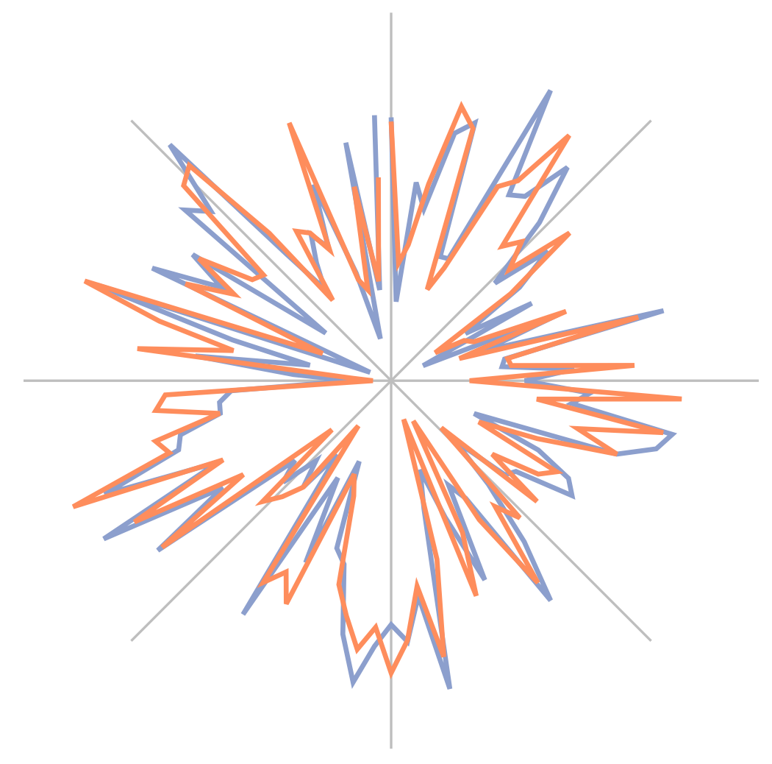
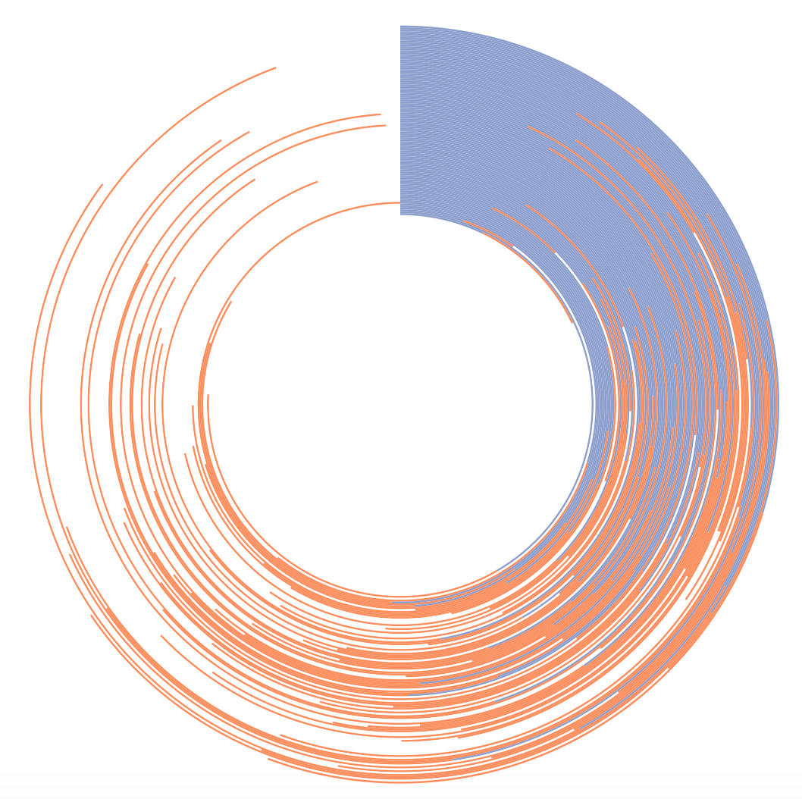
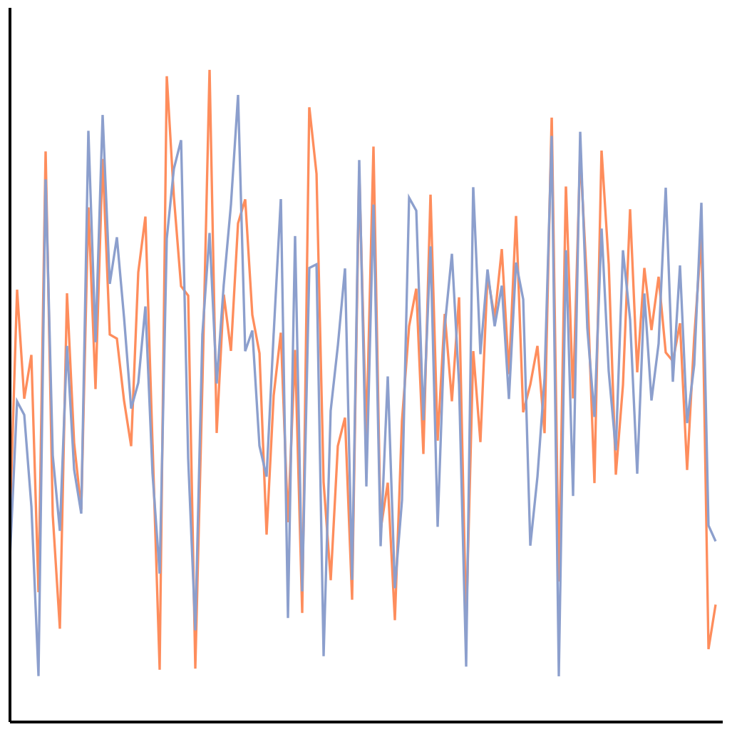
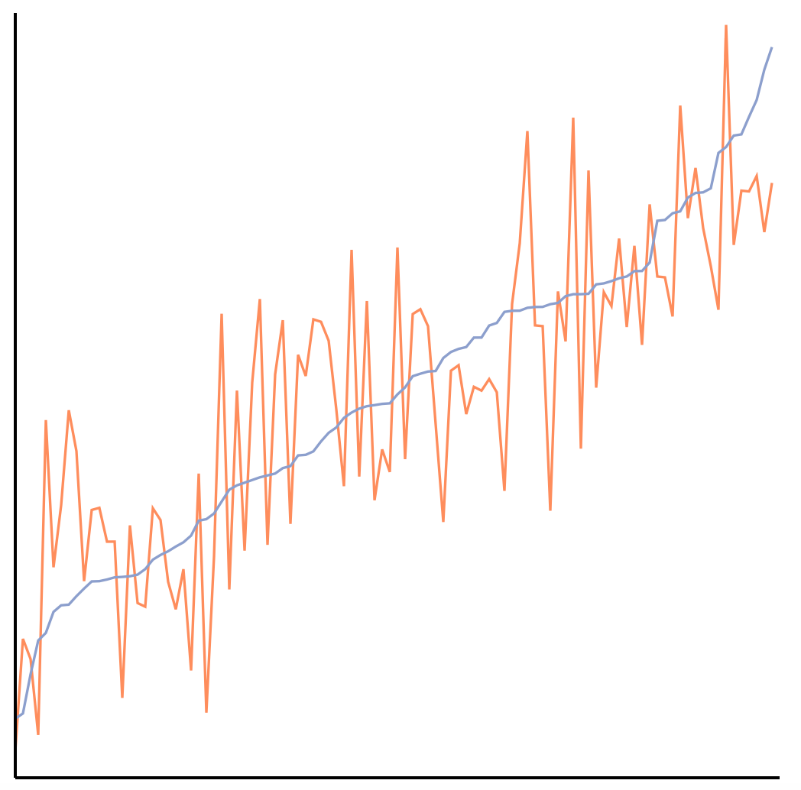
The perception of correlation
in every tested chart can be modeled using Weber’s law.
Notes:
Here we have a perceptual law that is used to study things like taste, line-length, brightness. Not only are we using it to model correlation, which is a higher-level concept, but it also applies across every chart tested!

Slide 71
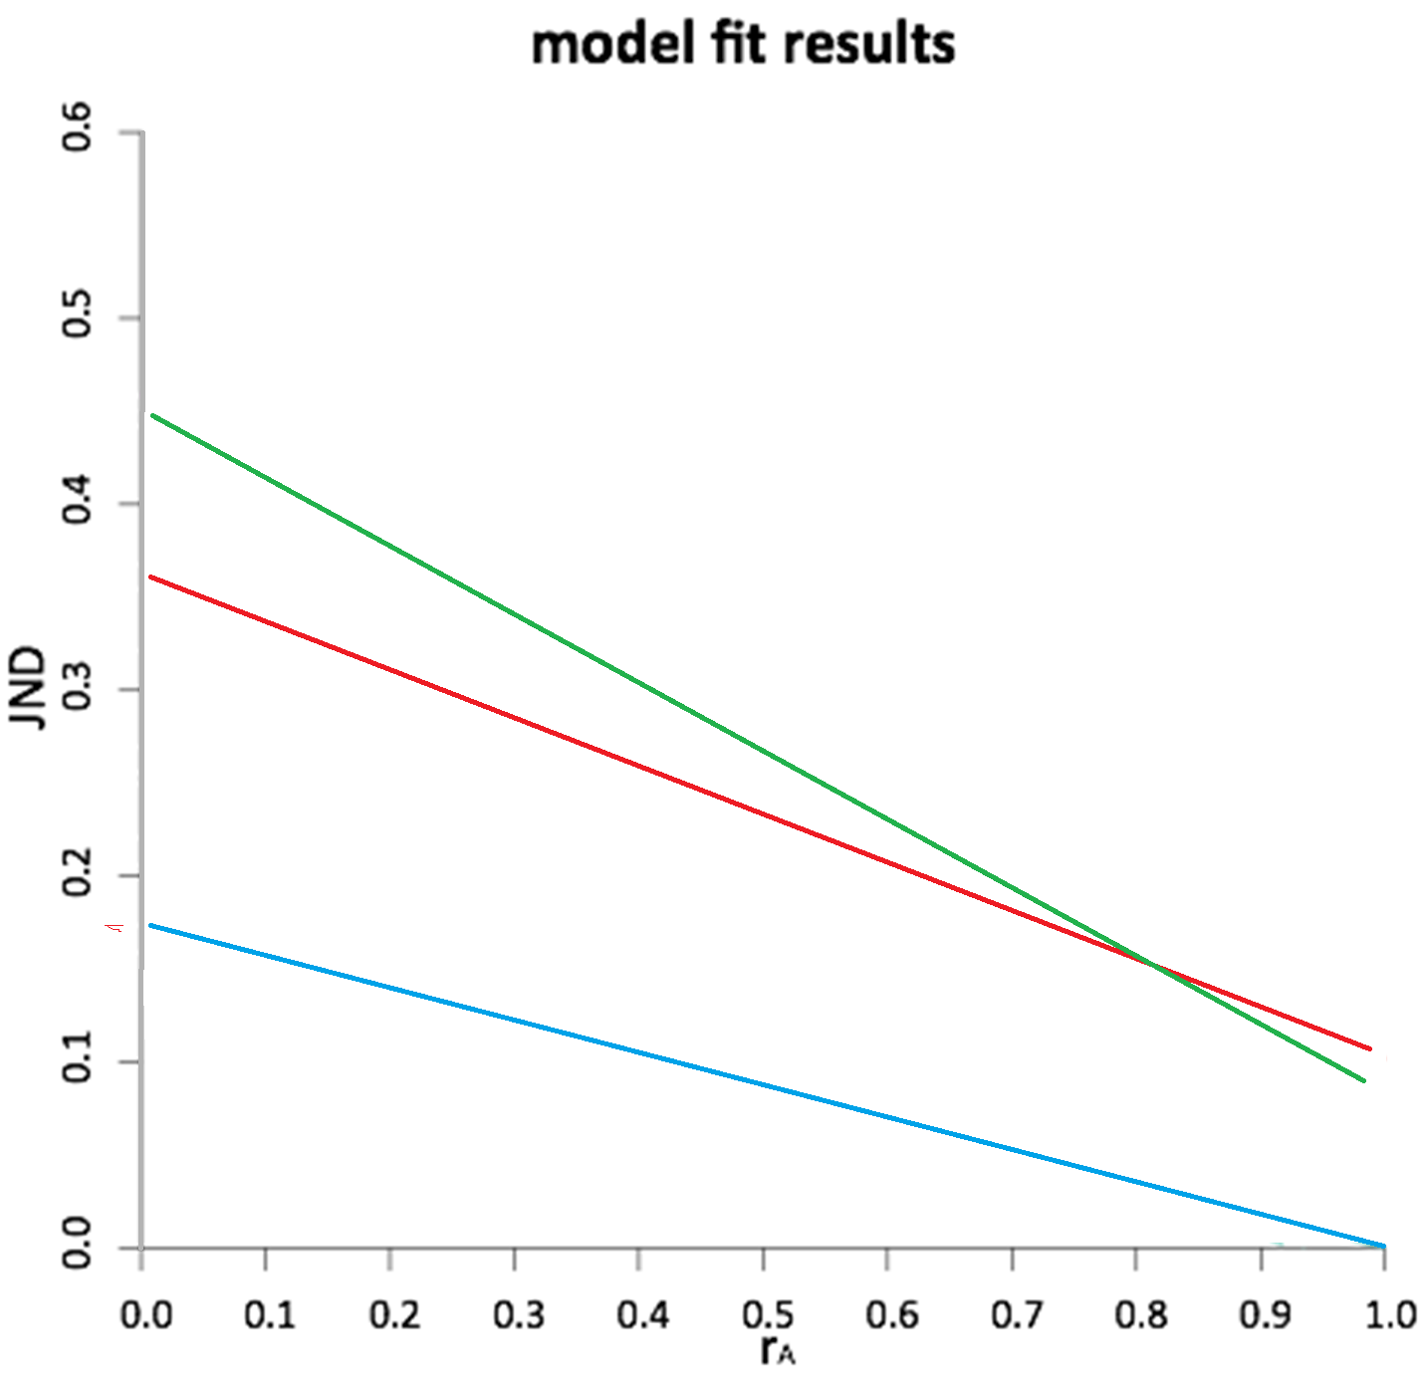




Slide 72

Application: Ranking Visualizations of Correlation

Slide 73

Potential Application: JND-based Sampling
Limits of Big Data visualization
  Screen resolution
  Javascript rendering (plot.ly)
JND-based sampling and visualization
  Similar to image compression (jpg2000)
  Differ in that the JND will be based on higher-level information (e.g. correlation)

Slide 74









Summary: Theory Into Practice
Interaction is key to exploratory visualizations
Big data -><- high interactivity
ForeCache seeks to address this
  Predictive prefetching based on past user actions (Waldo Experiment)
  Cache miss using EXPLAIN
Future Work: Build perceptual models to design sampling strategies

Slide 75


Questions? remco@cs.tufts.edu

