Slide 1
Big Data Visual Analytics:
A User Centric Approach
Remco Chang
Assistant Professor
Tufts University

Slide 2
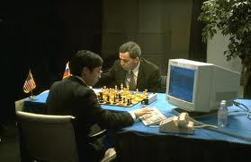
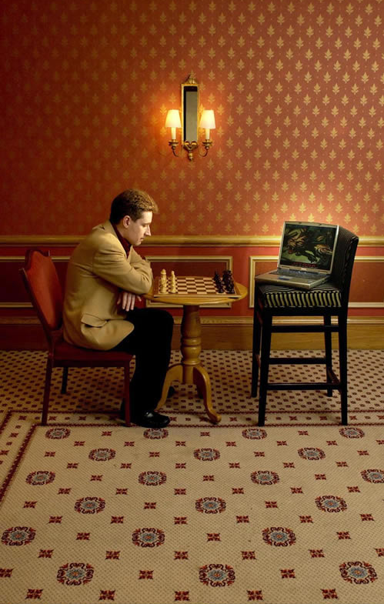
Human + Computer
Human vs. Artificial Intelligence
Garry Kasparov vs. Deep Blue (1997)
  Computer takes a “brute force” approach without analysis
  “As for how many moves ahead a grandmaster sees,” Kasparov concludes: “Just one, the best one”
Artificial vs. Augmented Intelligence
Hydra vs. Cyborgs (2005)
  Grandmaster + 1 chess program > Hydra (equiv. of Deep Blue)
  Amateur + 3 chess programs > Grandmaster + 1 chess program¹
1. http://www.collisiondetection.net/mt/archives/2010/02/why_cyborgs_are.php

Slide 3
Example: What Does (Wire) Fraud Look Like?
Financial Institutions like Bank of America have legal responsibilities to report all suspicious wire transaction activities (money laundering, supporting terrorist activities, etc)
Data size: approximately 200,000 transactions per day (73 million transactions per year)
Problems:
  Automated approach can only detect known patterns
  Bad guys are smart: patterns are constantly changing
  Data is messy: lack of international standards resulting in ambiguous data
Current methods:
  10 analysts monitoring and analyzing all transactions
  Using SQL queries and spreadsheet-like interfaces
  Limited time scale (2 weeks)

Slide 4
WireVis: Financial Fraud Analysis
In collaboration with Bank of America
  Develop a visual analytical tool (WireVis)
  Visualizes 7 million transactions over 1 year
  Beta-deployed at WireWatch
A great problem for visual analytics:
  Ill-defined problem (how does one define fraud?)
  Limited or no training data (patterns keep changing)
  Requires human judgment in the end (involves law enforcement agencies)
Design philosophy: “combating human intelligence requires better (augmented) human intelligence”
R. Chang et al., Scalable and interactive visual analysis of financial wire transactions for fraud detection. Information Visualization,2008.
R. Chang et al., Wirevis: Visualization of categorical, time-varying data from financial transactions. IEEE VAST, 2007.

Slide 5
WireVis: A Visual Analytics Approach
Search by Example (Find Similar Accounts)
Heatmap View
(Accounts to Keywords Relationship)
Keyword Network
(Keyword Relationships)
Strings and Beads
(Relationships over Time)

Slide 6
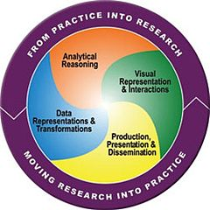
Visual Analytics = Human + Computer
Visual analytics is “the science of analytical reasoning facilitated by visual interactive interfaces.” ¹
By design, it is a collaboration between human and computer to solve hard problems.
1. Thomas and Cook, “Illuminating the Path”, 2005.

Slide 7
“The computer is incredibly fast, accurate, and stupid. Man is unbelievably slow, inaccurate, and brilliant. The marriage of the two is a force beyond calculation.”
-Leo Cherne, 1977
(often attributed to Albert Einstein)

Slide 8

Which Marriage?

Slide 9
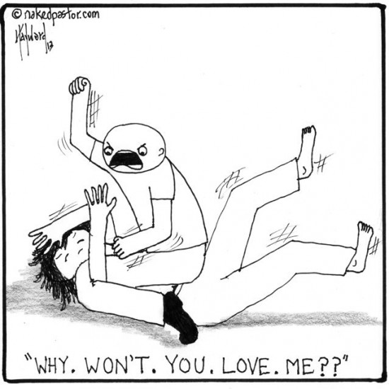
Which Marriage?

Slide 10




Applications of Visual Analytics
Political Simulation
  Agent-based analysis
  With DARPA
Global Terrorism Database
  With DHS
Bridge Maintenance
  With US DOT
  Exploring inspection reports
Biomechanical Motion
  Interactive motion comparison
R. Chang et al., Two Visualization Tools for Analysis of Agent-Based Simulations in Political Science. IEEE CG&A, 2012

Slide 11
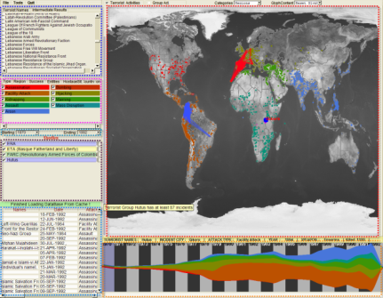
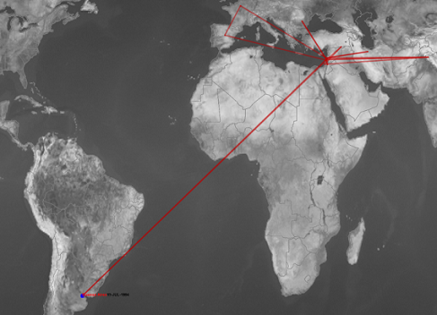
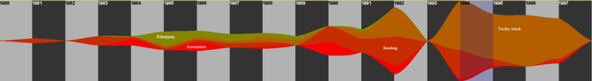
Applications of Visual Analytics
Who
Where
Political Simulation
  Agent-based analysis
  With DARPA
Global Terrorism Database
  With DHS
Bridge Maintenance
  With US DOT
  Exploring inspection reports
Biomechanical Motion
  Interactive motion comparison
What
Evidence
Box
Original
Data
When
R. Chang et al., Investigative Visual Analysis of Global Terrorism, Journal of Computer Graphics Forum, 2008.

Slide 12



Applications of Visual Analytics
Political Simulation
  Agent-based analysis
  With DARPA
Global Terrorism Database
  With DHS
Bridge Maintenance
  With US DOT
  Exploring inspection reports
Biomechanical Motion
  Interactive motion comparison
R. Chang et al., An Interactive Visual Analytics System for Bridge Management, Journal of Computer Graphics Forum, 2010. To Appear.

Slide 13



Applications of Visual Analytics
Political Simulation
  Agent-based analysis
  With DARPA
Global Terrorism Database
  With DHS
Bridge Maintenance
  With US DOT
  Exploring inspection reports
Biomechanical Motion
  Interactive motion comparison
R. Chang et al., Interactive Coordinated Multiple-View Visualization of Biomechanical Motion Data, IEEE Vis (TVCG) 2009.

Slide 14

Future of Visual Analytics
Keyboard, Mouse
Visualization
Input
Human
Output
Images (visualizations)
Current Approach:
  One command, one response (not quite a collaboration)
Assumptions:
  User’s mouse and keyboard actions with a visualization reflect a user’s reasoning process
  If the computer knows what the user’s reasoning process, it can better support (collaborate with) the user
Goals:
  Can we extract a higher level information about the user through analyzing the user’s interactions?
  How will the computer utilize such information?

Slide 15
Extracting User Model from Interactions
1. Learning about a User in Real-Time
Who is the user,
and what is she doing?

Slide 16
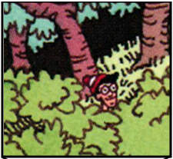
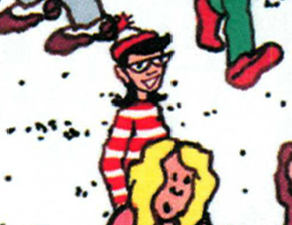
Experiment: Finding Waldo
Google-Maps style interface
  Left, Right, Up, Down, Zoom In, Zoom Out, Found

Slide 17
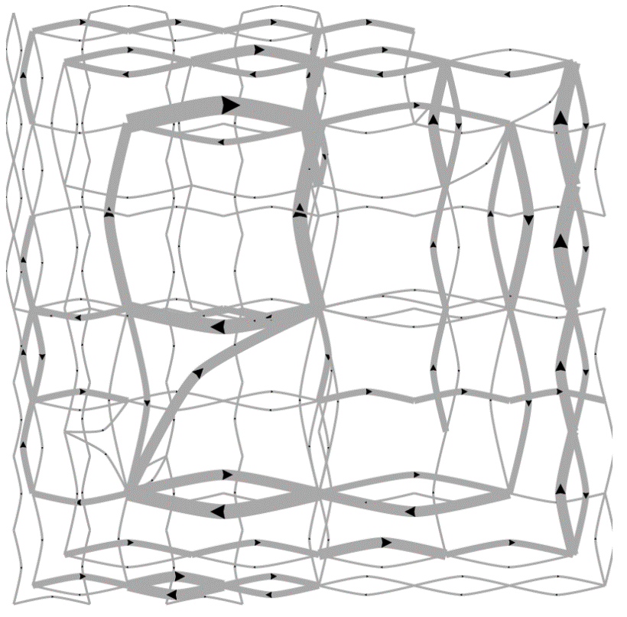
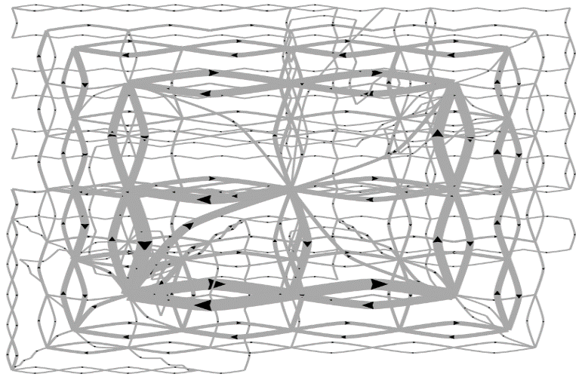
Pilot Visualization – Completion Time
Fast completion time
Slow completion time
Eli Brown et al., Where’s Waldo. IEEE VAST 2014.

Slide 18
Post-hoc Analysis Results
Mean Split (50% Fast, 50% Slow)
Data Representation | Classification Accuracy | Method
State Space | 72% | SVM
Edge Space | 63% | SVM
Action Sequence | 77% | Decision Tree
Mouse Event | 62% | SVM
Fast vs. Slow Split (Mean+0.5σ=Fast, Mean-0.5σ=Slow)
Data Representation | Classification Accuracy | Method
State Space | 96% | SVM
Edge Space | 83% | SVM
Action Sequence | 79% | Decision Tree
Mouse Event | 79% | SVM

Slide 19
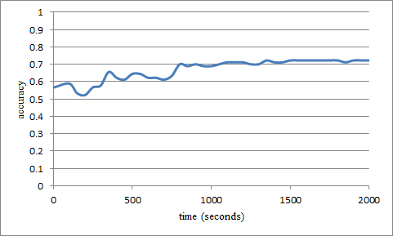
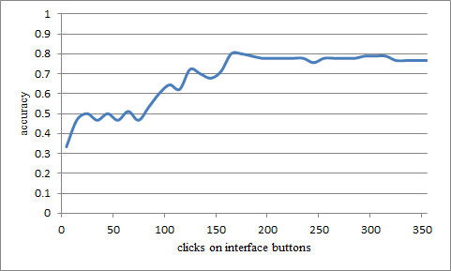
“Real-Time” Prediction
(Limited Time Observation)
State-Based
Linear SVM
Accuracy: ~70%
Interaction Sequences
N-Gram + Decision Tree
Accuracy: ~80%

Slide 20
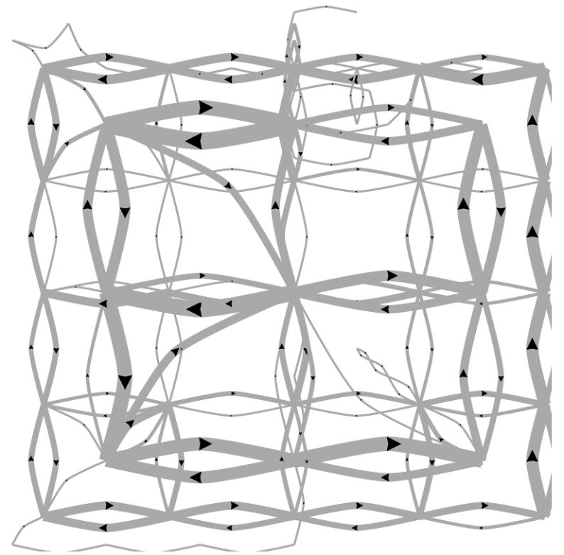
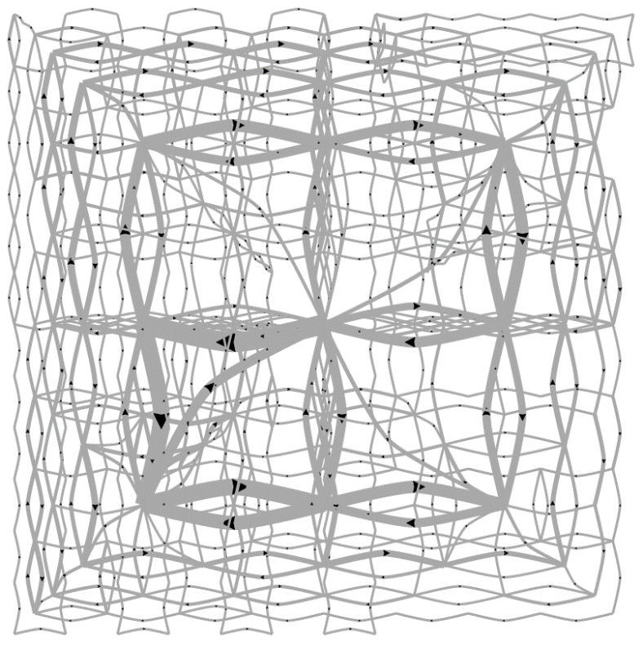
Predicting a User’s Personality
External Locus of Control
Internal Locus of Control
Ottley et al., How locus of control inﬂuences compatibility with visualization style. IEEE VAST , 2011.
Ottley et al., Understanding visualization by understanding individual users. IEEE CG&A, 2012.

Slide 21
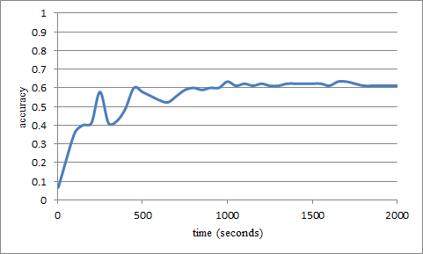
Predicting Users’ Personality Traits
Predicting user’s “Extraversion”
Linear SVM
Accuracy: ~60%
Noisy data, but can detect the users’ individual traits “Extraversion”, “Neuroticism”, and “Locus of Control” at ~60% accuracy by analyzing the user’s interactions alone.

Slide 22
User-Model Adaptive Databases
2. What Can a System Do
If It Knows Something About Its User?

Slide 23



Problem Domain: Big Data Exploration
Visualization on a
Commodity Hardware
Large Data in a
Data Warehouse

Slide 24
Problem Statement
Constraint: Data is too big to fit into the memory or hard drive of the personal computer
  Note: Ignoring various database technologies (OLAP, Column-Store, No-SQL, Array-Based, etc)
Goal: Guarantee a result set to a user’s query within X number of seconds.
  Based on HCI research, the absolute upperbound for X is 10 seconds
  Ideally, we would like to get it down to 1 second or less
In CS talk: trading speed for accuracy, but optimize on minimizing latency (user wait time).

Slide 25
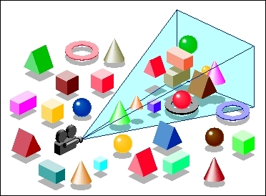
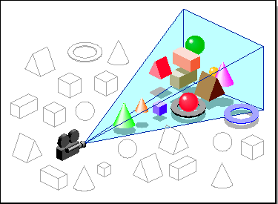
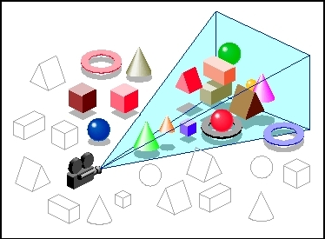
Our Approach:
Predictive Pre-Computation and Pre-Fetching
In collaboration with MIT and Brown
  Models the user based on their past interaction histories
  “Guesses” a set of the user’s possible next moves
  pre-computes and pre-fetches the necessary data chunks
  If the guesses are right, the user would experience no wait time

Slide 26

Interactive Visualization System
client
middleware
Recommender
Recommender
Predictive Engine
Recommender
Cooked Tile Cache
Caching and Query Execution
Semi-Cooked
Tile Cache
database
Server
Server
Server

Slide 27
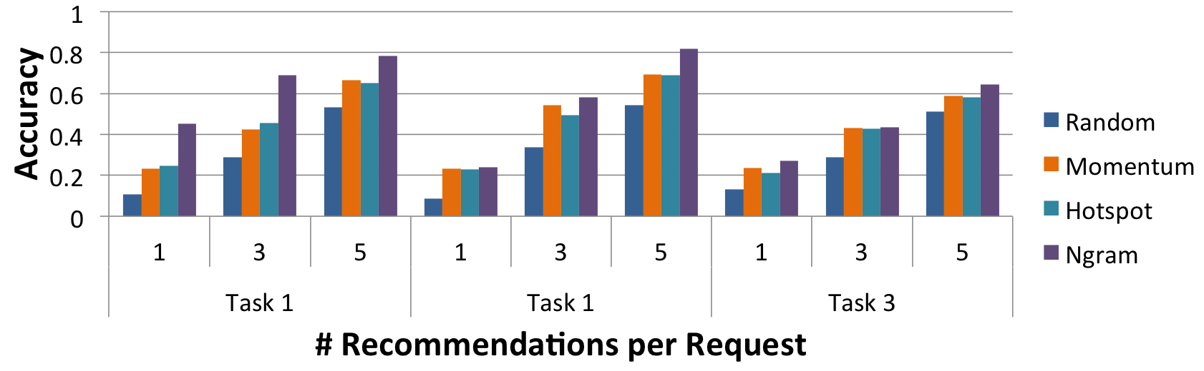
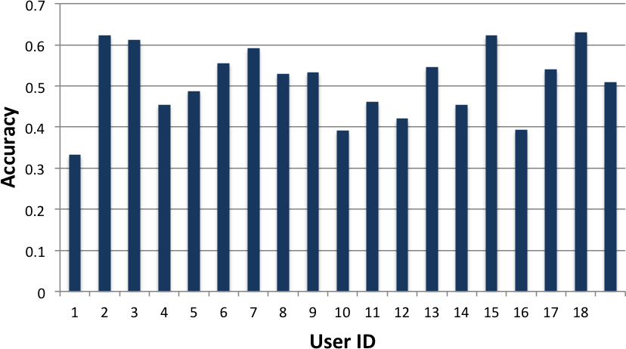
Preliminary System and Evaluation
Using a simple Waldo-like interface
18 users explored the NASA MODIS dataset
  Users were in WA
  Database in Boston
Tasks include “find 4 areas in Europe that have a snow coverage index above 0.5”
What happens if the guesses are “wrong”?

Slide 28
Summary

Slide 29

Wrap Up: Visual Analytics Theory and Practice
Visual analytics offers tremendous opportunities to combine “human + computer” as a collaborative computational unit
“Increasing the input bandwidth” is a critical challenge. There is a lot of “signal” about the user’s reasoning process and analysis behaviors that can be extracted from analyzing their (past) interactions.
By modeling the user based on their past interactions, we can design very complex (adaptive) systems to better support the user. The example of “big data” is just one of many potentially rich and impactful example.

Slide 30

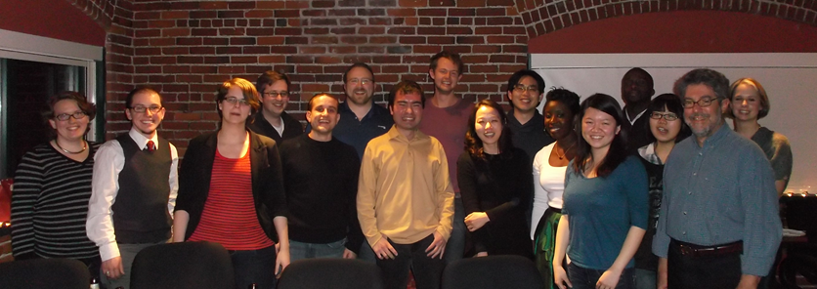
Questions? remco@cs.tufts.edu

Slide 31
Backup

Slide 32



Prediction Algorithms
General Idea:
  Lots of “experts” who recommends chunks of data to pre-fetch / pre-compute
  One “manager” who listens to the experts and chooses which experts’ advice to follow
  Each “expert” gets more of their recommendations accepted if they keep guessing correctly

Slide 33
Iteration: 0
13
48
11
3
99
2
13
99
67
45
82
7
22
42
31

Slide 34
Iteration: 0
13
48
11
3
99
2
13
99
67
45
82
7
22
42
31

Slide 35
Iteration: 0
13
48
11
3
99
2
13
99
67
45
82
7
22
42
31
User Requests Data Block 13

Slide 36

Iteration: 0
13
48
11
3
99
2
13
99
67
45
82
7
22
42
31
User Requests Data Block 13

Slide 37
Iteration: 0
13
48
11
3
99
2
13
99
67
45
82
7
22
42
31
User Requests Data Block 13

Slide 38
Iteration: 1
4
12
34
88
27
5
23
1
92
34
42
12
31
32
13

Slide 39
Training
Instead of training the manager in real-time, this process can be done offline
  Using past user interaction logs
This approach is similar to how Database are currently tuned
  Instead of a DBA manually tune the performance of a database
  Past SQL logs are used to automatically tune the database for an organization’s specific needs (e.g. read-mostly, write-often, etc.)

Slide 40
How to Determine the “Experts”?
More detail on this later
Some obvious ones include:
  Momentum-based
  Data similarity-based
  Frequency (hot-spot)-based
  Past action sequence-based
Generally speaking, given the “manager” approach, we want as many different types of “experts” as possible

Slide 41
Preliminary Results
Using a simple Google-maps like interface
18 users explored the NASA MODIS dataset
Tasks include “find 4 areas in Europe that have a snow coverage index above 0.5”

Slide 42

Worst Case Scenario: Cache Miss
13
48
11
3
99
2
13
99
67
45
82
7
22
42
31
User’s Requests Data Block 52

Slide 43
Cache Miss
How to guarantee response time when there’s a cache miss?
Trick: the ‘EXPLAIN’ command
Usage:
  explain select * from myTable;
Not standard SQL, but implemented in most commercial databases

Slide 44
Example EXPLAIN Output from SciDB
Example SciDB the output of (a query similar to)
Explain SELECT * FROM earthquake
[("[pPlan]:
schema earthquake
<datetime:datetime NULL DEFAULT null,
magnitude:double NULL DEFAULT null,
latitude:double NULL DEFAULT null,
longitude:double NULL DEFAULT null>
[x=1:6381,6381,0,y=1:6543,6543,0]
bound start {1, 1} end {6381, 6543}
density 1 cells 41750883 chunks 1
est_bytes 7.97442e+09
")]
The four attributes in the table ‘earthquake’
Notes that the dimensions of this array (table) is 6381x6543
This query will touch data elements from (1, 1) to (6381, 6543), totaling 41,750,833 cells
Estimated size of the returned data is 7.97442e+09 bytes (~8GB)

Slide 45
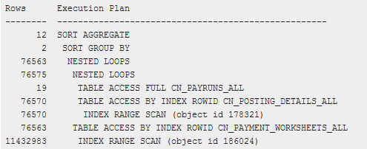
Other Examples
Oracle 11g Release 1 (11.1)

Slide 46
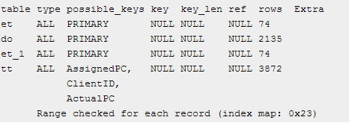
Other Examples
MySQL 5.0

Slide 47
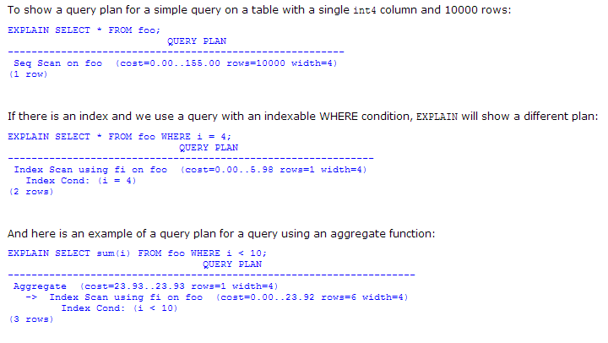
Other Examples
PostgreSQL 7.3.4

Slide 48
Query Modification
Based on the resulting query plan, our system chooses one of three strategies to reduce results from the query
  Can be based on the literal resolution of the visualization (number of pixels)
  Or desired data size

Slide 49
Reduction Strategies
Aggregation:
  In SciDB, this operation is carried out as
  regrid (scale_factorX, scale_factorY)
Sampling
  In SciDB, uniform sampling is carried out as
    bernoulli (query, percentage, randseed)
Filtering
  Currently, the filtering criteria is user specified
  where (clause)

Slide 50
Quick Summary
Key Components:
Pre-computation and pre-fetching
Three-tiered system
Pre-fetching based on “expert-manager” approach
Use the “explain” trick to handle cache-miss
Guarantees response time, but not data quality

Slide 51
Future Work: Streaming
Integrate Streaming [Fisher et al. CHI 2012]
t = 1 second
t = 5 minute
Fisher et al. , Trust Me, I'm Partially Right: Incremental Visualization Lets Analysts Explore Large Datasets Faster. CHI 2012

Slide 52
Designing “Experts”
How much can a user’s past interactions tell us about:
  The user’s future analysis behaviors?
  The user’s analysis style?
  The user’s analysis intent?
  The user’s mental model of the data and problem?
Fundamental question in Visualization and HCI…

Slide 53
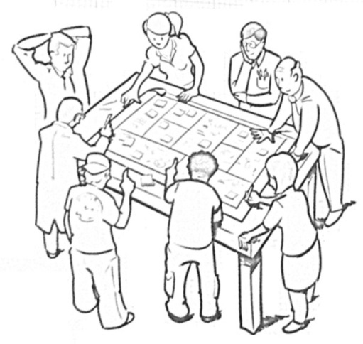

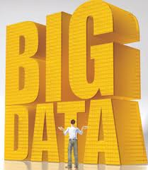
Project Outline
“Reverse engineer” the human cognitive black box (by analyzing user interactions)
Data Modeling
  Interactive Metric Learning
User Modeling
  Predict Analysis Behavior
Interactive Big Data Databases
  Adaptive Pre-fetching and computation
R. Chang et al., Science of Interaction, Information Visualization, 2009.

Slide 54
Data Modeling
Interactive Metric Learning
Quantifying a User’s Knowledge about Data

Slide 55
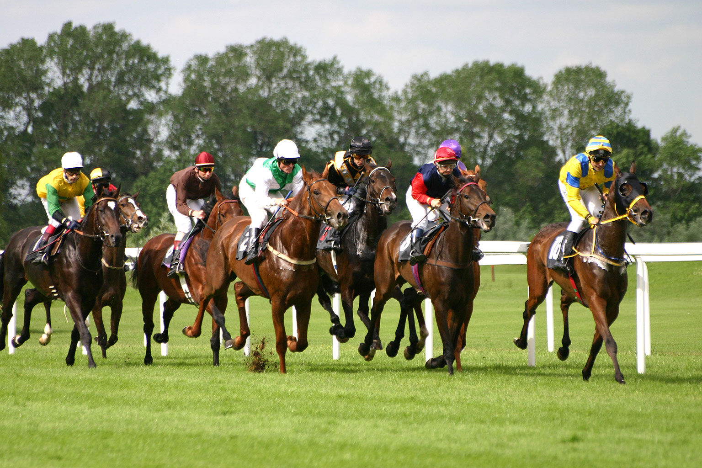
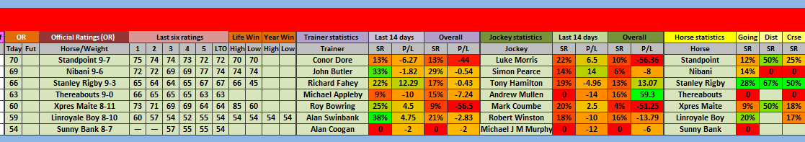
1. Richard Heuer. Psychology of Intelligence Analysis, 1999. (pp 53-57)

Slide 56
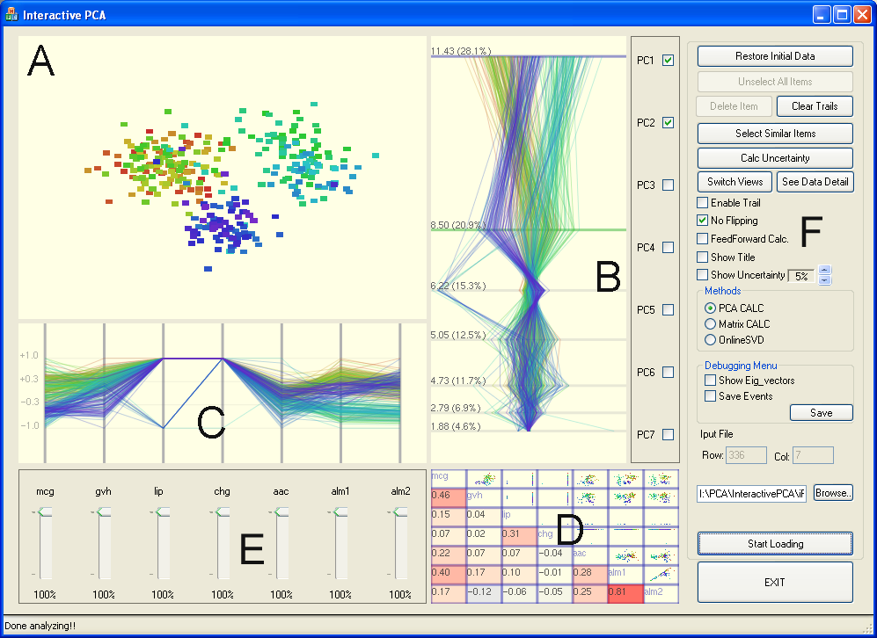
Exploring High-Dimensional Space: iPCA
Jeong et al., iPCA: An Interactive System for PCA-based Visual Analytics. Eurovis 2009.

Slide 57

Metric Learning
Finding the weights to a linear distance function
Instead of a user manually give the weights, can we learn them implicitly through their interactions?

Slide 58
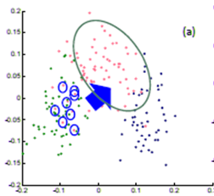
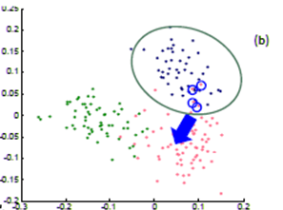
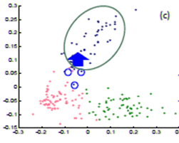
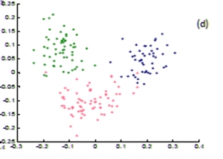
Metric Learning
In a projection space (e.g., MDS), the user directly moves points on the 2D plane that don’t “look right”…
Until the expert is happy (or the visualization can not be improved further)
The system learns the weights (importance) of each of the original k dimensions
Short Video (play)

Slide 59


Dis-Function
Optimization:
Brown et al., Find Distance Function, Hide Model Inference. IEEE VAST Poster 2011
Brown et al., Dis-function: Learning Distance Functions Interactively. IEEE VAST 2012.

Slide 60
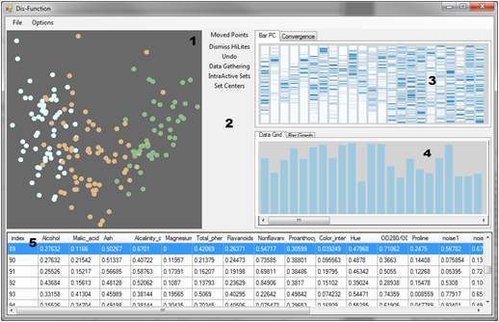
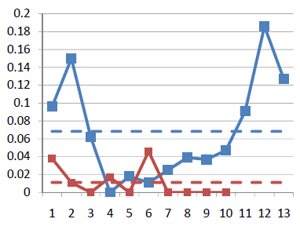
Results
Used the “Wine” dataset (13 dimensions, 3 clusters)
Added 10 extra dimensions, and filled them with random values
Blue: original data dimension
Red: randomly added dimensions
X-axis: dimension number
Y-axis: final weights of the distance function

