Slide 1
From Vision Science to Data Science: Applying Perception to Problems in Big Data
Remco Chang
Assistant Professor
Department of Computer Science, Tufts University

Slide 2
Role of Visualization in Big Data
Big Data
Machine Learning
Database
Visualization
Visualization allows the user to interactively and visually explore large amounts of data

Slide 3
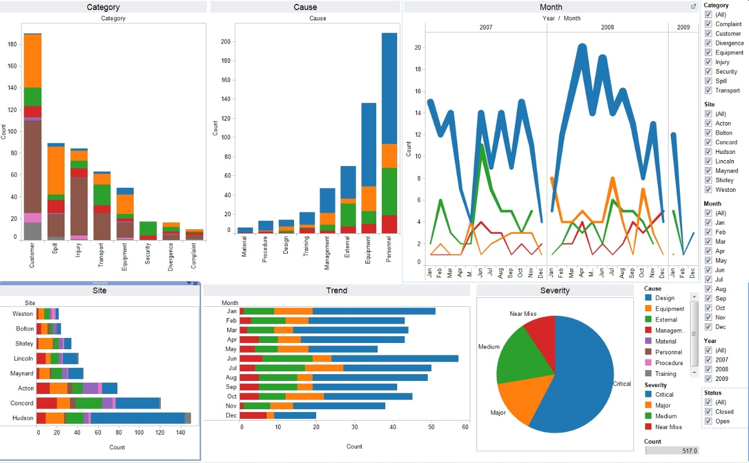
Role of Visualization in Big Data
Big Data
Machine Learning
Databases
Visualization
Visualization allows the user to interactively and visually explore large amounts of data
Tableau

Slide 4
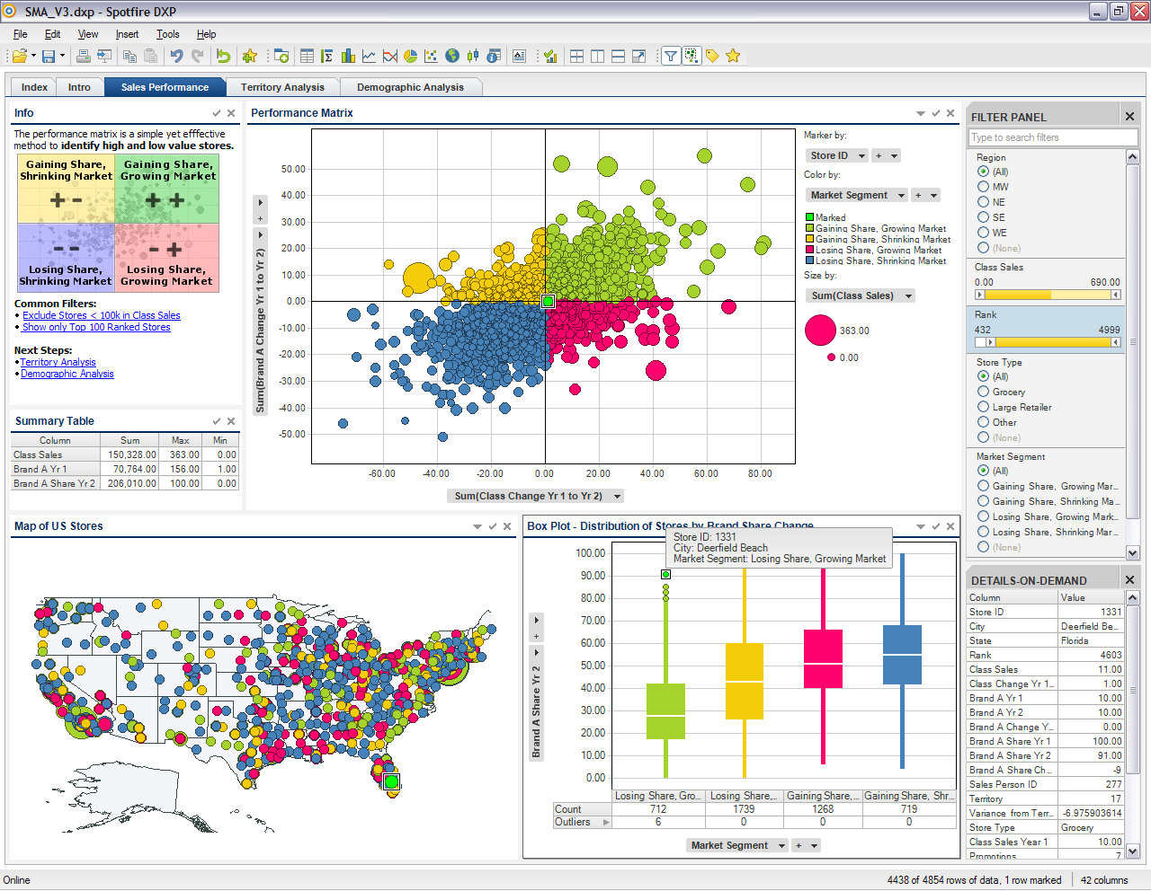
Role of Visualization in Big Data
Big Data
Machine Learning
Databases
Visualization
Visualization allows the user to interactively and visually explore large amounts of data
Spotfire

Slide 5
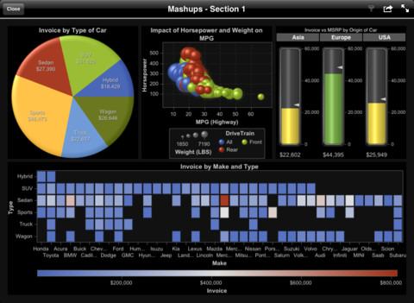
Role of Visualization in Big Data
Big Data
Machine Learning
Databases
Visualization
Visualization allows the user to interactively and visually explore large amounts of data
SAS Visual Analytics

Slide 6
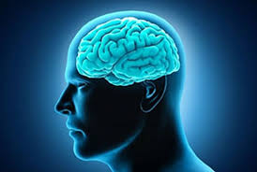
Data Visualization Pipeline

Slide 7
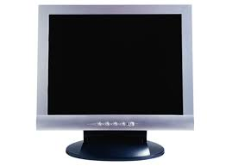
Limits In Big Data Visualization
1000 pixels
Visualize 10 million data points
“Information theoretic” upper-bound
10 million data -> 1 million pixels
10:1 aggregation
Problem is in fact worse, because…
There is a perceptual and cognitive limit
Adding more pixels doesn’t solve the problem
1000 pixels
1000x1000 = 1 million

Slide 8
Turning Obstacles Into Opportunities!
Fitting billions of data points into million of pixels can be an obstacle…
Or it can be an opportunity!!

Slide 9
Opportunities in Big Data Visualization
We should never fetch more than 1 million rows of data from the database
How to pick the 1 million points?
Since the user can’t see the details anyway, we can “simplify” the visualization a little for as long as the user can’t perceive the difference
How to model the perceptual limits?

Slide 10
A Simple Example of Perception-Driven Computation
Simple Box-and-Whisker plots (or Box Plots)
Spot the difference?

Slide 11
A Simple Example of Perception-Driven Computation
This difference, although perceptually small, can mean the difference of scanning all data points or using a smaller sampled data set.
If the user cannot perceive the difference, we can save computation time by not rendering the perfect visualization!

Slide 12
Why Vision Science Matters
Spot the difference?
Although the difference between the two bars is the same as the previous example, we know from vision science that the difference here is easier to spot.
But these are “rules”, not “models”
Does not indicate how many pixels for how much sampling

Slide 13
Perception-Driven Computation
Perception & Cognitive Model
Visualization
Approximate Data & Computation

Slide 14
Perceptual Modeling In Data Visualization?
With few exceptions, the Visualization community isn’t very good at this.
One promising direction is to consider modeling the JND (just noticeable differences) in different visualization designs.

Slide 15
JND-Based Modeling Example
A quick introduction of Just Noticeable Difference (and the Weber’s Law)
Imagine yourself in a dark room…

Slide 20
Perceptual Modeling
Weber’s Law (mid 1800s)
Low-level perceptual discrimination (sound, touch, taste, brightness, etc.)
$$dP=k\frac{dS}{S}$$
Change in Intensity
Perceived Difference
Weber Fraction
(via experiments)
Intensity of the Stimulus

Slide 21
Perceptual Modeling
Weber’s Law (mid 1800s)
Low-level perceptual discrimination (sound, touch, taste, brightness, etc.)
$$dP=k\frac{dS}{S}$$
Given a fixed stimulus $S$, the smallest of $dS$that
can be perceived by humans is known as the
“Just Noticeable Difference”, or JND

Slide 22
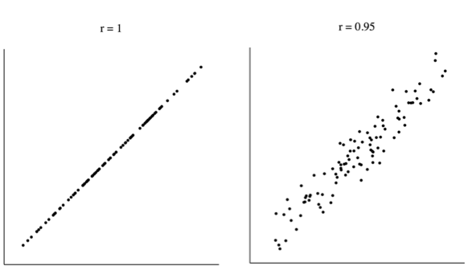
Baldridge & Rensink, 2010: Perception of Correlation
Δr = 0.05

Slide 23
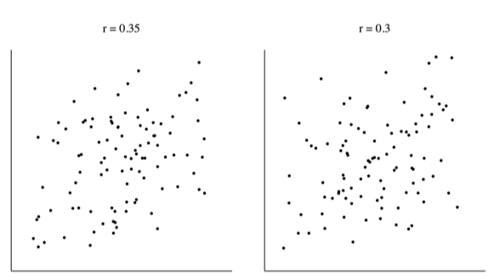
Baldridge & Rensink, 2010: Perception of Correlation
Δr = 0.05

Slide 24
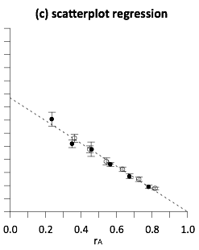
Baldridge & Rensink, 2010: Perception of Correlation
In 2010, Ron Rensink and colleague found that the perception of correlation in a scatterplot follows Weber’s Law
In 2014, our team extended this work to determine if perception of correlation in all bivariate visualizations follows Weber’s Law
worse
better

Slide 25
Notes:
both positively and negatively correlated data

Slide 26
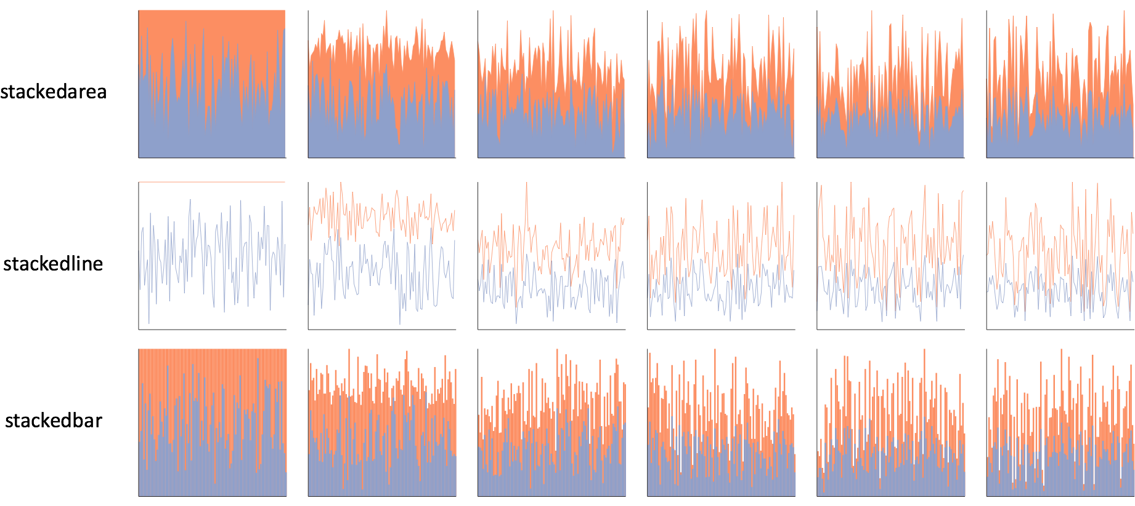
Notes:
one click away in excel

Slide 29
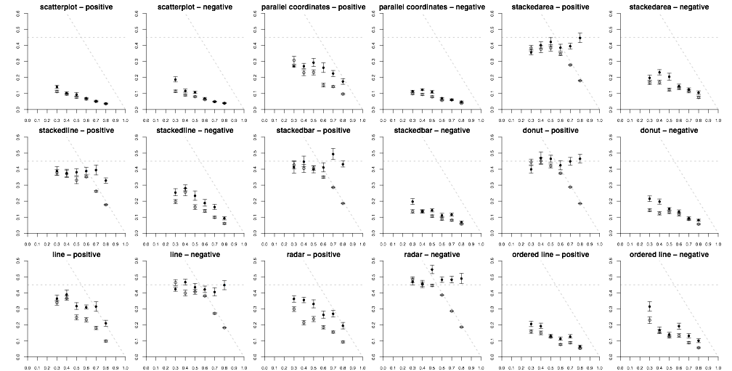
Notes:
whereas Rensink had one…
roughly 200,000 individual perceptual judgements

Slide 30
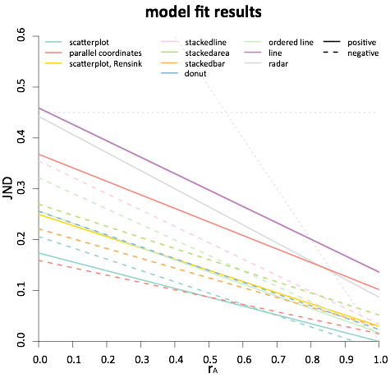
less precise
more precise
Notes:
this is essentially seeing if the trend of JNDs is linear
the moment of truth came when we checked the statistics

Slide 31
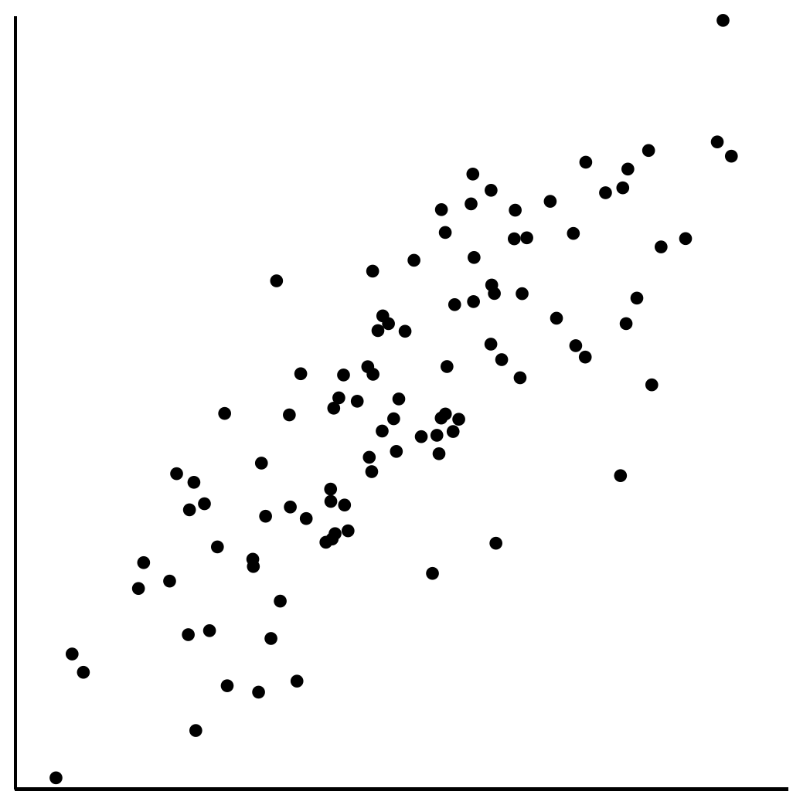
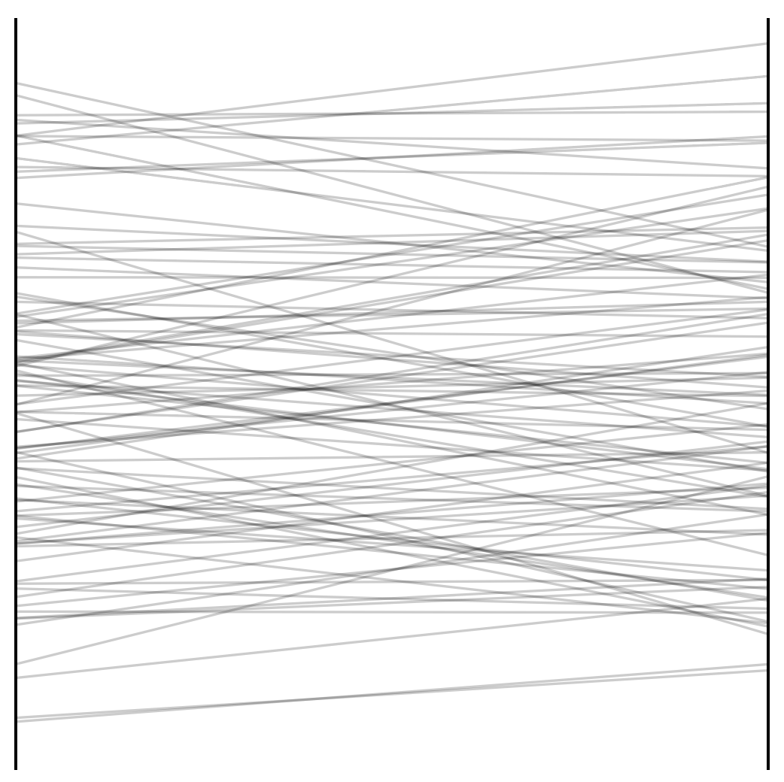
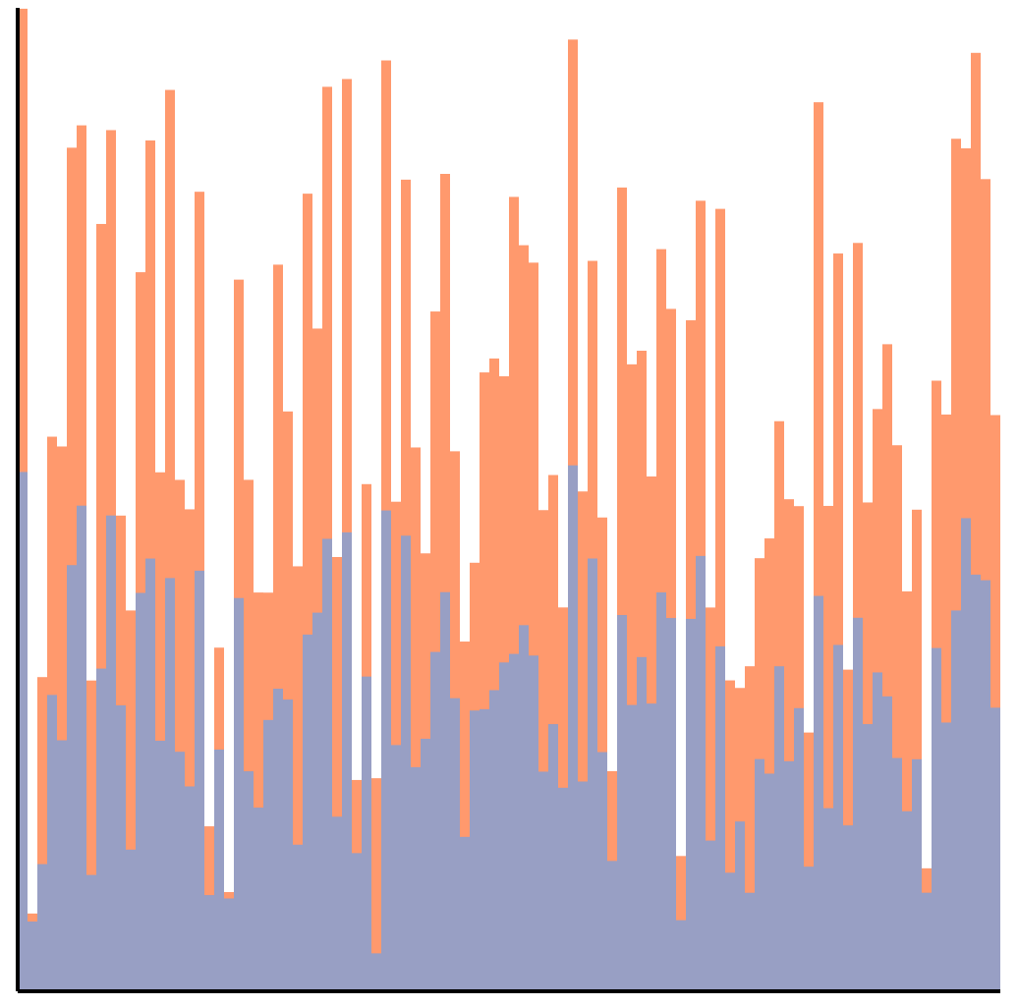
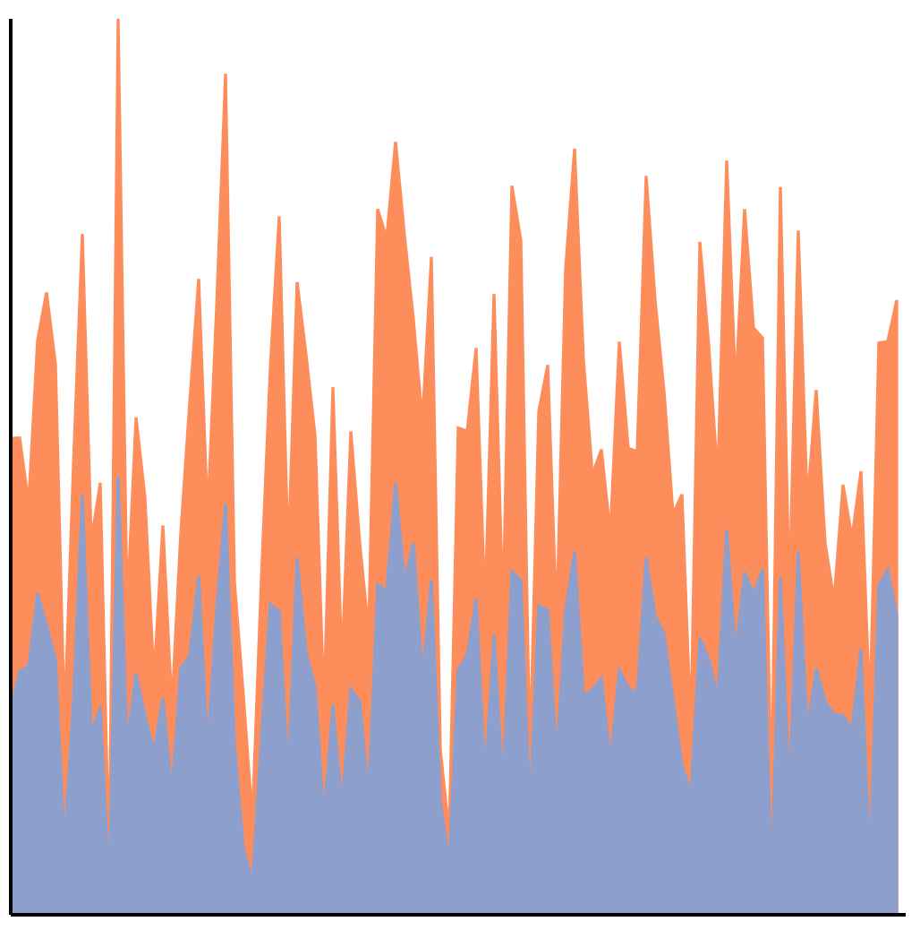
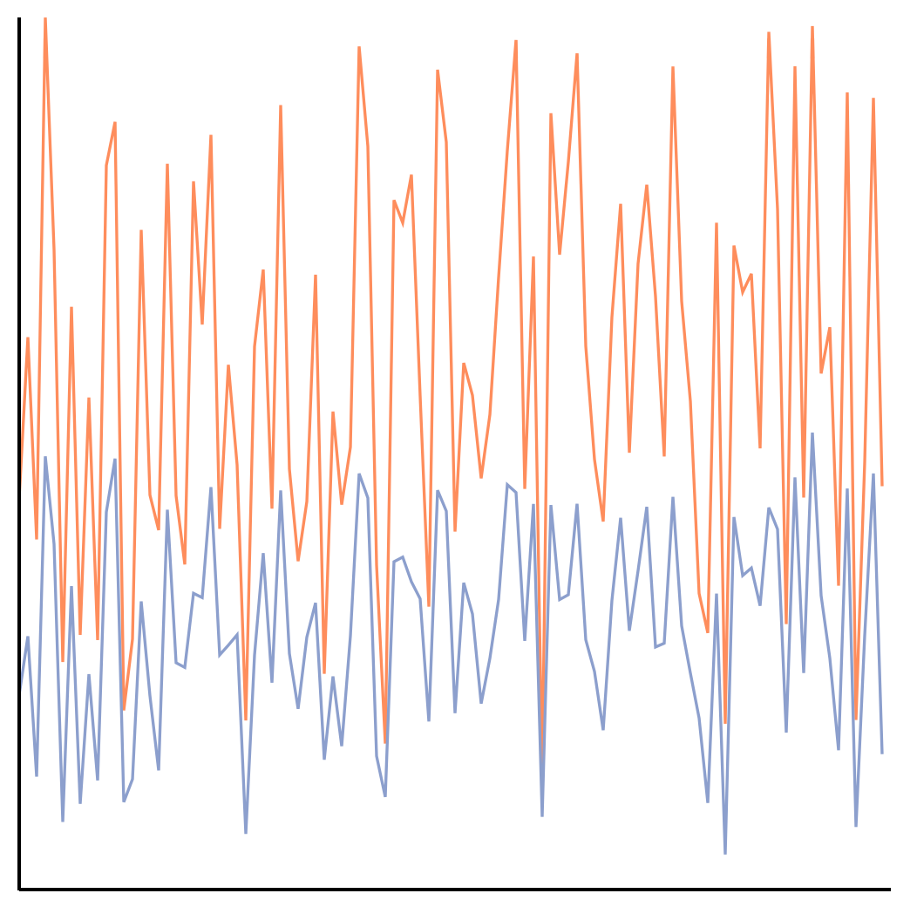
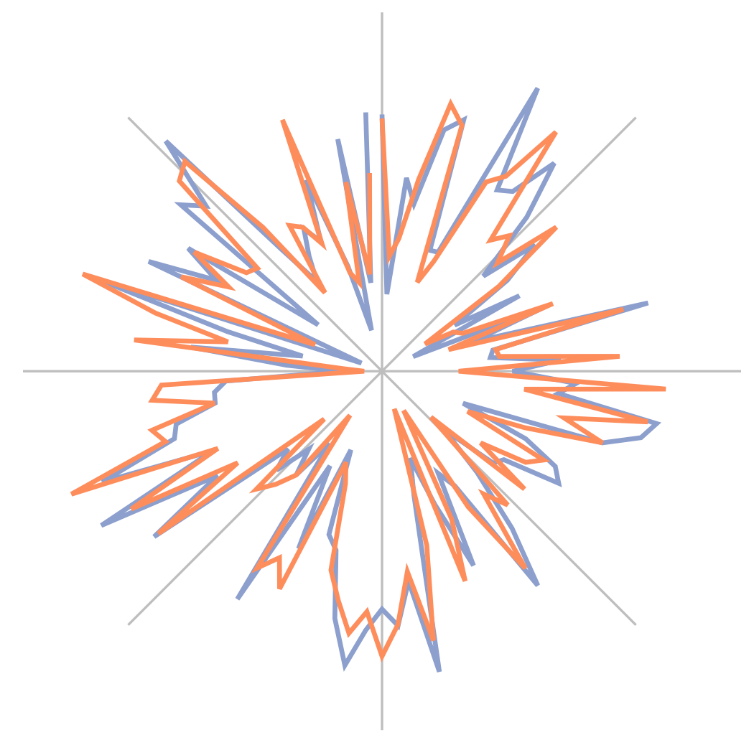
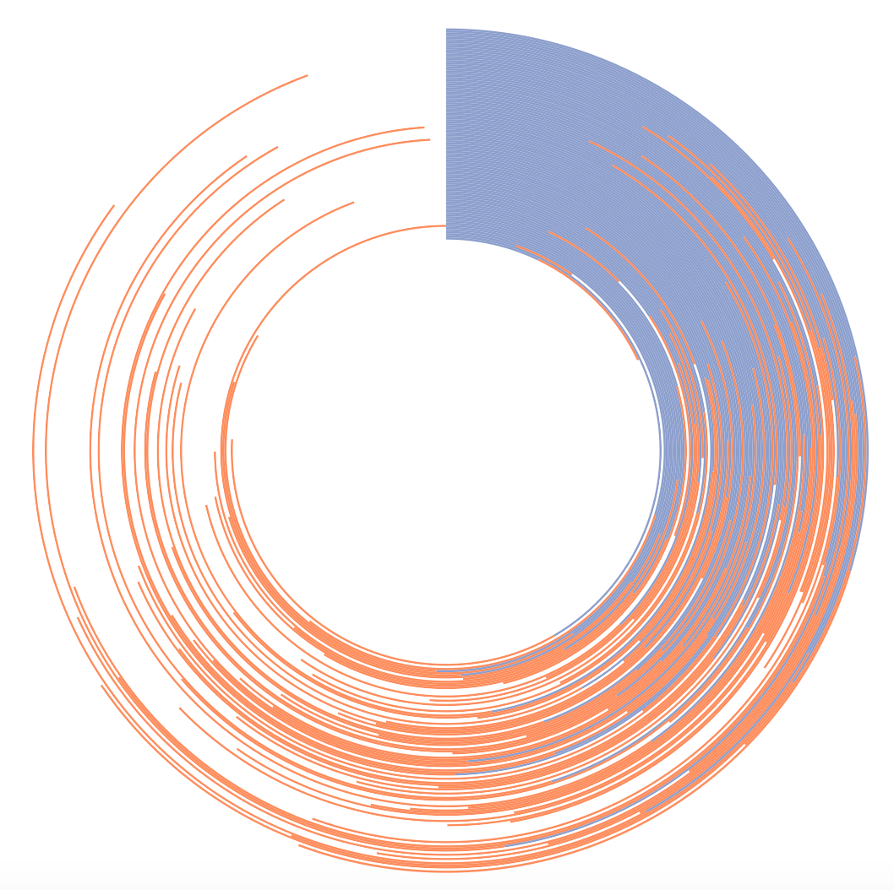
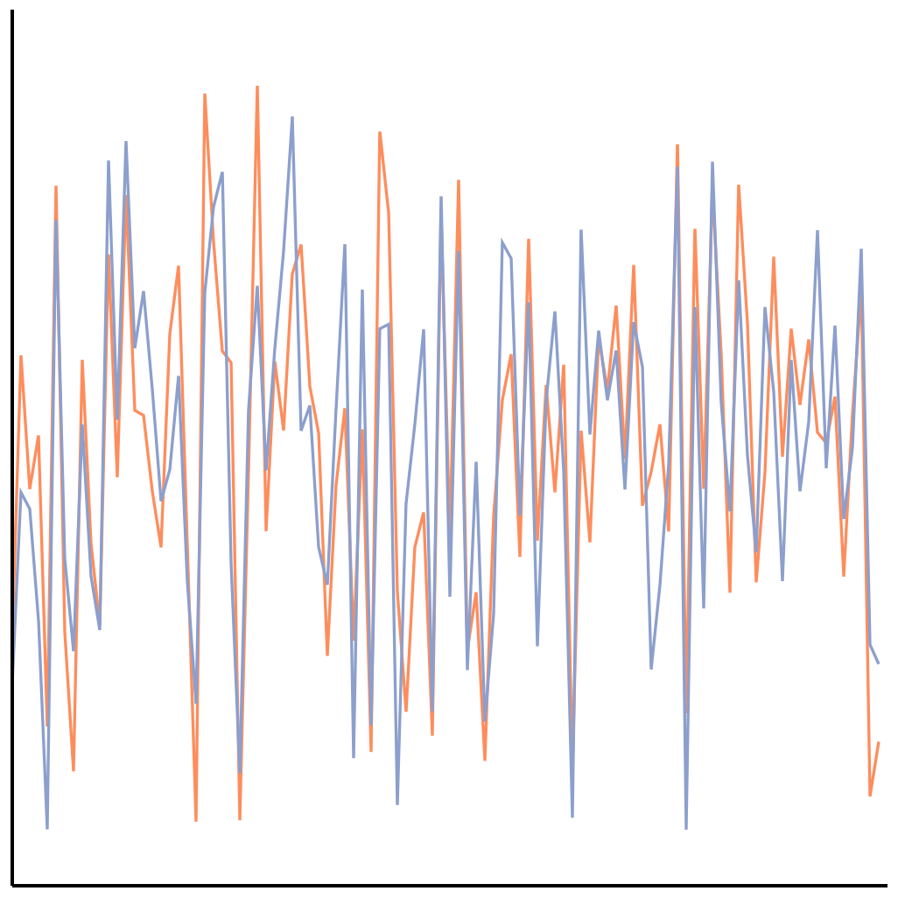
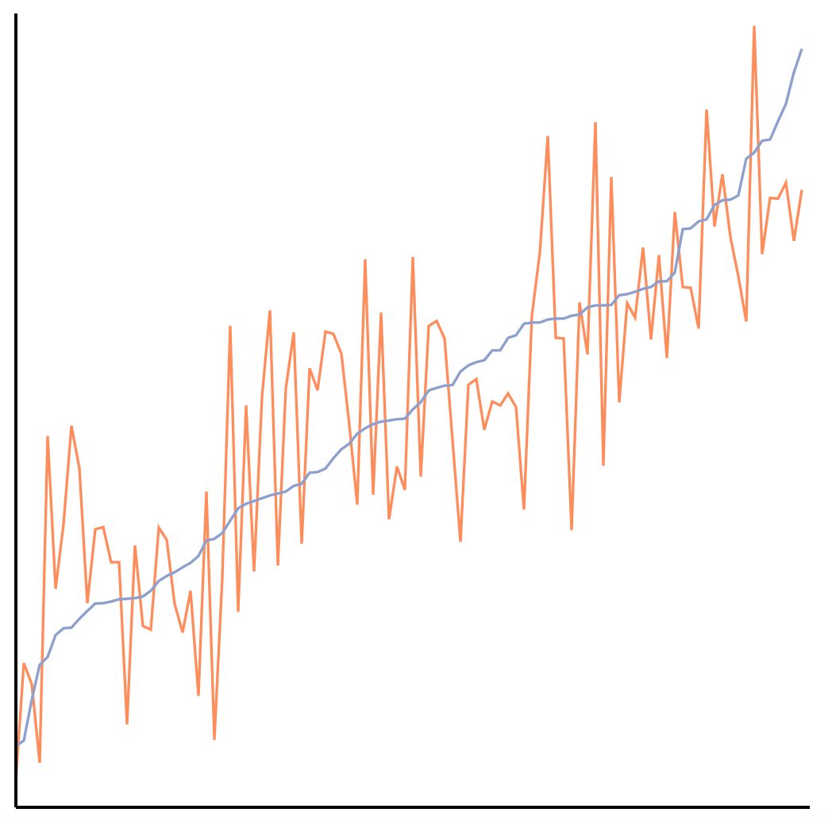
The perception of correlation in every tested chart can be modeled using Weber’s law.
Notes:
Here we have a perceptual law that is used to study things like taste, line-length, brightness. Not only are we using it to model correlation, which is a higher-level concept, but it also applies across every chart tested!

Slide 32
Why Is This So Cool?
Positives:
These models have both descriptive and prescriptive powers
They can be used to quantitatively compare the effectiveness of visualizations
Still Need:
To understand why the perception of correlation follows Weber’s Law (Work in Progress)
A more complete model beyond the single task of correlation discrimination

Slide 33
Summary & Conclusion
Vision Science can play a big role in big data computation!
Need more cross-disciplinary research between Perceptual Psych and Computer Science
With your help, perception-driven data computation can be the next big thing

Slide 34
Visual Analytics Lab at Tufts (VALT)
Questions? remco@cs.tufts.edu

