Slide 1
Data Presentation with Visualizations
Remco Chang
Assistant Professor
Computer Science
Tufts University

Slide 2
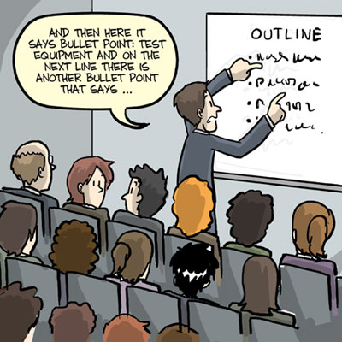
Dynamic vs. Static
Presenting your data in two settings:
Giving a talk and using slides as an aide
Presenting results in an academic paper

Slide 3
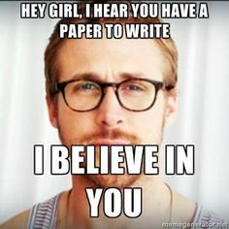
Dynamic vs. Static
Presenting your data in two settings:
Giving a talk and using slides as an aide
To show results in an academic paper

Slide 4
Give a Good Talk using Visualizations
Part I

Slide 5
Giving Talks:
Three Basic Rules of Thumb:
A talk should be Memorable
  Technical completeness is not as important
  What makes a talk memorable?
A slide should be Readable
  Be mindful of weird color schemes
  What makes a slide unreadable?
A chart (visualization) should be Understandable
  “Show what you mean, mean what you show”
  How does one lie with visualizations?

Slide 6
Three Basic Rules of Thumb:
A talk should be Memorable
  Technical completeness is not as important
  What makes a talk memorable?
A slide should be Readable
  Be mindful of weird color schemes
  What makes a slide unreadable?
A chart (visualization) should be Understandable
  “Show what you mean, mean what you show”
  How does one lie with visualizations?

Slide 7
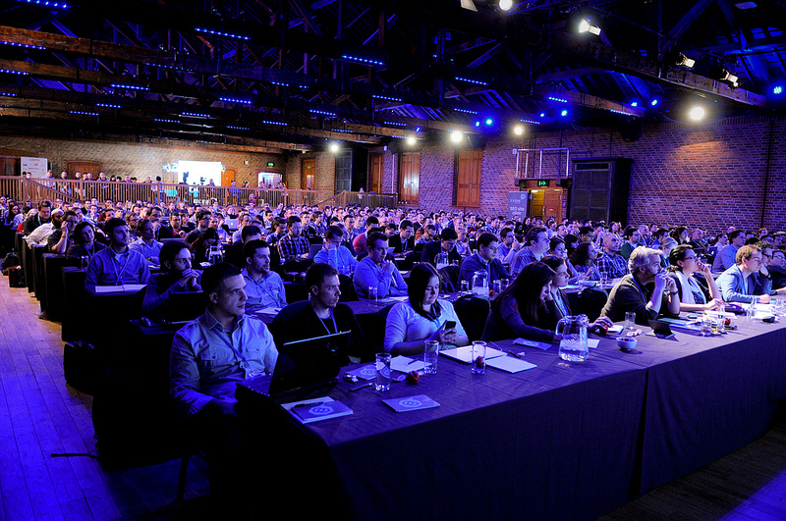
Your Audience

Slide 8
Above all, make your talk Memorable
Therefore, your talk should be
  Slow
  Simple to follow
  Easy to “jump back in”
  Clear
  Consistent
  Fun
  Enthusiastic!!
  Have a message
Highly technical material is hard to be those things

Slide 9
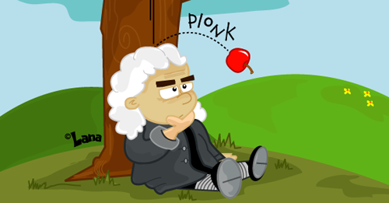
What is a “Message”?
A finding
A technique
A statement
A visualization
A graphic

Slide 10
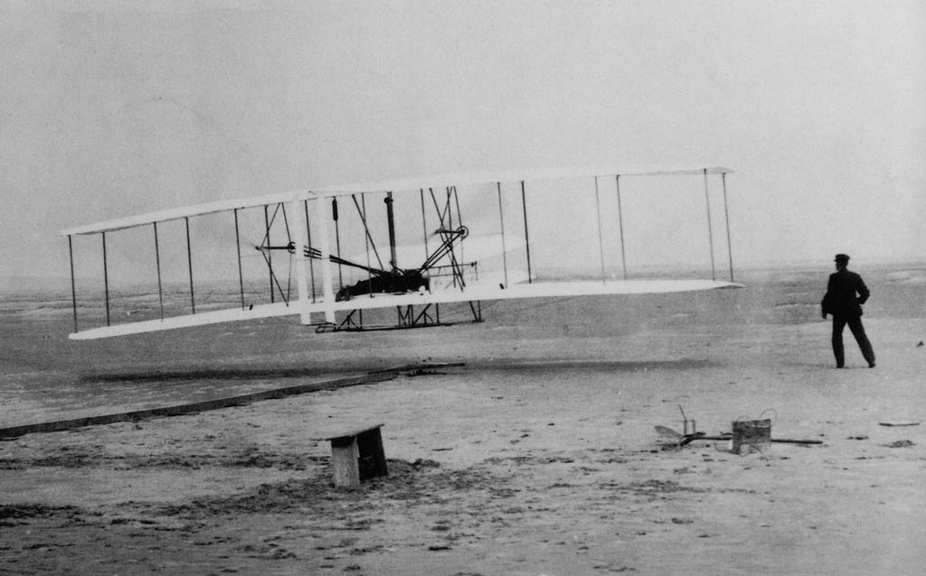
What is a “Message”?
A finding
A technique
A statement
A visualization
A graphic

Slide 11

What is a “Message”?
A finding
A technique
A statement
A visualization
A graphic

Slide 12
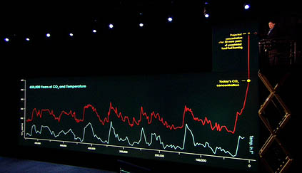
What is a “Message”?
A finding
A technique
A statement
A visualization
A graphic

Slide 13

What is a “Message”?
A finding
A technique
A statement
A visualization
A graphic

Slide 14
Three Basic Rules of Thumb:
A talk should be Memorable
  Technical completeness is not as important
  What makes a talk memorable?
A slide should be Readable
  Be mindful of weird color schemes
  What makes a slide unreadable?
A chart (visualization) should be Understandable
  “Show what you mean, mean what you show”
  How does one lie with visualizations?

Slide 15
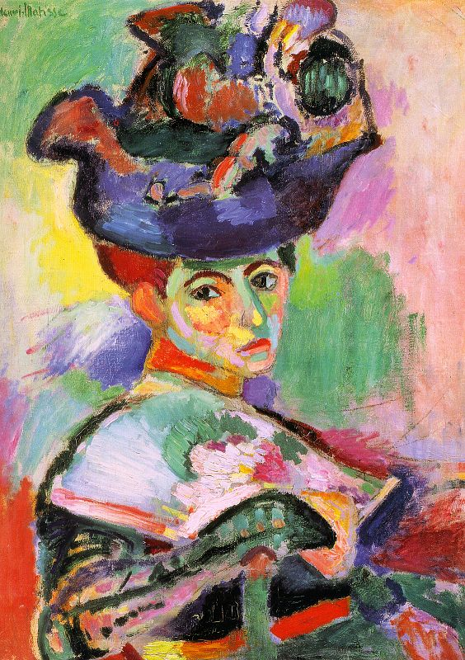
Matisse
Femme au Chapeau (1905)
The colors, although completely unrealistic, do not seem “offensive”
Notes:
This painting although the colors are offensive, looks somewhat “ordinary” because the relative luminance of the pigments is appropriate, even when the hue is not.

Slide 16
Matisse
Because the luminance values are consistent with what we expect to see.

Slide 17
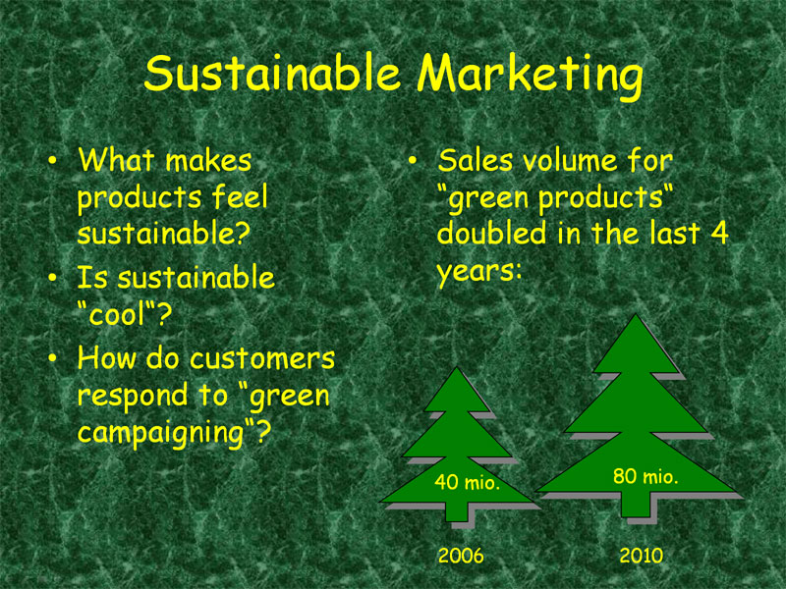

Slide 18
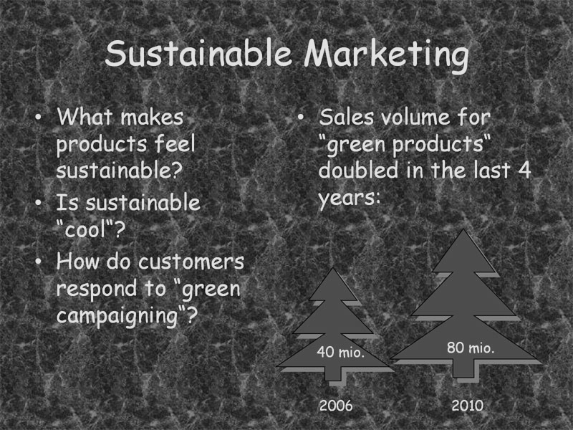
Notes:
Converted using grey scale

Slide 19
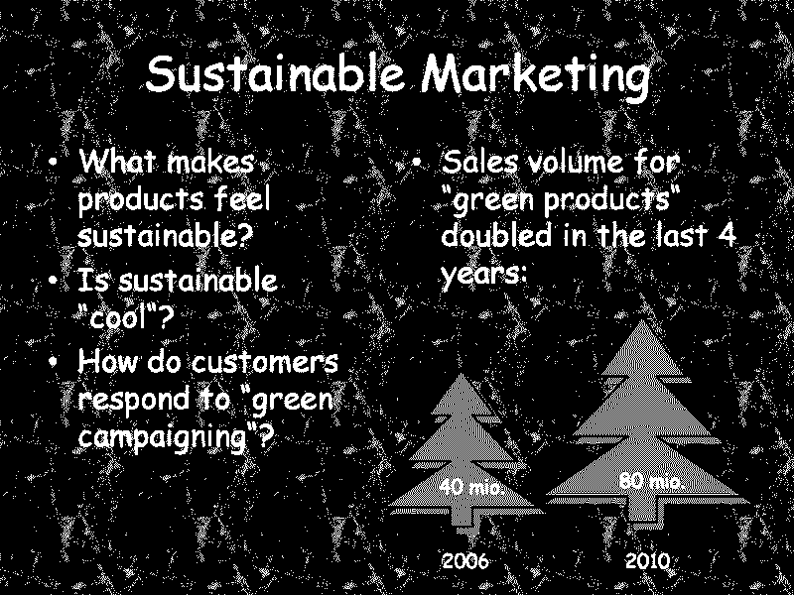
Notes:
Force into a 2 color scheme

Slide 20
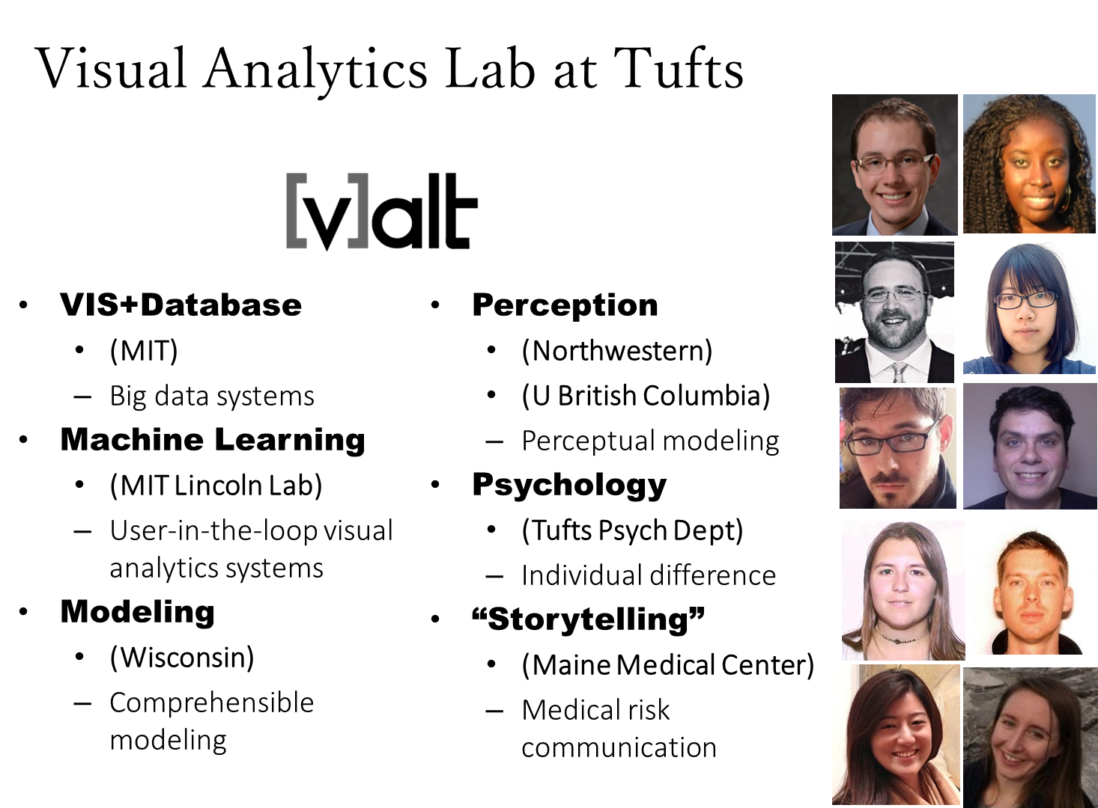

Slide 21
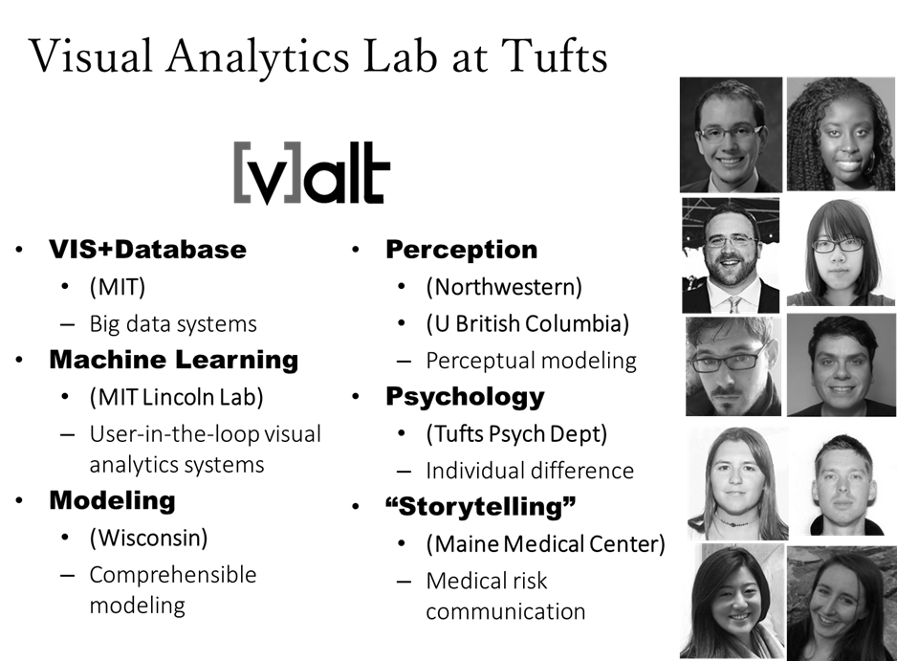

Slide 22
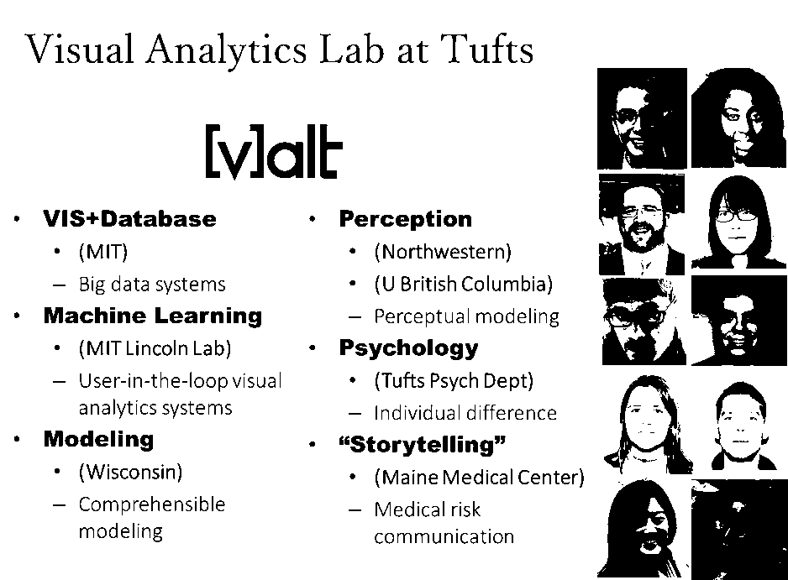
Notes:
Notice that the “fancy” aliased fonts can be blurry. Also note the photos – some of them would be harder to read and therefore less memorable.

Slide 23
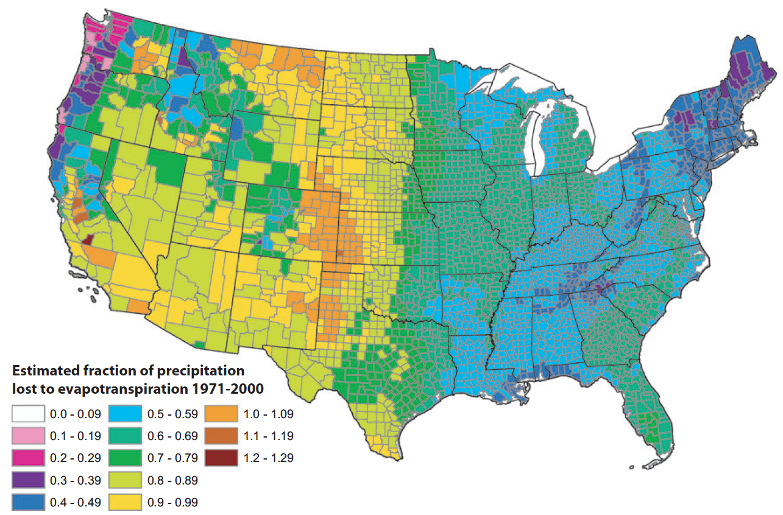
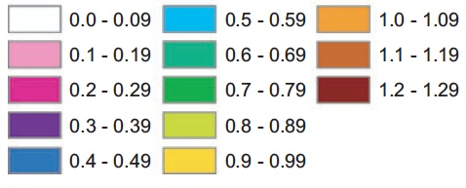
Image courtesy of https://eagereyes.org/basics/rainbow-color-map

Slide 24
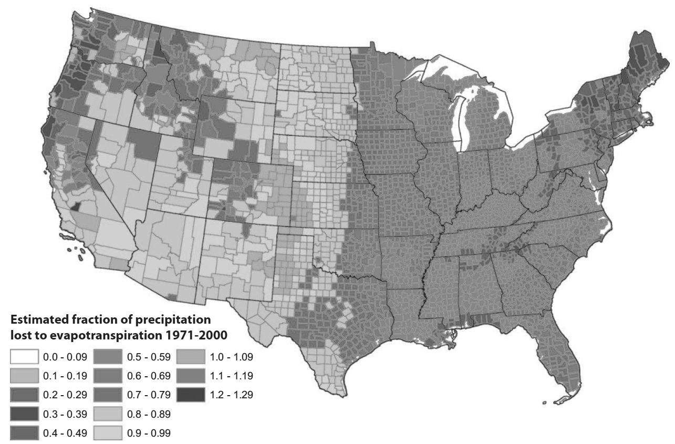
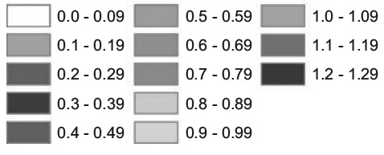

Slide 25
Notes:
Use colors carefully – avoid green!

Slide 26
Three Basic Rules of Thumb:
A talk should be Memorable
  Technical completeness is not as important
  What makes a talk memorable?
A slide should be Readable
  Be mindful of weird color schemes
  What makes a slide unreadable?
A chart (visualization) should be Understandable
  “Show what you mean, mean what you show”
  How does one lie with visualizations?

Slide 27
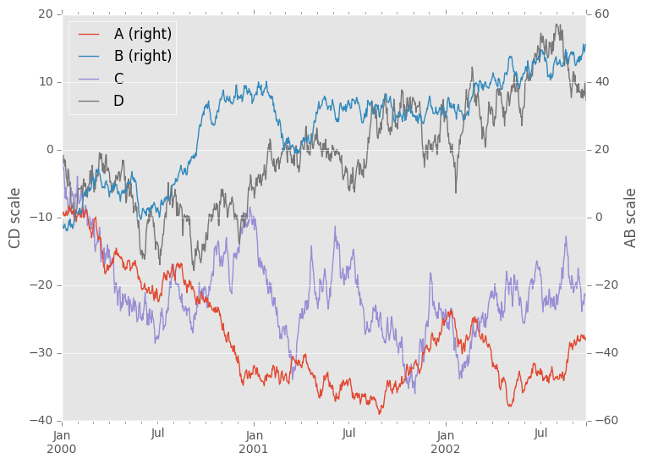
Need Explanation
Notes:
Make sure to slow down and explain to your audience what this graph is telling you. Don’t assume that they will get the message. You need to tell them the message that you want them to hear.

Slide 28
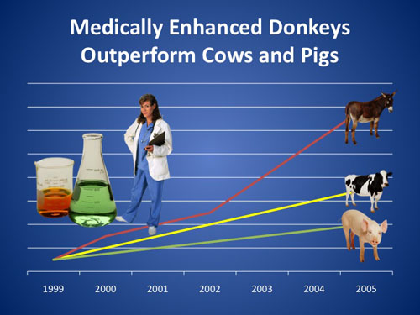
Self-Explanatory Visualization**
Notes:
Not suggesting that this is a particular great visualization (it needs a y-axis and the color is horrible), but it sure is self-explanatory!

Slide 29
Designing a good (static) visualization
Part II

Slide 30
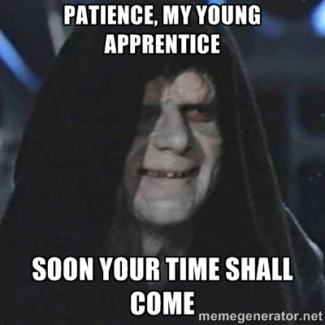
How to Design a Good Visualization?
Use what’s publicly available (and have been tested to be good!)
  Tableau is excellent
  Packages in R (e.g. ggplot) Excel has some good default data visualizations (and some really bad ones)
Color palettes:
  Colorbrewer
  Default on luminance

Slide 31

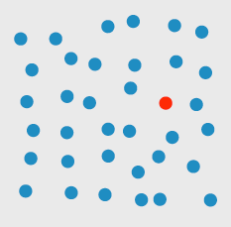
Advanced Topic 1:
Pre-Attentive Processing
Why do things “pop out”?

Slide 32


Pattern Recognition
Why do things “pop out”?

Slide 33
Strong vs. Weak Effects
Strong pop-up effects can be seen in a single eye fixation (one move) in less than 1/10 of a second
Weak pop-up effects can take several eye movements, with each eye movement costing 1/3 of a second
Many of these low-level visual features are understood, but using them is still challenging

Slide 34
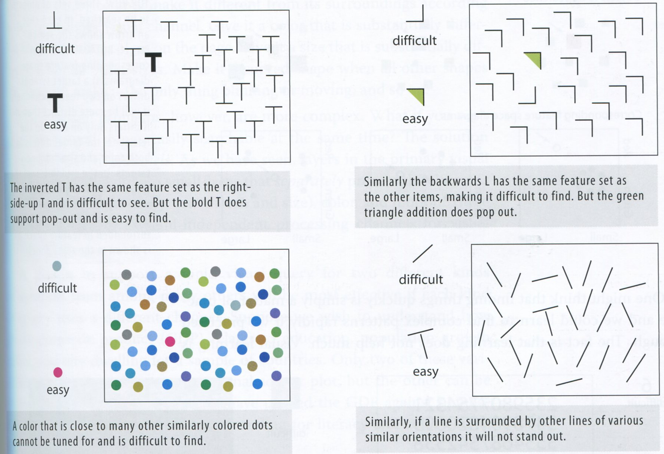

Slide 38
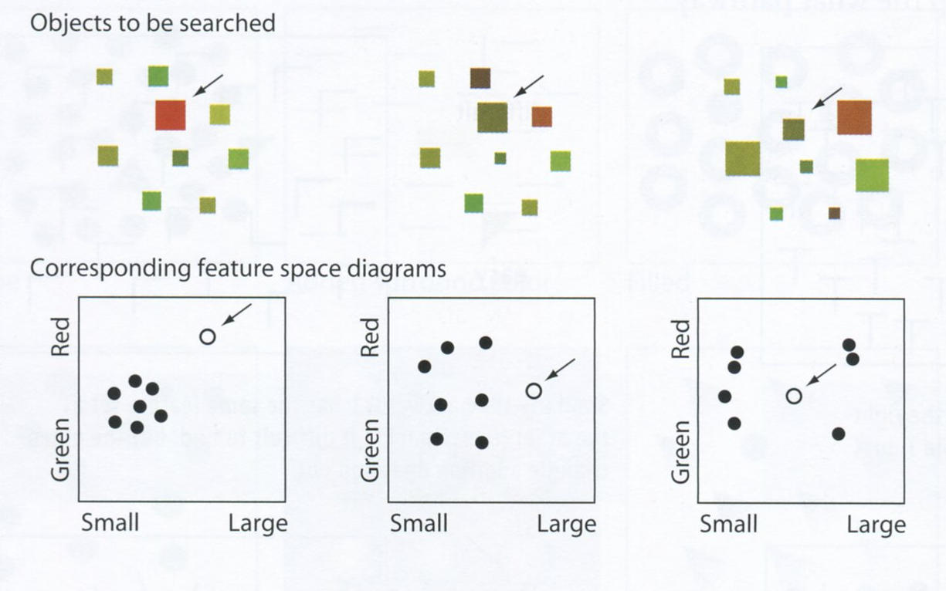
Feature Space Diagram

Slide 39
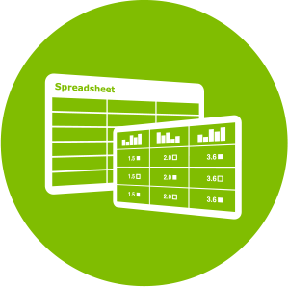

Advanced Topic 2:
Data – Visual Mapping
How many data attributes do you have?
How many visual attributes do you have?
Map each data attribute to each visual attribute on a 1:1 basis

Slide 40
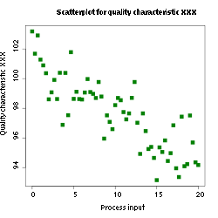
Example: Scatterplot
What are the data attributes?
What are the visual attributes?
Can a scatterplot display more dimensions of data?

Slide 41
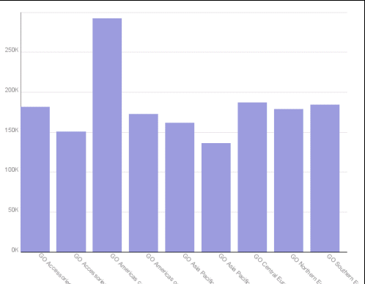
Example: Barchart
What are the data attributes?
What are the visual attributes?
What are the data-visual mappings?

Slide 42
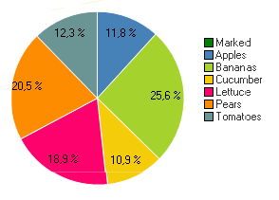
Example: Barchart
What are the data attributes?
What are the visual attributes?
What are the data-visual mappings?

Slide 43
Additional considerations (and other fun stuff)
Part III

Slide 44
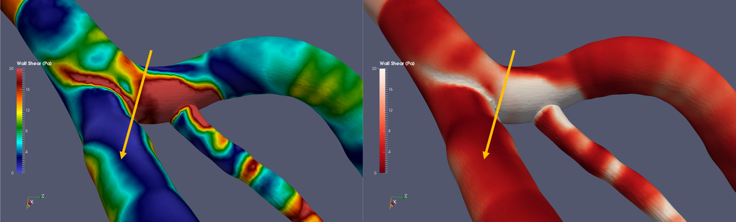
Using Visualization to Influence (Lie?)
Image courtesy of https://figureoneblog.wordpress.com/2014/03/12/misleading-with-pictures-the-pitfalls-of-data-visualization/

Slide 45
Food for Thought: Tradeoffs

Slide 46
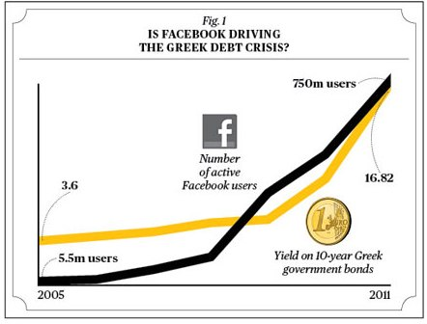
Causality vs. Correlation

Slide 47
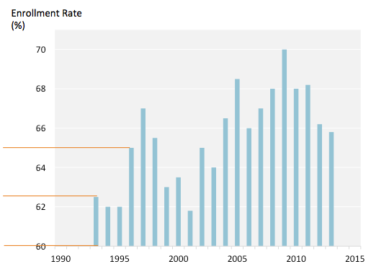

Slide 48
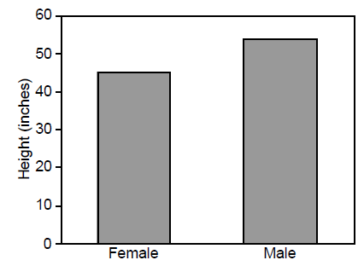
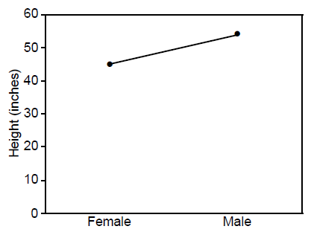
Structure and Form
Image courtesy of Barbara Tversky

Slide 49

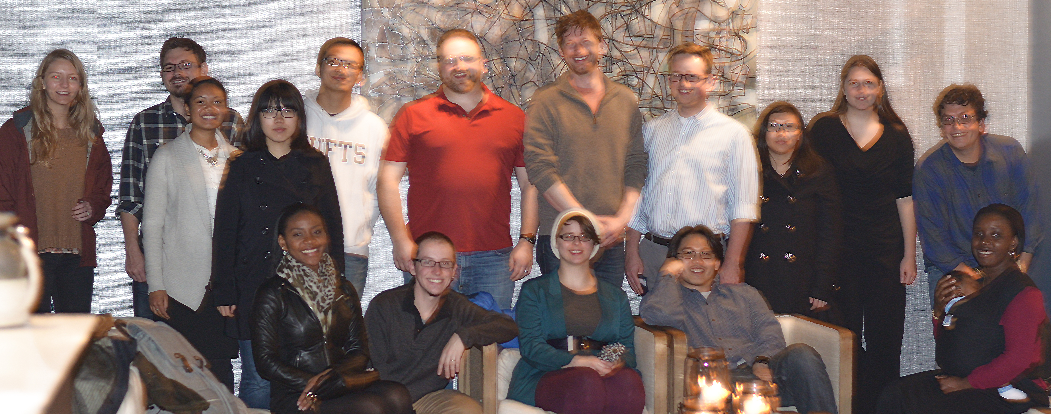
Questions? remco@cs.tufts.edu

