Slide 1
Big Data Visual Analytics:
A User-Centric Approach
Remco Chang
Assistant Professor
Computer Science
Tufts University

Slide 2







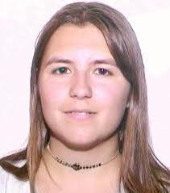



Visual Analytics Lab at Tufts
VIS+Database
  (MIT)
  Big data systems
Machine Learning
  (MIT Lincoln Lab)
  User-in-the-loop visual analytics systems
Interactive Modeling
  (Wisconsin)
  Comprehensible modeling
Perception
  (Northwestern)
  (U British Columbia)
  Perceptual modeling
Psychology
  (Tufts Psych Dept)
  Individual difference
“Storytelling”
  (Maine Medical Center)
  Medical risk communication
Notes:
Acknowledge David Madigan’s talk on ODHSI (Oddessy) and using visualization

Slide 3

Financial Fraud – A Case Study for Visual Analytics

Slide 4
Example: What Does (Wire) Fraud Look Like?
Financial Institutions like Bank of America have legal responsibilities to report all suspicious wire transaction activities (money laundering, supporting terrorist activities, etc)
Data size: approximately 200,000 transactions per day (73 million transactions per year)
Problems:
  Automated approach can only detect known patterns
  Bad guys are smart: patterns are constantly changing
  Data is messy: lack of international standards resulting in ambiguous data
Previous methods:
  10 analysts monitoring and analyzing all transactions
  Using SQL queries and spreadsheet-like interfaces
  Limited time scale (2 weeks)

Slide 5
WireVis: Financial Fraud Analysis
In collaboration with Bank of America
  Develop a visual analytical tool (WireVis)
  Visualizes 7 million transactions over 1 year
A great problem for visual analytics:
  Ill-defined problem (how does one define fraud?)
  Limited or no training data (patterns keep changing)
  Requires human judgment in the end (involves law enforcement agencies)
R. Chang et al., Scalable and interactive visual analysis of financial wire transactions for fraud detection. Information Visualization,2008.
R. Chang et al., Wirevis: Visualization of categorical, time-varying data from financial transactions. IEEE VAST, 2007.

Slide 6
WireVis: A Visual Analytics Approach
Search by Example (Find Similar Accounts)
Heatmap View
(Accounts to Keywords Relationship)
Keyword Network
(Keyword Relationships)
Multiple Temporal View
(Relationships over Time)

Slide 7
Evaluation
Challenging – lack of ground truth
Two types of evaluations:
  Grounded Evaluation: real fraud analysts, real data
    Find transactions that existing techniques can find
    Find new transactions that appear suspicious
  Controlled Evaluation: real financial analysts, synthetic data
    Find all injected threat scenarios
Adoption and Deployment

Slide 8

Good Lessons Learned
Similar to what Profs Blake and Hand mentioned:
  90% of time on Exploratory Data Analysis (EDA)
  10% on confirmation (CDA)
Big data analysis == fast hypothesis testing
High Interactivity is key
  Users can wait to find the exact answer

Slide 9





Interactive Visualization Systems
Jordan Crouser
Political Simulation
  Agent-based analysis
Bridge Maintenance
  Exploring inspection reports
Biomechanical Motion
  Interactive motion comparison
Interactive Metric Learning
  DisFunction: learn a model from projection
High-D Data Exploration
  iPCA: Interactive PCA
R. Chang et al., Two Visualization Tools for Analysis of Agent-Based Simulations in Political Science. IEEE CG&A, 2012

Slide 10



Interactive Visualization Systems
Political Simulation
  Agent-based analysis
Bridge Maintenance
  Exploring inspection reports
Biomechanical Motion
  Interactive motion comparison
Interactive Metric Learning
  DisFunction: learn a model from projection
High-D Data Exploration
  iPCA: Interactive PCA
R. Chang et al., An Interactive Visual Analytics System for Bridge Management, Journal of Computer Graphics Forum, 2010.

Slide 11



Interactive Visualization Systems
Political Simulation
  Agent-based analysis
Bridge Maintenance
  Exploring inspection reports
Biomechanical Motion
  Interactive motion comparison
Interactive Metric Learning
  DisFunction: learn a model from projection
High-D Data Exploration
  iPCA: Interactive PCA
R. Chang et al., Interactive Coordinated Multiple-View Visualization of Biomechanical Motion Data, IEEE Vis (TVCG) 2009.

Slide 12
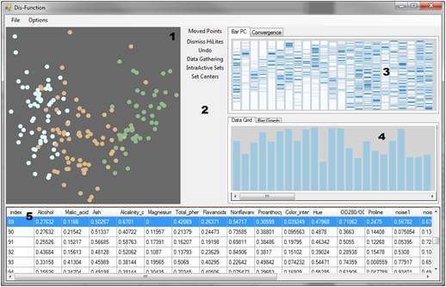
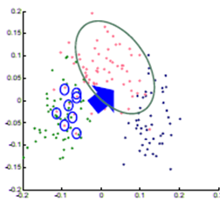

Interactive Visualization Systems
Eli Brown
Political Simulation
  Agent-based analysis
Bridge Maintenance
  Exploring inspection reports
Biomechanical Motion
  Interactive motion comparison
Interactive Metric Learning
  DisFunction: learn a model from projection
High-D Data Exploration
  iPCA: Interactive PCA
R. Chang et al., Dis-function: Learning Distance Functions Interactively, IEEE VAST 2011.

Slide 13
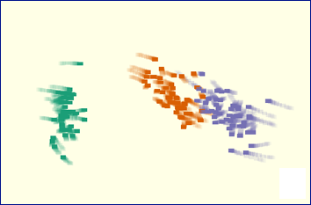
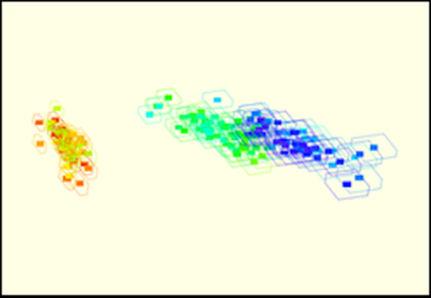
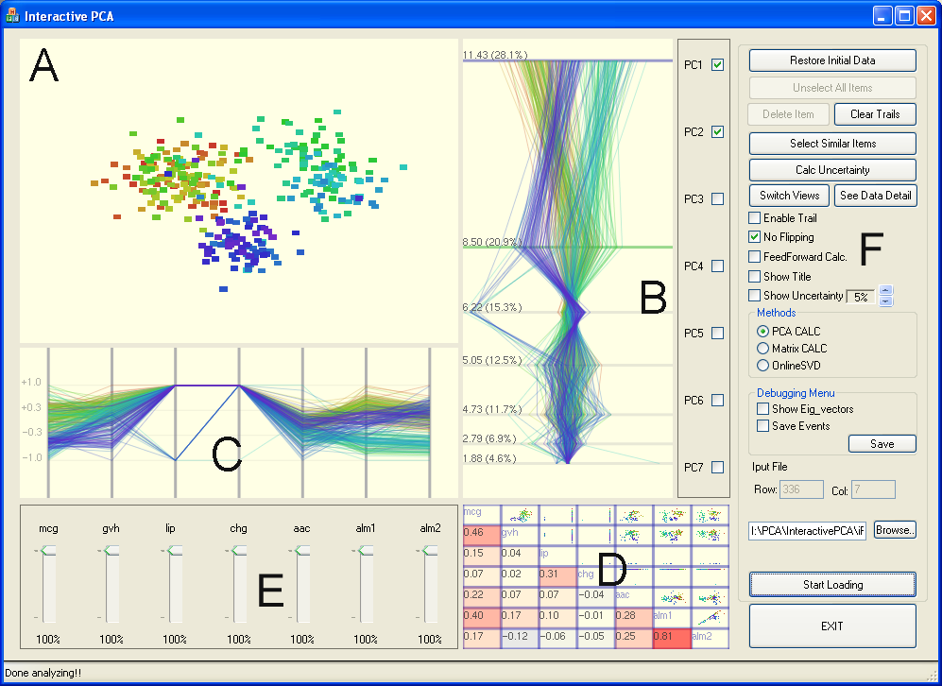
Interactive Visualization Systems
Political Simulation
  Agent-based analysis
Bridge Maintenance
  Exploring inspection reports
Biomechanical Motion
  Interactive motion comparison
Interactive Metric Learning
  DisFunction: learn a model from projection
High-D Data Exploration
  iPCA: Interactive PCA
R. Chang et al., iPCA: An Interactive System for PCA-based Visual Analytics, EuroVis 2009.

Slide 14
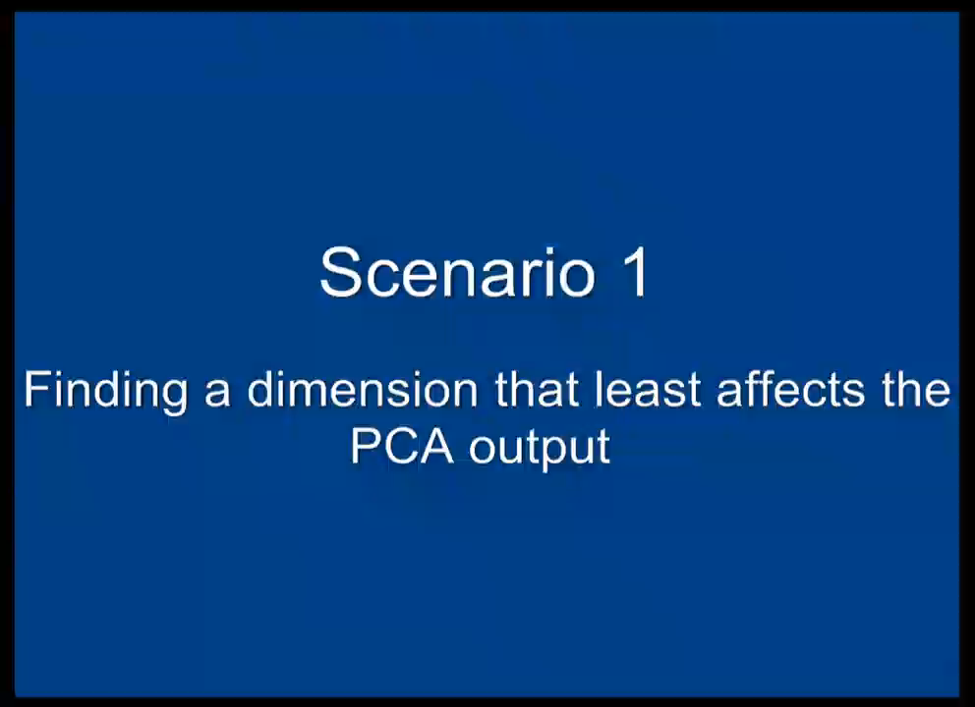

Slide 15
“Tough” Lessons Learned
Careful engineering is not enough… A new architecture is necessary to support this type of analysis.

Slide 16



Problem Statement
Visualization on a
Commodity Hardware
Large Data in a
Data Warehouse

Slide 17
Related Work
(see the DISA workshop proceeding)
Specialized Pull-based Databases
  Tableau, Spotfire
Pre-compiled Data Cubes
  Nanocube (Scheidegger), imMens** (Liu, Heer), Map-D** (Mostak)
Sampling
  BlinkDB (Agrawal, Berkeley), DICE (Kamat, Nandi)
Pre-Fetching
  Xmdv (Doshi, Ward), Time-series (Chan, Hanrahan), Query prediction (Cetintemel, Zdonik)
Others
  Streaming (Fisher), Optimization (Wu)
** GPU-accelerated

Slide 18
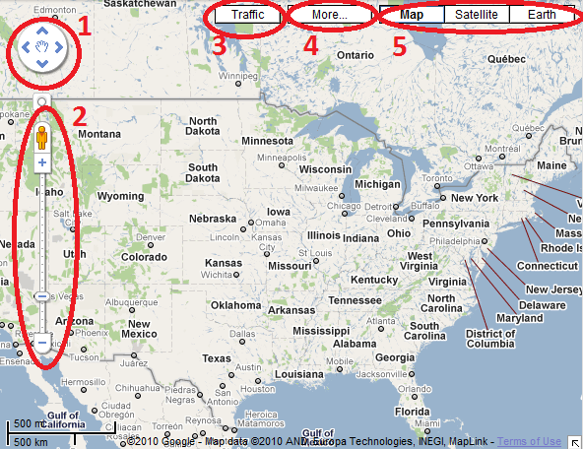
Two Observations:
The number of possible actions is finite and the user’s actions are “logical”.
Visualization itself is a bottleneck

Slide 19


Two Observations:
The number of possible actions is finite and the user’s actions are “logical”.
Visualization itself is a bottleneck
  User’s perception and cognition are added constraints
1000 pixels
1000 pixels
1000x1000 = 1 million

Slide 20
Problem Statement
Problem: Data is too big to fit into the memory of the personal computer
  Note: Ignoring various database technologies (OLAP, Column-Store, No-SQL, Array-Based, etc)
Goal: Guarantee a result set to a user’s query within X number of seconds.
  Based on HCI research, the upperbound for X is 10 seconds
  Ideally, we would like to get it down to 1 second or less
Method: trading accuracy and storage (caching), optimize on minimizing latency (user wait time).

Slide 21


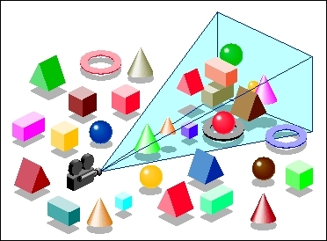
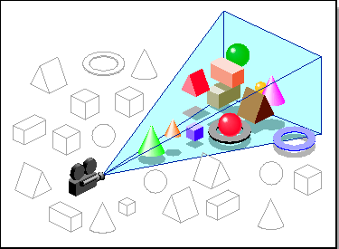
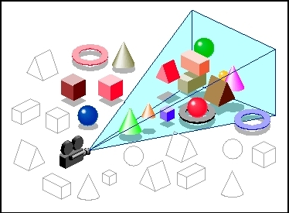

Our Approach: Predictive
Pre-Computation and Pre-Fetching
Stonebraker
Leilani Battle
In collaboration with MIT (Leilani Battle, Mike Stonebraker)
ForeCache: Three-tiered architecture
  Thin client (visualization)
  Backend (array-based database)
  Fat middleware
    Prediction Algorithms
    Storage Architecture
    Cache Management (Eviction Strategies)
R. Chang et al., Dynamic Prefetching of Data Tiles for Interactive Visualization. To Appear in SIGMOD 2016

Slide 23



Prediction Algorithms
General Idea:
  Lots of “experts” who recommend chunks of data to pre-fetch / pre-compute
  One “manager” who listens to the experts and chooses which experts’ advice to follow
  Each “expert” gets more of their recommendations accepted if they keep guessing correctly

Slide 24
Iteration: 0
13
48
11
3
99
2
13
99
67
45
82
7
22
42
31

Slide 25
Iteration: 0
13
48
11
3
99
2
13
99
67
45
82
7
22
42
31

Slide 26
Iteration: 0
13
48
11
3
99
2
13
99
67
45
82
7
22
42
31
User Requests Data Block 13

Slide 27


Iteration: 0
13
48
11
3
99
2
13
99
67
45
82
7
22
42
31
User Requests Data Block 13

Slide 28
Iteration: 0
13
48
11
3
99
2
13
99
67
45
82
7
22
42
31
User Requests Data Block 13

Slide 29
Iteration: 1
4
12
34
88
27
5
23
1
92
34
42
12
31
32
13

Slide 30
Training and Determining “Experts”
Instead of training the manager in real-time, this process can be done offline
  Using past user interaction logs
On choosing Experts, some obvious ones include:
  Momentum-based
  Data similarity-based
  Frequency (hot-spot)-based
  Past action sequence-based
Generally speaking, given the “manager” approach, we want as many different types of “experts” as possible

Slide 31
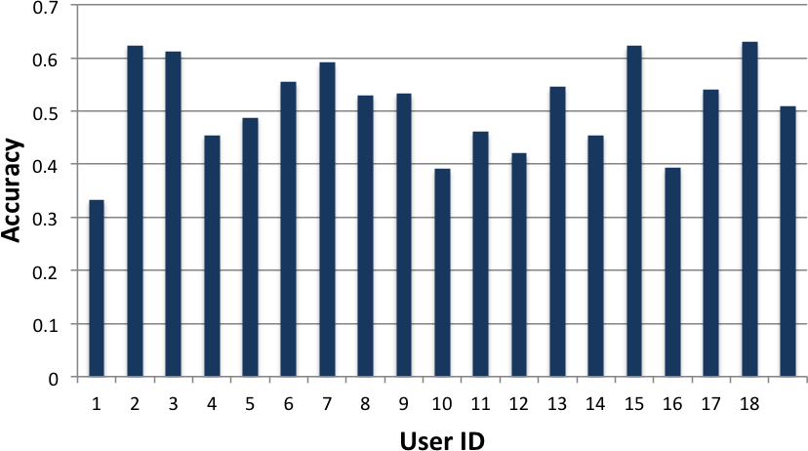
Preliminary Results
Using a simple Google-maps like interface
18 users explored the NASA MODIS dataset
Tasks include “find 4 areas in Europe that have a snow coverage index above 0.5”

Slide 32
Worst Case Scenario: Cache Miss
13
48
11
3
99
2
13
99
67
45
82
7
22
42
31
User’s Requests Data Block 52

Slide 33
Cache Miss
Stonebraker
Leilani Battle
How to guarantee response time when there’s a cache miss?
Trick: the ‘EXPLAIN’ command
Usage:
  explain select * from myTable;
Middleware “intercepts” a query from the client, and first asks for an “explain”
  If “ok” with explain result, execute the original query
  If “not ok”, modify the query dynamically
R. Chang et al., Dynamic Reduction of Result Sets for Interactive Visualization, IEEE Big Data Workshop on Visualization, 2013.

Slide 34
Example EXPLAIN Output from SciDB
Example SciDB the output of (a query similar to)
Explain SELECT * FROM earthquake
[("[pPlan]:
schema earthquake
<datetime:datetime NULL DEFAULT null,
magnitude:double NULL DEFAULT null,
latitude:double NULL DEFAULT null,
longitude:double NULL DEFAULT null>
[x=1:6381,6381,0,y=1:6543,6543,0]
bound start {1, 1} end {6381, 6543}
density 1 cells 41750883 chunks 1
est_bytes 7.97442e+09
")]
The four attributes in the table ‘earthquake’
Notes that the dimensions of this array (table) is 6381x6543
This query will touch data elements from (1, 1) to (6381, 6543), totaling 41,750,833 cells
Estimated size of the returned data is 7.97442e+09 bytes (~8GB)

Slide 35
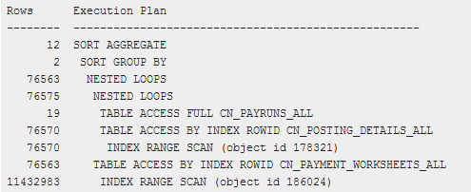
Other Examples
Oracle 11g Release 1 (11.1)

Slide 36
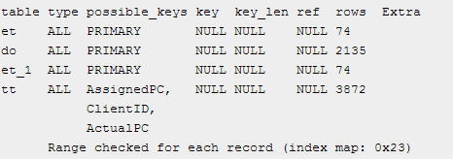
Other Examples
MySQL 5.0

Slide 37
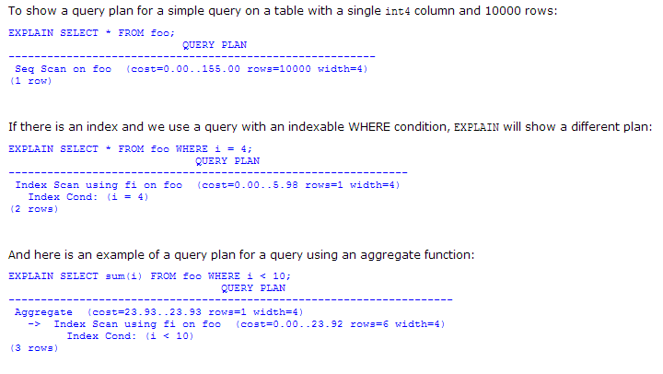
Other Examples
PostgreSQL 7.3.4

Slide 38
Reduction Strategies
If the query result is estimated to be too large, we can dynamically “modify” the query:
  Aggregation:
    In SciDB, this operation is carried out as
    regrid (scale_factorX, scale_factorY)
  Sampling
    In SciDB, uniform sampling is carried out as
    bernoulli (query, percentage, randseed)
  Filtering
    Currently, the filtering criteria is user specified
    where (clause)

Slide 39
Quick Summary
Key Components:
Pre-computation and pre-fetching
Three-tiered system
Pre-fetching based on “expert-manager” approach
Use the “explain” trick to handle cache-miss
Guarantees response time, but not data quality
Backbone (invisible) to data analysts

Slide 40
Two Observations (Ongoing & Future Work)
The number of possible actions is finite and the user’s actions are “logical”.
  Need to establish ground-truth.
Visualization and User Perception are bottlenecks
  Need quantitative methods for understanding the users’ perceptual and cognitive limitations
  (Unfortunately, no time today to talk about this)

Slide 41

Analyzing a User’s Interactions
Alvitta Ottley
Eli Brown
How are the user’s interactions predictable?

Slide 42
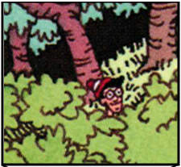
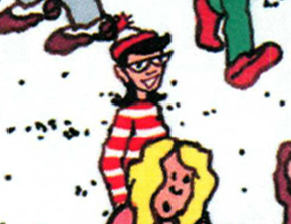
Experiment: Finding Waldo
Google-Maps style interface
  Left, Right, Up, Down, Zoom In, Zoom Out, Found
R. Chang et al., Finding Waldo: Learning about Users from their Interactions. IEEE VAST 2014

Slide 43
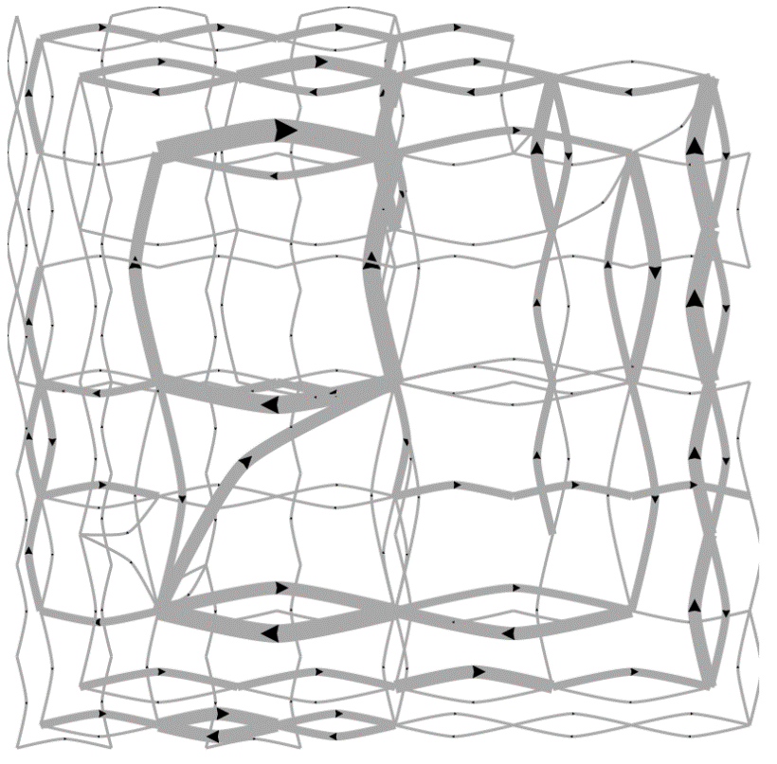
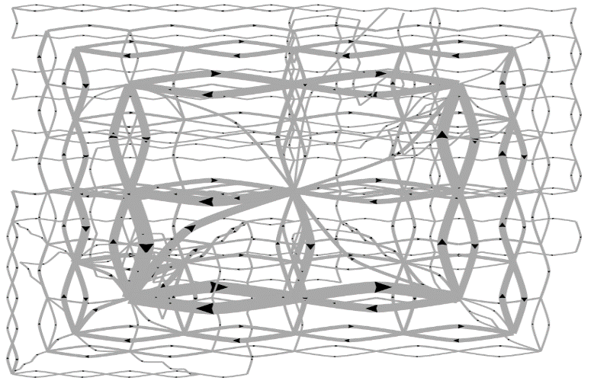
Pilot Visualization – Completion Time
Fast completion time
Slow completion time

Slide 44
Post-hoc Analysis Results
Mean Split (50% Fast, 50% Slow)
Data Representation | Classification Accuracy | Method
State Space | 72% | SVM
Edge Space | 63% | SVM
Sequence (n-gram) | 77% | Decision Tree
Mouse Event | 62% | SVM
Fast vs. Slow Split (Mean+0.5σ=Fast, Mean-0.5σ=Slow)
Data Representation | Classification Accuracy | Method
State Space | 96% | SVM
Edge Space | 83% | SVM
Sequence (n-gram) | 79% | Decision Tree
Mouse Event | 79% | SVM

Slide 45
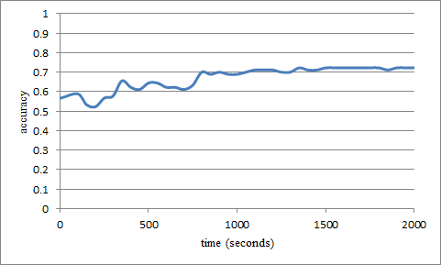
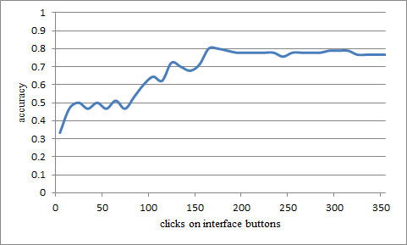
“Real-Time” Prediction
(Limited Time Observation)
State-Based
Linear SVM
Accuracy: ~70%
Interaction Sequences
N-Gram + Decision Tree
Accuracy: ~80%

Slide 46
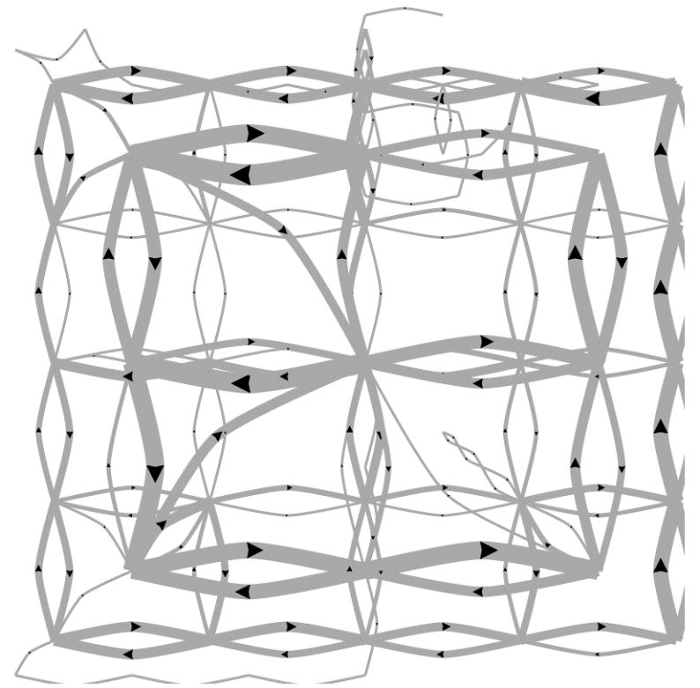
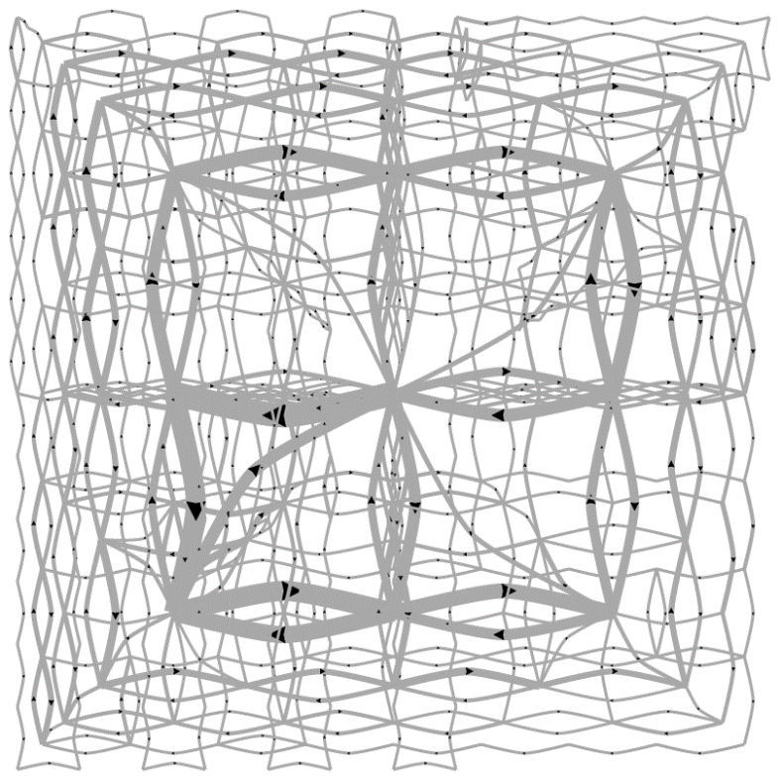
Predicting a User’s Personality
External Locus of Control
Internal Locus of Control
Ottley et al., How locus of control inﬂuences compatibility with visualization style. IEEE VAST , 2011.
Ottley et al., Understanding visualization by understanding individual users. IEEE CG&A, 2012.

Slide 47
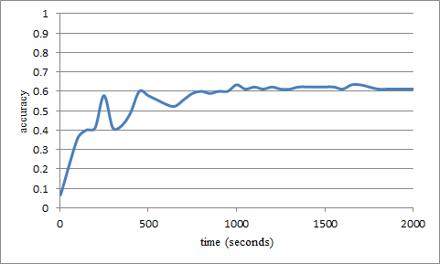
Predicting Users’ Personality Traits
Predicting user’s “Extraversion”
Linear SVM
Accuracy: ~60%
Noisy data, but can (almost) detect the users’ individual traits “Extraversion”, “Neuroticism”, and “Locus of Control” at ~60% accuracy.

Slide 48
Quick Summary
User’s interaction log encode a great deal of a user’s analysis behavior
Representation remains the biggest issue
Need more techniques for extracting this type of data
External Locus of Control
Internal Locus of Control

Slide 49

Summary: Theory Into Practice
Interaction is key to exploratory visualizations
Big data analysis -> high interactivity
ForeCache seeks to address this
  Leverages the two constraints:
    Consistent user interaction trails
    Resolution constraint
  Predictive prefetching based on past user actions (Waldo Experiment)
  Cache miss using EXPLAIN

Slide 50

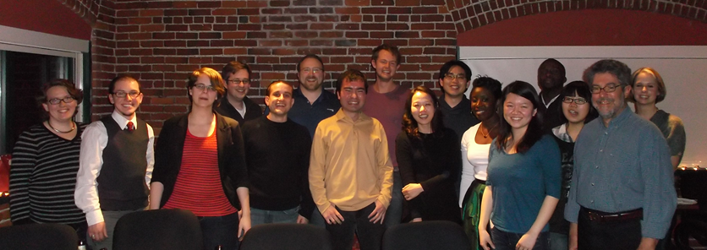
Questions? remco@cs.tufts.edu

