Slide 1
Individual Differences in
Information Visualization and
Visual Analytics
Remco Chang
Associate Professor
Computer Science, Tufts University

Slide 2
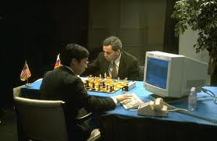
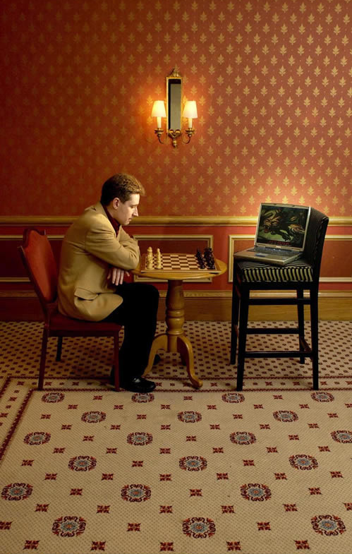
Human + Computer
Human vs. Artificial Intelligence
Garry Kasparov vs. Deep Blue (1997)
  Computer takes a “brute force” approach without analysis
  “As for how many moves ahead a grandmaster sees,” Kasparov concludes: “Just one, the best one”
Artificial vs. Augmented Intelligence Hydra vs. Cyborgs (2005)
  Grandmaster + 1 chess program > Hydra (equiv. of Deep Blue)
  Amateur + 3 chess programs > Grandmaster + 1 chess program1
1. http://www.collisiondetection.net/mt/archives/2010/02/why_cyborgs_are.php

Slide 3
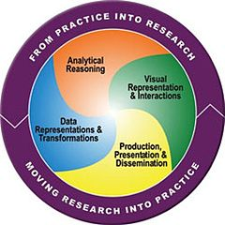
Visual Analytics = Human + Computer
Visual analytics is “the science of analytical reasoning facilitated by visual interactive interfaces.” ¹
By definition, it is a collaboration between human and computer to solve problems.
1. Thomas and Cook, “Illuminating the Path”, 2005.

Slide 4

Financial Fraud – A Case for Visual Analytics
Financial Institutions like Bank of America have legal responsibilities to report all suspicious wire transaction activities
  money laundering, supporting terrorist activities, etc.
Data size: approximately 200,000 transactions per day (73 million transactions per year)

Slide 5

Financial Fraud – A Case Study for Visual Analytics
Problems:
  Automated approach can only detect known patterns
  Bad guys are smart: patterns are constantly changing
Previous methods:
  10 analysts monitoring and analyzing all transactions
  Using SQL queries and spreadsheet-like interfaces
  Limited time scale (2 weeks)

Slide 6

WireVis: Financial Fraud Analysis
In collaboration with Bank of America
  Visualizes 7 million transactions over 1 year
A great problem for visual analytics:
  Ill-defined problem (how does one define fraud?)
  Limited or no training data (patterns keep changing)
  Requires human judgment in the end (involves law enforcement agencies)
R. Chang et al., Scalable and interactive visual analysis of financial wire transactions for fraud detection. Information Visualization,2008.
R. Chang et al., Wirevis: Visualization of categorical, time-varying data from financial transactions. IEEE VAST, 2007.

Slide 7
WireVis: A Visual Analytics Approach
Search by Example (Find Similar Accounts)
Heatmap View
(Accounts to Keywords Relationship)
Keyword Network
(Keyword Relationships)
Multiple Temporal View
(Relationships over Time)

Slide 8

Evaluation
Challenging – lack of ground truth
Two types of evaluations:
  Grounded Evaluation: real analysts, real data
    Find transactions that existing techniques can find
    Find new transactions that appear suspicious
  Controlled Evaluation: real analysts, synthetic data
    Find all injected threat scenarios
Adoption and Deployment

Slide 9
Lesson Learned
“The computer is incredibly fast, accurate, and stupid. Man is unbelievably slow, inaccurate, and brilliant. The marriage of the two is a force beyond calculation.”
-Leo Cherne, 1977
(often attributed to Albert Einstein)

Slide 10
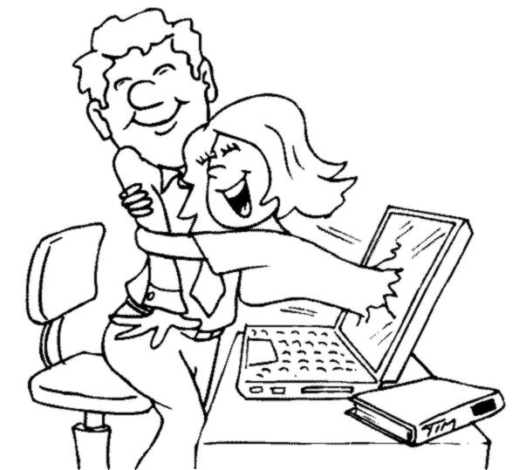
Which Marriage?

Slide 11
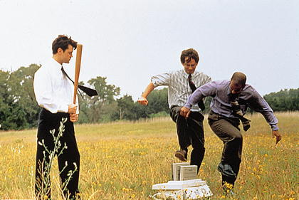
Which Marriage?

Slide 12
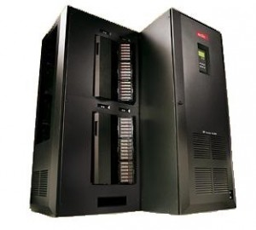

Work Distribution
Data Manipulation
Storage and Retrieval
Bias-Free Analysis
Prediction
Logic
Perception
Creativity
Domain Knowledge
Crouser et al., Balancing Human and Machine Contributions in Human Computation Systems. Human Computation Handbook, 2013
Crouser et al., An affordance-based framework for human computation and human-computer collaboration. IEEE VAST, 2012

Slide 13
Current Model of Visual Analytics
Interactive Data Exploration
Automated Data Analysis
Feedback Loop
Problem: (actually there are quite a few)
For our purpose, it’s that:
  VIS -> Model -> VIS doesn’t involve the human
Keim et al. Visual Analytics: Definition, Process, and Challenges. Information Visualization, 2008

Slide 14

The Need for Understanding Humans:
A Case Study of Bayesian Reasoning
Alvitta Ottley
R. Chang et al. Improving Bayesian Reasoning: The Effects of Phrasing, Visualization, and Spatial Ability. InfoVis 2016

Slide 15
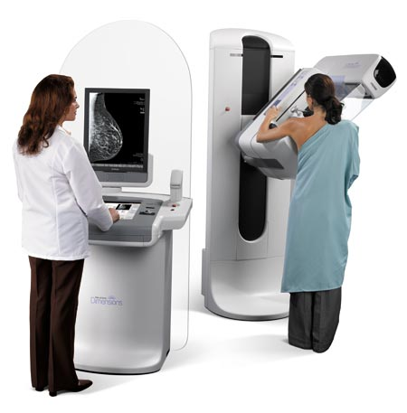
The probability of breast cancer is 1% for women at age forty who participate in routine screening. If a woman has breast cancer, the probability is 80% that she will get a positive mammography. If a woman does not have breast cancer, the probability is 9.3% that she will also get a positive mammography.
If a woman at age 40 is tested positive, what are her chances of actually having breast cancer?

Slide 16
The chance of actually having breast cancer given a positive mammogram:
7.9%
Answer: Bayes’ theorem states that P(A|B) = P(B|A) * P(A) / P(B). In this case, A is having breast cancer, B is testing positive with mammography. P(A|B) is the probability of a person having breast cancer given that the person is tested positive with mammography. P(B|A) is given as 80%, or 0.8, P(A) is given as 1%, or 0.01. P(B) is not explicitly stated, but can be computed as P(B,A)+P(B,˜A), or the probability of testing positive and the patient having cancer plus the probability of testing positive and the patient not having cancer. Since P(B,A) is equal 0.8*0.01 = 0.008, and P(B,˜A) is 0.093 * (1-0.01) = 0.09207, P(B) can be computed as 0.008+0.09207 = 0.1007. Finally, P(A|B) is therefore 0.8 * 0.01 / 0.1007, which is equal to 0.07944.

Slide 17
95 out of 100 doctors¹
estimate this probability
to be:
80%
1. Eddy, David M. "Probabilistic reasoning in clinical medicine: Problems and opportunities." (1982).

Slide 18
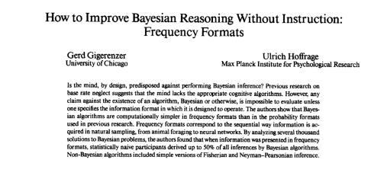
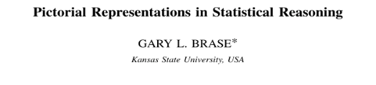

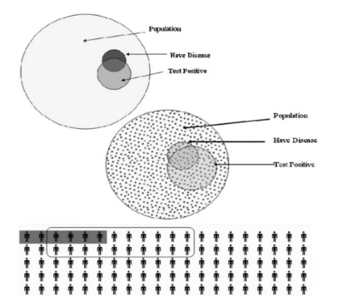

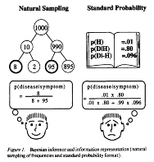
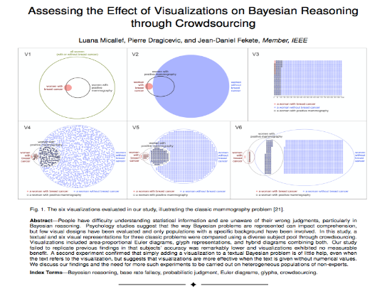
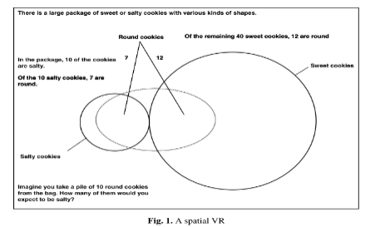
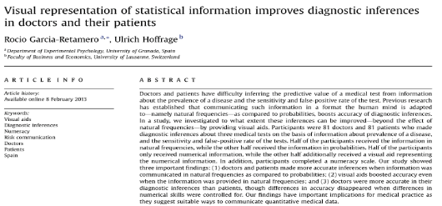
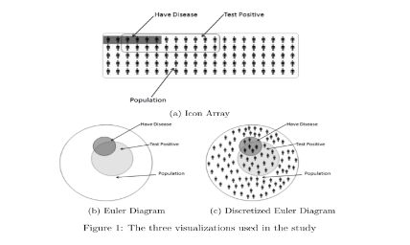
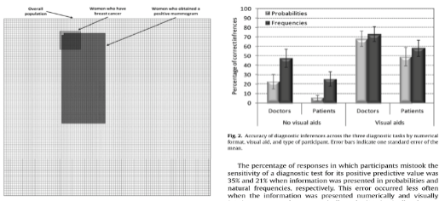
VIS Community

Slide 19


The Problem?
“
”
“
”
“
”
“
...”
They disagree.
* Reported accuracies range from 6% to 62%

Slide 20
Experiments
Need to understand how the wording of the problem impacts accuracy.
Need to understand how different reasoning aides impact accuracy.
Specifically:
does adding visualization to the text help?

Slide 21
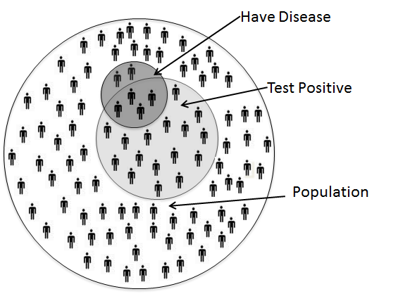
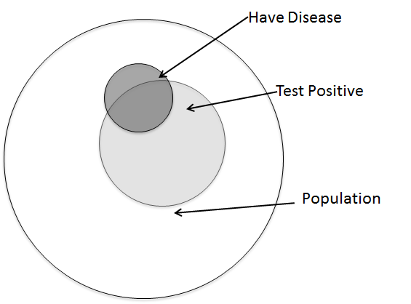
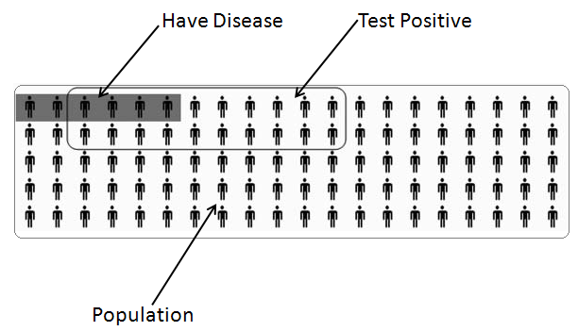
Visualization Aids
Ottley et al., Visually Communicating Bayesian Statistics to Laypersons. Tufts CS Tech Report, 2012.

Slide 22
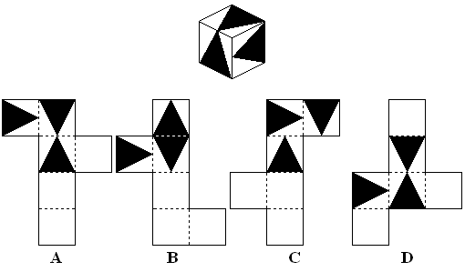
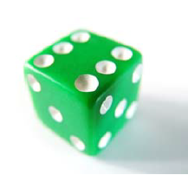

Experimental Design
6 conditions
377 participants
Between subjects experiment
Also measured spatial ability, numeracy
Answer: (A)
A dice has sides of 1.2cm. What is its volume in cubic mm?
Notes:
Describe spatial ability

Slide 23
Initial Results

Slide 24
Separated by Spatial Ability
Low spatial-ability
High spatial-ability

Slide 25
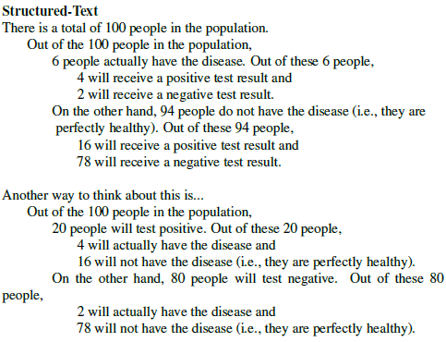
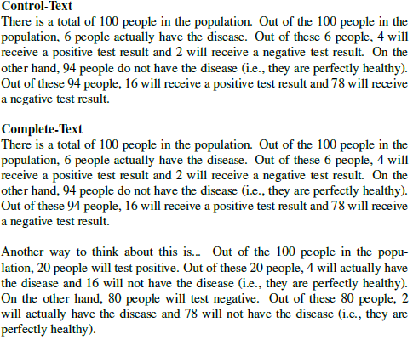
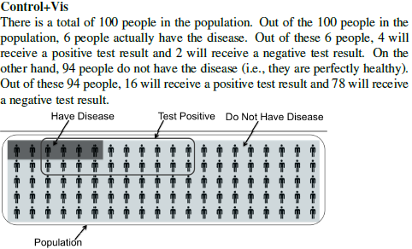
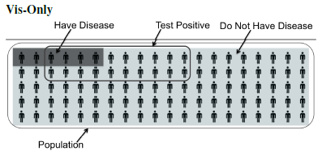
Conditions

Slide 26
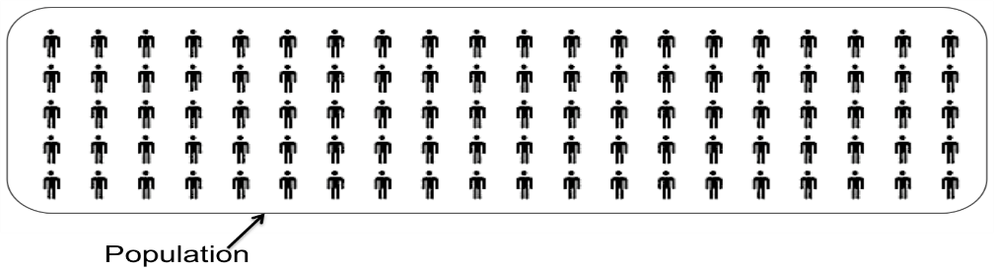
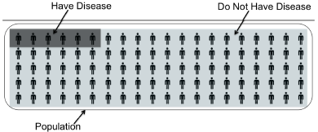
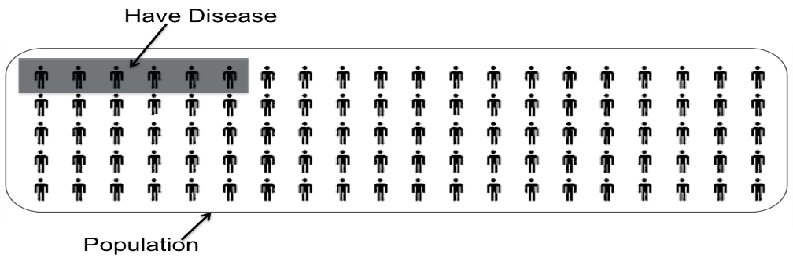
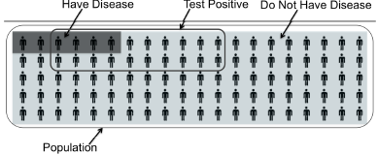
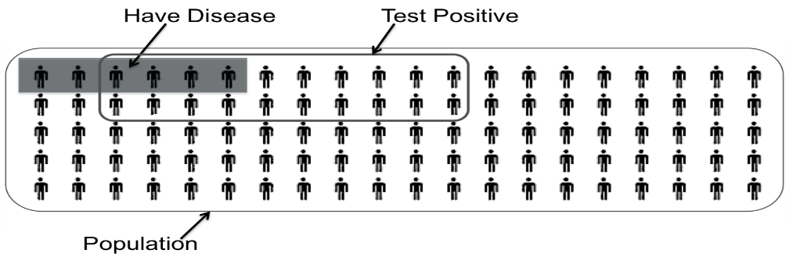
Storyboard (Storytelling Visualization)

Slide 27
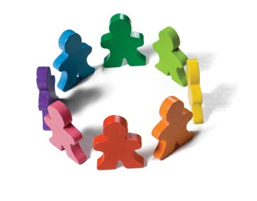

Short Summary
Individual differences matter
Not all problems can be solved with “better tools”
  We need to know what users need what support
Solving these problems (e.g. Bayesian Reasoning) can have a significant impact in a wide-range of applications:
  Health care, intelligence analysis, business decisions, etc.

Slide 28
Locus of Control:
Personality Trait, Priming, and Exploration of Hierarchical Data
Alvitta Ottley

Slide 29
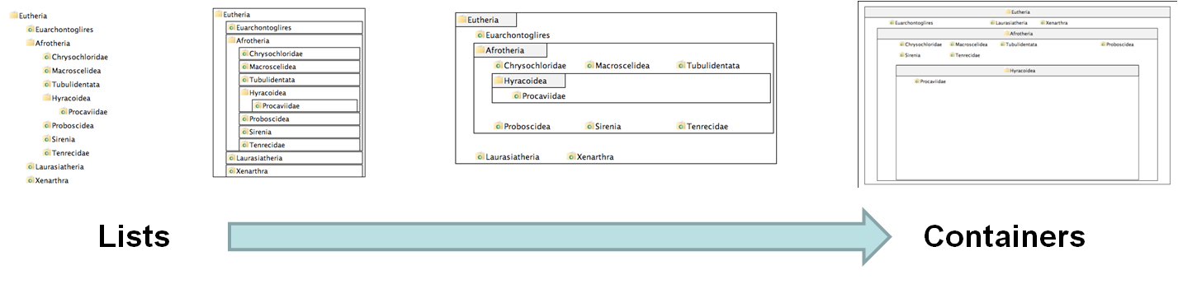
Experiment Procedure
Green and Fisher (VAST, 2011) did an exploratory study of personality traits on 2 commercial and research visualization systems
Our follow up study to isolate the effects:
  4 visualizations on hierarchical visualization
  From list-like view to containment view
  250 participants using Amazon’s Mechanical Turk
Questionnaire on “locus of control” (LOC)
  Definition of LOC: the degree to which a person attributes outcomes to themselves (internal LOC) or to outside forces (external LOC)
V1
V2
V3
V4
R. Chang et al., How Locus of Control Influences Compatibility with Visualization Style, IEEE VAST 2011.

Slide 30
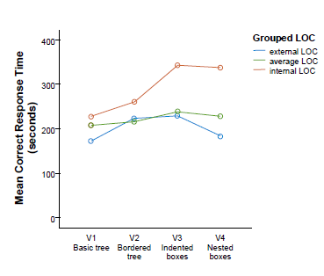
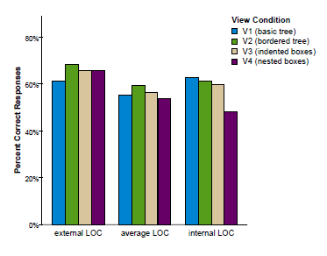
Results
When with list view compared to containment view, internal LOC users are:
  faster (by 70%)
  more accurate (by 34%)
Only for complex (inferential) tasks
The speed improvement is about 2 minutes (116 seconds)

Slide 31
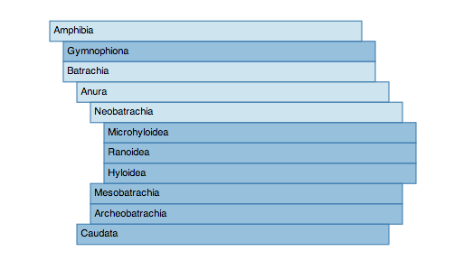
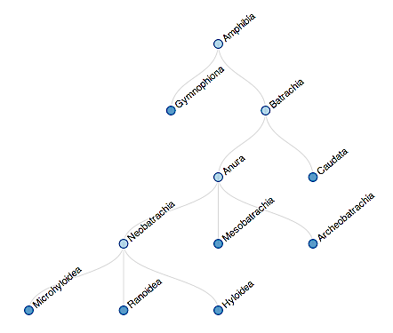
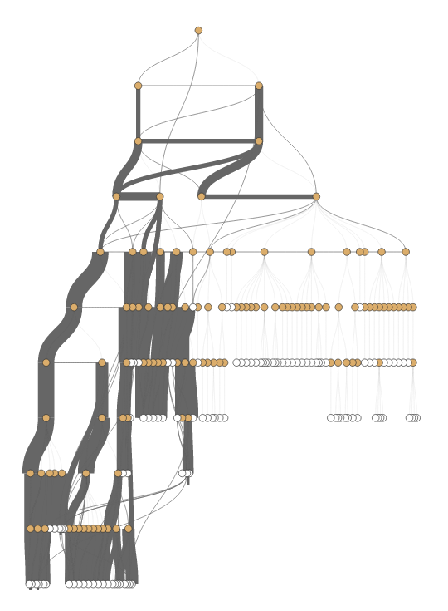
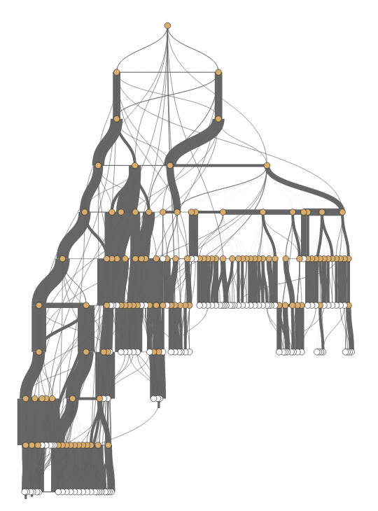
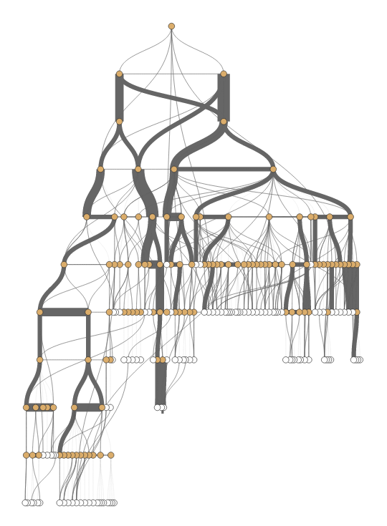
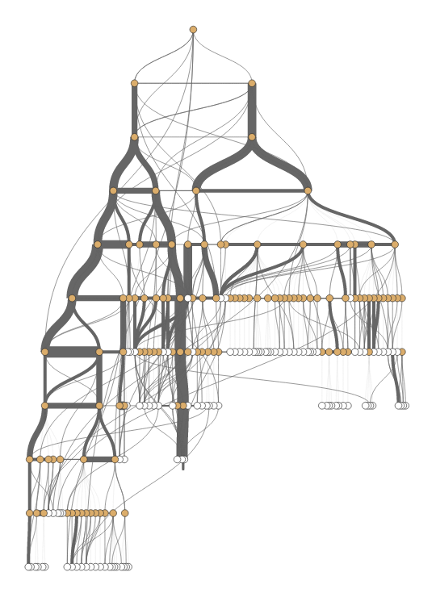
Differences in Interaction Behaviors
External LOC
Internal LOC
External LOC
Internal LOC
R. Chang et al., Personality as a Predictor of User Strategy: How Locus of Control Affects Search Strategies on Tree Visualizations, CHI 2016.

Slide 32
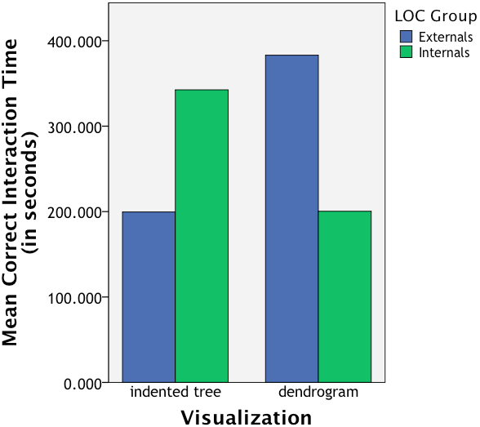
Differences in Interaction Behaviors
Consistent with prior results:
Strong effect between (Visualization Type x LOC)

Slide 33
What?
Is the relationship between LOC and Visualization Type coincidental or causal?
Alvitta Ottley

Slide 34

Cognitive Priming

Slide 35
Cognitive Priming of LOC
Based on Psychology research, we know that locus of control can be temporarily affected through priming
For example, to reduce locus of control (to make someone have a more external LOC)
  “We know that one of the things that influence how well you can do everyday tasks is the number of obstacles you face on a daily basis. If you are having a particularly bad day today, you may not do as well as you might on a day when everything goes as planned. Variability is a normal part of life and you might think you can’t do much about that aspect. In the space provided below, give 3 examples of times when you have felt out of control and unable to achieve something you set out to do. Each example must be at least 100 words long.”

Slide 36
What We Know: LOC and Visualization:
Performance
Good
External LOC
Average LOC
Internal LOC
Poor
Visual Form
List-View (V1)
Containment (V4)

Slide 37
Research Question
Known Facts:
  There is a relationship between LOC and visualization
  LOC can be primed
Research Question:
  If we can affect the user’s LOC, will that affect their use of visualization?
Hypothesis:
  If YES, then the relationship between LOC and visualization style is causal
  If NO, it suggests that LOC is a stable indicator of a user’s visualization style

Slide 38
LOC and Visualization
Performance
Good
External LOC
Condition 1:
Make Internal LOC more like External LOC
Average LOC
Internal LOC
Poor
Visual Form
List-View (V1)
Containment (V4)

Slide 39
LOC and Visualization
Performance
Good
External LOC
Condition 2:
Make External LOC more like Internal LOC
Average LOC
Internal LOC
Poor
Visual Form
List-View (V1)
Containment (V4)

Slide 40
LOC and Visualization
Performance
Good
Condition 3:
Make 50% of the Average LOC more like Internal LOC
Condition 4:
Make 50% of the Average LOC more like External LOC
External LOC
Average LOC
Internal LOC
Poor
Visual Form
List-View (V1)
Containment (V4)

Slide 41
Effects of Priming (Condition 1)
Performance
Good
External LOC
Average LOC
Internal->External
Internal LOC
Poor
Visual Form
List-View (V1)
Containment (V4)

Slide 42
Effects of Priming (Condition 2)
Performance
Good
External LOC
Average LOC
External -> Internal
Internal LOC
Poor
Visual Form
List-View (V1)
Containment (V4)

Slide 43
Effects of Priming (Condition 3)
Performance
Good
External LOC
Average LOC
Average ->Internal
Internal LOC
Poor
Visual Form
List-View (V1)
Containment (V4)

Slide 44
Result
Yes, users behaviors can be altered by priming their LOC! However, this is only true for:
  Speed (less so for accuracy)
  Reminder: only for complex tasks (inferential tasks)
Condition 4 (Average -> External): No idea what happened here…
R. Chang et al., Manipulating and Controlling for Personality Effects on Visualization Tasks, Information Visualization, 2013

Slide 45
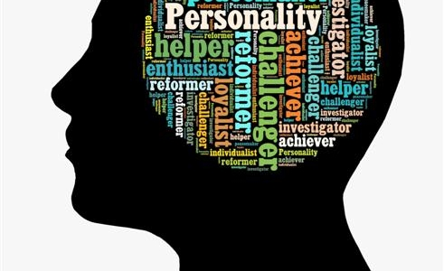
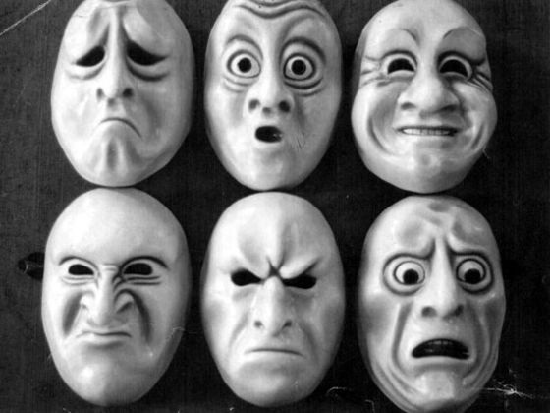
Short Summary
Locus of Control is can be an effective measure of how people search for information in hierarchical data
Research goal is to find the minimum set of individual differences
Cognitive Trait:
  Largely immutable (but can be primed)
Cognitive State:
  ??

Slide 46


Effects of Cognitive States
Lane Harrison
Evan Peck

Slide 47
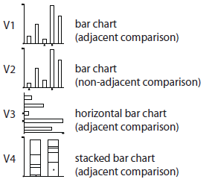
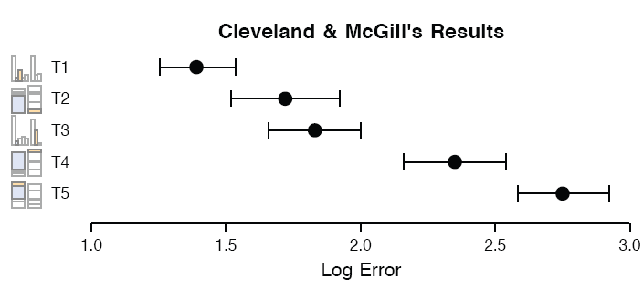
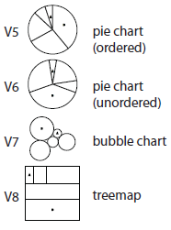
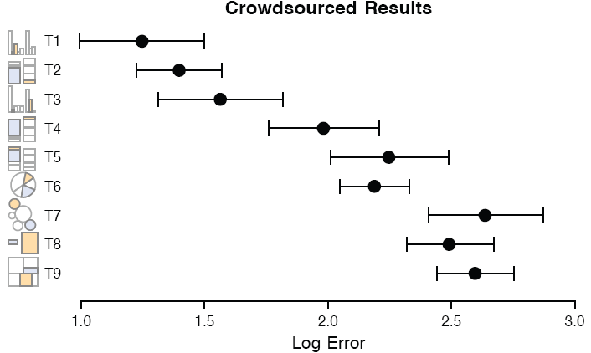
Visual Judgment
Cleveland and McGill study on perception of angle vs. position in statistical charts. (1984)
Heer and Bostock extension to using Amazon’s Mechanical Turk (2010)

Slide 48
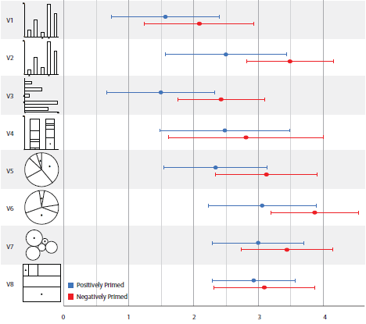
Priming Emotion on Visual Judgment
R. Chang et al., Influencing Visual Judgment Through Affective Priming, CHI 2013

Slide 49
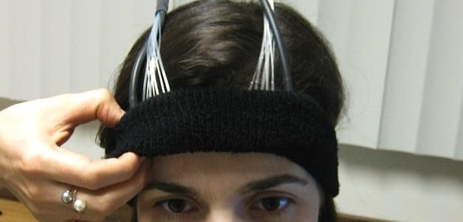
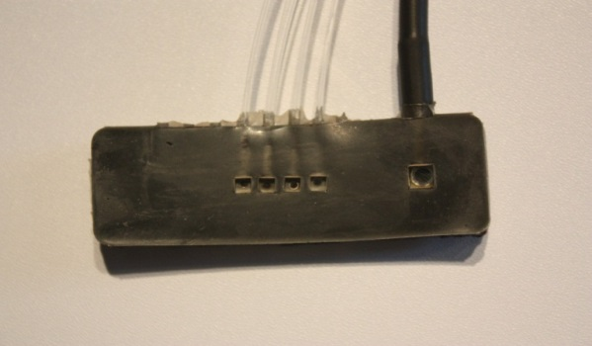

Using Brain Sensing (fNIRS)
Functional Near-Infrared Spectroscopy
a lightweight brain sensing technique
measures mental demand (working memory)
3-back test
R. Chang et al., Using fNIRS Brain Sensing to Evaluate Information Visualization Interfaces. CHI 2013.

Slide 50


fNIRS with Visualizations
Bar or Pie?
  Cleveland & McGill results says pies are terrible
  Designers (e.g. Tufte) recommends that no one should use pies
Yet it remains one of the more popular designs… Why?

Slide 51

Your Brain on Bar graphs and Pie Charts
NASA-TLX on participants using Pie and Bar
  2 equal sized groups: some people find pie to be easier to use, some find bar to be easier to use
The use of fNIRS (with 3-back) confirms this:

Slide 52


User Modeling meets
Interactive Big Data Visualization
Stonebraker
Leilani Battle

Slide 53


Problem Statement
Problem: Data is too big to fit into the memory of the personal computer
  Note: Ignoring various database technologies (OLAP, Column-Store, No-SQL, Array-Based, etc)
Goal: Guarantee a result set to a user’s query within X number of seconds.
  Based on HCI research, the upperbound for X is 10 seconds
  Ideally, we would like to get it down to 1 second or less
Method: trading accuracy and storage (caching), optimize on minimizing latency (user wait time).

Slide 54


Interactive Exploration of Big Data
Visualization on a
Commodity Hardware
Large Data in a
Data Warehouse

Slide 55




Our Approach:
Predictive Pre-Fetching
Stonebraker
Leilani Battle
In collaboration with MIT (Leilani Battle, Mike Stonebraker)
ForeCache: Three-tiered architecture
  Thin client (visualization)
  Backend (array-based database)
  Fat middleware
    Prediction Algorithms
    Storage Architecture
    Cache Management (Eviction Strategies)
R. Chang et al., Dynamic Prefetching of Data Tiles for Interactive Visualization. SIGMOD 2016

Slide 56

Predicting User Actions
Sensemaking
Two-tiered approach using Markov
First tier: predict what “phase” of analysis the user is in
Second tier: given a “phase”, use phase-specific models to predict user’s next actions
Navigation
Foraging
Card-Pirolli Sensemaking Loop

Slide 57

Predictions
Two-tiered approach using Markov
First tier: predict what “phase” of analysis the user is in
Second tier: given a “phase”, use phase-specific models to predict user’s next actions
  momentum, access-frequency, statistical distrib, SIFT (image-based), etc.
Navigation Phase
?

Slide 58
Prediction Accuracy
Comparison against existing techniques
“Random guessing” accuracy is: k/n
  n: number of possible user actions
  k: number of allowed “guesses”

Slide 59


Summary: Theory Into Practice
Visual analytics tasks are challenging and requires human+computer collaboration
To make effective visualizations, we therefore need to understand how humans work
We present preliminary work on user modeling:
  Bayesian Reasoning and Spatial ability
  LOC and hierarchy exploration
  Priming and fNIRS
When coupled with computation, these techniques can lead to new system architecture:
  Not just to increase usability
  But also to improve system efficiency

Slide 61


Questions? remco@cs.tufts.edu

Slide 62
Backup Slides

Slide 63


1. Richard Heuer. Psychology of Intelligence Analysis, 1999. (pp 53-57)

Slide 64

Metric Learning
Finding the weights to a linear distance function
Instead of a user manually give the weights, can we learn them implicitly through their interactions?

Slide 65




Metric Learning
In a projection space (e.g., MDS), the user directly moves points on the 2D plane that don’t “look right”…
Until the expert is happy (or the visualization can not be improved further)
The system learns the weights (importance) of each of the original k dimensions
Short Video (play)

Slide 66


Dis-Function
Optimization:
Brown et al., Find Distance Function, Hide Model Inference. IEEE VAST Poster 2011
Brown et al., Dis-function: Learning Distance Functions Interactively. IEEE VAST 2012.

Slide 67

Results
Used the “Wine” dataset (13 dimensions, 3 clusters)
  Assume a linear (sum of squares) distance function
Added 10 extra dimensions, and filled them with random values
Blue: original data dimension
Red: randomly added dimensions
X-axis: dimension number
Y-axis: final weights of the distance function
Shows that the user doesn’t care about many of the features (in this case, only 5 dimensions matter)
Reveals the user’s knowledge about the data (often in a way that the user isn’t even aware)

