Slide 1
Human Data Interaction:
Data Organization, Computation, and Visualization
Remco Chang
Associate Professor
Computer Science, Tufts University

Slide 2
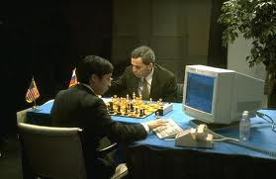

Human + Computer
Human vs. Artificial Intelligence
Garry Kasparov vs. Deep Blue (1997)
  Computer takes a “brute force” approach without analysis
  “As for how many moves ahead a grandmaster sees,” Kasparov concludes: “Just one, the best one”
Artificial vs. Augmented Intelligence Hydra vs. Cyborgs (2005)
  Grandmaster + 1 chess program > Hydra (equiv. of Deep Blue)
  Amateur + 3 chess programs > Grandmaster + 1 chess program1
1. http://www.collisiondetection.net/mt/archives/2010/02/why_cyborgs_are.php

Slide 3
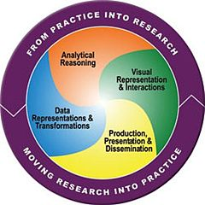
Visual Analytics = Human + Computer
Visual analytics is “the science of analytical reasoning facilitated by visual interactive interfaces.” ¹
By definition, it is a collaboration between human and computer to solve problems.
1. Thomas and Cook, “Illuminating the Path”, 2005.

Slide 4

Financial Fraud – A Case for Visual Analytics
Financial Institutions like Bank of America have legal responsibilities to report all suspicious wire transaction activities
  money laundering, supporting terrorist activities, etc.
Data size: approximately 200,000 transactions per day (73 million transactions per year)

Slide 5

Financial Fraud – A Case Study for Visual Analytics
Problems:
  Automated approach can only detect known patterns
  Bad guys are smart: patterns are constantly changing
Previous methods:
  10 analysts monitoring and analyzing all transactions
  Using SQL queries and spreadsheet-like interfaces
  Limited time scale (2 weeks)

Slide 6
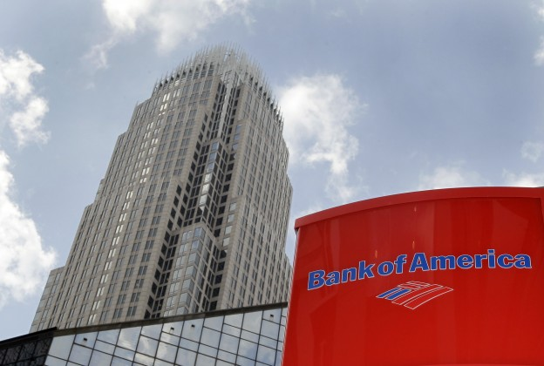
WireVis: Financial Fraud Analysis
In collaboration with Bank of America
  Visualizes 7 million transactions over 1 year
A great problem for visual analytics:
  Ill-defined problem (how does one define fraud?)
  Limited or no training data (patterns keep changing)
  Requires human judgment in the end (involves law enforcement agencies)
R. Chang et al., Scalable and interactive visual analysis of financial wire transactions for fraud detection. Information Visualization,2008.
R. Chang et al., Wirevis: Visualization of categorical, time-varying data from financial transactions. IEEE VAST, 2007.

Slide 7
WireVis: A Visual Analytics Approach
Search by Example (Find Similar Accounts)
Heatmap View
(Accounts to Keywords Relationship)
Keyword Network
(Keyword Relationships)
Multiple Temporal View
(Relationships over Time)

Slide 8

Evaluation
Challenging – lack of ground truth
Two types of evaluations:
  Grounded Evaluation: real analysts, real data
    Find transactions that existing techniques can find
    Find new transactions that appear suspicious
  Controlled Evaluation: real analysts, synthetic data
    Find all injected threat scenarios
Adoption and Deployment

Slide 9





Interactive Visualization Systems
Jordan Crouser
Political Simulation
  Agent-based analysis
Bridge Maintenance
  Exploring inspection reports
Biomechanical Motion
  Interactive motion comparison
Interactive Metric Learning
  Dis-Function: high-dimensional metric learning
High-D Data Exploration
  iPCA: Interactive PCA
R. Chang et al., Two Visualization Tools for Analysis of Agent-Based Simulations in Political Science. IEEE CG&A, 2012

Slide 10



Interactive Visualization Systems
Political Simulation
  Agent-based analysis
Bridge Maintenance
  Exploring inspection reports
Biomechanical Motion
  Interactive motion comparison
Interactive Metric Learning
  Dis-Function: high-dimensional metric learning
High-D Data Exploration
  iPCA: Interactive PCA
R. Chang et al., An Interactive Visual Analytics System for Bridge Management, Journal of Computer Graphics Forum, 2010.

Slide 11



Interactive Visualization Systems
Political Simulation
  Agent-based analysis
Bridge Maintenance
  Exploring inspection reports
Biomechanical Motion
  Interactive motion comparison
Interactive Metric Learning
  Dis-Function: high-dimensional metric learning
High-D Data Exploration
  iPCA: Interactive PCA
R. Chang et al., Interactive Coordinated Multiple-View Visualization of Biomechanical Motion Data, IEEE Vis (TVCG) 2009.

Slide 12

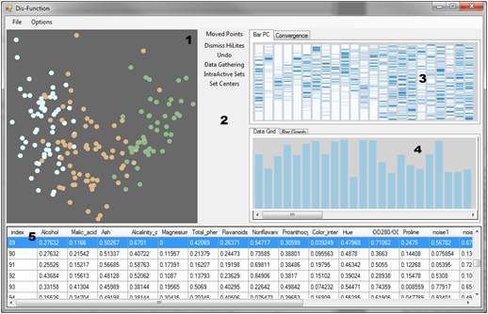
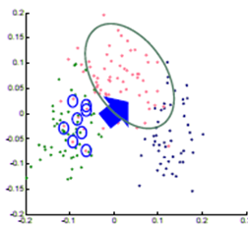

Interactive Visualization Systems
Eli Brown
Political Simulation
  Agent-based analysis
Bridge Maintenance
  Exploring inspection reports
Biomechanical Motion
  Interactive motion comparison
Interactive Metric Learning
  Dis-Function: high-dimensional metric learning
High-D Data Exploration
  iPCA: Interactive PCA
R. Chang et al., Dis-function: Learning Distance Functions Interactively, IEEE VAST 2011.

Slide 13
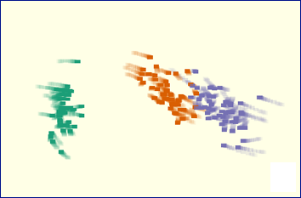
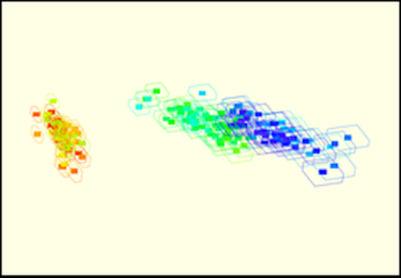
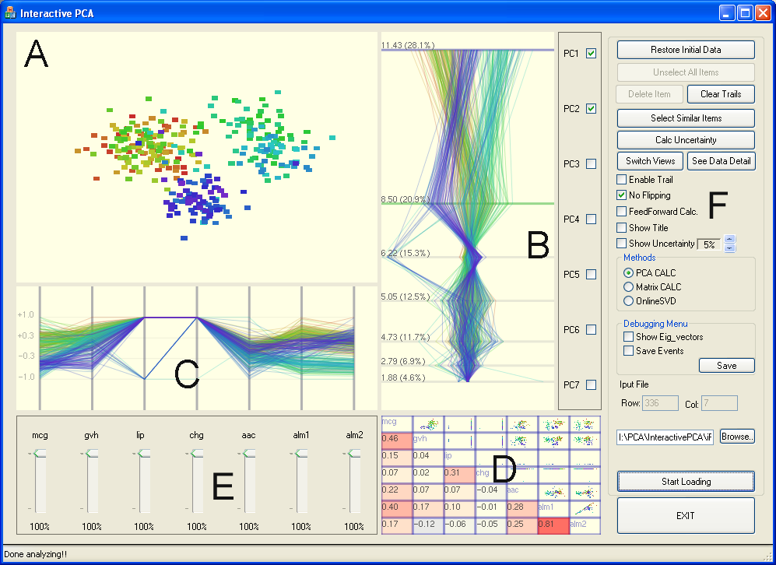
Interactive Visualization Systems
Political Simulation
  Agent-based analysis
Bridge Maintenance
  Exploring inspection reports
Biomechanical Motion
  Interactive motion comparison
Interactive Metric Learning
  Dis-Function: high-dimensional metric learning
High-D Data Exploration
  iPCA: Interactive PCA
R. Chang et al., iPCA: An Interactive System for PCA-based Visual Analytics, EuroVis 2009.

Slide 14
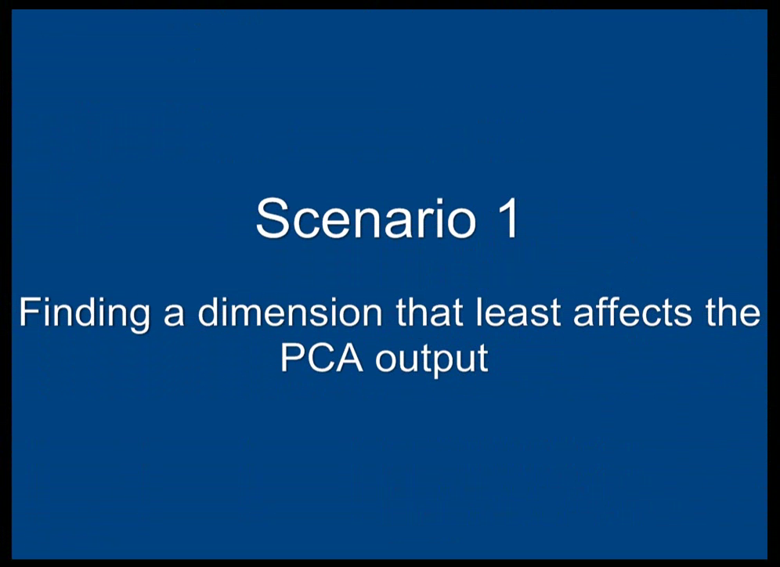

Slide 15
Lesson Learned
“The computer is incredibly fast, accurate, and stupid. Man is unbelievably slow, inaccurate, and brilliant. The marriage of the two is a force beyond calculation.”
-Leo Cherne, 1977
(often attributed to Albert Einstein)

Slide 16
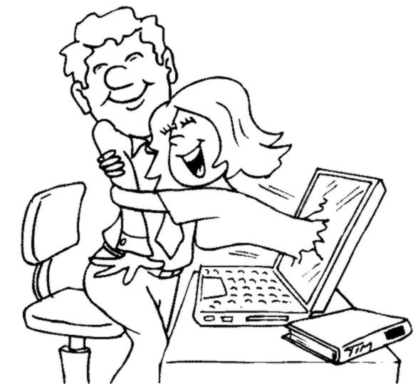
Which Marriage?

Slide 17
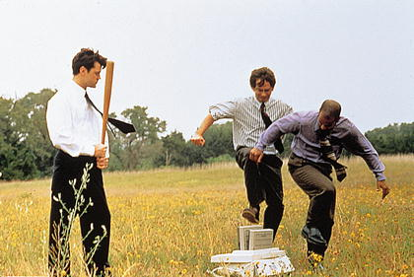
Which Marriage?

Slide 18
VALT
Visual Analytics Laboratory at Tufts
“Bring Data and Analysis to the People”
Understand how people interact with data
Develop tools and systems that can scale in data size, data complexity, and user’s abilities
Enable effective communication between computer and user in data analysis

Slide 19


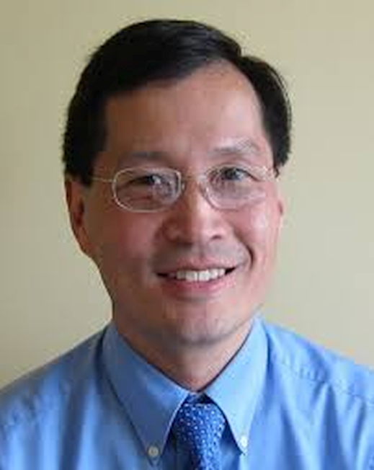
Understanding Users with Data:
A Case Study of Bayesian Reasoning
Alvitta Ottley
(PhD 2016)
Anzu Hakone (MS 2017)
Paul Han
R. Chang et al. Improving Bayesian Reasoning: The Effects of Phrasing, Visualization, and Spatial Ability. InfoVis 2015
R. Chang et al. PROACT: Iterative design of a patient-centered visualization for effective prostate cancer health risk communication, InfoVis 2016

Slide 20
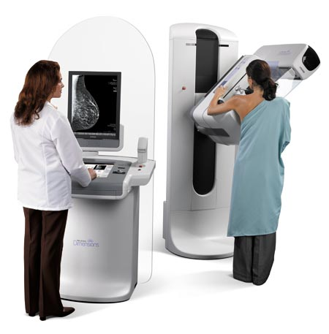
The probability of breast cancer is 1% for women at age forty who participate in routine screening. If a woman has breast cancer, the probability is 80% that she will get a positive mammography. If a woman does not have breast cancer, the probability is 9.3% that she will also get a positive mammography.
If a woman at age 40 is tested positive, what are her chances of actually having breast cancer?

Slide 21
The chance of actually having breast cancer given a positive mammogram:
7.9%
Answer: Bayes’ theorem states that P(A|B) = P(B|A) * P(A) / P(B). In this case, A is having breast cancer, B is testing positive with mammography. P(A|B) is the probability of a person having breast cancer given that the person is tested positive with mammography. P(B|A) is given as 80%, or 0.8, P(A) is given as 1%, or 0.01. P(B) is not explicitly stated, but can be computed as P(B,A)+P(B,˜A), or the probability of testing positive and the patient having cancer plus the probability of testing positive and the patient not having cancer. Since P(B,A) is equal 0.8*0.01 = 0.008, and P(B,˜A) is 0.093 * (1-0.01) = 0.09207, P(B) can be computed as 0.008+0.09207 = 0.1007. Finally, P(A|B) is therefore 0.8 * 0.01 / 0.1007, which is equal to 0.07944.

Slide 22
95 out of 100 doctors¹
estimate this probability
to be:
80%
1. Eddy, David M. "Probabilistic reasoning in clinical medicine: Problems and opportunities." (1982).

Slide 23
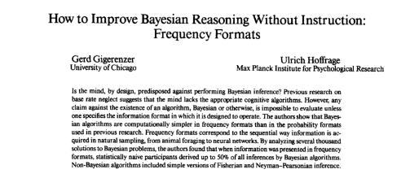
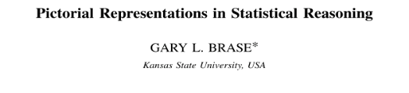
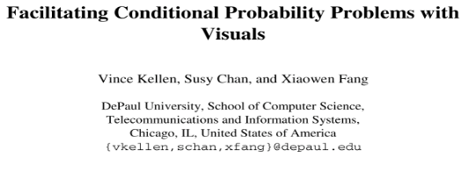
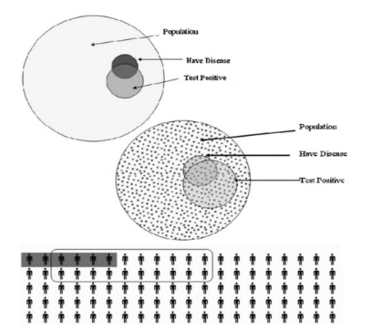
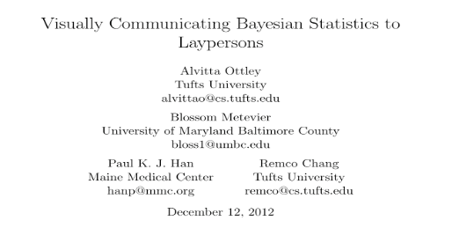
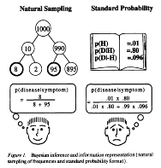
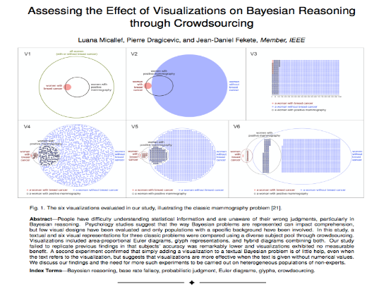
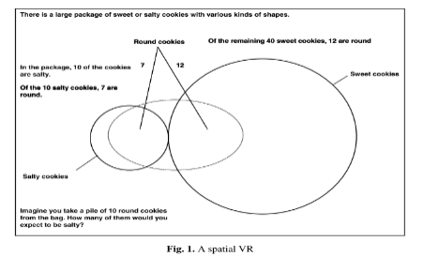
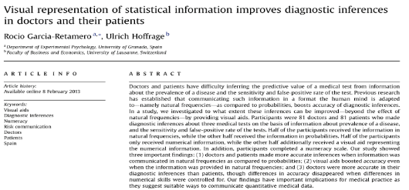
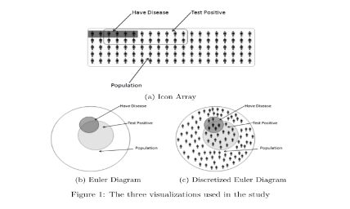
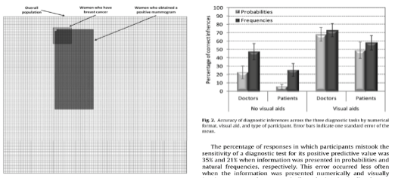
VIS Community

Slide 24


The Problem?
“
”
“
”
“
”
“
...”
They disagree.
* Reported accuracies range from 6% to 62%

Slide 25
Experiments
Need to understand how the wording of the problem impacts accuracy.
Need to understand how different reasoning aides impact accuracy.
Specifically:
does adding visualization to the text help?

Slide 26
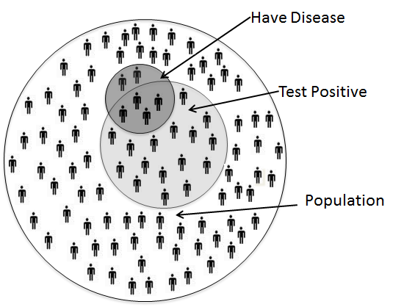
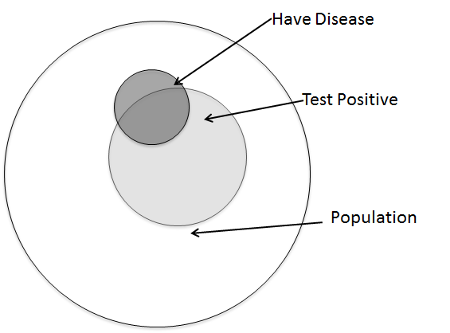
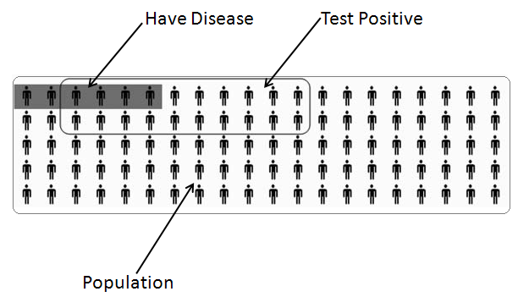
Visualization Aids
Ottley et al., Visually Communicating Bayesian Statistics to Laypersons. Tufts CS Tech Report, 2012.

Slide 27
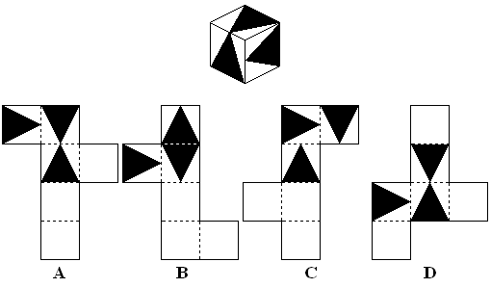
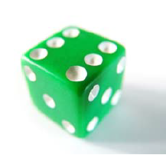

Experimental Design
6 conditions
377 participants
Between subjects experiment
Also measured spatial ability, numeracy
Answer: (A)
A dice has sides of 1.2cm. What is its volume in cubic mm?
Notes:
Describe spatial ability

Slide 28
Initial Results

Slide 29
Separated by Spatial Ability
Low spatial-ability
High spatial-ability

Slide 30
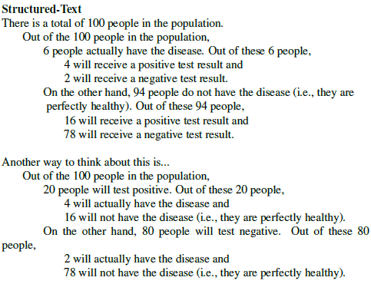
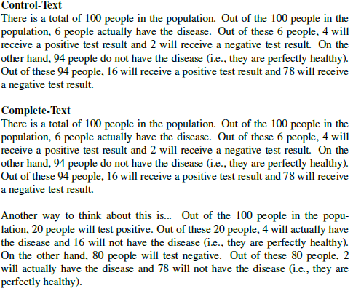
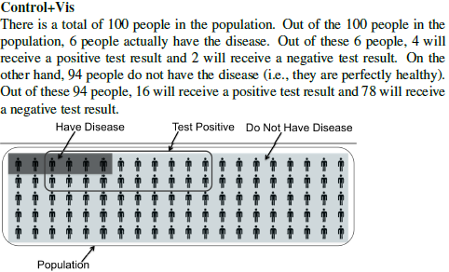
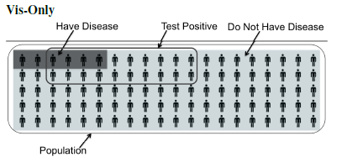
Conditions

Slide 31
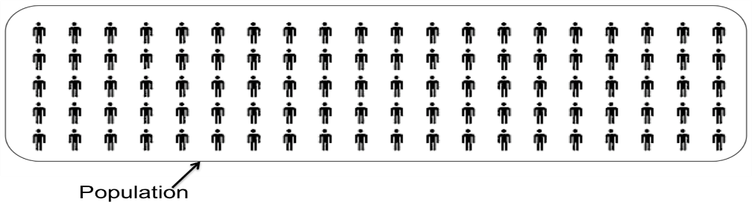
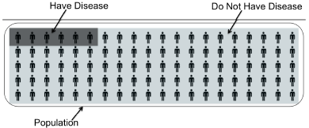
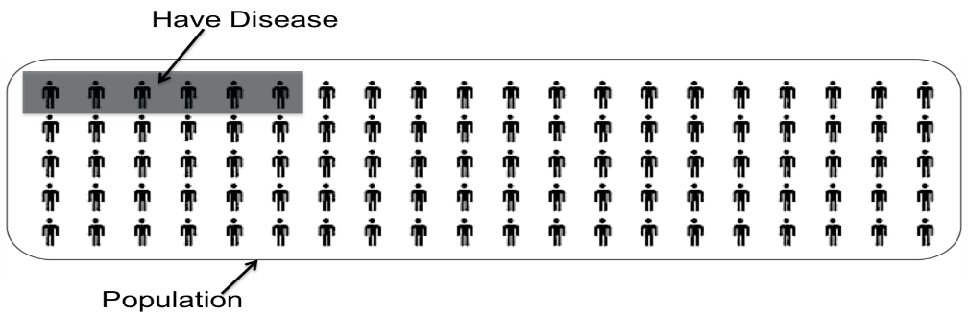
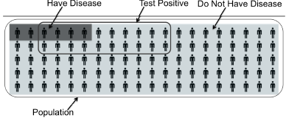
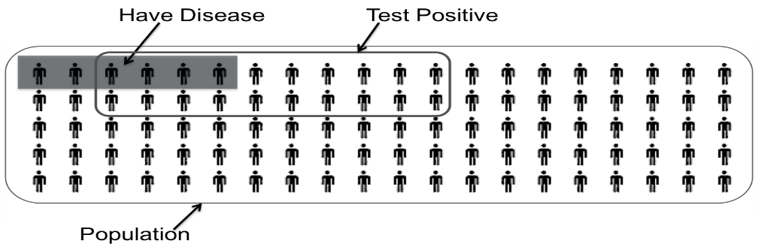
Storyboard (Storytelling Visualization)

Slide 32
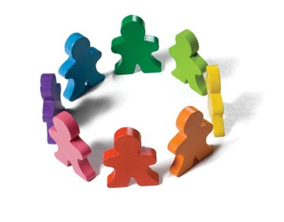

Short Summary
Individual differences matter
Not all problems can be solved with “better tools”
  We need to know what users need what support
Solving these problems (e.g. Bayesian Reasoning) can have a significant impact in a wide-range of applications:
  Health care, intelligence analysis, business decisions, etc.

Slide 33
Automated Learning from User Interactions
Alvitta Ottley
(PhD 2016)
Eli Brown
(PhD 2015)
R Chang et al., Finding Waldo: Learning about Users from their Interactions. IEEE VAST 2014.

Slide 34
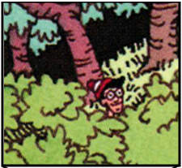
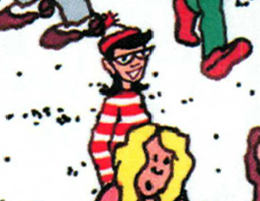
Finding Waldo: Learning From the Users’ Interactions
Google-Maps style interface
  Left, Right, Up, Down, Zoom In, Zoom Out, Found
R Chang et al., Finding Waldo: Learning about Users from their Interactions. IEEE VAST 2014.

Slide 35
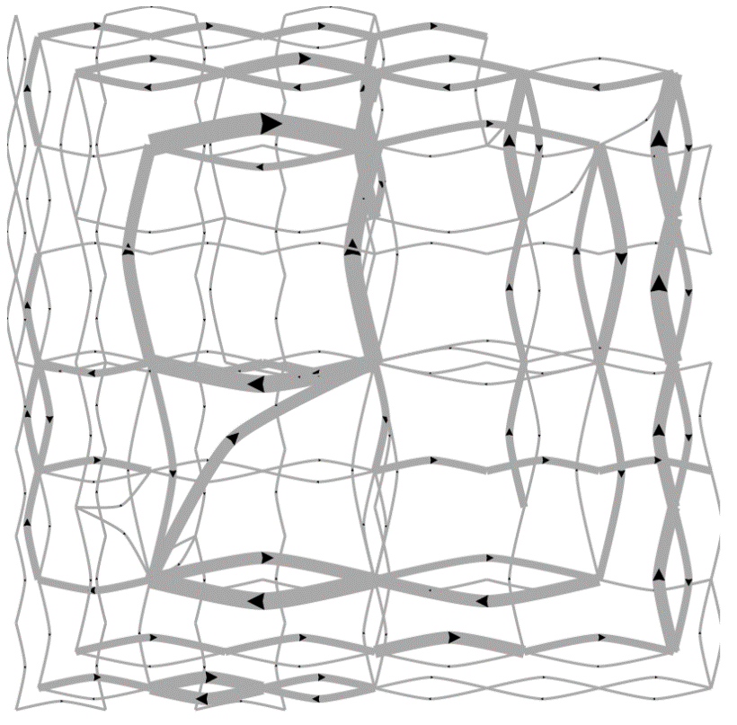
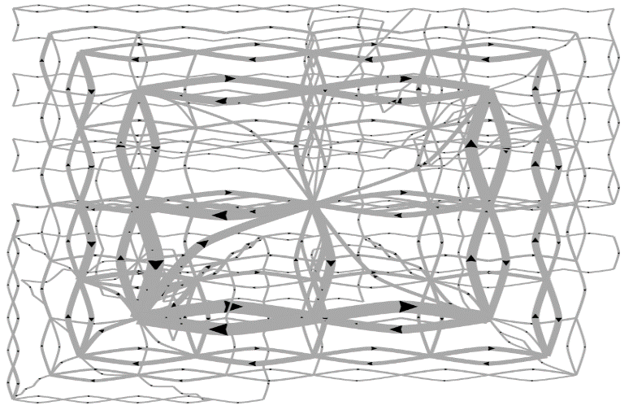
Pilot Visualization:
Completion Time
Fast completion time
Slow completion time

Slide 36
Post-hoc Analysis Results
Mean Split (50% Fast, 50% Slow)
Data Representation | Classification Accuracy | Method
State Space | 72% | SVM
Edge Space | 63% | SVM
Action Sequence | 77% | Decision Tree
Mouse Event | 62% | SVM
Fast vs. Slow Split (Mean+0.5σ=Fast, Mean-0.5σ=Slow)
Data Representation | Classification Accuracy | Method
State Space | 96% | SVM
Edge Space | 83% | SVM
Action Sequence | 79% | Decision Tree
Mouse Event | 79% | SVM

Slide 37
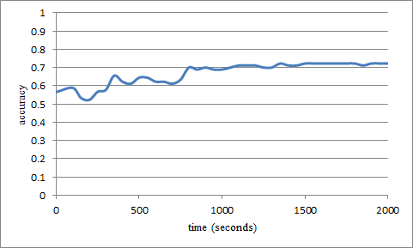
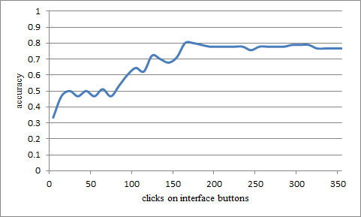
“Real-Time” Prediction
(Limited Time Observation)
State-Based
Linear SVM
Accuracy: ~70%
Interaction Sequences
N-Gram + Decision Tree
Accuracy: ~80%

Slide 38
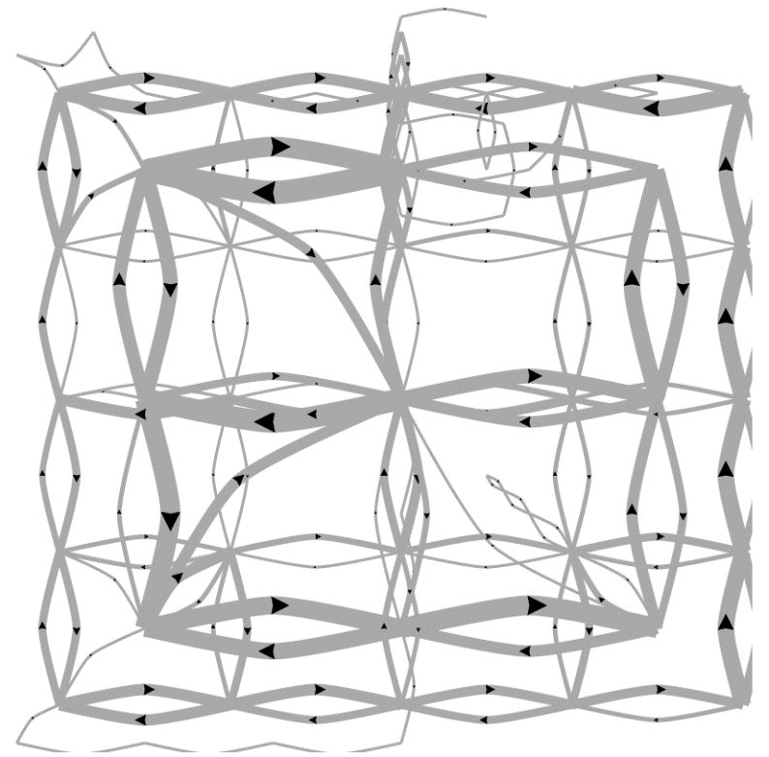
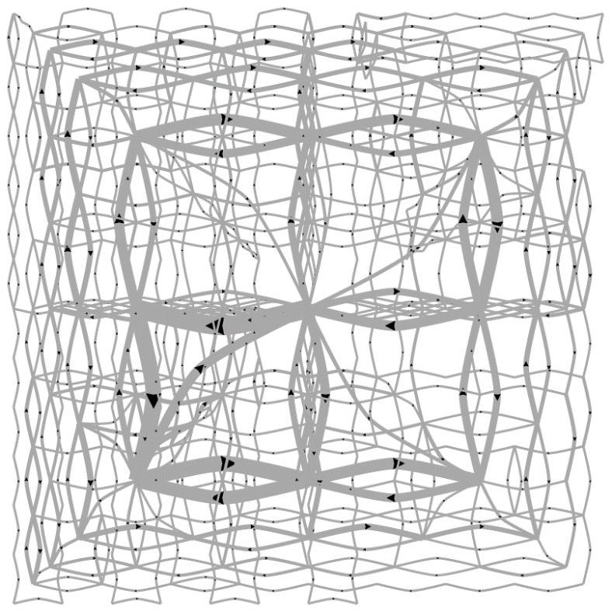
Predicting a User’s Personality
External Locus of Control
Internal Locus of Control
Ottley et al., How locus of control inﬂuences compatibility with visualization style. IEEE VAST , 2011.
Ottley et al., Understanding visualization by understanding individual users. IEEE CG&A, 2012.

Slide 39
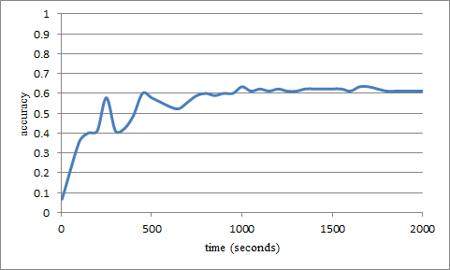
Predicting Users’ Personality Traits
Predicting user’s “Extraversion”
Linear SVM
Accuracy: ~60%
Noisy data, but can detect the users’ individual traits “Extraversion”, “Neuroticism”, and “Locus of Control” at ~60% accuracy by analyzing the user’s interactions alone.

Slide 40


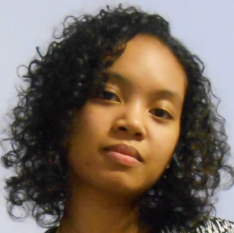
ForeCache: A System for Enabling Interactive Big Data Exploration
Marianne Procopio
Stonebraker
(MIT)
Leilani Battle
(PhD MIT 2017)
R. Chang et al., Dynamic Prefetching of Data Tiles for Interactive Visualization. SIGMOD 2016

Slide 41


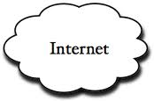
Interactive Exploration of Big Data
Visualization on a
Commodity Hardware
Large Data in a
Data Warehouse

Slide 42




Our Approach:
Predictive Pre-Fetching
In collaboration with MIT (Leilani Battle, Mike Stonebraker)
ForeCache: Three-tiered architecture
  Thin client (visualization)
  Backend (array-based database)
  Fat middleware
    Prediction Algorithms
    Storage Architecture
    Cache Management (Eviction Strategies)

Slide 43

Predicting User Actions
Sensemaking
Two-tiered approach using Markov
First tier: predict what “phase” of analysis the user is in
Second tier: given a “phase”, use phase-specific models to predict user’s next actions
Navigation
Foraging
Card-Pirolli Sensemaking Loop

Slide 44

Predictions
Two-tiered approach using Markov
First tier: predict what “phase” of analysis the user is in
Second tier: given a “phase”, use phase-specific models to predict user’s next actions
  momentum, access-frequency, statistical distrib, SIFT (image-based), etc.
Navigation Phase
?

Slide 45
Prediction Accuracy
Comparison against existing techniques
“Random guessing” accuracy is: k/n
  n: number of possible user actions
  k: number of allowed “guesses”

Slide 46







DARPA Data-Driven Discovery (D3M):
Data Analysis for the Masses
Shah Humayoun
Dylan Cashman
Abby Mosca
Mike Gleicher
(Wisconsin)
John Stasko
(GT)
Alex Endert
(GT)

Slide 47


“Masses”
Who are they?

Slide 48


“Masses”
What do they want to accomplish?

Slide 49


“Masses”
What do they need help with?

Slide 50


DARPA’s Ideal of the Project
Run regression
(sales-cost, year)
Linear? Logistic? Non-Linear?
“Masses”
Data Scientists
(Machine Learning Library)

Slide 51
Reality: Interviews with Companies
I want to improve profits next year!
??????
Everyday Users
Data Scientists
(Machine Learning Library)

Slide 52

Interviews with Companies
Everyday Users
Data Managers
Data Scientists
(Machine Learning Library)

Slide 53
Interviews with Companies
High Level Question
Formal Queries
Everyday Users
Data Managers
Data Scientists
(Machine Learning Library)

Slide 54
Interviews with Companies
High Level Question
Formal Queries
Everyday Users
Data Managers
Data Scientists
(Machine Learning Library)
Reports and Visualizations
Models and Metrics

Slide 55
Interviews with Companies
Active Learning
(Model Selection and Parameter Tuning)
User Feedback
High Level Question
Formal Queries
Everyday Users
Data Managers
Data Scientists
(Machine Learning Library)
Reports and Visualizations
Models and Metrics

Slide 56
Interviews with Companies
Active Learning
(Model Selection and Parameter Tuning)
User Feedback
High Level Question
Formal Queries
Everyday Users
Automated “Translator”
Data Managers
Data Scientists
(Machine Learning Library)
Reports and Visualizations
Models and Metrics

Slide 57
Ongoing Effort: An Example
How to let user specify a high-level question (and turn that into formal queries)?
Observation: open questions are messy.
Approach: Interactive Query Construction
I want to improve profits next year!
Everyday Users

Slide 58

Interactive Query Construction
I want to

Slide 59

Interactive Query Construction
I want to
Predict
Correlate
Detect Anomaly

Slide 60
Interactive Query Construction
I want to
Correlate

Slide 61
Interactive Query Construction
I want to
Correlate
the variable
with

Slide 62
Interactive Query Construction
K-Means
Predict
Linear Regression
Correlate
SVM
Detect Anomalies
Random Forest

Slide 63


Ongoing Effort
Query Formalization
Model and Metric Visualization

Slide 64


Summary: Theory Into Practice
Visual analytics tasks are challenging and requires human+computer collaboration
Happy marriage between user and computer requires better understanding of the user.
Bayesian Reasoning and Finding Waldo build profiles of users such that the ForeCache system can use for better prediction of a user’s future actions.
“Bring Data and Analysis to the People!”

Slide 65



Questions? remco@cs.tufts.edu

