Slide 1
Big Data Visualization:
A User-Centric Approach
Remco Chang
Associate Professor
Computer Science, Tufts University

Slide 2

Financial Fraud – A Case for Visual Analytics
Financial Institutions like Bank of America have legal responsibilities to report all suspicious wire transaction activities
  money laundering, supporting terrorist activities, etc
Data size: approximately 200,000 transactions per day (73 million transactions per year)

Slide 3

Financial Fraud – A Case Study for Visual Analytics
Problems:
  Automated approach can only detect known patterns
  Bad guys are smart: patterns are constantly changing
Previous methods:
  10 analysts monitoring and analyzing all transactions
  Using SQL queries and spreadsheet-like interfaces
  Limited time scale (2 weeks)

Slide 4

WireVis: Financial Fraud Analysis
In collaboration with Bank of America
  Visualizes 7 million transactions over 1 year
A great problem for visual analytics:
  Ill-defined problem (how does one define fraud?)
  Limited or no training data (patterns keep changing)
  Requires human judgment in the end (involves law enforcement agencies)
R. Chang et al., Scalable and interactive visual analysis of financial wire transactions for fraud detection. Information Visualization,2008.
R. Chang et al., Wirevis: Visualization of categorical, time-varying data from financial transactions. IEEE VAST, 2007.

Slide 5
WireVis: A Visual Analytics Approach
Search by Example (Find Similar Accounts)
Heatmap View
(Accounts to Keywords Relationship)
Keyword Network
(Keyword Relationships)
Multiple Temporal View
(Relationships over Time)

Slide 6

Evaluation
Challenging – lack of ground truth
Two types of evaluations:
  Grounded Evaluation: real analysts, real data
    Find transactions that existing techniques can find
    Find new transactions that appear suspicious
  Controlled Evaluation: real analysts, synthetic data
    Find all injected threat scenarios
Adoption and Deployment

Slide 7

Good Lessons Learned
Analyst behavior
  90% of time on Exploratory Data Analysis (EDA)
  10% on confirmation (CDA)
Big data analysis == fast hypothesis testing
High Interactivity is key
  Users can wait to find the exact answer

Slide 8





Interactive Visualization Systems
Jordan Crouser
Political Simulation
  Agent-based analysis
Bridge Maintenance
  Exploring inspection reports
Biomechanical Motion
  Interactive motion comparison
Interactive Metric Learning
  Dis-Function: learn a model from projection
High-D Data Exploration
  iPCA: Interactive PCA
R. Chang et al., Two Visualization Tools for Analysis of Agent-Based Simulations in Political Science. IEEE CG&A, 2012

Slide 9



Interactive Visualization Systems
Political Simulation
  Agent-based analysis
Bridge Maintenance
  Exploring inspection reports
Biomechanical Motion
  Interactive motion comparison
Interactive Metric Learning
  Dis-Function: learn a model from projection
High-D Data Exploration
  iPCA: Interactive PCA
R. Chang et al., An Interactive Visual Analytics System for Bridge Management, Journal of Computer Graphics Forum, 2010.

Slide 10



Interactive Visualization Systems
Political Simulation
  Agent-based analysis
Bridge Maintenance
  Exploring inspection reports
Biomechanical Motion
  Interactive motion comparison
Interactive Metric Learning
  Dis-Function: learn a model from projection
High-D Data Exploration
  iPCA: Interactive PCA
R. Chang et al., Interactive Coordinated Multiple-View Visualization of Biomechanical Motion Data, IEEE Vis (TVCG) 2009.

Slide 11

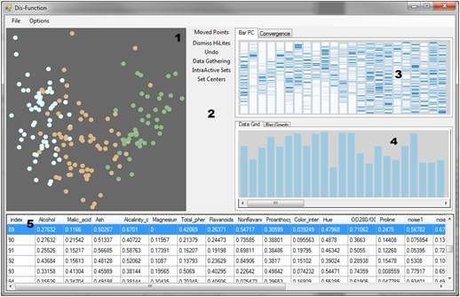
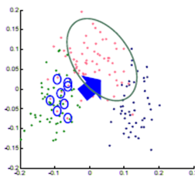

Interactive Visualization Systems
Eli Brown
Political Simulation
  Agent-based analysis
Bridge Maintenance
  Exploring inspection reports
Biomechanical Motion
  Interactive motion comparison
Interactive Metric Learning
  Dis-Function: learn a model from projection
High-D Data Exploration
  iPCA: Interactive PCA
R. Chang et al., Dis-Function: Learning Distance Functions Interactively, IEEE VAST 2011.

Slide 12

Metric Learning
Visualizing n-dimensional data in 2D
  Using multi-dimensional scaling (MDS), which requires a distance matrix
  Preserves (relative) distances in 2D as they are in m dimensions
Assume a weighted Euclidean distance function:
  Output: weights of each of the m dimensions
  Input: user’s interactions in 2D
    Direct manipulation of the points’ positions, signifying changes in distances between the points
    Moving points closer together -> increase similarity
    Moving points further part -> decrease similarity
Basis of our DARPA D3M project

Slide 13
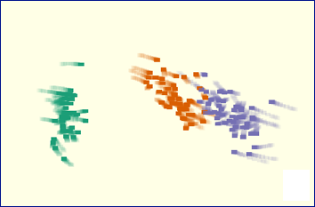
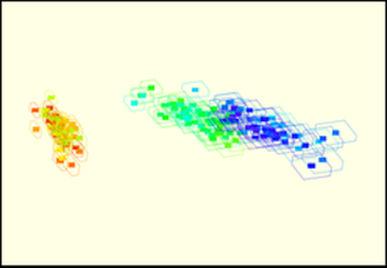
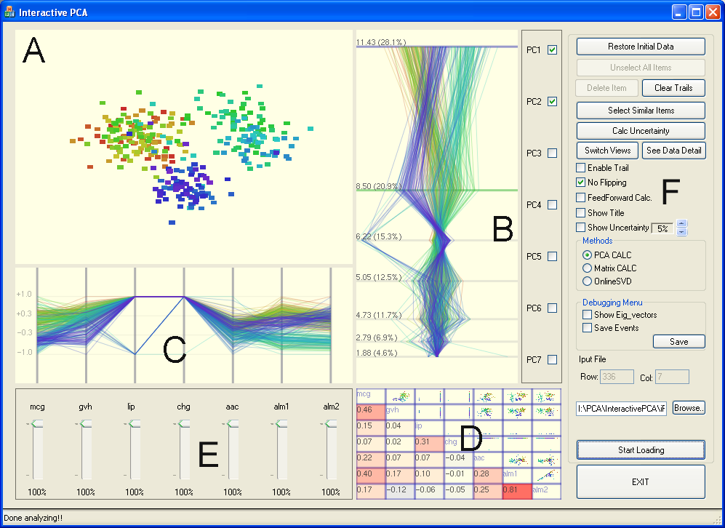
Interactive Visualization Systems
Political Simulation
  Agent-based analysis
Bridge Maintenance
  Exploring inspection reports
Biomechanical Motion
  Interactive motion comparison
Interactive Metric Learning
  Dis-Function: learn a model from projection
High-D Data Exploration
  iPCA: Interactive PCA
R. Chang et al., iPCA: An Interactive System for PCA-based Visual Analytics, EuroVis 2009.

Slide 14
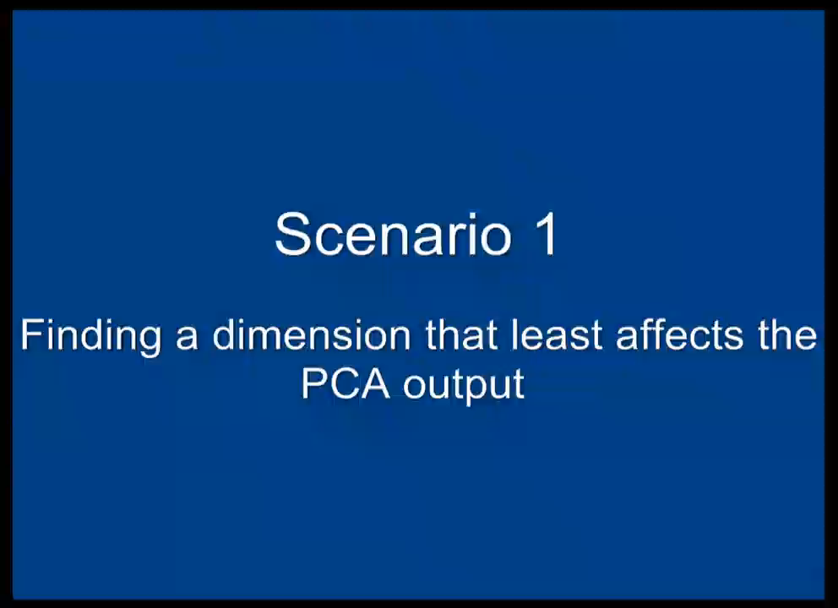

Slide 15
“Tough” Lessons Learned
Careful engineering is not enough… A new paradigm is necessary to support this type of interactive analysis.

Slide 16


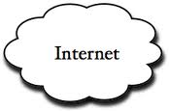
Problem Statement
Visualization on a
Commodity Hardware
Large Data in a
Data Warehouse

Slide 17
Related Work
(see the DSIA workshop proceeding)
Specialized Pull-based Databases
  Tableau, Spotfire
Pre-compiled Data Cubes
  Nanocube (Scheidegger), imMens** (Liu, Heer), Map-D** (Mostak)
Sampling
  BlinkDB (Agrawal, Berkeley), DICE (Kamat, Nandi), Ordering Guarantees (Kim et al.), Sample+Seek (Ding et al., MSR)
Pre-Fetching
  Xmdv (Doshi, Ward), Time-series (Chan, Hanrahan), Query prediction (Cetintemel, Zdonik)
Online Aggregation
  Online Aggregation (Hellerstein et al.), Ripple-Join (Haas and Hellerstein), WanderJoin (Li et al, Utah)
** GPU-accelerated

Slide 18
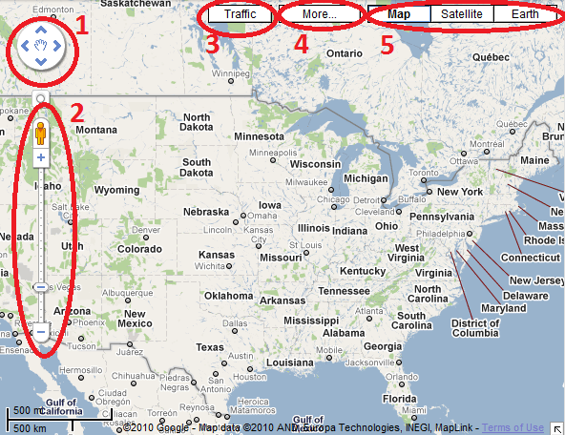
Two Observations:
The number of possible actions is finite and the user’s actions are “logical”.
Visualization itself is a bottleneck

Slide 19
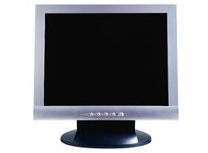

Two Observations:
The number of possible actions is finite and the user’s actions are “logical”.
Visualization itself is a bottleneck
1000 pixels
1000 pixels
User’s perception and cognition are further limitations
1000x1000 = 1 million

Slide 20

Analyzing a User’s Interactions
Alvitta Ottley
Eli Brown
Are the user interactions “logical”?
(If so, are the user’s interactions predictable?)

Slide 21
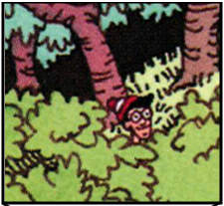
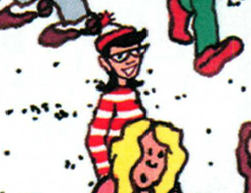
Finding Waldo: Can we Automate?
Google-Maps style interface
  Left, Right, Up, Down, Zoom In, Zoom Out, Found

Slide 22
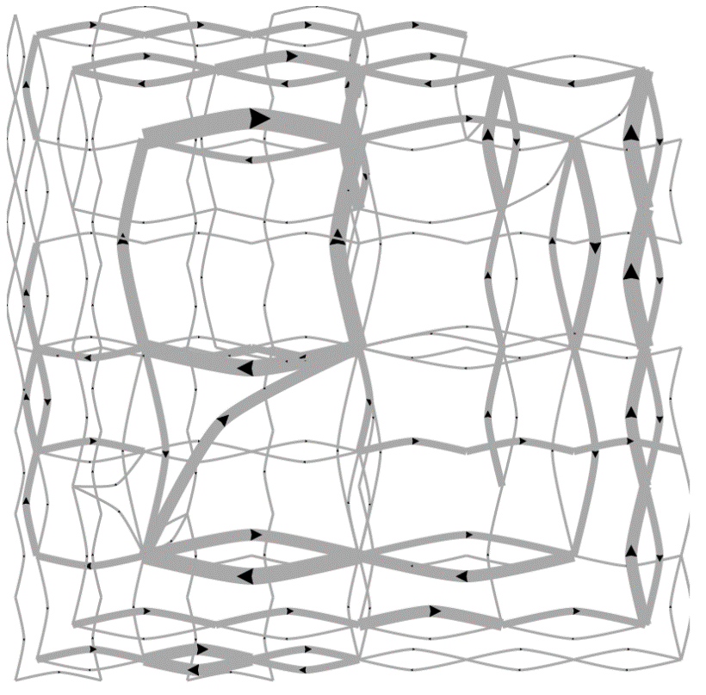
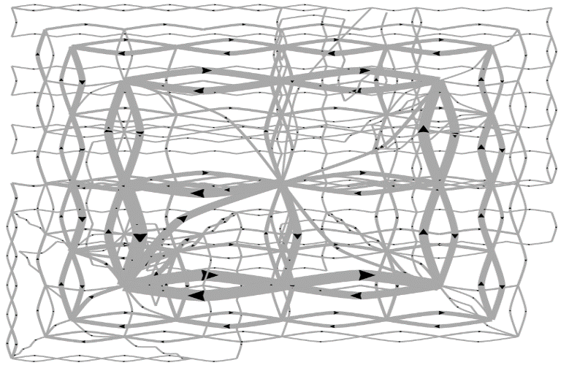
Pilot Visualization – Completion Time
Fast completion time
Slow completion time
Eli Brown et al., Finding Waldo: Learning about Users from their Interactions. IEEE VAST 2014.

Slide 23
Post-hoc Analysis Results
Mean Split (50% Fast, 50% Slow)
Data Representation | Classification Accuracy | Method
State Space | 72% | SVM
Edge Space | 63% | SVM
Action Sequence | 77% | Decision Tree
Mouse Event | 62% | SVM
Fast vs. Slow Split (Mean+0.5σ=Fast, Mean-0.5σ=Slow)
Data Representation | Classification Accuracy | Method
State Space | 96% | SVM
Edge Space | 83% | SVM
Action Sequence | 79% | Decision Tree
Mouse Event | 79% | SVM

Slide 24
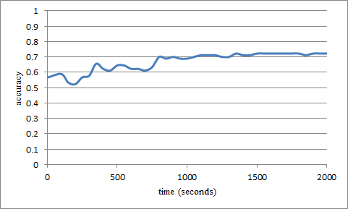
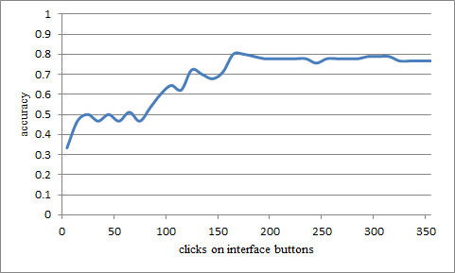
“Real-Time” Prediction
(Limited Time Observation)
State-Based
Linear SVM
Accuracy: ~70%
Interaction Sequences
N-Gram + Decision Tree
Accuracy: ~80%

Slide 25
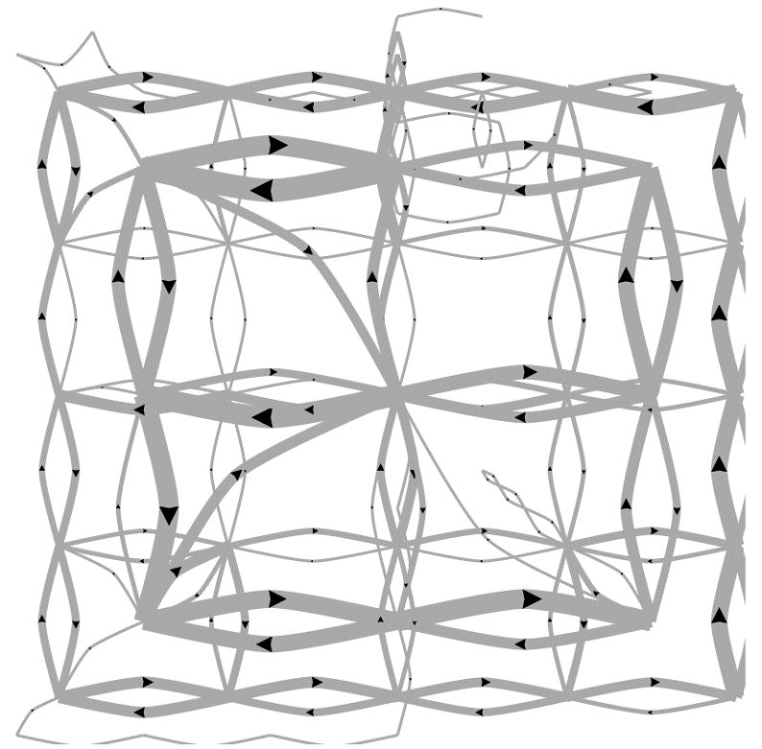
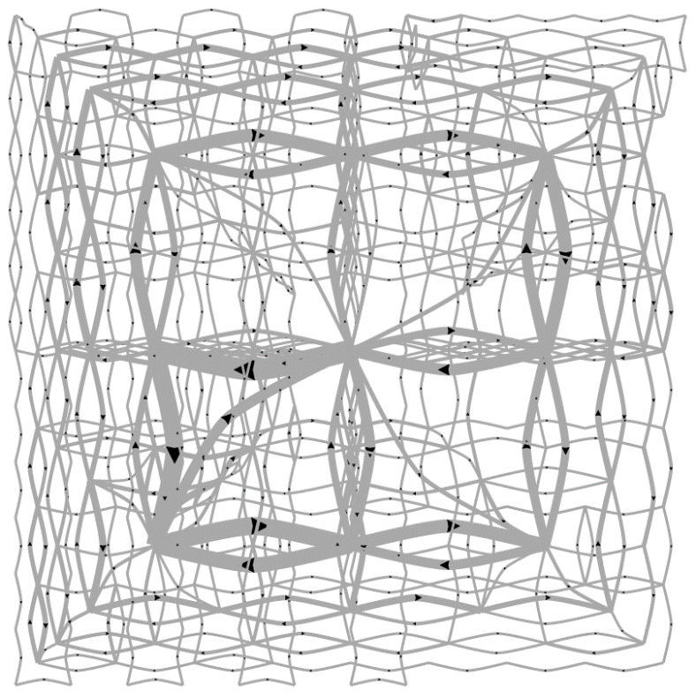
Predicting a User’s Personality
External Locus of Control
Internal Locus of Control
Ottley et al., How locus of control inﬂuences compatibility with visualization style. IEEE VAST , 2011.
Ottley et al., Understanding visualization by understanding individual users. IEEE CG&A, 2012.

Slide 26
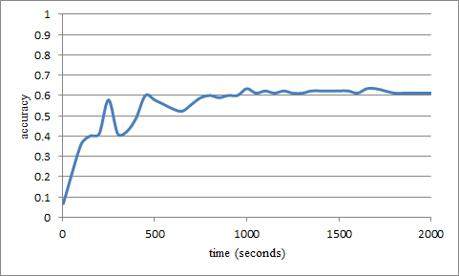
Predicting Users’ Personality Traits
Predicting user’s “Extraversion”
Linear SVM
Accuracy: ~60%
Noisy data, but can detect the users’ individual traits “Extraversion”, “Neuroticism”, and “Locus of Control” at ~60% accuracy by analyzing the user’s interactions alone.

Slide 27

Problem Statement
Problem: Data is too big to fit into the memory of the personal computer
  Note: Ignoring various database technologies (OLAP, Column-Store, No-SQL, Array-Based, etc)
Goal: Guarantee a result set to a user’s query within X number of seconds.
  Based on HCI research, the upperbound for X is 10 seconds
  Ideally, we would like to get it down to 1 second or less
Method: trading accuracy and storage (caching), optimize on minimizing latency (user wait time).

Slide 28


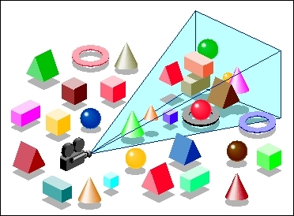
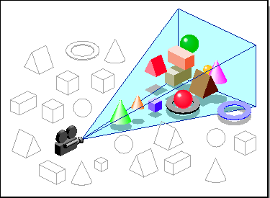
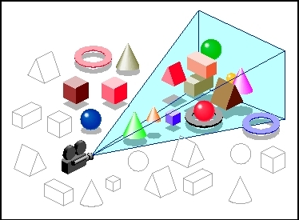

Our Approach:
Predictive Pre-Fetching
Stonebraker
Leilani Battle
In collaboration with MIT (Leilani Battle, Mike Stonebraker)
ForeCache: Three-tiered architecture
  Thin client (visualization)
  Backend (array-based database)
  Fat middleware
    Prediction Algorithms
    Storage Architecture
    Cache Management (Eviction Strategies)
R. Chang et al., Dynamic Prefetching of Data Tiles for Interactive Visualization. SIGMOD 2016

Slide 30
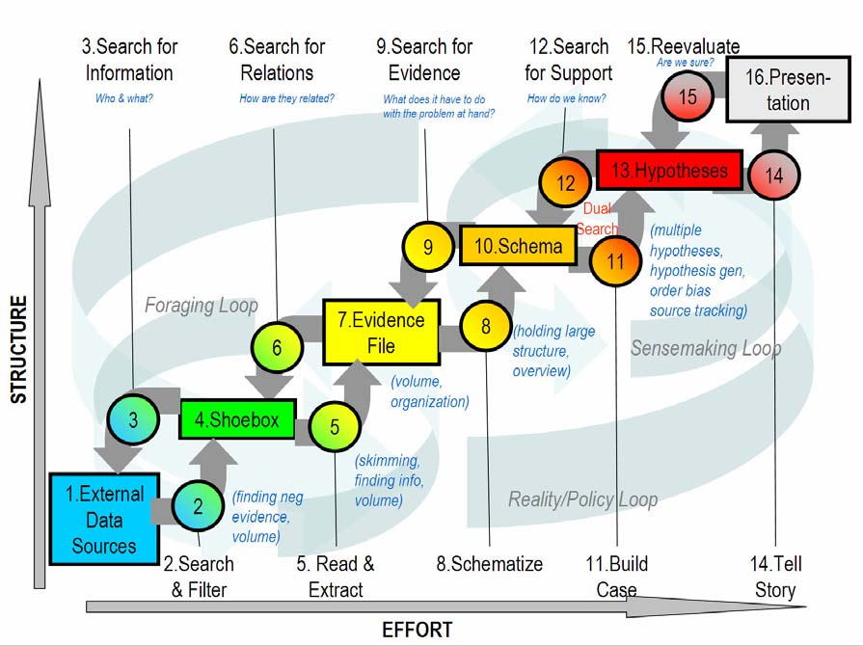
Predictions
Sensemaking
Two-tiered approach using Markov
First tier: predict what “phase” of analysis the user is in
Second tier: given a “phase”, use phase-specific models to predict user’s next actions
Navigation
Foraging
Card-Pirolli Sensemaking Loop

Slide 31
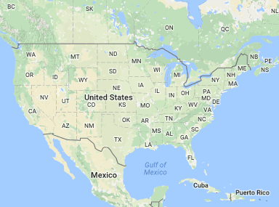
Predictions
Two-tiered approach using Markov
First tier: predict what “phase” of analysis the user is in
Second tier: given a “phase”, use phase-specific models to predict user’s next actions
  momentum, access-frequency, statistical distrib, SIFT (image-based), etc.
Navigation Phase
?

Slide 32
Predictions Accuracy
Comparison against existing techniques
“Random guessing” accuracy is: k/n
n: number of possible user actions
k: number of allowed “guesses”

Slide 33
Two Observations:
The number of possible actions is finite and the user’s actions are “logical”.
Visualization itself is a bottleneck
1000 pixels
1000 pixels
User’s perception and cognition are further limitations
1000x1000 = 1 million

Slide 34


Modeling the Perception of Data
Lane Harrison
Fumeng Yang
Can we quantitatively model a user’s ability to perceive information from a visualization?
R. Chang et al., Ranking Visualization Effectiveness Using Weber's Law. IEEE InfoVis 2014

Slide 35
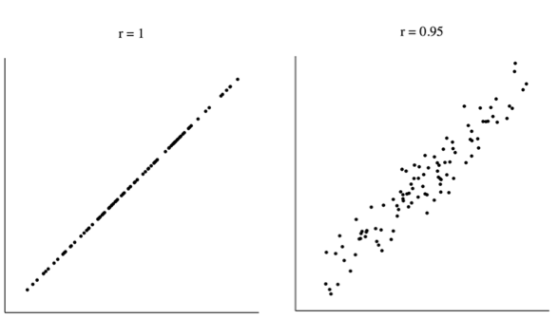

Slide 36
Δr = 0.05

Slide 37
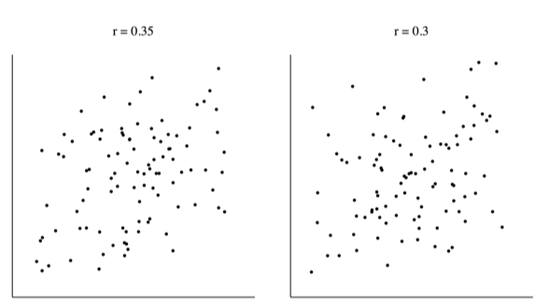

Slide 38
Δr = 0.05

Slide 39
Another Experiment
Imagine yourself in a dark room….

Slide 44
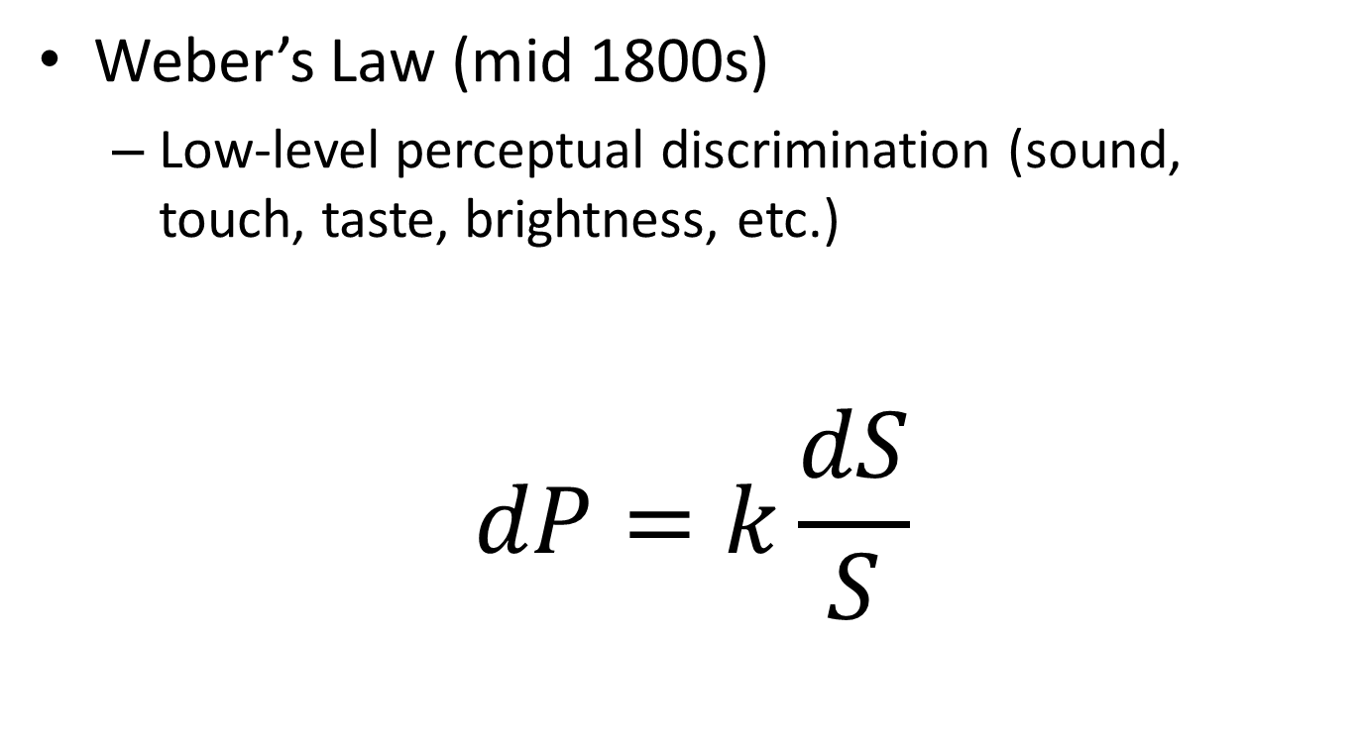
Perceptual Modeling
Weber’s Law (mid 1800s)
  Low-level perceptual discrimination (sound, touch, taste, brightness, etc.)
$$dP=k\frac{dS}{S}$$
Change in Intensity
Perceived Difference
Weber’s Constant
(via experiments)
Intensity of the Stimulus

Slide 45
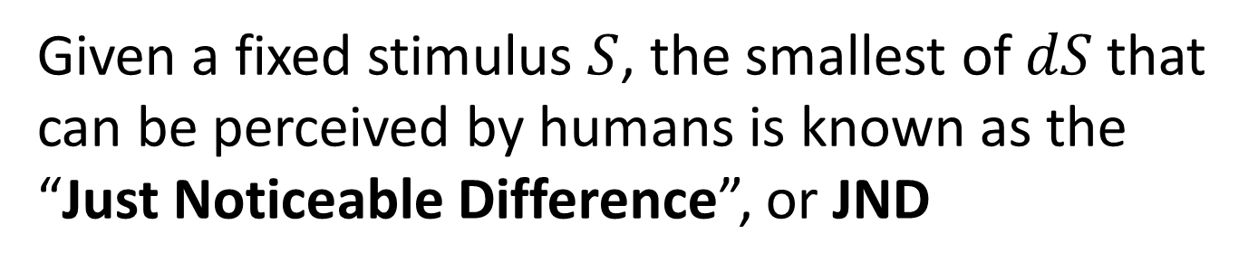
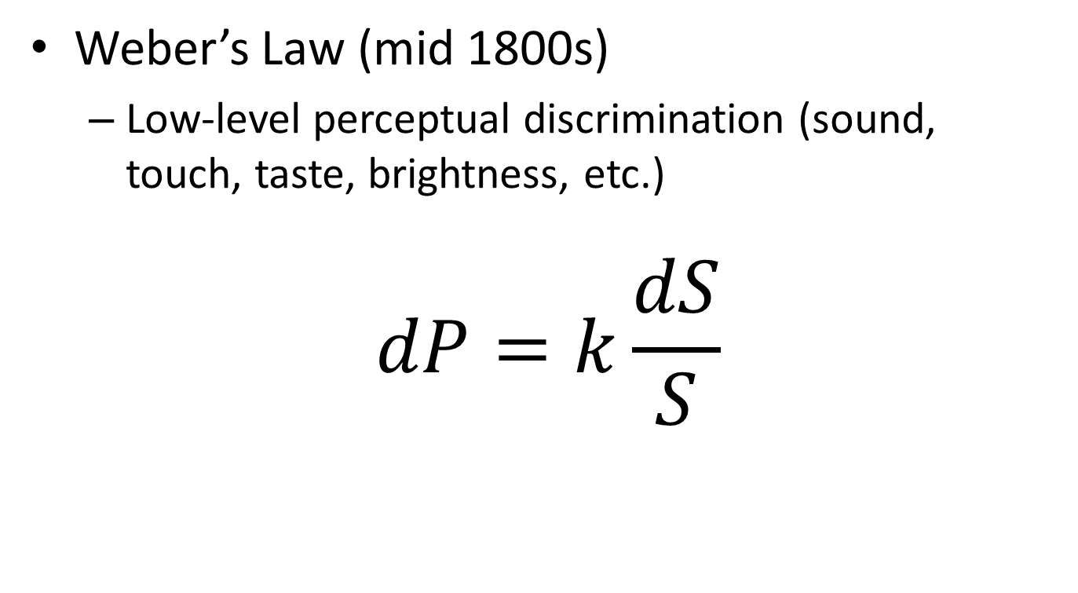
Perceptual Modeling
Weber’s Law (mid 1800s)
  Low-level perceptual discrimination (sound, touch, taste, brightness, etc.)
$$dP=k\frac{dS}{S}$$
Given a fixed stimulus $S$, the smallest of $dS$that
can be perceived by humans is known as the
“Just Noticeable Difference”, or JND

Slide 46
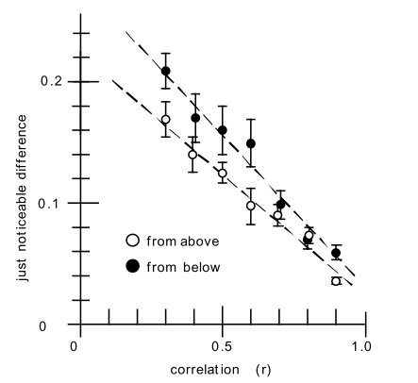
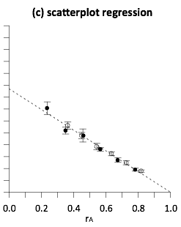
Perceptual Modeling
In 2010, Ron Rensink (UBC) found that the relationship between JND and correlation (r) is linear in scatterplots and follows the Weber’s Law

Slide 47
Our Question…
worse
If the perception of correlation in scatterplots follows Weber’s law…
better

Slide 48
worse
What does the perception of correlation in other charts look like?
better
Notes:
are some linear like scatterplots, or logarithmic, or exponential?

Slide 49
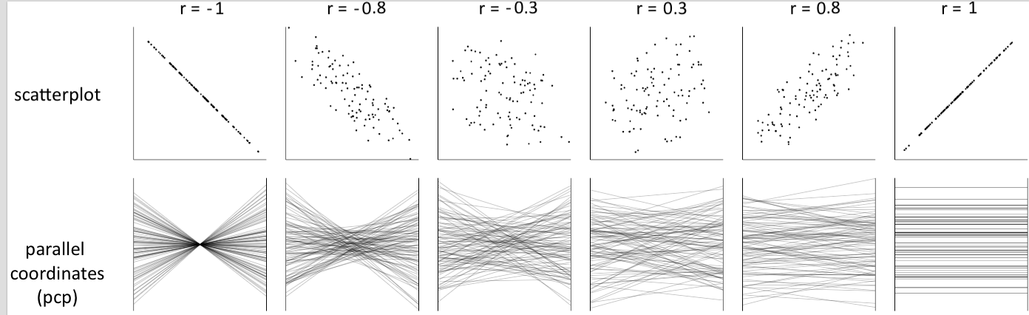
Notes:
both positively and negatively correlated data

Slide 50
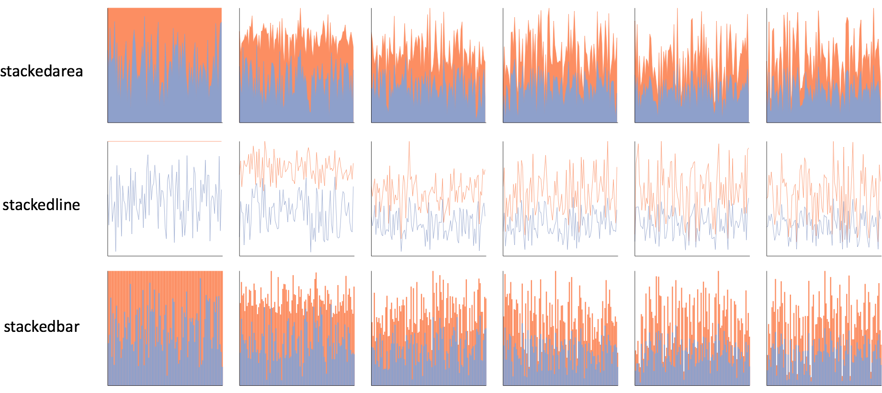
Notes:
one click away in excel

Slide 51
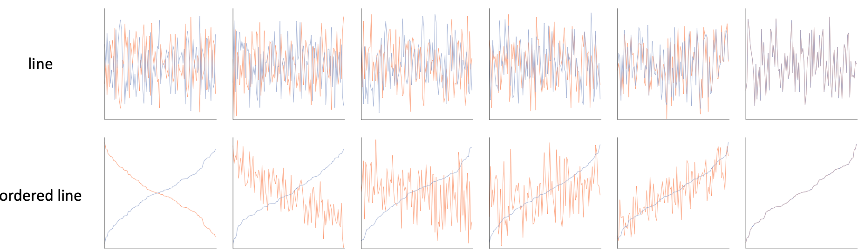

Slide 52
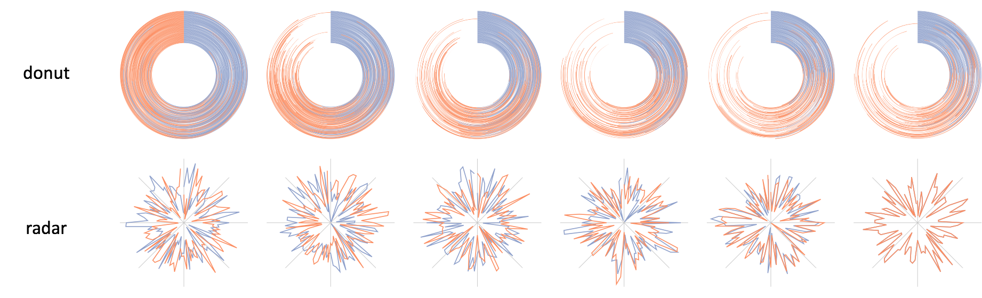

Slide 53
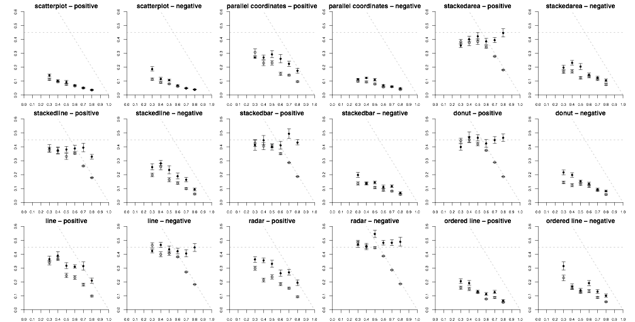
Notes:
whereas Rensink had one…
roughly 200,000 individual perceptual judgements

Slide 54
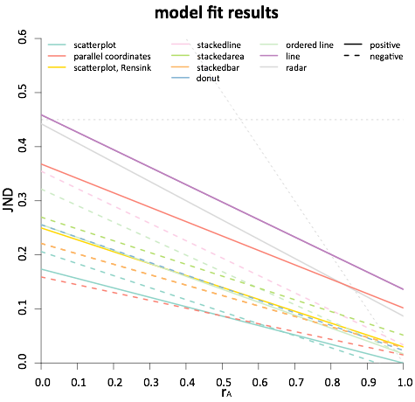
less precise
more precise
Notes:
this is essentially seeing if the trend of JNDs is linear
the moment of truth came when we checked the statistics

Slide 55
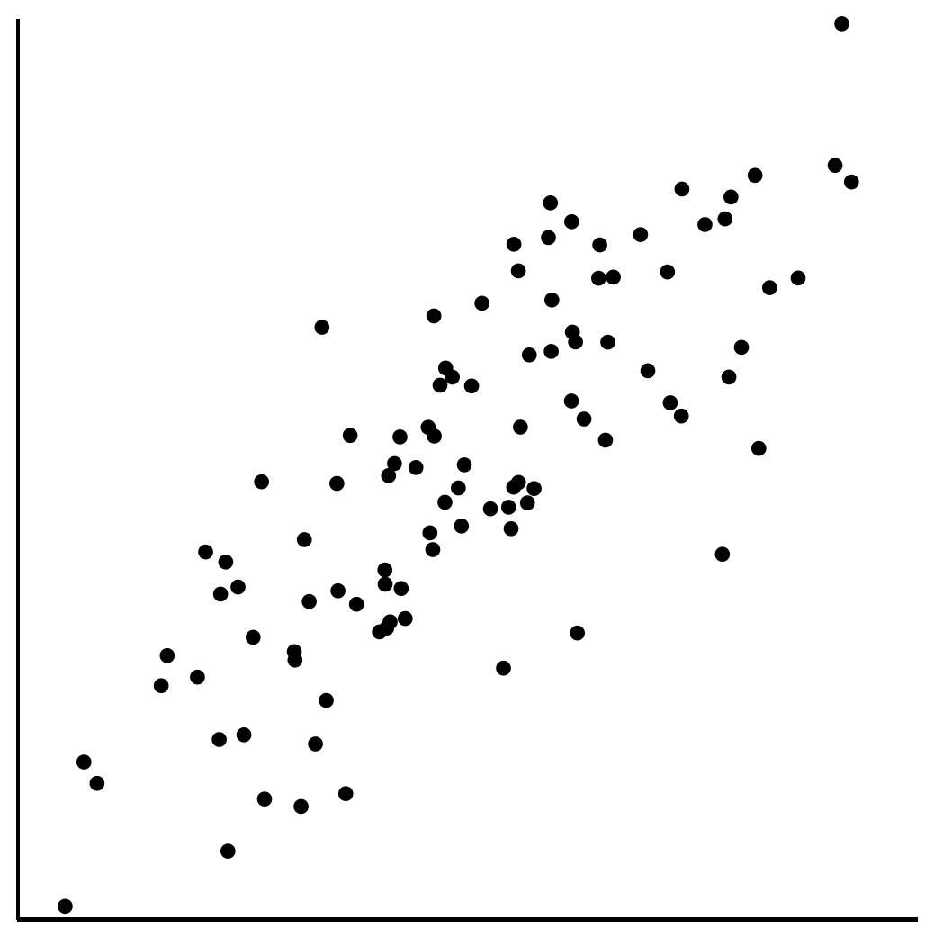
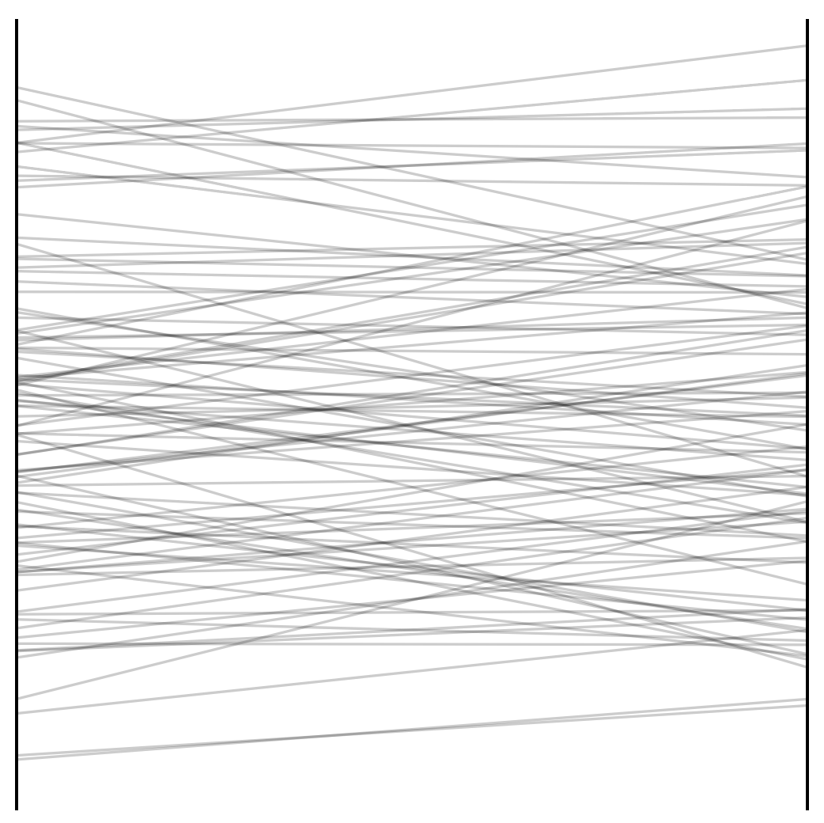
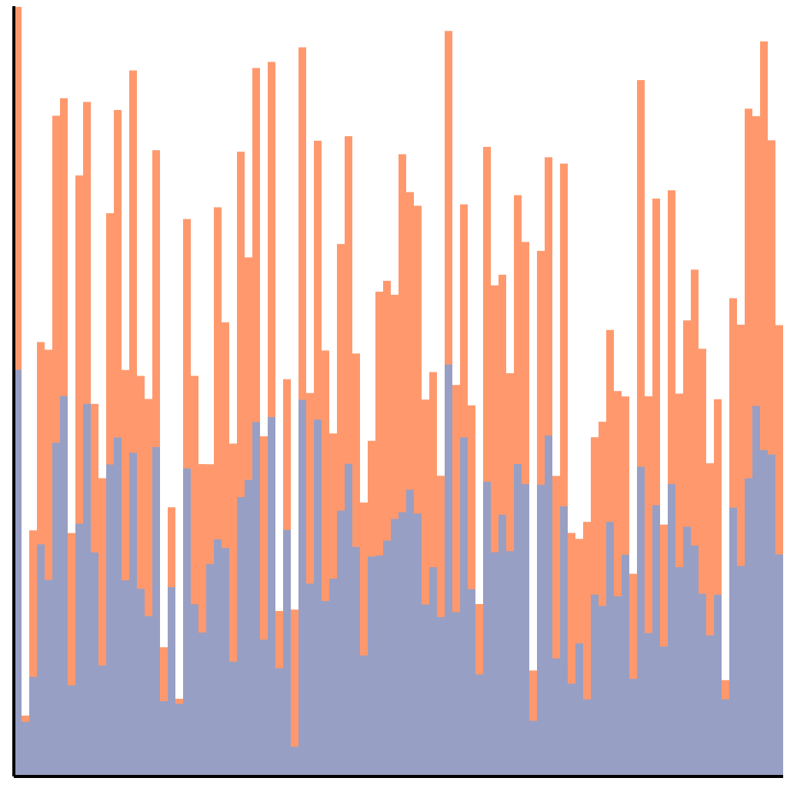
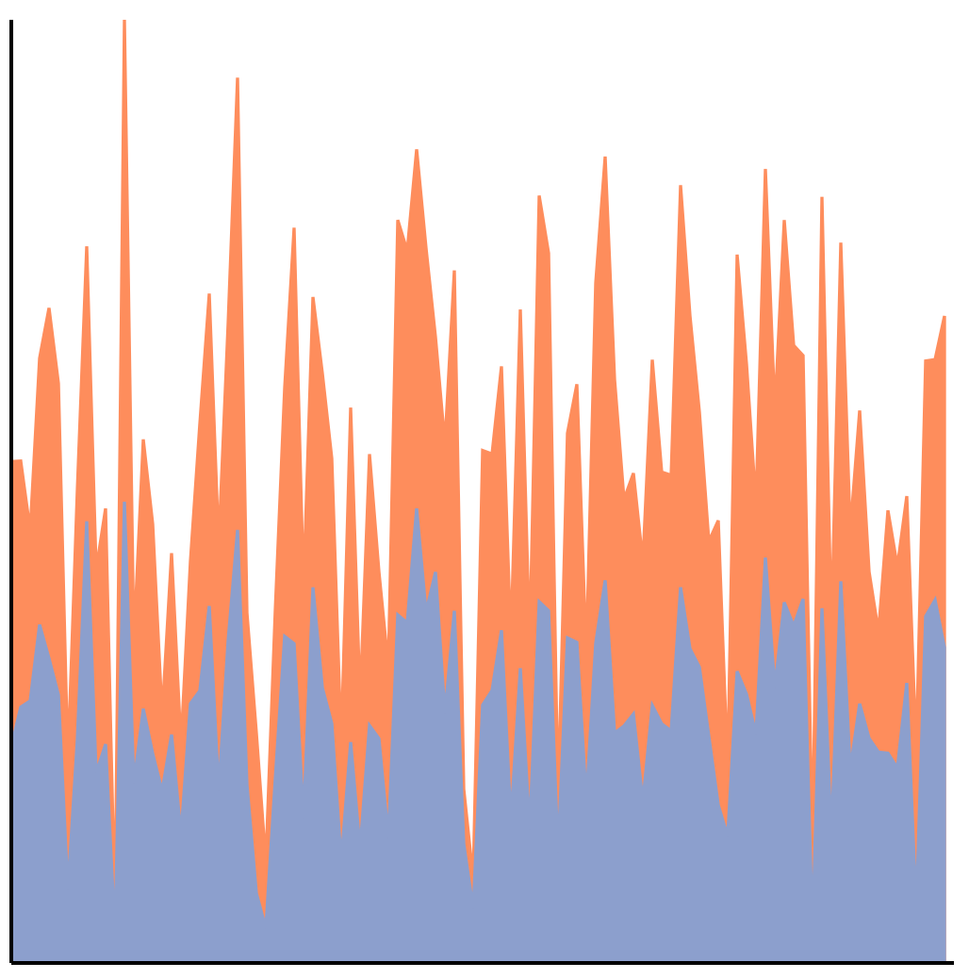
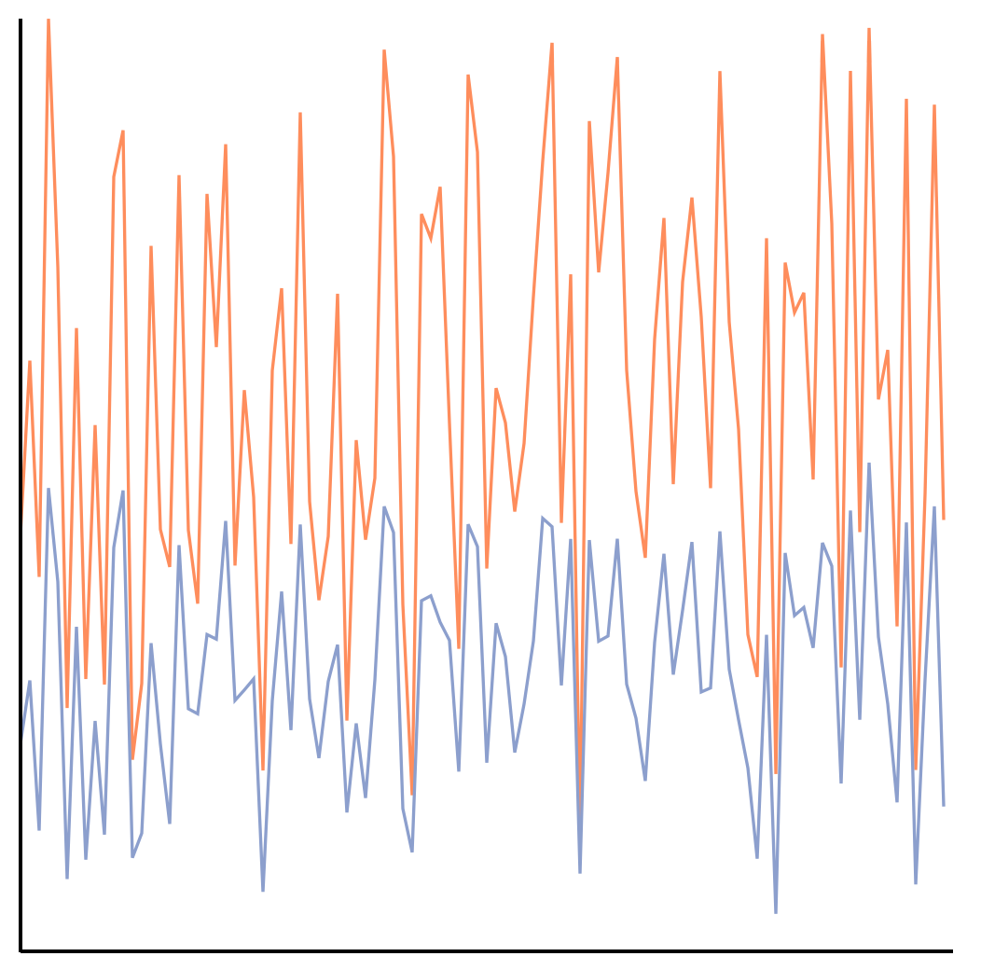
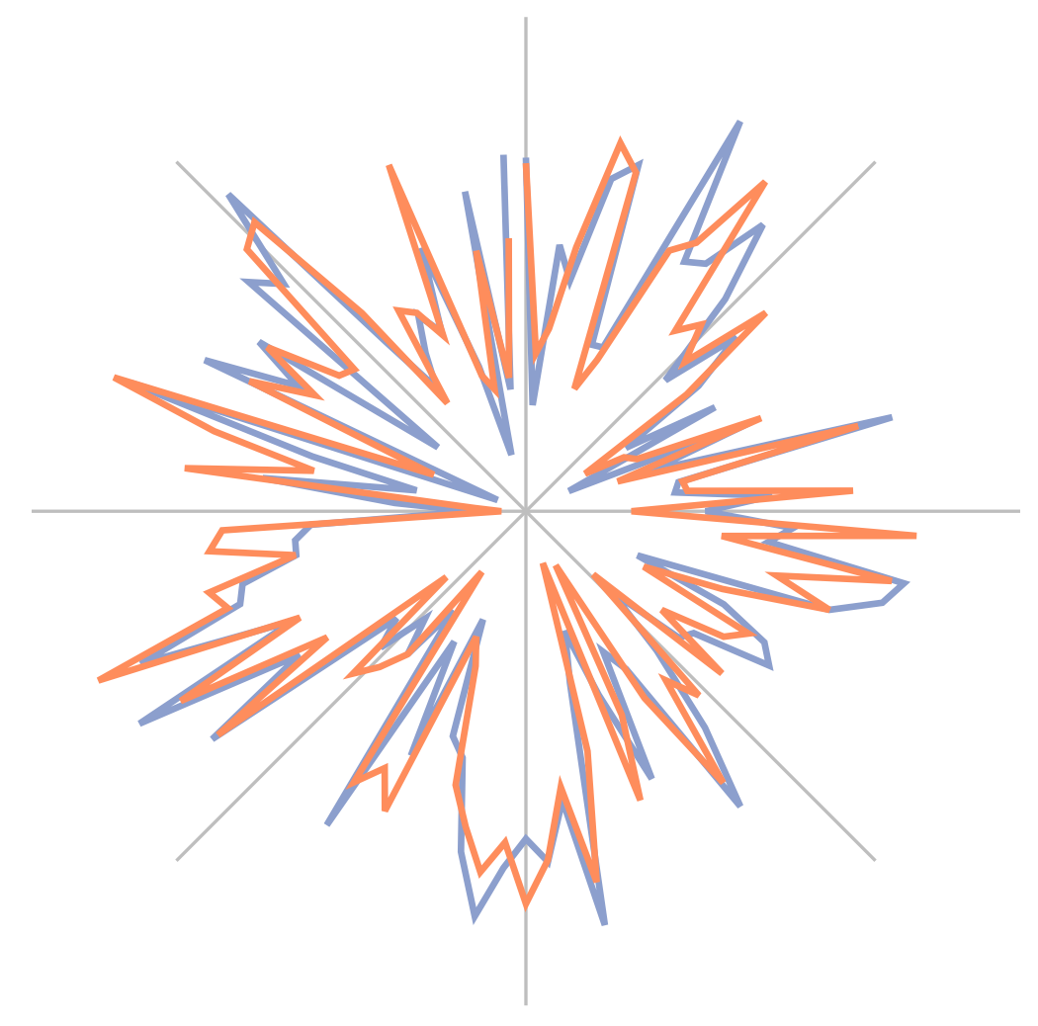
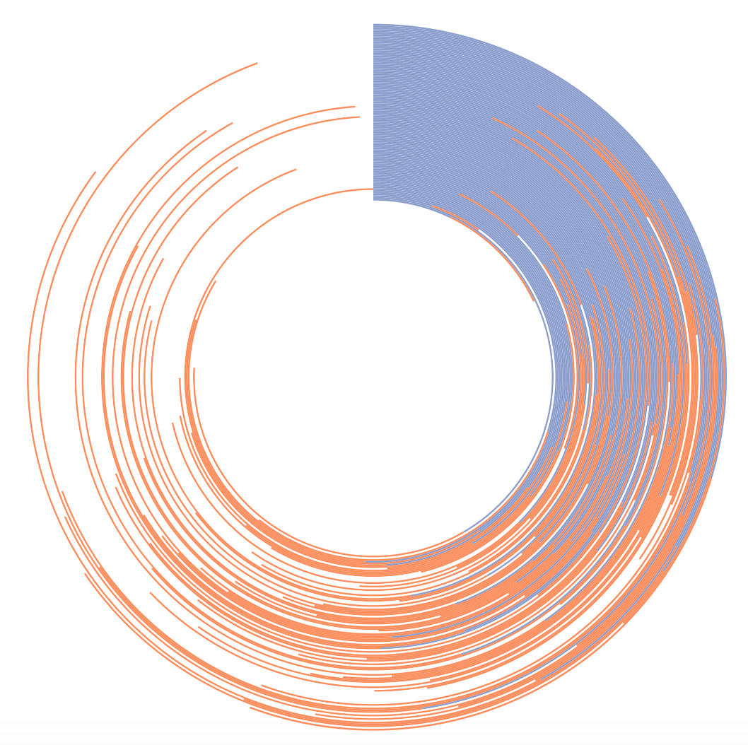
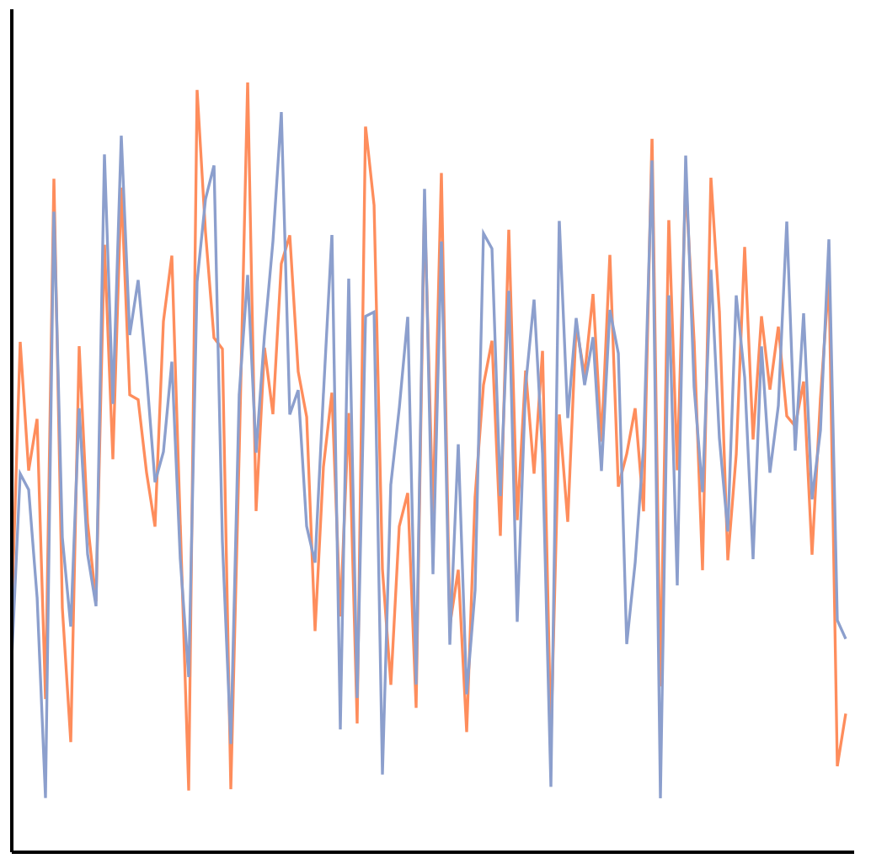
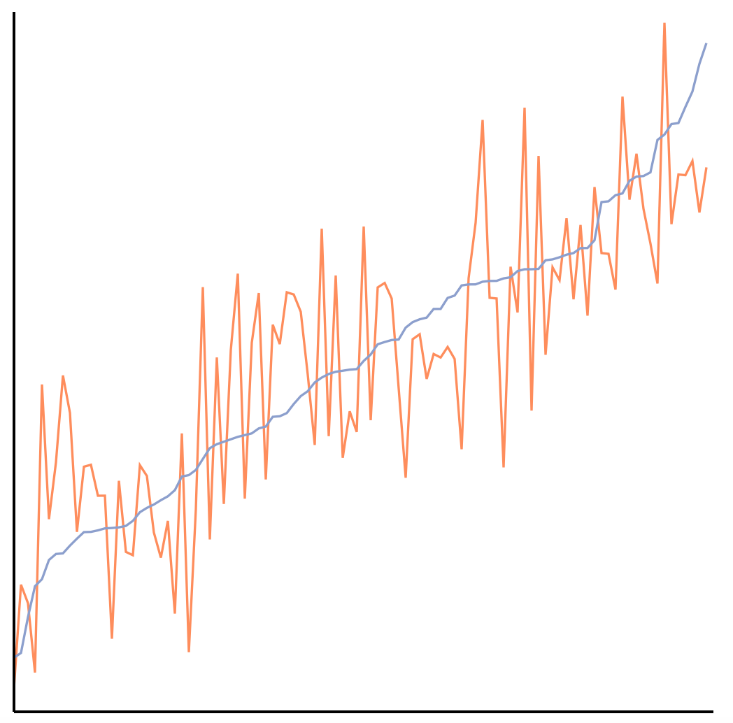
The perception of correlation in every tested chart can be modeled using Weber’s law.
Notes:
Here we have a perceptual law that is used to study things like taste, line-length, brightness. Not only are we using it to model correlation, which is a higher-level concept, but it also applies across every chart tested!

Slide 56
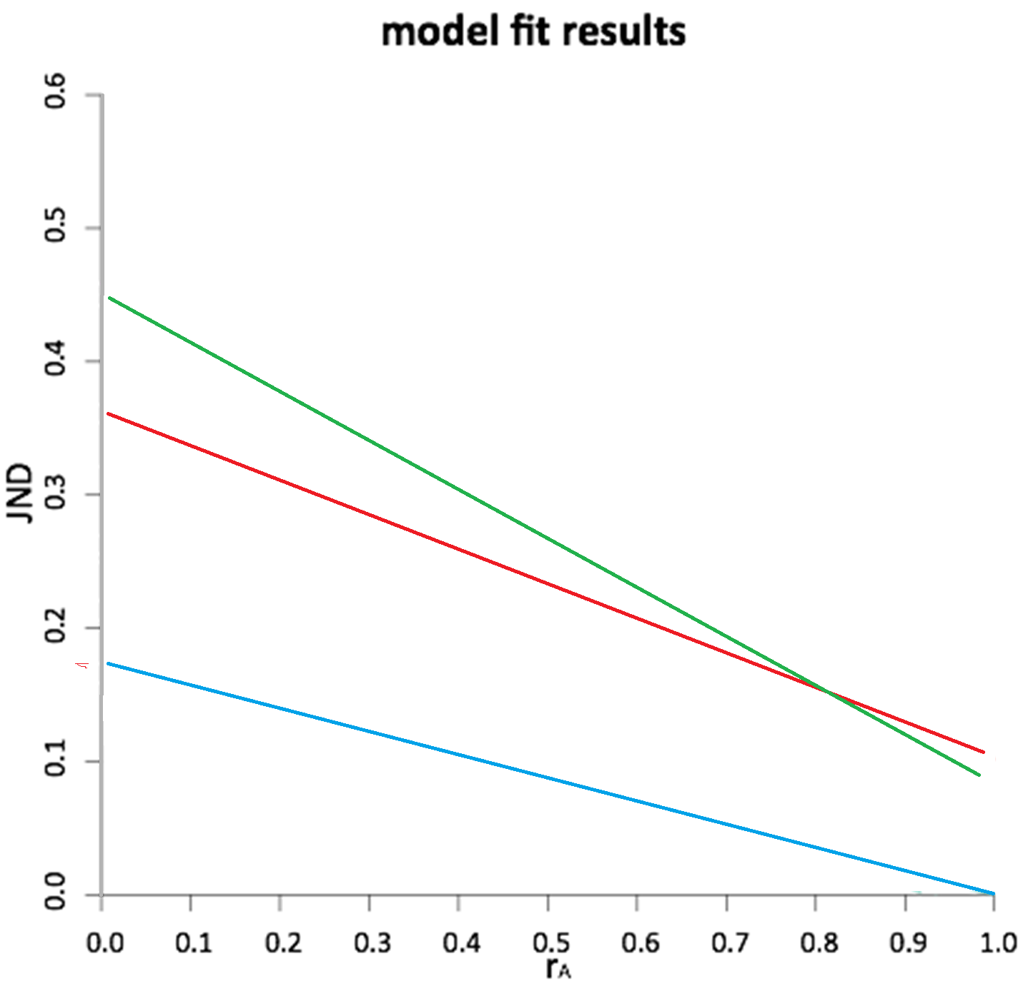
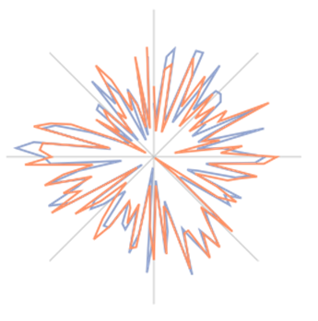
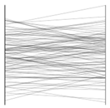
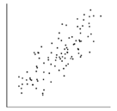

Slide 57
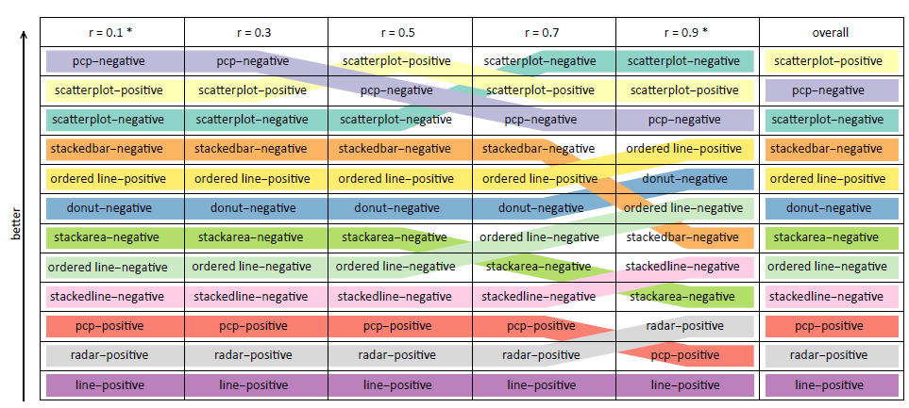
Application: Ranking Visualizations of Correlation

Slide 58

Potential Application: JND-based Sampling
Limits of Big Data visualization
  Screen resolution
JND-based sampling and visualization
  Similar to image compression (jpg2000)
  Differ in that the JND will be based on higher-level information (e.g. correlation)

Slide 59

Summary: Theory Into Practice
Interaction is key to exploratory visualizations
Big data -><- high interactivity
ForeCache seeks to address this
  Predictive prefetching based on past user actions (Waldo Experiment)
  Cache miss using EXPLAIN
“Human Data Interaction” is an open topic that needs more advancement
  Human is the bottleneck!

Slide 60


Questions? remco@cs.tufts.edu

