Slide 1
Human Data Interaction:
Data Organization, Computation, and Visualization
Remco Chang
Associate Professor
Computer Science, Tufts University

Slide 2
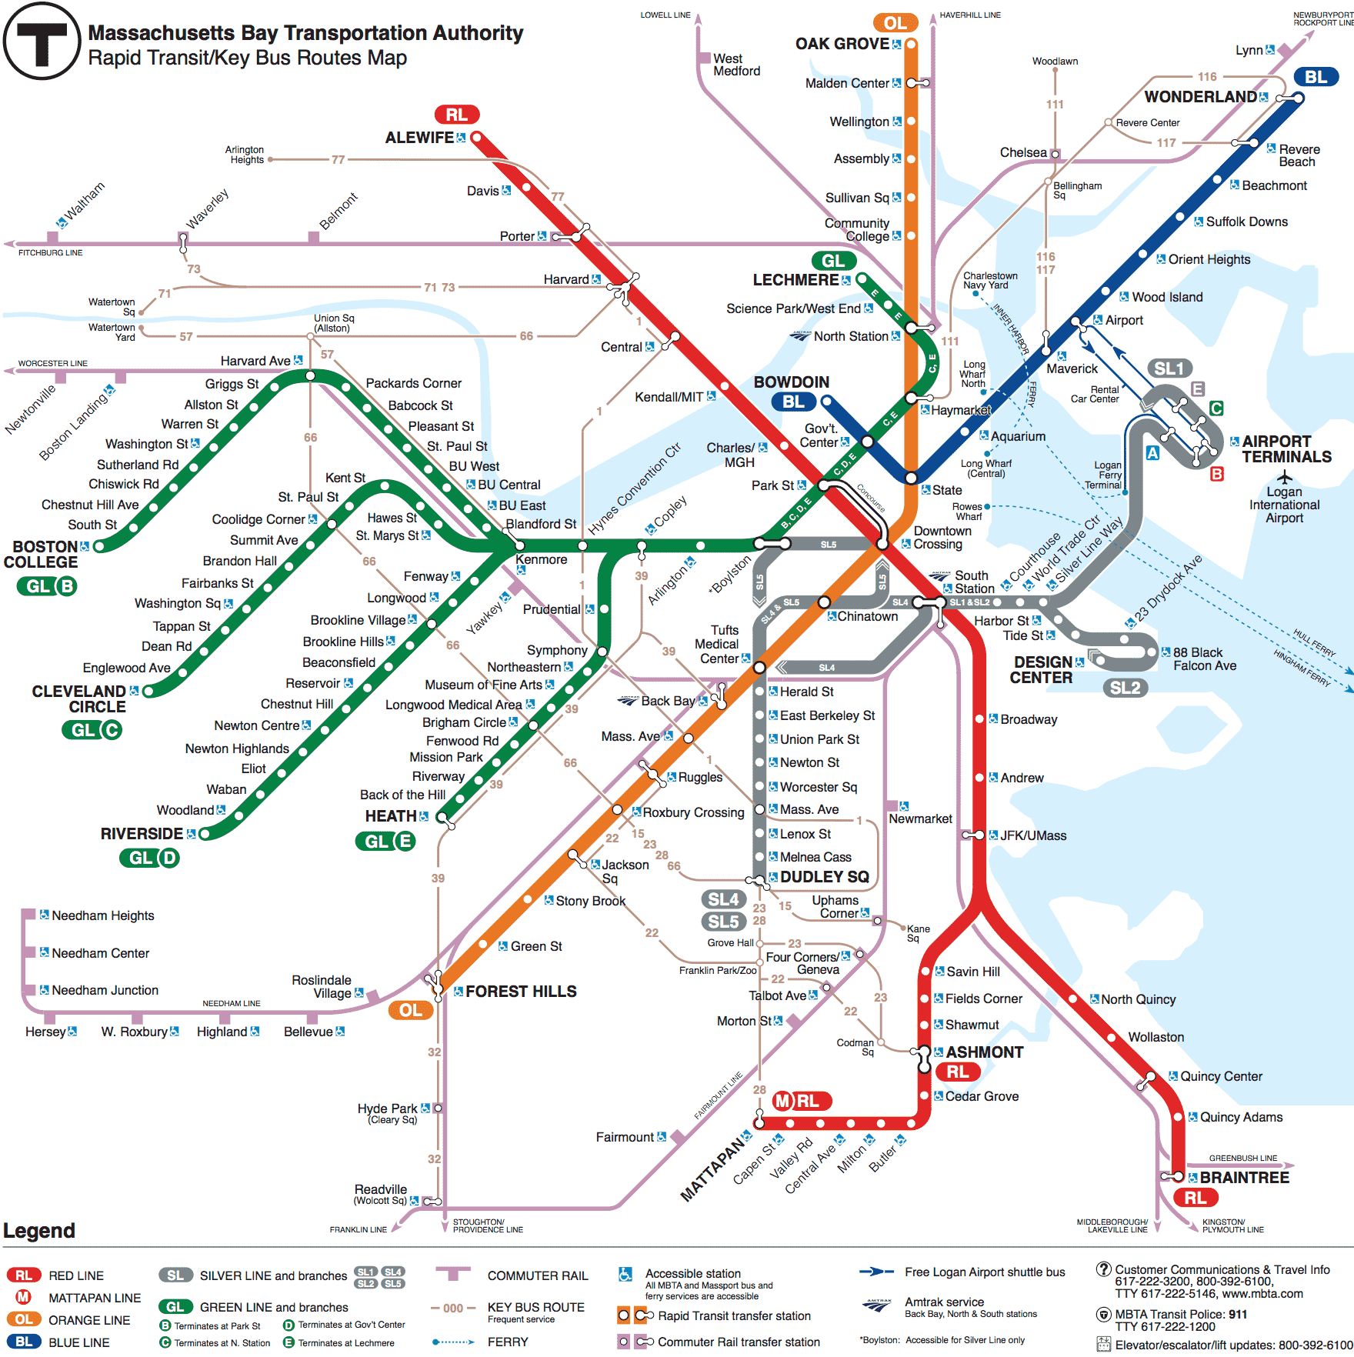

Slide 3
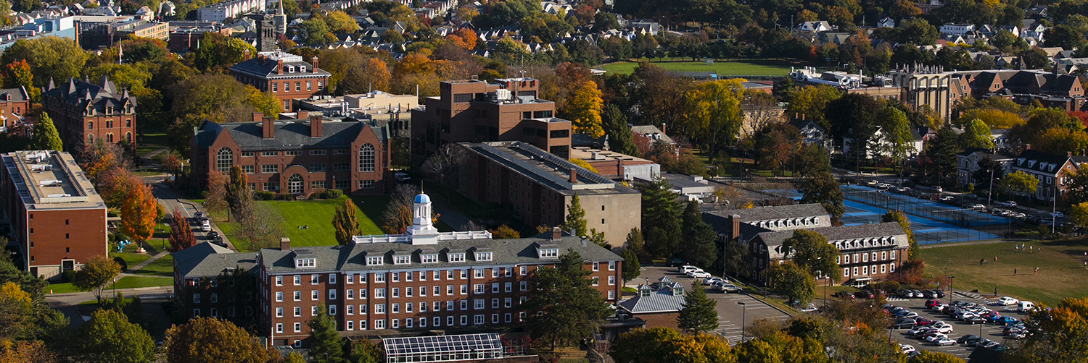
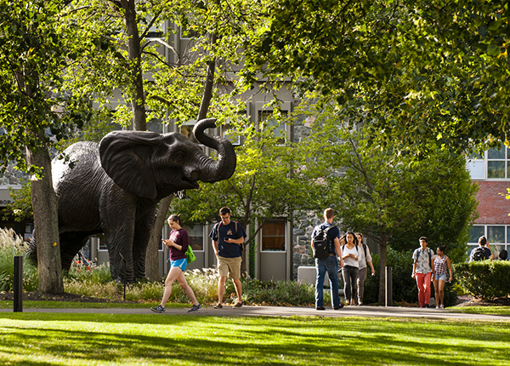


Slide 4
“The computer is incredibly fast, accurate, and stupid. Man is unbelievably slow, inaccurate, and brilliant. The marriage of the two is a force beyond calculation.”
-Leo Cherne, 1977
(often attributed to Albert Einstein)

Slide 5
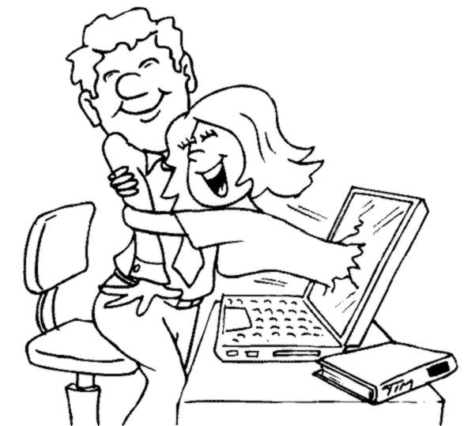
Which Marriage?

Slide 6
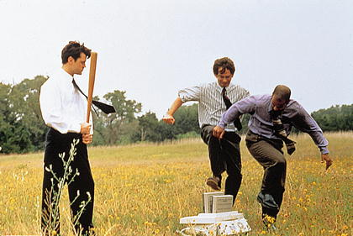
Which Marriage?

Slide 7
VALT
Visual Analytics Laboratory at Tufts
“Bring Data and Analysis to the People”
Understand how people interact with data
Develop tools and systems that can scale in data size, data complexity, and user’s abilities
Enable effective communication between computer and user in data analysis

Slide 8





Interactive Visualization Systems
Jordan Crouser
Political Simulation
  Agent-based analysis
Bridge Maintenance
  Exploring inspection reports
Biomechanical Motion
  Interactive motion comparison
Interactive Metric Learning
  Dis-Function: high-dimensional metric learning
High-D Data Exploration
  iPCA: Interactive PCA
R. Chang et al., Two Visualization Tools for Analysis of Agent-Based Simulations in Political Science. IEEE CG&A, 2012

Slide 9



Interactive Visualization Systems
Political Simulation
  Agent-based analysis
Bridge Maintenance
  Exploring inspection reports
Biomechanical Motion
  Interactive motion comparison
Interactive Metric Learning
  Dis-Function: high-dimensional metric learning
High-D Data Exploration
  iPCA: Interactive PCA
R. Chang et al., An Interactive Visual Analytics System for Bridge Management, Journal of Computer Graphics Forum, 2010.

Slide 10



Interactive Visualization Systems
Political Simulation
  Agent-based analysis
Bridge Maintenance
  Exploring inspection reports
Biomechanical Motion
  Interactive motion comparison
Interactive Metric Learning
  Dis-Function: high-dimensional metric learning
High-D Data Exploration
  iPCA: Interactive PCA
R. Chang et al., Interactive Coordinated Multiple-View Visualization of Biomechanical Motion Data, IEEE Vis (TVCG) 2009.

Slide 11

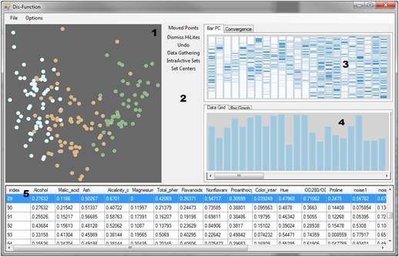
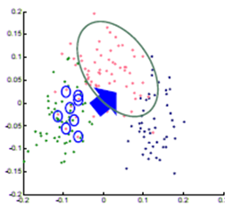

Interactive Visualization Systems
Eli Brown
Political Simulation
  Agent-based analysis
Bridge Maintenance
  Exploring inspection reports
Biomechanical Motion
  Interactive motion comparison
Interactive Metric Learning
  Dis-Function: high-dimensional metric learning
High-D Data Exploration
  iPCA: Interactive PCA
R. Chang et al., Dis-function: Learning Distance Functions Interactively, IEEE VAST 2011.

Slide 12
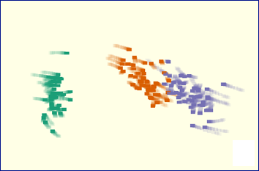
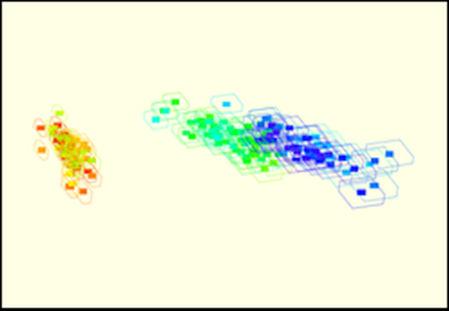
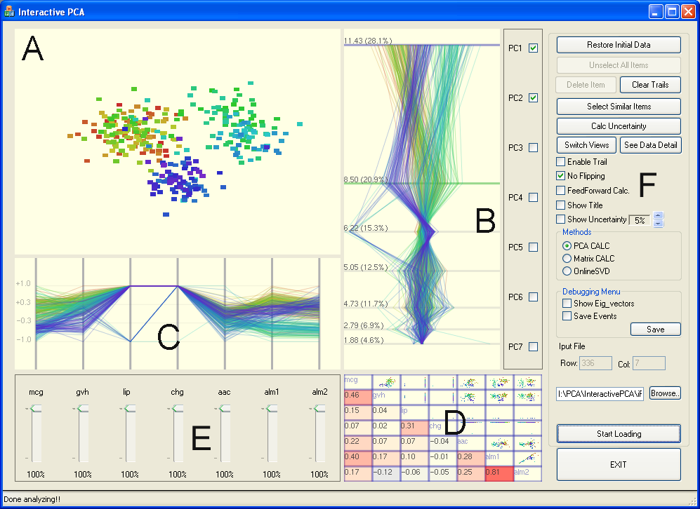
Interactive Visualization Systems
Political Simulation
  Agent-based analysis
Bridge Maintenance
  Exploring inspection reports
Biomechanical Motion
  Interactive motion comparison
Interactive Metric Learning
  Dis-Function: high-dimensional metric learning
High-D Data Exploration
  iPCA: Interactive PCA
R. Chang et al., iPCA: An Interactive System for PCA-based Visual Analytics, EuroVis 2009.

Slide 13



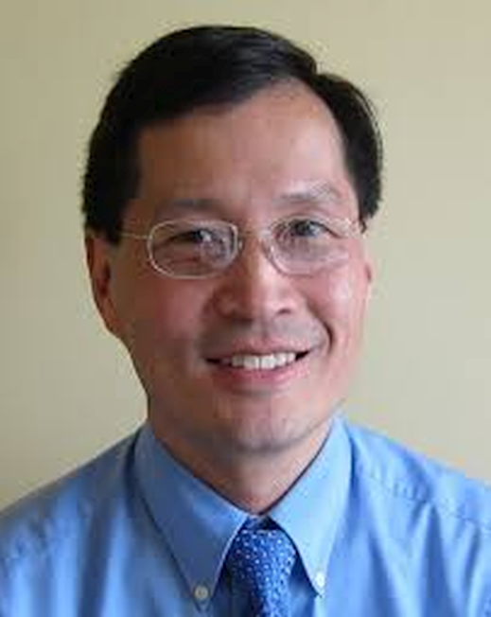
Do People Understand Data Differently?
A Case Study of Bayesian Reasoning
Alvitta Ottley
(PhD 2016)
Anzu Hakone (MS 2017)
Holly Taylor
Paul Han
R. Chang et al. Improving Bayesian Reasoning: The Effects of Phrasing, Visualization, and Spatial Ability. InfoVis 2015
R. Chang et al. PROACT: Iterative design of a patient-centered visualization for effective prostate cancer health risk communication, InfoVis 2016

Slide 14
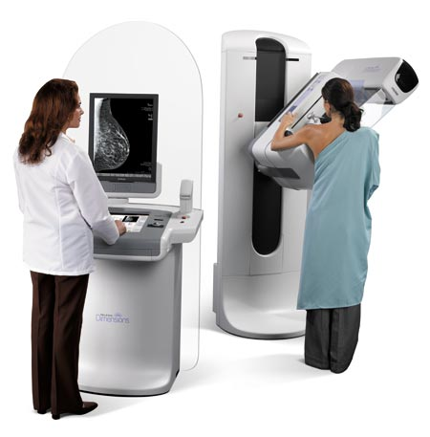
The probability of women at age forty having breast cancer is 1%. If a woman has breast cancer, the probability is 80% that she will get a positive mammography. If a woman does not have breast cancer, the probability is 9.3% that she will also get a positive mammography.
If a woman at age 40 is tested positive, what are her chances of actually having breast cancer?

Slide 15
The chance of actually having breast cancer given a positive mammogram:
7.9%
Answer: Bayes’ theorem states that P(A|B) = P(B|A) * P(A) / P(B). In this case, A is having breast cancer, B is testing positive with mammography. P(A|B) is the probability of a person having breast cancer given that the person is tested positive with mammography. P(B|A) is given as 80%, or 0.8, P(A) is given as 1%, or 0.01. P(B) is not explicitly stated, but can be computed as P(B,A)+P(B,˜A), or the probability of testing positive and the patient having cancer plus the probability of testing positive and the patient not having cancer. Since P(B,A) is equal 0.8*0.01 = 0.008, and P(B,˜A) is 0.093 * (1-0.01) = 0.09207, P(B) can be computed as 0.008+0.09207 = 0.1007. Finally, P(A|B) is therefore 0.8 * 0.01 / 0.1007, which is equal to 0.07944.

Slide 16
95 out of 100 doctors¹
estimate this probability
to be:
80%
1. Eddy, David M. "Probabilistic reasoning in clinical medicine: Problems and opportunities." (1982).

Slide 17
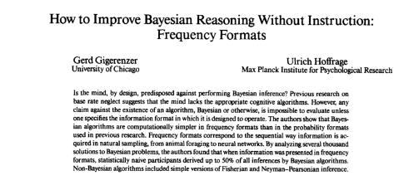
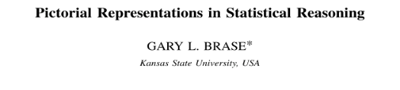
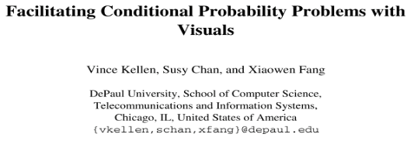
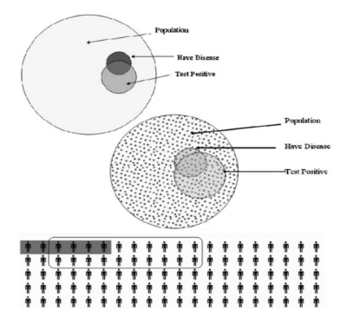
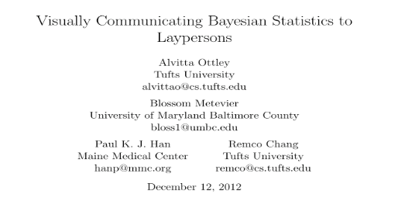
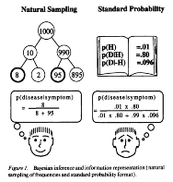
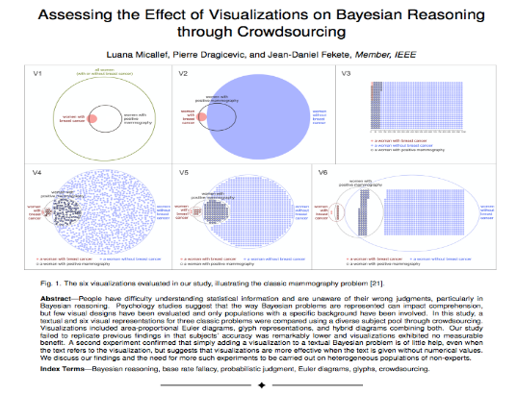
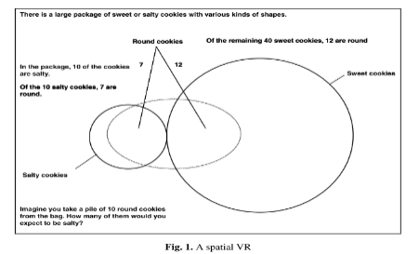
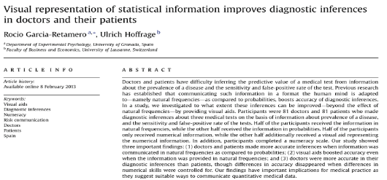
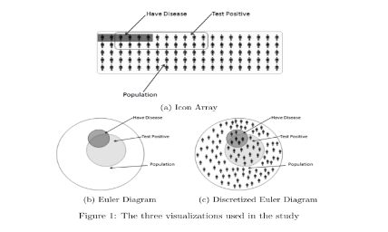
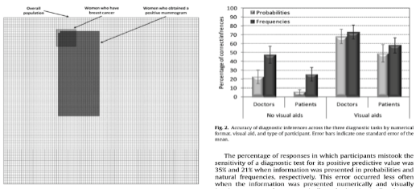
VIS Community

Slide 18


The Problem?
“
”
“
”
“
”
“
...”
They disagree.
* Reported accuracies range from 6% to 62%

Slide 19
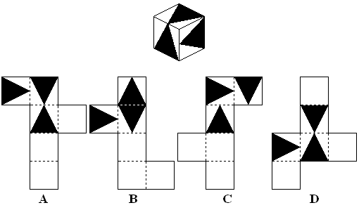
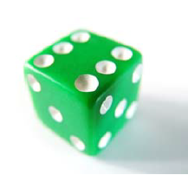

Experiment: Does Visualization help with Bayesian Reasoning?
6 conditions
377 participants
Between subjects experiment
Also measured spatial ability, numeracy
Answer: (A)
A dice has sides of 1.2cm. What is its volume in cubic mm?
Notes:
Describe spatial ability

Slide 20
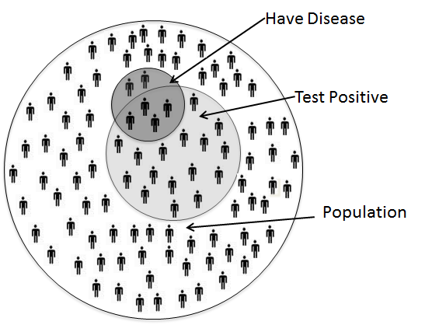
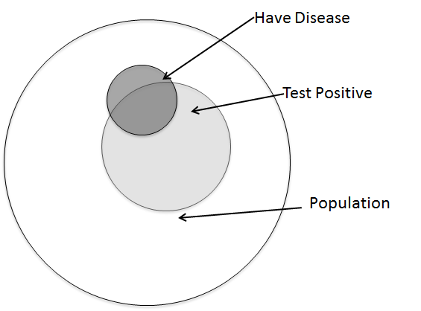
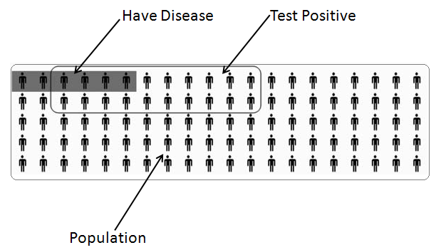
Visualization Aids
Ottley et al., Visually Communicating Bayesian Statistics to Laypersons. Tufts CS Tech Report, 2012.

Slide 21
Initial Results

Slide 22
Separated by Spatial Ability
Low spatial-ability
High spatial-ability

Slide 23
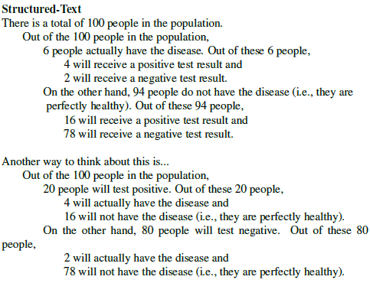
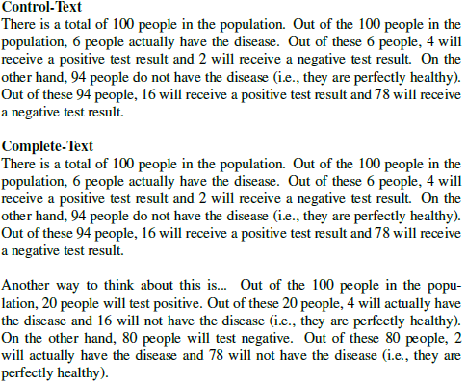
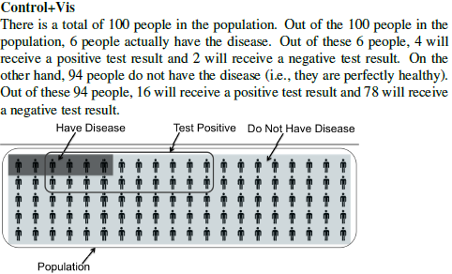
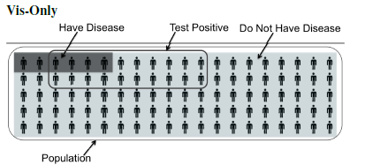
Conditions

Slide 24
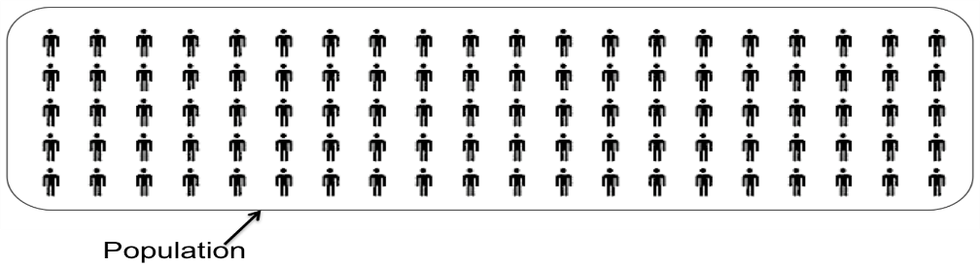
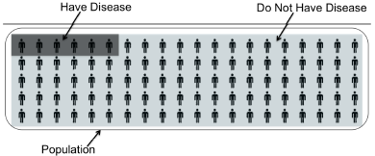
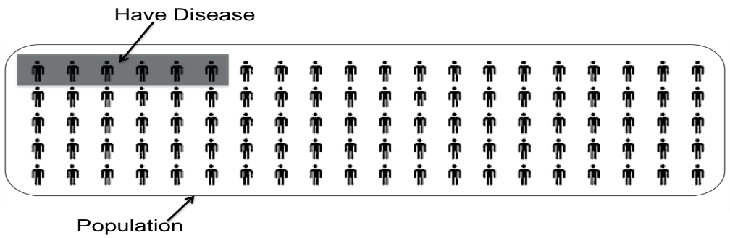
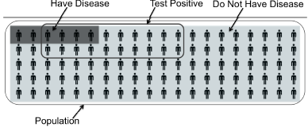
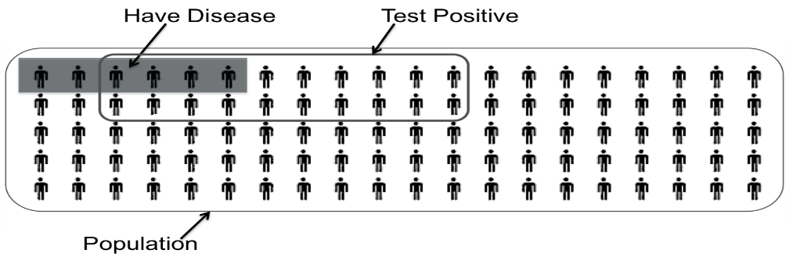
Storyboard (Storytelling Visualization)

Slide 25
Do Users Explore Data in the Same Way?
Automated Learning from User Interactions
Alvitta Ottley
(PhD 2016)
Eli Brown
(PhD 2015)
R Chang et al., Finding Waldo: Learning about Users from their Interactions. IEEE VAST 2014.

Slide 26
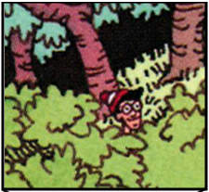
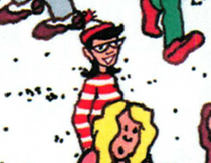
Finding Waldo: Learning From the Users’ Interactions
Google-Maps style interface
  Left, Right, Up, Down, Zoom In, Zoom Out, Found
R Chang et al., Finding Waldo: Learning about Users from their Interactions. IEEE VAST 2014.

Slide 27
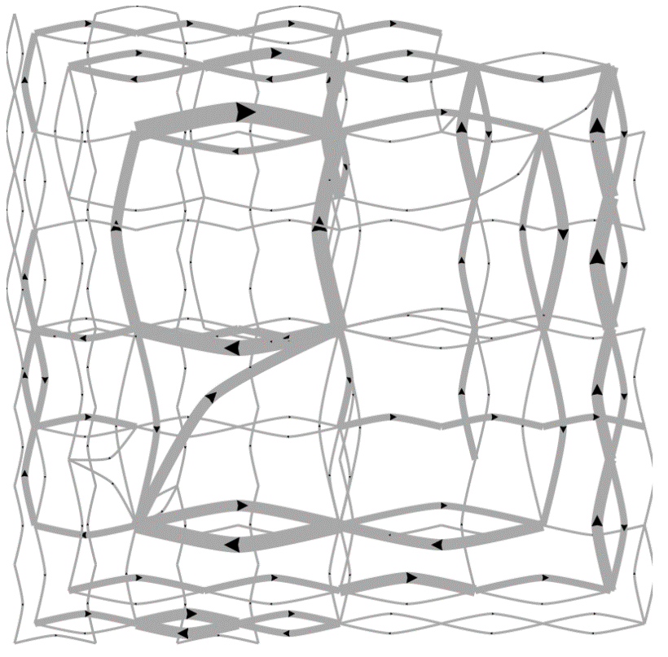
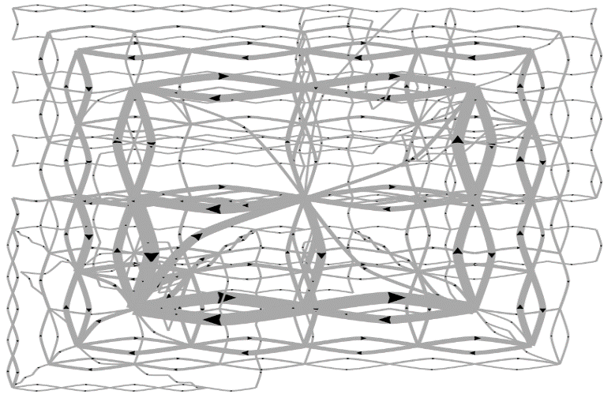
Pilot Visualization:
Completion Time
Fast completion time
Slow completion time

Slide 28
Post-hoc Analysis Results
Mean Split (50% Fast, 50% Slow)
Data Representation | Classification Accuracy | Method
State Space | 72% | SVM
Edge Space | 63% | SVM
Action Sequence | 77% | Decision Tree
Mouse Event | 62% | SVM
Fast vs. Slow Split (Mean+0.5σ=Fast, Mean-0.5σ=Slow)
Data Representation | Classification Accuracy | Method
State Space | 96% | SVM
Edge Space | 83% | SVM
Action Sequence | 79% | Decision Tree
Mouse Event | 79% | SVM

Slide 29
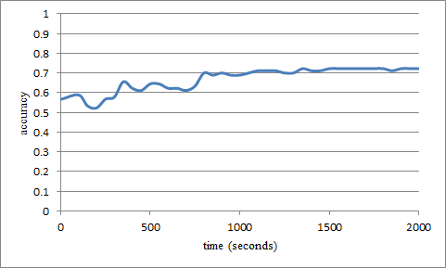
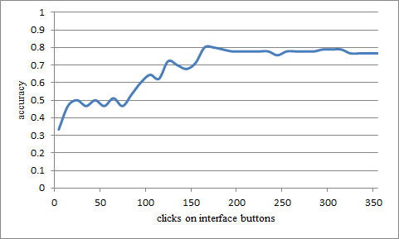
“Real-Time” Prediction
(Limited Time Observation)
State-Based
Linear SVM
Accuracy: ~70%
Interaction Sequences
N-Gram + Decision Tree
Accuracy: ~80%

Slide 30
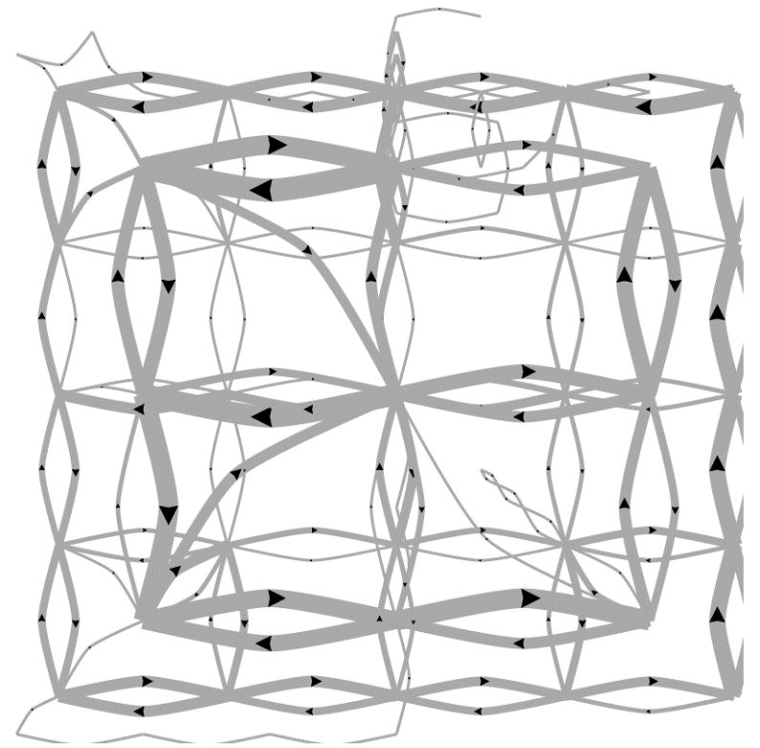
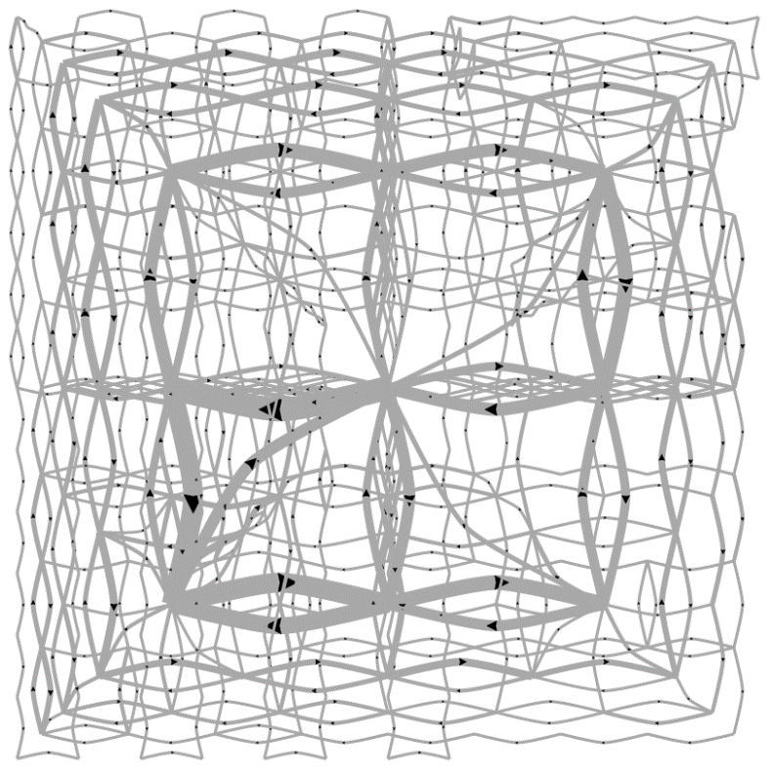
Predicting a User’s Personality
External Locus of Control
Internal Locus of Control
Ottley et al., How locus of control inﬂuences compatibility with visualization style. IEEE VAST , 2011.
Ottley et al., Understanding visualization by understanding individual users. IEEE CG&A, 2012.

Slide 31
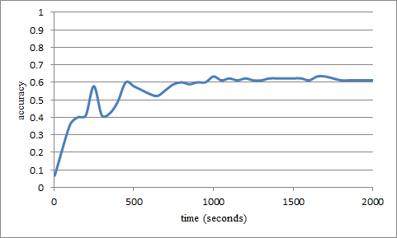
Predicting Users’ Personality Traits
Predicting user’s “Extraversion”
Linear SVM
Accuracy: ~60%
Noisy data, but can detect the users’ individual traits “Extraversion”, “Neuroticism”, and “Locus of Control” at ~60% accuracy by analyzing the user’s interactions alone.

Slide 32



What can we do with User Behavior Prediction?
ForeCache: Interactive Large Data Exploration
Marianne Procopio
Stonebraker
(MIT)
Leilani Battle
(PhD MIT 2017)
R. Chang et al., Dynamic Prefetching of Data Tiles for Interactive Visualization. SIGMOD 2016

Slide 33



Case Stuyd: Interactive Exploration of Big Data
Visualization on a
Commodity Hardware
Large Data in a
Data Warehouse

Slide 34
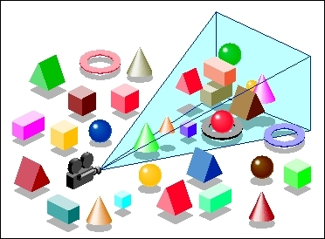
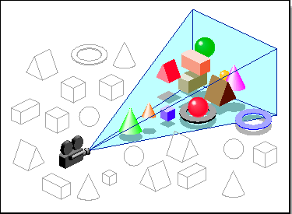
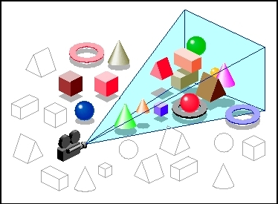

Predictive Pre-Fetching
If we know what the user might do next, we can pre-compute the task and pre-fetch the result
  Reduces user wait time (e.g. after they click a button to perform a task)
ForeCache: Three-tiered architecture
  Thin client (visualization)
  Backend (array-based database)
  Fat middleware
Challenge: turning the “Finding Waldo” toy-example into practice

Slide 35
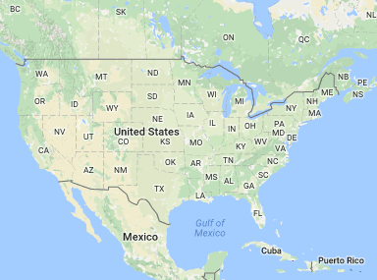
Predictions, an Example
What is the user going to do next?
  Likely “right” or “up”
Prediction of behavior is pretty easy IF we know that the user is “navigating”
But what if the user is doing something else?
?

Slide 36

Predicting User Actions
Sensemaking
Two-tiered approach using Markov
First tier: predict what “phase” of analysis the user is in.
Second tier: given a “phase”, use phase-specific models to predict user’s next actions.
  For example, for “navigation”, use momentum-based prediction
  For others, use a combination of access-frequency, statistical distribution, SIFT (image-based), etc.
Navigation
Foraging
Card-Pirolli Sensemaking Loop

Slide 37
Evaluation: Prediction Accuracy
Comparison against existing techniques
“Random guessing” accuracy is: k/n
  n: number of possible user actions
  k: number of allowed “guesses”

Slide 38
Projects
NSF CAREER (current)
  User Modeling / Sequence Analysis
MIT + CIA (current)
  Developing Databases for VIS
Navy (current)
  Analysis of training/exam data of soldiers
DARPA D3M (current)
  Integration of AutoML with VIS
DARPA CHESS (starting Nov)
  How to help novice hackers become better hackers
Walmart (starting Oct?)
  “Nudge” users in online shopping behaviors
MIT Lincoln Lab (starting Oct)
  Cyber analysis and defense
Google (in discussion)
  How to end cyber bullying (or cyber harassment)

Slide 39



Summary: Theory Into Practice
Visual analytics tasks are challenging and requires human+computer collaboration
Happy marriage between user and computer requires better understanding of the user.
Bayesian Reasoning and Finding Waldo build profiles of users such that the ForeCache system can use for better prediction of a user’s future actions.
“Bring Data and Analysis to the People!”

Slide 40



Questions? remco@cs.tufts.edu

Slide 41
Backup Slides

Slide 42







DARPA Data-Driven Discovery (D3M):
Data Analysis for the Masses
Shah Humayoun
Dylan Cashman
Abby Mosca
Mike Gleicher
(Wisconsin)
John Stasko
(GT)
Alex Endert
(GT)

Slide 43


“Masses”
Who are they?

Slide 44


“Masses”
What do they want to accomplish?

Slide 45


“Masses”
What do they need help with?

Slide 46


DARPA’s Ideal of the Project
Run regression
(sales-cost, year)
Linear? Logistic? Non-Linear?
“Masses”
Data Scientists
(or Automated Machine Learning)

Slide 47
Reality: Interviews with Companies
I want to improve profits next year!
??????
Everyday Users
Data Scientists
(Machine Learning Library)

Slide 48
How Do Companies Do This Now?
Everyday Users
Data Insight Managers
Data Scientists
(Machine Learning Library)

Slide 49
Interviews with Companies
High Level Question
Formal Queries
Everyday Users
Data Managers
Data Scientists
(Machine Learning Library)

Slide 50
Interviews with Companies
High Level Question
Formal Queries
Everyday Users
Data Managers
Data Scientists
(Machine Learning Library)
Reports and Visualizations
Models and Metrics

Slide 51
Interviews with Companies
Active Learning
(Model Selection and Parameter Tuning)
User Feedback
High Level Question
Formal Queries
Everyday Users
Data Managers
Data Scientists
(Machine Learning Library)
Reports and Visualizations
Models and Metrics

Slide 52
Interviews with Companies
Active Learning
(Model Selection and Parameter Tuning)
User Feedback
High Level Question
Formal Queries
Everyday Users
Automated “Translator”
Data Managers
Data Scientists
(Machine Learning Library)
Reports and Visualizations
Models and Metrics

Slide 53

SnowCat System Overview

Slide 54

Utility and Workflow
User provides a “problem description”, including:
  Task goals, optimization metric, subsets of data, etc.
Using automated machine learning (autoML)
  System automatically finds the “best” machine learning models
User examines the discovered models
  Compares the resulting outcomes
  Selects the most appropriate model for future data

Slide 55


Utility and Workflow
User provides a “problem description”, including:
  Task goals, optimization metric, subsets of data, etc.
Using automated machine learning (autoML)
  System automatically finds the “best” machine learning models
User examines the discovered models
  Compares the resulting outcomes
  Selects the most appropriate model for future data

Slide 56

Utility and Workflow
User provides a “problem description”, including:
  Task goals, optimization metric, subsets of data, etc.
Using automated machine learning (autoML)
  System automatically finds the “best” machine learning models
User examines the discovered models
  Compares the resulting outcomes
  Selects the most appropriate model for future data

Slide 57

Supported Data and Task Types
Currently supports the following data and task types
  Note that not all task/data pairing is valid

Slide 58
Discussion
Work in Progress!
  Your input and suggestion will be greatly appreciated!
Potential impact
  Hides (as much as possible) math and machine learning
    Allows domain experts and subject matter experts to use advanced machine learning techniques
  System can be domain agnostic
    Unlike “tailor-made” visual analytics systems described earlier
  Emphasis on data and task types
    Allows problem decomposition
    For example, in cyber analysis, data can be converted into time-series, graphs, vectors, frequency, etc.
      Each data type affords different analytic methods.
      Actual “answer” might be somewhere between the analyses

Slide 59


Short Summary
Individual differences matter
Not all problems can be solved with “better tools”
  Different users have different needs
Solving these problems (e.g. Bayesian Reasoning) can have a significant impact in a wide-range of applications:
  Health care, intelligence analysis, business decisions, etc.

Slide 60
Ongoing Effort: An Example
How to let user specify a high-level question (and turn that into formal queries)?
Three Methods:
  “40 Questions”
  “Tell me what you want”
  “See what sticks”
I want to improve profits next year!
Everyday Users

Slide 61

40 Questions:
Interactive Query Construction
I want to

Slide 62

40 Questions:
Interactive Query Construction
I want to
Predict
Correlate
Detect Anomaly

Slide 63
40 Questions:
Interactive Query Construction
I want to
Correlate

Slide 64
40 Questions:
Interactive Query Construction
I want to
Correlate
the variable
with

Slide 65
40 Questions:
Interactive Query Construction
K-Means
Predict
Linear Regression
Correlate
SVM
Detect Anomalies
Random Forest

Slide 66


Ongoing Effort
Query Formalization
Model and Metric Visualization

