Slide 1
From Vision Science to Data Science: Applying Perception to Problems in Big Data
Remco Chang
Associate Professor, Computer Science
Tufts University

Slide 2
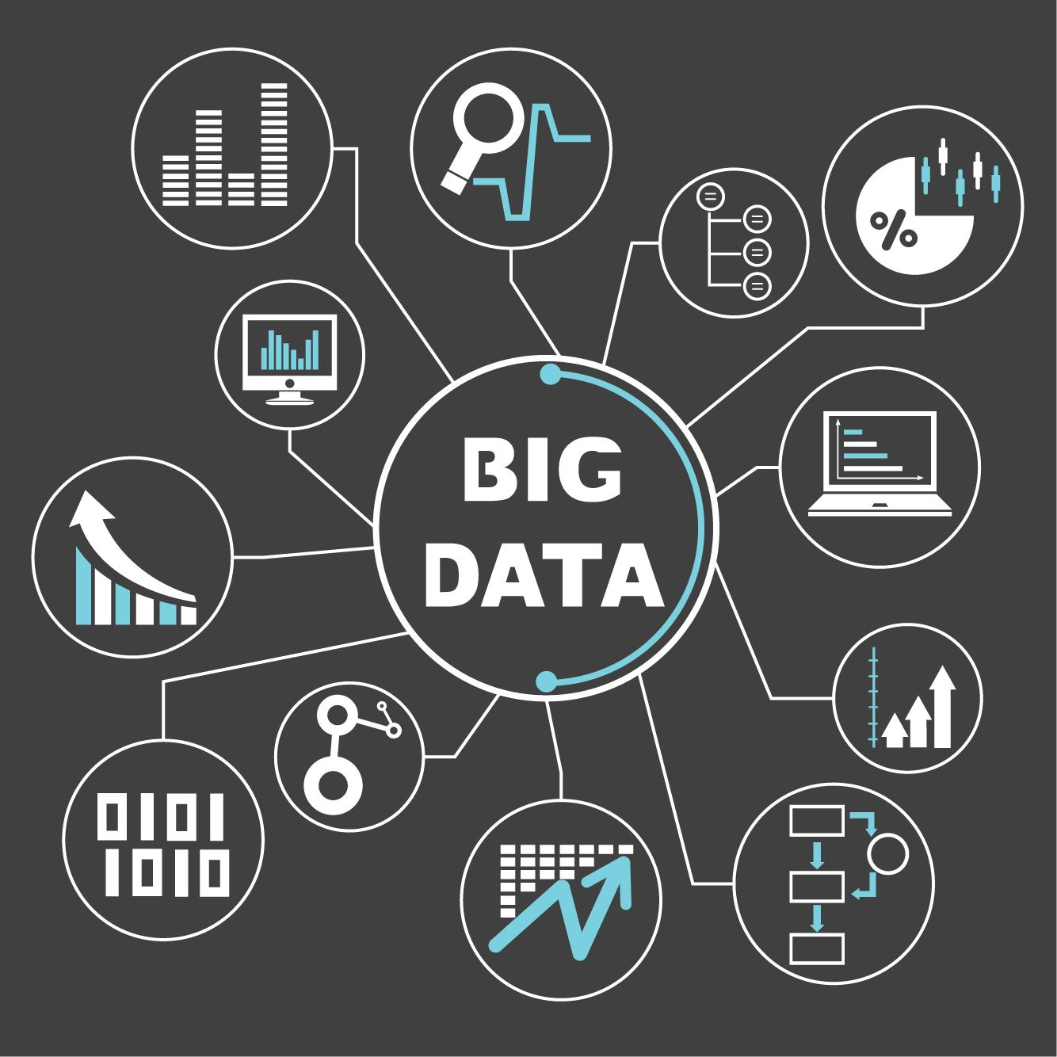
Role of Visualization in Big Data
Big Data
  Machine Learning
  Databases
  Visualization
Visualization allows the user to interactively and visually explore large amounts of data

Slide 3
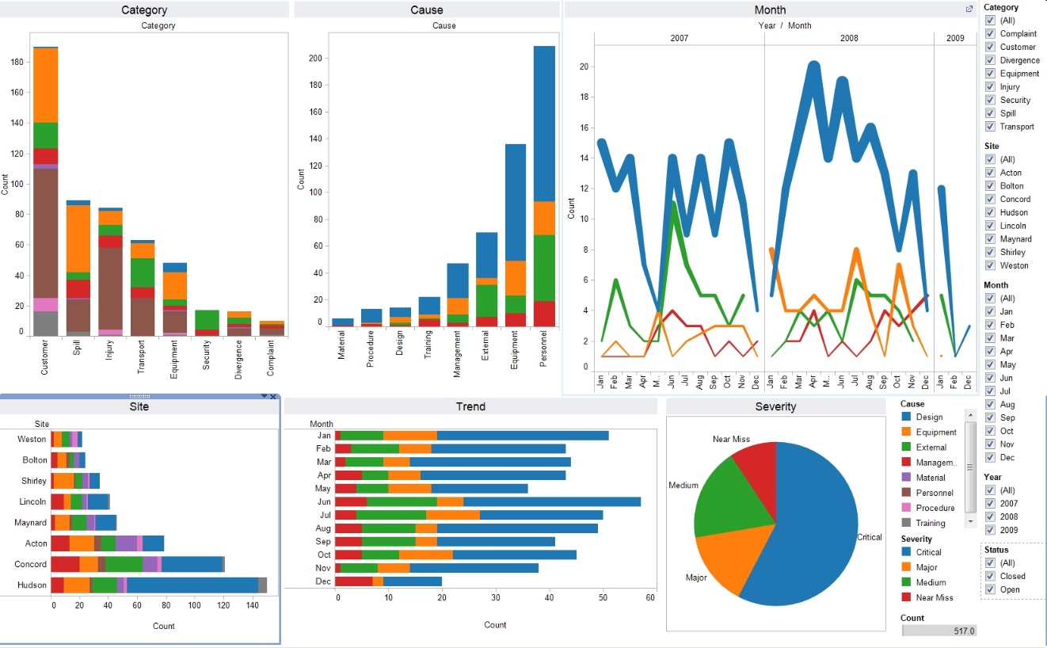
Role of Visualization in Big Data
Big Data
  Machine Learning
  Databases
  Visualization
Visualization allows the user to interactively and visually explore large amounts of data
Tableau

Slide 4
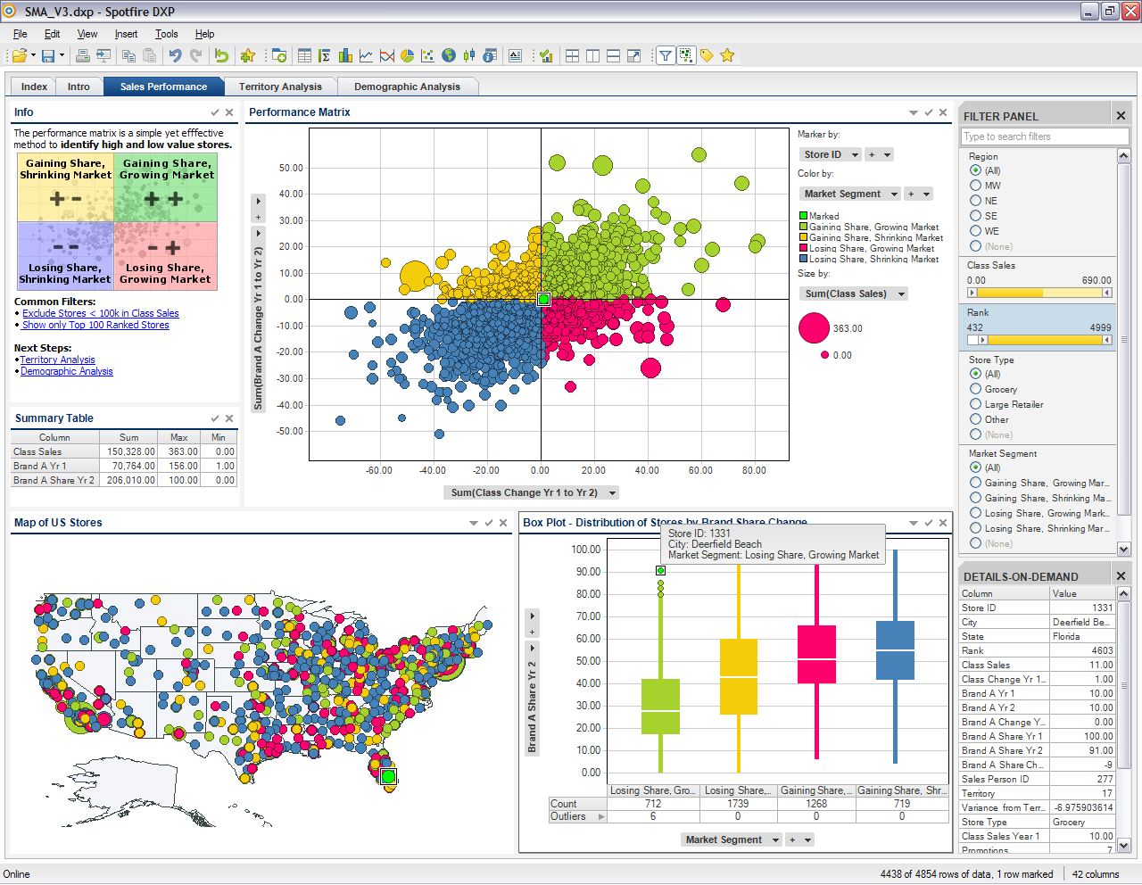
Role of Visualization in Big Data
Big Data
  Machine Learning
  Databases
  Visualization
Visualization allows the user to interactively and visually explore large amounts of data
Spotfire

Slide 5
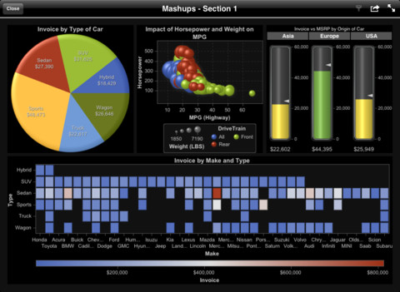
Role of Visualization in Big Data
Big Data
  Machine Learning
  Databases
  Visualization
Visualization allows the user to interactively and visually explore large amounts of data
SAS Visual Analytics

Slide 6
Domain-Specific Visual Analytics Systems
Financial Fraud Detection
  Bank of America
Political Simulation
  DARPA
Global Terrorism Database
  DHS
Bridge Maintenance
  US DOT
Biomechanical Motion
  Brown University

Slide 7




Applications of Visual Analytics
Financial Fraud Detection
  Bank of America
Political Simulation
  DARPA
Global Terrorism Database
  DHS
Bridge Maintenance
  US DOT
Biomechanical Motion
  Brown University
R. Chang et al., Two Visualization Tools for Analysis of Agent-Based Simulations in Political Science. IEEE CG&A, 2012

Slide 8
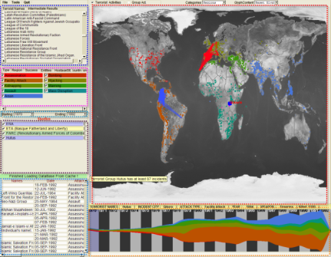
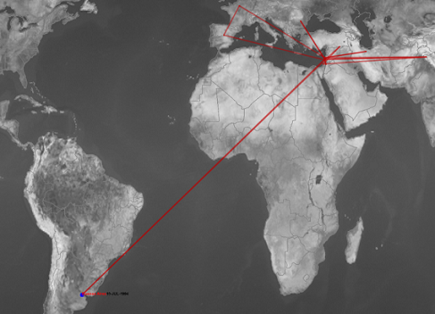
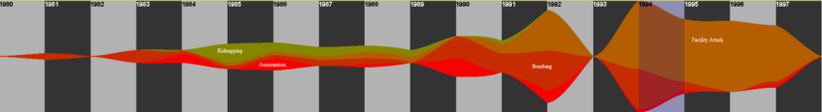
Applications of Visual Analytics
Financial Fraud Detection
  Bank of America
Political Simulation
  DARPA
Global Terrorism Database
  DHS
Bridge Maintenance
  US DOT
Biomechanical Motion
  Brown University
Who
Where
What
Evidence
Box
Original
Data
When
R. Chang et al., Investigative Visual Analysis of Global Terrorism, Journal of Computer Graphics Forum, 2008.

Slide 9



Applications of Visual Analytics
Financial Fraud Detection
  Bank of America
Political Simulation
  DARPA
Global Terrorism Database
  DHS
Bridge Maintenance
  US DOT
Biomechanical Motion
  Brown University
R. Chang et al., An Interactive Visual Analytics System for Bridge Management, Journal of Computer Graphics Forum, 2010. To Appear.

Slide 10



Applications of Visual Analytics
Financial Fraud Detection
  Bank of America
Political Simulation
  DARPA
Global Terrorism Database
  DHS
Bridge Maintenance
  US DOT
Biomechanical Motion
  Brown University
R. Chang et al., Interactive Coordinated Multiple-View Visualization of Biomechanical Motion Data, IEEE Vis (TVCG) 2009.

Slide 11
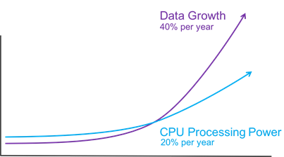
Insufficient for Big Data?
Scalability
  Data growing faster than compute power
  With Big Data, every user’s interaction can take seconds, minutes, hours, or days to complete.
For Library-of-Congress-scale of IC data, existing tools do not scale to meet the needs (Dr. Fingar).

Slide 12


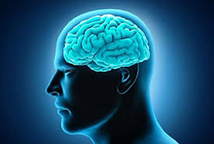

Data Visualization Pipeline

Slide 13

Interactive Systems for Big Data
Effects of Latency
  Interrupts analysis flow
  Cannot meet “time sensitive” needs (Dr. Wilson)
  Affects short-term memory
    500ms affects exploration
    10 minutes affects recall
Conversely, highly interactive systems allow:
  Higher “throughput” for analysts
  Better “communication” between human and computer
  Increase efficiency and accuracy of decision

Slide 14
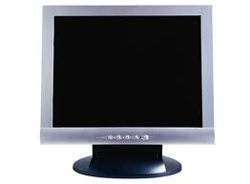

Taking a Step Back: Big Data Visualization
1000 pixels
Visualize 10 million data points
  “Information theoretic” upper-bound
  10 million data -> 1 million pixels
  10:1 reduction in information
Problem is in fact worse, because…
  There is a perceptual and cognitive limit
  Adding more pixels doesn’t solve the problem
1000 pixels
1000x1000 = 1 million

Slide 15

Turning Obstacles Into Opportunities!
Fitting billions of data points into million of pixels can be an obstacle…
  Or it can be an opportunity!!

Slide 16

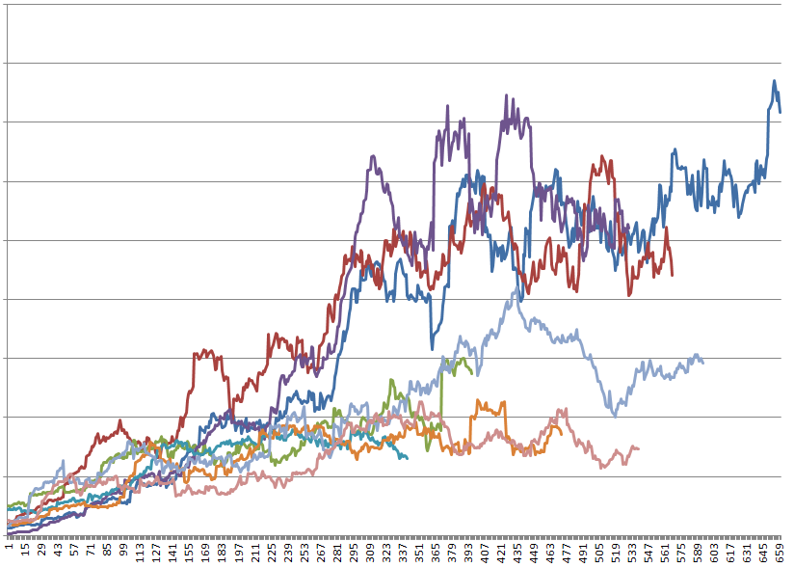
Opportunities in Big Data Visualization
  We should never fetch more than 1 million rows of data from the database
    How to pick the 1 million points?
  Since the user can’t see the details anyway, we can “simplify” the visualization a little for as long as the user can’t perceive the difference
    How to model the perceptual limits in data visualization?

Slide 17
A Simple Example of Perception-Driven Computation
Simple Box-and-Whisker plots (or Box Plots)
Spot the difference?

Slide 18
A Simple Example of Perception-Driven Computation
This difference, although perceptually small, can mean the difference of scanning all data points or using a smaller sampled data set.
If the user cannot perceive the difference, we can save computation time by not rendering the perfect visualization!

Slide 19
Why Vision Science Matters
Spot the difference?
Although the difference between the two bars is the same as the previous example, we know from vision science that the difference here is easier to spot.
But these are “rules”, not “models”
  Does not indicate how many pixels for how much sampling

Slide 20
Perception-Driven Computation
Perception & Cognitive Model
Visualization
Approximate Data & Computation

Slide 21
Perceptual Modeling In Data Visualization?
Requires collaboration between the Perceptual Psychologists with Computer Scientists.
One promising direction is to consider modeling the JND (just noticeable differences) in different visualization designs.
Example of JND: Imagine yourself in a dark room…

Slide 22

Perceptual Modeling
Weber’s Law (mid 1800s)
  Low-level perceptual discrimination (sound, touch, taste, brightness, etc.)
$$dP=k\frac{dS}{S}$$
Change in Intensity
Perceived Difference
Weber Fraction
(via experiments)
Intensity of the Stimulus

Slide 23
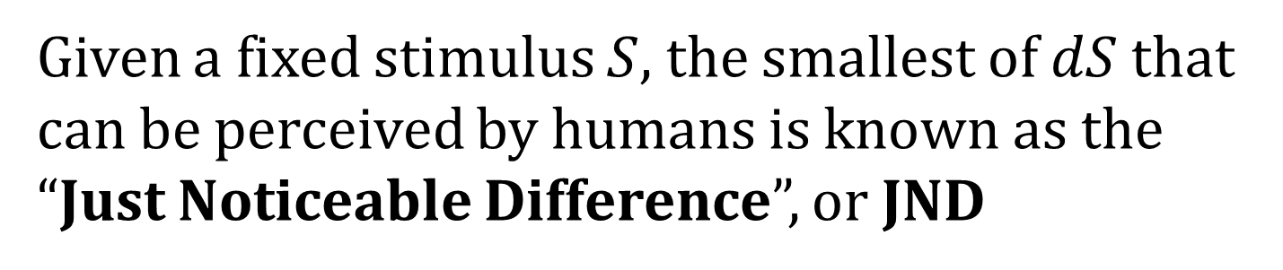
Perceptual Modeling
Weber’s Law (mid 1800s)
  Low-level perceptual discrimination (sound, touch, taste, brightness, etc.)
$$dP=k\frac{dS}{S}$$
Given a fixed stimulus $S$, the smallest of $dS$that
can be perceived by humans is known as the
“Just Noticeable Difference”, or JND

Slide 24
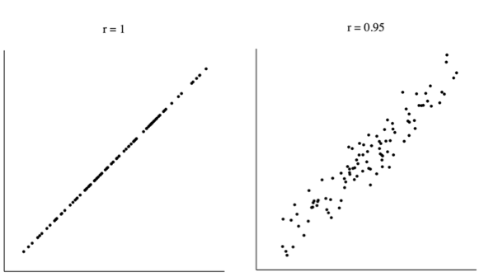
Baldridge & Rensink, 2010: Perception of Correlation
Δr = 0.05

Slide 25
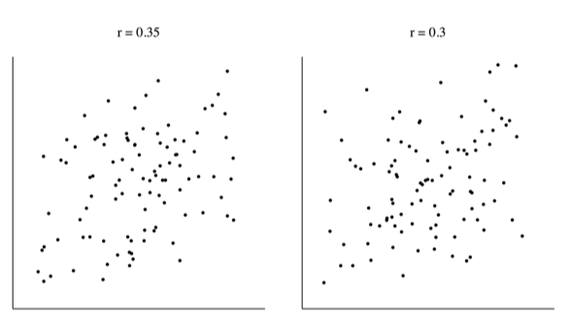
Baldridge & Rensink, 2010: Perception of Correlation
Δr = 0.05

Slide 26
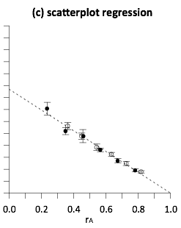
Perception of Correlation
In 2010, Ron Rensink and colleague found that the perception of correlation in a scatterplot follows Weber’s Law
In 2014, our team extended this work to determine if perception of correlation in all bivariate visualizations follows Weber’s Law
worse
better

Slide 27
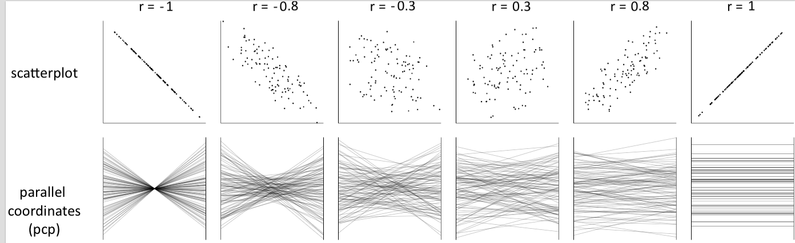
Notes:
both positively and negatively correlated data

Slide 28
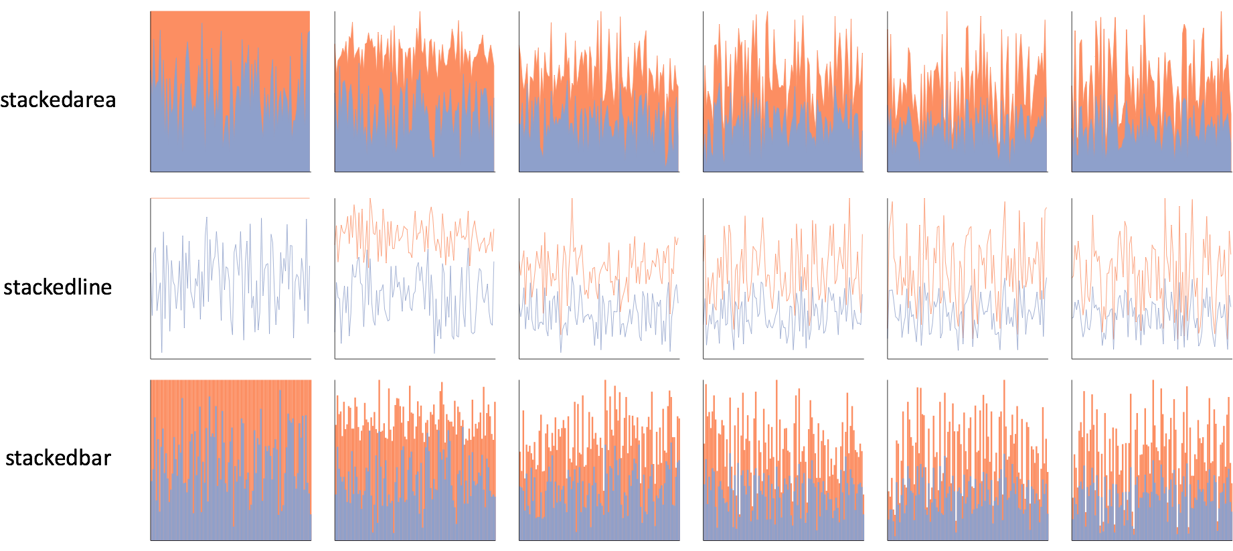
Notes:
one click away in excel

Slide 29
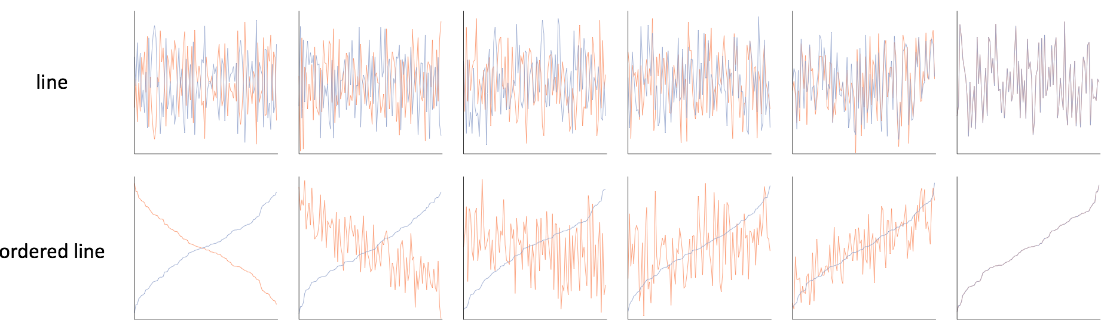

Slide 30
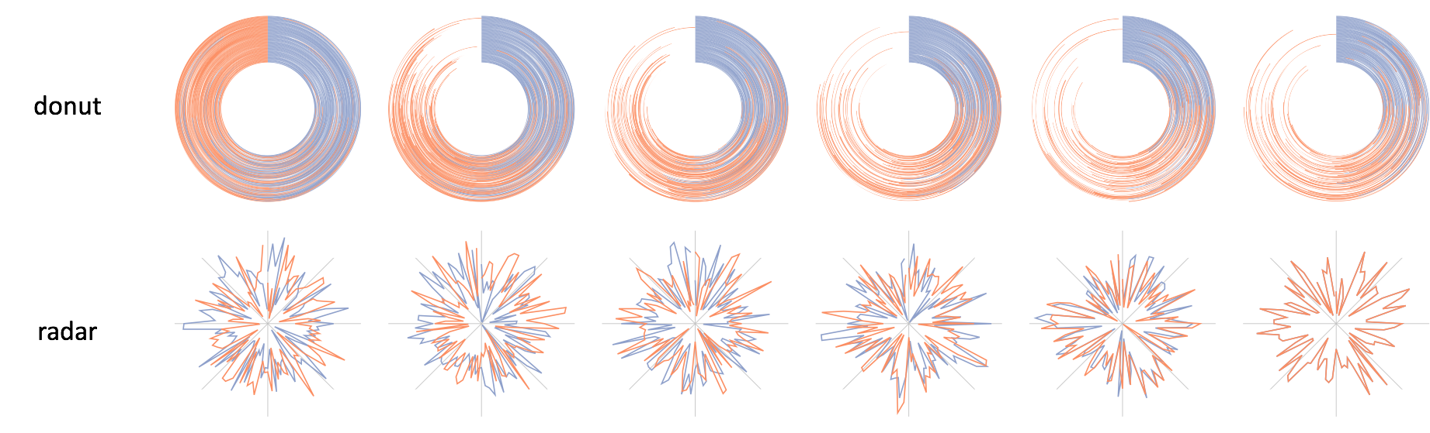

Slide 31
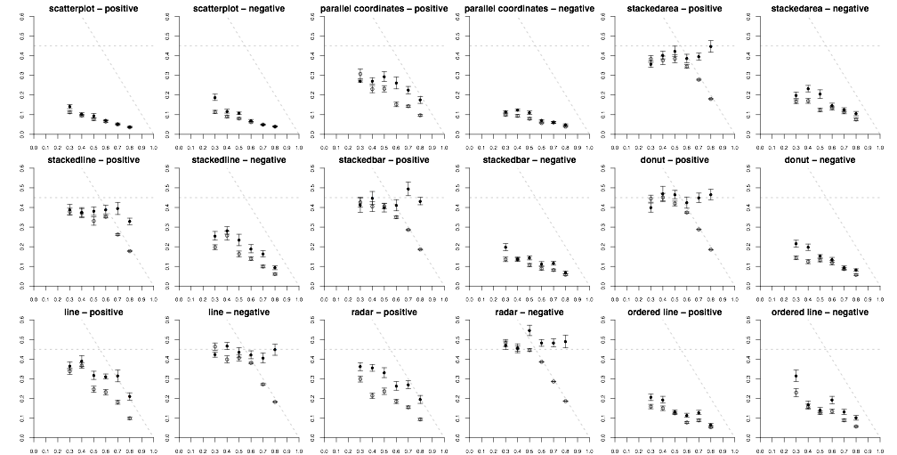
Notes:
whereas Rensink had one…
roughly 200,000 individual perceptual judgements

Slide 32
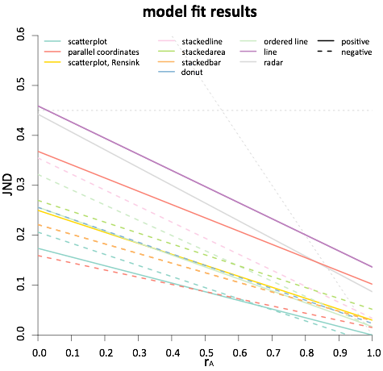
less precise
more precise
Notes:
this is essentially seeing if the trend of JNDs is linear
the moment of truth came when we checked the statistics

Slide 33
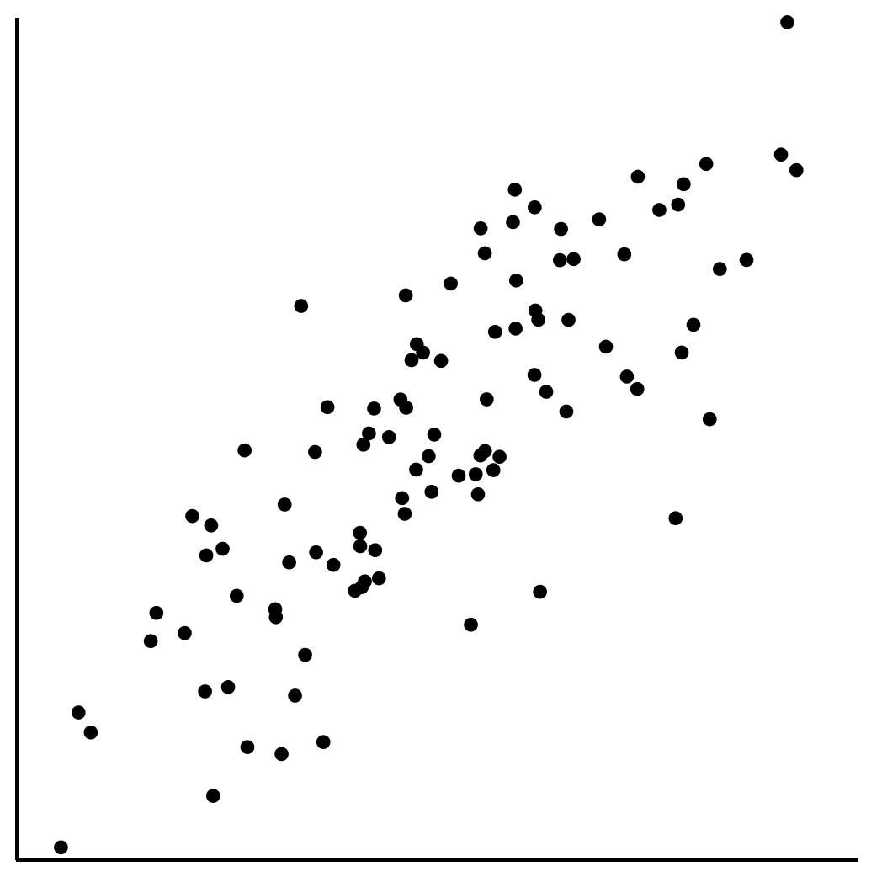
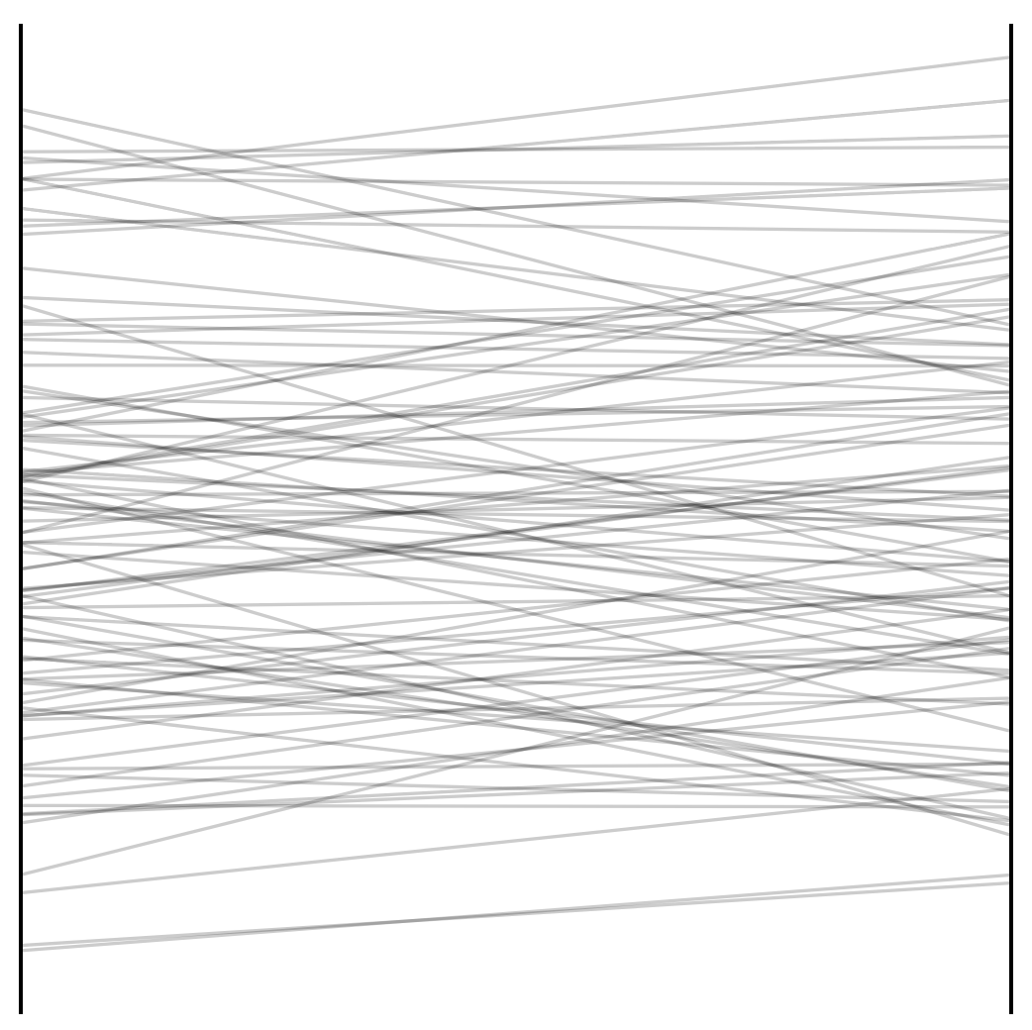
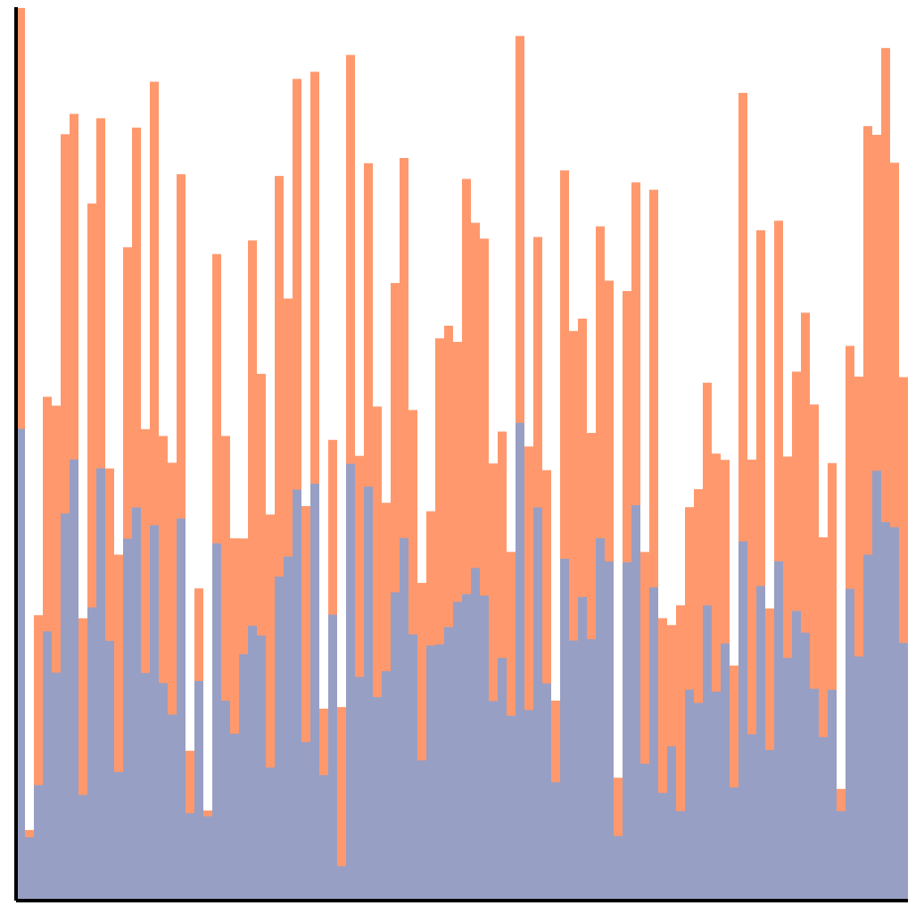
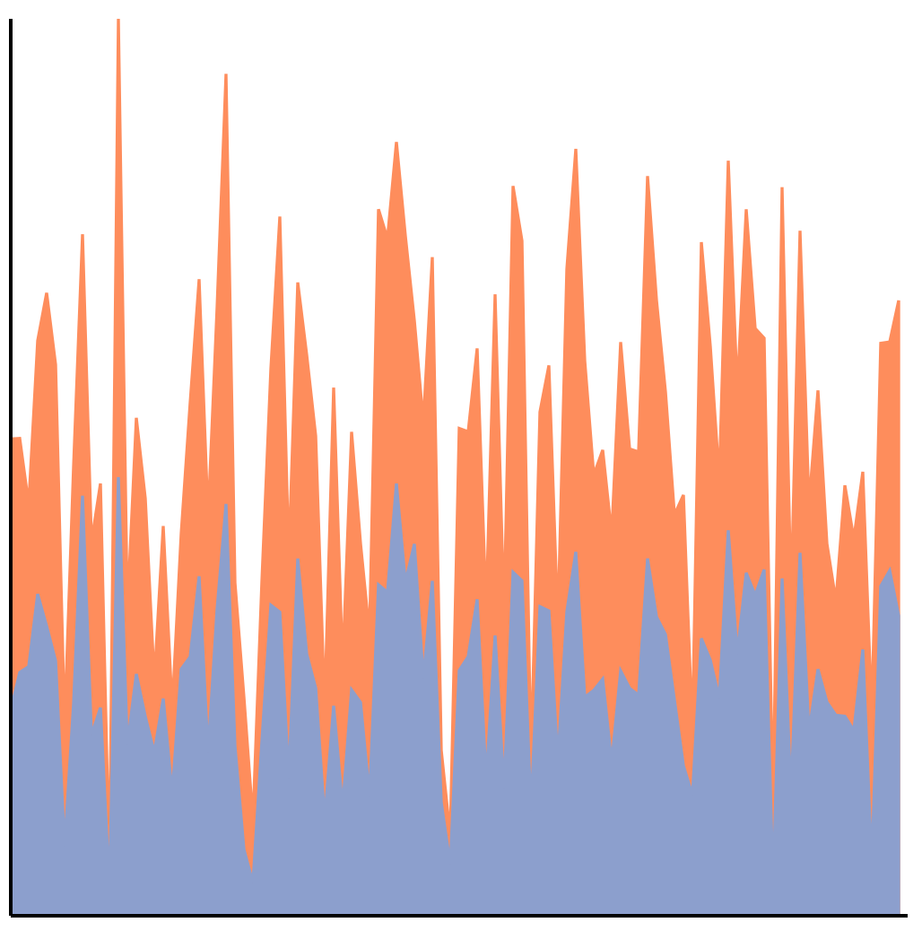
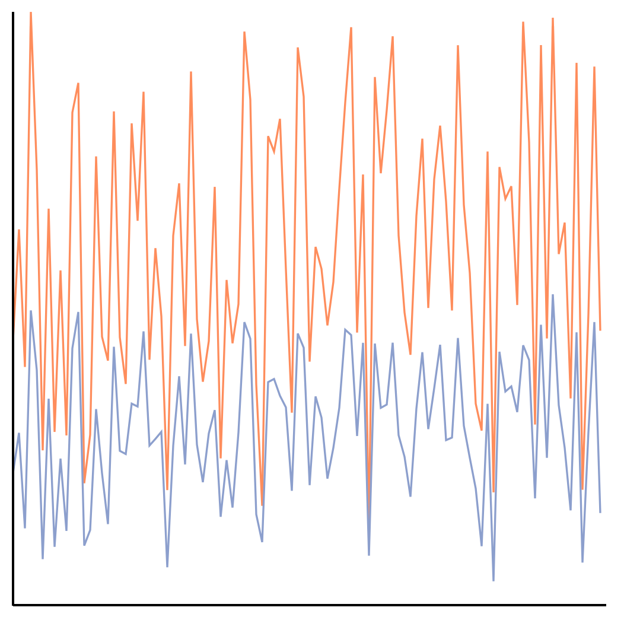
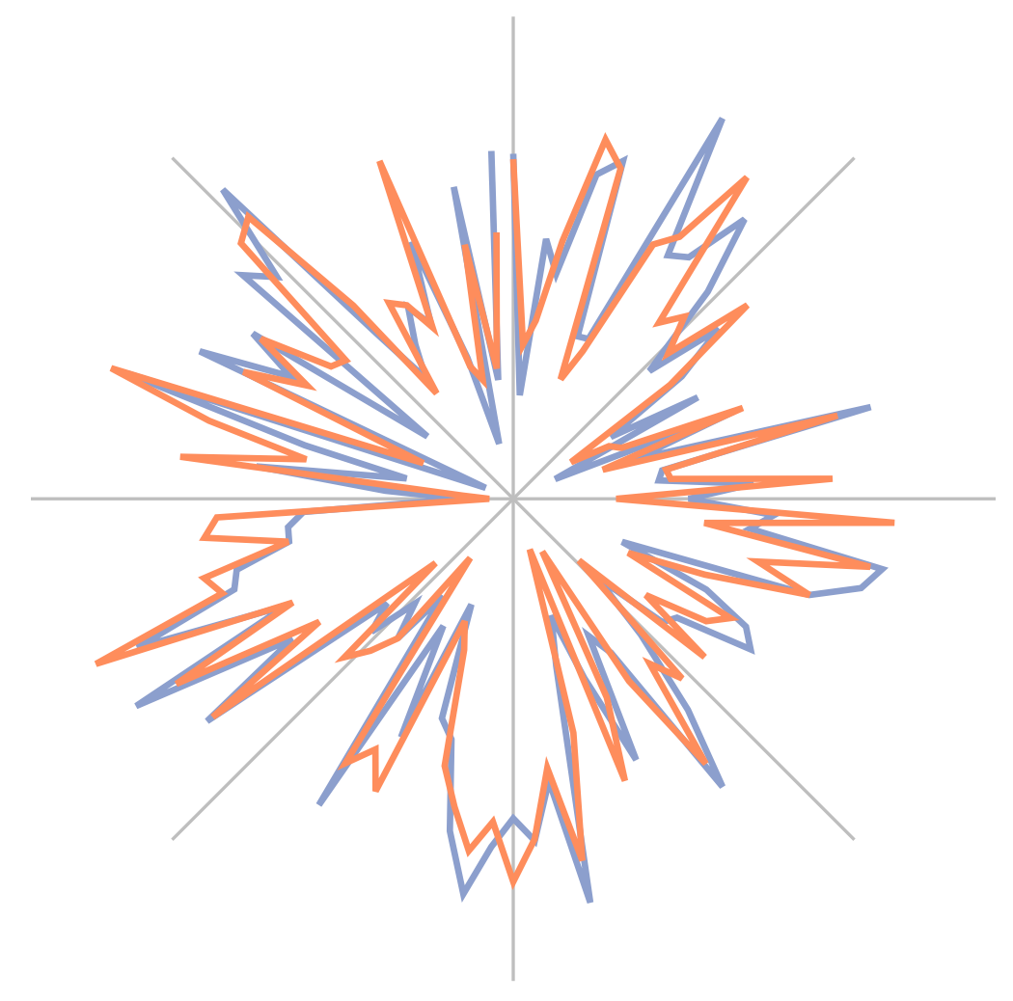
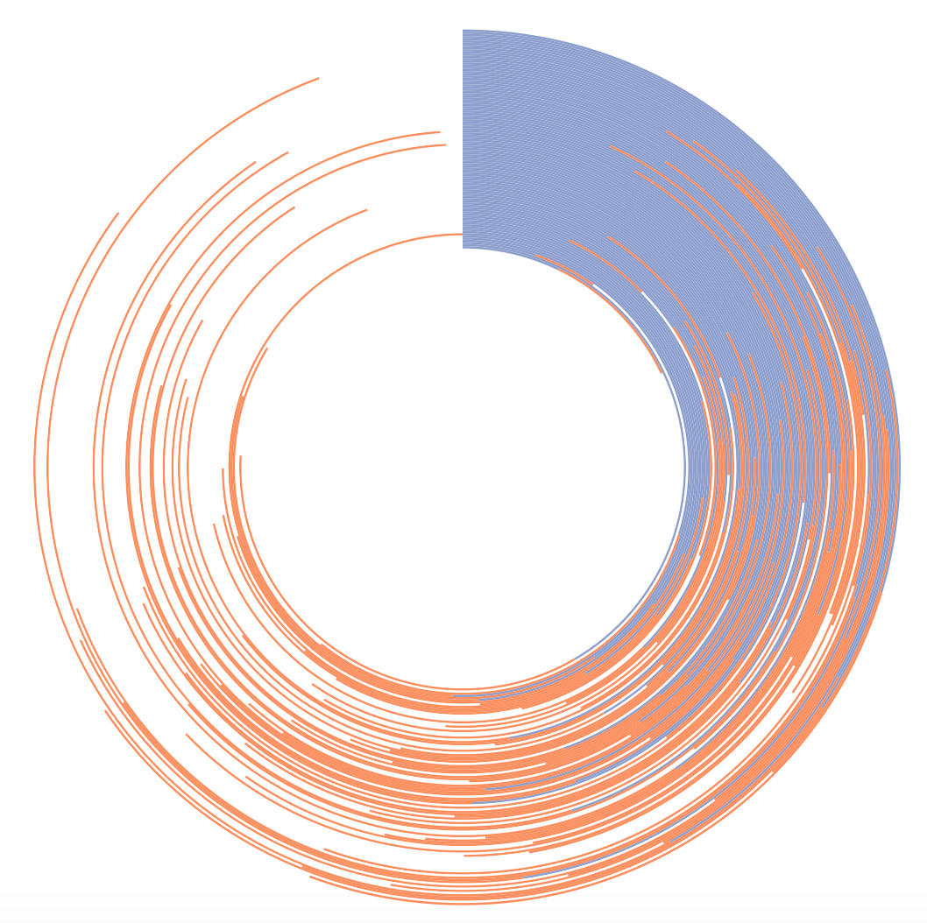
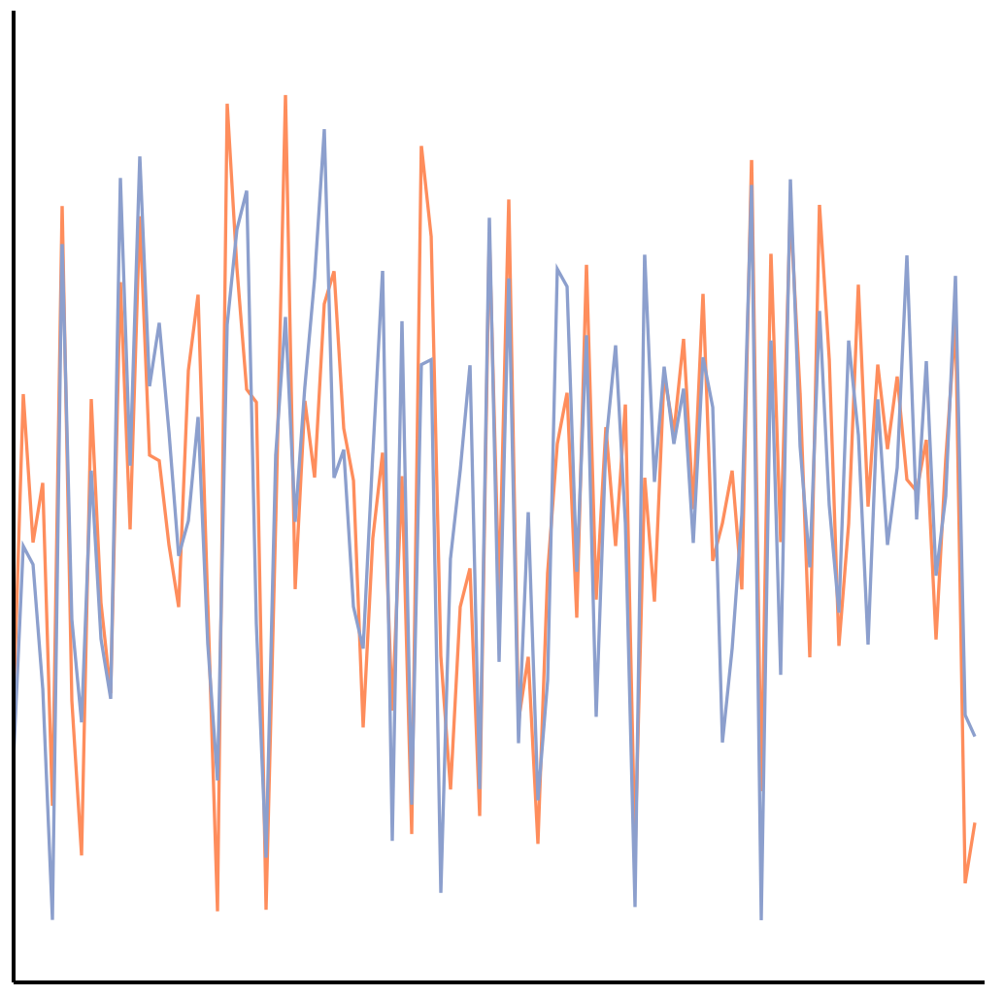
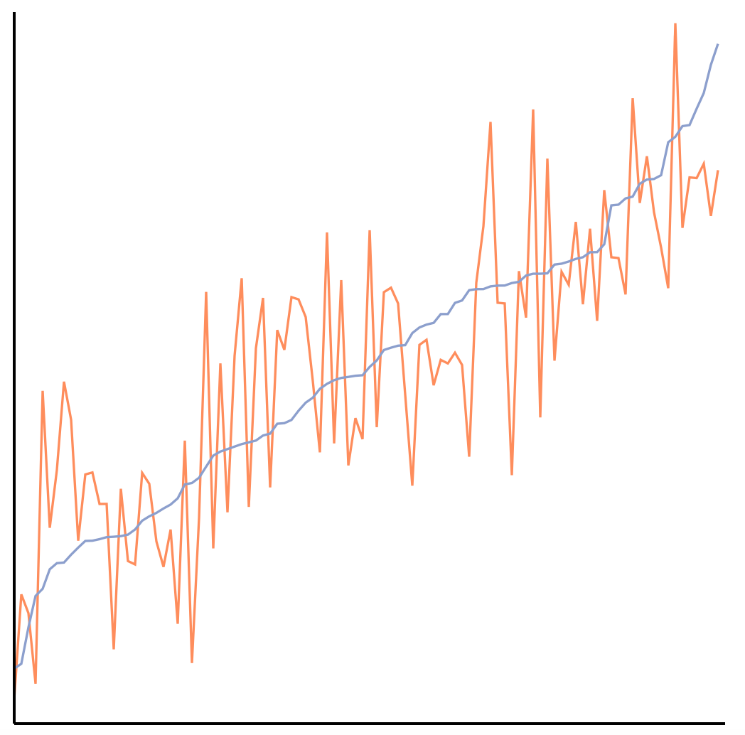
The perception of correlation
in every tested chart can be modeled using Weber’s law.
Notes:
Here we have a perceptual law that is used to study things like taste, line-length, brightness. Not only are we using it to model correlation, which is a higher-level concept, but it also applies across every chart tested!

Slide 34
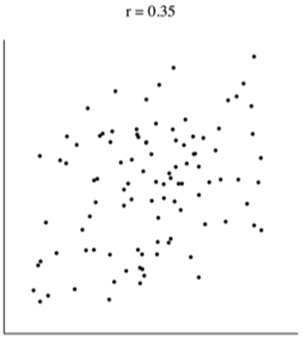
Why Is This So Cool?
Positives:
  These models have both descriptive and prescriptive powers
    It “describes” what people see (and don’t see) from the data
    It “predicts” what people will see given a new data
  They can be used to quantitatively compare the effectiveness of visualizations
  They can be used to drive computation (sampling)
Useful, but limited to correlation…

Slide 35
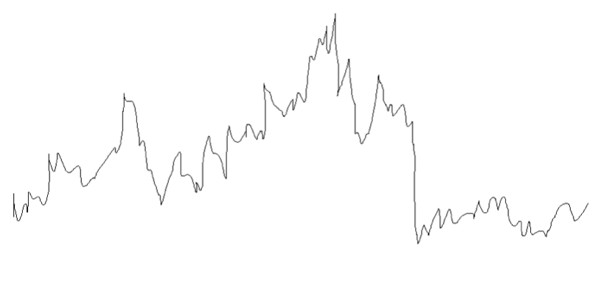
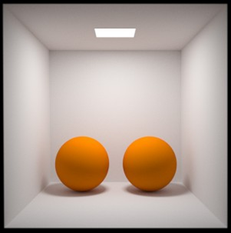
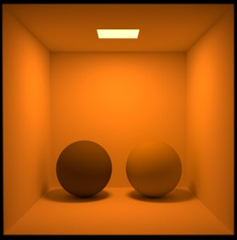
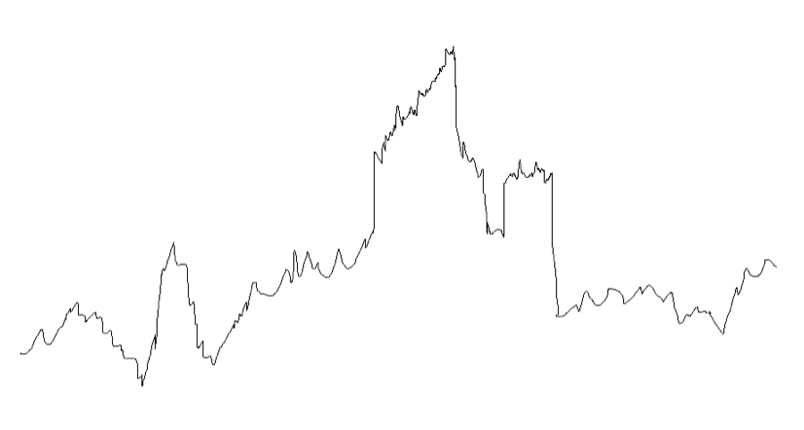
Beyond Correlation: Visualization Metamers
Metamers:
  Stimuli that are different but appear the same (under some condition)
Visualization Metamers
  Visualizations that appear the same (under some condition)
  Uses much less data
  Are much faster to render
Collaboration with Steve Franconeri (Northwestern) and Eugene Wu (Columbia)

Slide 36
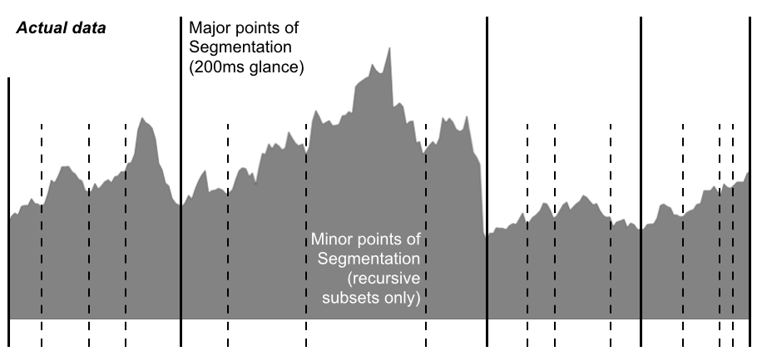
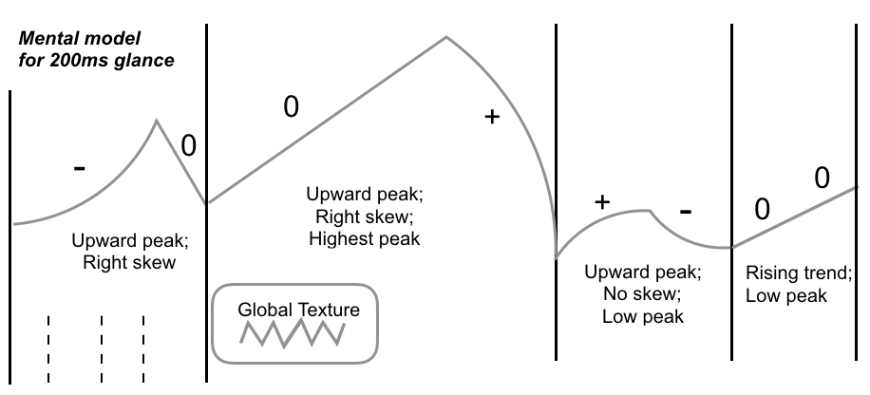
Visualization Metamers
Focus: 1D visualizations
  Bar charts, line graphs, heatmaps, etc.
Properties of the model for visualization metamers
  Recursive
  Peaks and valleys
  Slope
  Concavity
  Texture
  ⋮
Progressive Refinement

Slide 37


In 10 Years…
Science of Perception (and Cognition)
  What do people see (and not see) when perceiving data?
  Can we model these properties and anticipate what mistakes will be made?
Engineering of Data Systems based on Perception and Cognitive Principles
  “Compute only what you can see”
  Conversely, “Make more clear what an analyst cannot see”
Two sides of the same coin. Collaboration between the fields (Psych, CogSci, CS, IC) is essential

Slide 38



Questions? remco@cs.tufts.edu

Slide 39
Backup Slides

Slide 40
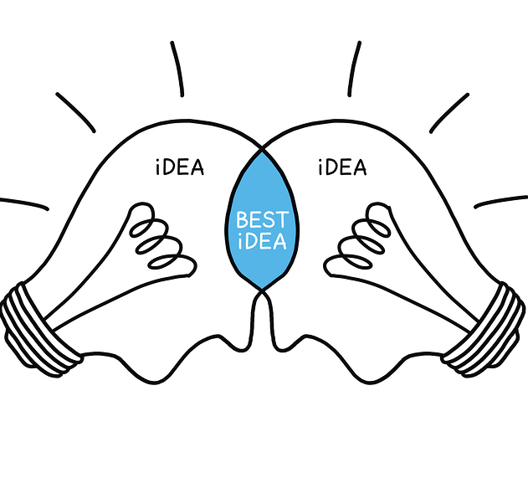
Summary & Conclusion
Need more cross-disciplinary research between Vision Science and Computer Science
In 10 Years: need more systems to help analyst combat the data deluge
  More CPUs is not the answer!
Perception- and Cognitive- based approaches enable “building machines that make analysts smarter” (Dr. Klein)
  Data analysis for the Masses (DARPA)
  Support Bayesian Reasoning
  Interaction Inferencing for Predictive Analysis

Slide 41
Hypothesis
Perception of Correlation follows Weber’s Law because the Visual Features used to discriminate Correlation follows Weber’s Law.
  Regression (Logistic) Analysis of Visual Features vs. Judgment
  Mathematical Confirmation

Slide 42
Visual Features

Slide 43
Hypothesis
Perception of Correlation follows Weber’s Law because the Visual Features used to discriminate Correlation follows Weber’s Law.
  Regression (Logistic) Analysis of Visual Features vs. Judgment

Slide 44
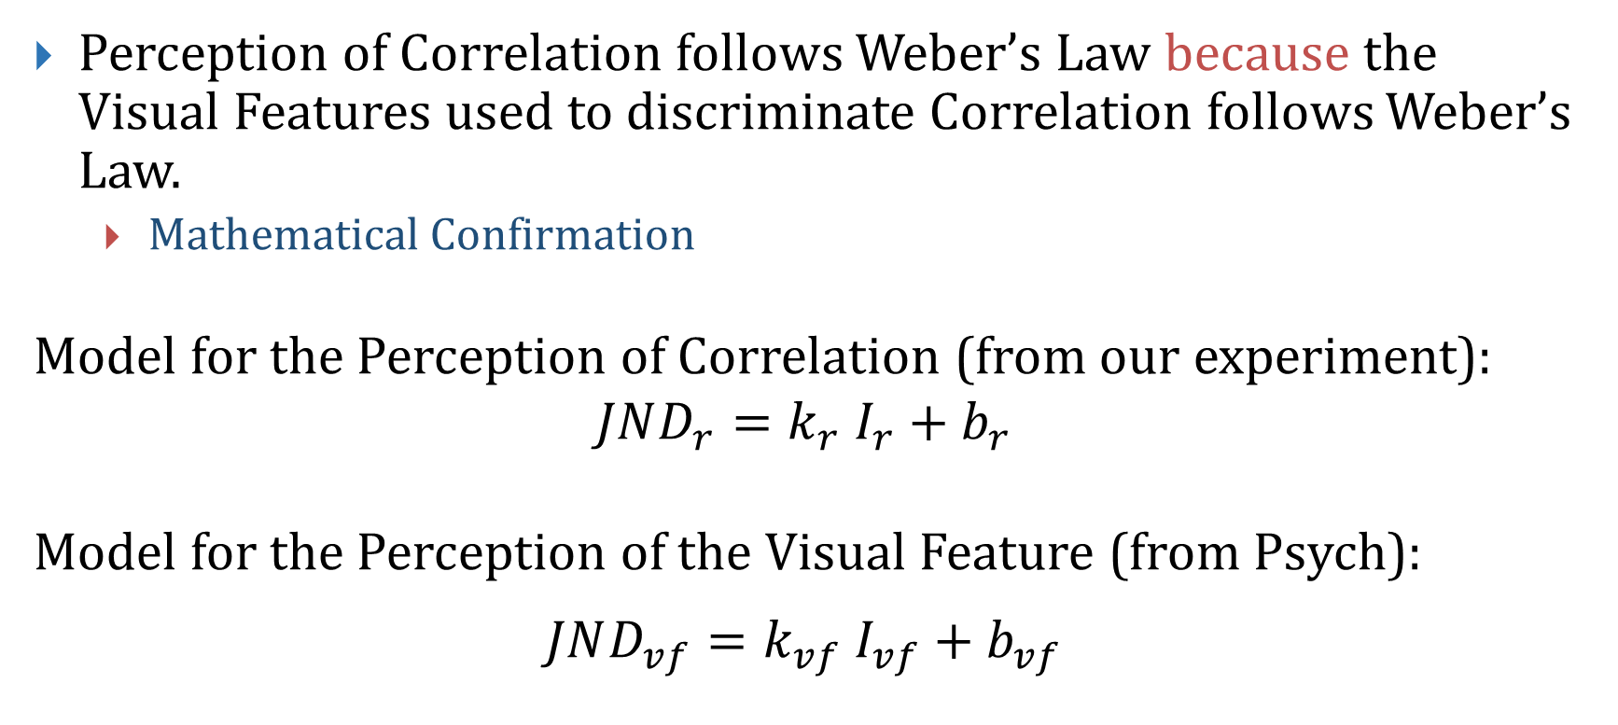
Hypothesis
Perception of Correlation follows Weber’s Law because the Visual Features used to discriminate Correlation follows Weber’s Law.
  Mathematical Confirmation
Model for the Perception of Correlation (from our experiment):
$$JND_{r}=k_{r} I_{r}+b_{r}$$
Model for the Perception of the Visual Feature (from Psych):
$$JND_{vf}=k_{vf} I_{vf}+b_{vf}$$

Slide 45
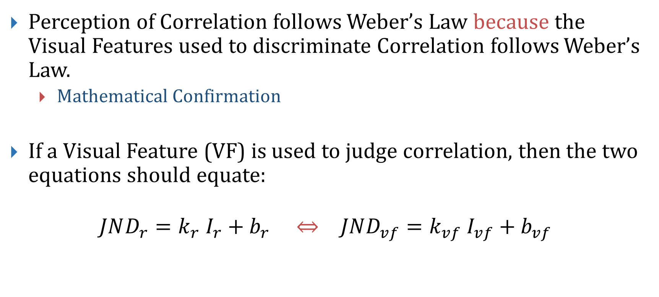
Hypothesis
Perception of Correlation follows Weber’s Law because the Visual Features used to discriminate Correlation follows Weber’s Law.
  Mathematical Confirmation
If a Visual Feature (VF) is used to judge correlation, then the two equations should equate:
$$JND_{r}=k_{r} I_{r}+b_{r} ⇔ JND_{vf}=k_{vf} I_{vf}+b_{vf}$$

Slide 46
Visualization Metamers: Beyond Correlation

