Slide 1
From Web Documents to Web Applications
CS 117: Internet Scale Distributed Systems (Fall 2023)
Noah Mendelsohn
Tufts University Email: noah@cs.tufts.edu
Web: http://www.cs.tufts.edu/~noah
Copyright 2012, 2013, 2015, 2016, 2017,2022 & 2023

Slide 2
Goals
Documents…why do they matter?
Designing good document formats
Explore the differences between static documents and “live” applications
Learn the Rule of Least Power
Learn how (what used to be called) AJAX applications:
Increased the power of the Web
Stretched the architecture of the traditional document-oriented Web

Slide 3
Documents and Data Formats

Slide 4
Document Data formats: various approaches
Documents vs data:
Data tends to be fields, often labeled, often unordered (e.g. studentId:123)
Documents tend to treat order as significant (this pargraph comes before that one…often intended for human readers)
Smart documents: include data fields in document (e.g. insurance policy template with space for policy holder name, amount of policy, etc.)
Approaches
Ad-hoc: just do whatever works
Meta-formats: common conventions used for lots of purposes
Examples: plain text, CSV (comma-separated variables), XML JSON
Reason: common tools usable on all the formats (e.g. Python libraries, spreadsheet import)
Self-describing: fields labeled in each document Implicit: specification tells you what’s where

Slide 5
Sharing Documents, Data, & Applications

Slide 6
Sharing documents, data & applications
Since early days of computing: all have been shared
Often, we send documents through a network (e.g. Web pages)
Programs & data/documents on:
Punched cards, paper tape, magnetic tape
Floppy disks, CD ROMS, thumb drives, etc.
Networking early days:
Sharing via FTP and e-mail
Model
Copy the data/documents
Manually install the programs

Slide 7
What makes applications different?
Documents don’t do anything
Programs can:
Perform arbitrary computations for you
Alter your machine
Run for a long time, with multiple interactions
Masquerade as other programs (spoofing)
Do much more (open network connections, etc.)!
The Web:
Allowed instantaneous “activation” of documents
Now doing the same for applications

Slide 8
What makes applications different?
Documents don’t do anything
Programs can:
Perform arbitrary computations for you
Alter your machine
Run for a long time, with multiple interactions
Masquerade as other programs (spoofing)
Do much more (open network connections, etc.)!
The Web:
Allowed instantaneous “activation” of documents
Eventually did the same for applications
A new model: applications built from smart documents

Slide 9
Encoding logic and semantics
Declarative code sets out the desired result not details of the necessary computation (e.g. how to compute where the 1st character goes when centering something)
Declarative code sets out the desired result not details of the necessary computation (e.g. how to compute where the 1st character goes when centering something)
Declarative code sets out the desired result not details of the necessary computation (e.g. how to compute where the 1st character goes when centering something)
Declarative markup (e.g. <boldface>some text</boldface>)
Constraint based (a powerful kind of declarative coding):
<center>some text</center>
<p style=“margin-left:20%”> some text</p>
Functional: answer is the result of some function
Imperative: give the steps that need to be performed
E.g. To center text: 1) Compute width of page 2) Compute width of text 3) Position start of text at (pagewidth-textwidth)/2 4) Write the text.
HTML and CSS are declarative, Javascript is imperative
Semantics depend on context… * Center within <body> or <div> * Margin from left of current border and width 20% of containing <body> or <div>

Slide 10
JavaScript & Web Pages

Slide 11
Javascript
A general purpose programming language
Runs on Web pages
Turing complete – this is a big deal!
Check out the amazing: http://bellard.org/jslinux/
Remember, these are running entirely in a Web page in your browser!
Proving the power of JavaScript
The JavaScript is emulating a CPU and controller chip at the instruction level
A Linux is booted on that!
Also:
https://archive.org/details/win3_stock and https://archive.org/details/mac_MacOS_7.0.1_compilation https://www.pcjs.org/devices/pc/machine/5160/cga/256kb/win101/
See tech notes at: http://bellard.org/jslinux/tech.html

Slide 12
JavaScript is a scripting language
Even a single statement can be used in some cases
<!DOCTYPE html>
<html>
<head>
<title>JavaScript Demo #1</title>
</head>
<body>
<h1>JavaScript Demo</h1>
<p>Try moving your mouse over the word below:</p>
<p id="hellopara" style=:font-size:large"
onmouseover='this.style.color="red";'
onmouseout='this.style.color="black";'>Hello!</p>
</body>
</html>
The ability to write single statement programs tends to be a distinguishing characteristic of scripting languages.

Slide 13
JavaScript is integrated with the Web page
What is “this”?
<!DOCTYPE html>
<html>
<head>
<title>JavaScript Demo #1</title>
</head>
<body>
<h1>JavaScript Demo</h1>
<p>Try moving your mouse over the word below:</p>
<p id="hellopara" style=:font-size:large"
onmouseover='this.style.color="red";'
onmouseout='this.style.color="black";'>Hello!</p>
</body>
</html>

Slide 14
JavaScript is integrated with the Web page
<html>
<head>
<script type="text/javascript">
function makeColor(elem,color) {
elem.style.color=color;
}
function loadfunction() {
helloPara = document.getElementById('hellopara');
helloPara.onmouseover = function() {
makeColor(this,"red");
};
helloPara.onmouseout = function() {
makeColor(this,"black");
};
}
</script>
<title>JavaScript Demo #2</title>
</head>
<body onload='loadfunction()'>
<h1>JavaScript Demo #2</h1>
<p>Try moving your mouse over the word below:</p>
<p id="hellopara" style=:font-size:large">Hello!</p>
</body>
</html>
We can dynamically find elements by their id’s!

Slide 15
Uses for JavaScript on the Web
Making Web pages smarter
Form field input checking
Dynamic highlighting & selection
In this case, we still have a document
Using HTML as an application container
The user interacts with an application, not a document
Example: the Linux system we just saw
GMail, Yahoo Mail
AJAX
Building smart documents and applications by integrating content from multiple sources dynamically at the client
The original mashup: http://www.housingmaps.com/ (no longer active ☹)

Slide 16
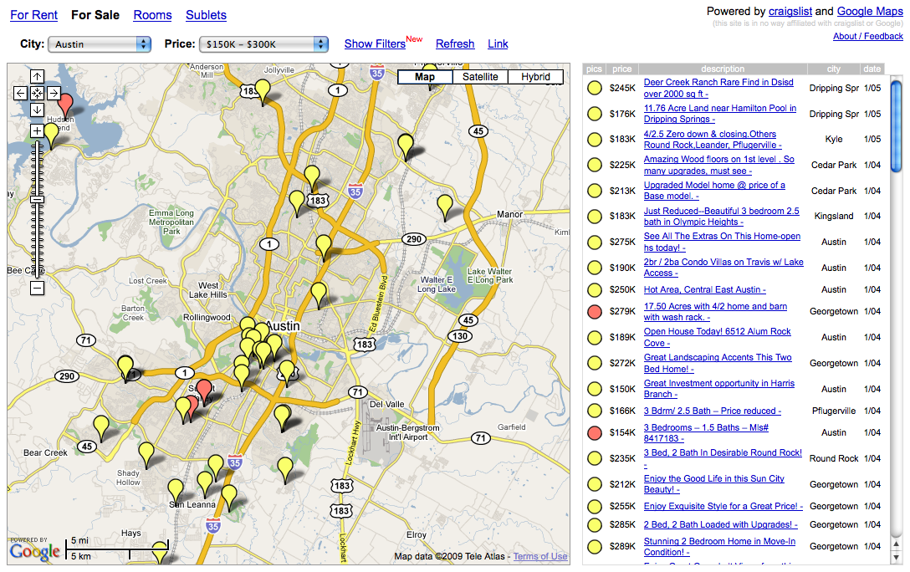
The original housingmaps mashup – the first Ajax app!

Slide 17
From : http://www2.technologyreview.com/tr35/profile.aspx?TRID=437

Slide 18
Uses for JavaScript on the Web
Making Web pages smarter
Form field input checking
Dynamic highlighting & selection
In this case, we still have a document
Using HTML as an application container
The user interacts with an application, not a document
Example: the Linux system we just saw
GMail, Yahoo Mail
AJAX
Building smart documents and applications by integrating content from multiple sources dynamically at the client
The original mashup: http://www.housingmaps.com/ (no longer active ☹)
HTML Games and Animations
E.g. Euro-soccar HTML5 game http://play.famobi.com/euro-soccer-sprint

Slide 19
Summary: Integrating JavaScript with Web Pages
Web applications are HTML pages w/JavaScript smarts
HTML serves as the display list for the application
JavaScript can manipulate the HTML tree & CSS at anytime
Page is dynamically re-rendered
History footnote:
1997 or so: Netscape had invented JavaScript (which has nothing to do with Java, but was named to sound like it did…)
Microsoft was behind in the “browser wars”, but…
…Microsoft had in an internal product a rendering engine that can incrementally re-render a page when parts of a document change
They repurposed that engine to make Internet Explorer’s dynamic HTML rendering better than Netscape’s
Result: Internet Explorer became the leading browser (until Firefox, based on a reworked Netscape engine, became an attractive open-source alternative)

Slide 20
Mashups 101

Slide 21
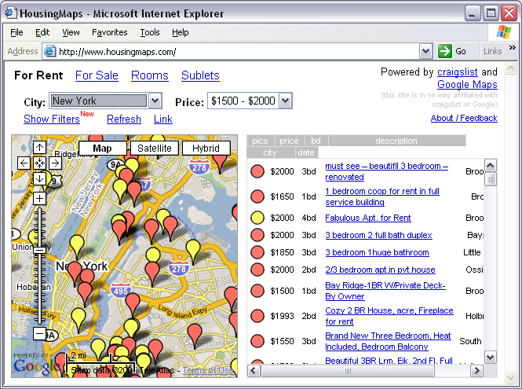
The original mashup
Warning!
This explanation was researched a few years ago. Details of Google Maps may have changed since.
Google Maps
+
craigslist
=
www.housingmaps.com

Slide 22
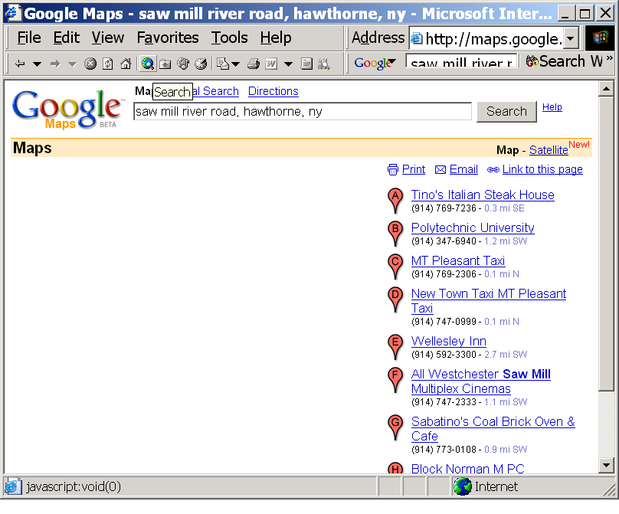
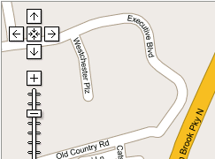
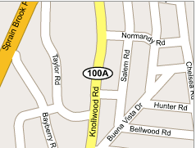
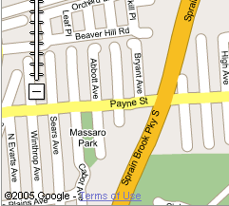
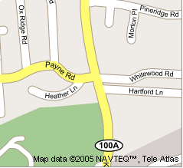
How Google Maps Work
Images retrieved in segments using ordinary Web HTTP Requests

Slide 23
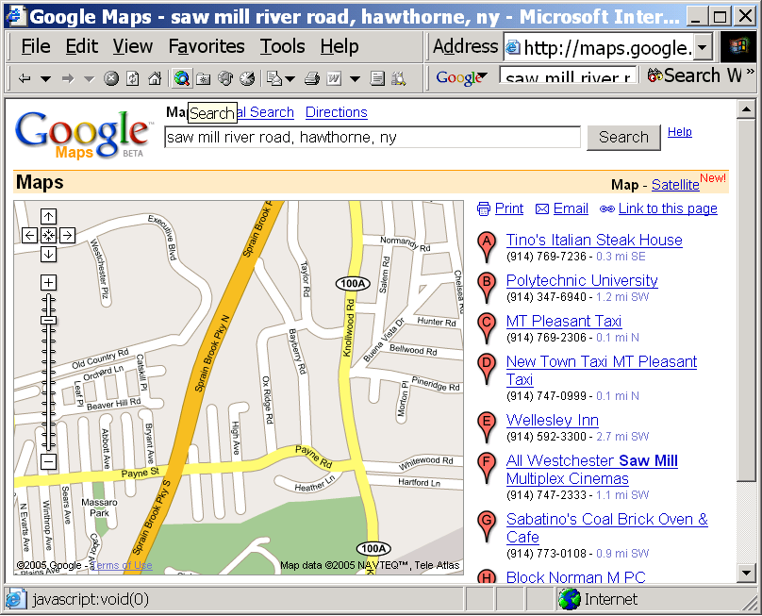
How Google Maps Work
JavaScript at client tracks mouse and moves images for smooth panning…
asynchronously requests new image tiles in background

Slide 24
How Google Maps Work
The Web is used to retrieve an ordinary XML file listing points of interest….
<?xml version="1.0" ?> <page> <title>hotels in hawthorne</title> <query>pizza in atlanta</query> <center lat="33.748888" lng="-84.388056" /> <info> <title>Wellesley Inn</title> <address> <line>540 Saw Mill River Rd.</line> <line>Elmsford, NY 10523</line> </address> </page>

Slide 25
How Google Maps Work
…and XSLT in the browser converts that to HTML
<?xml version="1.0" ?> <page> <title>hotels in hawthorne</title> <query>pizza in atlanta</query> <center lat="33.748888" lng="-84.388056" /> <info> <title>Wellesley Inn</title> <address> <line>540 Saw Mill River Rd.</line> <line>Elmsford, NY 10523</line> </address> </page>

Slide 26
How Google Maps Work
…and XSLT in the browser converts that to HTML
<?xml version="1.0" ?> <page> <title>hotels in hawthorne</title> <query>pizza in atlanta</query> <center lat="33.748888" lng="-84.388056" /> <info> <title>Wellesley Inn</title> <address> <line>540 Saw Mill River Rd.</line> <line>Elmsford, NY 10523</line> </address> </page>

Slide 27
How the Mashup works
Javascript opens a connection to Craigslist
Craiglist information converted to Google-Maps compatible form
Information is “injected” into Google Maps client side runtime.

Slide 28
How Google Maps Work
…now we’ve got real estate listings instead of restaurants
<?xml version="1.0" ?> <page> <title>Housing from Craigsilst</title> <info> <title>Cute apartment</title> <address> <line>101 5th Avenue.</line> <line>New York, NY 10001</line> </address> </page>

Slide 29
How the Mashup works
Javascript opens a connection to Craigslist
Craiglist information converted to Google-Maps compatible form
Information is “injected” into Google Maps client side runtime.

Slide 30
Challenge What if Everything on the Web was Javascript?

Slide 31
The Rule of Least Power
Javascript is powerful, but…you can’t extract much information from JavaScript source
If all Web content were JavaScript…we wouldn’t have Google!
Where possible, use declarative languages
HTML
CSS
Etc..
Read TAG Finding “Rule of Least Power” http://www.w3.org/2001/tag/doc/leastPower.html

Slide 32
Architecture Challenges: Naming

Slide 33
How do we name application states
URI fragment IDs name elements in an HTML document
What to do when the document hosts an application?
This proved a subtle problem…read the TAG finding
What would you want to link in that soccer game?
One useful idiom: if your application is serving documents, give each one a URI
Maps, Office Documents, E-mail
Remember: keep naming orthogonal to access control
Read TAG Finding “Identifying Application State” http://www.w3.org/2001/tag/doc/IdentifyingApplicationState

Slide 34
Architecture Challenges: Security

Slide 35
Mobile Code is Powerful but Dangerous
Advantages
Can do “anything” – build powerful applications
Supports very fluid interactivity
Zero install: we’re always running the latest version of Google Maps, Yahoo! Mail, etc.
Dangers:
Can do “anything” – at least if security controls fail
Hard to check what a Turing-complete program is going to do: virus detection unreliable
Be especially suspicious of code that manipulates other code
Read Ken Thompson’s Turing Award Lecture “Reflections on Trusting Trust” http://cm.bell-labs.com/who/ken/trust.html

Slide 36
Summary

Slide 37
Summary
With JavaScript, the Web evolved
Now: documents + applications
Least Power: don’t use powerful languages unnecessarily
Model applications as documents where practical
Think hard about naming things with URIs
Mobile code: powerful but dangerous!
Is the Web really working the way Tim Berners-Lee planned it? (We’ll discuss that next time)

