Slide 1

Web Security Origins and Evolution
Mary Ellen Zurko
mez@ll.mit.edu
November 12, 2020
DISTRIBUTION STATEMENT A. Approved for public release. Distribution is unlimited. This material is based upon work supported under Air Force Contract No. FA8721-05-C-0002 and/or FA8702-15-D-0001. Any opinions, findings, conclusions or recommendations expressed in this material are those of the author(s) and do not necessarily reflect the views of the U.S. Air Force.© 2018 Massachusetts Institute of Technology. Delivered to the U.S. Government with Unlimited Rights, as defined in DFARS Part 252.227-7013 or 7014 (Feb 2014). Notwithstanding any copyright notice, U.S. Government rights in this work are defined by DFARS 252.227-7013 or DFARS 252.227-7014 as detailed above. Use of this work other than as specifically authorized by the U.S. Government may violate any copyrights that exist in this work.
Notes:
1
1
What do you know about (web) security?
Which security courses taken?

Slide 2
It’s 1992. You’re Tim Berners-Lee. What one security feature do you put in your World Wide Web proposal?
Notes:
Start of Lesson 1
The World Wide Web, as conceived, is open
While there’s a vision of the read/write web, it’s a read only experience for users. And it’s all data (static web pages), no code.
Basic authentication is it.

Slide 3
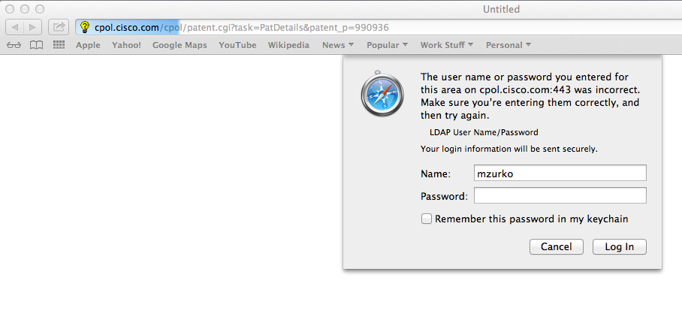
(Basic) Authentication
Security the way Tim intended
Server says: WWW-Authenticate: Basic realm="insert realm”
User prompted for their password
Client says: Authorization: Basic QWxhZGluOnNlc2FtIG9wZW4=
  User agent remembers and sends for that URI domain/realm
Notes:
These realms allow the protected resources on a server to be partitioned into a set of protection spaces, each with its own authentication scheme and/or authorization database. The realm value is a string, generally assigned by the origin server, which may have additional semantics specific to the authentication scheme.
Authorization method sent back
base64 encoding of ID and password separated by a colon
What’s good here? Hint: success and simplicity (for users, for deployments)
What’s not so good?

Slide 4
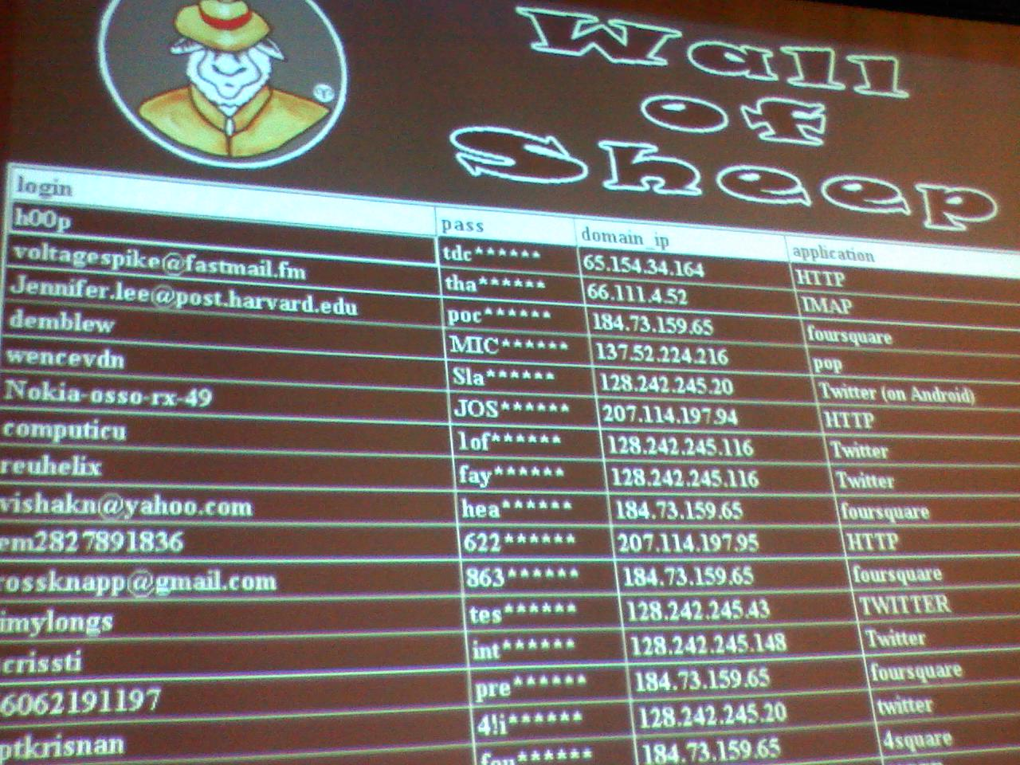
Original (Basic) Authentication Challenges
Password unprotected
  Encoding is not encrypting
Every domain+realm does their own authentication
  No Single Sign On
  Password proliferation
Who’s asking you for your password?
  For what?
Notes:
DEFCON – one of the world’s largest hacker conventions; started in 1993
Wall of Sheep – DEFCON passive network sniffing
Education and awareness

Slide 5
The future will be different
So will attacks and attackers
(But only if you’re successful)
Notes:
Security Lesson 1

Slide 6
It’s 1994.
You want to protect passwords on the WWW.
How do you do it?
Notes:
Start of Lesson 2
Passwords zipping around on this open network
Lead in to the wonders of encryption and Digest authentication

Slide 7
There’s Cryptography – It’s Secure!
Cryptography is to Security as Caching is to Performance
Trust, Trustworthy, and Trust for What?
Quis custodiet ipsos custodes?
Notes:
Is cryptography enough? What does it do? What can it do?
Roman poet Juvenal
Who will guard the guards themselves?
Who will watch the watchers?

Slide 8
Digest Authentication
Cryptographically hash the password
With the username and realm
  Defense against Rainbow Tables
Nonces in the server challenge for replay protection
Started in 1994; RFC in 1997
Resists passive attacker on the network
Minimizes handling of password plaintext
  No passing the password itself in the protocol
  No need to store the password in the clear
Notes:
A rainbow table is a precomputed table for reversing cryptographic hash functions, usually for cracking password hashes. Tables are usually used in recovering a plaintext password up to a certain length consisting of a limited set of characters. It is a practical example of a space/time trade-off,
Always salt your passwords
Replay attack would allow capture and replay for authentication to that realm
Passwords often reused between sites, so getting it out of plaintext is good

Slide 9
Digest Authentication Challenges
The world was no longer a clean slate
Needs both browser support and server support, which can’t be assumed
The protocol for negotiating mutual support allows a Man in the Middle to spoof lack of support
  Active attacker gets the password anyway
Three tier architectures
  Calling a back end service as the web user
  Sometimes you need that password to propagate the user
  authentication to some service not supporting Digest
Why put in the resources to support this?
  No attacks in the wild, no high value web site interactions, known imperfections
Notes:
The security wasn’t perfect! A common discussion point for security measures

Slide 10
Deployment means interoperability and co-existence with systems without the new security feature
Notes:
Part of lesson 2 – deployment at endpoint scale
Part of lesson 3 – deployment will introduce new issues

Slide 11
Story break:
Always tell (the customer) the truth
Themes:
  Passwords – users vs system parts
    Web server and files
  Compliance
Lessons:
  Defense in depth matters
  Secrets protecting secrets protecting secrets protecting ...
    It’s not turtles all the way down
Notes:
Customer security review of early web conferencing SaaS offering
Explain turtles myth – infinite recursion
The world rests on a Turtle. That turtle is supported by another turtle. Etc.
Who will watch the watchers?
Example in the news of something security related that “got out”? (FB passwords)

Slide 12
It’s 1994. You want to protect the content in web pages. How do you do it?
Notes:
Encryption is the answer:
S-HTTP
Related reading - Why Johnny Can't Encrypt, and Johnny 2

Slide 13
There’s Encryption – It’s Secure!
Secure HyperText Transfer Protocol - S-HTTP:
Flexible framework for encryption of the HTML document
  Page data and submitted data – not the headers
  The specific URL moved into encrypted portion
Headers defined to specify type of encryption and algorithm, type of key management
  Supports pre arranged keys, public/private keys, PGP, etc.
  Server and client negotiate which enhancements they’ll use
Digital signature option
  Another form of authentication
End to end
  Clients can initiate the encrypted request
  Resists Man in the Middle
Notes:
You need to recover the plaintext for content, so encryption
Open standard - RFC published in 1999
SSL – 1996 draft of 3.0 published as historical doc by ietf (v2 released in 1995)
Separate mechanisms for password and content
Key exchange could be algorithmic or out of band
Specification includes nonce header
Format of an HTTP request/response – status line, headers, body
Not a separate protocol – no need for another port

Slide 14
Why Didn’t S-HTTP Take Over The World?
End to end protection requires client side deployment of secrets
  Scale of client deployment was much larger than server deployment
  Still a challenge – key directory services vs traditional key exchange
End user had to interact with secrets at the scale of web pages
Flexible framework meant (too) many choices for deployment
  Which type of secrets do which users have?
  Which type of secrets do which web pages require?
Notes:
Lesson: Deployment at user/file scale is hard
An Inconvenient Trust: User Attitudes Towards Security and Usability Trade-offs for Key-Directory Encryption Schemes. Bai et al (including Kelley and Mazurek) 2016
Usability/Security tradeoffs of key directory model and traditional key exchange model – qual study of ability to use both and understanding tradeoffs – key directory “good enough”
What’s App – client generates private key; service holds public key

Slide 15
Flexibility without use cases leaves questions for someone else to answer
Deploying to end point scale is hard
Notes:
Part of lesson 2 – deployment at endpoint scale
Part of lesson 3 – deployment will introduce new issues
Deployment means interoperability and co-existence with existing systems
Lesson: Deployment/rollout of client and server software is hard.
Open systems – lots of them, and bio diversity (including non open systems)

Slide 16




SSL/TLS – HTTPS:
  Encryption! Authentication! Security!
  Open standard
  Authentication of the server using public key certificate
  Authentication of the client using public key certificate is an option
  The encryption part works pretty darn well
  The authentication part…
Notes:
https scheme
Also started back in 1994
Open security might also mean visible security
Security that is not opaque or hidden
Security that can be seen by humans
SSL – 1996 draft of 3.0 published as historical doc by ietf (v2 released in 1995)
Harder to find unprotected web servers; Baidu deployed HTTPS in the last 6 months (fall 2019)
Not sure what’s up with sohu. Pull down shows Location (Ask), Flash (Ask), and USB devices (Block).

Slide 17
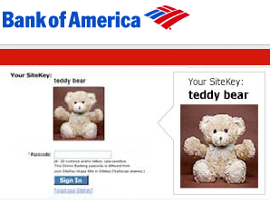
What do users do when web site authentication fails?
The Emperor’s New Security Indicators (2007)
Lab study of bank customers (67)
  3 groups; as self, role playing + not primed,
  role playing + security primed
Removed HTTPS indicators
  “https” in address bar and lock icon in bottom right
  0 withheld password
Removed the customer selected site-authentication image
  Replaced it with a bank upgrade maintenance notice
  23 of 25 using their own accounts entered their password
  All 36 role playing entered their password
Role playing participants behaved statistically significantly less securely
  Even the group that was security primed
Notes:
Co-authored by MIT LL
How much attention do users pay to passive security indicators?
Two role playing groups; one security primed, one not
BoA announced discontinuation in May 2015

Slide 18
It’s 2012: Which of these domains are not owned by Citibank?
Citigroup.com
Citibank.com
Cititigroup.com
Citigroup.de
Citibank.co.uk
Citigroup.org
Thisiscitigroup.org
Citibank.info
Citicards.com
Citicreditcards.com
Citibank-cards.us
Citimoney.com
Citigold.net
Citigrøup.org
Notes:
What does server authentication mean?
Hint – there are 4
In 2012, no one owns these 4
Cititigroup.com
Thisiscitigroup.org
Citimoney.com
Citigrøup.org - .com is taken. Maps to citigrup in a search

Slide 19
It’s 2012: Which of these domains are not owned by Citibank?
Citigroup.com
Citibank.com
Cititigroup.com
Citigroup.de
Citibank.co.uk
Citigroup.org
Thisiscitigroup.org
Citibank.info
Citicards.com
Citicreditcards.com
Citibank-cards.us
Citimoney.com
Citigold.net
Citigrøup.org
Notes:
Cititigroup.com
Thisiscitigroup.org
Citimoney.com
Citigrøup.org - .com is taken. Maps to citigrup in a search

Slide 20
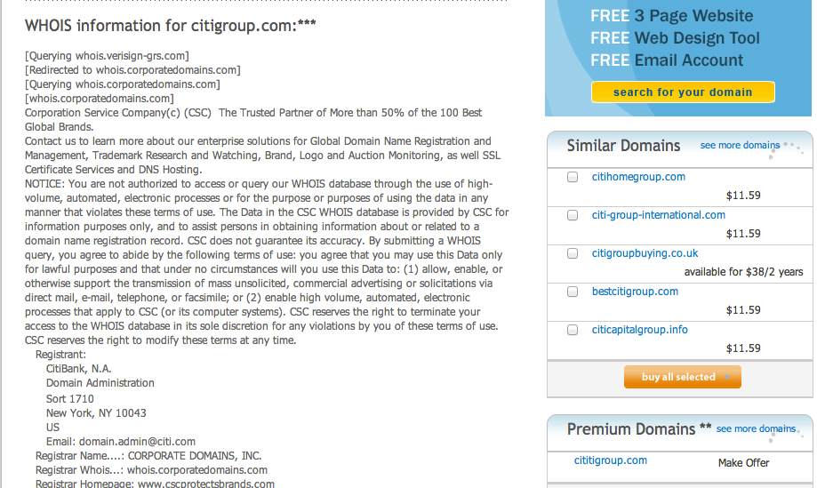
Notes:
Did the list in – 2012
Used Verisign service for looking up and purchasing domains
Verisign is offering me lovely alternative phishing names
Cititigroup.com

Slide 21
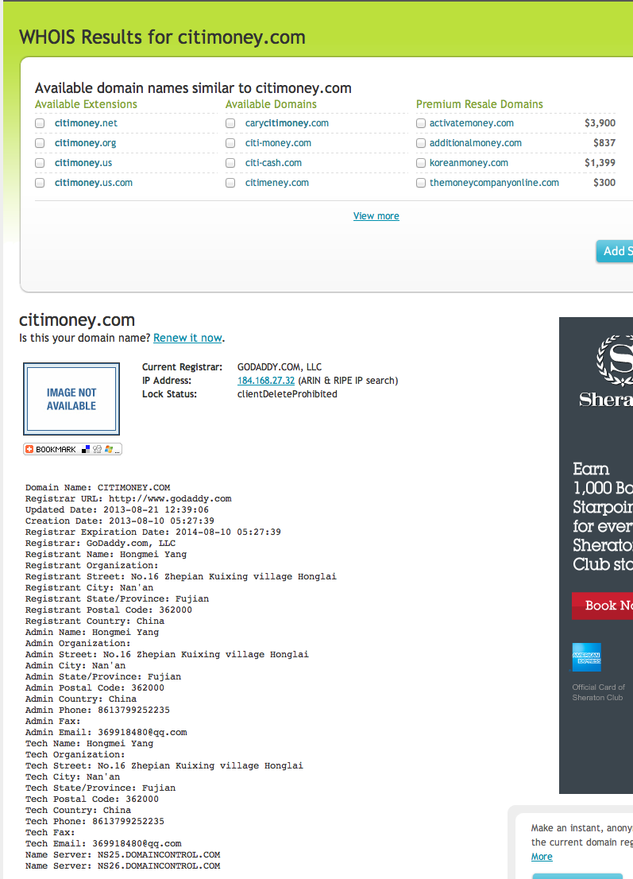
Who else thought citimoney.com was an excellent domain name in 2013?
Notes:
Checking in 2013 to make sure Citi doesn’t own any of my 4
Look; someone’s taken one of mine !
Citimoney.com
GoDaddy is the Registrar
2019 – it’s back on sale by hugedomains.com

Slide 22
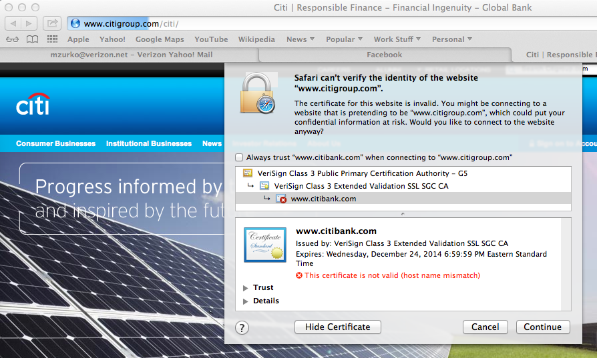

Are warnings about domains from HTTPS meaningful?
Notes:
(2013)
Can we get server authentication via https?
It’s citibank. Or citigroup.

Slide 23
Error Handling in TLS web site authentication
Ask the user!
  Which no one seemed to think was a problem when the protocol was designed
What does it mean if a server has a self signed certificate?
  CA issued certificates cost money
  Users learned to ignore warnings
  Assumed by the usable security research community as early as 2008
Crying Wolf: An Empirical Study of SSL Warning Effectiveness
  2009 study using FF2 as a baseline for clickthrough
  90% ignore rate in their in-lab user study of a banking scenario
ImperialViolet documented a 60% rate of bypassing SSL interstitials in 2012
WWW2013 paper documented a false positive rate substantially higher than presumed attack rate
  1.54% false positive warning rateon 3.9 billion TLS connections across 300k academic users
Notes:
Nobody thought users learning to ignore warnings was a problem until online banking
FF2 + bank scenario – 18 in lab participants (part of a 100 person in lab between subjects study across multiple warning types)
Imperial Violet is Adam Langley’s blog. He works at Google (and did at the time of that blog entry)
Here’s My Cert, So Trust Me, Maybe? Understanding TLS Errors on the
Misconfigurations, self signed, name mismatch – false positives. Attacks considered “true” are MitM; considered much rarer than the false positives.

Slide 24
Certificate Authority challenges
My browser has 179 “System Roots” - They’re all trusted to issue web site certificates
  Associate the public key with the information in the certificate
12 CA incidents in 2011
Attack on Comodo
  Username/password of a Registration Authority stolen
  9 fraudulent certificates issued, including login.yahoo.com, mail.google.com, login.skype.com, addons.mozilla.org
  Certificate revoked upon discovery
DigiNotar attacked and fraudulent certificates issued
KPN discovered attack tools on its server during an audit and stopped issuing certificates
  DDoS tool there for as long as 4 years
Certificate transparency allows domain owners to see CA issued certificates for their domain
Notes:
Certificate Transparency – monitor and audit certs – system of public logs
Safari: System Roots are at the OS, not in the browser
In the keychain access app, which is under “other” in apps
179 in March 2019; 164 in Feb 2018; 175 in April 2017; 179 in March 2016; 214 in Feb 2015
2015 and google cert. browser pinning helped.
http://arstechnica.com/security/2015/03/google-warns-of-unauthorized-tls-certificates-trusted-by-almost-all-oses/
2017 – deprecated in Chrome
PKP offers a way to defend against certificate misissuance, by providing a Web-exposed mechanism (HPKP) for sites to limit the set of certificate authorities (CAs) that can issue for their domain.
It is hard to build a pin-set that is guaranteed to work, due to the variance in both user-agent trust stores and CA operations.
There is a risk of rendering a site unusable.
There is a risk of hostile pinning, should an attacker obtain a misissued certificate. While there are no confirmed or rumored cases of this having happened, the risk is present even for sites that don’t use PKP.
The choice and selection of CAs is a product-level security decision made by browsers or by OS vendors, and the choice and use of sub-CAs, cross-signing, and other aspects of the PKI hierarchy are made independently by CAs.
As a consequence, site operators face difficulties selecting a reliable set of keys to pin to, and adoption of PKP has remained low.
When site operators’ expectations don’t match the reality of trust anchors on real world client machines, users suffer. Unexpected or spurious pinning errors can result in error fatigue rather than user safety.

Slide 25
Humans didn’t do what the technologists assumed.
The user is not an exception handling module.
In theory, there is no difference between theory and practice.
In practice, there is.
- Yogi Berra
Notes:
Lesson 2 continued
SSL turns out to be entirely orthogonal to the kind of website authentication humans need
CA certs weren’t deployed. Users didn’t care.
What happens when something breaks, is forgotten, goes wrong?
The level of security includes security in the face of mistakes and aberrations

Slide 26
Can Open Standards Help With User Experience Security?
Notes:
Skip if it’s 5:10
Maybe if things were standardized

Slide 27
W3C Web Security Context (WSC)
First usable security standard
Charter: To enable users to come to a better understanding of the context that they are operating in when making trust decisions on the Web
  Specify a baseline set of security context information and practices for the secure and usable presentation of this information
Functional areas: TLS encryption, Domain name (authenticated or claimed), Certificate information, Browsing history, Errors
Principles: Visibility, assurance, attention
Notes:
2010 Recommendation
http://www.w3.org/TR/wsc-ui/
First and so far only usable security standard
Assurance – keep it separate

Slide 28
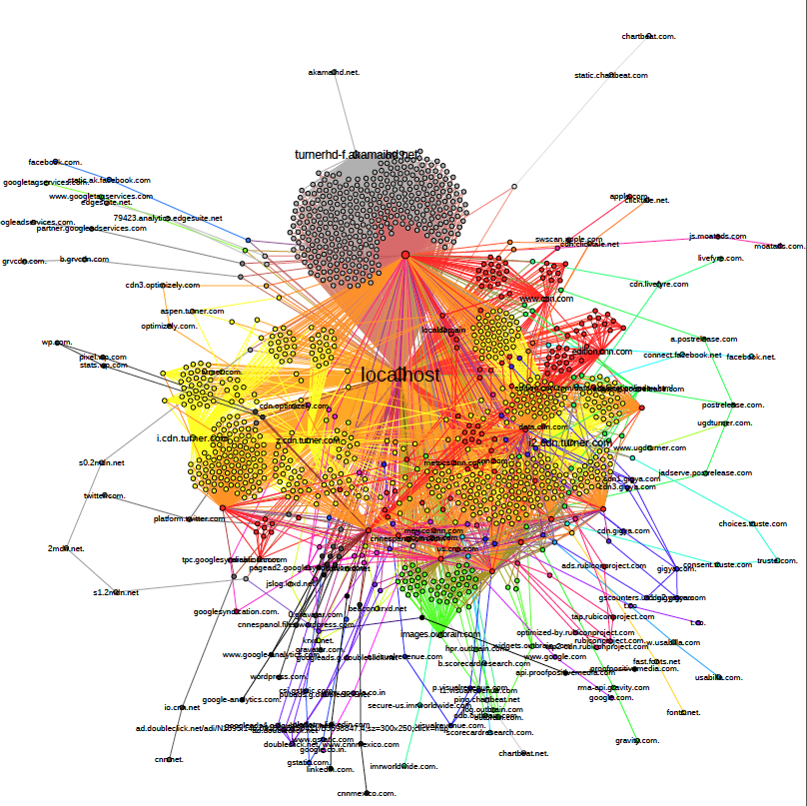
WSC Tried to Make This Understandable
Notes:
Trying to make the security implications of this understandable
CNN home page
Domains? SSL? What matters?

Slide 29
WSC Recommendations
Certificate Trust validation
  Extended Validation, self-signed, and untrusted, and user interactions around validation
Existence of encryption
Strong cipher suites
User interactions for error handling based on error severity
  Attempting to combat habituation
Consistent visual presentation of authenticated DNS identity
MUST NOTs – mixed content, obscuring security info, techno jargon, unsupervised installation, automatic bookmarks

Slide 30
WSC Challenges
Standards Challenges
  “Successful standards enable”
    We had a lot of “Don’t do this thing” and constraints
  UI standards are process, not presentation
Context Challenges
  Browser vendor participation
    Some of the reasons vendors participate:
    Interoperability (as required by/for the market)
    Customer requirements (compliance and laws and features)
    Some of the reasons vendors don’t participate:
    IP/patents
    Dilution of their brand
    Market advantage in the area
  And then mobile
    Technology marches forward

Slide 31
Open Standards Haven’t Worked for User Experience and Web Security

Slide 32
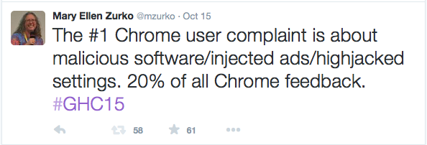
User Experience and Warnings Continued To Be a Challenge
Firefox Click Through Rate (CTR) for malware
warnings is 33% (2014)
  Google Chrome’s 70%
Mock Firefox styling closed that difference by
12 to 20 points in a 10 day at scale controlled
experiment
  Change to text, layout, default button
  Users heed warnings to sites they have not visited
  Users unpredictable for warnings on sites
  they have visited
  Survey said users trust high reputation sites more than malware warnings
Further change promoted the safe choice and demoted the unsafe choice (2015)
  Chrome CTR 38%
Notes:
What’s been happening in some of those areas since WSC?
Experimenting at scale with google chrome ssl warnings – felt, reeder, almuhimedi, consolvo – 2014
How much of the difference is due to design?
Alice in warningland – ctr – 2013
Your Reputation Precedes You: History, Reputation, and the Chrome Malware Warning – same authors – 2014
Improving SSL warnings: comprehension and adherence – brought it to 61% with a visual design that promotes the safe choice. Better text for understanding had no impact. CHI 2015
Lab and field experiments
“opinionated design”

Slide 33
It’s 1997. Dynamic HTML introduces tags that contain code.
Security Principle:
Data and Code should not mix
Code is dangerous. Data is not.
Speech vs action
Notes:
Let’s take a closer look at code security
Introduced in IE 4.0
Be here by 5:10

Slide 34
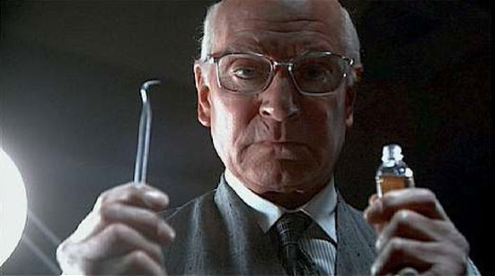
Is It Safe?
Who vouches for the code on this web site?
  Javascript
  Sandbox + same origin policy
Web mail
  Earliest web application serving data in pages not created by web site developers
  Broke domain name authentication assumptions
  Cross site scripting (XSS)
Response - HTML escaping of everything
  Where are my bold text and dancing pigs?
Next steps: Whitelist vs Blacklist of HTML tags
  What are the tradeoffs?
Notes:
Marathon Man, Laurence Olivier to Dustin Hoffman
An emphasis on domains for active content security policies
Because domains are how HTTPS authenticates
Because of course all content from a domain is produced by a web developer who is all knowing and well meaning within the scope of the domain

Slide 35
Story break: There are always bugs
Major technical university’s web site
Cross Site Scripting (XSS)
  Every link modified to redirect through proxy
  Links to other web sites (e.g. LinkedIn, Facebook)
Insecure Direct Object Reference
  Walk the OS file system
Lesson: Developers are (fallible) people too
Notes:
Declarative vs interpretive – cliff (who put the D in DHTML?)

Slide 36
Active Content Security Challenge
Beware the Code that Executes
GET stopped being safe and idempotent
  Which gave us CSRF
  JSON and XML enable CSRF with POST
Browser based downloads
Browser extensions
Web based updates/patches
Mobile applications
  Introduced in 2007 on Apple iPhone iOS
  Controls include permissions model
Notes:
GET parallels OS malware – run a command as the user
JSON call to XMLHTTPRequest
FF browser extension exploit – week of April 2 2016
Spectre/Meltdown example

Slide 37


User Experience Installing Code with Android Permissions (2012)
17% of participants paid attention to permissions during installation
(self reported and lab experiment)
  42% aware permissions exist but do not always consider them
3% of survey respondents could answer correctly and exactly all three randomly chosen permission comprehension questions
  53% of the answers contain at least one correct choice
READ_CALENDAR – 46% correct
READ_PHONE_STATE – 4.7% correct
Notes:
Android permissions: User Attention, Comprehension, and Behavior – Felt, Ha, Egelman, Haney, Chin, Wagner (2012)
308 in the Internet study, 25 in the lab
By way of historical contrast, 44% of target population of ECL study executes unsigned content; 25% of the population with a user interaction on the dialog
Android has open apps. How’s their security?
“Unknown sources” can provide you with Android apps
http://www.androidcentral.com/android-apps-install
“be sure you you trust your sources before installing!”
Plus, think app developers make mistakes?
http://developer.android.com/training/articles/security-tips.html

Slide 38
Given enough eyeballs, all bugs are shallow
Open Source, Bugs and Vulnerabilities
Notes:
Bugs in software lead to vulnerabilities
Another form of open security – the security of open source code itself
Many eyes make secure code
The theory that bugs that are security vulnerabilities will be caught in the open process of open source
Want to be here by 5:15

Slide 39

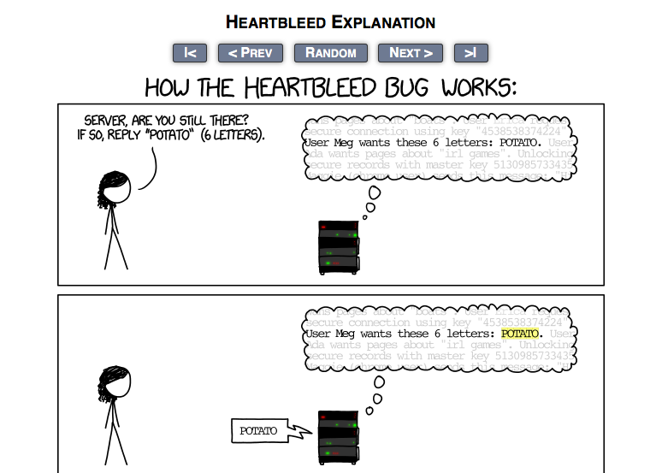
Notes:
Open source for a security mechanism based on an open standard, and the security of that open source – what would be more “open security”?
heartbleed broke at seoul plenary panel

Slide 40
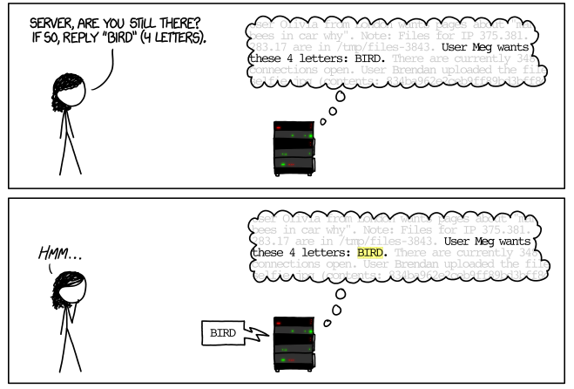

Slide 41
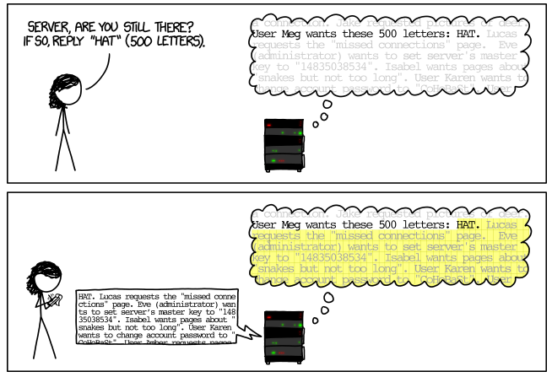
Notes:
Mouseover: Are you still there, server? It’s me, Margaret.

Slide 42

What does Heartbleed tell us about Open Security?
Heartbeat standard is an extension to TLS standard
  Keep Alive performance enhancement
  TCP has its own keep alive
Popular OpenSSL cryptographic library
  SSL/TLS widely used to secure a variety of communications
  Over 66% of the Internet deployed OpenSSL
  17% of secured web servers (.5 million) were believed to be vulnerable
Full recovery would mean changing anything secret that could have been in memory while the vulnerable version was deployed
Improper input validation due to a missing bounds check
  C language – specify string sizes
  Common source of error for programmers (aka humans)
Open source – Many eyes for development, deployment, use
  Process for commits – was reviewed by one of the four core developers
  Process for tests? Negative tests? Security tests? None?
    One of the teams that found this was Codenomicon
Notes:
RFC6520
http://news.netcraft.com/archives/2014/04/02/april-2014-web-server-survey.html
Open source used in a lot of places – saves effort, open standard implemented in open source, avoid expertise
Compile time disable. SSL termination before the service helped. Or if you were running an old version. Really old. 3 years old.
2011 the code was committed. Found the flaw in 2014 (by Codenomicon testers in part, and by google). Reminds me of 1992. Reminds me of the car ride with Steve Lipner. We thought code reviews and formal methods were enough.
Ben Laurie – audit would have found it
Agile – TDD – testing is key to so much

Slide 43
Open Response: Core Infrastructure Initiative
Member companies provide money and advice
Risk score of Open Source projects to focus funding
Planned and potential activities
  Compensating full time developers
  Security audits
  Deploying test infrastructure
    Fuzzing, reproducible builds, positive/negative test suites, auditing, static checking
  Education on security best practices
  A badging program for best practices in open source security
Research, as well as experience, can help guide the efficacy of these approaches
  How Trust Seals can be used in attacks
Notes:
CII – open organization response to Heartbleed – provide open security by…
The Core Infrastructure Initiative is a project of the Linux Foundation to fund and support free and open-source software projects that are critical to the functioning of the Internet and other major information systems.
These activities are not focused on increasing the number of eyes
http://www.itworld.com/article/2973995/linux/linus-torvalds-security-is-never-going-to-be-perfect.html
https://github.com/linuxfoundation/cii-best-practices-badge/blob/master/criteria.md
https://github.com/linuxfoundation/cii-best-practices-badge/blob/master/background.md
2016 – OWASP ZAP – open source testing tool for web applications

Slide 44
Clubbing Seals: Exploring the Ecosystem of
Third-party Security Seals
Do sites with seals have better security than sites without?
  Statistically significant difference for 3 of 9 passively discoverable security mechanisms, 2 to 1 in favor of web sites without seals
Are sites with seals clean from basic and well known vulnerabilities?
  Stood up a website with 12 vulnerabilities with 8 security seal providers
  Seal providers found from 0 to 5 of the vulnerabilities
  3 automated scanning tools found from 5 to 6 of the vulnerabilities
    Automated scanners can tolerate more false positives, leading to more true positives
At least security seals do not decrease the security of websites
  Transition from visible to invisible, plus status on seal provider, an indicator of known vulnerability on a web site
  2 months of monitoring 8k websites showed 333 seal transitions
  Attacker who can purchase a seal and craft their website, can also capture likely seal scanning information for replay or analysis to identify potential vulnerabilities
Seals can be visually spoofed or directly included with a simple ruse
Notes:
https://vagosec.org/papers/seals_ccs2014.pdf. Nick Nikiforakis was the panelist/author
Over ~2k of each type of site. http-only cookies – sites with seals. X frame options (anti clickjacking) and anti-csrf tokens – sites without seals
Also time-box pen-tested 9 sealed websites that consented – found exposures in 7 of the 9
2 security seal providers required proof of business to stand up a website – didn’t try to spoof them
Avoiding scans – malware can identify the ip as the seal provider and stay benign; web sites can redirect the scans to a static web page to maintain the seal
Ruse – lack of referrer field – achieved with meta referrer
Related research on trust impact of seals is variable

Slide 45
Coding is a human endeavor with tools
Inevitable bugs become Inevitable vulnerabilities

Slide 46
The Open Web
For Attackers and Defenders
Notes:
Embracing the Kobayashi Maru – Conti and Caroland
Money and where security comes from
Who will watch the watchers
Who you gonna call?
The open web; used by scammers, and used by defenders

Slide 47
Reverse Social Engineering Tech Support Scammers
Fraudulent tech support scams
  Charge for the “service” of removing (nonexistent) malware
  Sometimes also spread malware
  $1.5 billion industry in first 10 months of 2015
Contact starts with cold calls, or with pop ups or web sites claiming the user has malware and should call the fake tech support
Talos security researchers called one to understand their methods and infrastructure
  Set up a virtual machine
  Recorded the interactions
Notes:
http://blog.talosintel.com/2015/11/tech-support-scammers.html
November 2015
Something security people do – keep scammers on the phone when they call. Keep their social engineering skills sharp!

Slide 48
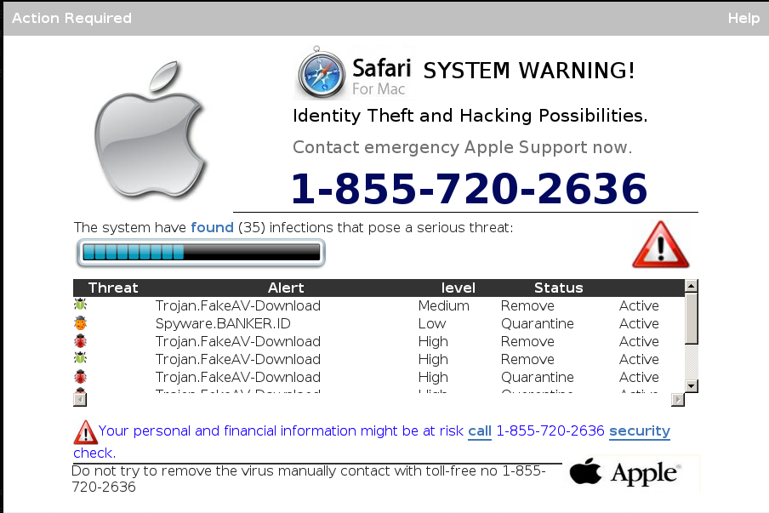

Slide 49
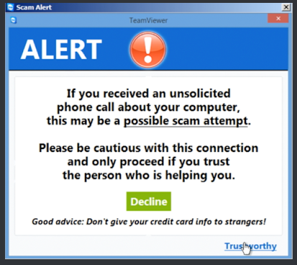
Step 1: Get connected over the web
Called the phone number, and talked to “Kelly Thompson”
“Are you using a phone?” as the device that needs cleansing
  Confirmed their computer was a Toshiba, not a Macbook
  Kelly asserted she could still take care of the issue
Instructed to follow a (shortened) URL
  The URL loaded TeamViewer which
  provides remote control of a computer
    Which has a built in warning about exactly
    this sort of thing
  Promptly instructed by Kelly to ignore
  the warning
    “Tap on Trustworthy”
Notes:
Downloading over the web is easy
Tap on Trustworthy – reminds us of how users are conditioned to ignore security warnings

Slide 50
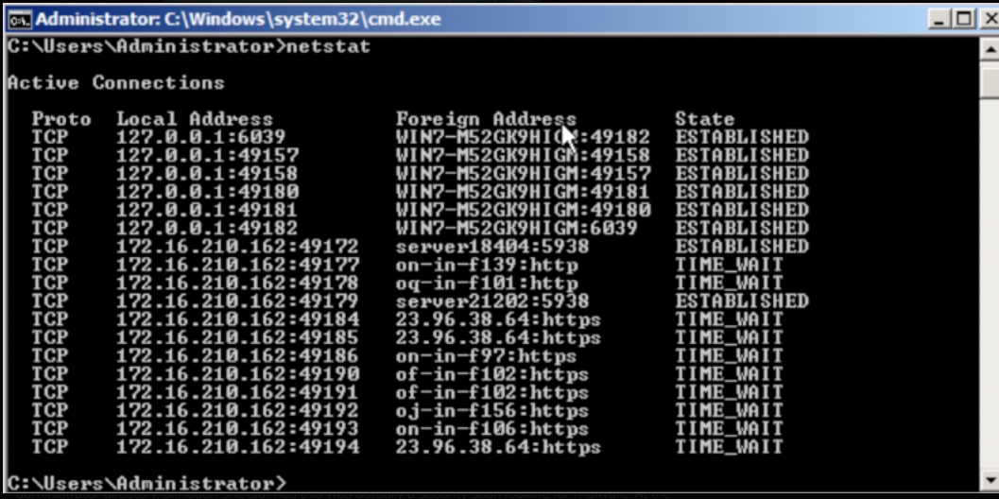
Step 2: Hackers are infiltrating your computer
Kelly now has remote access
Displayed a variety of harmless processes as evidence of malicious activities
  Netstat shows network connections with “foreign addresses”
  These are hackers infiltrating your computer from another country!

Slide 51
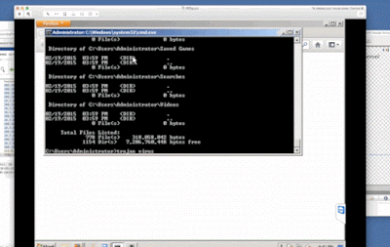
Step 3: Discovery of a trojan on the computer
Kelley typed in a command that showed a long recursive directory listing
Kelly typed “trojan virus” at the end of it
  Look, that shows you have a trojan virus!
Kelly showed the wikipedia
page on Trojans to explain
the problem
  Which had a link to an
  article on “social engineering”
  Which the researcher clicked on
Notes:
Click on the gif to show the listing
He clicks on the social engineering link – what a riot

Slide 52
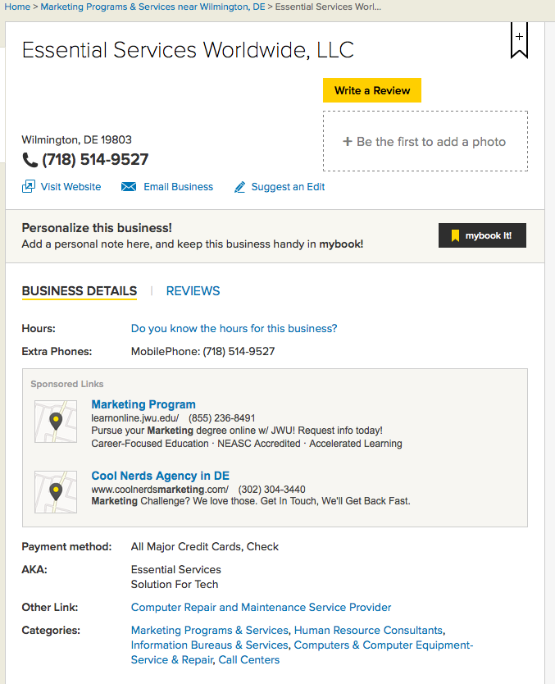
Step 4: Payment
$100 for the virus removal,
$50 to fix security drivers
  “I do not have credit or debit cards”
  “Can I pay by check?”
What do the researchers find out from this?
Pay to Essential Services Worldwide
  Yellow pages links to a website
Other websites resolve to that IP
  Including one for the company
  Essential Services
Notes:
Now the defenders use the open web for intel
Essential Services Worldwide
4630 Border Village Road Suite N1497, San Ysidro, CA, 92173

Slide 53
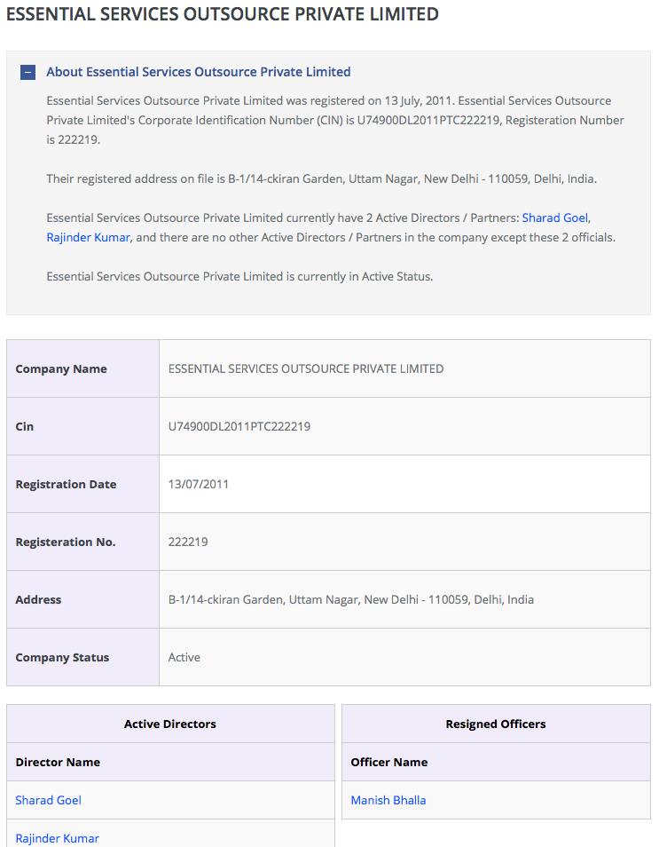
corporatedir.com
Lists company information that is a
matter of public record
Individual listed as a director
Also listed as registrant of
one of the aforementioned
websites
Notes:
FAQ – how do I get my company off this web site?

Slide 54
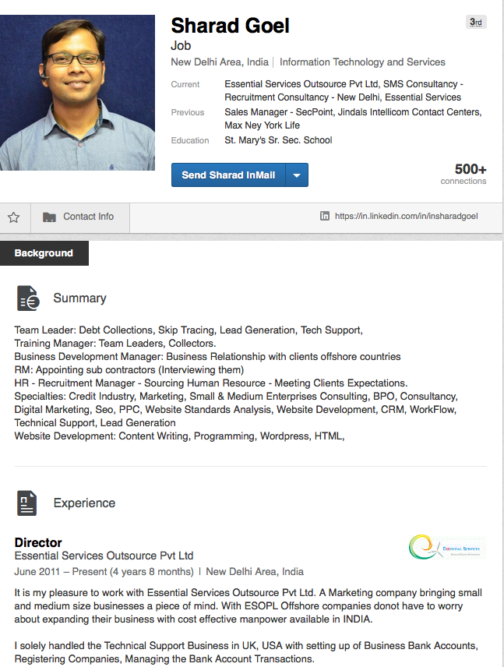
Profile on LinkedIn
“To sum up so far, it would appear
Sharad Goel and a number of tech
support websites under his control
through Essential Services are
linked to our original
macinscan[.]org scammer through
their payment instructions.”
Notes:
Use of social media

Slide 55
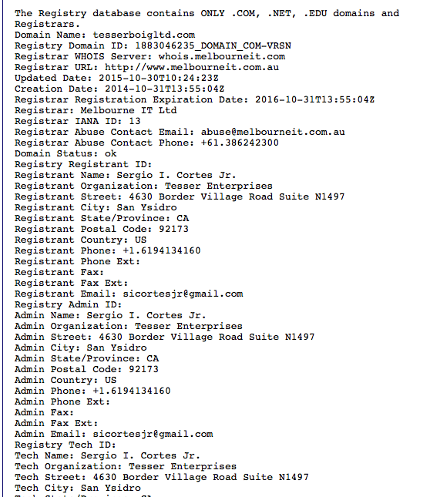
WHOIS
The address to send the check to is a
WHOIS registrant
With Admin contact information

Slide 56
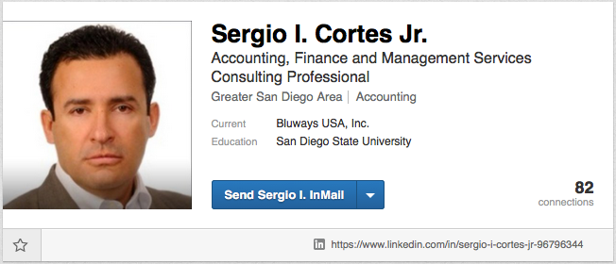
WHOIS registrant
“Fortunately for us, Sergio I. Cortes Jr. has a relatively large social media footprint, including a LinkedIn, Badoo profile, YouTube page, and a profile on a freelancer website. Through these various profiles, we can gather that he attended Grossmont College from 1990 to 1993 and San Diego State University from 1993-1995. He also claims to have served as an interim accountant at Blueways USA, which designs and builds hybrid electric drive systems and components. According to a post on a car enthusiast forum, he also served at one point in time as a loan officer. He was also quoted in a press release for communication software Intellinote as president of Tesserboig Ltd.“
Notes:
I am following the social media links 2 months after the blog. They were all still there.

Slide 57
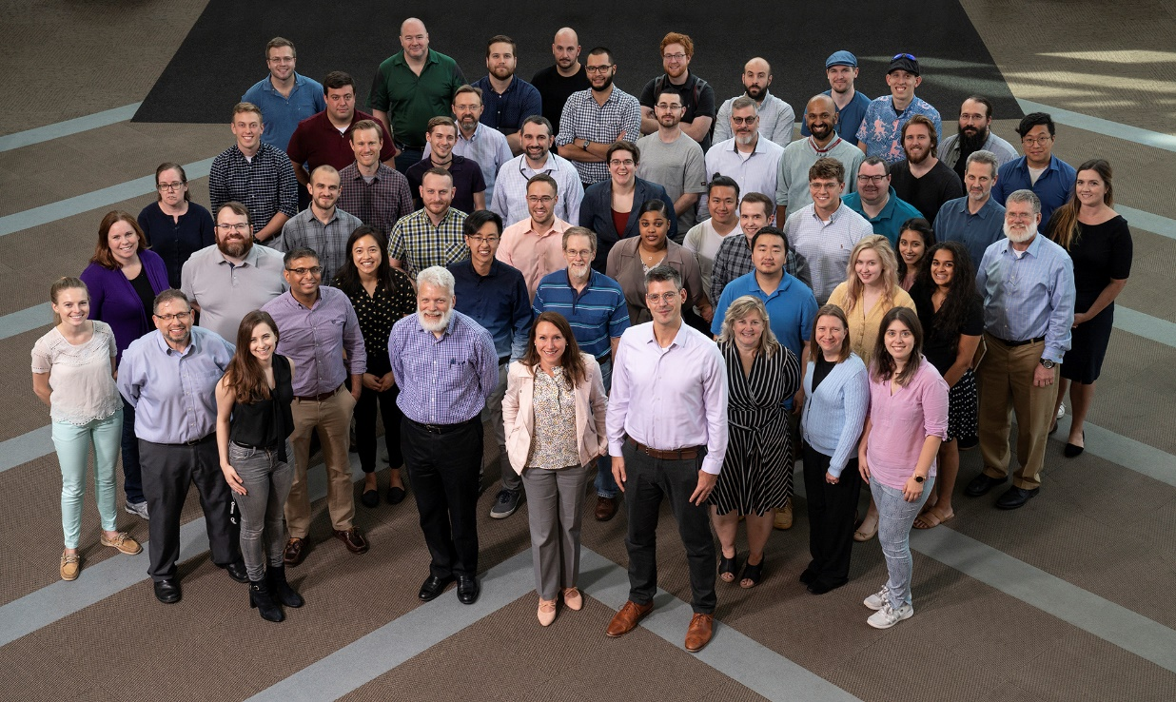
Cyber Operations and Analysis Technology Group
Designing, prototyping, and fielding technology
AI and data science capabilities
Integrated joint architectures
Human system integration research
Network security technology
Range and testbed architectures for embedded systems
Cyber security testing capabilities
Analysis capabilities to augment assessments
MISSION: Design, prototype, and transition cyber technology to enable effective missions, operations, and assessments
Notes:
Zero Trust Architectures, like Google’s BeyondCorp

Slide 58
Security Lessons Recap
The future will be different. So will the attacks and the attackers.
  But only if you’re successful.
Beware of implicitly assumed infinite recursion
Defense in Depth matters
Doing security at the scale of end points is hard
  Internet of Things will increase that
Deployment will introduce issues you ignored in design
  There will be errors and they will matter to security
Ignoring humans or claiming they’ll do something with no basis in reality won’t give you the security you’re looking for
In security, there is a huge difference between data and code
Standards are not a help for Layer 8 (the human layer)
Coding is a human and error prone endeavor
Old attacks (scams) can become new attacks
The Open Web is for attackers and defenders
Notes:
Have lessons learned
Move to backup when the talk flows

Slide 59
Thank you for your attention and questions
mez@ll.mit.edu

Slide 60
Backup

Slide 61
A Thought on Metcalfe’s Law and Security
The value of a telecommunications network is proportional to the square of the number of connected users of the system (n²).
“Why do you rob banks?” “Because that’s where the money is.”
As the number of interconnections increases, so will the attacks
  IoT increases the number of interconnections
There are markets for defense specifically targeted to attacks
  Anti-virus was probably the first
New technology will bring new attacks
  Cyber Physical Systems of all sorts are emerging technologies
Notes:
Metcalfe – WWW4 collapse, WWW6 ate his words, WWW8 more predictions
Open might imply more connections; fewer barriers to connections
https://web.archive.org/web/19990913090034/http://www.infoworld.com/cgi-bin/displayNew.pl?/metcalfe/990412bm.htm
``Metcalfe's Law is Wrong'', Andrew Odlyzko argues approximately n log n
Sutton story is apocryphal, but he says it’s also obvious and what he would have said if asked
Google finds this thought in 2007 cyber warfare collection, chapter called bits and bytes vs bullets and bombs: a new form of warfare by Nugent and Raisingham, complete with Metcalfe cite
Just as value increases with interconnections, so do threats, vulnerabilities, risks and attacks

Slide 62
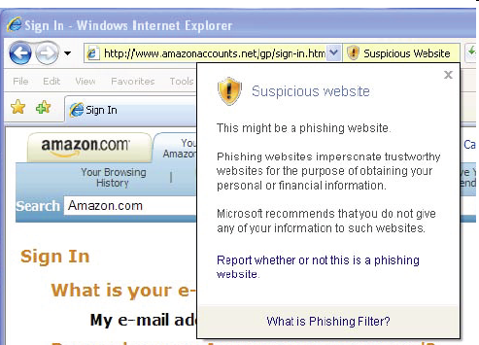
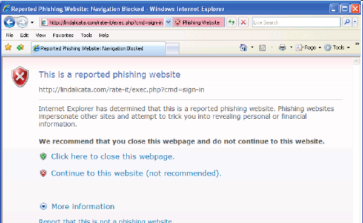
You’ve Been Warned
An Empirical Study of the Effectiveness of Web Browser Phishing Warnings
Simulated spear phishing
  97% fell for at least one
  79% heeded active warnings when presented
Active warnings directly interrupt the task, give the user choices, and make recommendations
  Fail safely
Correlations between understanding a warning and heeding it
Notes:
S. Egelman, L. Cranor, and J. Hong. You've Been Warned: An Empirical Study of the Effectiveness of Web Browser Phishing Warnings. CHI 2008.
1 participant heeded passive warning (size 10; control group)
Studied warning comprehension
10 control, 10 passive IE, 20 active IE, 20 FF

Slide 63
Other approaches to code security
Penetrate and patch
  Bug bounties
  Penetration testing
Tools that inspect code (e.g. static and dynamic analysis)
  False positives increase cost of use and required skill set for determining true positives
Formal methods
Safe coding tools and frameworks (e.g. SafeC, safehtml)
Security practice checklists (e.g. OWASP)
Secure Development Lifecycles (some of most of the above)
  Examples include work from Microsoft, Cisco, Common Criteria

Slide 64
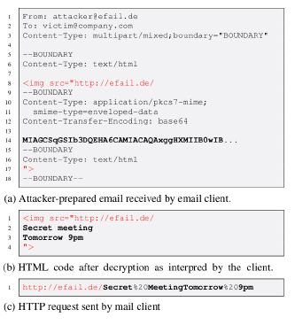
Efail: Breaking S/MIME and OpenPGP Email Encryption using Exfiltration Channels (2018)
Multipurpose Internet Mail Extensions (MIME)
  RFCs 1993 – 2005
S/MIME – RFCs 2002 – 04
Browser based email clients – pre 2000
Attacks inserting backchannels
  E.g. GET to an HTTP URL in a malicious domain include
  decrypted email in the URL reference to exfiltrate it
Attacks inserting gadgets into Cipher Block Chaining
(CBC) which allows modification of plaintext and
reordering of ciphertext blocks
Notes:
New attacks and vulnerabilities are being discovered all the time
Backchannels include email headers (remote-attachement-url) and attachment previews
Some clients require user interaction. 40/47 do not.
CBC attack requires known plaintext: “Content-type: multipart/signed” works.
Example of simplest attack on MITE parsing sandwiching crypto text within an <img src= > worked on 5 clients directly

Slide 65


Cyber Security and Information Sciences
Secure Resilient Systems and Technology
Cyber Operations
and Analysis Technology
Cyber
System
Assessments
Lincoln Laboratory Supercomputing Center
Cyber-Physical Systems
AI Technology and Systems

