Slide 1
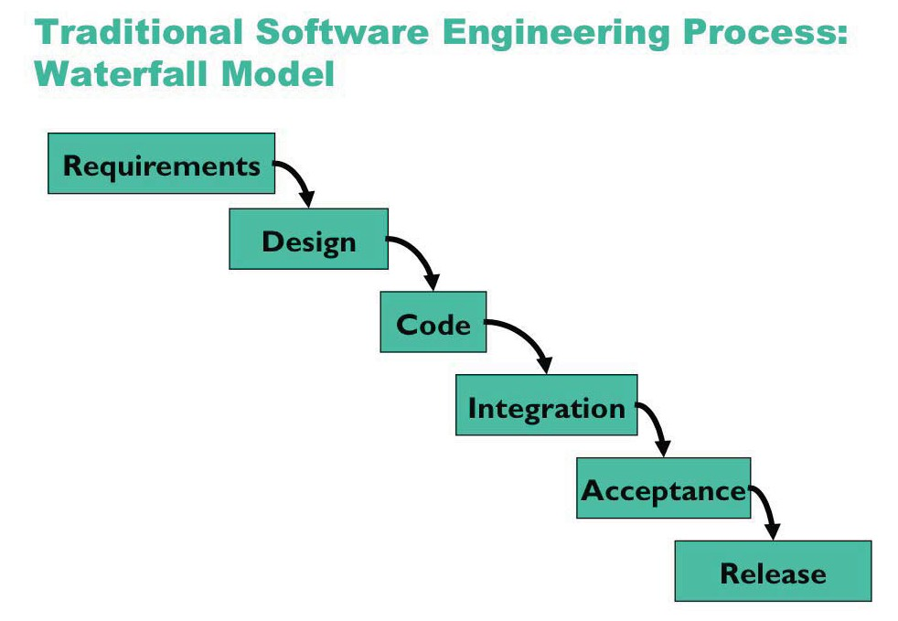

Slide 2
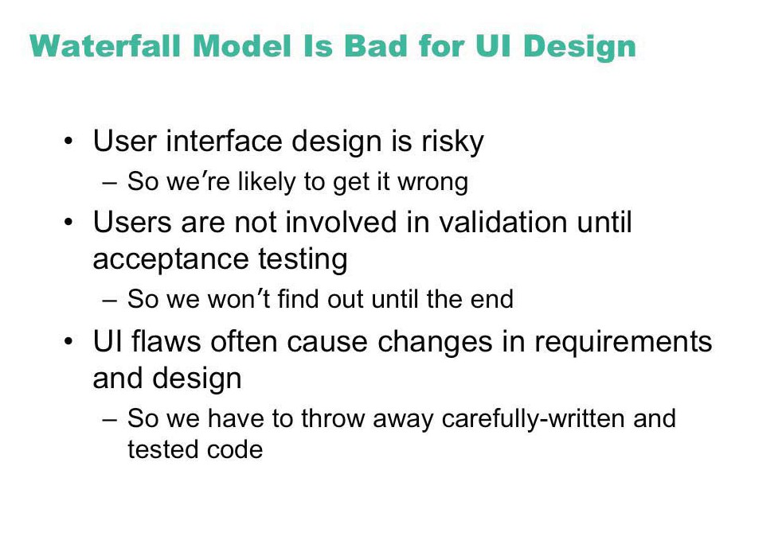

Slide 3
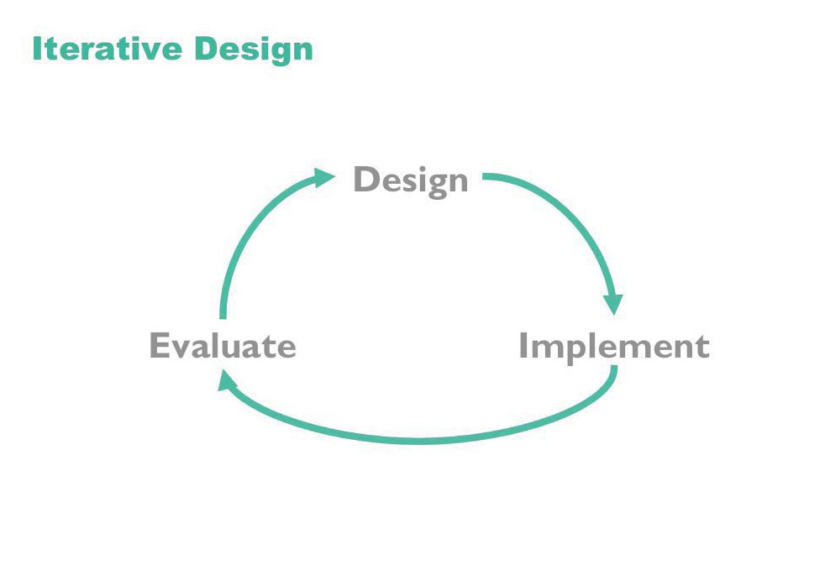

Slide 4
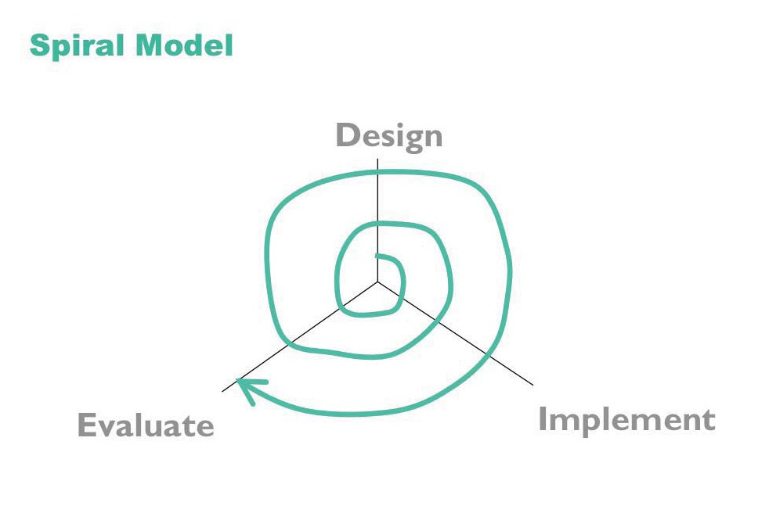

Slide 5
Methodology Outline
Task analysis
User definition
Conceptual design
Semantic design
Syntactic design
Lexical design
Documentation design
Design reviews
Prototyping
User testing
Implementation

Slide 6
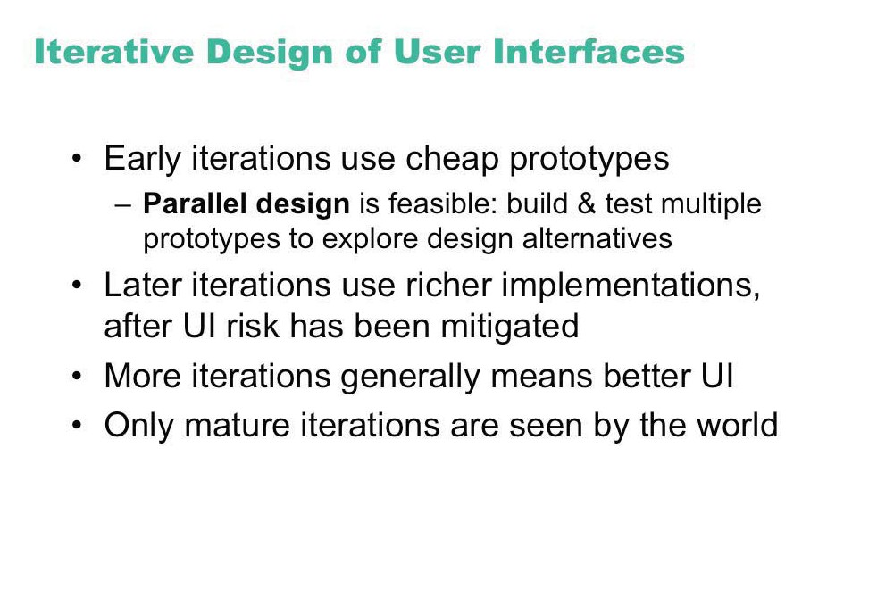

Slide 7
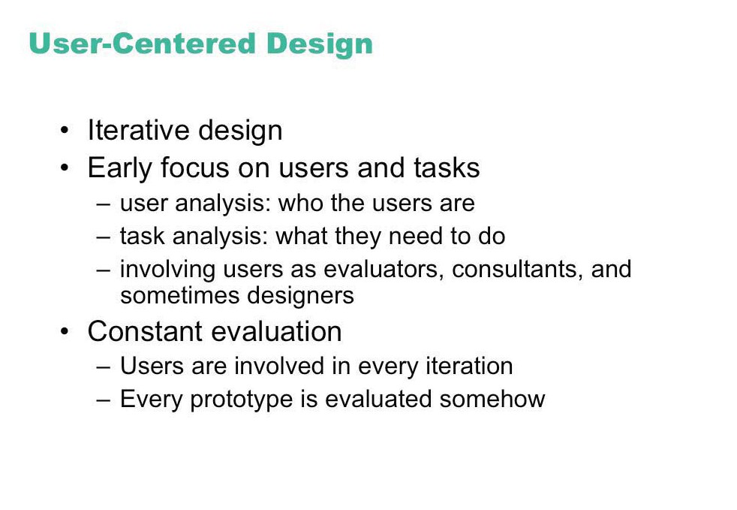

Slide 8
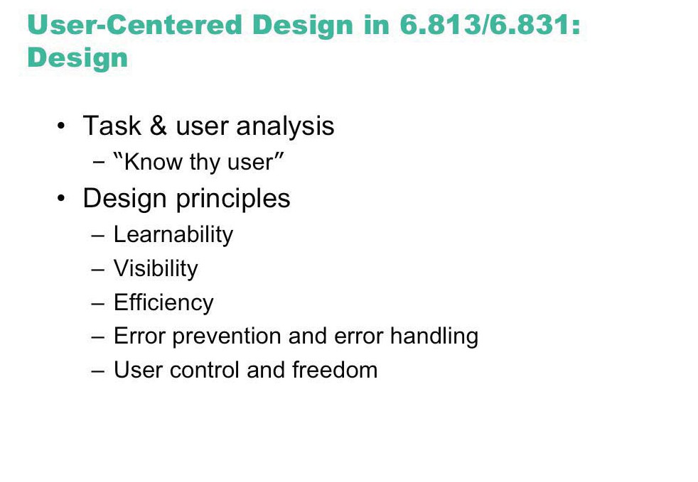
Design

Slide 9
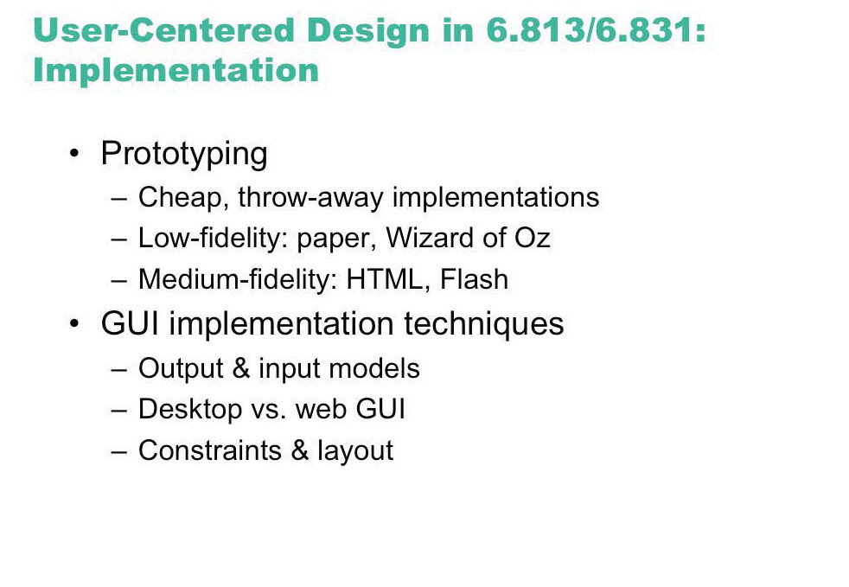
Implementation

Slide 10
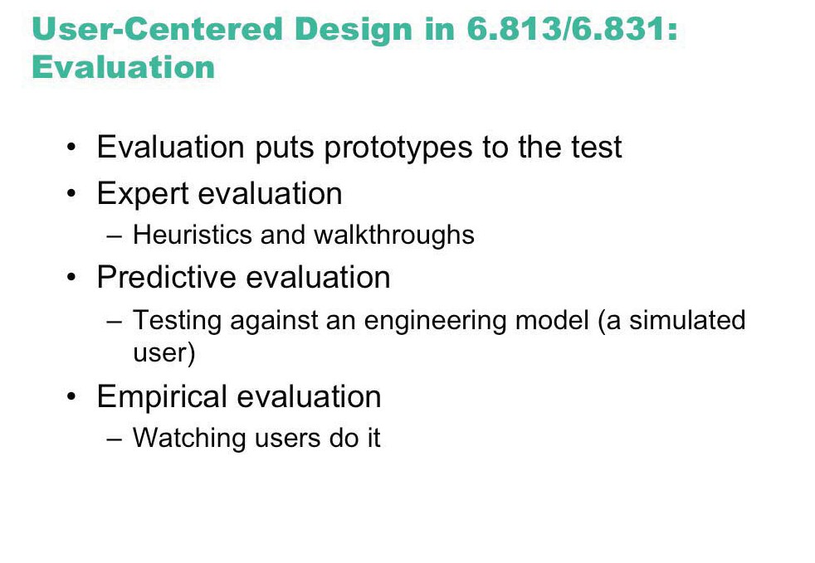
Evaluation

Slide 11
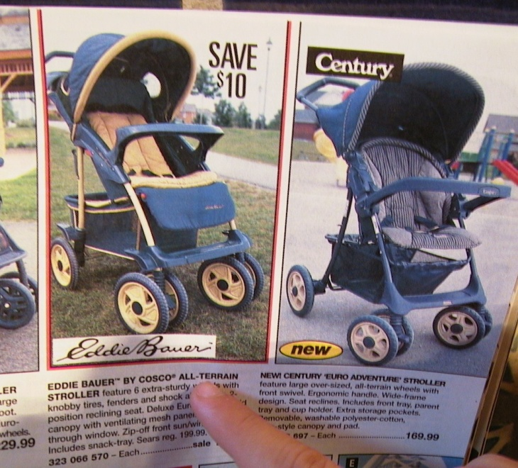
Example: The Cheap Shop Catalog Store
  In Cheap Shop, people shop by browsing paper catalogs scattered around the store.
  When people see an item they want, they enter its item code from the catalog onto a form.
  People give this form to a clerk, who brings the item(s) from the back room to the front counter.
  People then pay for the items they want.
Item code Amount

Slide 12
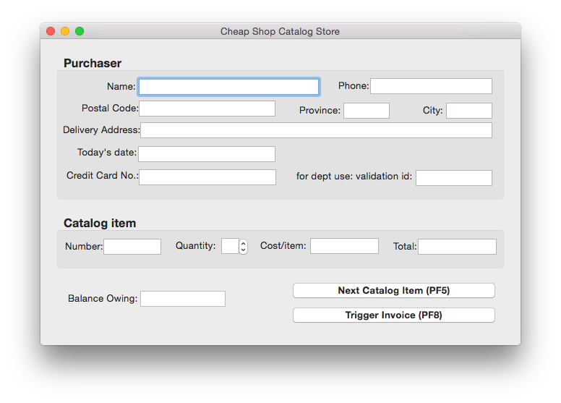
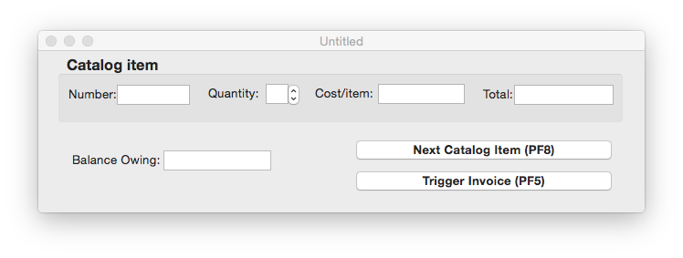
Cheap Shop
Screen 1
Screen 2

Slide 13
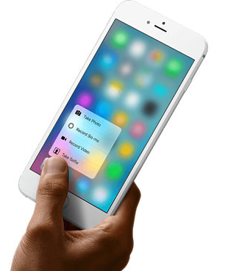
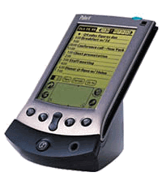
Phase 1: Identify users + tasks
If there are no real users or tasks…
  think again, there probably are!
  Jeff Hawkins, the inventor of the Palm Pilot, was said to
  have carried a small block of wood around in his shirt pocket … As various everyday situations arose, he would take out the block of wood and imagine how he would use the device.¹
  The same technique can be used to evoke a response from expected end-users
¹see Sato and Salvador, interactions 6(5)

Slide 14
The Cheap Shop Catalog Store
  In Cheap Shop, people shop by browsing paper catalogs scattered around the store.
  When people see an item they want, they enter its item code from the catalog onto a form.
  People give this form to a clerk, who brings the item(s) from the back room to the front counter.
  People then pay for the items they want.

Slide 15
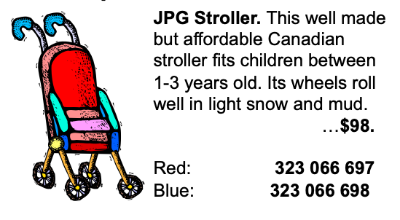
Developing task examples
Task example 1
  Fred Johnson, who is caring for his demanding toddler son, wants a good quality umbrella stroller (red is preferred, but blue is acceptable).
  He browses the catalog and chooses the JPG stroller (cost $98. item code 323 066 697).
  He pays for it in cash, and uses it immediately.
  Fred is a first-time customer to this store, has little computer experience, and says he types very slowly with one finger. He lives nearby on Dear Bottom Avenue NW.

Slide 16
Developing task examples
Task example 2
  Mary Vornushia is price-comparing the costs of a child’s bedroom set, consisting of a wooden desk, a chair, a single bed, a mattress, a bedspread, and a pillow all made by Furnons Inc.
  She takes the description and total cost away with her to check against other stores.
  Three hours later, she returns and decides to buy everything but the chair.
  She pays by credit card,
  She asks for the items to be delivered to her daughter’s home at 31247 Lucinda Drive, in the basement suite at the back of the house.
  Mary is elderly and arthritic.

Slide 17
Developing task examples
Task example 3
  John Forham, the sole salesperson in the store, is given a list of 10 items by a customer who does not want to use the computer.
  The items are:
    4 pine chairs, 1 pine table, 6 blue place mats, 6 “lor” forks, 6 “lor” table spoons, 6 “lor” teaspoons, 6 “lor” knives, 1 “tot” tricycle, 1 red ball, 1 “silva” croquet set
  After seeing the total, the customer tells John he will take all but the silverware
  The customer then decides to add 1 blue ball to the list.
  The customer starts paying by credit card, but then decides to pay cash. The customer tells John he wants the items delivered to his home the day after tomorrow. While this is occurring, 6 other customers are waiting for John.
  John has been on staff for 1 week, and is only partway through his training program

Slide 18
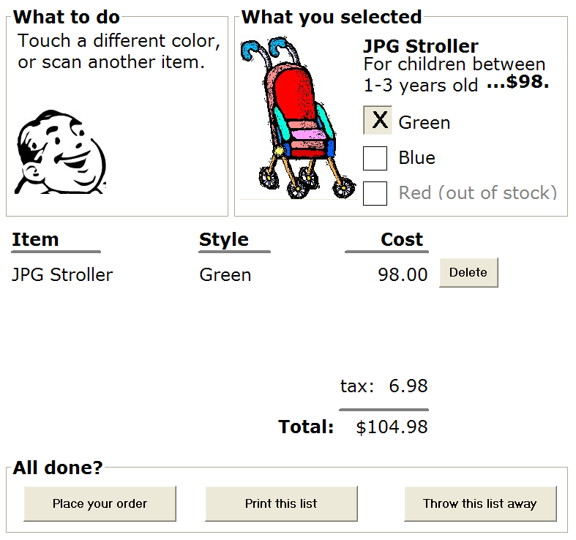
Are there better ways to do it?
A task-centered prototype
  partial wizard approach to tasks
  prototyped several different ways
    paper - 45 minutes
    scripted animation - 2 hours

Slide 19
Cheap Shop
Screen 1
Screen 2

Slide 20
Walkthrough template
Task number: ____
Description of
Step
Does the user have the knowledge/training to do this?
Is it believable that they would do it?
Are they motivated?
Comment / solution
A walkthrough for this exercise is found in Greenberg, S. “Working through Task-Centered System Design. in Diaper, D. and Stanton, N. (Eds) The Handbook of Task Analysis for Human-Computer Interaction. Lawrence Erlbaum Associates.

Slide 21
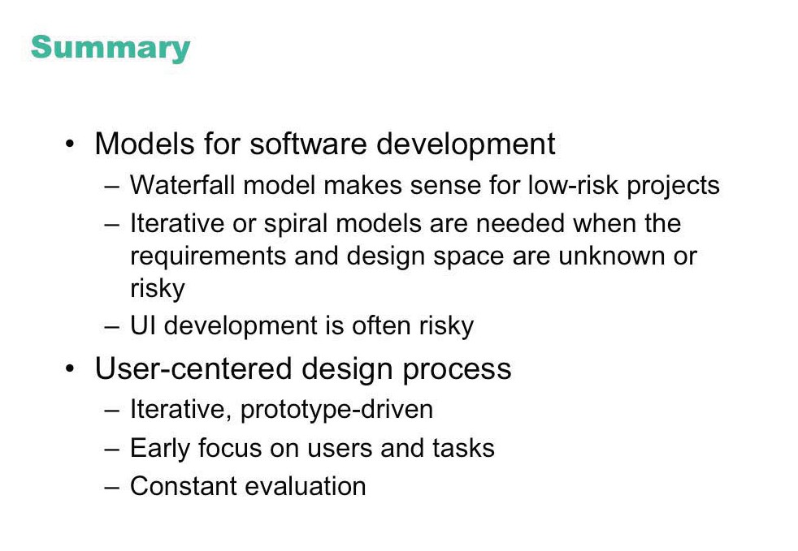

Slide 22
Methodology Outline
Task analysis
User definition
Conceptual design
Semantic design
Syntactic design
Lexical design
Documentation design
Design reviews
Prototyping
User testing
Implementation

Slide 23
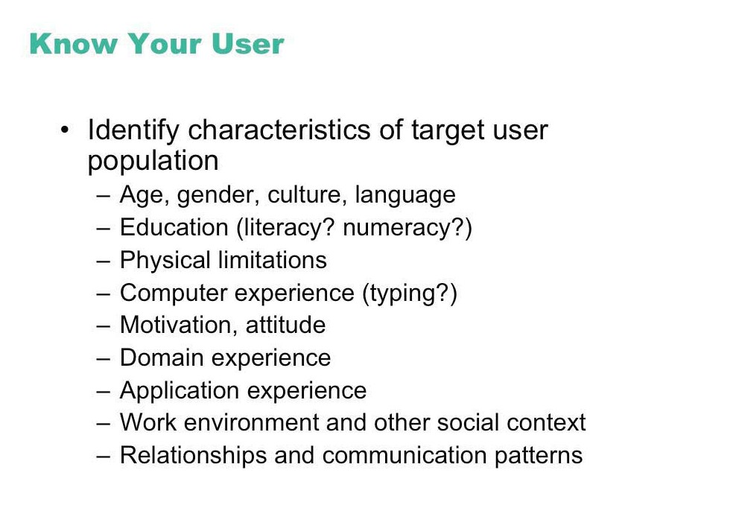

Slide 24
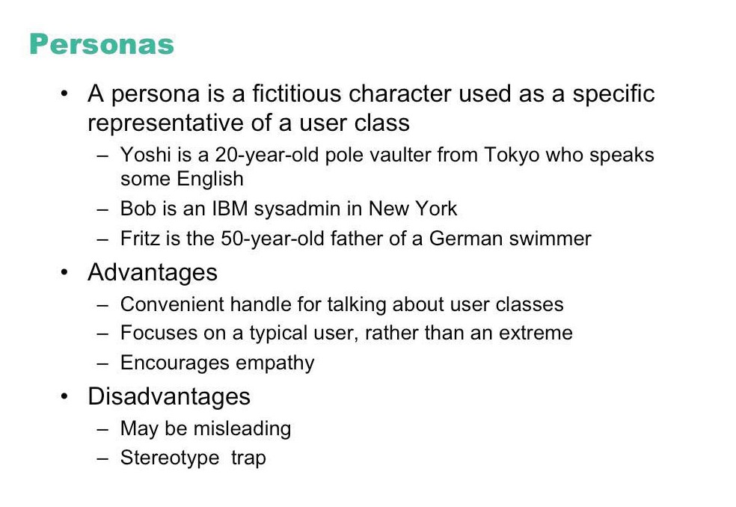

Slide 25
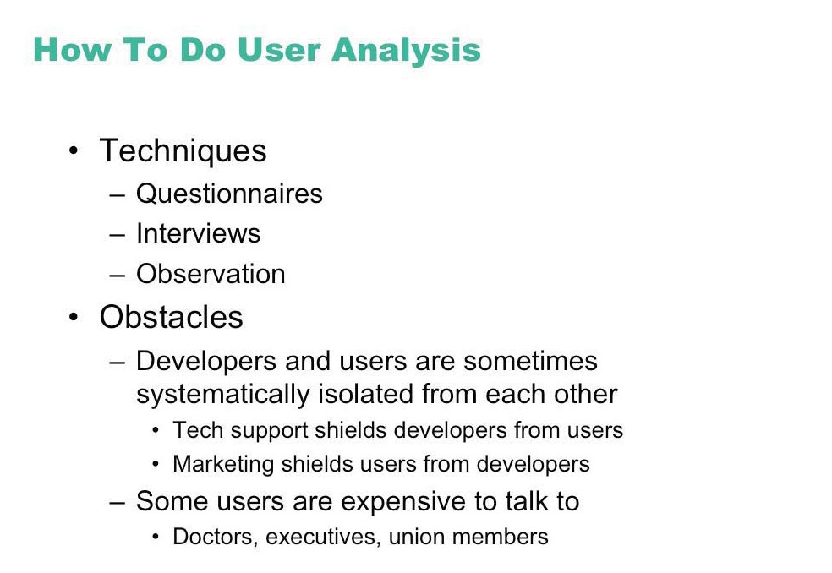

Slide 26
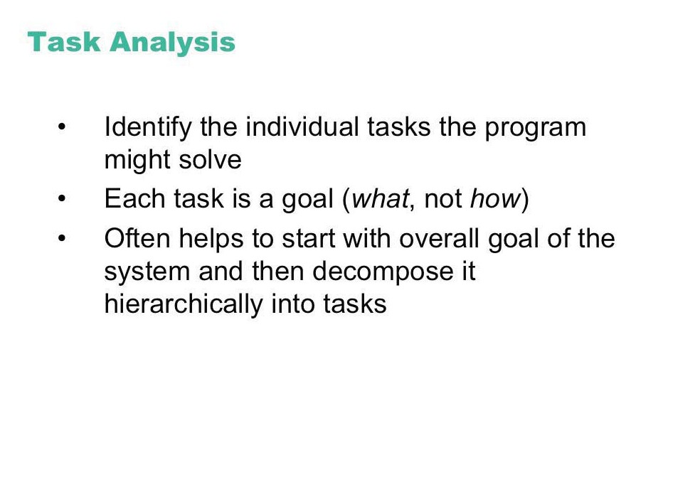

Slide 27
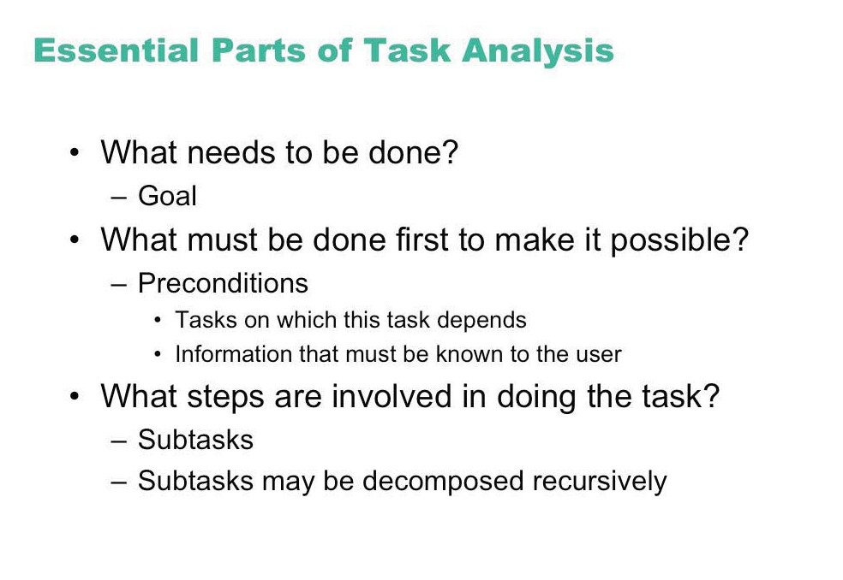

Slide 28
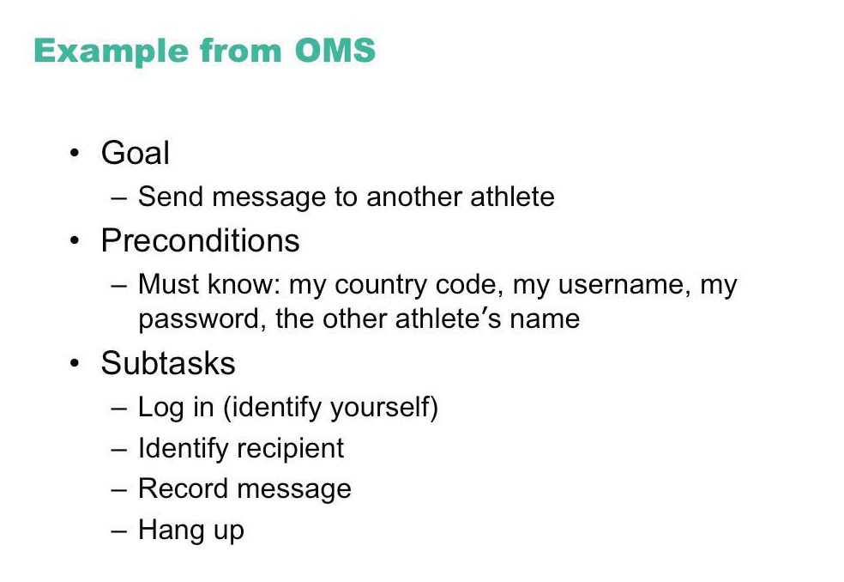

Slide 29
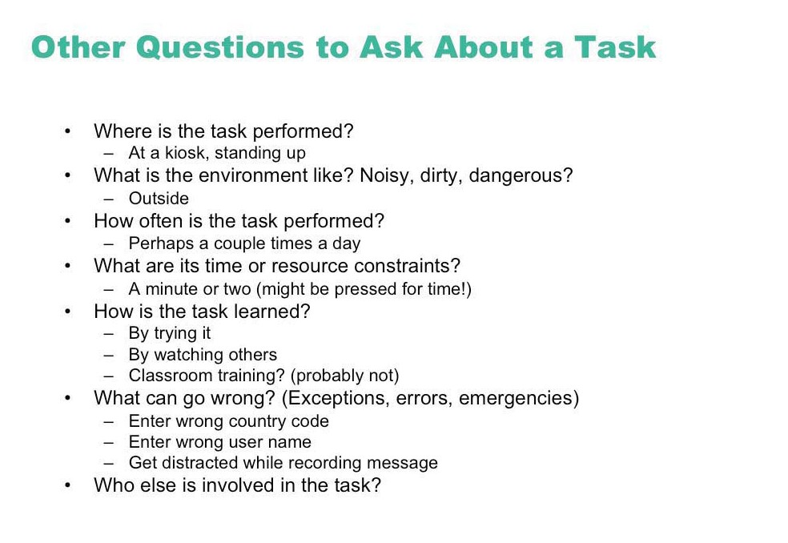

Slide 30
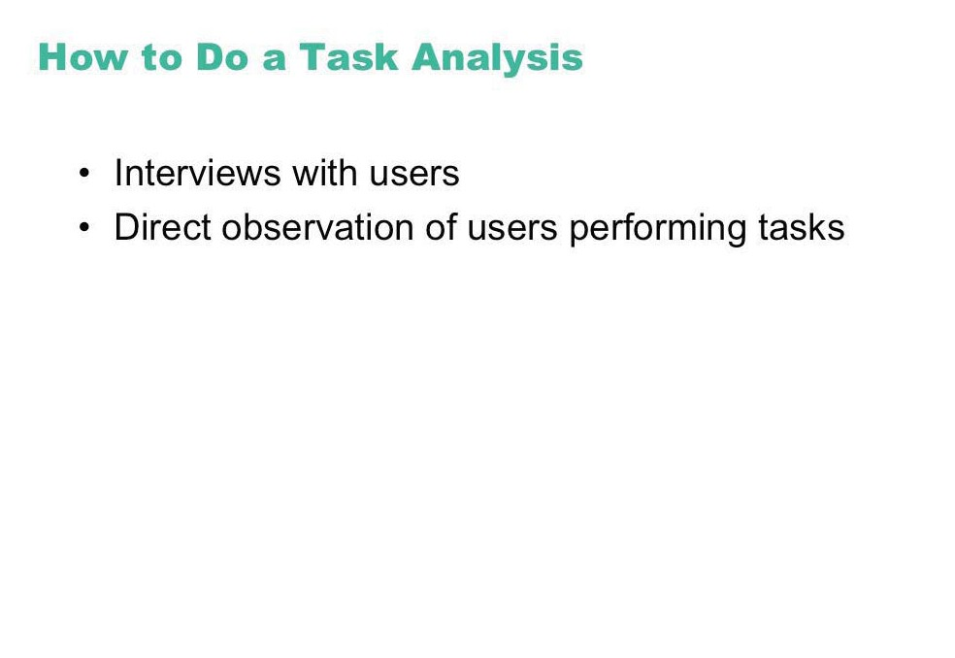

Slide 31
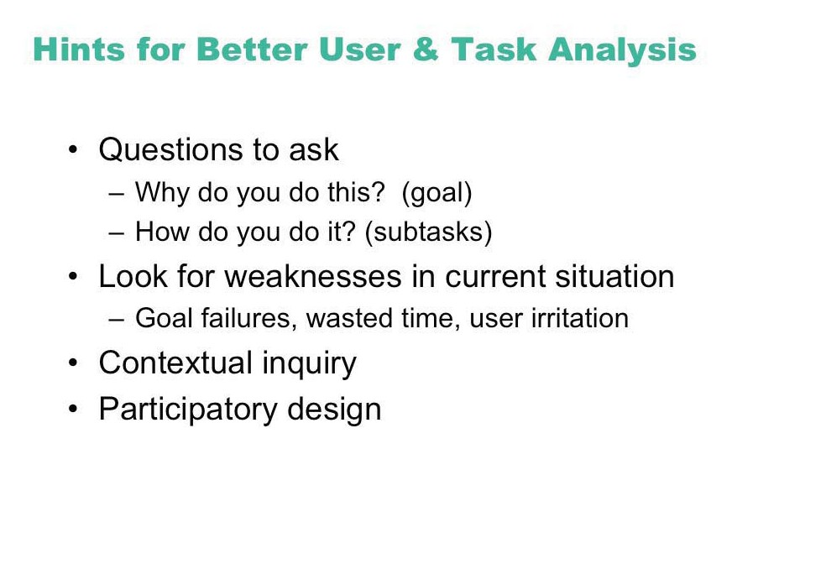

Slide 32
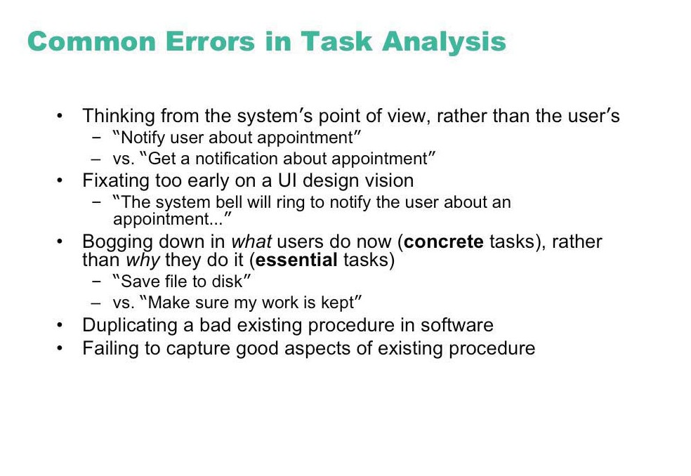

Slide 33
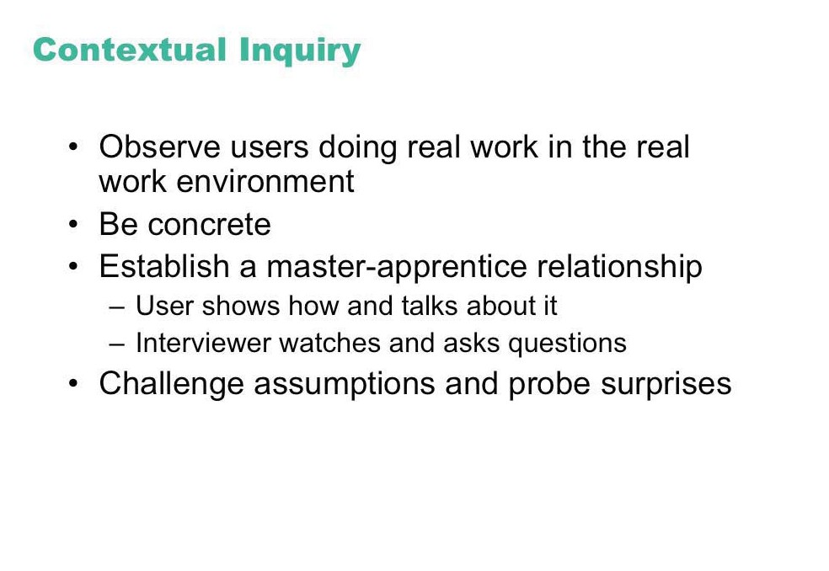
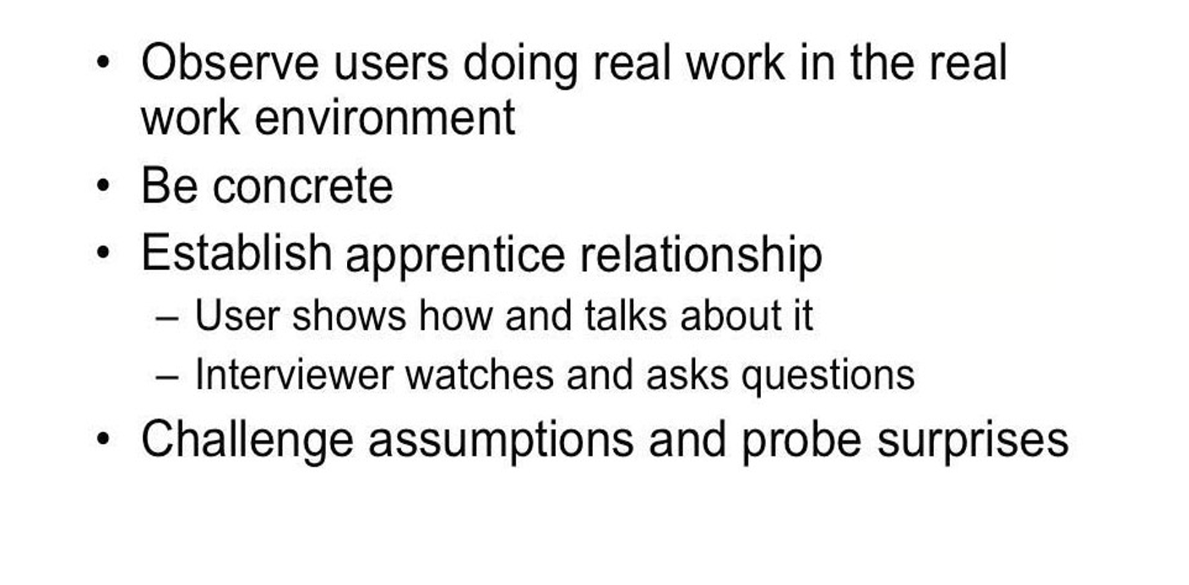

Slide 34
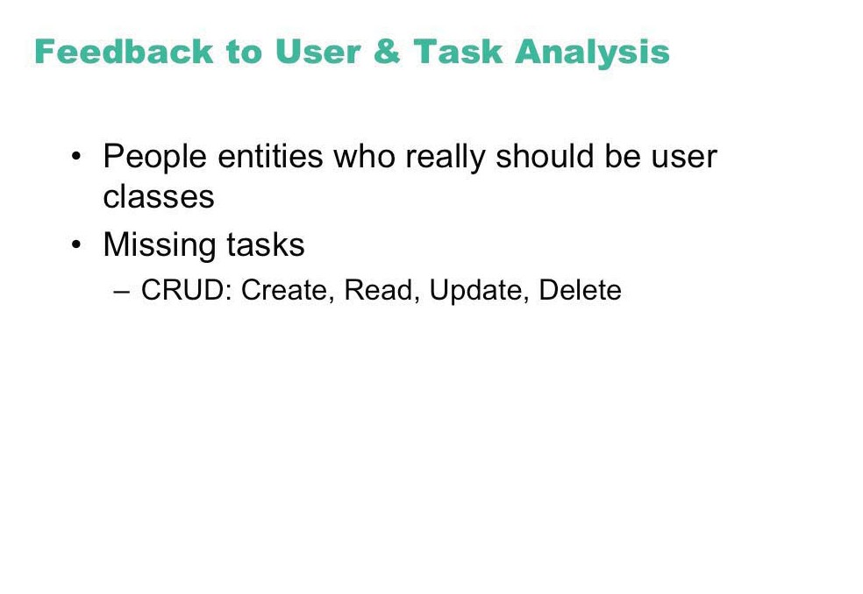

Slide 35
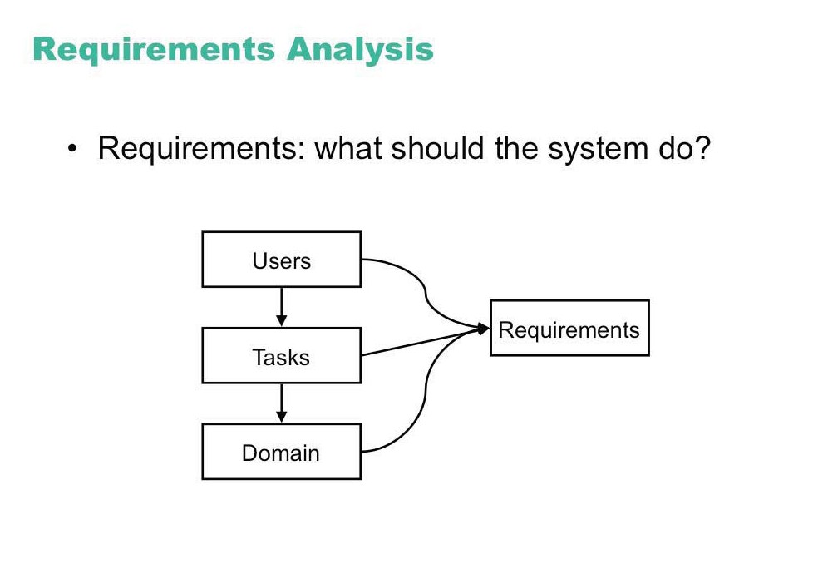

Slide 36
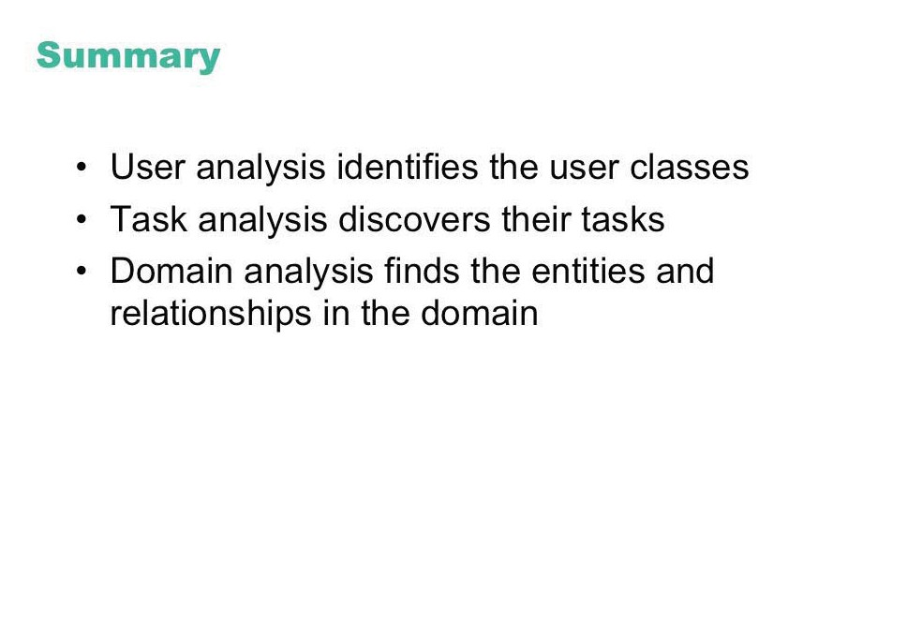

Slide 37
Design Process for Interactive Systems
Partition into Four Levels
  Conceptual
  Semantic
  Syntactic
  Lexical

Slide 38
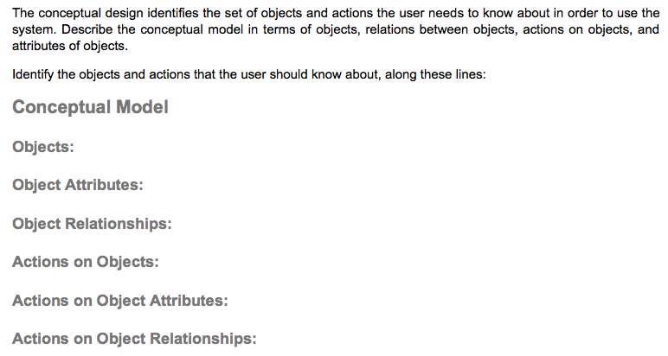
Conceptual Level
For templates, see Canvas page “Templates for conceptual, semantic, syntactic, lexical level user interface specifications”

Slide 39
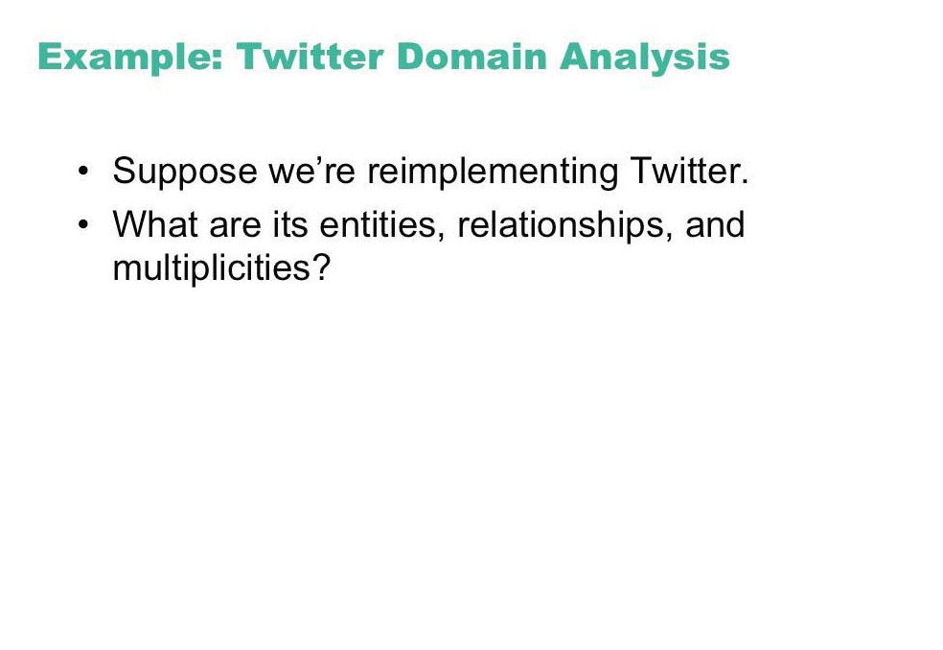

Slide 40
Design Process for Interactive Systems
Partition into Four Levels
  Conceptual
  Semantic
  Syntactic
  Lexical

Slide 41
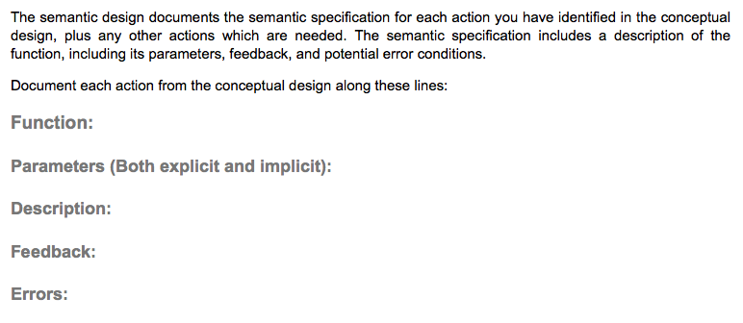
Semantic Level

Slide 42
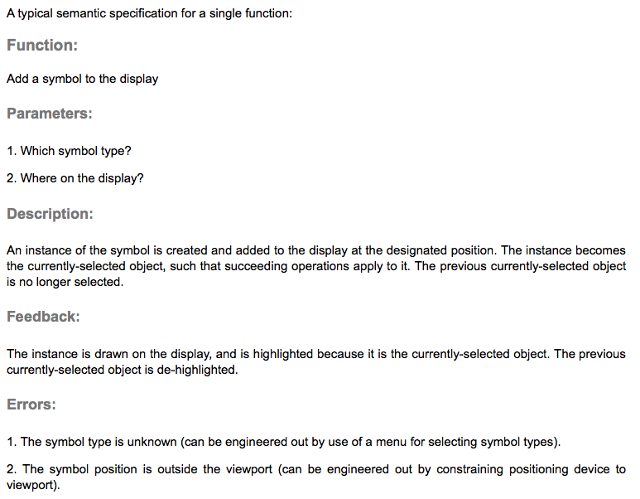
Semantic Level Specification

Slide 43
Design Process for Interactive Systems
Partition into Four Levels
  Conceptual
  Semantic
  Syntactic
  Lexical

Slide 44
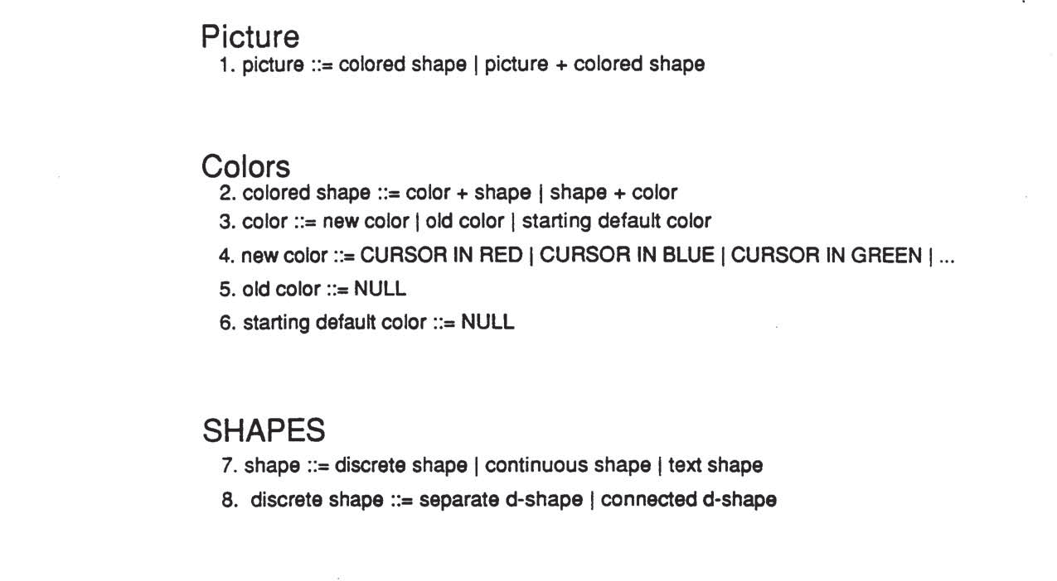
BNF (Backus-Naur Form) Example

Slide 45
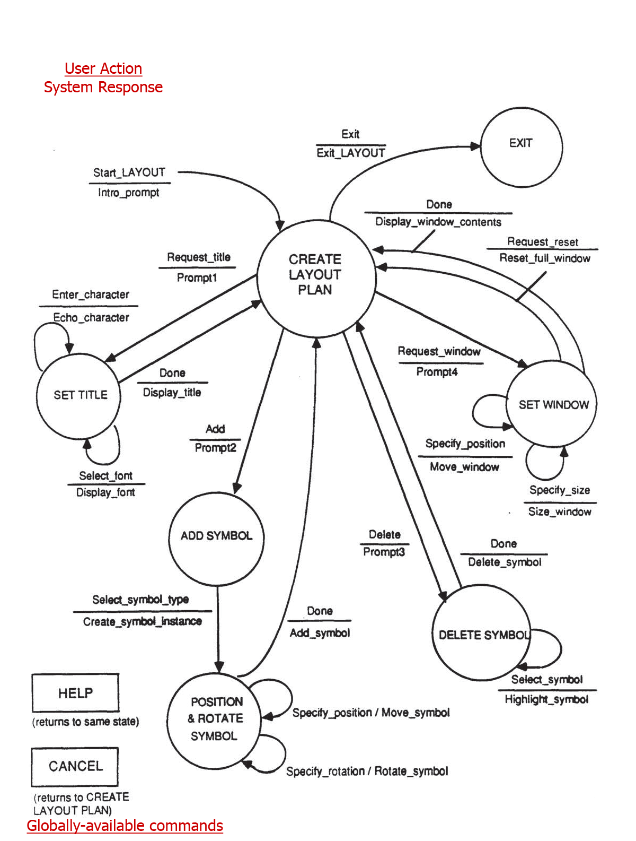
State Transition Diagram Example

Slide 46
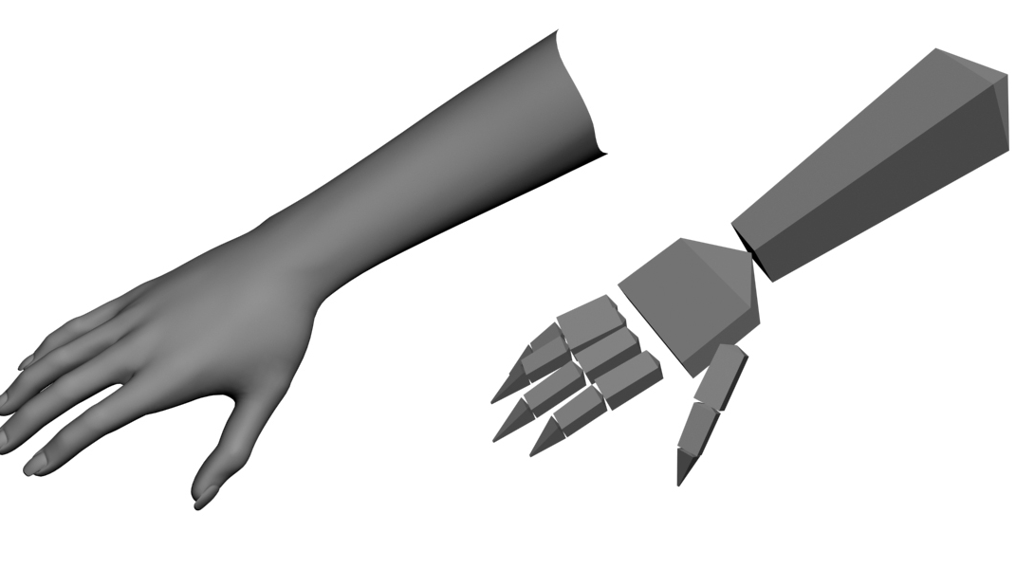
Commands for 3D Object Picking

Slide 47
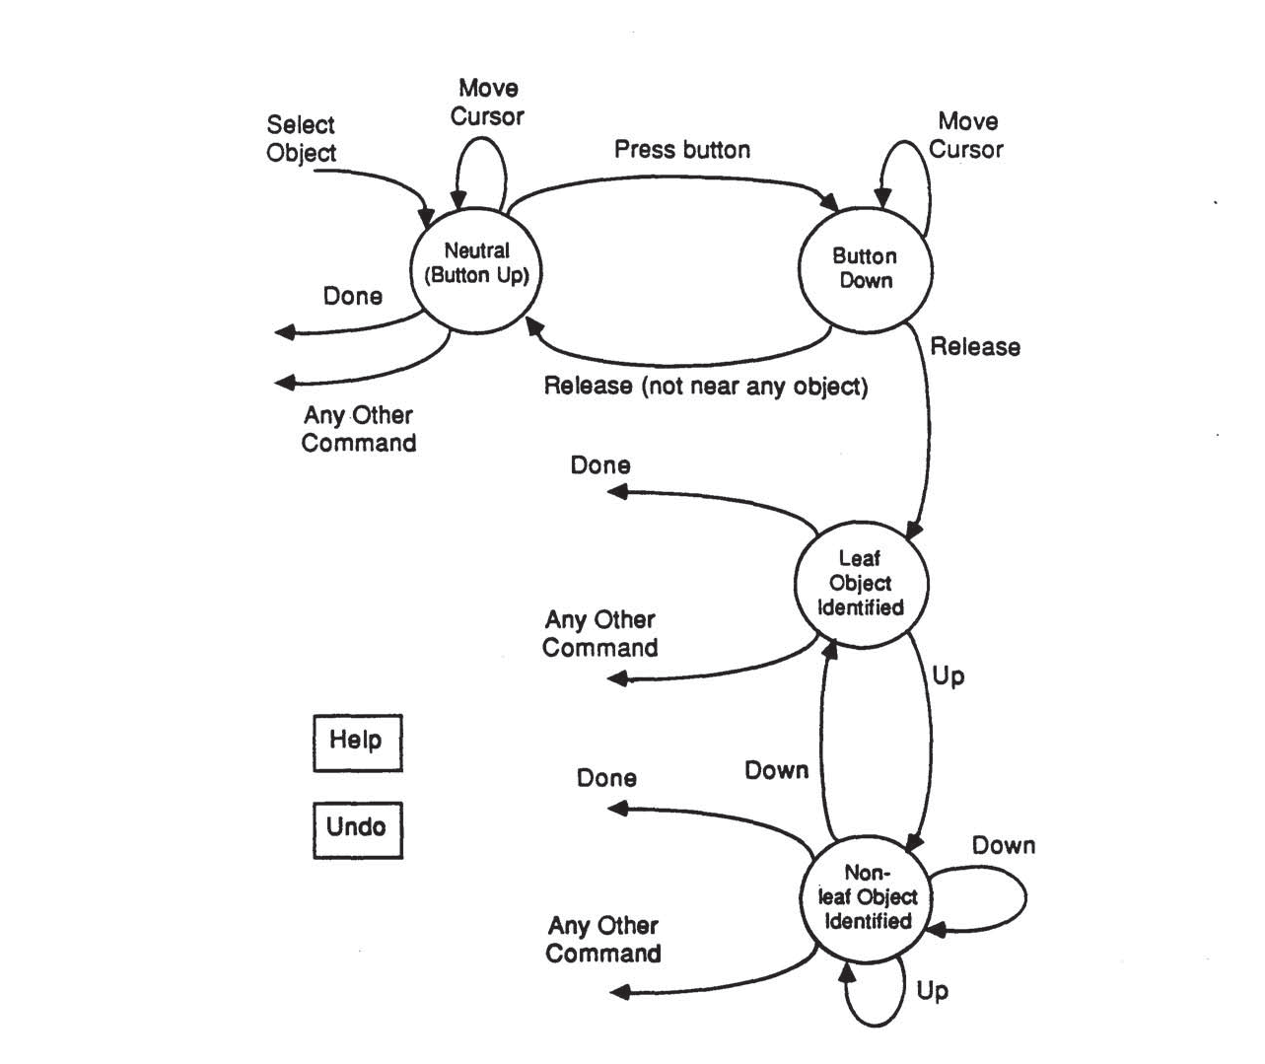
State Transition Diagram Example (2)

Slide 48
Design Process for Interactive Systems
Partition into Four Levels
  Conceptual
  Semantic
  Syntactic
  Lexical

Slide 49
Command Names (1)
Menu Choices for Electronic Calendar System
  1. Schedule a meeting
  2. Cancel a meeting
  3. Edit a meeting
  4. See calendar
  5. Other options
  6. Leave calendar

Slide 50
Command Names (2)
Designing Command Names for an Email System
Functions
  Begin writing text
  Put more text at end of current text
  Make hard copy
  Preserve text in a file
  Get rid of some words
  Get rid of whole document
  Ship text as mail to addressee
  Terminate session and leave system
Commands
Abbreviations
Synonyms

