Slide 1
Design of Everyday Things
Pathological designs
Many human errors result from design errors
Designers help through a good conceptual model
Slide deck by Saul Greenberg. Permission is granted to use this for non-commercial purposes as long as general credit to Saul Greenberg is clearly maintained.
Notice: some material in this deck is used from other sources without permission. Credit to the original source is given if it is known,

Slide 2
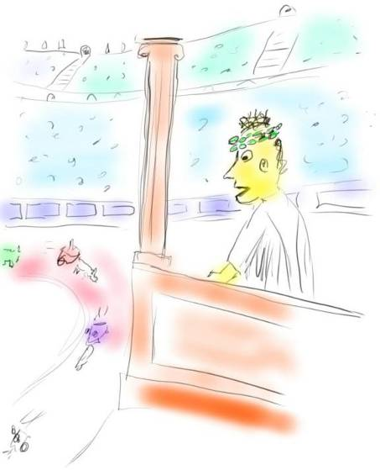
41 BC: Emperor tired of losing to Gauls
Win me the Chariot Race
Slide idea from David Hill

Slide 3
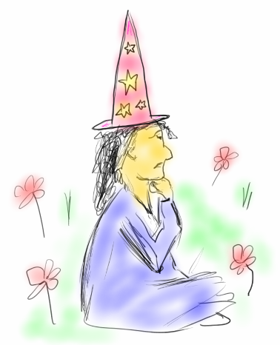
Advisor intuitively finds a solution...
Hmmm……
AHA!
The Wind!
Slide idea from David Hill

Slide 4
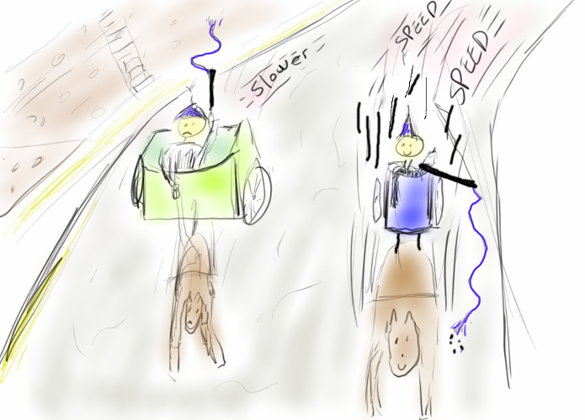
The Chariot Race
Notice aerodynamic efficiency of the faster chariot
Yes!!!
Nuts…
Slide idea from David Hill

Slide 5
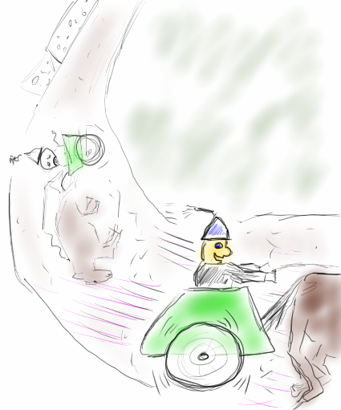
The Chariot Race
But, in maneuvering for position on the turn,
the DRIVER makes an error!!!
Har,
har…
Ooops…
Or was it
the DESIGNER???
Slide idea from David Hill

Slide 6
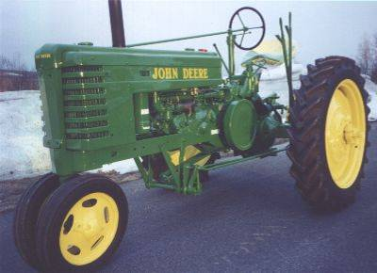

Tractors
high center
of gravity
Early design
Terrain
  unsurfaced and rough
  hilly
Farmer
  works long hours
  works quickly
narrow front
wheel base
Images from www.co.lawrence.tn.us and www.uni-magdeburg.de

Slide 7
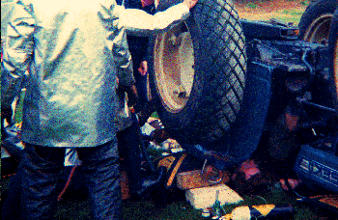
Tractors
Result
Quotes from National AG Safety Database
  older tractors have narrow front ends that are easily upset
  tractor upsets cause more fatalities than other farm accidents
  injuries often include a broken or crushed pelvis.
Accident image from //www.osh.dol.govt.nz/

Slide 8
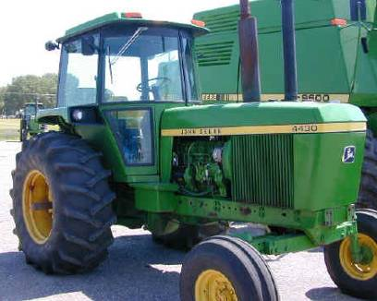
Tractors
Used to be called driver’s error
But
  accidents less frequent as modern designs have
    roll cage
    low center of gravity
    wider wheel bases
Tractor from www.historylink101.com

Slide 9
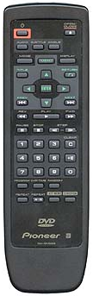
Remote Controls
The phone rings…
  hit pause
Pioneer DVD Remote
Slide idea from Jacob Nielsen Alertbox March 15, 2004

Slide 10

First TiVo DVR Remote Control
The phone rings…
  hit pause
Why is it easier?
  big button easier to hit (Fitt’s Law)
  visually distinctive (color)
  reasonably different from other buttons
  shape and central position means its easy to
  find by feel in zero light conditions
TiVo designed for usability
  part of early product development
TiVo DVR Remote
Slide idea from Jacob Nielsen Alertbox March 15, 2004

Slide 11

Remote Slide Clicker
How do you forward/reverse?
Instruction manual:
  short press: slide change forward
  long press: slide change backward
Slide idea from Donald Norman

Slide 12
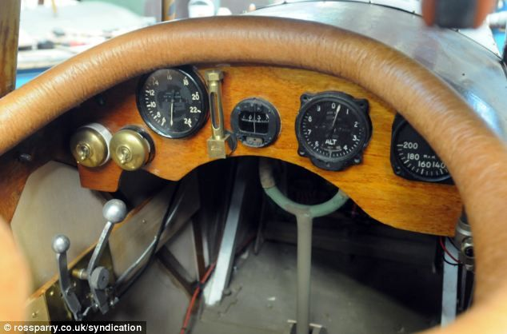
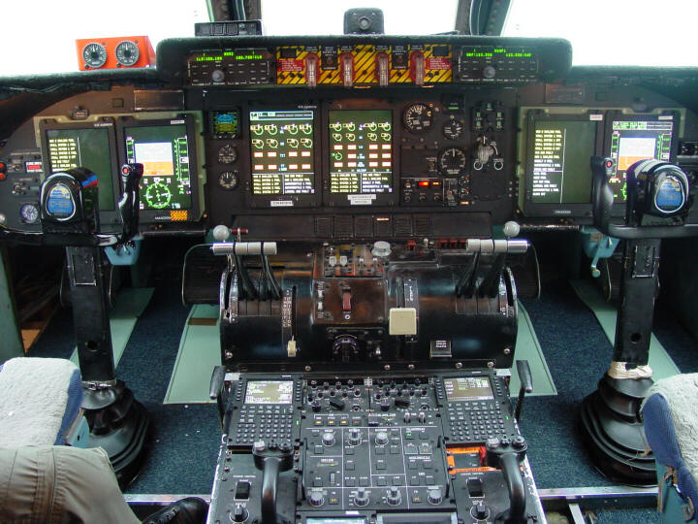
Human Factors in the Airplane Cockpit
World War I
Today
Notes:
Sources:
WWI fighter plane, from pinterest
C-5M, from wikipedia

Slide 13
What’s the altitude?
  Early days (< 1000’):
    only one needle needed
0
9
1
  As ceilings increased over 1000’
    small needle added
8
2
  As they increased beyond 10,000’
    box indicated 10,000’ increment through color change
7
3
6
4
5
< 10,000’
> 10,000’
Slide ideas from David Hill

Slide 14
The Harvard Airplane Control Panel
U/C horn
cut-out
button
Problem #1: Conditioned response
  stall -> push button; therefore stimulus nullified
Slide ideas from David Hill

Slide 15
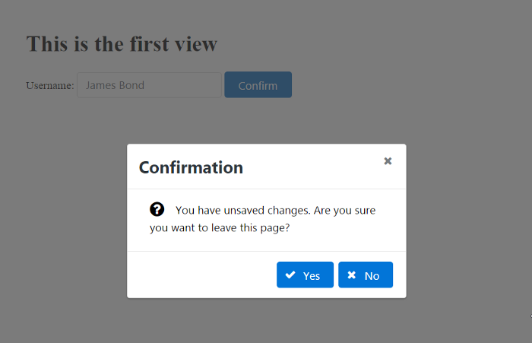
Still Happens

Slide 16
The Harvard Control Panel
The T-33 Control Panel
U/C horn
cut-out
button
Tip-tank
jettison
button
Problem #2: Negative transfer
  T-33’s: tip-tank jettison button in same location
Slide ideas from David Hill

Slide 17
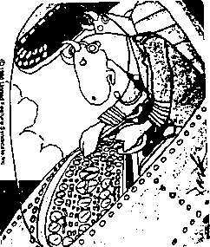
Darn these hooves! I hit the wrong switch again!
Who designs these instrument panels, raccoons?

Slide 18
Psychology of HCI
Perceived affordances
Causality
Visible constraints
Mapping
Transfer effects
Idioms and population stereotypes
Mental models

Slide 19
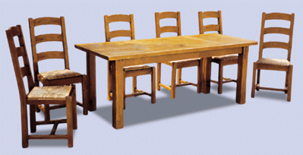
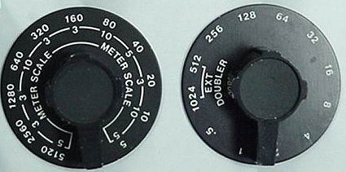
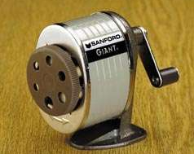
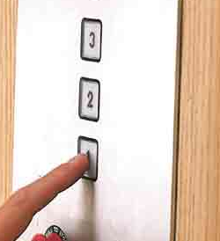
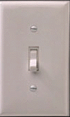

Perceived Affordance
The perceived properties of the object that suggest how one could use it
chairs are for sitting
table for placing things on
knobs are for turning
slots are for inserting
handles are for turning
switch for toggling
computer for…
buttons are for pressing
Many concepts in this section are adapted from Don Norman’s book: The Design of Everyday Things

Slide 20
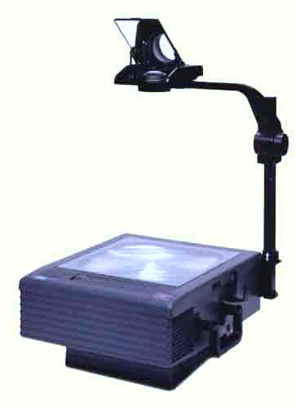
Perceived Affordances
Product design
  perceived affordances:
    design invites people to take possible actions
  actual affordances:
    the actual actionable properties of the product
Problems occur when
  these are not the same,
  people’s perceptions are not what the designer expects
In-depth discussion available at www.jnd.org/dn.mss/affordances-and-design.html

Slide 21
Perceived Affordances
    Mirrors for not touching
Knobs for turning
Handles for lifting
Surface for placing transparencies

Slide 22
Perceived Affordance Problems
    Mirrors for not touching
    people don’t reposition image
Knobs for turning
focus or image position?
Handles for lifting
bends frame, focus distorted
Surface for placing transparencies
which way is up?
what about this?

Slide 23
Visible Constraints
Limitations of the actions possible perceived from object’s appearance
  provides people with a range of usage possibilities
Push or pull?
Which side?
Can only push,
side to push clearly visible

Slide 24
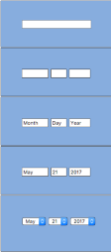
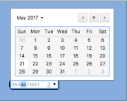
Visible constraints: Enter a Date
The more constraints, the less opportunity for error
  particularly important for managing user input
Controls constructed in Visual Basic

Slide 25
Mapping
The set of possible relations between objects
Control-display compatibility
  the natural relationship between controls and displays
  e.g., visual mapping of stove controls to elements
arbitrary
paired
full mapping
back
right
front
left
back
left
front
right
back
front
front
back
24 possibilities, requires:
-visible labels + memory
2 possibilities per side
=4 total possibilities

Slide 26
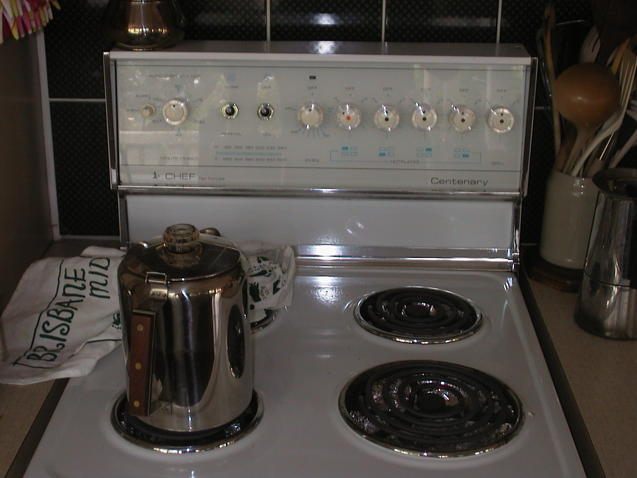

Slide 27
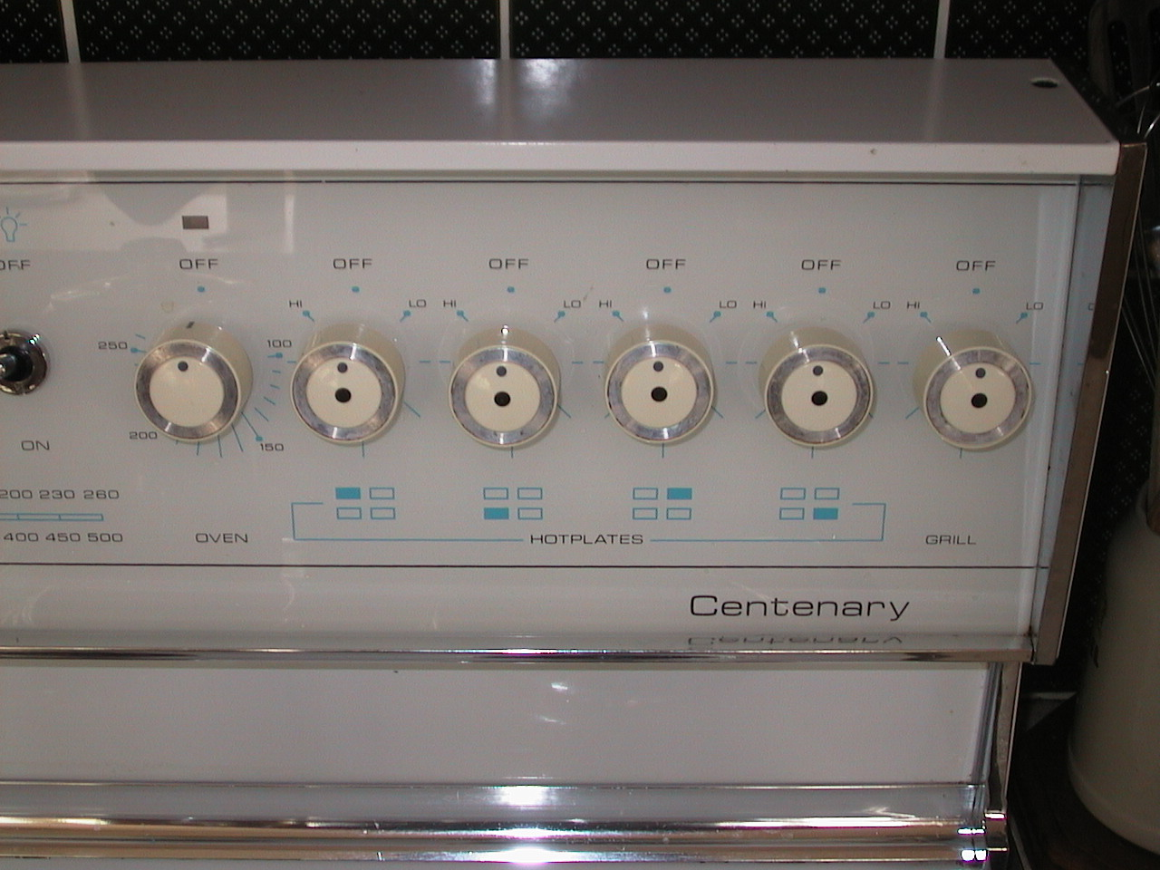

Slide 28
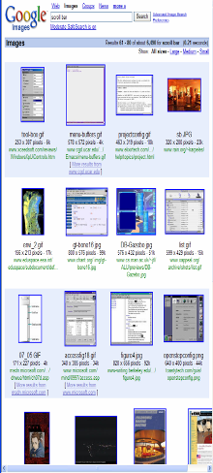
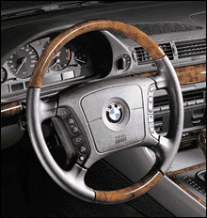
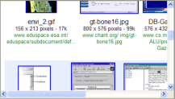
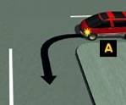
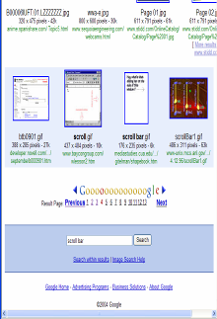
Mapping
Control-display compatibility
  cause and effect
steering wheel-
turn left, car turns left
scroll bar – scroll down viewport goes down

Slide 29
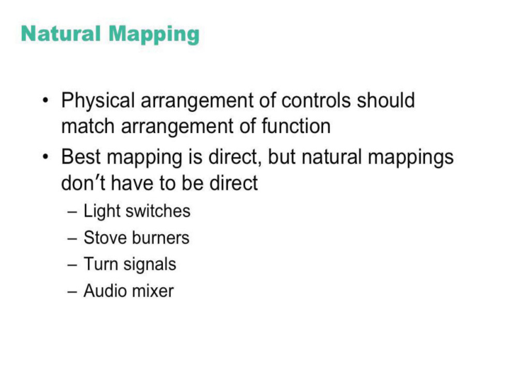
© IBM.

Slide 30
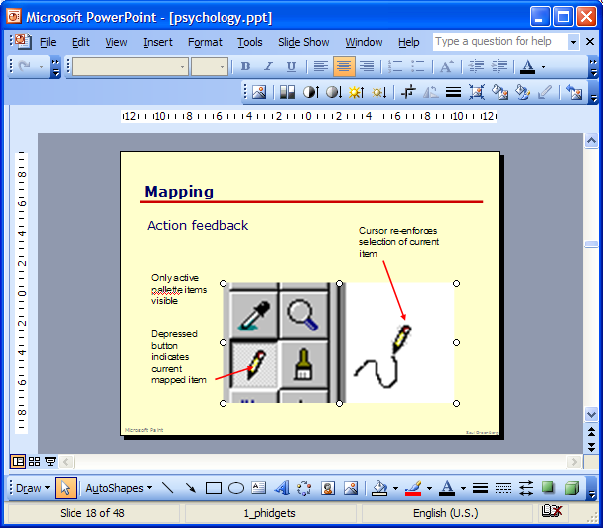
Mapping
Palette controls and active objects
Only controls that can operate on a picture are fully visible
Others are grayed out
Selected picture

Slide 31
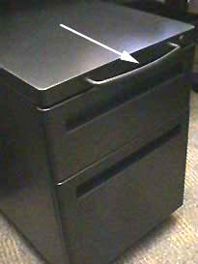
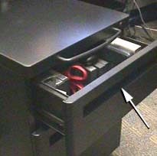
Mapping Problems
Quick, open the top drawer
Affordance:
handle is for pulling
Move cabinet
Mapping:
suggests it should open the drawer but doesn’t
Photograph courtesy of www.baddesigns.com

Slide 32
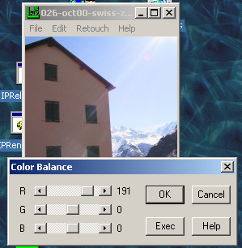
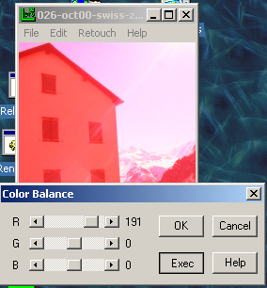
Causality Problems
Effects visible only after Exec button is pressed
  Ok does nothing!
  awkward to find appropriate color level
LViewPro

Slide 33
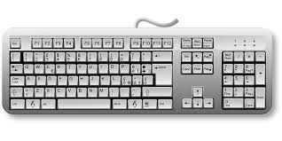
Transfer Effects
People transfer their learning/expectations of similar objects to the current objects
    positive transfer: previous learning's also apply to new situation
    negative transfer: previous learning's conflict with the new situation

Slide 34
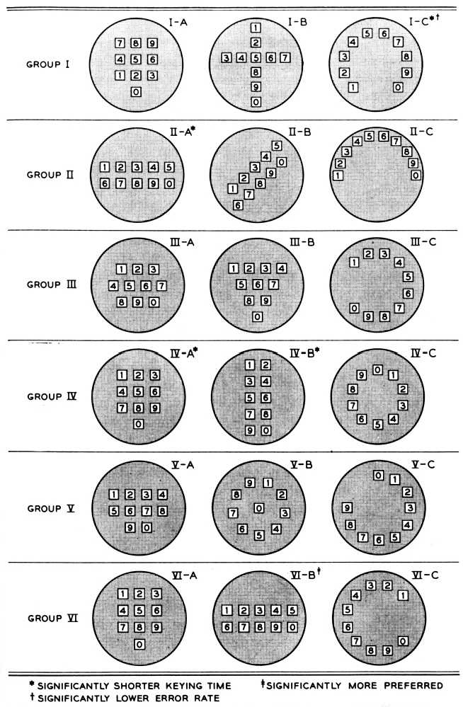
Early study for phone number pad layout

Slide 35
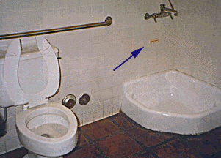

Transfer Effect Problems
A Restaurant in Santa Barbara
Photograph courtesy of www.baddesigns.com

Slide 36

Idioms and Population Stereotypes
Interface idioms:
  ‘standard’ interface features we learnt, use and remember
Idioms may define arbitrary behaviours
  red means danger
  green means safe
Population stereotypes: Idioms vary in different cultures
  Light switches
    America: down is off
    Britain: down is on
  Faucets
    America: counter-clockwise on
    Britain: counter-clockwise off

Slide 37
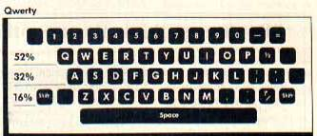
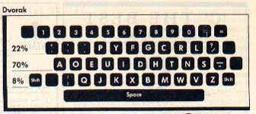
Idioms and Population Stereotypes
Ignoring/changing idioms?
  home handyman
    light switches installed upside down
  calculators vs. phone number pads
    which did computer keypads follow and why?
Difficulty of changing stereotypes
  Qwerty keyboard: designed to prevent jamming of keyboard
  Dvorak keyboard (’30s): provably faster to use
Images from www.atarimagazines.com/v5n11/dvorakkeyboard.html

Slide 38
Mental model
People have “mental models” of how things work, built from
  affordances
  causality
  constraints
  mapping
  positive transfer
  population stereotypes/cultural standards
  instructions
  interactions
models allow people to mentally simulate operation of device
models may be wrong
  particularly if above attributes are misleading

Slide 39

Good example: Scissors
affordances:
  holes for something to be inserted
constraints:
  big hole for several fingers, small hole for thumb
mapping:
  between holes and fingers suggested and constrained by appearance
positive transfer and cultural idioms
  learnt when young
  constant mechanism
mental model:
  implications clear of how the operating parts work

Slide 40
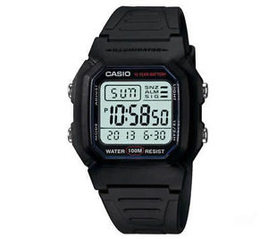
Bad example: First generation digital watch
affordances:
  four push buttons to push, but not clear what they will do
constraints and mapping unknown
  no visible relation between buttons, possible actions and end result
transfer of training
  little relation to analog watches
cultural idiom
  somewhat standardized core controls and functions
  but still highly variable
mental model:
  must be learnt

Slide 41
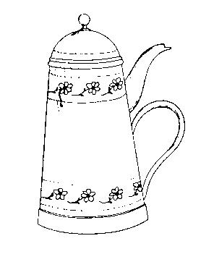
Donald Norman Design of Everyday Things, Basic Books

Slide 42
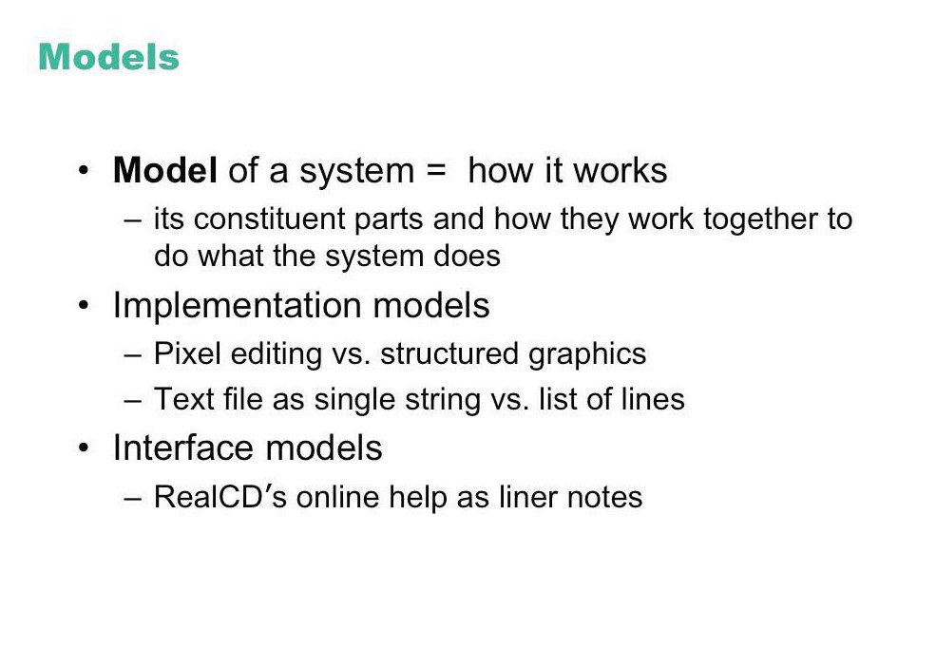

Slide 43
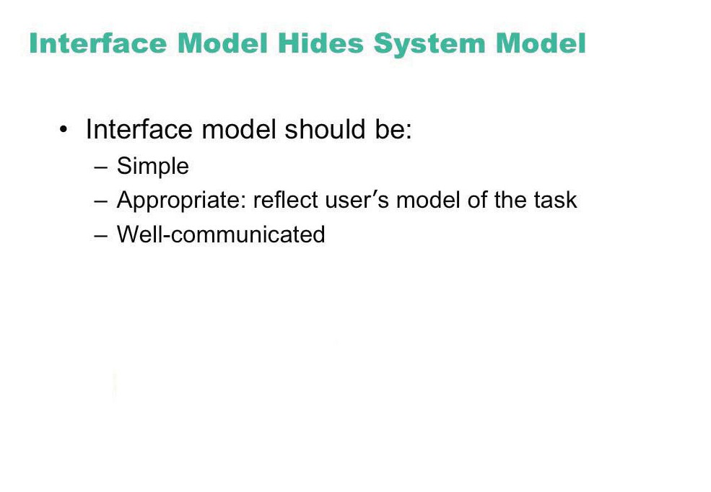
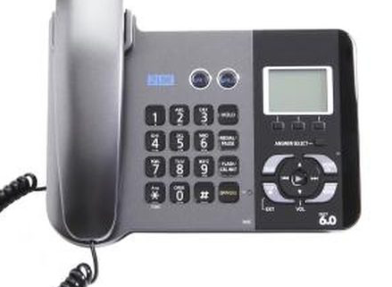
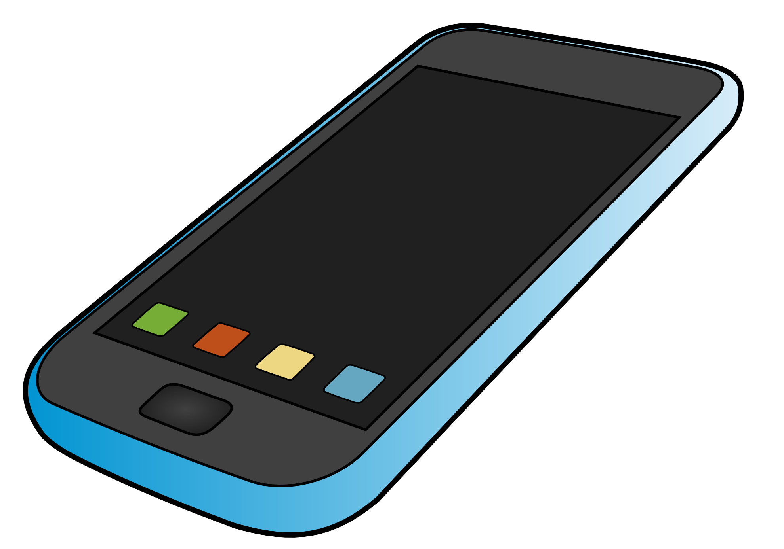

Slide 44
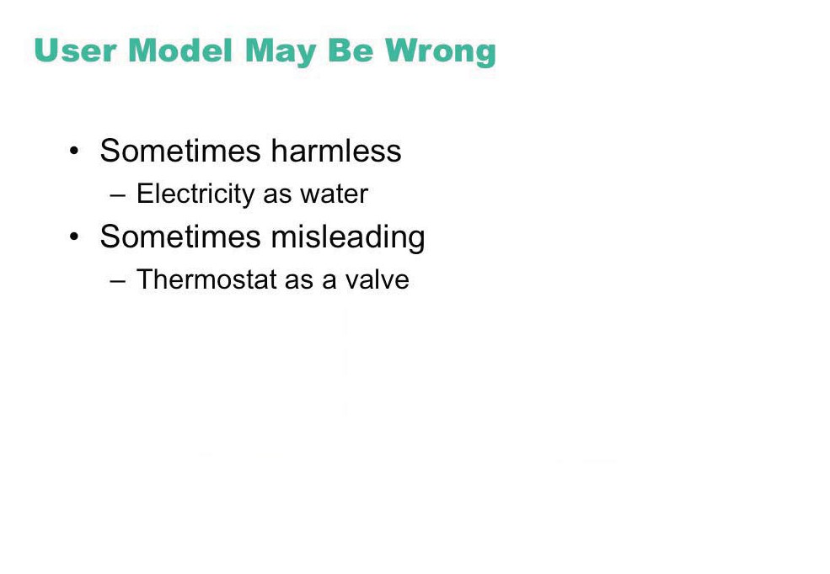
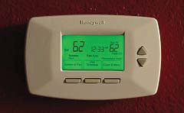

Image courtesy of KitAy on Flickr.
Image courtesy of John Loo on Flickr.

Slide 45
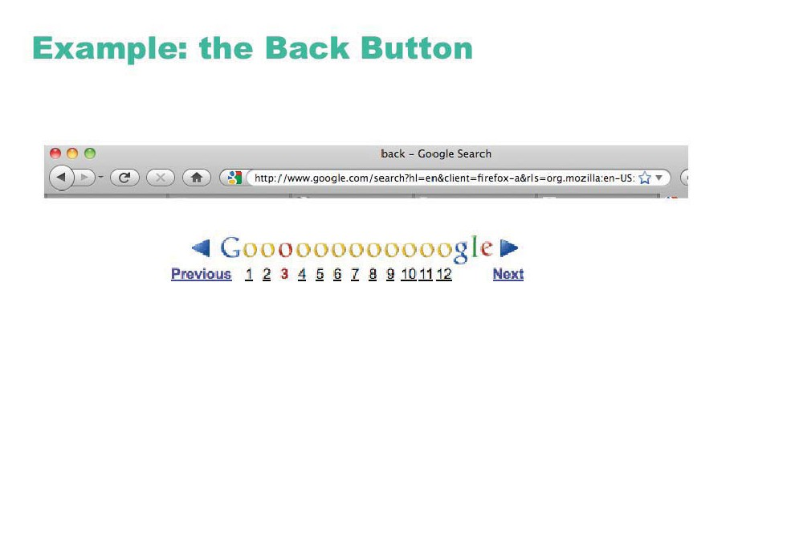
© Google Inc.

Slide 46
Designing a good mental model
communicate model through visual image
  visible affordances, mappings, and constraints
  visible causality of interactions
  cultural idioms, transfer
  instructions augments visuals
all work together to remind a person of what can be done and how to do it

Slide 47
Why design is hard
Over the last century
  the number of things to control has increased dramatically
    car audio: smartphone controls, online music services, AM, FM1, FM2, pre-sets, station selection, balance, fader, bass, treble, distance, mono/stereo, fast forward and reverse, etc (while driving at night!)
  display is increasingly artificial
    red lights in car indicate problems vs flames for fire
  feedback more complex, subtle, and less natural
    is your digital watch alarm on and set correctly?
  errors increasing serious and/or costly
    airplane crashes, losing days of work...

Slide 48
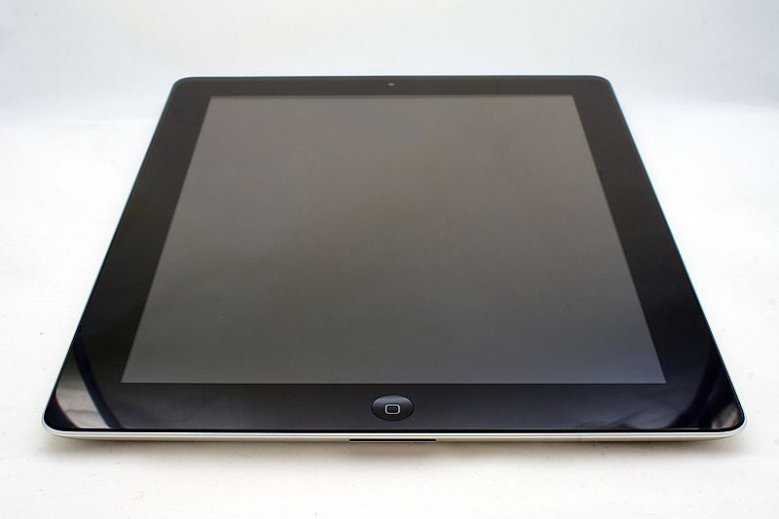
Human Factors in Computing
What does this do?
  computers far more complex to control than everyday devices
  general purpose computer contains no natural mental model
  completely up to the designer to craft a mental model

Slide 49
Whom do you design for?
  novices walk up and use systems
      interface affords restricted set of tasks
      introductory tutorials to more complex uses
  casual standard idioms
  recognition (visual affordances) over recall
  reference guides
  interface affords basic task structure
  intermediate advanced idioms
  complex controls
  reminders and tips
  interface affords advanced tasks
  expert shortcuts for power use
  interface affords full task + task customization
most kiosk + internet systems
most shrink-
wrapped
systems
custom software

Slide 50
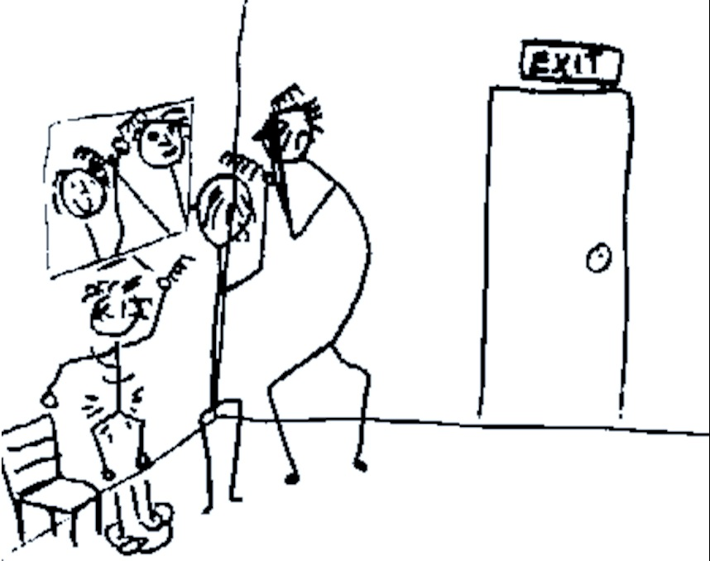
Whom do you design for?

Slide 51
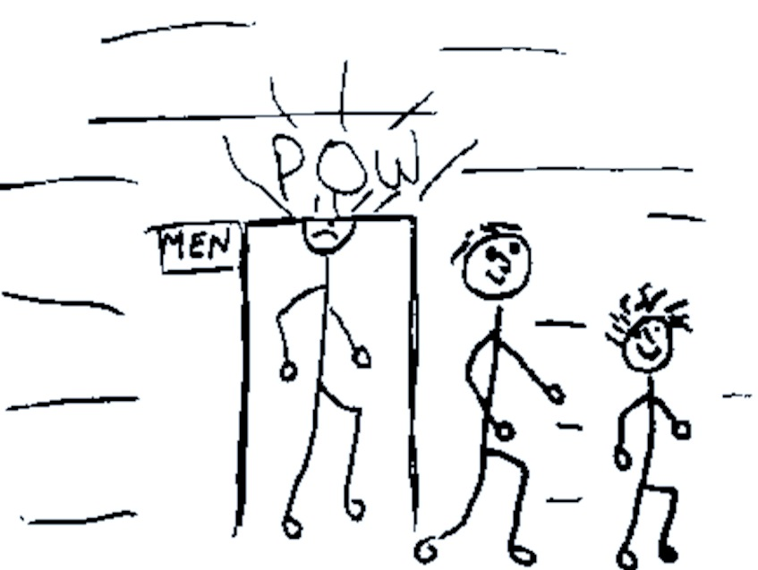
Whom do you design for?

Slide 52

Mean and
50th percentile

Slide 53
Design principles and guidelines
Broad usability statements that guide a developer’s design efforts
  use the users language
  provide feedback…
Derived from common design problems across many systems

Slide 54
Guidelines
Visibility
Simple and natural dialogue
Speak the user’s language
Minimize user's memory load
Be consistent
Give user control and freedom
Support undo
Provide shortcuts
Deal with errors in a positive way
Provide help

Slide 55
Guidelines:
1. Visibility

Slide 56

© IBM

Slide 57



Slide 58

© Microsoft

Slide 59

Provide feedback
Continuously inform the user about
  what it is doing
  how it is interpreting the user’s input
  user should always be aware of what is going on
What’s it doing?
Time for coffee.
> Doit
> Doit
This will take
5 minutes...

Slide 60

© The GIMP Team
© Microsoft

Slide 61
Provide feedback
What mode am I in now?
What did I select?
How is the system interpreting my actions?
Microsoft Paint

Slide 62


Slide 63



Provide feedback
Be as specific as possible, based on user’s input
Best within the context of the action

Slide 64

Provide feedback
Multiple files being copied,
but feedback is file by file.
Drawing Board LT

Slide 65


Slide 66

Read wear/Edit wear
Scrollbar shows extra information, but takes no extra space
Predecessor of modern social navigaion/recommender system
James Hollan

Slide 67


More Recent Examples
Harvard Stacklife
Matejka et al, Patina
  http://www.youtube.com/watch?v=Tz3MtN89gSQ
  http://www.youtube.com/watch?v=PuMw0CR_FYI

Slide 68

© Microsoft

Slide 69


Slide 70


Image courtesy of James Fleeting on Flickr.

Slide 71


Slide 72


Slide 73

© Microsoft

Slide 74


Slide 75


Slide 76


Dealing with long delays
  Cursors
    for short transactions
  Percent done dialogs
      time left
      estimated time
  Random
    for unknown times

Slide 77

Unnecessary Feedback
Original source: Interface Hall of Shame

Slide 78


Slide 79


Slide 80


Slide 81
Guidelines:
2. Simple and Natural Dialogue

Slide 82
Simple and natural dialogue
Use the user’s mental model
Match the users’ task sequence
Minimize mapping between interface and task semantics

Slide 83
Simple and natural dialogue
Present exactly the information the user needs
  less is more
    less to learn, to get wrong, to distract...
  information should appear in natural order
    related information is graphically clustered
    order of accessing information matches user’s expectations
  remove or hide irrelevant or rarely needed information
    competes with important information on screen
  remove modes
  use windows frugally
    don’t add unneeded navigation and window management

Slide 84

Good: information all in the same place
By previous 481 students Brant LeClercq, Lloyd Yoon, Amy Yang (with permission)

Slide 85

Good: information all in the same place
Bad: special edit mode
By previous 481 students Brant LeClercq, Lloyd Yoon, Amy Yang (with permission)

Slide 86
By previous 481 students Brant LeClercq, Lloyd Yoon, Amy Yang (with permission)

Slide 87

Good: Stable parts of the window
Bad: Prescriptions separate from graphics
By previous 481 students Brant LeClercq, Lloyd Yoon, Amy Yang (with permission)

Slide 88

collapsed onto
one screen
(needs formatting)
Click to get info
Double click to edit
(mode buttons gone)
Add Undo
By previous 481 students Brant LeClercq, Lloyd Yoon, Amy Yang (with permission)

Slide 89

© FileMatrix

Slide 90

© Google Inc.

Slide 91

Techniques: Remove nonessential elements
© Google Inc.

Slide 92


Slide 93
Guidelines:
3. Speak the User’s Language

Slide 94


Speak the User’s Language
Use common words, not technical jargon
  But use domain-specific terms where appropriate
Allow aliases/synonyms in command languages
Original source: Interface Hall of Shame

Slide 95



Speak the user’s language
Terminology based on users’ language for task
  e.g. withdrawing money from a bank machine
Use meaningful mnemonics, icons & abbreviations
  eg File / Save
    Ctrl + S (abbreviation)
    Alt FS (mnemonic for menu action)
    (tooltip icon)

Slide 96



Speak the users’ language

Slide 97
Guidelines:
4. Minimize User’s Memory Load

Slide 98


Minimize user’s memory load
Computers good at remembering, people are not!
Promote recognition over recall
  menus, icons, choice dialog boxes vs commands, field formats
  relies on visibility of objects to the user (but less is more!)
From Microsoft applications

Slide 99
Minimize user’s memory load
Gives input format, example and default

Slide 100


People Don’t Learn Instantly
Original source: Interface Hall of Shame

Slide 101

Inane Dialog Boxes
Midwest Microwave's online catalog
Some of these interfaces were posted on Interface Hall of Shame

Slide 102
Guidelines:
5. Be Consistent

Slide 103


Slide 104
Be consistent
Consistent syntax of input
Consistent language and graphics
  same visual appearance across the system (e.g. widgets)
  same information/controls in same location on all windows
Consistent effects
  commands, actions have same effect in equivalent situations
    predictability
Ok
Cancel
Cancel
Ok
Ok
Accept
Dismiss
Cancel

Slide 105




© The GIMP Team. All rights reserved.
© Remember the Milk. All rights reserved.

Slide 106

Be Consistent
These are labels with a raised appearance.
Is it any surprise that people try and click on them?

Slide 107


From Peachpit website

Slide 108

© Microsoft

Slide 109


Slide 110
Guidelines:
6. Give User Control and Freedom

Slide 111


Slide 112


© GlobalSCAPE, Inc.

Slide 113
Provide clearly marked exits
Users don’t like to feel trapped by the computer!
  should offer an easy way out of as many situations as possible
Strategies:
  Cancel button (for dialogs waiting for user input)
  Universal Undo (can get back to previous state)
  Interrupt (especially for lengthy operations)
  Quit (for leaving the program at any time)
  Defaults (for restoring a property sheet)
Core
Dump

Slide 114

Provide clearly marked exits
How do I get out of this?

Slide 115


Wizard vs. Center Stage: Who’s in Control?

Slide 116


© Google.

Slide 117



Slide 118


Slide 119

© Facebook

Slide 120
Guidelines:
7. Support Undo

Slide 121

© Apple Inc. All rights reserved.
© Google. All rights reserved.
© Wikipedia Foundation, Inc.

Slide 122


Slide 123


Slide 124


Slide 125


Slide 126


Slide 127


Slide 128


Slide 129
Guidelines:
8. Provide Shortcuts

Slide 130

Provide shortcuts
Keyboard accelerators for menus
Customizable toolbars and
palettes for frequent actions
Split menu, with recently used fonts on top
Right click raises object-specific menu
Scrolling controls for line- or page-sized increments
Microsoft Powerpoint

Slide 131

Provide shortcuts
Alternate representation for quickly doing different set of tasks
Toolset brought in appropriate to this representation
Microsoft Powerpoint

Slide 132
Guidelines:
9. Deal with Errors in a Positive Way

Slide 133

Deal with errors in a positive way
What is “error 15762”?

Slide 134


Slide 135


Slide 136


Slide 137
Mode Error
Modes : states in which same actions have different meanings
vi insert mode vs. command mode
Caps lock
Drawing tool palette

Slide 138


Slide 139

© Microsoft

Slide 140


Slide 141


Slide 142


Slide 143



%
© Microsoft

Slide 144



Slide 145

Problematic message to a nuclear power plant operator

Slide 146



Deal with errors in a positive way
Adobe's ImageReady
Windows Notepad
Microsoft's NT Operating System

Slide 147

© Apple, Inc
© Microsoft
© Autodesk, Inc.

Slide 148


Slide 149

© Adobe Systems Inc.

Slide 150
Provide meaningful error messages
error messages should be in the user’s task language
don’t make people feel stupid
  Try again, bonehead!
  Error 25
  Cannot open this document
  Cannot open “chapter 5” because the application “Microsoft Word” is not on your system
  Cannot open “chapter 5” because the application “Microsoft Word” is not on your system. Open it with “TextEdit” instead?

Slide 151


Deal with errors in a positive way
Prevent errors
  try to make errors impossible
  widgets where you can only enter legal data
Provide reasonableness checks on input data
  on entering order for office supplies
    5000 pencils is an unusually large order. Do you really want to order that many?

Slide 152




Inane Dialog Boxes
Umm, thanks for the warning,
but what should I do?
What happens when you
cancel a cancelled operation?
Do I have any choice in this?
Uhhh… I give up on this one
Some of these interfaces were posted on Interface Hall of Shame

Slide 153



Inane Dialog Boxes
These are too good not to show
Some of these interfaces were posted on Interface Hall of Shame

Slide 154




Inane Dialog Boxes
ClearCase, source-code control Rational Software
Some of these interfaces were posted on Interface Hall of Shame

Slide 155

One More Example

Slide 156
Guidelines:
10. Provide Help

Slide 157
Provide help
Help is not a replacement for bad design!
Simple systems:
  walk up and use; minimal instructions
Most other systems
  feature rich
  simple things should be simple
  learning path for advanced features
Volume 37:
A user's
guide to...

Slide 158
Documentation and how it is used
Many users do not read manuals
  prefer to spend their time pursuing their task
Usually used when users are in some kind of panic
  paper manuals often unavailable or inaccessible
  online documentation better
  good search/lookup tools
  online help specific to current context
Sometimes used for quick reference
  syntax of actions, possibilities...
  list of shortcuts ...

Slide 159
Types of help
Tutorial and/or getting started manuals
  short guides that people are likely to read when first obtaining their systems
    encourages exploration and getting to know the system
    tries to get conceptual material across and essential syntax
  on-line “tours”, exercises, and demos
    demonstrates very basic principles through working examples

Slide 160


Types of help
Reference manuals
  used mostly for detailed lookup by experts
    rarely introduces concepts
    thematically arranged
  on-line hypertext
    search / find
    table of contents
    index
    cross-index

Slide 161
Types of help
Reminders
  short reference cards
    expert user who just wants to check facts
    novice who wants to get overview of system’s capabilities
  keyboard templates
    shortcuts/syntactic meanings of keys; recognition vs. recall; capabilities
  tooltips and other context-sensitive help
    text over graphical items indicates their meaning or purpose
Microsoft Word

Slide 162

Types of help
Wizards
  walks user through typical tasks
  but dangerous if user gets stuck
What’s my computer’s name?
Fred?
Intel?
Dell?
Microsoft Powerpoint

Slide 163


Types of help
Tips
  migration path to learning system features
  also context-specific tips on being more efficient
  must be “smart”, otherwise boring and tedious
Microsoft Word

Slide 164
Summary of Guidelines
Visibility
Simple and natural dialogue
Speak the user’s language
Minimize user's memory load
Be consistent
Give user control and freedom
Support undo
Provide shortcuts
Deal with errors in a positive way
Provide help

Slide 165


Slide 166
Heuristic evaluation
Compare UI design to guidelines
Issues
  Problems found by a single inspector
  Problems found by multiple inspectors
  Individuals vs. teams
  Self guided or scenarios?

Slide 167
Problems found by one inspector
Average over six case studies
  35% of all usability problems;
  42% of the major problems
  32% of the minor problems
Not great, but
  finding some problems with one evaluator is
  much better than finding no problems with
  no evaluators!

Slide 168
Problems found by one inspector
Varies according to
  difficulty of the interface being evaluated
  the expertise of the inspectors
Average problems found by:
  novice evaluators - 22%
    no usability expertise
  regular specialists - 41%
    expertise in usability
  double specialists - 60%
    experience in both usability and the particular
    kind of interface being evaluated
    also find domain-related problems
Tradeoff
  novices poorer, but cheaper!

Slide 169

Problems found by one inspector
Evaluators miss both easy and hard problems
  ‘best’ evaluators can miss easy problems
  ‘worse’ evaluators can discover hard problems

Slide 170

Problems found by multiple evaluators
3-5 evaluators find 66-75% of usability problems
  different people find different usability problems
  only modest overlap between the sets of problems found

Slide 171

Problems found by multiple evaluators
Where is the best cost/benefit?

Slide 172
Individuals vs teams
Nielsen
  recommends individual evaluators inspect the interface alone
Why?
  evaluation is not influenced by others
  independent and unbiased
  greater variability in the kinds of errors found
  no overhead required to organize group meetings

Slide 173
Self Guided vs Scenario Exploration
Self-guided
  open-ended exploration
  Not necessarily task-directed
  good for exploring diverse aspects of the interface, and to follow potential pitfalls
Scenarios
  step through the interface using representative end user tasks
  ensures problems identified in relevant portions of the interface
  ensures that specific features of interest are evaluated
  but limits the scope of the evaluation - problems can be missed

