Slide 1
Analyzing User Interactions for
Data and User Modeling
Remco Chang
Assistant Professor
Tufts University

Slide 2
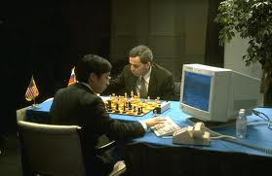
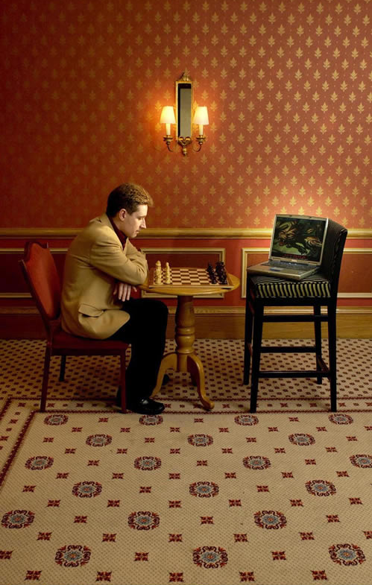
Human + Computer
Human vs. Artificial Intelligence
Garry Kasparov vs. Deep Blue (1997)
  Computer takes a “brute force” approach without analysis
  “As for how many moves ahead a grandmaster sees,” Kasparov concludes: “Just one, the best one”
Artificial vs. Augmented Intelligence
Hydra vs. Cyborgs (2005)
  Grandmaster + 1 chess program > Hydra (equiv. of Deep Blue)
  Amateur + 3 chess programs > Grandmaster + 1 chess program¹
1. http://www.collisiondetection.net/mt/archives/2010/02/why_cyborgs_are.php

Slide 3
“The computer is incredibly fast, accurate, and stupid. Man is unbelievably slow, inaccurate, and brilliant. The marriage of the two is a force beyond calculation.”
-Leo Cherne, 1977
(often attributed to Albert Einstein)

Slide 4
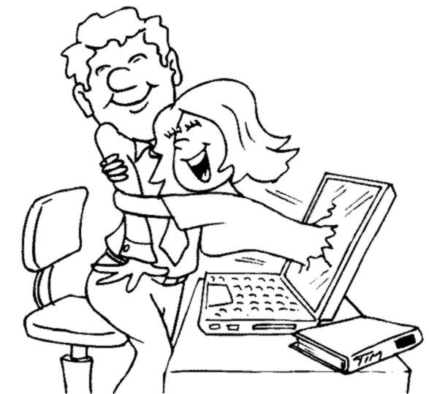
Which Marriage?

Slide 5
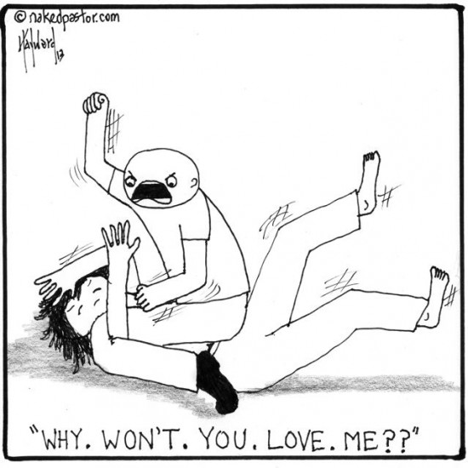
Which Marriage?

Slide 6
(Modified) Van Wijk’s Model of Visualization
Data
Visualization
User
Vis
Image
Perceive
Data
Discovery
Params
Interaction
Explore

Slide 7


When the Analyst is Successful….
Data
Visualization
User
Vis
Image
Perceive
Data
Discovery
Params
Interaction
Explore
Data + Vis + Interaction + User = Discovery

Slide 8
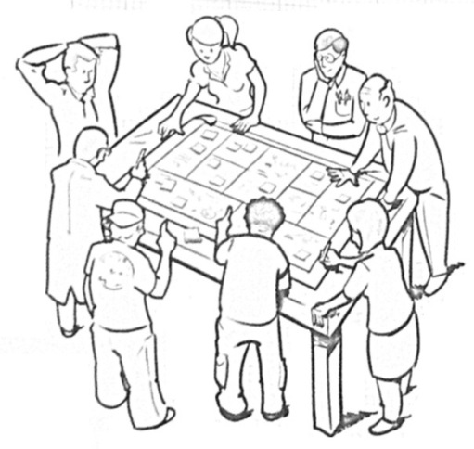

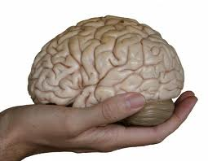
Remco’s Research Goal
“Reverse engineer” the human cognitive black box (by analyzing user interactions)
Data Modeling
  Interactive Metric Learning
User Modeling
  Predict Analysis Behavior
Perception and Cognition
  Perception Modeling
  Cognitive Priming
Mixed Initiative Systems
  Adaptive Visualization and Computation
R. Chang et al., Science of Interaction, Information Visualization, 2009.

Slide 9
Data Modeling
Interactive Metric Learning
Quantifying a User’s Knowledge about Data

Slide 10
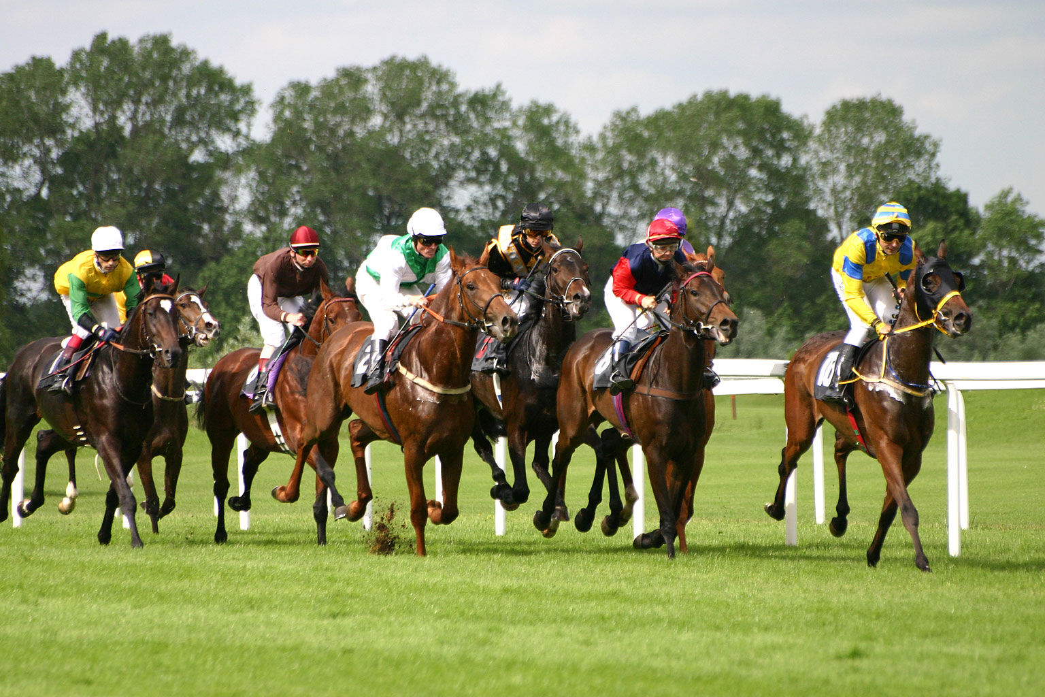
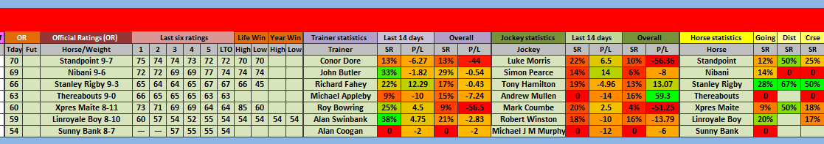
1. Richard Heuer. Psychology of Intelligence Analysis, 1999. (pp 53-57)

Slide 11
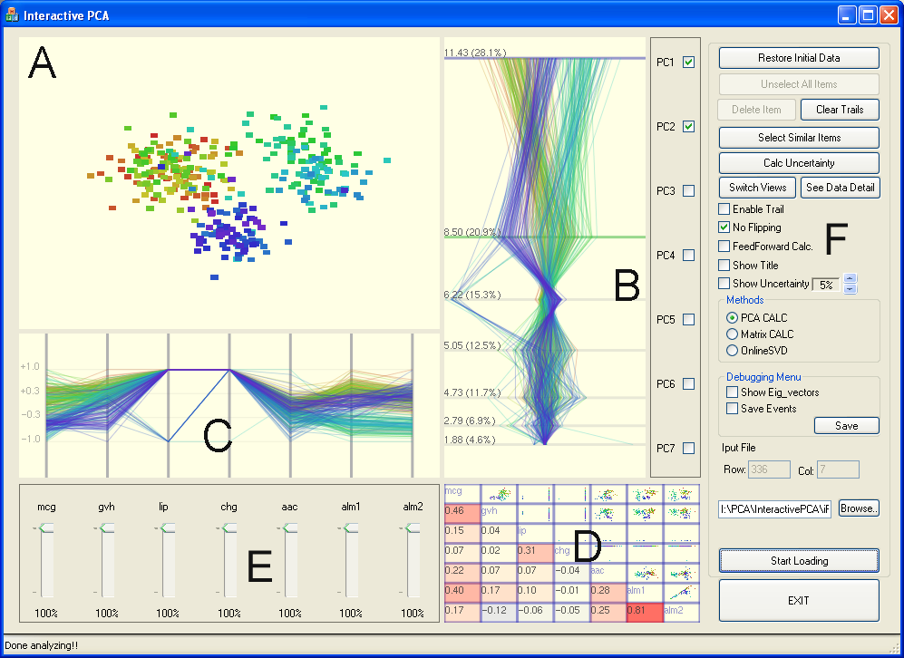
Exploring High-Dimensional Space: iPCA
Jeong et al., iPCA: An Interactive System for PCA-based Visual Analytics. Eurovis 2009.

Slide 12

Metric Learning
Finding the weights to a linear distance function
Instead of a user manually give the weights, can we learn them implicitly through their interactions?

Slide 13
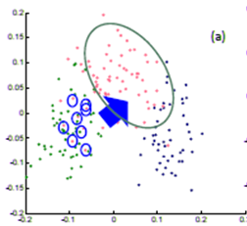
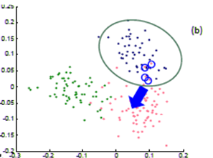
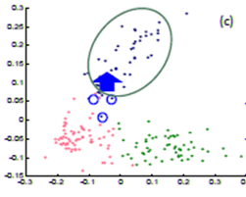
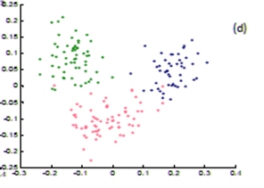
Metric Learning
In a projection space (e.g., MDS), the user directly moves points on the 2D plane that don’t “look right”…
Until the expert is happy (or the visualization can not be improved further)
The system learns the weights (importance) of each of the original k dimensions
Short Video (play)

Slide 14


Dis-Function
Optimization:
Brown et al., Find Distance Function, Hide Model Inference. IEEE VAST Poster 2011
Brown et al., Dis-function: Learning Distance Functions Interactively. IEEE VAST 2012.

Slide 15
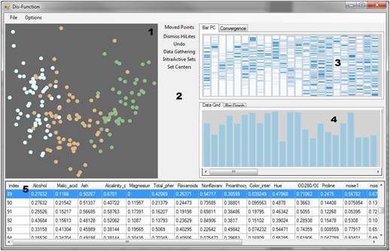
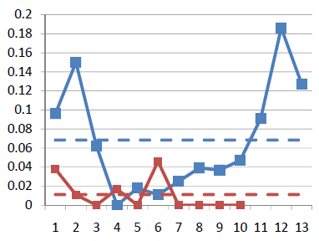
Results
Used the “Wine” dataset (13 dimensions, 3 clusters)
Added 10 extra dimensions, and filled them with random values
Blue: original data dimension
Red: randomly added dimensions
X-axis: dimension number
Y-axis: final weights of the distance function

Slide 16
User Modeling
2. Learning about a User in Real-Time
Who is the user,
and what is she doing?

Slide 17
One Question at a Time
Data
Visualization
User
Fast
or
Slow?
Novice or
Expert?
Vis
Introvert or
Extrovert?
Image
Perceive
Data
Discovery
Params
Interaction
Explore
Data + Vis + Interaction + User = Discovery

Slide 18
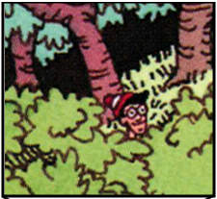
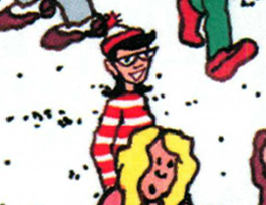
Experiment: Finding Waldo
Google-Maps style interface
  Left, Right, Up, Down, Zoom In, Zoom Out, Found

Slide 19
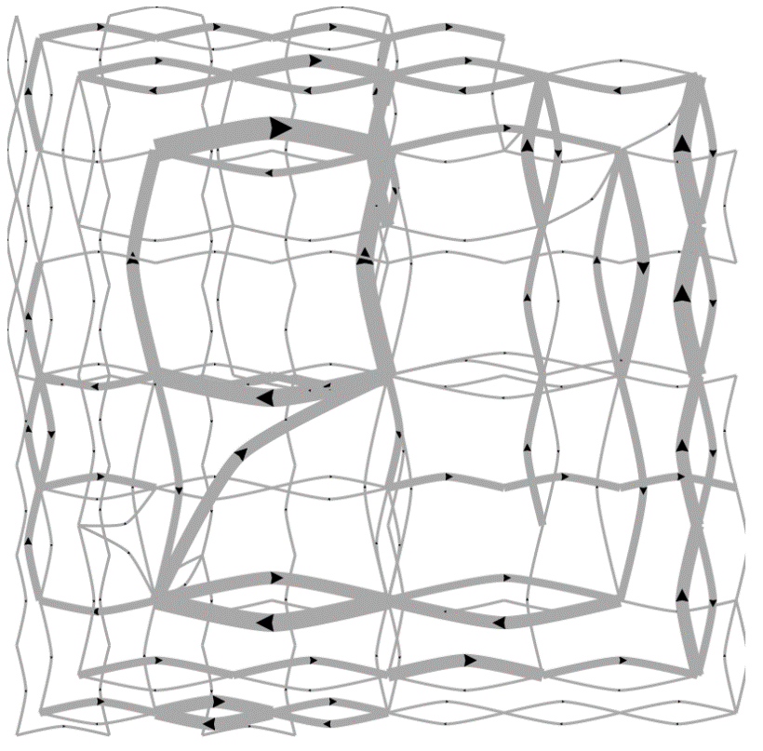
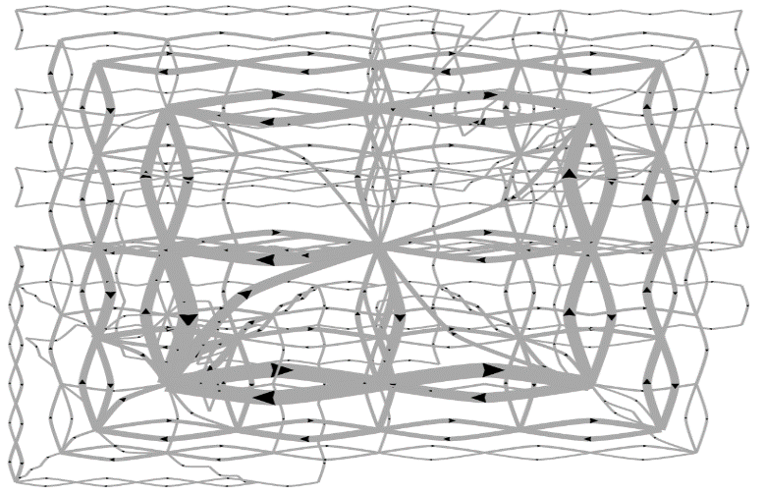
Pilot Visualization – Completion Time
Fast completion time
Slow completion time
Eli Brown et al., Where’s Waldo. IEEE VAST 2014, Conditionally Accepted.

Slide 20
Post-hoc Analysis Results
Mean Split (50% Fast, 50% Slow)
Data Representation | Classification Accuracy | Method
State Space | 72% | SVM
Edge Space | 63% | SVM
Action Sequence | 77% | Decision Tree
Mouse Event | 62% | SVM
Fast vs. Slow Split (Mean+0.5σ=Fast, Mean-0.5σ=Slow)
Data Representation | Classification Accuracy | Method
State Space | 96% | SVM
Edge Space | 83% | SVM
Action Sequence | 79% | Decision Tree
Mouse Event | 79% | SVM

Slide 21
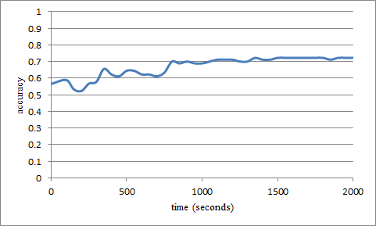
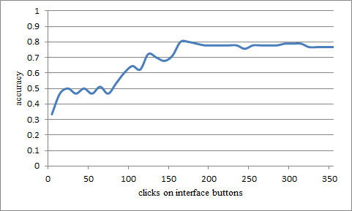
“Real-Time” Prediction
(Limited Time Observation)
State-Based
Linear SVM
Accuracy: ~70%
Interaction Sequences
N-Gram + Decision Tree
Accuracy: ~80%

Slide 22
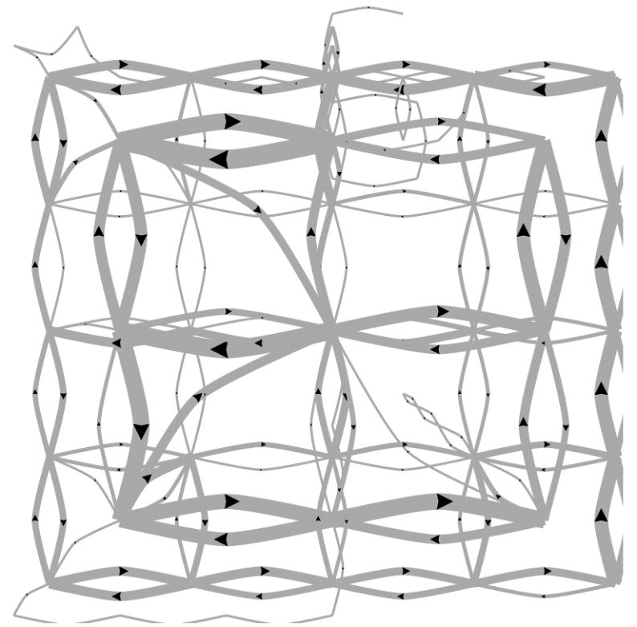
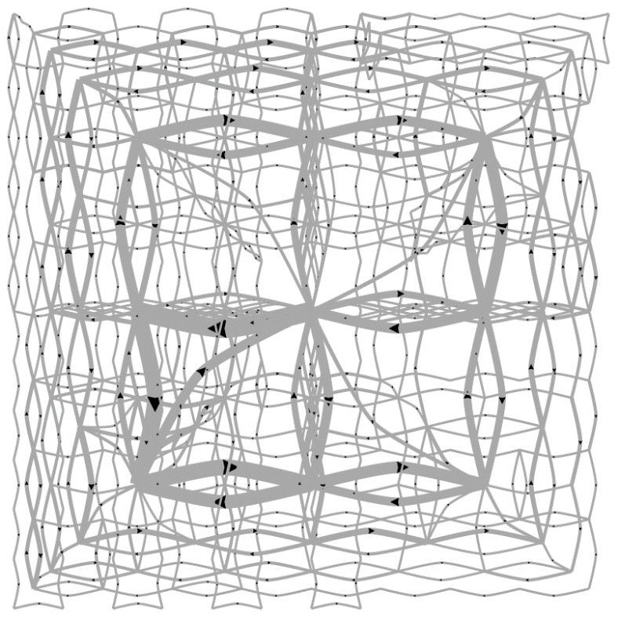
Predicting a User’s Personality
External Locus of Control
Internal Locus of Control
Ottley et al., How locus of control inﬂuences compatibility with visualization style. IEEE VAST , 2011.
Ottley et al., Understanding visualization by understanding individual users. IEEE CG&A, 2012.

Slide 23
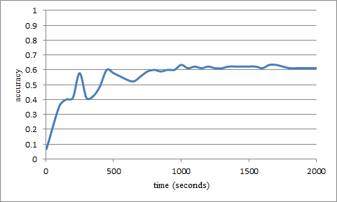
Predicting Users’ Personality Traits
Predicting user’s “Extraversion”
Linear SVM
Accuracy: ~60%
Noisy data, but can detect the users’ individual traits “Extraversion”, “Neuroticism”, and “Locus of Control” at ~60% accuracy by analyzing the user’s interactions alone.

Slide 24
Perception and Cognition
3. What are the Factors that
Correlate with a User’s Performance?

Slide 25
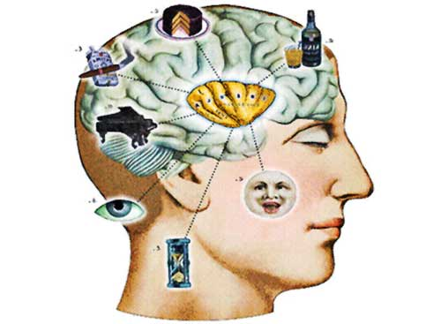
Individual Differences and Interaction Pattern
Existing research shows that all the following factors affect how someone uses a visualization:
  Spatial Ability
  Experience (novice vs. expert)
  Emotional State
  Personality
  Cognitive Workload/Mental Demand
  Perception
  … and more
Peck et al., ICD³: Towards a 3-Dimensional Model of Individual Cognitive Differences. BELIV 2012
Peck et al., Using fNIRS Brain Sensing To Evaluate Information Visualization Interfaces. CHI 2013

Slide 26
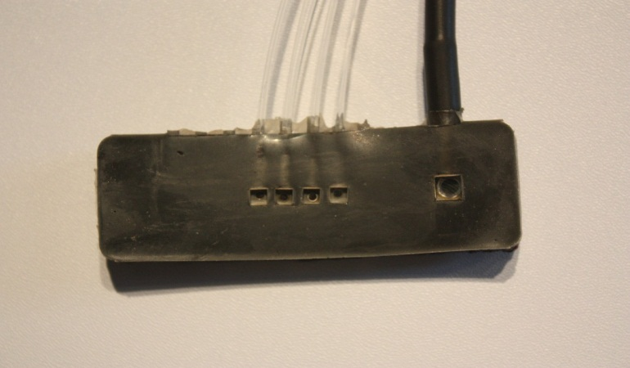
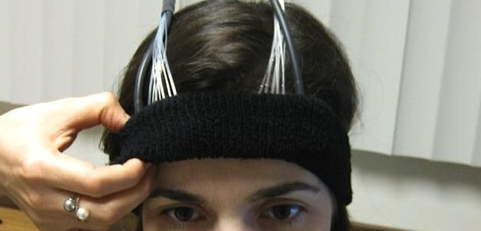
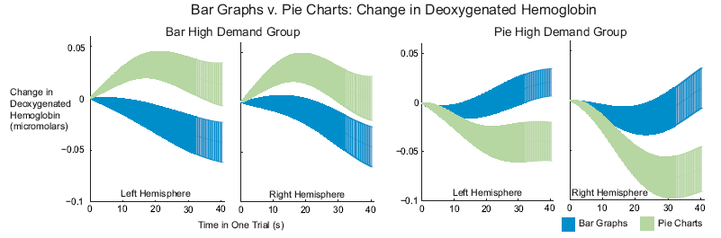
Cognitive Load
Functional Near-Infrared Spectroscopy
fNIRS
a lightweight brain sensing technique
measures mental demand (working memory)
Evan Peck et al., Using fNIRS Brain Sensing to Evaluate Information Visualization Interfaces. CHI 2013.

Slide 27

Cognitive Priming

Slide 28
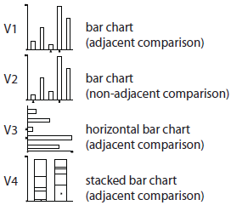
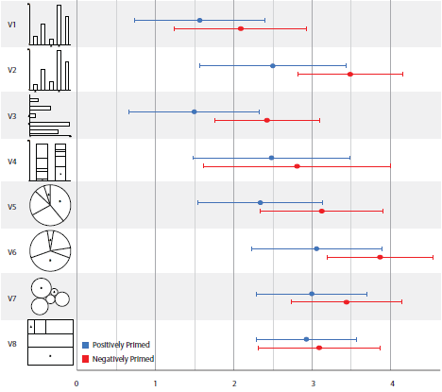
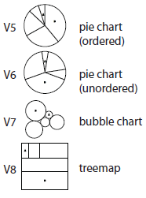
Emotion and Visual Judgment
Harrison et al., Influencing Visual Judgment Through Affective Priming, CHI 2013

Slide 29


Modeling User Perception with Weber’s Law

Slide 30
Weber’s Law & Just Noticeable Difference (JND)
Perception
Perception
Perceived Stimulus
Ideal
Just Noticeable Difference
Ideal
Objective Stimulus
Objective Stimulus

Slide 31
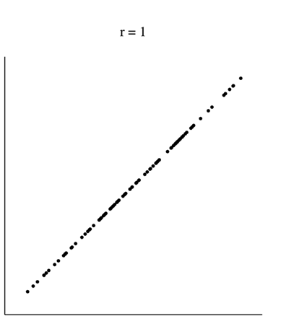
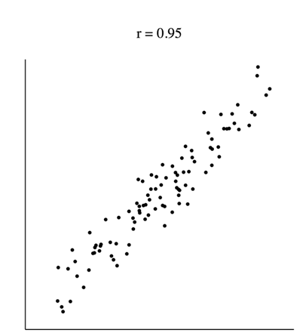
Perception of Correlation and Weber’s
Rensink and Baldridge, The Perception of Correlation in Scatterplots. EuroVis 2010.

Slide 32
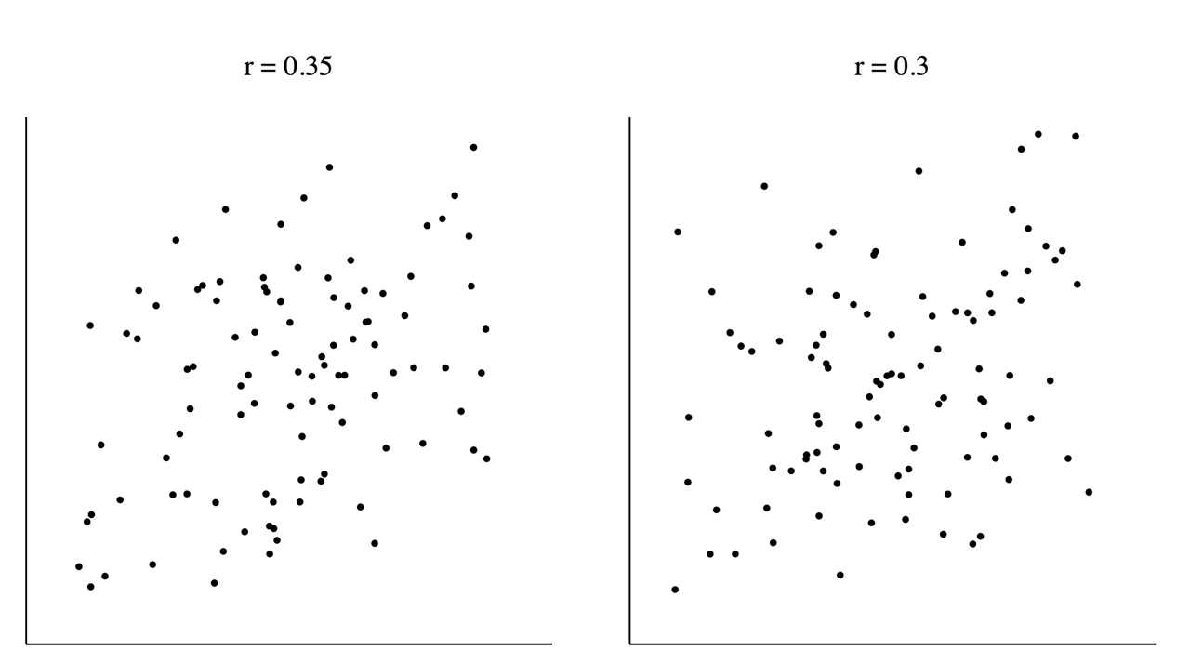
Perception of Correlation and Weber’s

Slide 33
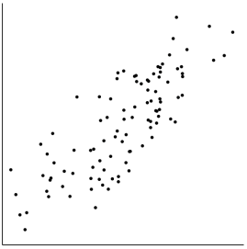
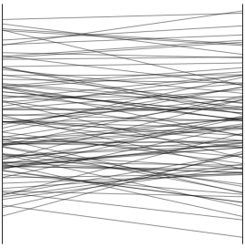
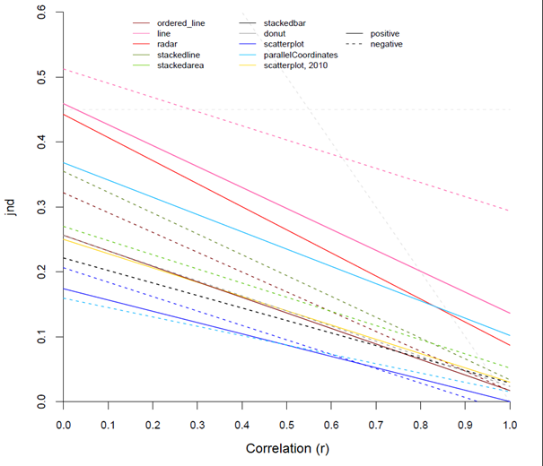
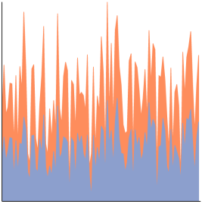
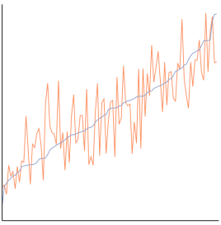
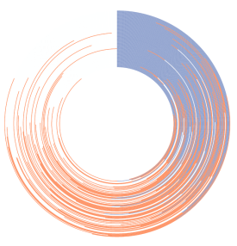
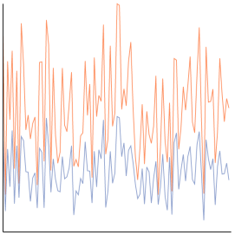
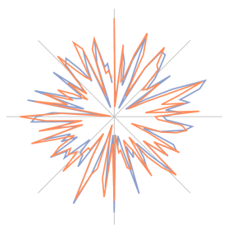
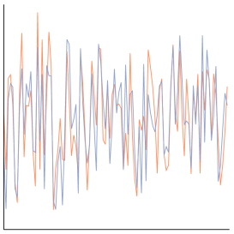
Ranking Visualizations
Harrison et al., Ranking Visualization of Correlation with Weber’s Law. InfoVis 2014 (Conditional)

Slide 34
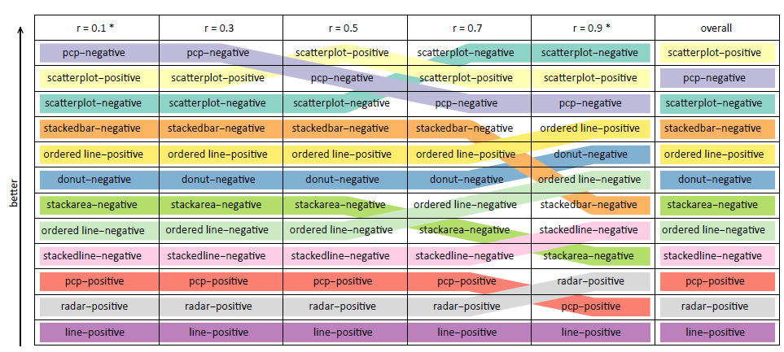
Ranking Visualizations of Correlation

Slide 35
Mixed Initiative (Adaptive) Systems
4. What Can a System Do
If It Knows Everything About Its User?

Slide 36
(Human+Computer) Visual Analytics
User
Discovery
Intent
(Model)
Adaptive Visualization
Visualization
Waldo
Adaptive Computation
Interaction
Data
(Model)
Dis-Function

Slide 37
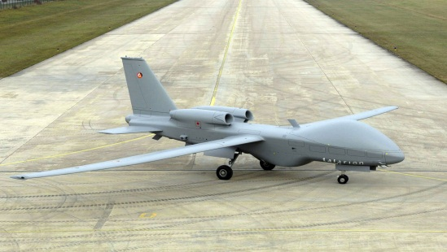
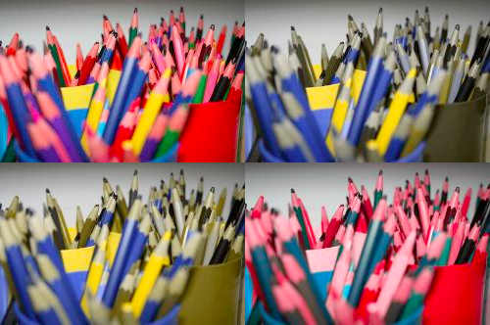
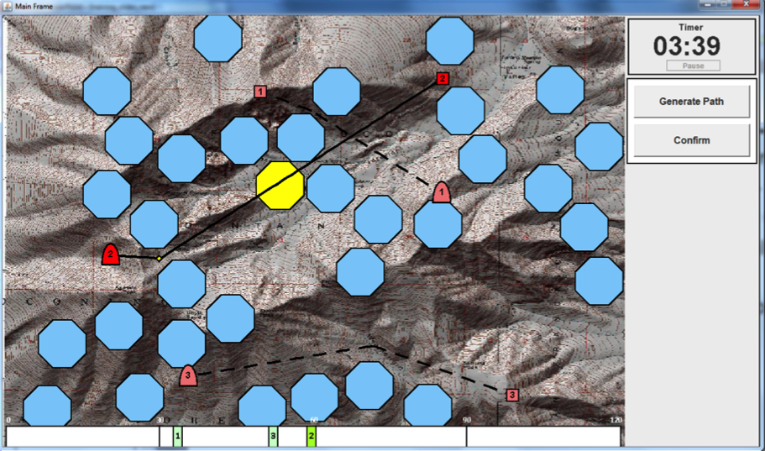
Adaptive Visualization
Color-Blindness, Cultural Differences, Personality, etc.
Cognitive Workload
Afergan et al., Dynamic Difficulty Using Brain Metrics of Workload. CHI 2014

Slide 38
Adaptive Computation
A new approach for Big Data visualization
Observation: Data is so large that…
  There are more data items than there are pixels
  Each computation (across all data items) takes tremendous amount of time, space, and energy
Solution: User-Driven Computation
  Conserve these precious resources by computing “partial” information based on User and Data Models

Slide 39


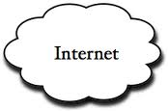
Example Problem: Big Data Exploration
Visualization on a
Commodity Hardware
Large Data in a
Data Warehouse

Slide 40
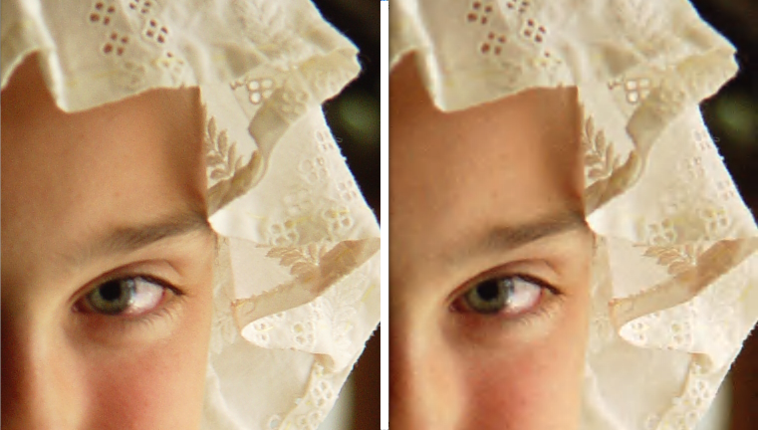
Example 1:
JND + Streaming Data
Streaming visualization (Fisher et al., CHI 2012)
JND-based streaming data and visualization
  Stop the computation and streaming at JND
  Similar to audio (mp3), image (jpg2000), graphics (progressive meshing)
  Differ in that the JND will be based on semantic information (e.g. correlation)
t = 1 second
t = 5 minute

Slide 41
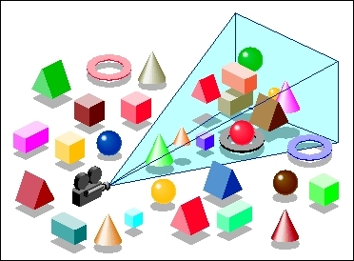


Example 2: Predictive
Pre-Computation and Pre-Fetching
In collaboration with MIT and Brown
Using an “ensemble” approach for prediction
  Large number of prediction algorithms
  Each prediction algorithm is given more computational resources based on past performance
Evaluated system with domain scientists using the NASA MODIS dataset (multi-sensory satellite imagery)
Remote analysis on commodity hardware shows (near) real-time interactive analysis

Slide 42
Summary

Slide 43



Summary
“Interaction is the analysis”¹
A user’s interactions in a visual analytics system encodes a large amount of data
Successful analysis can lead to a better understanding of the user
The future of visual analytics lies in better human-computer collaboration
That future starts by enabling the computer to better understand the user
1. R. Chang et al., Science of Interaction, Information Visualization, 2009.

Slide 44

Summary
“Reverse engineer” the human cognitive black box (by analyzing user interactions)
Data Modeling
  Interactive Metric Learning
User Modeling
  Predict Analysis Behavior
Perception and Cognition
  Perception Modeling
  Cognitive Priming
Mixed Initiative Systems
  Adaptive Visualization
  Adaptive Computation

Slide 45


Questions? remco@cs.tufts.edu

Slide 46
Backup

Slide 47

Priming Inferential Judgment
The personality factor, Locus of Control* (LOC), is a predictor for how a user interacts with the following visualizations:
Ottley et al., How locus of control inﬂuences compatibility with visualization style. IEEE VAST , 2011.

Slide 48


Locus of Control vs. Visualization Type
When with list view compared to containment view, internal LOC users are:
  faster (by 70%)
  more accurate (by 34%)
Only for complex (inferential) tasks
The speed improvement is about 2 minutes (116 seconds)

Slide 49
Priming LOC - Stimulus
Borrowed from Psychology research: reduce locus of control (to make someone have a more external LOC)
  “We know that one of the things that influence how well you can do everyday tasks is the number of obstacles you face on a daily basis. If you are having a particularly bad day today, you may not do as well as you might on a day when everything goes as planned. Variability is a normal part of life and you might think you can’t do much about that aspect. In the space provided below, give 3 examples of times when you have felt out of control and unable to achieve something you set out to do. Each example must be at least 100 words long.”

Slide 50
Results: Averages Primed More Internal*
Performance
Good
External LOC
Average LOC
Average ->Internal
Internal LOC
Poor
Visual Form
List-View
Containment
Ottley et al., Manipulating and Controlling for Personality Effects on Visualization Tasks, Information Visualization, 2013

Slide 51
Results

