Slide 1
Big Data Visual Analytics:
A User-Centric Approach
Remco Chang
Assistant Professor
Computer Science, Tufts University

Slide 2

Financial Fraud – A Case for Visual Analytics
Financial Institutions like Bank of America have legal responsibilities to report all suspicious wire transaction activities
  money laundering, supporting terrorist activities, etc
Data size: approximately 200,000 transactions per day (73 million transactions per year)

Slide 3

Financial Fraud – A Case Study for Visual Analytics
Problems:
  Automated approach can only detect known patterns
  Bad guys are smart: patterns are constantly changing
Previous methods:
  10 analysts monitoring and analyzing all transactions
  Using SQL queries and spreadsheet-like interfaces
  Limited time scale (2 weeks)

Slide 4

WireVis: Financial Fraud Analysis
In collaboration with Bank of America
  Visualizes 7 million transactions over 1 year
A great problem for visual analytics:
  Ill-defined problem (how does one define fraud?)
  Limited or no training data (patterns keep changing)
  Requires human judgment in the end (involves law enforcement agencies)
R. Chang et al., Scalable and interactive visual analysis of financial wire transactions for fraud detection. Information Visualization,2008.
R. Chang et al., Wirevis: Visualization of categorical, time-varying data from financial transactions. IEEE VAST, 2007.

Slide 5
WireVis: A Visual Analytics Approach
Search by Example (Find Similar Accounts)
Heatmap View
(Accounts to Keywords Relationship)
Multiple Temporal View
(Relationships over Time)
Keyword Network
(Keyword Relationships)

Slide 6

Evaluation
Challenging – lack of ground truth
Two types of evaluations:
  Grounded Evaluation: real analysts, real data
    Find transactions that existing techniques can find
    Find new transactions that appear suspicious
  Controlled Evaluation: real analysts, synthetic data
    Find all injected threat scenarios
Adoption and Deployment

Slide 7

Good Lessons Learned
Analyst behavior
  90% of time on Exploratory Data Analysis (EDA)
  10% on confirmation (CDA)
Big data analysis == fast hypothesis testing
High Interactivity is key
  Users can wait to find the exact answer

Slide 8





Interactive Visualization Systems
Jordan Crouser
Political Simulation
  Agent-based analysis
Bridge Maintenance
  Exploring inspection reports
Biomechanical Motion
  Interactive motion comparison
Interactive Metric Learning
  DisFunction: learn a model from projection
High-D Data Exploration
  iPCA: Interactive PCA
R. Chang et al., Two Visualization Tools for Analysis of Agent-Based Simulations in Political Science. IEEE CG&A, 2012

Slide 9



Interactive Visualization Systems
Political Simulation
  Agent-based analysis
Bridge Maintenance
  Exploring inspection reports
Biomechanical Motion
  Interactive motion comparison
Interactive Metric Learning
  DisFunction: learn a model from projection
High-D Data Exploration
  iPCA: Interactive PCA
R. Chang et al., An Interactive Visual Analytics System for Bridge Management, EuroVis, 2010

Slide 10



Interactive Visualization Systems
Political Simulation
  Agent-based analysis
Bridge Maintenance
  Exploring inspection reports
Biomechanical Motion
  Interactive motion comparison
Interactive Metric Learning
  DisFunction: learn a model from projection
High-D Data Exploration
  iPCA: Interactive PCA
R. Chang et al., Interactive Coordinated Multiple-View Visualization of Biomechanical Motion Data, IEEE Vis (TVCG) 2009.

Slide 11

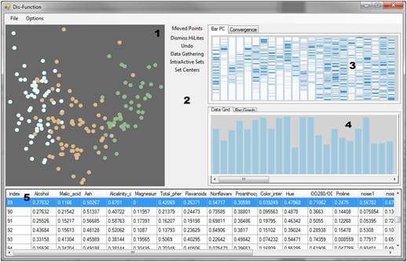
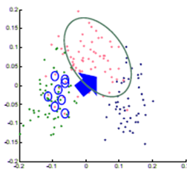

Interactive Visualization Systems
Eli Brown
Political Simulation
  Agent-based analysis
Bridge Maintenance
  Exploring inspection reports
Biomechanical Motion
  Interactive motion comparison
Interactive Metric Learning
  DisFunction: learn a model from projection
High-D Data Exploration
  iPCA: Interactive PCA
R. Chang et al., Dis-function: Learning Distance Functions Interactively, IEEE VAST, 2012

Slide 12
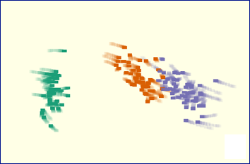
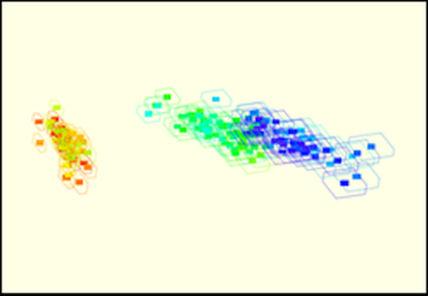
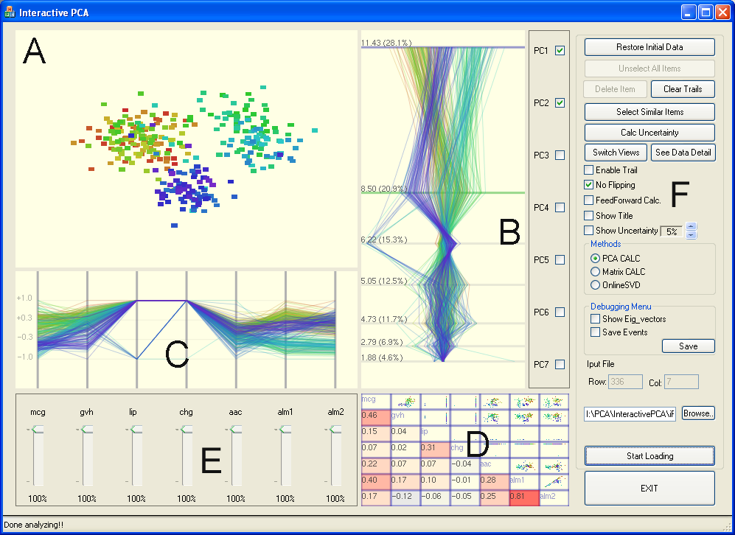
Interactive Visualization Systems
Political Simulation
  Agent-based analysis
Bridge Maintenance
  Exploring inspection reports
Biomechanical Motion
  Interactive motion comparison
Interactive Metric Learning
  DisFunction: learn a model from projection
High-D Data Exploration
  iPCA: Interactive PCA
R. Chang et al., iPCA: An Interactive System for PCA-based Visual Analytics, EuroVis 2009.

Slide 13
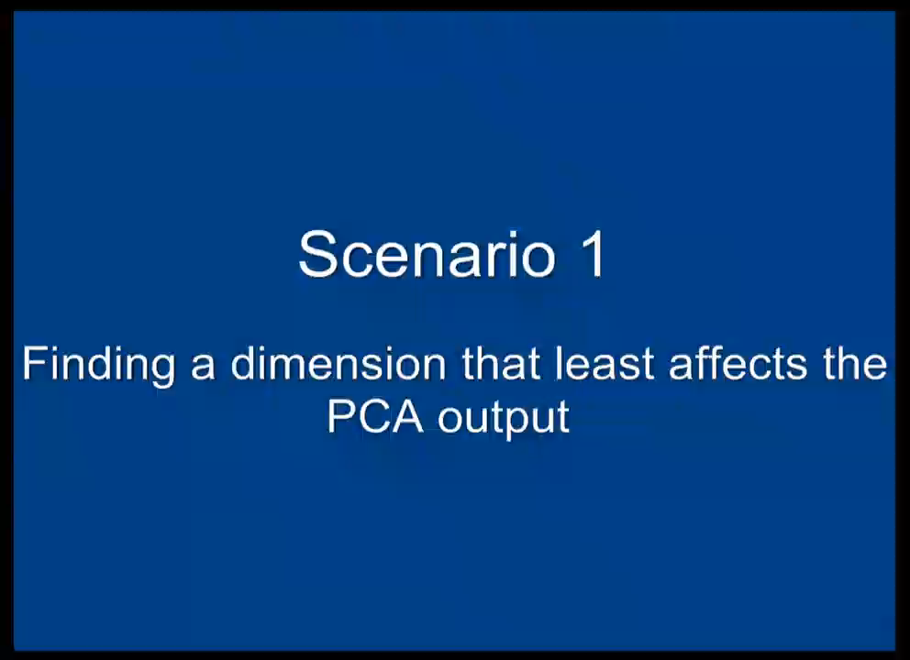

Slide 14
“Tough” Lessons Learned
Careful engineering is not enough… A new paradigm is necessary to support this type of interactive analysis.

Slide 15



Problem Statement
Visualization on a
Commodity Hardware
Large Data in a
Data Warehouse

Slide 16
Related Work
(See the DSIA workshop proceeding)
  Organized with Carlos Scheidegger (Arizona), Jeff Heer (UW), Danyel Fisher (Microsoft Research)
Specialized Pull-based Databases
  Tableau, Spotfire
Pre-compiled Data Cubes
  Nanocube (Scheidegger), imMens** (Liu, Heer), Map-D** (Mostak)
Sampling
  BlinkDB (Agrawal, Berkeley), DICE (Kamat, Nandi), Ordering guarantees (Kim et al.)
Pre-Fetching
  Xmdv (Doshi, Ward), Time-series (Chan, Hanrahan), Query prediction (Cetintemel, Zdonik)
Others
  Streaming (Fisher), Optimization (Wu)

Slide 17
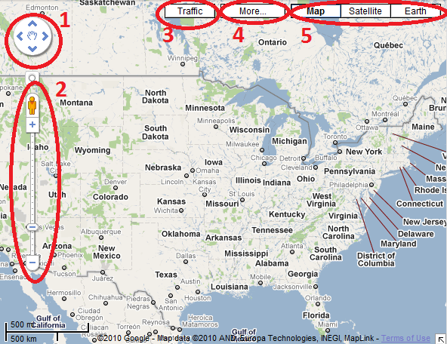
Two Observations:
The number of possible actions is finite and the user’s actions are “logical”.
Visualization itself is a bottleneck

Slide 18


Two Observations:
The number of possible actions is finite and the user’s actions are “logical”.
Visualization itself is a bottleneck
  7 million data points lead to a 7:1 aggregation
1000 pixels
1000 pixels
User’s perception and cognition are further limitations
1000x1000 = 1 million

Slide 19

Problem Statement
Problem: Data is too big to fit into the memory of the personal computer
  Note: Ignoring various database technologies (OLAP, Column-Store, No-SQL, Array-Based, etc)
Goal: Guarantee a result set to a user’s query within X number of seconds.
  Based on HCI research, the upperbound for X is 10 seconds
  Ideally, we would like to get it down to 1 second or less
Method: trading accuracy and storage (caching), optimize on minimizing latency (user wait time).

Slide 20


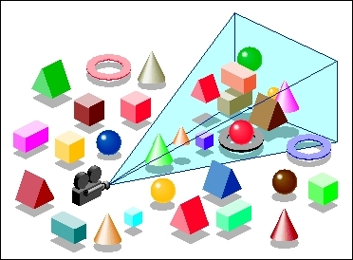
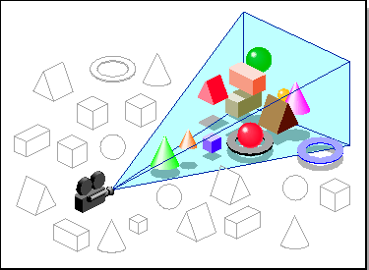
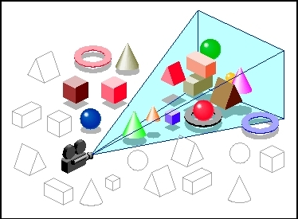

Our Approach:
Predictive Pre-Fetching
Stonebraker
Leilani Battle
In collaboration with MIT (Leilani Battle, Mike Stonebraker)
ForeCache: Three-tiered architecture
  Thin client (visualization)
  Backend (array-based database)
  Fat middleware
    Prediction Algorithms
    Storage Architecture
    Cache Management (Eviction Strategies)
R. Chang et al., Dynamic Prefetching of Data Tiles for Interactive Visualization. To Appear in SIGMOD 2016

Slide 22



Prediction Algorithms
General Idea:
  Lots of “experts”
    Represent different prediction algorithms
      Image based
      Statistics based
      Interaction based
      (See our other publications on this topic)
  One “manager”
    Chooses which expert to listen to
  Iterate
    Manager builds “trusts” in the experts

Slide 23
Iteration: 0
13
48
11
3
99
2
13
99
67
45
82
7
22
42
31

Slide 24
Iteration: 0
13
48
11
3
99
2
13
99
67
45
82
7
22
42
31

Slide 25
Iteration: 0
13
48
11
3
99
2
13
99
67
45
82
7
22
42
31
User Requests Data Block 13

Slide 26


Iteration: 0
13
48
11
3
99
2
13
99
67
45
82
7
22
42
31
User Requests Data Block 13

Slide 27
Iteration: 0
13
48
11
3
99
2
13
99
67
45
82
7
22
42
31
User Requests Data Block 13

Slide 28
Iteration: 1
4
12
34
88
27
5
23
1
92
34
42
12
31
32
13

Slide 29
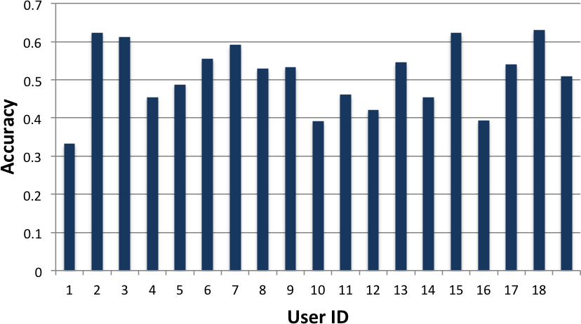
Study Results
Using a simple Google-maps like interface
18 users explored the NASA MODIS dataset
Tasks include “find 4 areas in Europe that have a snow coverage index above 0.5”

Slide 30
Worst Case Scenario: Cache Miss
13
48
11
3
99
2
13
99
67
45
82
7
22
42
31
User’s Requests Data Block 52

Slide 31
Cache Miss
Stonebraker
Leilani Battle
How to guarantee response time when there’s a cache miss?
Trick: the ‘EXPLAIN’ command
Usage:
  explain select * from myTable;
Returns the query plan and a cost estimation of running the query.
R. Chang et al., Dynamic Reduction of Result Sets for Interactive Visualization, IEEE Big Data Workshop on Visualization, 2013.

Slide 32
Example EXPLAIN Output from SciDB
Example SciDB the output of (a query similar to)
Explain SELECT * FROM earthquake
[("[pPlan]:
schema earthquake
<datetime:datetime NULL DEFAULT null,
magnitude:double NULL DEFAULT null,
latitude:double NULL DEFAULT null,
longitude:double NULL DEFAULT null>
[x=1:6381,6381,0,y=1:6543,6543,0]
bound start {1, 1} end {6381, 6543}
density 1 cells 41750883 chunks 1
est_bytes 7.97442e+09
")]
The four attributes in the table ‘earthquake’
Notes that the dimensions of this array (table) is 6381x6543
This query will touch data elements from (1, 1) to (6381, 6543), totaling 41,750,833 cells
Estimated size of the returned data is 7.97442e+09 bytes (~8GB)

Slide 33
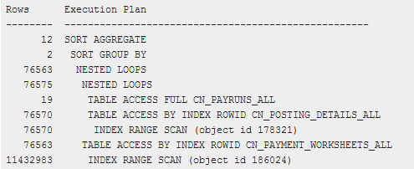
Other Examples
Oracle 11g Release 1 (11.1)

Slide 34
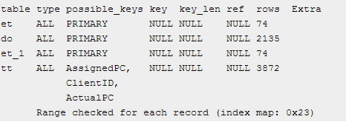
Other Examples
MySQL 5.0

Slide 35
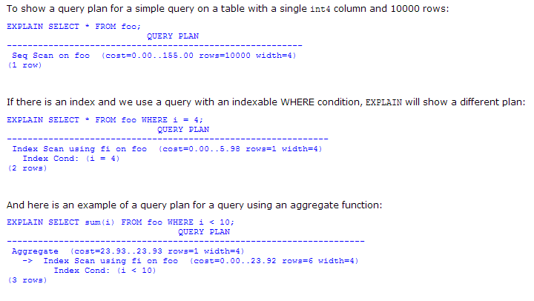
Other Examples
PostgreSQL 7.3.4

Slide 36
Reduction Strategies
If the query is estimated to be too expensive to execute, the middleware dynamically “modifies” the query by using:
  Aggregation:
    In SciDB, this operation is carried out as
    regrid (scale_factorX, scale_factorY)
  Sampling
    In SciDB, uniform sampling is carried out as
    bernoulli (query, percentage, randseed)
  Filtering
    Currently, the filtering criteria is user specified
    where (clause)

Slide 37
Summary
Big data visual analytics requires fast interactive data systems.
A growing subfield in DB, VIS, and ML
Our approach:
  Predictive pre-fetching
  Three-tiered system
  Pre-fetching based on “expert-manager” approach
  Use the “explain” trick to handle cache-miss
  Guarantees response time, but not data quality
Backbone (invisible) to data analysts

Slide 38

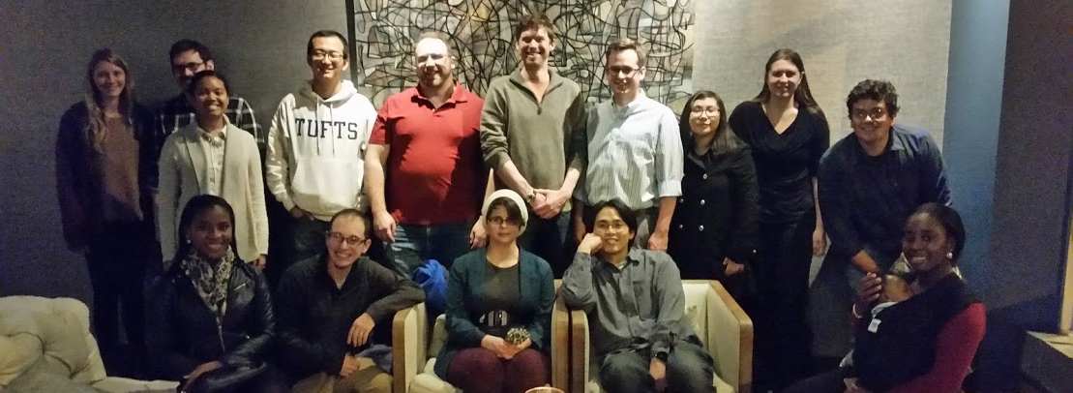
Questions? remco@cs.tufts.edu

