Slide 1
The
Talk
Talk
Me

Slide 2
The
What
What?
You

Slide 3
Practice Talk
YOUR TALK!

Slide 4
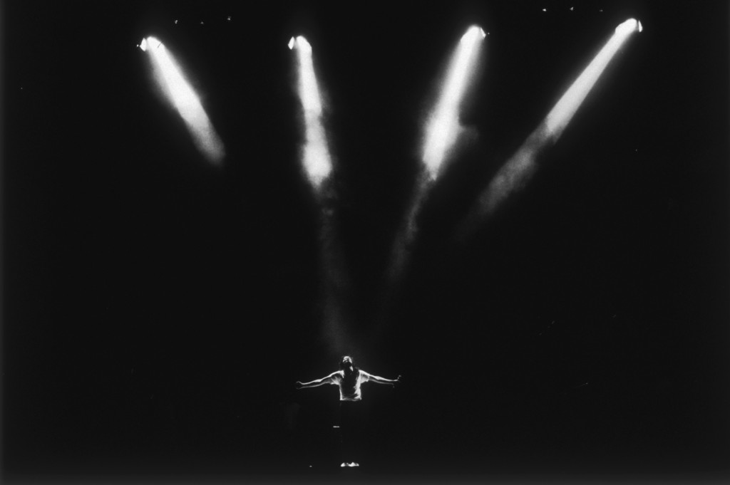

Slide 5
CHI
Talk

Slide 6
CHI
Talk
MIT
Talk

Slide 7
CHI
Talk
MIT
Talk
IBM
Job

Slide 8
CHI
Talk
MIT
Talk
IBM
Job
Tufts
Job

Slide 9
CHI
Talk
MIT
Talk
IBM
Job
Tufts
Job

Slide 10
Practice Talk
YOUR TALK!

Slide 11
PREP
YOUR TALK!

Slide 12
PREP
YOUR TALK!

Slide 13
1
2
3
4
5
6
7
YOUR TALK!

Slide 14
Nerves
Notes:
In a prefect world – you could just memorize the whole thing

Slide 15
PREP
YOUR TALK!

Slide 16
THINKING
NO THINKING

Slide 17
Nerves
Notes:
In a prefect world – you could just memorize the whole thing

Slide 18
Nerves
Cats/Porn
Notes:
In a prefect world – you could just memorize the whole thing

Slide 19
Cats/Porn
Difficulty Level
Time
Notes:
In a prefect world – you could just memorize the whole thing

Slide 20
Cats/Porn
Your Talk
Difficulty Level
Time
Notes:
In a prefect world – you could just memorize the whole thing

Slide 21
PREP
YOUR TALK!

Slide 22
Prep
Prep
YOUR TALK!

Slide 23
Prep
Practice Talk
Prep
YOUR TALK!

Slide 24
Prep
Practice Talk
Prep
YOUR TALK!

Slide 25
Story
Prep
Practice Talk
Prep
YOUR TALK!

Slide 26
Story

Slide 27
1
2
3

Slide 28
1
2
3
Point

Slide 29
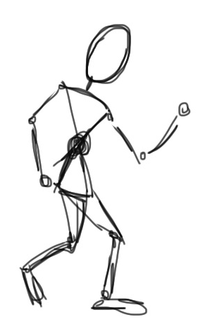
What was that talk about?
________________
!

Slide 30
1
2
3
Point

Slide 31
1
2
3
Point

Slide 32
Point

Slide 33
Point
Audience

Slide 34
Point
Audience

Slide 35
Data Mining
Data structures
Point
Run time complexity

Slide 36
Doctor visits
Filling prescriptions
Point
Death by Excel

Slide 37
1
2
3

Slide 38
Point

Slide 39
Point

Slide 40
1
2
3
Point

Slide 41
1
2
3

Slide 42
1
2
3

Slide 43
1
2
3

Slide 44
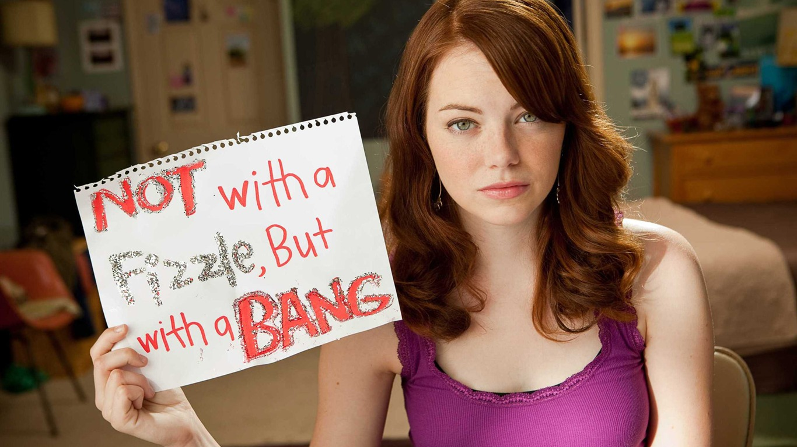
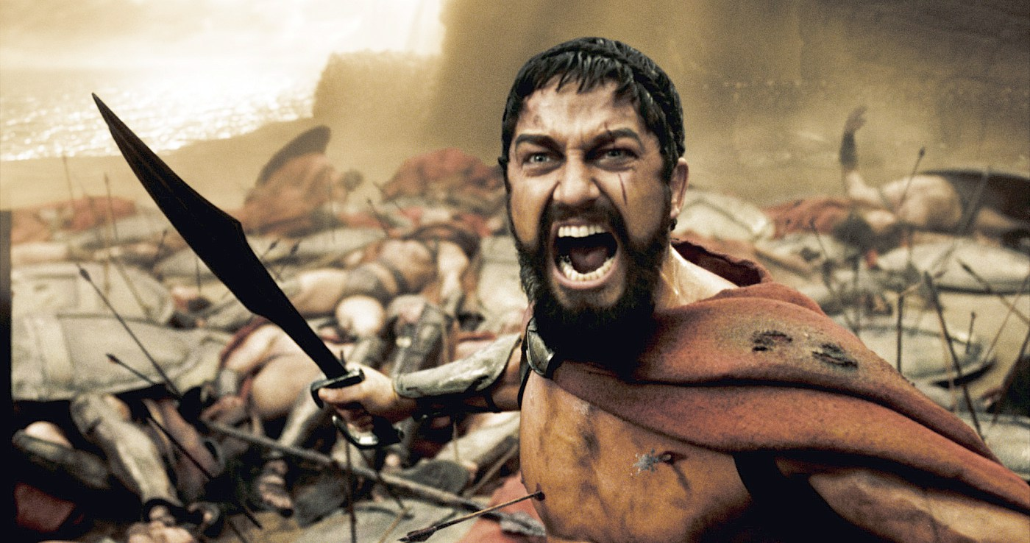
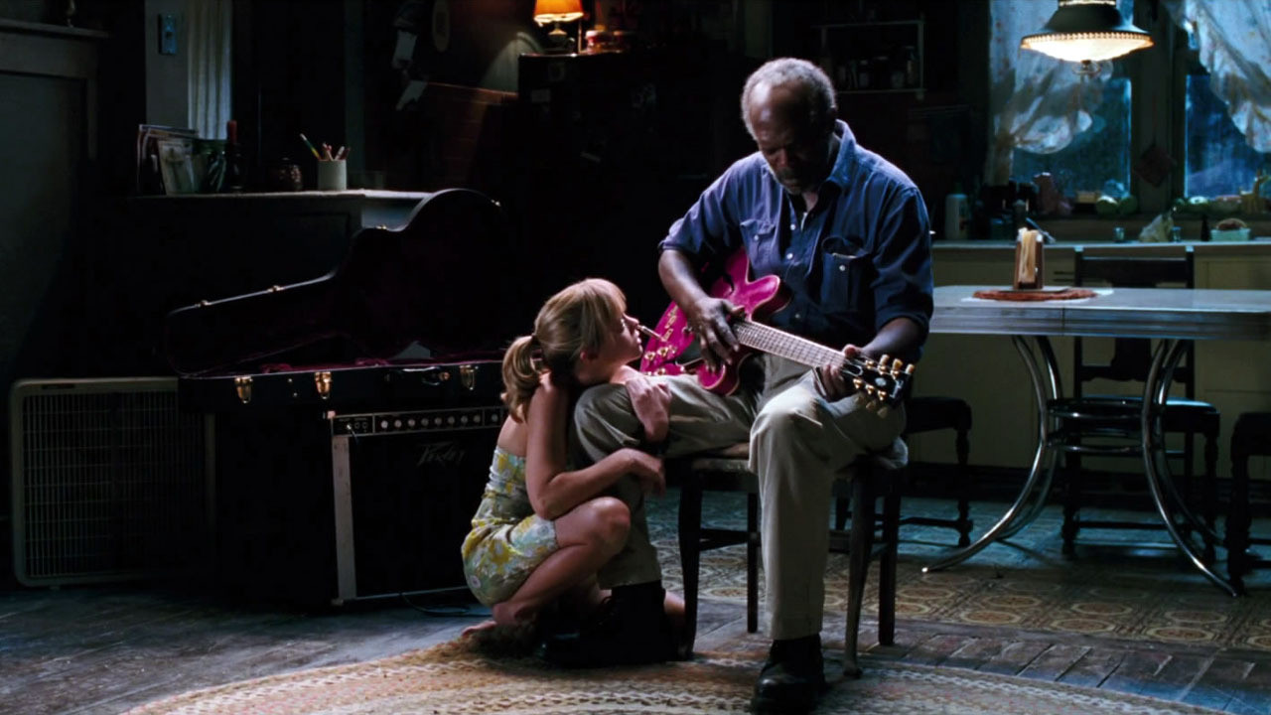
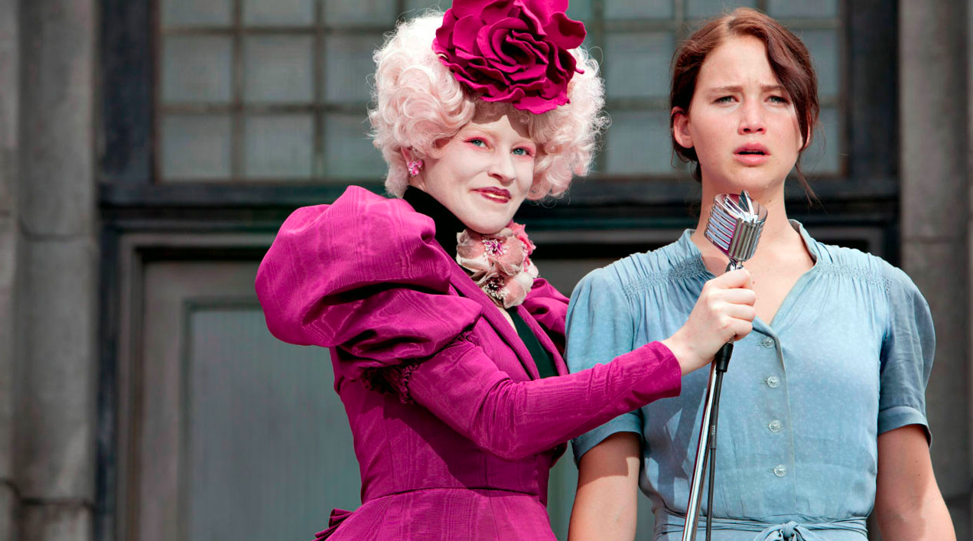
Three-Act Structure
The Hero’s Journey
6-Stage Plot

Slide 45
Cats/Porn
Movies
Difficulty Level
Time
Notes:
In a prefect world – you could just memorize the whole thing

Slide 46
1
2
3

Slide 47
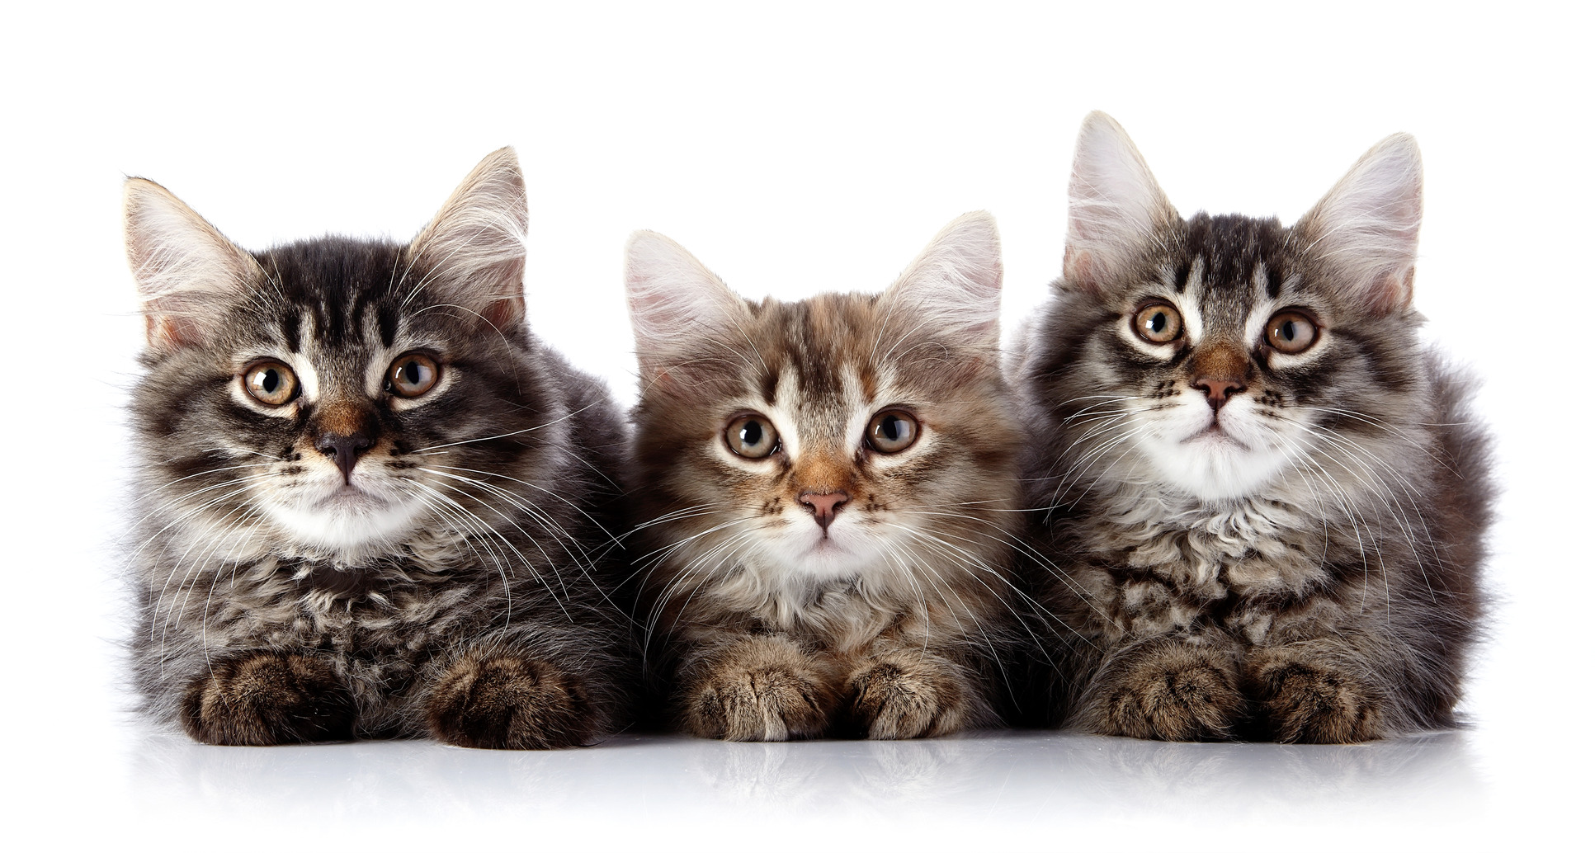
1
2
3

Slide 48
Story
Prep
Practice Talk
Prep
YOUR TALK!

Slide 49
1
2
3

Slide 50
1
2
3

Slide 51
1
2
3

Slide 52
1
2
3

Slide 53
1
2
3

Slide 54
Story

Slide 55
Story
Prep
Practice Talk
Prep
YOUR TALK!

Slide 56
Story
Prep
Slides
Practice Talk
Prep
YOUR TALK!

Slide 59
PREP
YOUR TALK!

Slide 60
The
Talk
Talk
Megan
Monroe

Slide 61
The
Talk
Talk
Megan
Monroe

Slide 62
What was that talk about?
______________!?

Slide 64
What was that talk about?
______________!!

Slide 65
1
2

Slide 66
1
2
Provide images

Slide 68
Develop linear narrative

Slide 69
Something totally else

Slide 70
Another different thing

Slide 71
Sorry, I’m asleep now

Slide 72
THINKING
NO THINKING

Slide 73
THINKING
NO THINKING

Slide 74
Develop linear narrative

Slide 75
Even when there’s not an obvious graphical representation for the idea that you’re trying to get across, there is no need to put text on slides that you could just as easily say out loud. Your audience WILL read whatever text you put on your slides. And if you’re talking while they’re reading, then YOU’RE being annoying.

Slide 76
It doesn’t have to be this way…

Slide 78
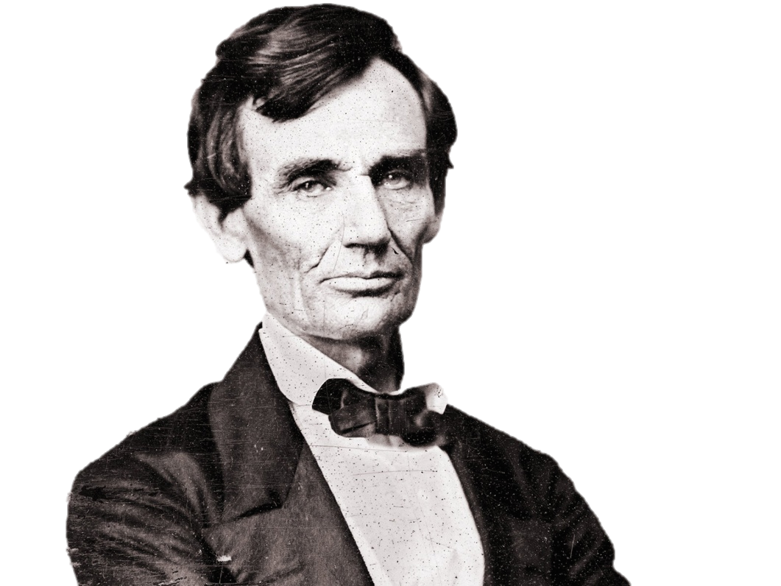
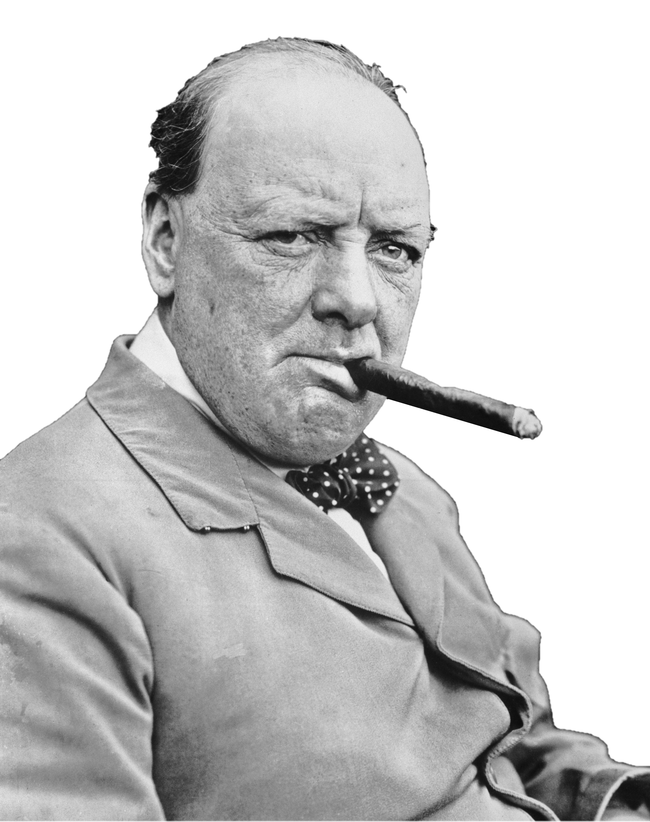
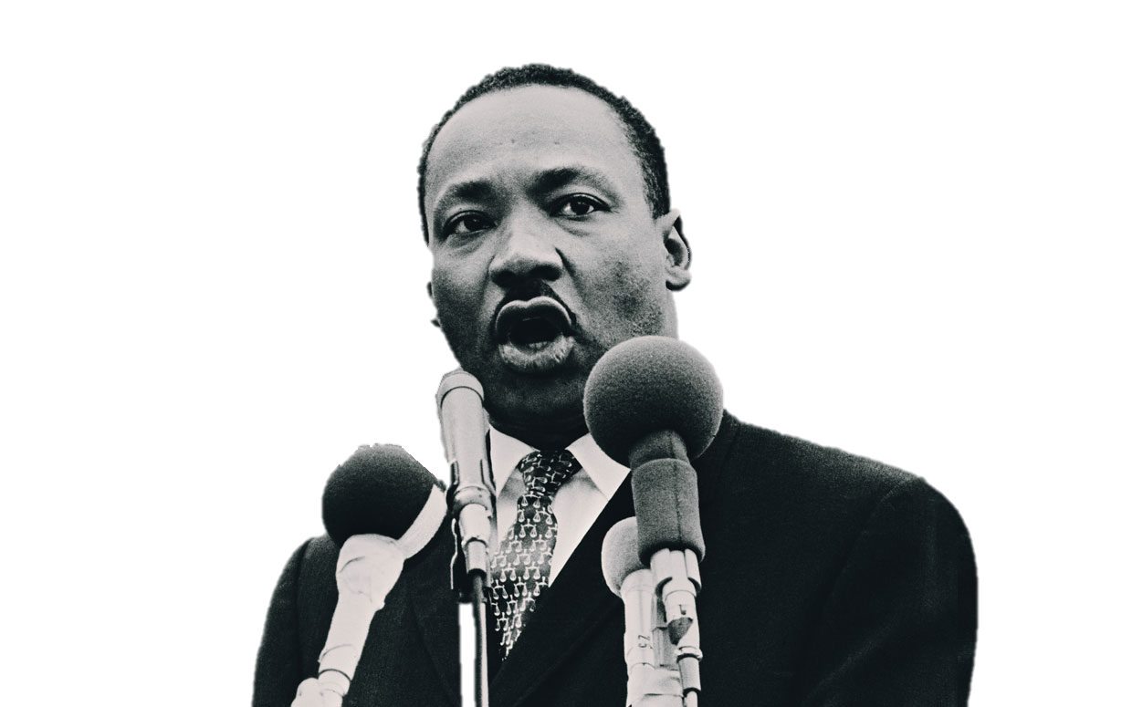

Slide 79
1
2
Provide images
Nix the text.

Slide 80
1
2
Provide images
Provide Rhythm

Slide 81
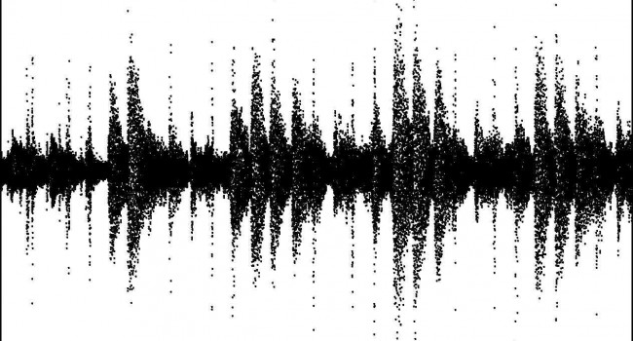
Notes:
Slide change is more noticeable than topic change

Slide 82
Notes:
Slide change is more noticeable than topic change

Slide 83
Point A
Point B
Point C

Slide 84
Point A
Point B
Point C

Slide 85
Point A
Point B
Point C

Slide 86
Point A
Point B
Point C

Slide 87
Point A
Point B
Point C

Slide 90
Cats/Porn
Your Talk
Difficulty Level
Time
Notes:
In a prefect world – you could just memorize the whole thing

Slide 91
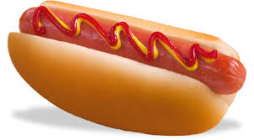
What was that talk about?
______________.

Slide 92
1
2
One thing at a time.
Provide Rhythm

Slide 93
Point A
Point B
Point C

Slide 94
Point A
Point A
Point B
Point C

Slide 95
Point A
Point A
Point B
Point B
Point C

Slide 96
Point A
Point A
Point B
Point B
Point C
Point C

Slide 97
Point A
Point A
Point A
Point B
Point B
Point B
Point C
Point C
Point C

Slide 98
Point A
Point A
Point A
Point B
Point B
Point B
Point C
Point C
Point C

Slide 99
Point A
Point A
Point A
Point B
Point B
Point B
Point C
Point C
Point C

Slide 102
THINKING
NO THINKING

Slide 103
THINKING
NO THINKING

Slide 104
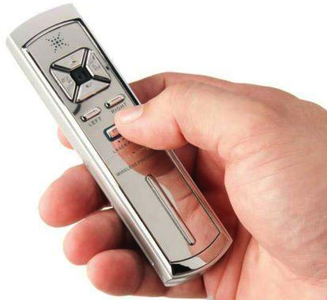

Slide 105
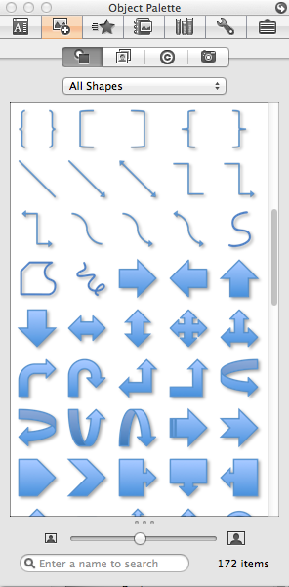

Slide 114
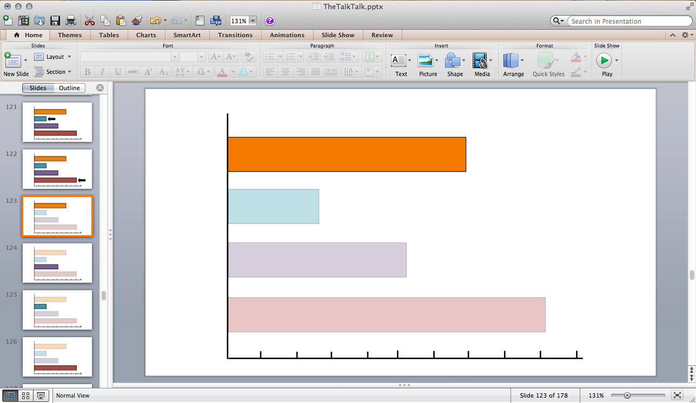

Slide 115
Slides

Slide 116
Slides
Nix the text.

Slide 117
Slides
Nix the text.
One thing at a time.

Slide 118
Story
Prep
Slides
Practice Talk
Prep
YOUR TALK!

Slide 119
Story
Prep
Slides
Practice
Practice Talk
Prep
YOUR TALK!

Slide 120
1
2
3

Slide 121
1
2
3
1.) Memorize Slide Deck

Slide 124
1
2
3
1.) Memorize Slide Deck

Slide 125
1
2
3
1.) Memorize Slide Deck
2.) Memorize First 3 Sentences

Slide 126
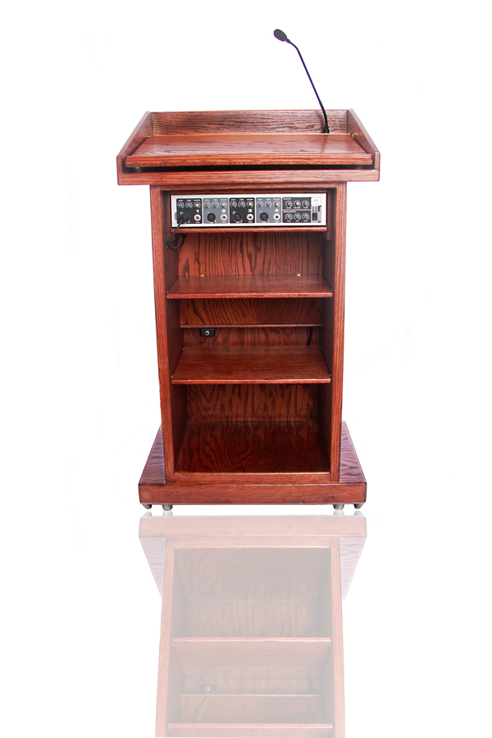

Slide 127
1
2
3
1.) Memorize Slide Deck
2.) Memorize First 3 Sentences

Slide 128
1
2
3
1.) Memorize Slide Deck
2.) Memorize First 3 Sentences
3.) Out Loud. Complete. Run-Throughs.

Slide 129
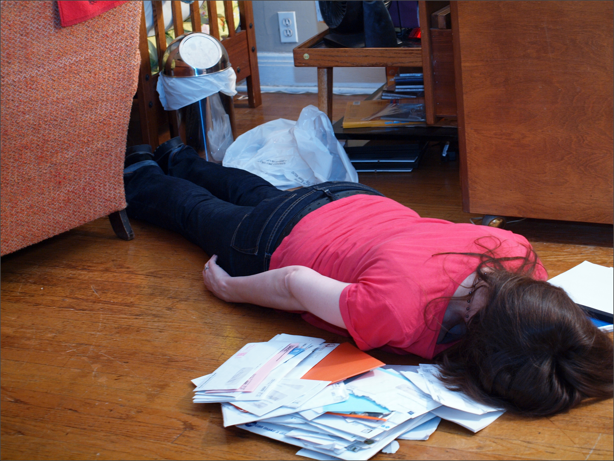

Slide 130
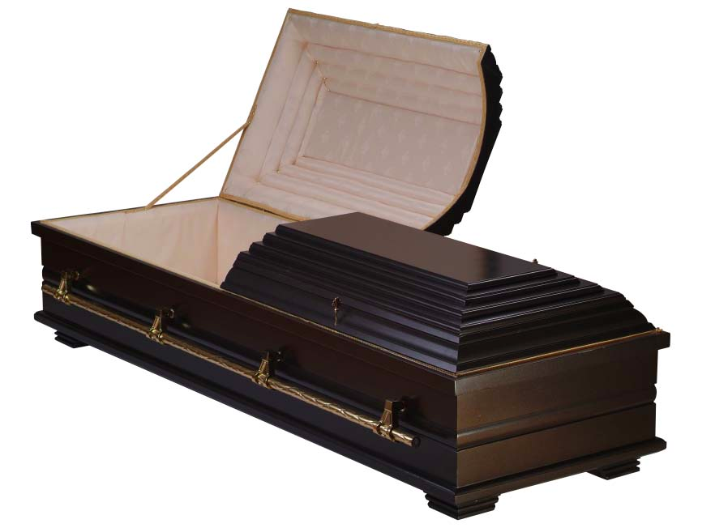
Monday
Tuesday
Wednesday
10

Slide 131
Monday
Tuesday
Wednesday
2
2
2

Slide 132
Your
Talk
Time

Slide 133
3 days
Your
Talk
Practice
Time

Slide 134
3 days
Your
Talk
Story
Slides
Practice

Slide 135
1
2
3
1.) Memorize Slide Deck
2.) Memorize First 3 Sentences
3.) Out Loud. Complete. Run-Throughs.

Slide 136
1
2
3
1.) Memorize Slide Deck
2.) Memorize First 3 Sentences
3.) Out Loud. Complete. Run-Throughs.

Slide 137
!@$#&!

Slide 139
Practice
3 days
Your
Talk
Practice
1.) Memorize Slide Deck
2.) Memorize First 3 Sentences
3.) Out Loud. Complete. Run-Throughs.

Slide 140
Story
Prep
Slides
Practice
Practice Talk
Prep
YOUR TALK!

Slide 141
Story
Prep
Slides
Practice
Practice Talk
Prep
YOUR TALK!

Slide 148
Story
Prep
Slides
Practice

Slide 154
What was that talk about?
_________________!

Slide 155
Story
Prep
Slides
Practice
Practice Talk
Prep
YOUR TALK!

Slide 156
Story
Prep
Slides
Practice
Practice Talk
YOUR TALK!

Slide 157
Story

Slide 158
Slides
Nix the text.
One thing at a time.

Slide 159
Practice
3 days
Your
Talk
Practice
1.) Memorize Slide Deck
2.) Memorize First 3 Sentences
3.) Complete. Out Loud. Run-Throughs.

Slide 160
Story
Prep
Slides
Practice
Practice Talk
YOUR TALK!

Slide 161
YOUR TALK!

Slide 162
Story
Prep
Slides
Practice

Slide 163
Story
Prep
Slides
Practice

Slide 169
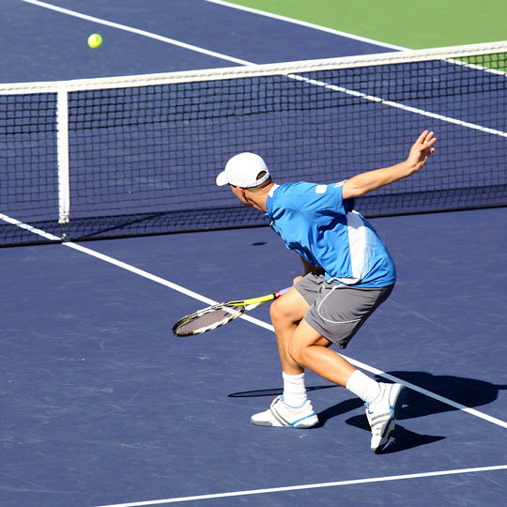

Slide 171
Story
Prep
Slides
Practice

