Slide 1
Preventing Sepsis:
Artificial Intelligence, Knowledge Discovery, & Visualization
Phillip Chang, MD (Dept of Surgery) Judy Goldsmith, PhD (Dept of Computer Science)
Remco Chang, PhD (UNC-Charlotte Visualization Center)

Slide 2
NIH Challenge Grant
This application addresses broad Challenge Area (10) Information Technology for Processing Health Care Data Topic, 10-LM-102*: Advanced decision support for complex clinical decisions

Slide 3
Clinical Problem: sepsis
Definition: serious medical condition characterized by a whole-body inflammatory state (called a systemic inflammatory response syndrome or SIRS) and the presence of a known or suspected infection
Top 10 causes of death in the US
Kills more than 200,000 per year in the US (more than breast & lung cancer combined)

Slide 4
Cost of severe sepsis
Estimated cases per year in US: 751,000
Estimated cost per case: $22,100
Estimated total cost per year: $16.7 billion
Mortality (in this series): 28%
Projected increase 1.5% per annum
Angus et al. Epidemiology of severe sepsis in the United States: Analysis of incidence, outcome, and associated costs of care. Critical Care Medicine. July, 2001

Slide 5
SIRS
Temperature < 36° C or > 38° C
Heart Rate > 90 bpm
Respiratory Rate > 20 breaths/min
or PaCO₂ < 32 mmHg
White Blood Cell Count > 12,000 or < 4,000 cells/mm³; or > 10% bands

Slide 6
Progression of Disease

Slide 7

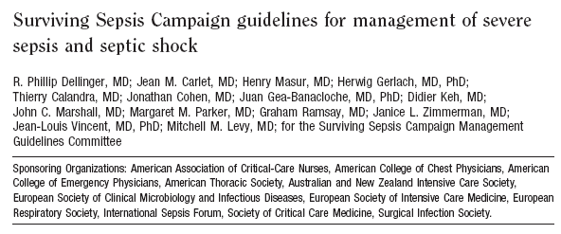
Surviving Sepsis Campaign

Slide 8
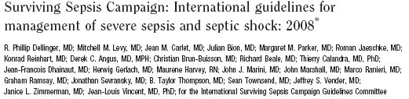
2008 version
Mortality remains 35-60%

Slide 9
What’s the problem?
Early recognition
  Biomarkers?
    Equivalent of troponin-I for sepsis
  Alert systems?

Slide 10

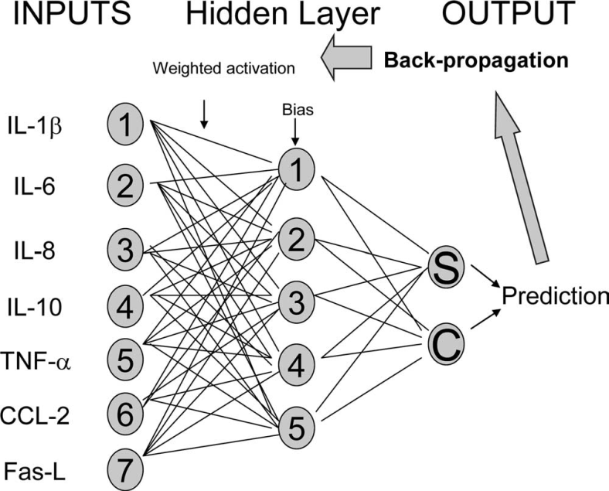
Biomarkers
Not a single marker exist, yet….

Slide 11
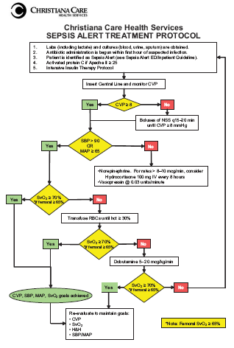
Alert Systems
True alerts
  Neither sensitive nor specific
  Cannot find “sweet-spot”
  We’re working on one now….
Other forms are “early recognition”

Slide 12
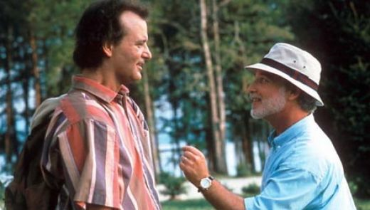
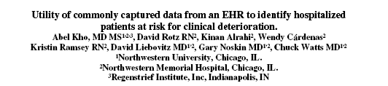
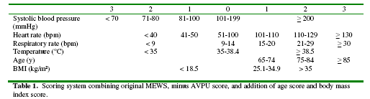
UK’s “Bob” project

Slide 13
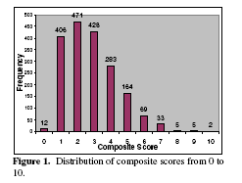

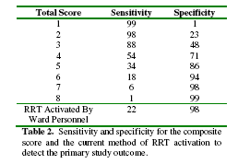
What about Bob?

Slide 14
Our premise
Retrospective chart review often yields time frame when one feels early intervention could have changed outcome
Clinical “hunch” that something “bad” might happen which demands more attention
What if we could predict sepsis before sepsis criteria were met?

Slide 15
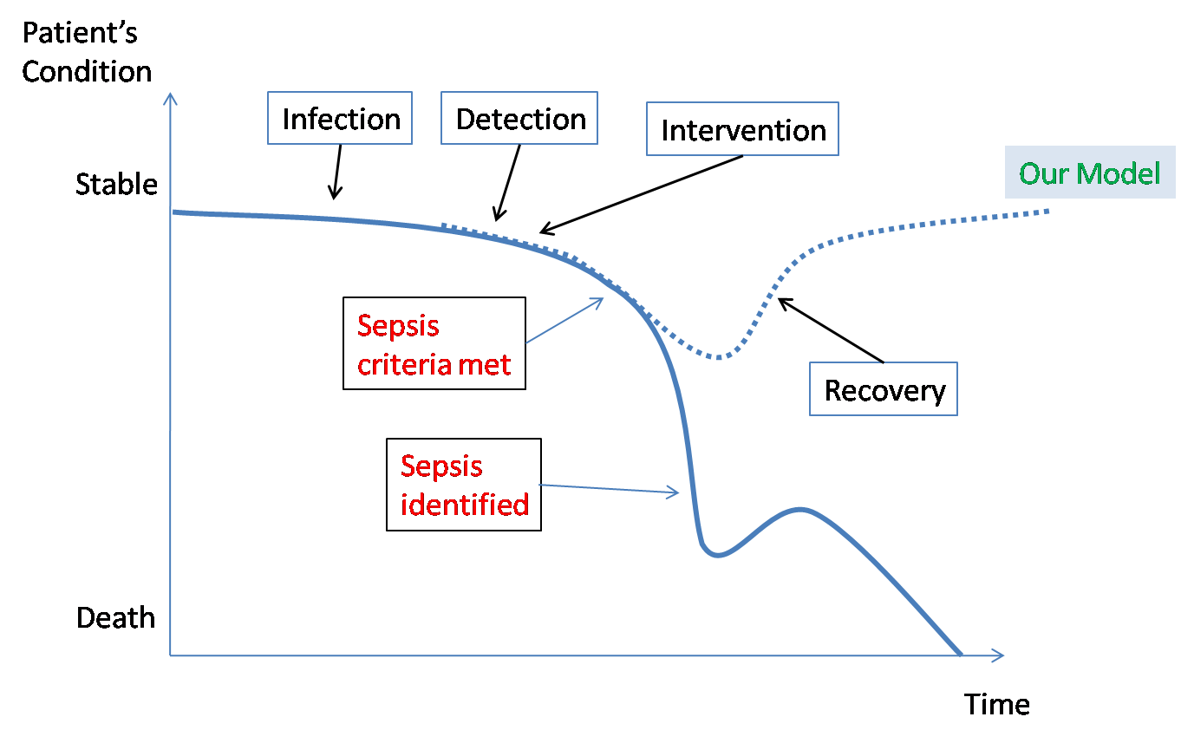
Our goal

Slide 16
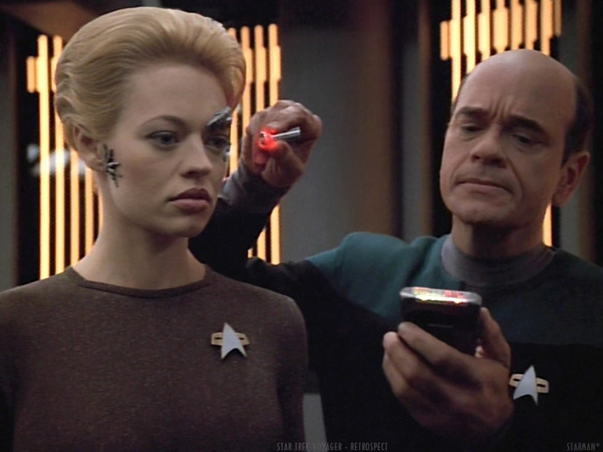
How do we do this?
Data Mining
Artificial Intelligence
Visualization (computer-human interface)

Slide 17

Data! Data! Data!
Heartrate
??????
Temperature
PaCO₂
Respiratory Rate
White Blood Cell Count

Slide 18
Marriage of computer science
& medicine
Data mining
  identify previously undiscovered patterns and correlations
    Changes in vital signs
    Rate of change of the vitals signs
    Perhaps correlations of seemingly unrelated events
      Recently found that prior to significant hemodynamic compromise, the variation in heart rate actually decreases in mice

Slide 19
Marriage of computer science
& medicine
Decision making
  Increased monitoring of vitals?
  More tests? (Which ones?)
  Antibiotics?
  Exploratory surgery?
  None of the above?
What drives decisions?
  Costs, benefits
  Likelihood of benefits

Slide 20
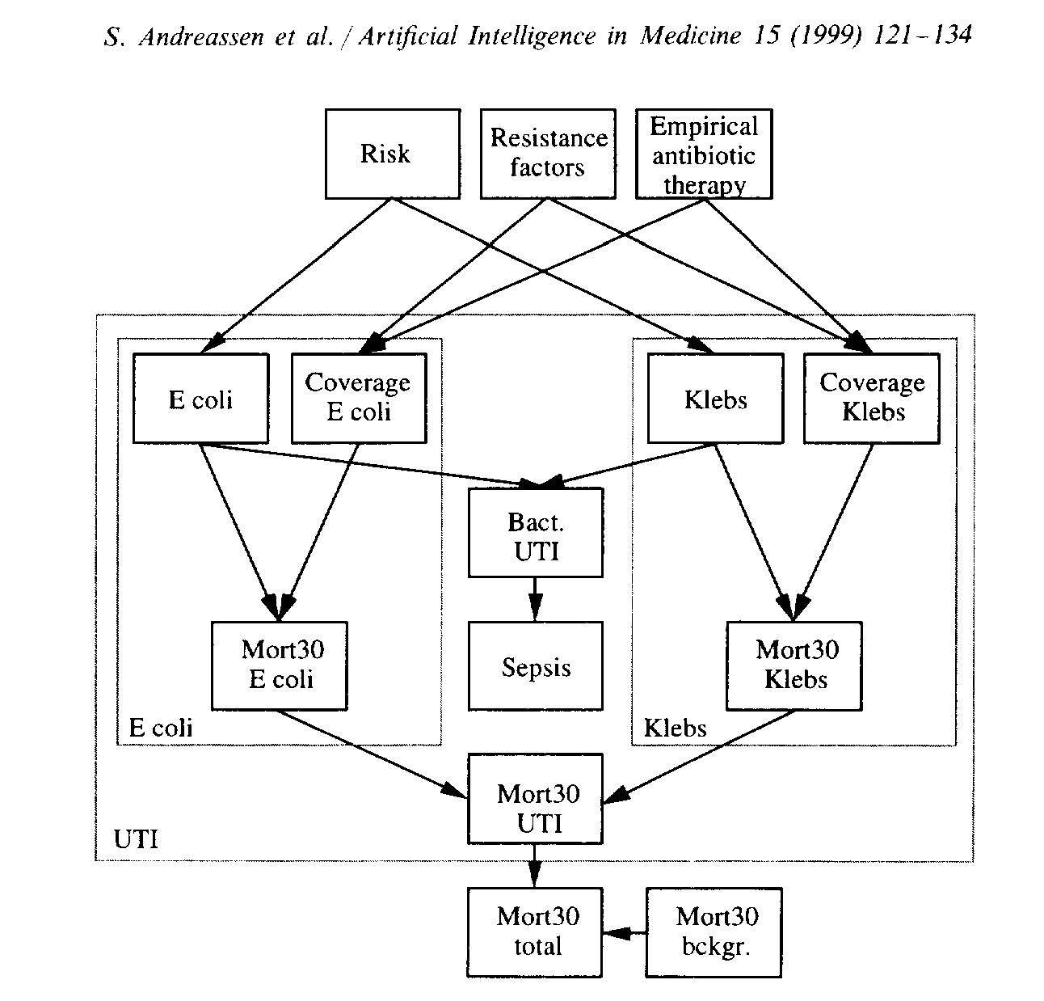
Marriage of computer science
& medicine
Artificial Intelligence
  Model knowledge (from data mining) into partially observable Markov decision process (POMDP)

Slide 21
Markov Decision Processes
Actions have probabilistic effects
  Treatments sometimes work
  Testing can have effects
    The probabilities depend on the patient’s state and the actions
Actions have costs
The patient’s state has an immediate value
  Quality of life
M = <S, A, Pr, R>, Pr: SxAxS→ [0,1]

Slide 22
Decision-Theoretic Planning
“Plans” are policies: Given
  the patient’s history,
  the insurance plan (establishes costs)
  probabilities of effects
Optimize long term expected outcomes
(That’s a lot of possibilities, even for computers!)
(π: S → A)

Slide 23
Partially Observable MDPs
The patient’s state is not fully observable
This makes planning harder
  Put probabilities on unobserved variables
  Reason over possible states as well as possible futures
(π: Histories → A)
Optimality is no longer feasible ☹
Don’t despair! Satisficing policies are possible.

Slide 24
AI Summary
Use data mining, machine learning to find patterns and predictors
Build POMDP model
Find policy that considers long-term expected costs
Get alerts when sepsis is likely, suggested tests or treatments that are cost- and outcome-effective

Slide 25
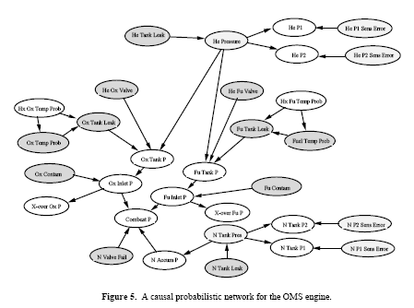
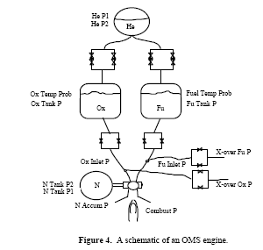
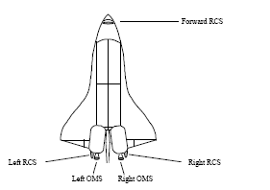
NASA used it….
To reduce “cognitive load”

Slide 26
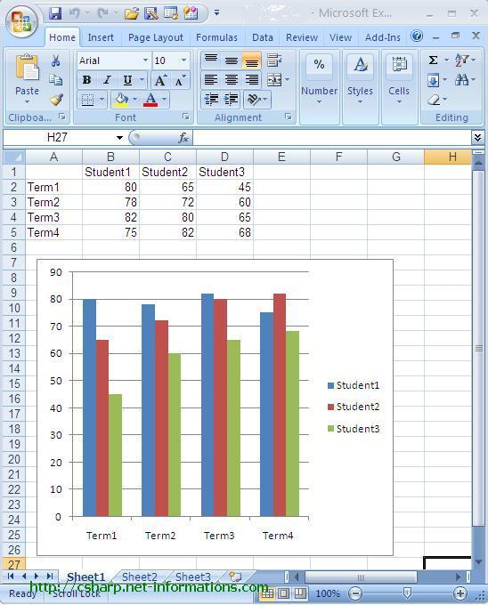
Values of Visualization
Presentation
Analysis
Notes:
2008 – 455 billion
2009 – proposed 533 billion

Slide 27
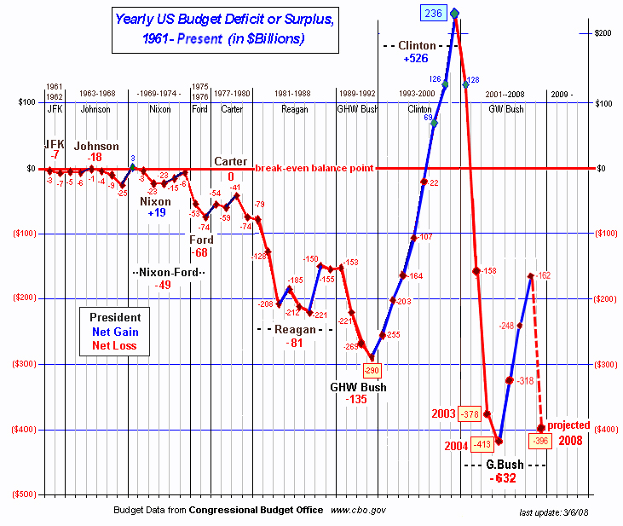
Values of Visualization
Presentation
Analysis
Notes:
2008 – 455 billion
2009 – proposed 533 billion

Slide 28
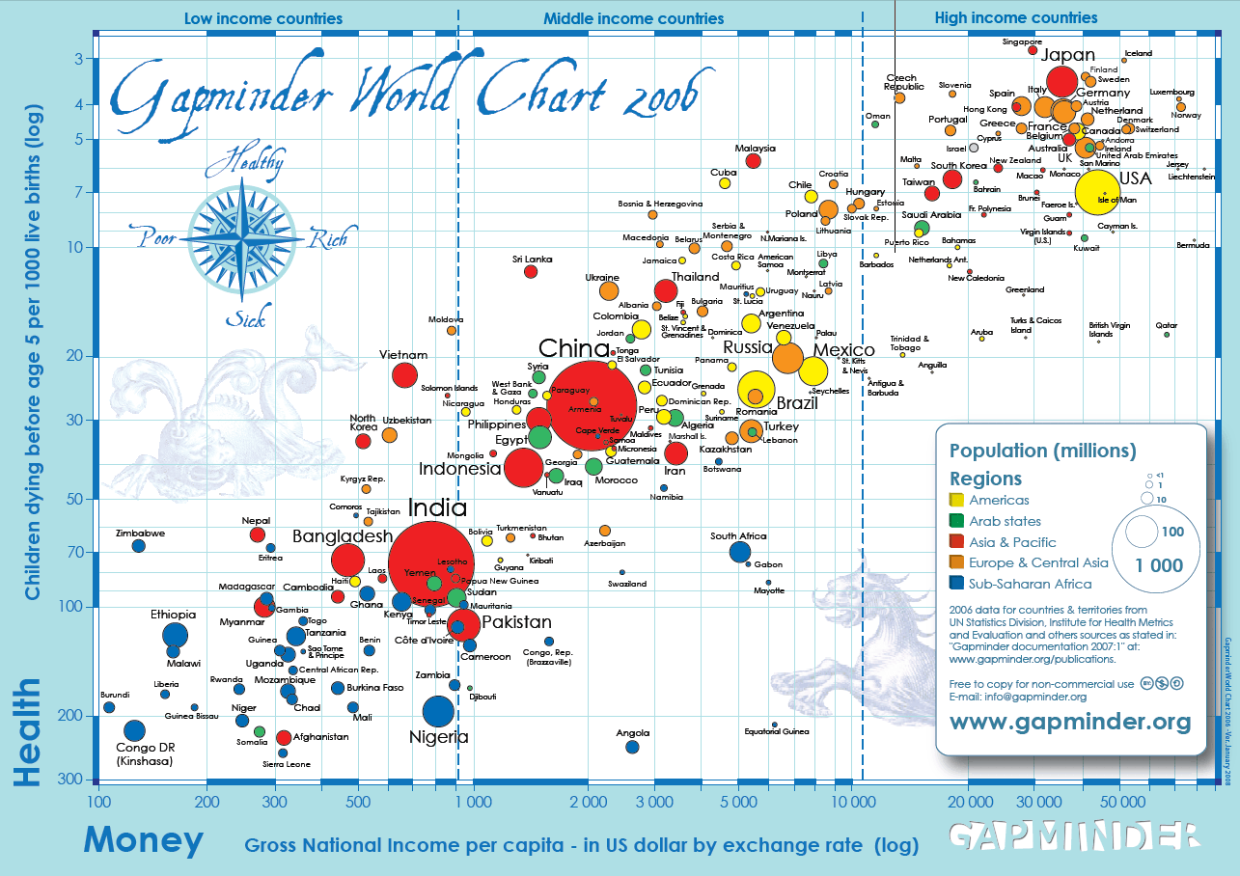
Values of Visualization
Presentation
Analysis
Notes:
2008 – 455
2009 – proposed 533

Slide 29
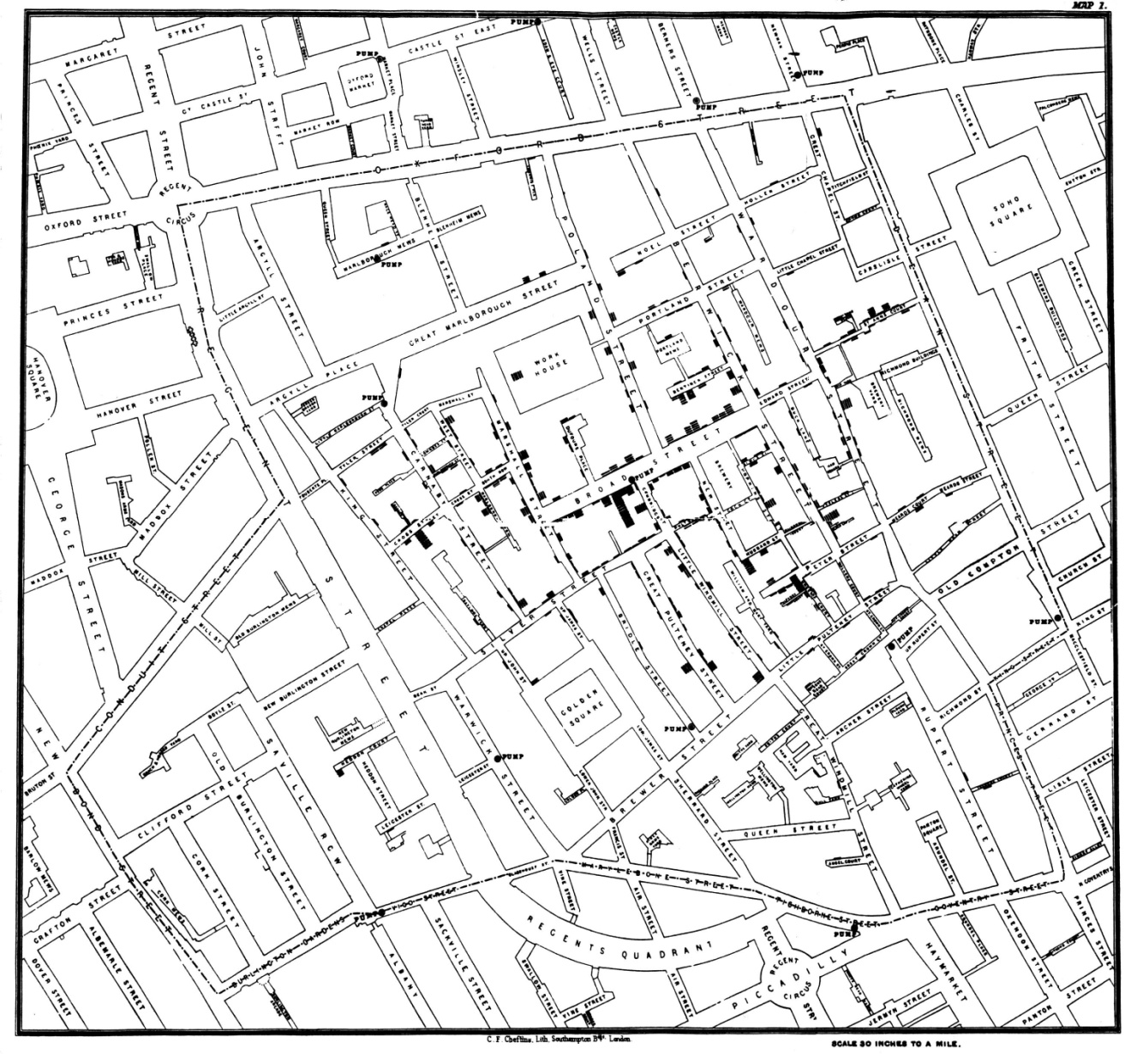
Values of Visualization
Presentation
Analysis
Notes:
I recently finished reading a wonderful book by Steven Johnson entitled The Ghost Map: The Story of London’s Most Terrifying Epidemic – and How It Changed Science, Cities, and the Modern World. In the summer of 1854 cholera swept through a section of London with unprecedented intensity. At the time, the cause of cholera was unknown and rapidly growing modern cities such as London, with dense populations packed into small areas, were rich breeding grounds for this disease. Most of those who concerned themselves with disease and its cure held tightly to the miasma theory that cholera spread through the air and was associated with the bad smells and the unclean urban environments that produced them. In fact, cholera is a bacterium, which was spreading through the water supply. This book tells the story much as a journalist who witnessed it firsthand would do, but a journalist who had the advantage of hindsight informed by knowledge of modern medicine.
Several people of the time play important roles in this story – none more than John Snow, a medical doctor and research scientist. The ghost map refers to a map that he drew by hand during the process of his investigations, which could clearly demonstrate to anyone with open eyes that the source of the outbreak was the Broad Street well. Despite the evidence that this map displayed, however, the miasma theory of cholera transmission prevailed for several years after the epidemic. Eventually, due largely to the tenacious efforts of John Snow and an unlikely supporter, Reverend Henry Whitehead, the evidence won out and steps were taken to eliminate the conditions in which cholera could spread.

Slide 30
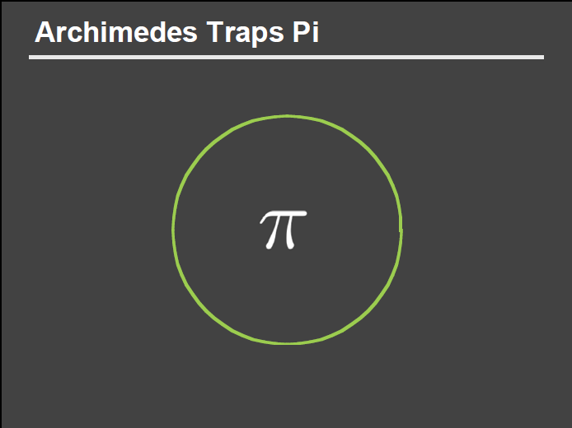
Values of Visualization
Presentation
Analysis
Slide courtesy of Dr. Pat Hanrahan, Stanford

Slide 31
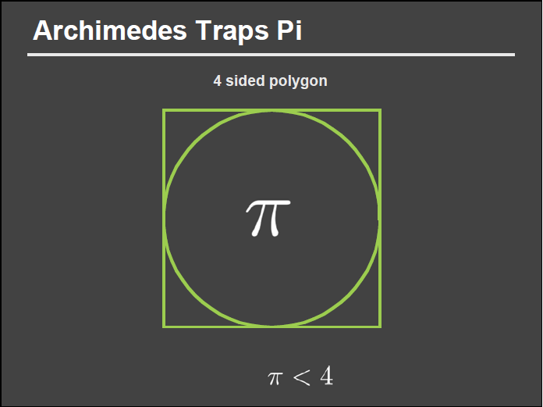
Values of Visualization
Presentation
Analysis
Slide courtesy of Dr. Pat Hanrahan, Stanford

Slide 32
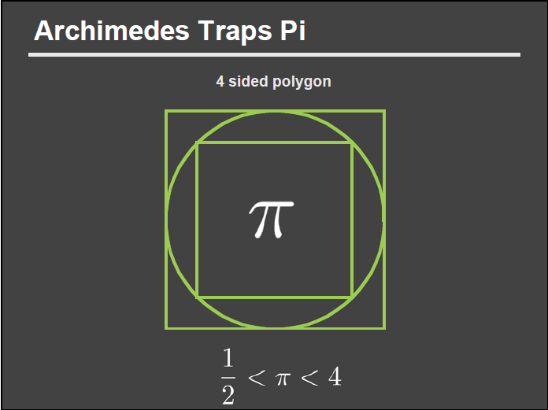
Values of Visualization
Presentation
Analysis
Slide courtesy of Dr. Pat Hanrahan, Stanford

Slide 33
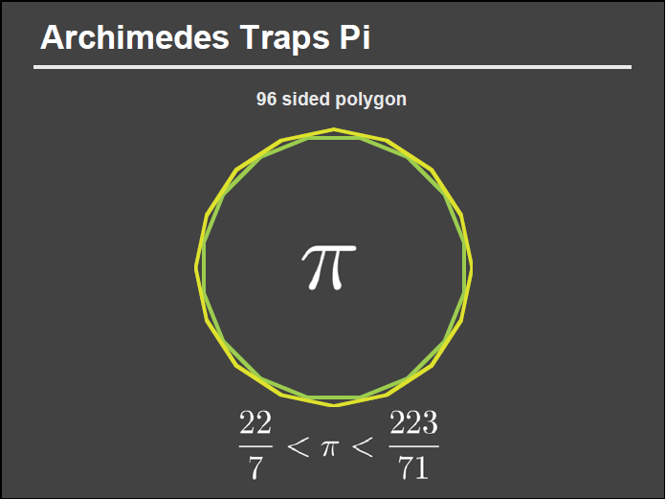
Values of Visualization
Presentation
Analysis
>
>
Slide courtesy of Dr. Pat Hanrahan, Stanford
Notes:
22/7: 3.14286
223/71: 3.140845

Slide 34
Values of Visualization
Presentation
Analysis
3.14286
>
3.140845
>
Slide courtesy of Dr. Pat Hanrahan, Stanford
Notes:
22/7: 3.14286
223/71: 3.140845

Slide 35
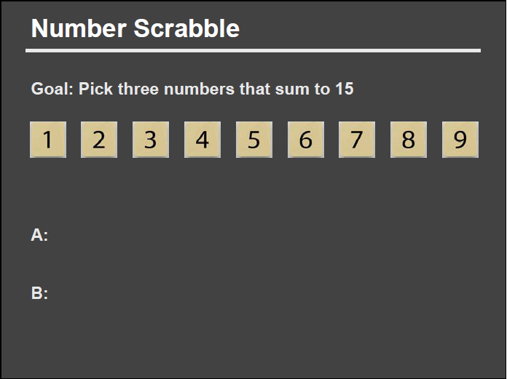
Values of Visualization
Presentation
Analysis
Slide courtesy of Dr. Pat Hanrahan, Stanford

Slide 36
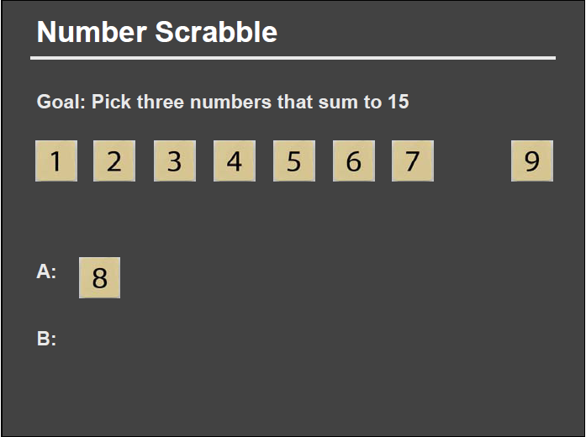
Values of Visualization
Presentation
Analysis
Slide courtesy of Dr. Pat Hanrahan, Stanford

Slide 37
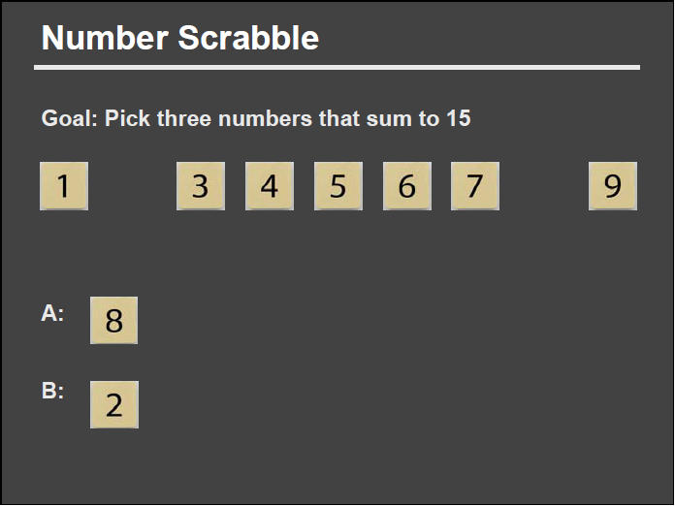
Values of Visualization
Presentation
Analysis
Slide courtesy of Dr. Pat Hanrahan, Stanford

Slide 38
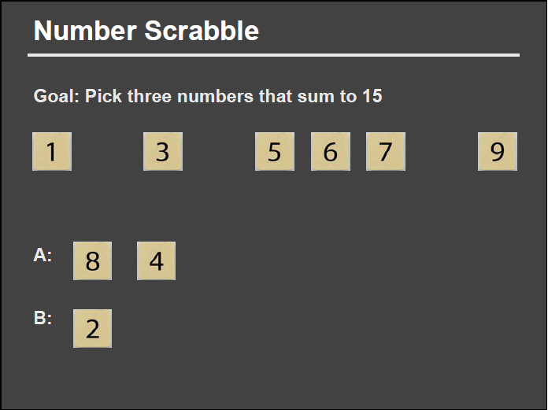
Values of Visualization
Presentation
Analysis
Slide courtesy of Dr. Pat Hanrahan, Stanford

Slide 39
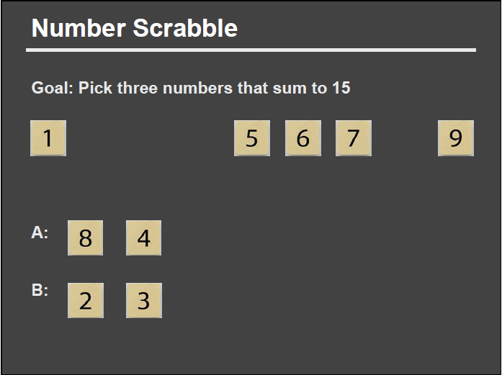
Values of Visualization
Presentation
Analysis
Slide courtesy of Dr. Pat Hanrahan, Stanford

Slide 40
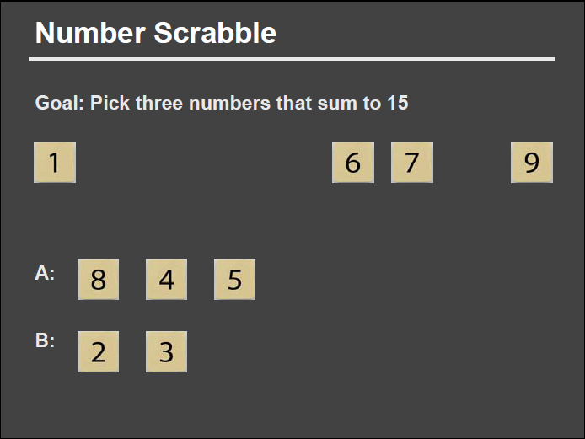
Values of Visualization
Presentation
Analysis
Slide courtesy of Dr. Pat Hanrahan, Stanford

Slide 41

Values of Visualization
Presentation
Analysis
Slide courtesy of Dr. Pat Hanrahan, Stanford

Slide 42
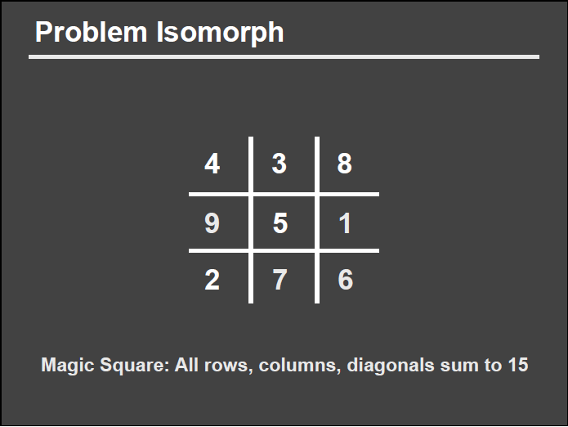
Values of Visualization
Presentation
Analysis
Slide courtesy of Dr. Pat Hanrahan, Stanford

Slide 43
Values of Visualization
Presentation
Analysis
Slide courtesy of Dr. Pat Hanrahan, Stanford

Slide 44
Values of Visualization
Presentation
Analysis
Slide courtesy of Dr. Pat Hanrahan, Stanford

Slide 45
Values of Visualization
Presentation
Analysis
Slide courtesy of Dr. Pat Hanrahan, Stanford

Slide 46
Values of Visualization
Presentation
Analysis
Slide courtesy of Dr. Pat Hanrahan, Stanford

Slide 47
Values of Visualization
Presentation
Analysis
Slide courtesy of Dr. Pat Hanrahan, Stanford

Slide 48
Values of Visualization
Presentation
Analysis
?
Slide courtesy of Dr. Pat Hanrahan, Stanford

Slide 49
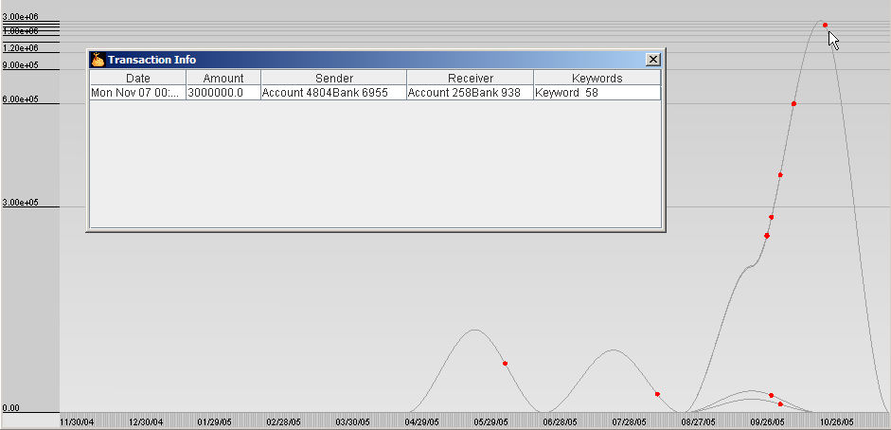
Using Visualizations To
Solve Real-World Problems…

Slide 50
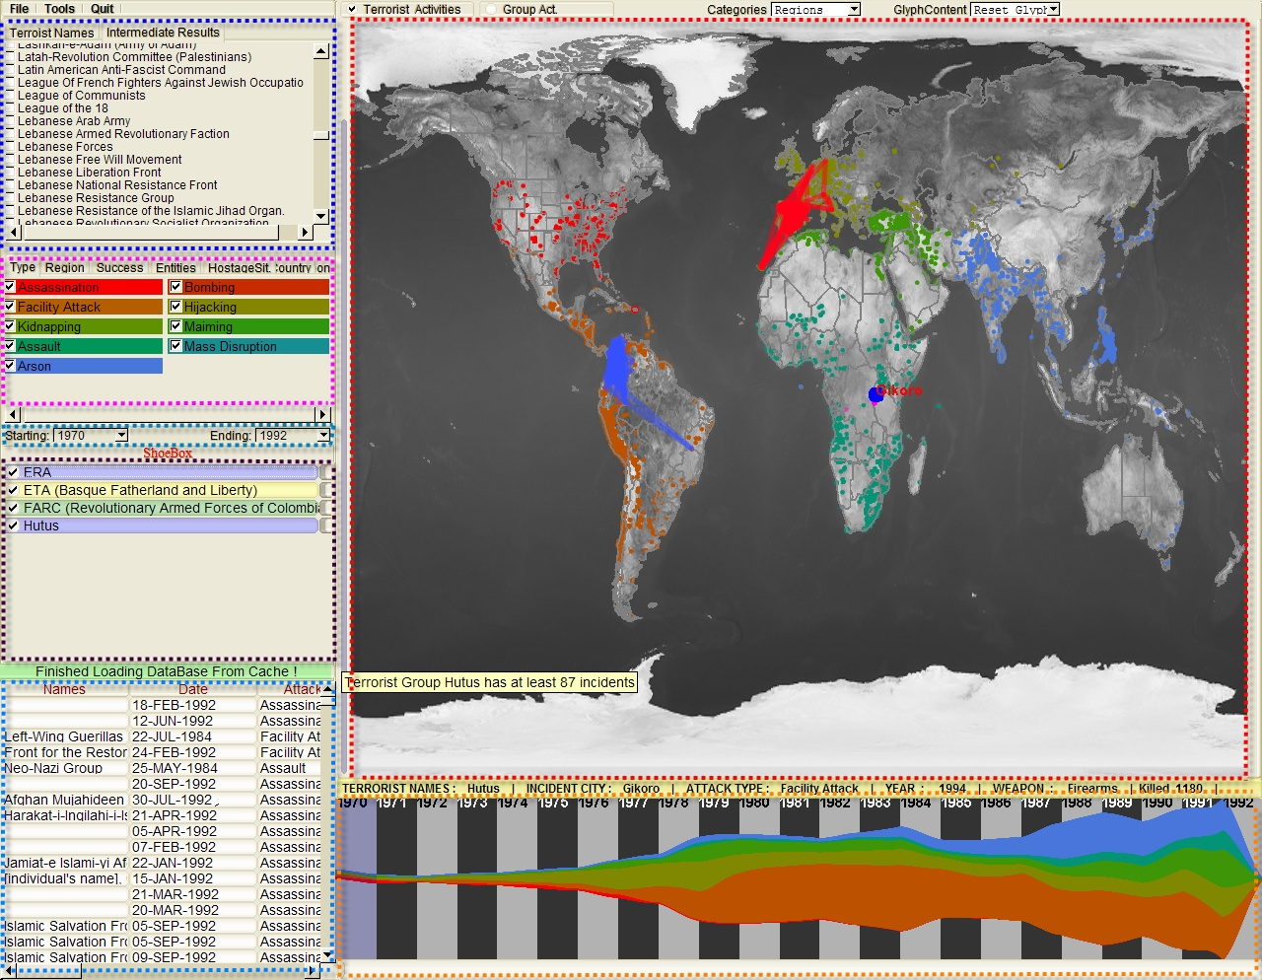
Using Visualizations To
Solve Real-World Problems…
Who
Where
What
Evidence
Box
Original
Data
When

Slide 51
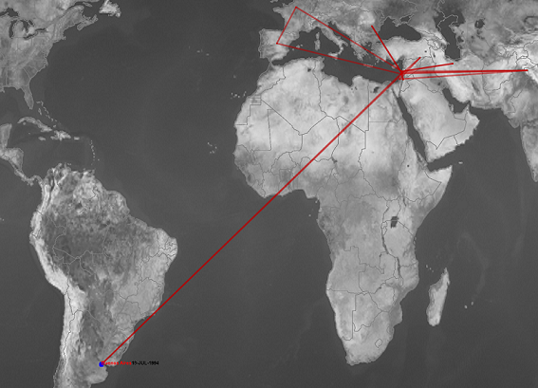
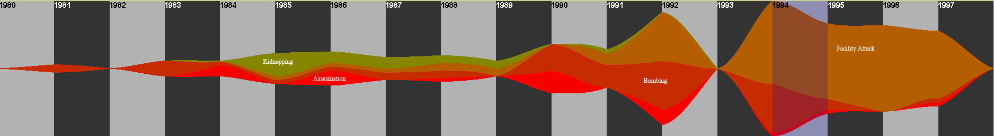
Using Visualizations To
Solve Real-World Problems…
This group’s attacks are not bounded by geo-locations but instead, religious beliefs.
Its attack patterns changed with its developments.

Slide 52
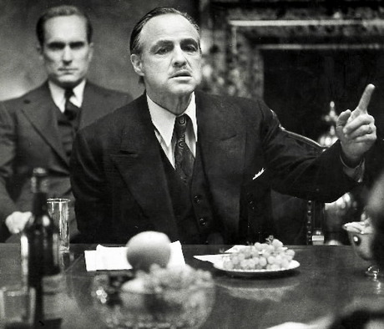
Visualization concept
It’s your consigliere – always there, in the background

Slide 53
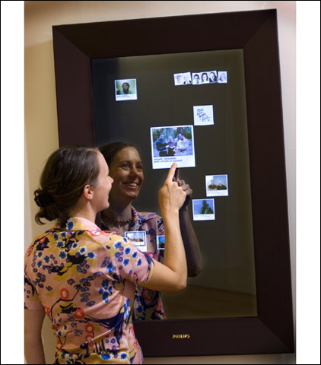
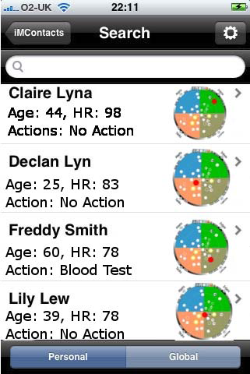
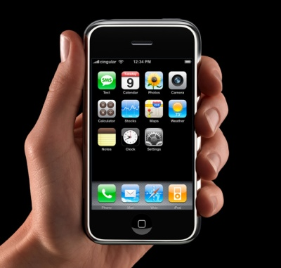
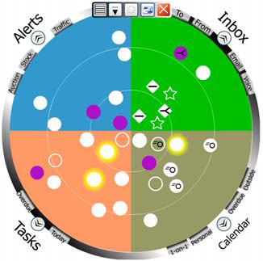
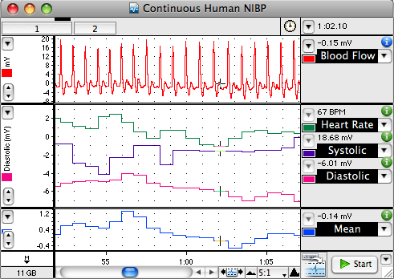

Visualizing Sepsis
Challenges
  Connecting to Data Mining and AI components
  Doctors don’t sit in front of a computer all the time…

Slide 54
Validation
Model will need to be built on retrospective data
Validated on real-time prospective data
Clinical trial?

Slide 55

Leap of faith?

