Slide 1
Debugging and Hacking the User
Remco Chang
Assistant Professor
Tufts University

Slide 2
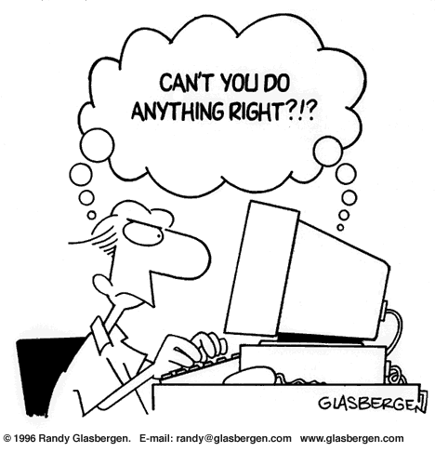
“Let the Data Talk to You”

Slide 3




Domain-Specific Visual Analytics Systems
Political Simulation
  Agent-based analysis
  With DARPA
Wire Fraud Detection
  With Bank of America
Bridge Maintenance
  With US DOT
  Exploring inspection reports
Biomechanical Motion
  Interactive motion comparison
R. Chang et al., Two Visualization Tools for Analysis of Agent-Based Simulations in Political Science. IEEE CG&A, 2012

Slide 4
Domain-Specific Visual Analytics Systems
Political Simulation
  Agent-based analysis
  With DARPA
Wire Fraud Detection
  With Bank of America
Bridge Maintenance
  With US DOT
  Exploring inspection reports
Biomechanical Motion
  Interactive motion comparison
R. Chang et al., WireVis: Visualization of Categorical, Time-Varying Data From Financial Transactions, VAST 2008.

Slide 5



Domain-Specific Visual Analytics Systems
Political Simulation
  Agent-based analysis
  With DARPA
Wire Fraud Detection
  With Bank of America
Bridge Maintenance
  With US DOT
  Exploring inspection reports
Biomechanical Motion
  Interactive motion comparison
R. Chang et al., An Interactive Visual Analytics System for Bridge Management, Journal of Computer Graphics Forum, 2010. To Appear.

Slide 6



Domain-Specific Visual Analytics Systems
Political Simulation
  Agent-based analysis
  With DARPA
Wire Fraud Detection
  With Bank of America
Bridge Maintenance
  With US DOT
  Exploring inspection reports
Biomechanical Motion
  Interactive motion comparison
R. Chang et al., Interactive Coordinated Multiple-View Visualization of Biomechanical Motion Data, IEEE Vis (TVCG) 2009.

Slide 7
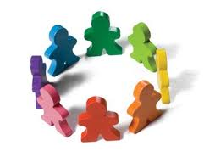
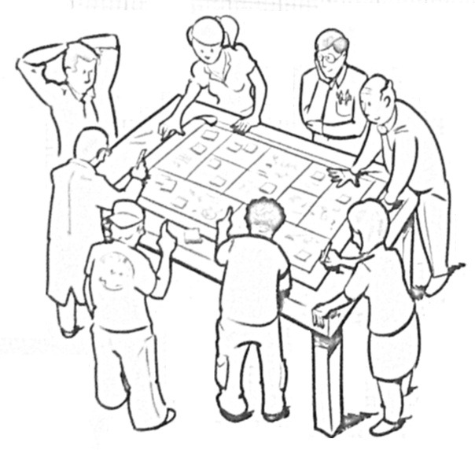
The User is NOT the Enemy
Vis design starts with user and task analyses. However,
  When no two users are exactly the same, (expert-based) design is very difficult
  Evaluation is correspondingly very difficult (WireVis evaluation)
  “Time to insight” is very much user dependent
Users are the domain experts
  They can provide a lot of information
  Question is how to harvest and leverage it

Slide 8
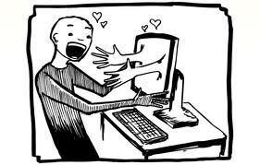
Human + Computer

Slide 9
Making the Users Work For You
(Without Them Realizing that They Are)
Examples
  “Crowdsourcing”
  Model learning from user’s interactions
  Predict the user’s behavior

Slide 10

What is in a User’s Interactions?
Keyboard, Mouse, etc
Visualization
Input
Human
Output
Images (monitor)
Types of Human-Visualization Interactions
  Word editing (input heavy, little output)
  Browsing, watching a movie (output heavy, little input)
  Visual Analysis (closer to 50-50)
Challenge:
  Can we capture and extract a user’s reasoning and intent through capturing a user’s interactions?

Slide 11
CrowdSourcing
Can we leverage multiple user’s past histories?

Slide 12
Example 1: Crowdsourcing
Scented Widget (Willet et al. 2007)

Slide 13
Example 1: Scented Widget

Slide 14
  Model learning from user’s interactions
  How do we help a user define a (weighted) distance metric?

Slide 15

Example 2: Metric Learning
Finding the weights to a linear distance function
Instead of a user manually give the weights, can we learn them implicitly through their interactions?

Slide 16
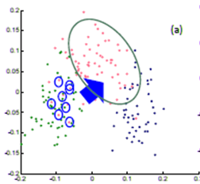
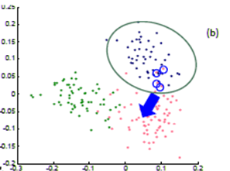
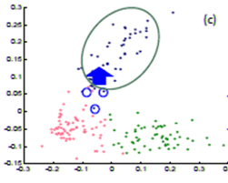
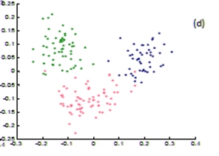
Example 2: Metric Learning
In a projection space (e.g., MDS), the user directly moves points on the 2D plane that don’t “look right”…
Until the expert is happy (or the visualization can not be improved further)
The system learns the weights (importance) of each of the original k dimensions

Slide 17
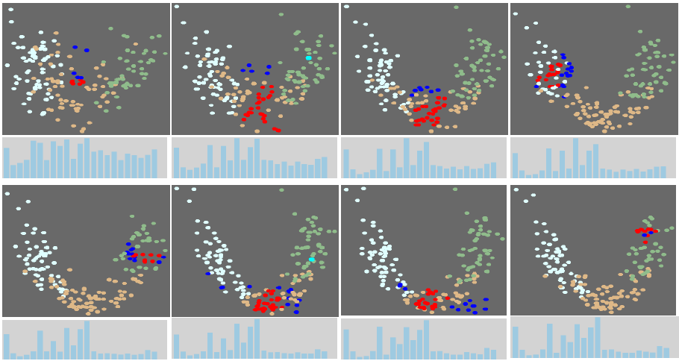

Dis-Function
Optimization:
R. Chang et al., Find Distance Function, Hide Model Inference. IEEE VAST Poster 2011
R. Chang et al., Dis-function: Learning Distance Functions Interactively, IEEE VAST 2012.

Slide 18
  Predicting User’s Behavior
  Can we predict how well the user will do in a visual search task?

Slide 19
Task: Find Waldo
Google-Maps style interface
  Left, Right, Up, Down, Zoom In, Zoom Out, Found

Slide 20
Classifying Users
Collect two types of data about the user in real-time
Physical mouse movement
  Mouse position, velocity, acceleration, angle change, distance, etc.
Interaction sequences
  Sequences of button clicks
  7 possible symbols
Goal: Predict if a user will find Waldo within 500 seconds

Slide 21
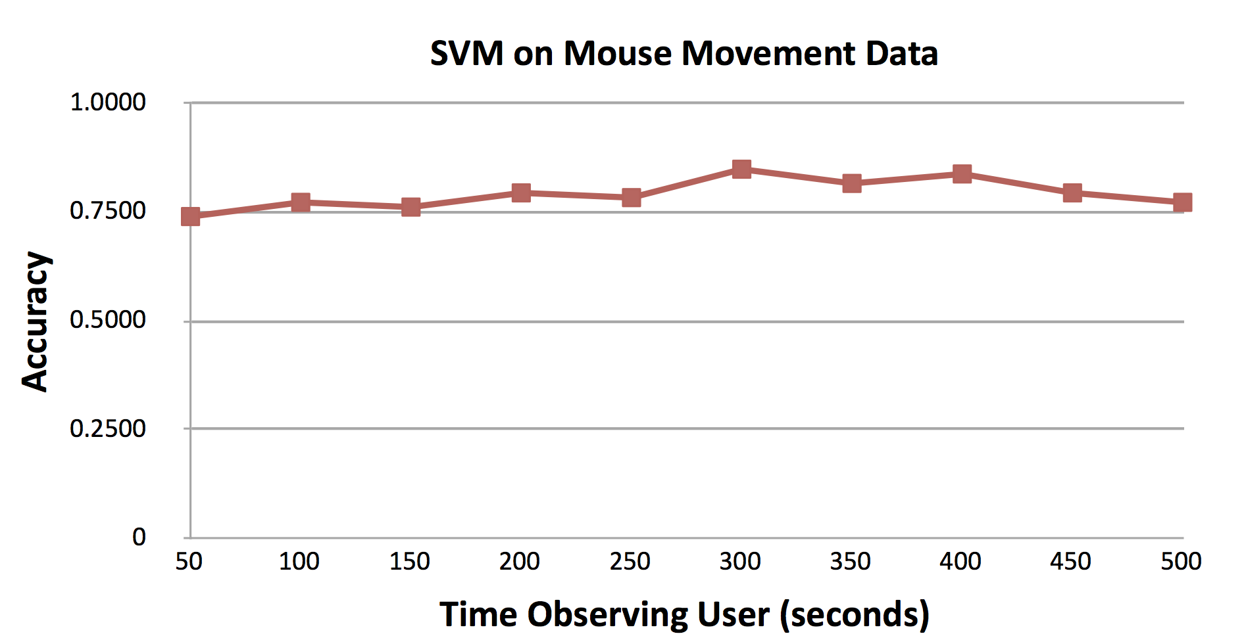
Analysis 1: Mouse Movement

Slide 22
Analysis 2: Interaction Sequences
Uses a combination of n-grams and decision tree

Slide 23
Detecting User’s Characteristic
We can detect a faint signal on the user’s personality traits…

Slide 24
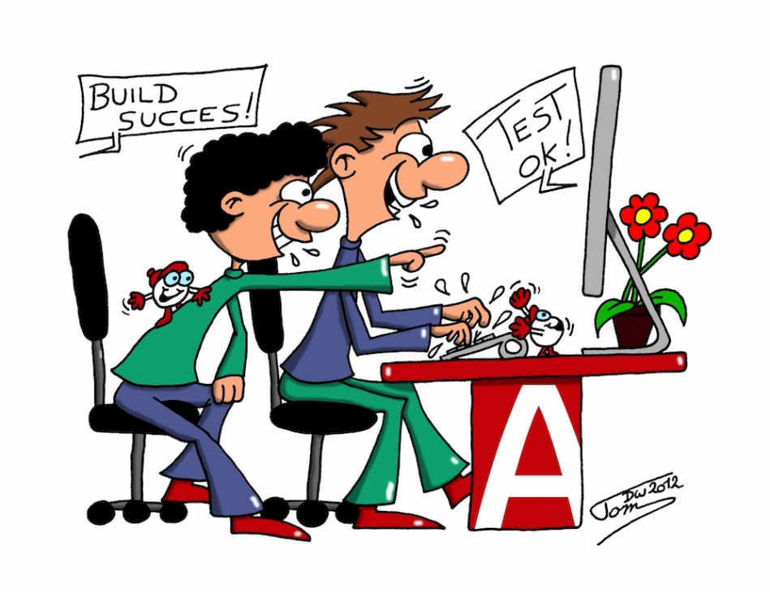
Possible Implications
A note on “Paired Analytics”
  A PA user needs to do everything!
  Paired analysis reduces cognitive workload

Slide 25
Conclusion
Users are very valuable commodity. Leverage their domain knowledge!!
Like the analysts who gained experience and knowledge, the computer can get “smarter” too!!
“Hacking” the user can be done unobtrusively, and there’s a lot of signal in their interaction trails…

Slide 26
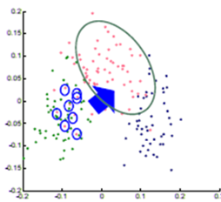
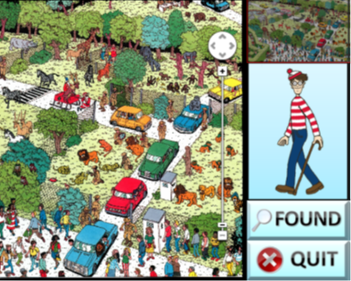
Thank you!
Remco Chang
remco@cs.tufts.edu

Slide 27
Backup

Slide 28
Possible Implications
A note on “Paired Analytics”
  A PA user needs to do everything!
Collaboration with the MIT Big Data Center
Goal: Predictive pre-fetching from DB
Teams: MIT, Brown, Tufts
  MIT: Based on data characteristic
  Brown: Based on past SQL queries
  Tufts: Based on user’s past analysis profile

