Slide 1
Improving Health Risk Communication:
Designing Visualizations for Spatial Ability
Remco Chang (Computer Science)
Paul Han (Tufts Medical / Maine Medical)
Holly Taylor (Psychology)

Slide 2
Health Risk Communication
Diagnosis
Screening/diagnostic test accuracy
Probability of disease given test result
Prognosis
Probability of future health outcome
Treatment effectiveness (benefits, harms)
Risk reduction: absolute, relative

Slide 3
Health Risk Communication
Diagnosis
Screening/diagnostic test accuracy
Probability of disease given test result
Prognosis
Probability of future health outcome
Treatment effectiveness (benefits, harms)
Risk reduction: absolute, relative

Slide 4
Health Risk and Bayesian Reasoning
“The probability that a woman over age 40 has breast cancer is 1%. However, the probability that mammography accurately detects the disease is 80% with a false positive rate of 9.6%.”
If a 40-year old woman tests positive in a mammography exam, what is the probability that she indeed has breast cancer?

Slide 5
Bayesian Reasoning is Hard
Correct Answer is 7.8%.
Solving this problem as a Bayesian reasoning task would go as follows:
Bayes’ theorem states that P(A|B) = P(B|A)*P(A)/P(B). In this case, A is having breast cancer, B is testing positive with mammography. P(A|B) is the probability of a person having breast cancer given that the person is tested positive with mammography.
P(B|A) is given as 80%, or 0.8, P(A) is given as 1%, or 0.01. P(B) is not explicitly stated, but can be computed as P(B,A)+P(B,˜A), or the probability of testing positive and the patient having cancer plus the probability of testing positive and the patient not having cancer. Since P(B,A) is equal 0.8*0.01 = 0.008, and P(B,˜A) is 0.096*0.99=0.09504. P(B) can be computed as 0.008+0.09504 = 0.10304. Finally, P(A|B) is therefore 0.8*0.01/0.10304, which is equal to 0.07764.

Slide 6
Understanding Conditional Probability
Bayesian reasoning and conditional probability are not “natural” for humans.
A study in 1982 by Eddy showed that 95% of doctors were incorrect in estimating the probability of the mammography problem¹.
Most doctors thought that the probability of having cancer is between 70 to 80%.
Such misunderstanding of health risk can lead to overestimation and over-diagnosis by an order of magnitude. As an example, over-diagnosis and over-treatment costs over $200 Billion each year in the US².
Eddy, D. M. Probabilistic reasoning in clinical medicine: Problems and opportunities. In Judgment under uncertainty: Heuristics and biases, D. Kahneman, P. Slovic, and A. Tversky, Eds. Cambridge University Press, Cambridge, UK, 1982.
Berwick, D. M., And Hackbarth, A. D. Eliminating waste in US healthcare. JAMA 307,14 (2012), 1513–1516.

Slide 7
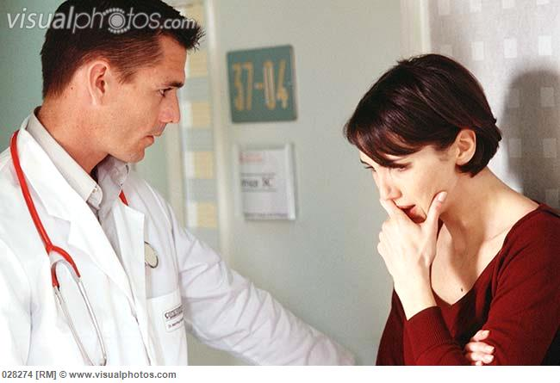
Health Risk Communication Challenge
Most study show that estimation accuracy is somewhere between 6-30% regardless of background, aide, or techniques (more later).
The problem is already hard.
In emotionally-charged situation (as receiving a positive diagnosis), it is even harder for patients who might not have statistical training.
Can we help patients?

Slide 8
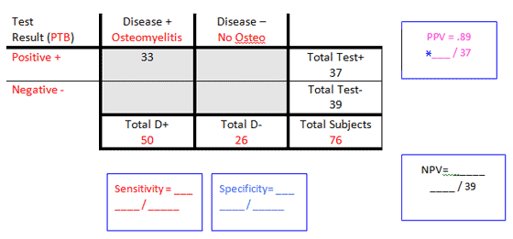
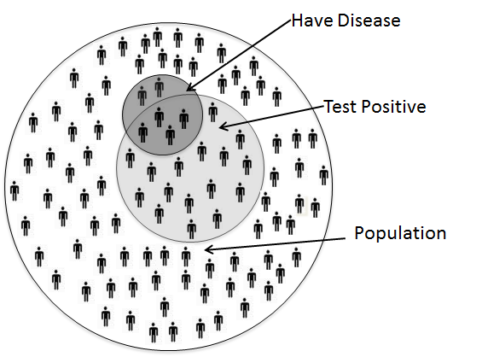
Strategies for Helping Patients
Natural Frequency (Gigerenzer¹)
96 out of 1,000 instead of 9.6%
Training to use tools (e.g. truth table)
Use of visualizations
Euler’s Diagram
G. Gigerenzer and U. Hoffrage. How to improve bayesian reasoning without instruction: Frequency formats. Psychological Review, 102(4):684, 1995.

Slide 9
Effectiveness of Strategies
There are typically two problems found with these techniques:
The effectiveness of these techniques is often limited.
E.g., Natural Frequency improves people’s estimation accuracy by around 10%.
The study results are highly inconsistent. Results are difficult to replicate due to changes in subject pool, study condition, problem type, wording, etc.
E.g., the same stimulus and visualization technique results in an accuracy of 40% in one study, but 6% in another.

Slide 10
Project Goal
There’s a GREAT need of tools that can help patients better understand their health risk and health information!! This is true for:
The Bayesian problem
Other health-related model predictions
Or general individual health records and information
In most of these studies, the study is conducted mostly by one domain expert – e.g. physicians, visualization experts, or psychologists.
We see an opportunity to leverage all three groups to solve the problem together.

Slide 11
Interdisciplinary Research Group
Our team consists of three professors from
Computer Science (visualization)
Medical School (risk communication)
Psychology (mental model of information)
Study has been going on for about 2 years.
Initial support from Tufts Collaborates.
Funding partially supported 1 PhD student and 1 Post-Doc.

Slide 12
Hypotheses of the Bayesian Reasoning Problem:
Our two primary hypotheses are that:
Different representations (visual or textual) can affect a user’s ability, and that
Different users have different needs when solving this problem.

Slide 13
H1: Different Text Representations
Text Representations. For example, consider the following statements:
“The probability that a person having a disease is 6%. However, the probability that a test accurately detects the disease is 66.67% with a false positive rate of 16%.”
“There is a total of 100 people in the population. Out of the 100 people in the population, 6 people actually have the disease. Out of these 6 people, 4 will receive a positive test result and 2 will receive a negative test result. On the other hand, 94 people do not have the disease (i.e., they are perfectly healthy). Out of these 94 people, 16 will receive a positive test result and 78 will receive a negative test result.”

Slide 14
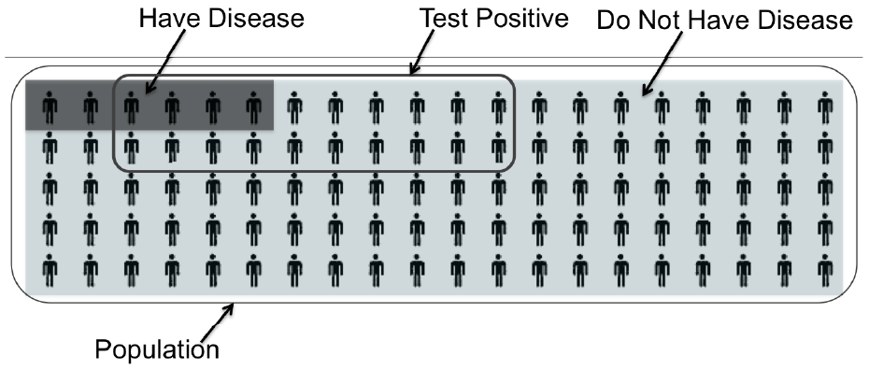
H1: Different “Visualization” Representations
There is a total of 100 people in the population.
Out of the 100 people in the population,
6 people actually have the disease. Out of these 6 people,
4 will receive a positive test result and
2 will receive a negative test result.
On the other hand, 94 people do not have the disease (i.e., they are perfectly healthy). Out of these 94 people,
16 will receive a positive test result and
78 will receive a negative test result.
Another way to think about this is...
Out of the 100 people in the population,
20 people will test positive. Out of these 20 people,
4 will actually have the disease and
16 will not have the disease (i.e., they are perfectly healthy).
On the other hand, 80 people will test negative. Out of these 80 people,
2 will actually have the disease and
78 will not have the disease (i.e., they are perfectly healthy).

Slide 15
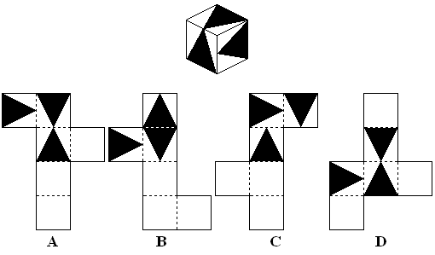
H2: Individual Differences
We conduct the study online (via crowdsourcing) to avoid sampling problem
Each subject is asked to complete two surveys to measure their:
Spatial Ability
Numeracy
A dice has sides of 1.2cm. What is its volume in cubic mm?

Slide 16
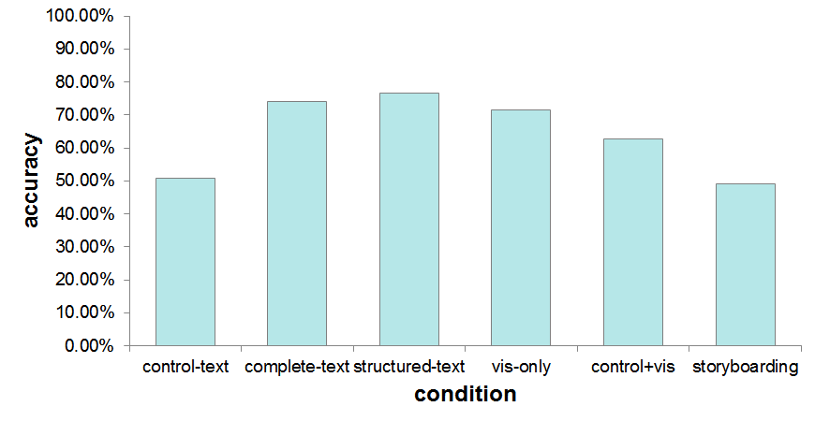
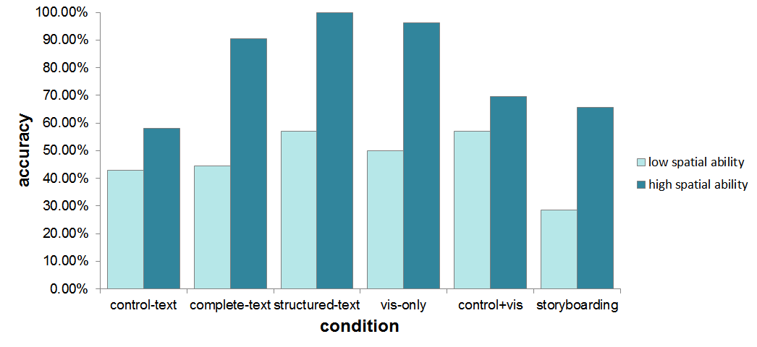
Results on Accuracy
Overall results (accuracy) across conditions
Conditions across spatial ability scores
(Numeracy has no effect)

Slide 17
Conclusion
Both hypotheses are supported by our findings.
Intuition on spatial ability is that there’s a text + visualization interference effect. Subjects are solving the same problem “twice” (once in text, once in vis) if text and vis are incongruent (different mental representation).
This study and its results have implications to all three areas (Visualization, Health Risk Communication, and Psychology).
More importantly, we couldn’t have tackled the problem ourselves. The collaboration between the teams is the key to success.

Slide 18
Questions?
Thank you!
Remco Chang (remco@cs.tufts.edu)
Paul Han (hanp@mmc.org)
Holly Taylor (holly.taylor@tufts.edu)

