Slide 1
Analyzing User Interactions for
Data and User Modeling
Remco Chang
Assistant Professor
Tufts University

Slide 2
(Modified) Van Wijk’s Model of Visualization
Data
Visualization
User
Vis
Image
Perceive
Data
Discovery
Params
Interaction
Explore

Slide 3


When the Analyst is Successful….
Data
Visualization
User
Vis
Image
Perceive
Data
Discovery
Params
Interaction
Explore
Data + Vis + Interaction + User = Discovery

Slide 4
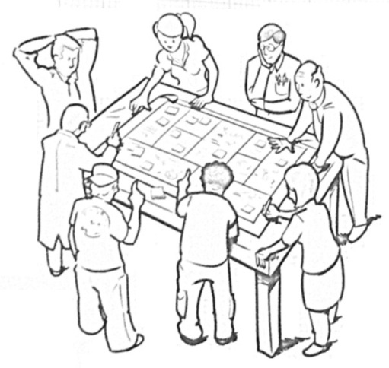

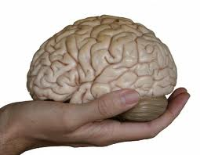
Remco’s Research Goal
“Reverse engineer” the human cognitive black box (by analyzing user interactions)
Data Modeling
  Interactive Metric Learning
User Modeling
  Predict Analysis Behavior
Cognitive States and Traits
Mixed-Initiative Visual Analytics
R. Chang et al., Science of Interaction, Information Visualization, 2009.

Slide 5
Data Modeling
Interactive Metric Learning
Quantifying a User’s Knowledge about Data

Slide 6

Metric Learning
Finding the weights to a linear distance function
Instead of a user manually give the weights, can we learn them implicitly through their interactions?

Slide 7
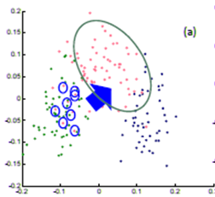
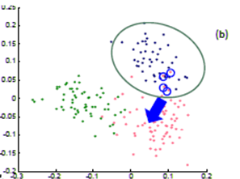
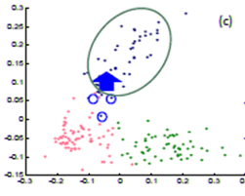
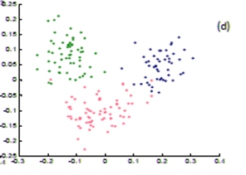
Metric Learning
In a projection space (e.g., MDS), the user directly moves points on the 2D plane that don’t “look right”…
Until the expert is happy (or the visualization can not be improved further)
The system learns the weights (importance) of each of the original k dimensions

Slide 8


Dis-Function
Optimization:
Brown et al., Find Distance Function, Hide Model Inference. IEEE VAST Poster 2011
Brown et al., Dis-function: Learning Distance Functions Interactively. IEEE VAST 2012.

Slide 9
User Modeling
2. Learning about a User in Real-Time
Who is the user,
and what is she doing?

Slide 10
One Question at a Time
Data
Visualization
User
Fast
or
Slow?
Novice or
Expert?
Vis
Introvert or
Extrovert?
Image
Perceive
Data
Discovery
Params
Interaction
Explore
Data + Vis + Interaction + User = Discovery

Slide 11
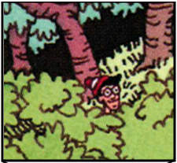
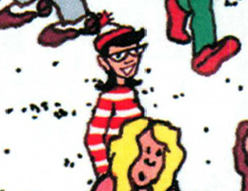
Experiment: Finding Waldo
Google-Maps style interface
  Left, Right, Up, Down, Zoom In, Zoom Out, Found

Slide 12
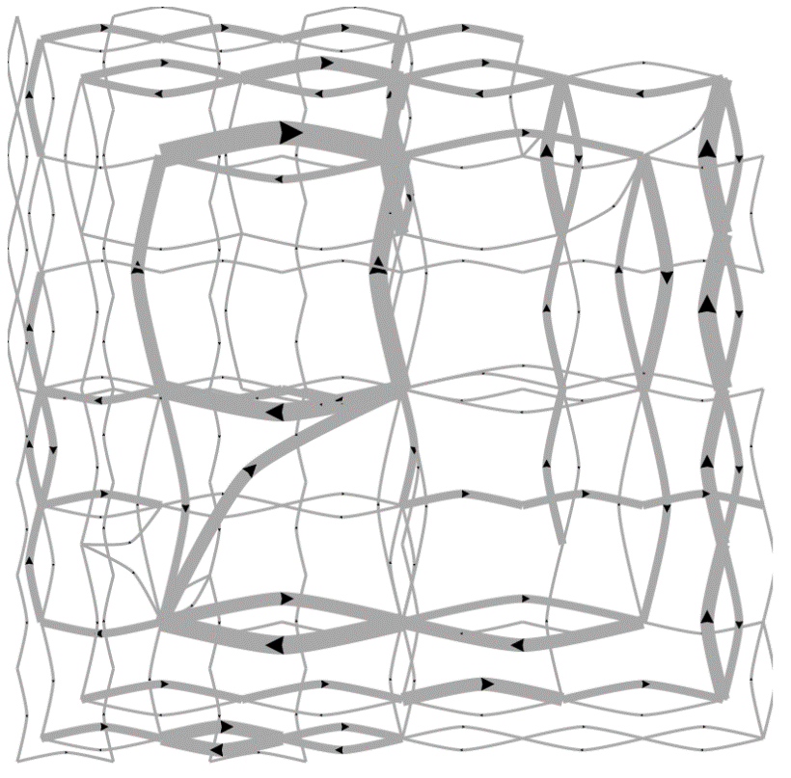
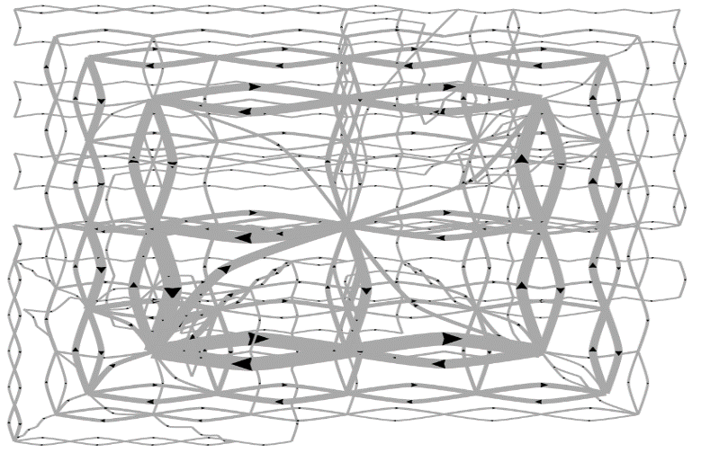
Pilot Visualization – Completion Time
Fast completion time
Slow completion time
Helen Zhao et al., Modeling user interactions for complex visual search tasks. Poster, IEEE VAST , 2013.
Eli Brown et al., Where’s Waldo. IEEE VAST 2014, Conditionally Accepted.

Slide 13
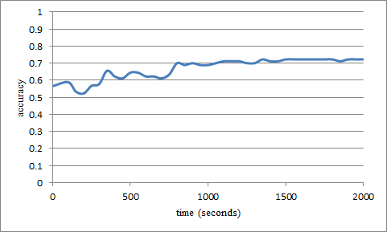
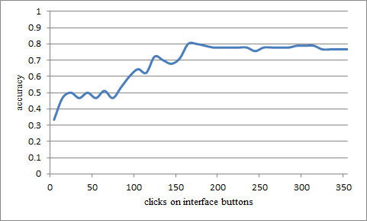
Predicting Fast and Slow Performers
State-Based (data exploration statistics)
Linear SVM
Accuracy: ~70%
Interaction pattern (high-level button clicks)
N-Gram + Decision Tree
Accuracy: ~80%

Slide 14
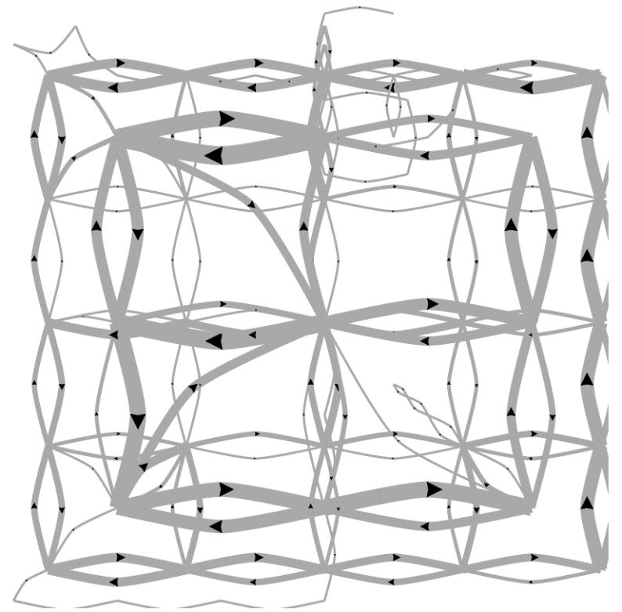
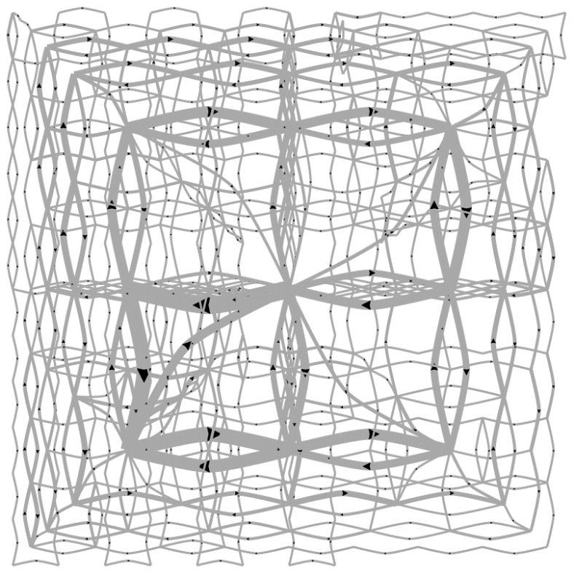
Predicting a User’s Personality
External Locus of Control
Internal Locus of Control
Ottley et al., How locus of control inﬂuences compatibility with visualization style. IEEE VAST , 2011.
Ottley et al., Understanding visualization by understanding individual users. IEEE CG&A, 2012.

Slide 15
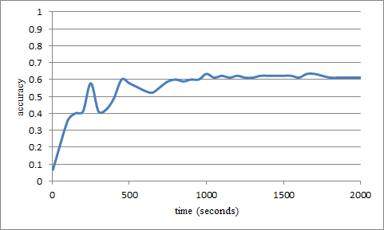
Predicting Users’ Personality Traits
Predicting user’s “Extraversion”
Accuracy: ~60%
Noisy data, but can detect the users’ individual traits “Extraversion”, “Neuroticism”, and “Locus of Control” at ~60% accuracy by analyzing the user’s interactions alone.

Slide 16
Cognitive States and Traits
3. What are the Cognitive Factors that
Correlate with a User’s Performance?

Slide 17
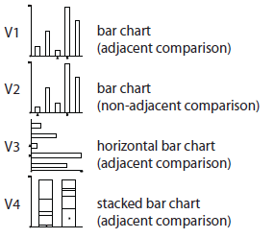
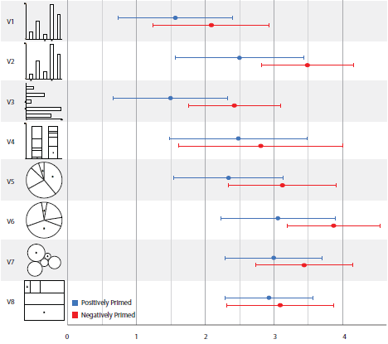
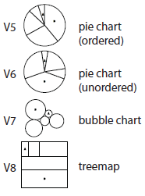
Emotion and Visual Judgment
Harrison et al., Influencing Visual Judgment Through Affective Priming, CHI 2013

Slide 18
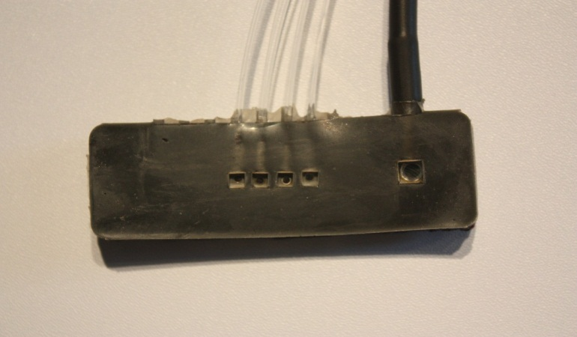
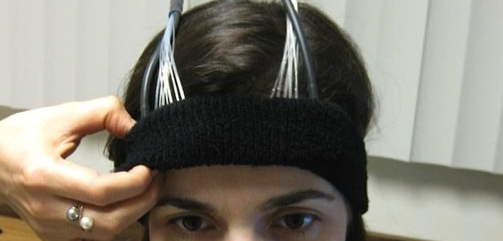
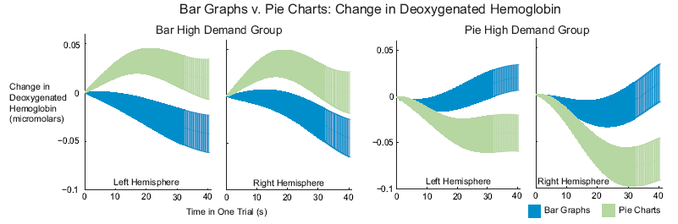
Cognitive Load
Functional Near-Infrared Spectroscopy
a lightweight brain sensing technique
measures mental demand (working memory)
Evan Peck et al., Using fNIRS Brain Sensing to Evaluate Information Visualization Interfaces. CHI 2013.

Slide 19
Spatial Ability: Bayes Reasoning
The probability that a woman over age 40 has breast cancer is 1%. However, the probability that mammography accurately detects the disease is 80% with a false positive rate of 9.6%.
If a 40-year old woman tests positive in a mammography exam, what is the probability that she indeed has breast cancer?
Answer: Bayes’ theorem states that P(A|B) = P(B|A) * P(A) / P(B). In this case, A is having breast cancer, B is testing positive with mammography. P(A|B) is the probability of a person having breast cancer given that the person is tested positive with mammography. P(B|A) is given as 80%, or 0.8, P(A) is given as 1%, or 0.01. P(B) is not explicitly stated, but can be computed as P(B,A)+P(B,˜A), or the probability of testing positive and the patient having cancer plus the probability of testing positive and the patient not having cancer. Since P(B,A) is equal 0.8*0.01 = 0.008, and P(B,˜A) is 0.093 * (1-0.01) = 0.09207, P(B) can be computed as 0.008+0.09207 = 0.1007. Finally, P(A|B) is therefore 0.8 * 0.01 / 0.1007, which is equal to 0.07944.

Slide 20
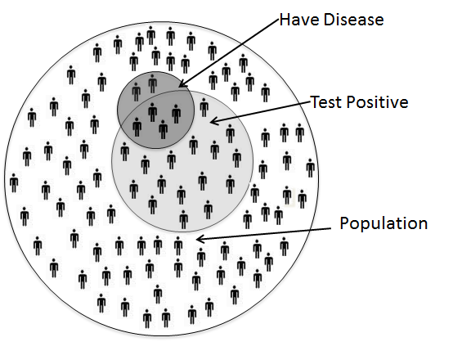
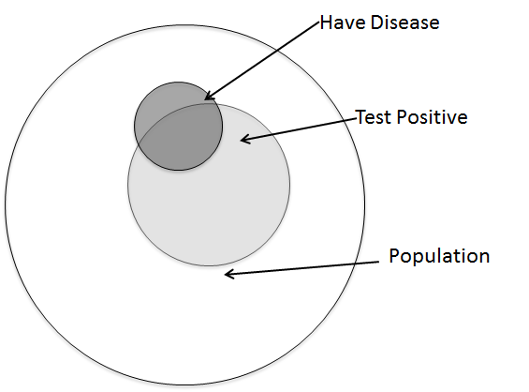
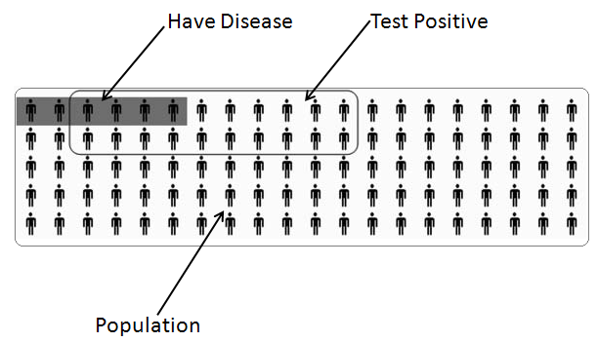
Visualization Aids
Ottley et al., Visually Communicating Bayesian Statistics to Laypersons. Tufts CS Tech Report, 2012.

Slide 21
Spatial Ability

Slide 22
Mixed Initiative Systems
4. What Can a Visualization System Do
If It Knows Everything About Its User?

Slide 23
“The computer is incredibly fast, accurate, and stupid. Man is unbelievably slow, inaccurate, and brilliant. The marriage of the two is a force beyond calculation.”
-Leo Cherne, 1977
(often attributed to Albert Einstein)

Slide 24
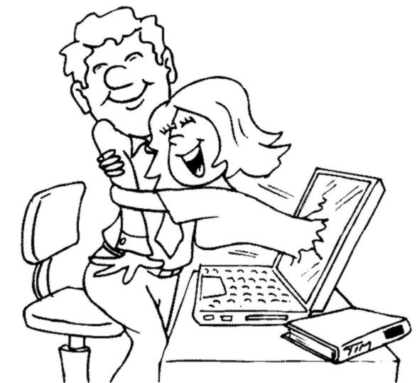
Which Marriage?

Slide 25
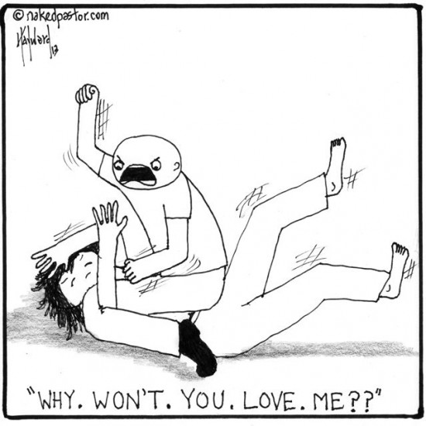
Which Marriage?

Slide 26
Remco’s Prediction
The future of visual analytics lies in better human-computer collaboration
That future starts by enabling the computer to better understand the user

Slide 27

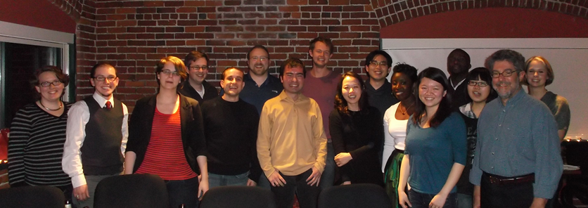
Questions? remco@cs.tufts.edu

Slide 28



Putting Theory into Practice: Big Data
Visualization on a
Commodity Hardware
Large Data in a
Data Warehouse

Slide 29
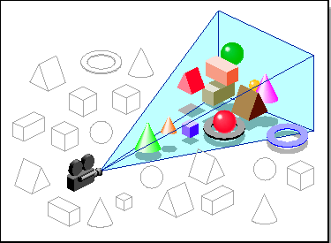
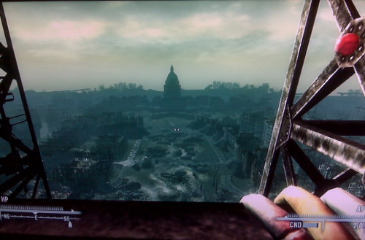
Problem Statement
Constraint: Data is too big to fit into the memory or hard drive of the personal computer
  Note: Ignoring various database technologies (OLAP, Column-Store, No-SQL, Array-Based, etc)
Classic Computer Science Problem…

Slide 30
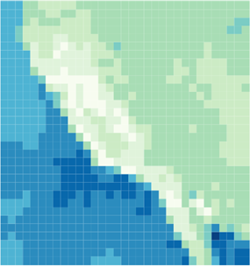
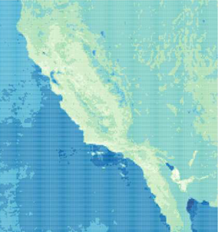
Work in Progress…*
However, exploring large DB (usually) means high degrees of freedom
Goal: Predictive Pre-Fetching from large DB
Collaboration with MIT Big Data Center
Teams:
  MIT: Based on data characteristic
  Brown: Based on past SQL queries
  Tufts: Based on user’s analysis profile
Current progress: developed middleware (ScalaR)
Battle et al., Dynamic Reduction of Result Sets for Interactive Visualization. IEEE BigData, 2013.

