Slide 1
The Need for Interactivity in Visual Analytics Systems
Remco Chang
Associate Professor
Computer Science, Tufts University

Slide 2

Financial Fraud – A Case for Visual Analytics
Financial Institutions like Bank of America have legal responsibilities to report all suspicious wire transaction activities
  money laundering, supporting terrorist activities, etc
Data size: approximately 200,000 transactions per day (73 million transactions per year)

Slide 3

Financial Fraud – A Case Study for Visual Analytics
Problems:
  Automated approach can only detect known patterns
  Bad guys are smart: patterns are constantly changing
Previous methods:
  10 analysts monitoring and analyzing all transactions
  Using SQL queries and spreadsheet-like interfaces
  Limited time scale (2 weeks)

Slide 4

WireVis: Financial Fraud Analysis
In collaboration with Bank of America
  Visualizes 7 million transactions over 1 year
A great problem for visual analytics:
  Ill-defined problem (how does one define fraud?)
  Limited or no training data (patterns keep changing)
  Requires human judgment in the end (involves law enforcement agencies)
R. Chang et al., Scalable and interactive visual analysis of financial wire transactions for fraud detection. Information Visualization,2008.
R. Chang et al., Wirevis: Visualization of categorical, time-varying data from financial transactions. IEEE VAST, 2007.

Slide 5
WireVis: A Visual Analytics Approach
Search by Example (Find Similar Accounts)
Heatmap View
(Accounts to Keywords Relationship)
Keyword Network
(Keyword Relationships)
Multiple Temporal View
(Relationships over Time)

Slide 6

Evaluation
Challenging – lack of ground truth
Two types of evaluations:
  Grounded Evaluation: real analysts, real data
    Find transactions that existing techniques can find
    Find new transactions that appear suspicious
  Controlled Evaluation: real analysts, synthetic data
    Find all injected threat scenarios
Adoption and Deployment

Slide 7





Interactive Visualization Systems
Jordan Crouser
Political Simulation
  Agent-based analysis
Bridge Maintenance
  Exploring inspection reports
Biomechanical Motion
  Interactive motion comparison
Interactive Metric Learning
  Dis-Function: high-dimensional metric learning
High-D Data Exploration
  iPCA: Interactive PCA
R. Chang et al., Two Visualization Tools for Analysis of Agent-Based Simulations in Political Science. IEEE CG&A, 2012

Slide 8



Interactive Visualization Systems
Political Simulation
  Agent-based analysis
Bridge Maintenance
  Exploring inspection reports
Biomechanical Motion
  Interactive motion comparison
Interactive Metric Learning
  Dis-Function: high-dimensional metric learning
High-D Data Exploration
  iPCA: Interactive PCA
R. Chang et al., An Interactive Visual Analytics System for Bridge Management, Journal of Computer Graphics Forum, 2010.

Slide 9



Interactive Visualization Systems
Political Simulation
  Agent-based analysis
Bridge Maintenance
  Exploring inspection reports
Biomechanical Motion
  Interactive motion comparison
Interactive Metric Learning
  Dis-Function: high-dimensional metric learning
High-D Data Exploration
  iPCA: Interactive PCA
R. Chang et al., Interactive Coordinated Multiple-View Visualization of Biomechanical Motion Data, IEEE Vis (TVCG) 2009.

Slide 10

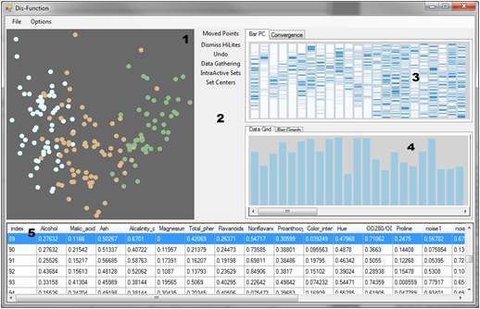
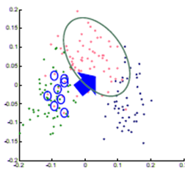

Interactive Visualization Systems
Eli Brown
Political Simulation
  Agent-based analysis
Bridge Maintenance
  Exploring inspection reports
Biomechanical Motion
  Interactive motion comparison
Interactive Metric Learning
  Dis-Function: high-dimensional metric learning
High-D Data Exploration
  iPCA: Interactive PCA
R. Chang et al., Dis-function: Learning Distance Functions Interactively, IEEE VAST 2011.

Slide 11
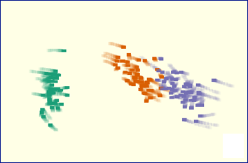
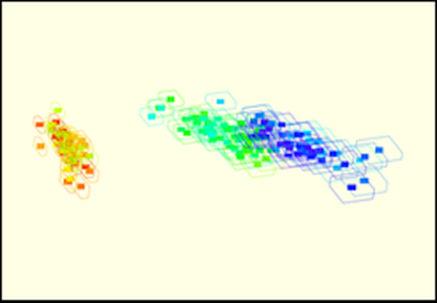
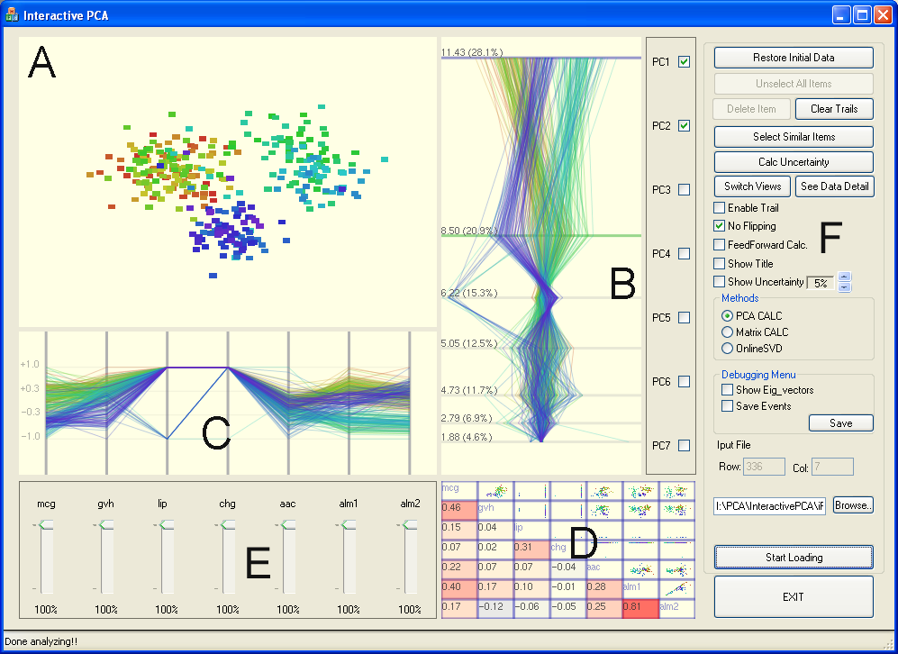
Interactive Visualization Systems
Political Simulation
  Agent-based analysis
Bridge Maintenance
  Exploring inspection reports
Biomechanical Motion
  Interactive motion comparison
Interactive Metric Learning
  Dis-Function: high-dimensional metric learning
High-D Data Exploration
  iPCA: Interactive PCA
R. Chang et al., iPCA: An Interactive System for PCA-based Visual Analytics, EuroVis 2009.

Slide 12
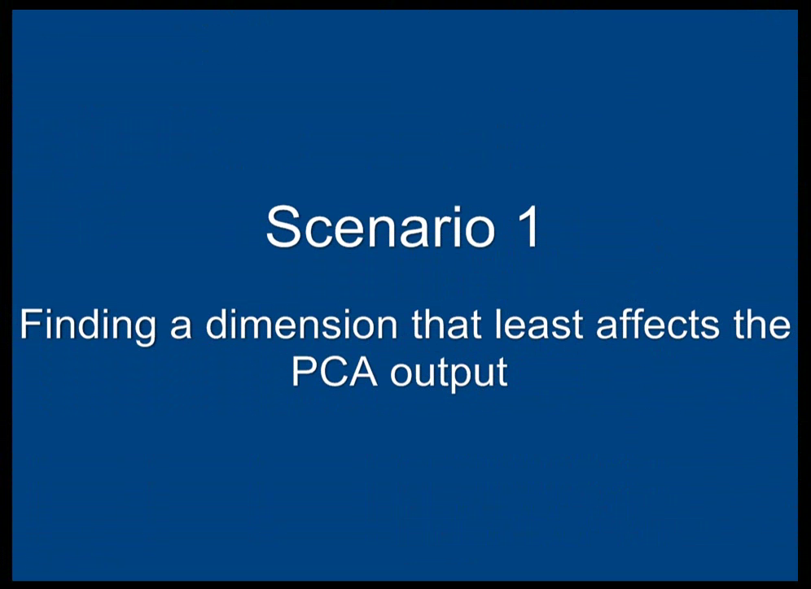

Slide 13

Lessons Learned
Coordinated Multiple View (CMV) is better than one single complex visualization
Analyst behavior
  90% of time on Exploratory Data Analysis (EDA)
  10% on confirmation (CDA)
Big data analysis == fast hypothesis testing
High Interactivity is key
  Wait time disrupts the analysis process

Slide 14
How Individual Differences Affect Interactions and
(Bayesian) Reasoning

Slide 15
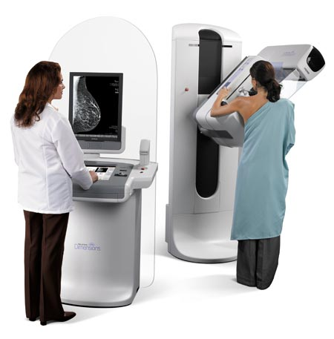
The probability of breast cancer is 1% for women at age forty who participate in routine screening. If a woman has breast cancer, the probability is 80% that she will get a positive mammography. If a woman does not have breast cancer, the probability is 9.6% that she will also get a positive mammography.
If a woman at age 40 is tested positive, what are her chances of actually having breast cancer?
Notes:
Consider the following mammography problem:
Take some time to read problem and think about the answer
So how many of you can confidently answer the following question? [CLICK] and ask them the question verbally.

Slide 16
The chance of actually having breast cancer given a positive mammogram:
7.8%
Answer: Bayes’ theorem states that P(A|B) = P(B|A) * P(A) / P(B). In this case, A is having breast cancer, B is testing positive with mammography. P(A|B) is the probability of a person having breast cancer given that the person is tested positive with mammography. P(B|A) is given as 80%, or 0.8, P(A) is given as 1%, or 0.01. P(B) is not explicitly stated, but can be computed as P(B,A)+P(B,˜A), or the probability of testing positive and the patient having cancer plus the probability of testing positive and the patient not having cancer. Since P(B,A) is equal 0.8*0.01 = 0.008, and P(B,˜A) is 0.093 * (1-0.01) = 0.09207, P(B) can be computed as 0.008+0.09207 = 0.1007. Finally, P(A|B) is therefore 0.8 * 0.01 / 0.1007, which is equal to 0.07944.
Notes:
How many of you got it right? Not very many.
Well maybe that’s okay, because when you’re trying to make these kind of decisions you’ve got your doctor there to help you, right?
How many of you would expect your doctor to be able to accurately answer this question?

Slide 17
95 out of 100 doctors¹
estimate this probability
to be:
80%
¹Eddy, David M. "Probabilistic reasoning in clinical medicine: Problems and opportunities." (1982).
Notes:
Ten times greater than the actual risk.
There are real health implications to this mismatch. People may opt for invasive biopsies, undergo painful treatment, and suffer significant emotional distress.

Slide 18
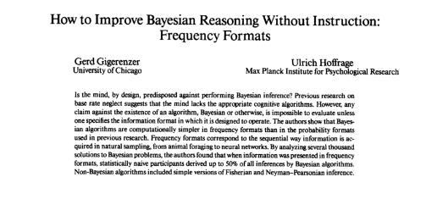
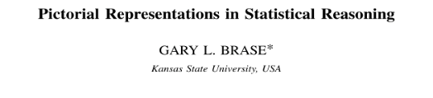
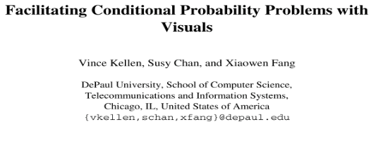
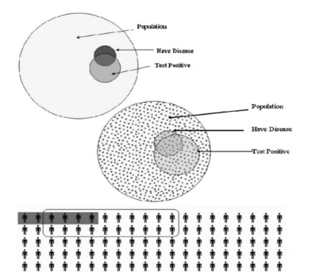

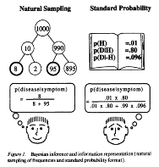
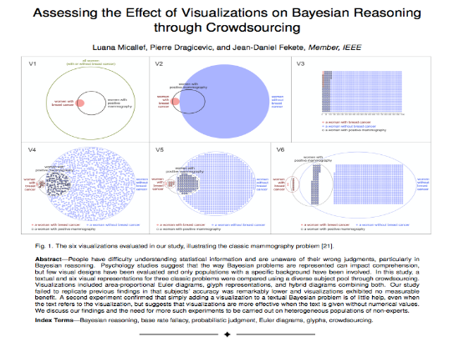
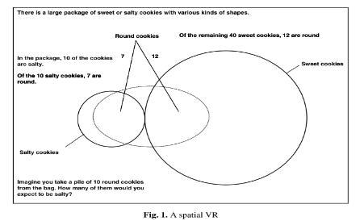
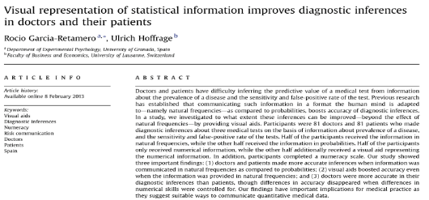
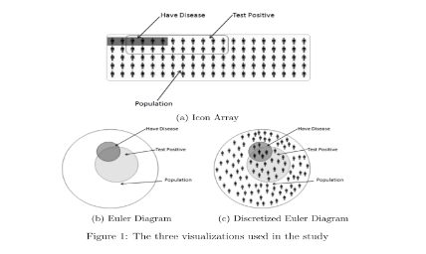
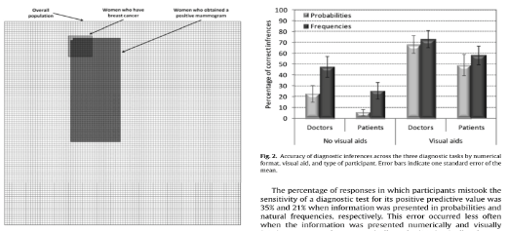
VIS Community
Notes:
In fact researchers including the VIS community has been trying to address exactly this problem for years.
And unfortunately, they disagree

Slide 19


The Problem?
“
”
“
”
“
”
“
...”
They disagree.
* Reported accuracies range from 6% to 62%
Notes:
We see conflicting reports on whether visualizations helps people make better statistical judgments.
The reported accuracies for using visualizations range from 6% to 62%

Slide 20
Experiments
Need to understand how the wording of the problem impacts accuracy.
Need to understand how different reasoning aides impact accuracy.
Specifically:
does adding visualization to the text help?
Notes:
Specifically, we want to ask: does adding visualization to the text help?

Slide 21
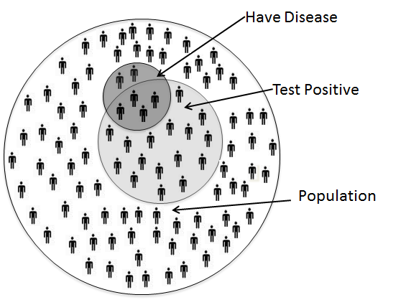
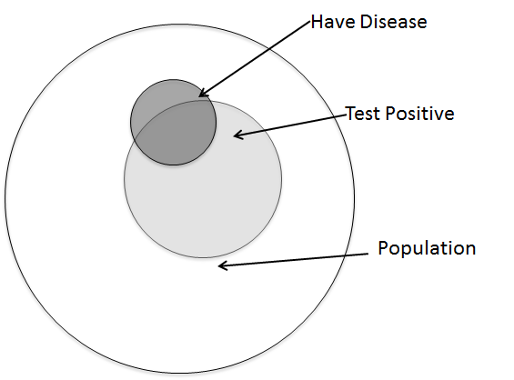
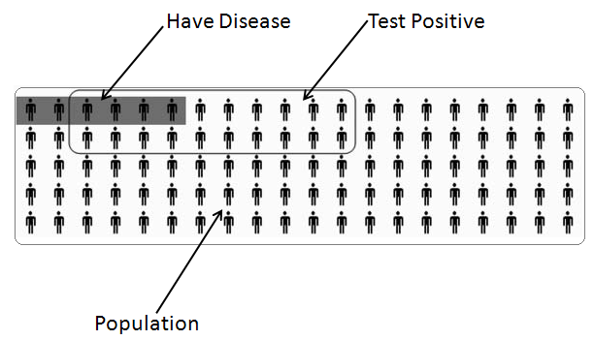
Visualization Aids
Ottley et al., Visually Communicating Bayesian Statistics to Laypersons. Tufts CS Tech Report, 2012.

Slide 22
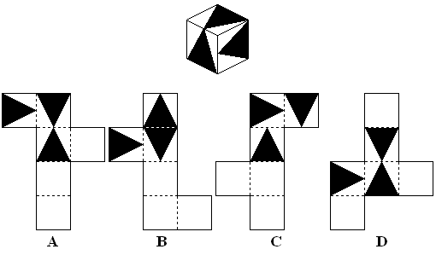
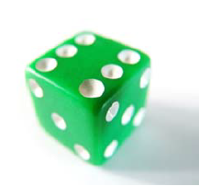

Experimental Design
6 conditions
377 participants
Between subjects experiment
Also measured spatial ability, numeracy
A dice has sides of 1.2cm. What is its volume in cubic mm?
Notes:
Describe spatial ability

Slide 23
Initial Results
Notes:
So what did we learn?
They was no difference between the conditions and adding visualizations to text didn’t not help.

Slide 24
Separated by Spatial Ability
Low spatial-ability
High spatial-ability
Notes:
People high high spatial ability across the board were better at performing statistical reasoning

Slide 25
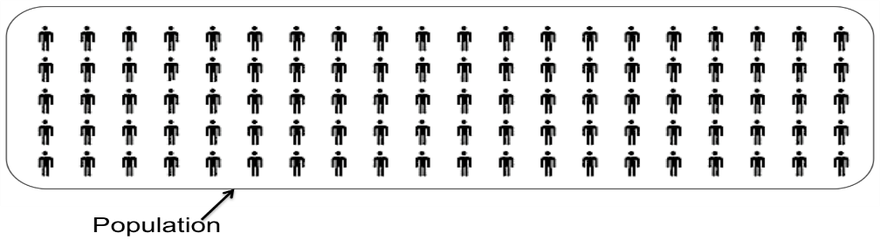
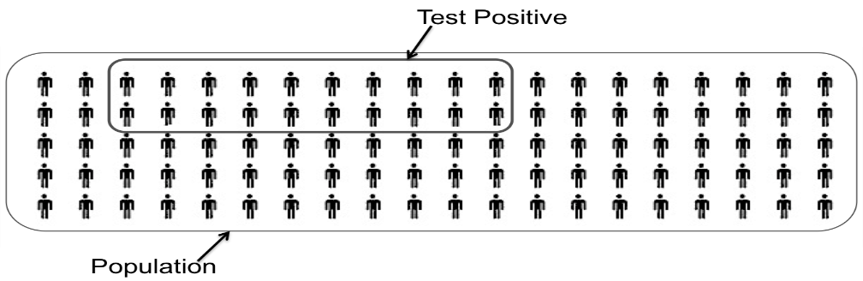
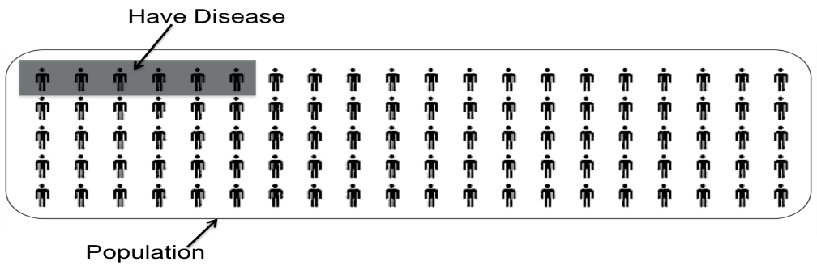
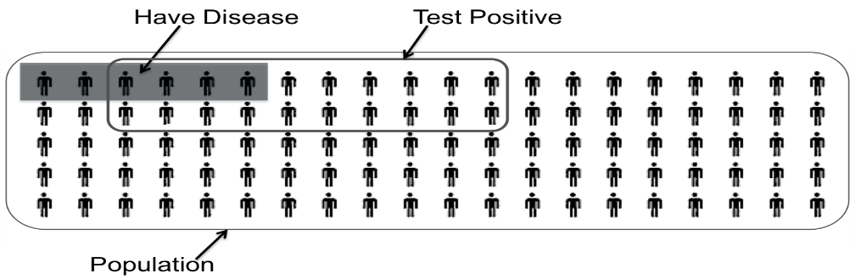
“Storytelling” Visualization
Notes:
Explain advantage
Without instructions, users can FRAME the problem based on what best fits their mental model.
For instance…
So back to our conditions

Slide 26
Adding User Interaction
Tsai, Miller, Kirlik (2011), HFES

Slide 27
The Effect of Interaction

Slide 28

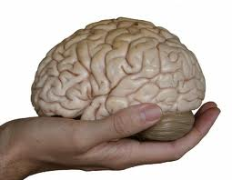
Quick Recap: Individual Differences
A static visualization, by itself, is limited in helping users reason with the information
  Users with low spatial ability have particular trouble following an “unfamiliar” reasoning path (such as storytelling)
  Interactions allow different users to construct reasoning paths that are suitable to them
Question, how do we know that interactions actually reflect the user’s reasoning process?

Slide 29
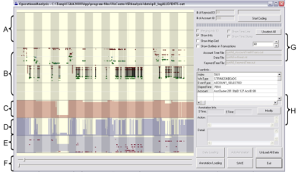
Interactions: An Extension of Thought
Goal: determine if a user’s reasoning and intent are reflected in a user’s interactions.
Grad
Students
(Coders)
Analysts
Compare!
(manually)
Strategies
Methods
Findings
Guesses of
Analysts’ thinking
Logged
(semantic)
Interactions
WireVis
Interaction-Log Vis

Slide 30
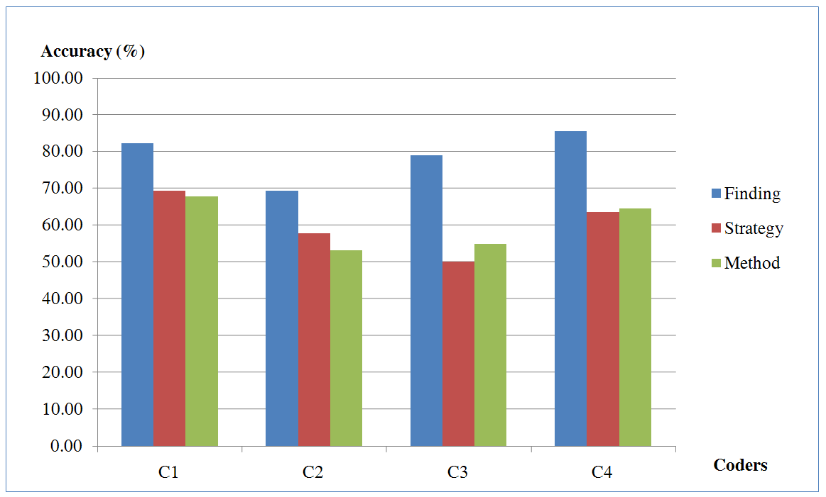
What’s in a User’s Interactions
From this experiment, we find that interactions contains at least:
  60% of the (high level) strategies
  60% of the (mid level) methods
  79% of the (low level) findings
R. Chang et al., Recovering Reasoning Process From User Interactions. IEEE Computer Graphics and Applications, 2009.
R. Chang et al., Evaluating the Relationship Between User Interaction and Financial Visual Analysis. IEEE Symposium on VAST, 2009.

Slide 31
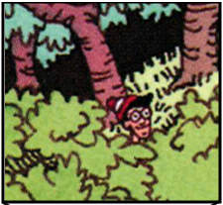
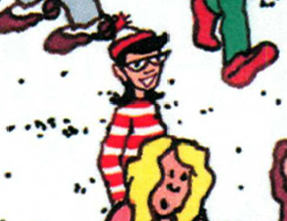
Finding Waldo: Can we Automate?
Google-Maps style interface
  Left, Right, Up, Down, Zoom In, Zoom Out, Found

Slide 32
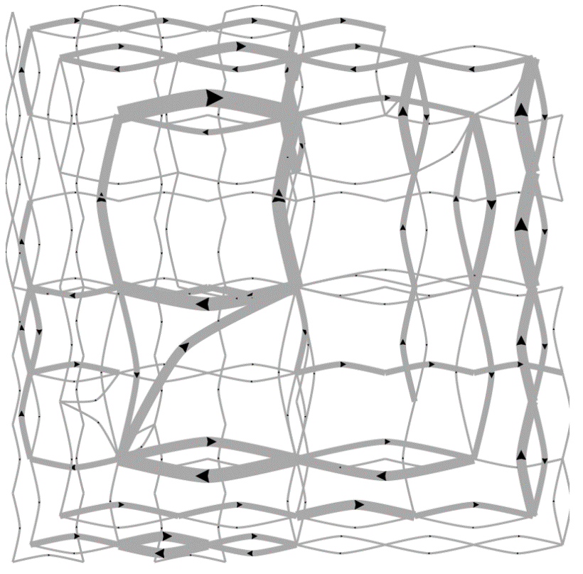
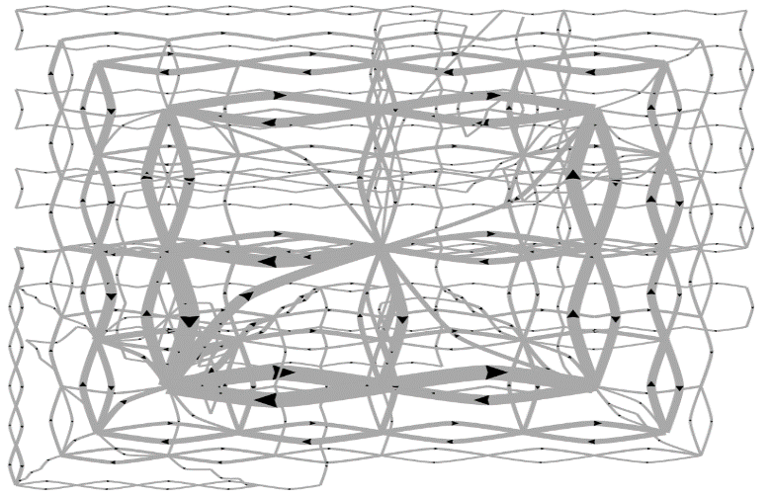
Pilot Visualization – Completion Time
Fast completion time
Slow completion time
Eli Brown et al., Where’s Waldo. IEEE VAST 2014, Conditionally Accepted.

Slide 33
Post-hoc Analysis Results
Mean Split (50% Fast, 50% Slow)
Data Representation | Classification Accuracy | Method
State Space | 72% | SVM
Edge Space | 63% | SVM
Action Sequence | 77% | Decision Tree
Mouse Event | 62% | SVM
Fast vs. Slow Split (Mean+0.5σ=Fast, Mean-0.5σ=Slow)
Data Representation | Classification Accuracy | Method
State Space | 96% | SVM
Edge Space | 83% | SVM
Action Sequence | 79% | Decision Tree
Mouse Event | 79% | SVM

Slide 34
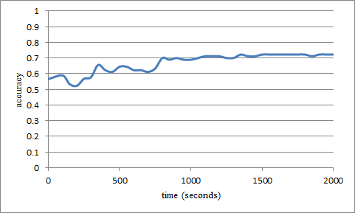
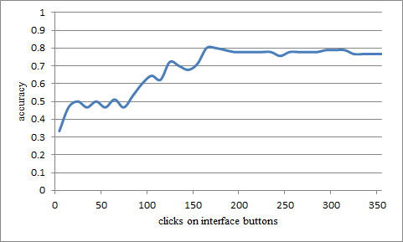
“Real-Time” Prediction
(Limited Time Observation)
State-Based
Linear SVM
Accuracy: ~70%
Interaction Sequences
N-Gram + Decision Tree
Accuracy: ~80%

Slide 35
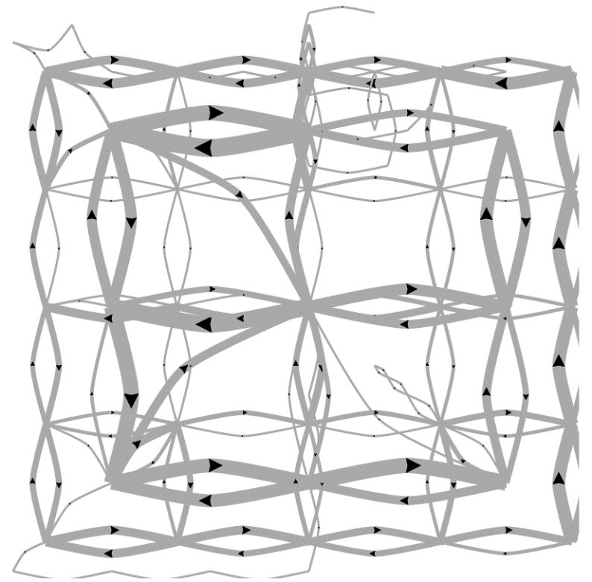
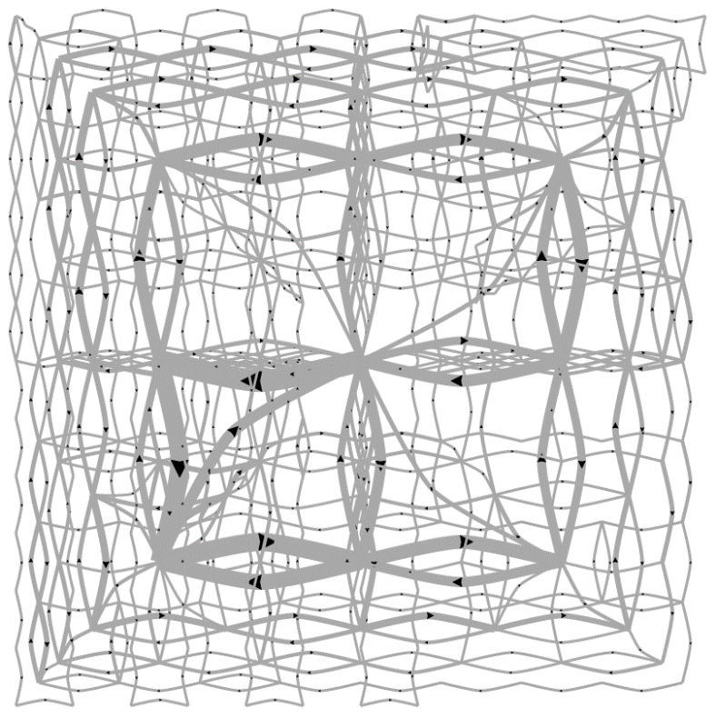
Predicting a User’s Personality
External Locus of Control
Internal Locus of Control
Ottley et al., How locus of control inﬂuences compatibility with visualization style. IEEE VAST , 2011.
Ottley et al., Understanding visualization by understanding individual users. IEEE CG&A, 2012.

Slide 36
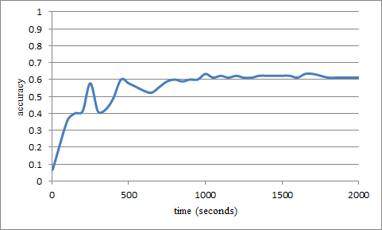
Predicting Users’ Personality Traits
Predicting user’s “Extraversion”
Linear SVM
Accuracy: ~60%
Noisy data, but can detect the users’ individual traits “Extraversion”, “Neuroticism”, and “Locus of Control” at ~60% accuracy by analyzing the user’s interactions alone.

Slide 37
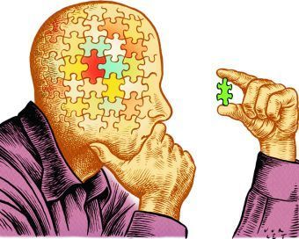

Quick Recap: Interaction Analysis
A user’s interactions reflect a great deal of the user’s reasoning process
  Up to 60-80% of the low-level (findings), mid-level (methods), and high-level (strategies) can be manually extracted.
Automated machine learning techniques can be used to classify and predict a user’s behavior based on their past actions.

Slide 38
How to Make Visualizations Interactive for Large Data Exploration?
Notes:
I hope that I’ve convinced you at this point that interactions are important for reasoning, and that “effective” visualizations do allow the users to extend their thoughts via their interactions.
The next challenge is, how do we build interactive visualizations when data size becomes really large?

Slide 39
WireVis System Architecture
Careful engineering is not enough… A new paradigm is necessary to support this type of interactive analysis.

Slide 40



Problem Statement
Visualization on a
Commodity Hardware
Large Data in a
Data Warehouse

Slide 41

Problem Statement & Observations
Goal: Guarantee a result set to a user’s query within X number of seconds.
  Based on HCI research, the upperbound for X is 10 seconds
  Ideally, we would like to get it down to 500 ms or less
Method: trading accuracy and storage (caching), optimize on minimizing latency (user wait time).
Observation: Waldo experiment results suggests that a user’s interactions are consistent (not random) and therefore predictable.

Slide 42


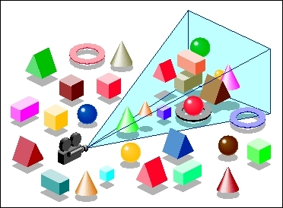
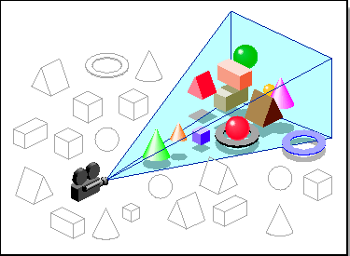
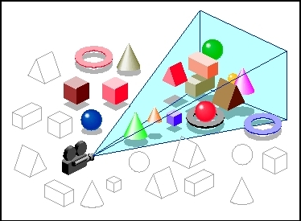

Our Approach:
Predictive Pre-Fetching
Stonebraker
Leilani Battle
In collaboration with MIT (Leilani Battle, Mike Stonebraker)
ForeCache: Three-tiered architecture
  Thin client (visualization)
  Backend (array-based database)
  Fat middleware
    Prediction Algorithms
    Storage Architecture
    Cache Management (Eviction Strategies)
R. Chang et al., Dynamic Prefetching of Data Tiles for Interactive Visualization. SIGMOD 2016

Slide 43
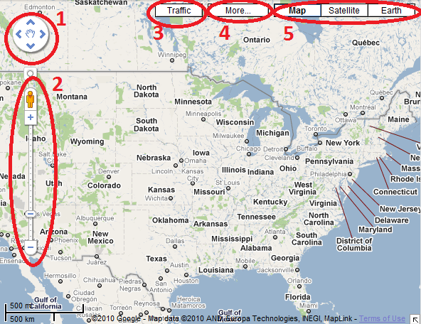
Why Prediction? An Observation
The number of possible actions is finite and the user’s actions are logical.
  Logical: as demonstrated in the Waldo study
  Finite: count the number of available user actions at any given time

Slide 45
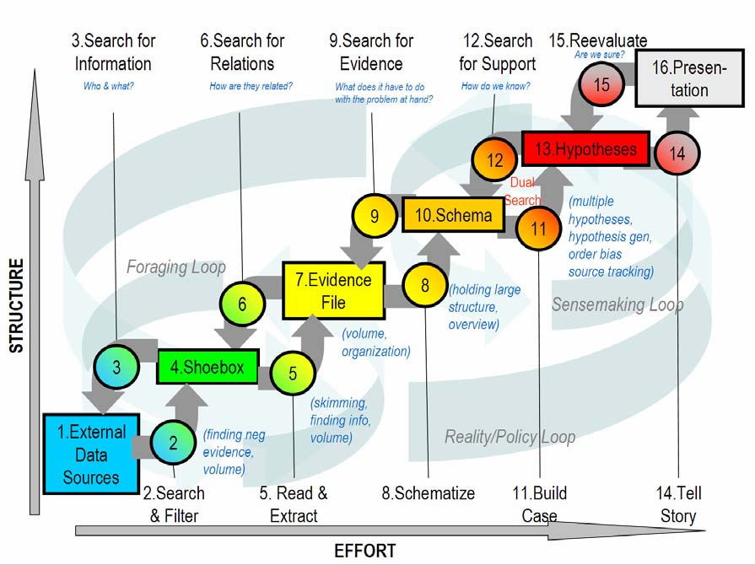
Predictions
Sensemaking
Two-tiered approach using Markov
First tier: predict what “phase” of analysis the user is in
Second tier: given a “phase”, use phase-specific models to predict user’s next actions
Navigation
Foraging
Card-Pirolli Sensemaking Loop

Slide 46
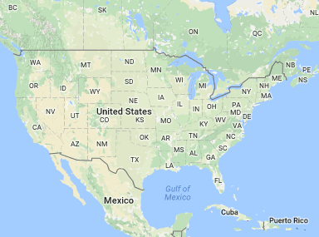
Predictions
Two-tiered approach using Markov
First tier: predict what “phase” of analysis the user is in
Second tier: given a “phase”, use phase-specific models to predict user’s next actions
  momentum, access-frequency, statistical distrib, SIFT (image-based), etc.
Navigation Phase
?

Slide 47
Predictions Accuracy
Comparison against existing techniques
“Random guessing” accuracy is: k/n
n: number of possible user actions
k: number of allowed “guesses”

Slide 48
Sculpin: Pre-Computation + Pre-Fetching
ForeCache assumes that all data tiles have been materialized or can be materialized in negligible amount of time
  Not true for many data analysis tasks
Sculpin relaxes this assumption and combines pre-materialization with “just in time” materialization
  Paper in submission to SIGMOD

Slide 49

Summary: Theory Into Practice
Interaction is key to exploratory visual analysis and reasoning
A user’s interactions reflect a their thinking process and individual differences
Big Data -><- high interactivity
Developing new system infrastructure to support interactive exploration and analysis is a critically important challenge for the future of visual analytics in the Big Data age

